Slide 1
Partners Reducing the Effects of Diabetes: Initiatives through Collaboration and Teamwork
P.R.E.D.I.C.T
David L. Katz, MD, MPH, FACPM, FAAC
Georgia Jennings, MPH
Margot Zaharek, MS
Ann Agro, MPH
Lindsey Greene, BA
Valentine Yanchou Njike, MD, MPH
Zubaida Faridi, MBBS, MPH
Yale Prevention Research Center
Yale University School of Medicine

Slide 2
Sponsors
Centers for Disease Control and Prevention (CDC)
Connecticut Health Foundation (CHF)

Slide 3
Proposed Project
Diabetes prevention and management among African Americans
Highly participatory, 3-phase intervention

Slide 4
Background and Significance
7th leading cause of death in CT
Disproportionate burden: African Americans are 2 times as likely as whites to get diabetes
Hospitalization is 3.5 times in African Americans as compared to the whites
27% more likely to die of complications

Slide 5
Methods
  Consisted of 3 Phases
  I. Formative Research
  II. Design and implement intervention
  III. Evaluation

Slide 6
Phase I. Formative Research
Literature Search of Best Practices
Formation of Community Partnership Team
Focus Groups
Environmental Audit

Slide 7
Phase II. Intervention Description
Purpose
  Demonstrate the efficacy of using a Community Health Advisor (CHA) model
  Improve diabetes prevention and management behaviors in an urban African American community

Slide 8
Church Based Component
Setting:
  13 churches in New Haven (intervention site)
  6 churches in Bridgeport (control site)
Participants:
  21 CHAs in New Haven
  17 CHAs in Bridgeport
  134 congregation members in New Haven
  125 congregation members in Bridgeport

Slide 9
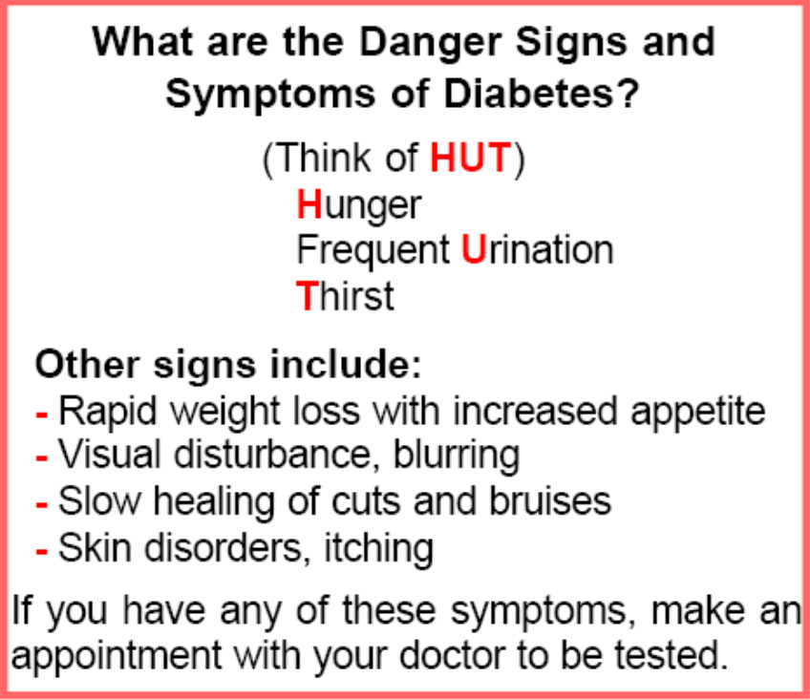
Church Based Component, Con’t
CHA Training
  10-week training session on diabetes prevention and management
  Each session lasted 2 hours and was conducted by a Certified Diabetes Educator
  About the disease, healthy dietary patterns, increased physical activity

Slide 10
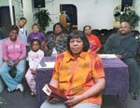
Church Based Component, Con’t

Slide 11
Phase III. Evaluation
Quantitative
  CHA training: Pre/post diabetes knowledge survey
  Church based component:
  7 Day Physical Activity Recall
  Harvard Food Frequency Questionnaire
  Nutrition Self Efficacy
  Physical activity self efficacy
  Medical Outcomes Social Support Survey

Slide 12
Demographic Characteristics and Baseline values
Variable | New Haven (N=121) | Bridgeport (N=125) | p-value
Gender
Female, n (%) | 101 ( 84.87) | 95 ( 77.87) | 0.1630
Male, n (%) | 18 ( 15.13) | 27 ( 22.13)
Education Level
Some High School or High School Diploma, n (%) | 56 (47.46) | 35 (28.46) | 0.0098
Some College, n (%) | 38 (32.20) | 54 (43.90)
Associate or Bachelor Degree, n (%) | 24 (20.34) | 34 (27.64)
Household Income
Less than $29.999, n (%) | 55 ( 51.89) | 37 ( 32.17) | 0.0105
$30.000- $49.000, n (%) | 23 ( 21.70) | 39 ( 33.91)
More than $50.000, n (%) | 28 ( 26.42) | 39 ( 33.91)
Body Weight (lbs) | 204.63 ± 52.40 | 193.92 ± 43.74 | 0.0939
Body Mass Index (kg/m²) | 33.86 ± 8.4 | 31.90 ± 7.15 | 0.0603
Social Support
Emotional/Information Support | 31.79 ± 7.58 | 30.62 ± 7.91 | 0.2395
Tangible Support | 15.97 ± 3.89 | 14.79 ± 4.45 | 0.0283
Affectionate Support | 12.91 ± 2.67 | 12.06 ± 3.42 | 0.0313
Positive Social Interaction | 12.59 ± 2.88 | 11.75 ± 3.19 | 0.0316
Overall Support Index | 76.97 ± 15.16 | 72.41 ± 18.08 | 0.0329
Diabetic Knowledge (%) | 65.99 ± 9.93 | 68.12 ± 10.27 | 0.1004
Physical Activity self-efficacy | 13.42 ± 4.02 | 14.02 ± 3.73 | 0.2315
Energy Expenditure (kcal/kg/wk) | 124.87 ± 109.92 | 134.35 ± 110.47 | 0.5051
Nutrition self Efficacy | 14.99 ± 3.92 | 15.54 ± 3.62 | 0.1648

Slide 13
Baseline values of selected nutrients
Variable | Bridgeport (n=124) | New Haven (n=122) | p-value
Total calories | 2232.1 ± 2029.6 | 2656.2 ± 2802.6 | 0.1760
Total Protein | 101.4 ± 90.2 | 114.0 ± 112.1 | 0.3322
Total Carbohydrates | 278.9 ± 298.2 | 348.2 ± 402.6 | 0.1269
Fats
Trans fats | 81.2 ± 67.9 | 93.3 ± 96.2 | 0.2571
Saturated fatty acid | 25.9 ± 19.8 | 30.7 ± 32.8 | 0.1665
Mono-unsaturated fatty acid | 30.5 ± 26.5 | 34.9 ± 34.9 | 0.2889
Poly-unsaturated fatty acid | 16.4 ± 17.1 | 17.8 ± 18.6 | 0.5378
Total Cholesterol | 334.7 ± 262.6 | 385.5 ± 425.1 | 0.2619

Slide 14
Change in Outcome measures
Variable | New Haven (N=83) | Bridgeport (N=78) | p-value
Body Weight (lbs) | 0.32 ± 25.92 | 0.82 ± 19.30 | 0.8974
Body Mass Index (kg/m²) | -0.63 ± 6.72 | 0.13 ± 3.18 | 0.4191
Social Support
Emotional/Information Support | 0.99 ± 7.74 | 0.32 ± 7.48 | 0.5757
Tangible Support | -0.52 ± 4.49 | 0.09 ± 3.38 | 0.3312
Affectionate Support | -0.33 ± 3.09 | -0.17 ± 3.55 | 0.7648
Positive Social Interaction | -0.33 ± 3.18 | -0.49 ± 3.77 | 0.7743
Overall Support Index | 0.14 ± 15.45 | 0.20 ± 16.40 | 0.9816
Diabetic Knowledge (%) | 2.45 ± 11.22* | 1.76 ± 0.87 | 0.6896
Physical Activity self-efficacy | 0.23 ± 5.46 | 0.38 ± 3.49 | 0.8400
Physical Activity Level, past 3 months
Increased, n (%) | 20 (25.64) | 25 (32.05) | 0.6652
Decreased, n (%) | 14 (17.95) | 12 (15.38)
About the same, n (%) | 44 (56.41) | 41 (52.56)
Nutrition self Efficacy | 0.31 ± 4.66 | 0.64 ± 2.82* | 0.5858

Slide 15
Table 2. Change in outcome measures from baseline of selected nutrients
Change in outcome measures from baseline of selected nutrients
Variable | Bridgeport (n=78) | New Haven (n=83) | p-value†
Total calories | -198.2 ± 1263.3 | -375.5 ± 1553.1 | 0.3287
p-value‡ | 0.0832 | 0.0089
Total Protein | -9.0 ± 60.1 | -11.3 ± 63.9 | 0.7691
p-value‡ | 0.0982 | 0.0537
Total Carbohydrates | -28.2 ± 180.1 | -64.1 ± 248.1 | 0.1970
p-value‡ | 0.0843 | 0.0053
Fats
Trans fats | -6.1 ± 48.3 | -9.0 ± 47.0 | 0.6358
p-value‡ | 0.1592 | 0.0365
Saturated fatty acid | -1.5 ± 14.2 | -2.2 ± 14.0 | 0.6940
p-value‡ | 0.2445 | 0.0868
Mono-unsaturated fats | -2.2 ± 18.7 | -3.4 ± 19.5 | 0.6255
p-value‡ | 0.1980 | 0.0600
Poly-unsaturated fats | -1.8 ± 12.5 | -2.3 ± 11.2 | 0.7375
p-value‡ | 0.1054 | 0.0227
Total Cholesterol | -12.6 ± 194.9 | -16.4 ± 219.3 | 0.8862
p-value‡ | 0.4732 | 0.4127

Slide 16
Challenges
Re-engaging disengaged CHAs
CHAs lack of education

Slide 17
Thank you
New Haven Churches
Bridgeport Churches
Survey Participants
Bridgeport and New Haven Community Partnership Teams

