Slide 1
Promoting Healthy Behaviors in Clinical Practice: Lessons Learned From Practice Based Research and Education
Helen Burstin, MD, MPH
Director, Center for Primary Care, Prevention and
Clinical Partnerships
Secretary’s Prevention Summit
October 23, 2005

Slide 2
Mission Statement: AHRQ
The mission of the Agency for Healthcare Research and Quality is to improve the quality, safety, efficiency, and effectiveness of health care for all Americans.

Slide 3
Research at HHS:
Where Does AHRQ Fit In?
NIH -- basic biomedical, lab bench research and “efficacy” clinical trials
CDC -- the public health system, community-based interventions
AHRQ -- “effectiveness” of health care services and the health care delivery system (What works in real world settings?)
Notes:
To further help differentiate AHRQ’s research from CDC’s and NIH’s research, I’ll use an example related to diabetes--a condition that occurs with great frequency within the African American population.. NIH research identifies what can work to improve patient health. NIH’s primary orientation is laboratory bench science, which seeks to broaden our understanding of basic biology and the biological mechanisms of disease, and clinical trials, designed to establish the potential usefulness of new interventions under ideal conditions (“efficacy”). For example, how does type A and B diabetes differ and what treatments might be instituted to cure the disease. CDC evaluates health behaviors and tests community interventions that might be used to reverse unhealthy behaviors or reinforce healthy ones. For example, programs to increase exercise or improve diet.
By contrast, AHRQ develops evidence to help clinicians and patients select the best interventions for that individual. For example, do multiple medications control the patient’s diabetes or does it work better to combine medication therapy with support from team made up of doctors, nurses, and exercise coaches? AHRQ research then helps providers develop measures to evaluate what works best. This research relates to quality improvement efforts.
In its clinical research, AHRQ assesses the effectiveness in daily practice of promising new interventions, compares their benefits, costs, and side-effects with existing approaches, and when effective interventions are not being used, identifies options for overcoming barriers to their widespread use. AHRQ’s clinical research is unique in two other ways: its focus on the interaction between patients and their care-givers and patient-centered research (rather than treating each disease in isolation), recognizing that the number of individuals with multiple chronic conditions is growing and the care for their different conditions must be coordinated.
AHRQ’s research on the health care delivery system reflects the belief that health care services are not delivered in a vacuum. The outcomes, effectiveness, and quality of health care interventions are influenced by who delivers the service, the extent to which the systems in which clinicians work support or frustrate their efforts, and the financial incentives or barriers to provide the right service at the right time in the right way. For example, research related to the development of effective disease management strategies and improved coordination of care draws upon both clinical and health systems research.

Slide 4


2004 National Reports on Quality and Disparities
Second annual reports focus on quality of and disparities in health care in America
www.qualitytools.ahrq.gov
Notes:
Quality Report finds that quality is improving and identifies areas which are in need of major improvements

Slide 5
Diffusion of knowledge
Clinical Procedure
Landmark Trial*
NHQR 2004
Flu Vaccine
1968
63%
Pneumococcal Vaccine
1977
54%
Diabetic Eye Exam
1981
70%
Mammography
1982
70%
Cholesterol Screening
1984
67%
*Balas EA, Boren SA., Managing Clinical Knowledge for Health Care Improvement. Yearbook of Medical Informatics 2000.

Slide 6
AHRQ Prevention Continuum
Provide
User-driven
Knowledge
Facilitate
Dissemination &
Implementation
Knowledge
Generation
Effective preventive services
USPSTF
Effective delivery
PBRNs
Engaging stakeholders
clinicians, consumers,payers
purchasers, policy makers
Publications/products
journals, fact sheets,
web-based resources
Targeted partnerships
Federal & Private
User-driven tools
Health Information Technology (PDA,EHR), Cancer Planet, Data sets (PQI)
Integrate evidence with outreach
Steps to a Healthier US,
HRSA Prevention Pilots

Slide 7


Slide 8
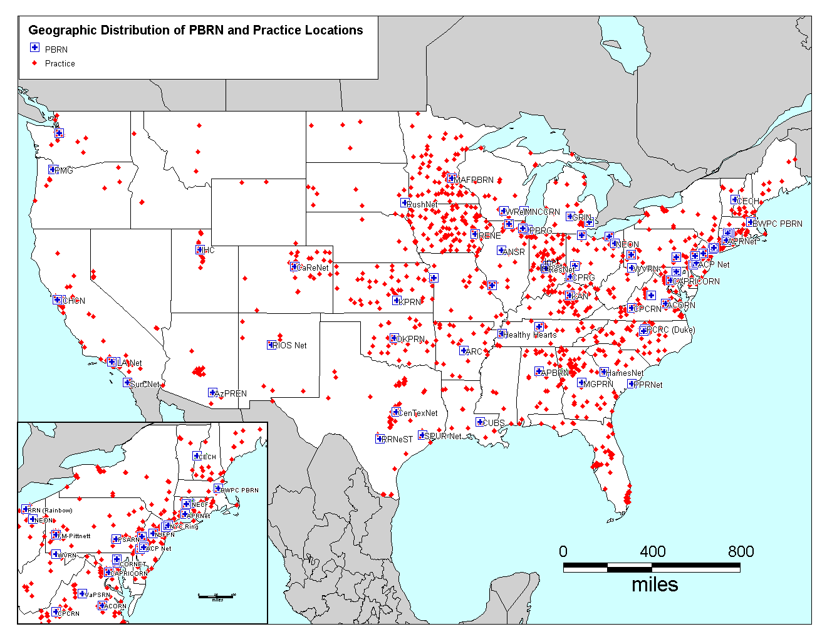
PBRN 1st Interdisciplinary Meeting
July 21-22, 2005
185 participants

Slide 9
AHRQ Support of PBRNs:
Resource Center
Contract awarded in 2002 to Indiana University/NORC
Directors: Bill Tierney, MD (Indiana) Dan Gaylin, MPA (NORC)
Support has been extended to any primary care network based in U.S. that registers with the Resource Center
Learning collaboratives, Extranet, National Conference

Slide 10

RWJ-AHRQ Initiative
PBRNs to develop creative, practical strategies for promoting healthy behaviors that can be easily adopted by other primary care practices.
4 health risk behaviors: smoking, risky drinking, sedentary lifestyle; and unhealthy diet

Slide 11
PDA: Preventive Services
Selector Program
PDA Program for Clinicians:
  USPSTF recommendations searchable by age and sex
  Available to download PDA application at www.ahrq.gov
  Updated regularly

Slide 12
AHRQ Prevention Continuum
Provide
User-driven
Knowledge
Facilitate
Dissemination &
Implementation
Knowledge
Generation
Effective preventive services
USPSTF,EPC
Effective delivery
PBRN’s
Engaging stakeholders
clinicians, consumers,payers
purchasers, policy makers
Publications/products
journals, fact sheets,
web-based resources
Targeted partnerships
Federal & Private
User-driven tools
Health Information Technology (PDA,EHR), Cancer Planet, Data sets (PQI)
Integrate evidence with outreach
Steps to a Healthier US,
HRSA Prevention Pilots

Slide 13
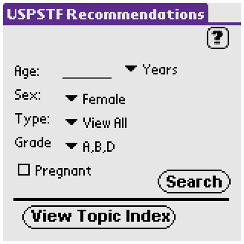
Notes:
The search form allows the user to view an index of all recommendations in the database or search for recommendations based on age, sex, or pregnancy. In addition, the user can filter the results by the grade level of evidence (A, B, D) and the type of recommendation (Screening, Counseling, Preventive Medications).
How to use the search form:
To see all USPSTF recommendations select the View Topic Index button at the bottom of the screen.

Slide 14
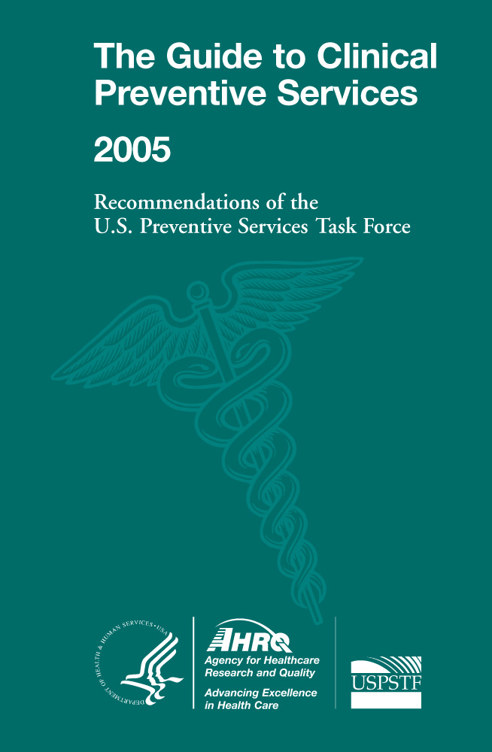
New annual user-driven resource
Remarkable response to date
(in your packets)

Slide 15
Presenters
Kurt Stange, M.D., Ph.D.
Prescription for Health: Promoting Healthy Behaviors in Primary Care Practice
Steven H. Woolf, M.D., M.P.H.
A Multi-Component Systems Approach for Promoting Healthy Behaviors in Primary Care
Richard Riegelman, M.D., Ph.D., M.P.H.
Educating for Practicing Prevention: The Clinical Prevention and Population Health Curriculum Framework

Slide 16
For additional questions, please contact:
Dr. Helen Burstin hburstin@ahrq.gov

