Slide 1


NIHSeniorHealth
The Web Site for Older Adults
Medical Library Association
May 21 – 26, 2004
National Library of Medicine
National Institutes of Health
Health and Human Services

Slide 2
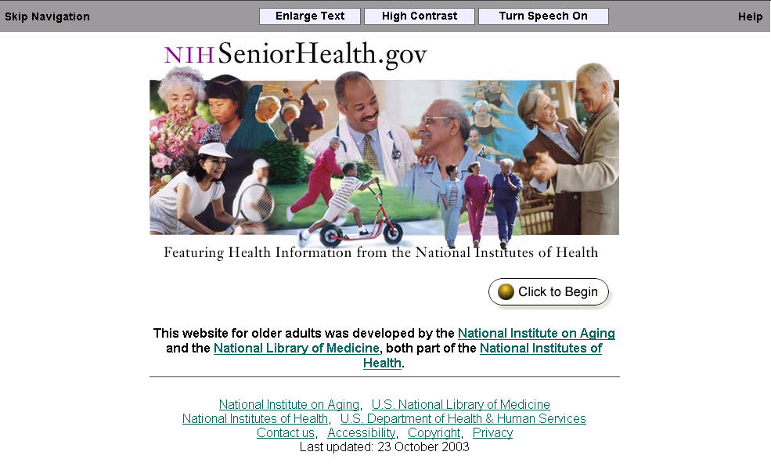
http://nihseniorhealth.gov

Slide 3
NIHSeniorHealth
Collaboration between National Library of Medicine and National Institute on Aging
Content provided by National Institutes of Health
Officially launched October, 2003
Currently features 10 topics
Tested on groups aged 60 - 88

Slide 4
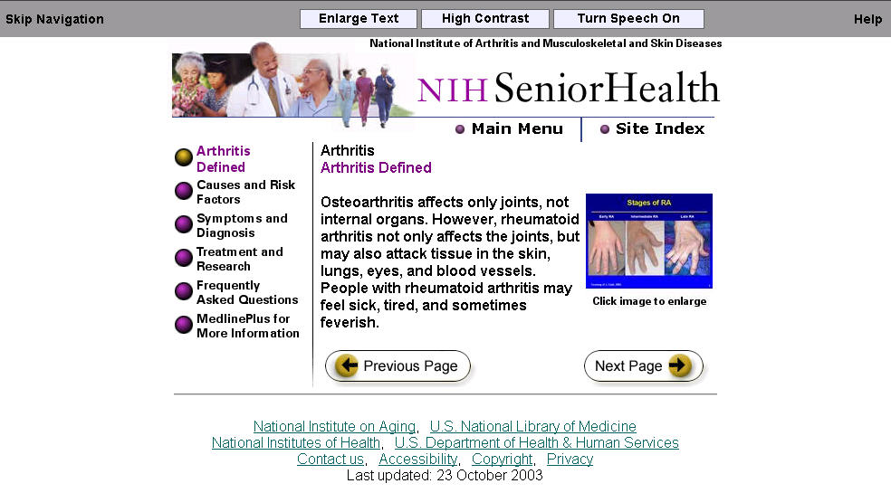
All images can be enlarged
Default font size larger, paragraph size limited to minimize scrolling

Slide 5
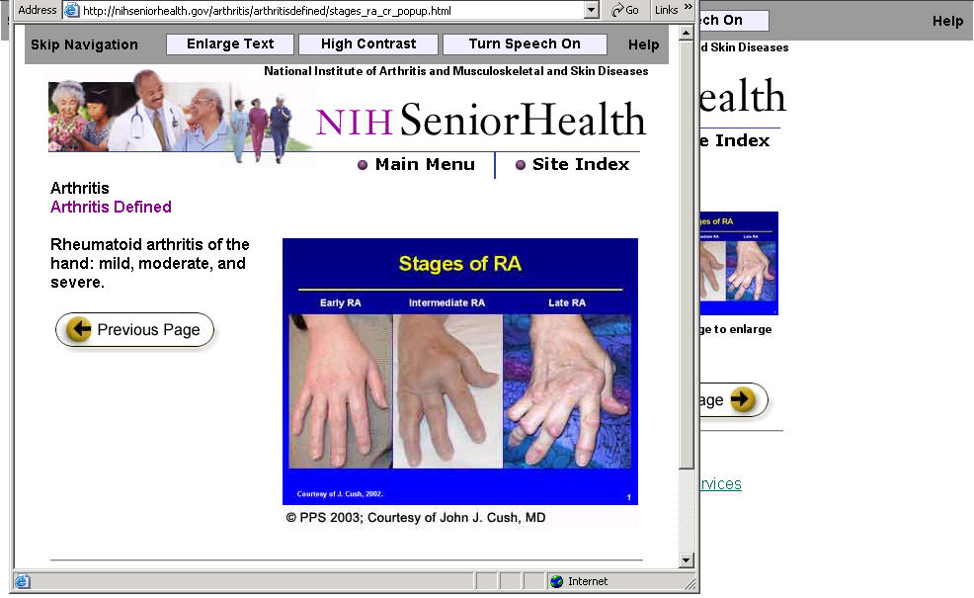
Enlarged Images

Slide 6
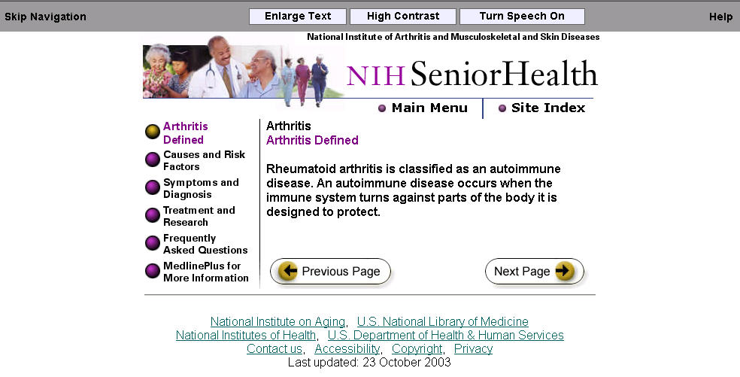
Accessibility Features
Enlarge text size

Slide 7
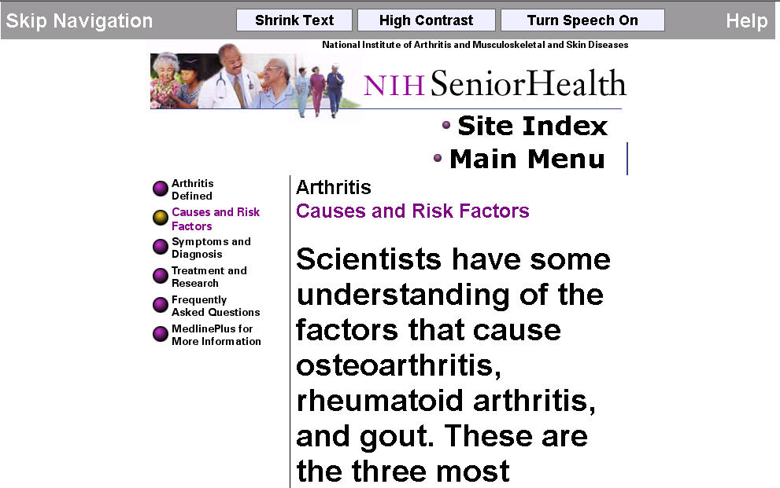
Enlarged Text

Slide 8
Accessibility Features
High contrast colors

Slide 9
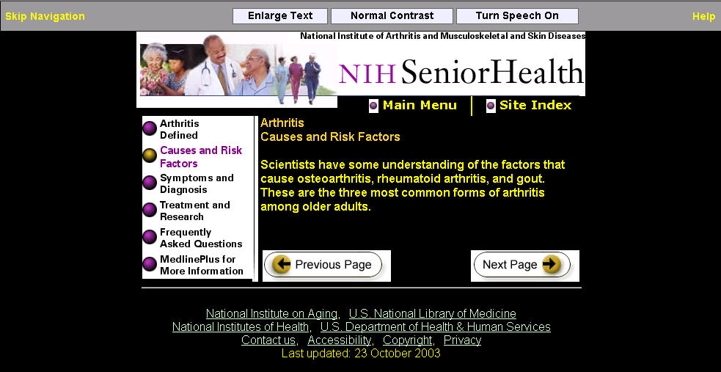
High Contrast

Slide 10
Accessibility Features
Activate talking Web

Slide 11
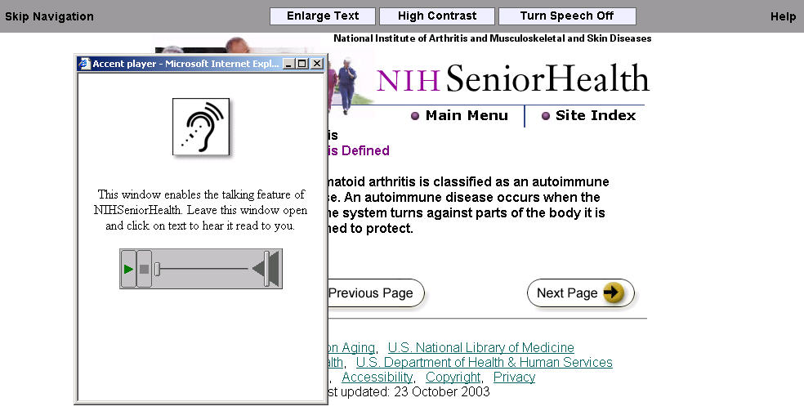
Talking Web
Speech function does not require a download. A small pop-up window will briefly appear when you click the Turn Speech On button. The window will automatically disappear from the screen, but will remain open to activate the speech.

Slide 12
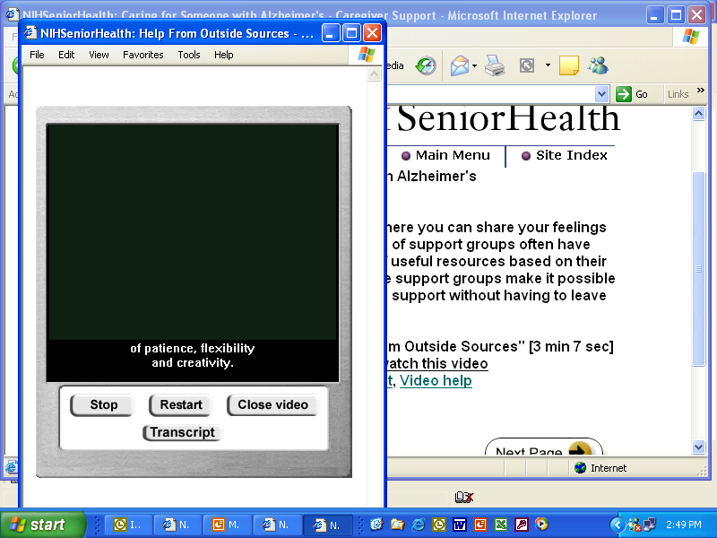
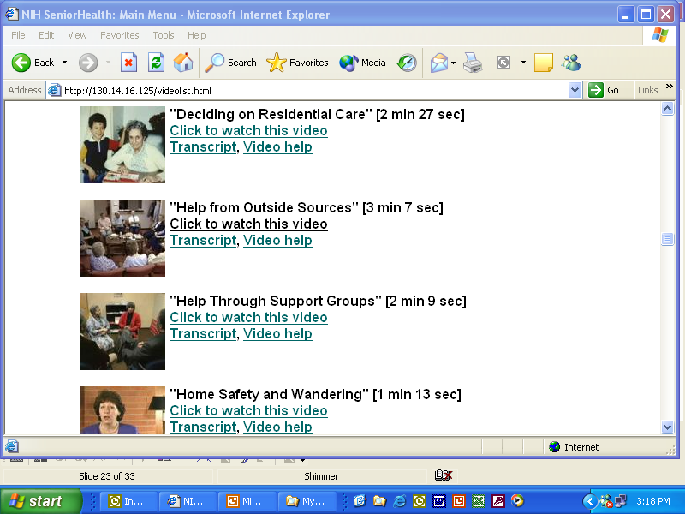
Captioned Videos
Open-captioning on videos reinforces
audio information
Transcript of video available

Slide 13
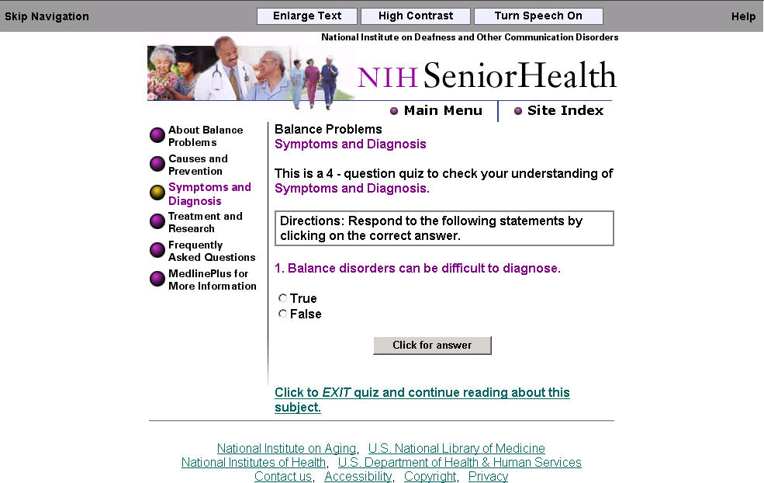
Quizzes for each Topic
Quizzes provide reinforcement of information

Slide 14
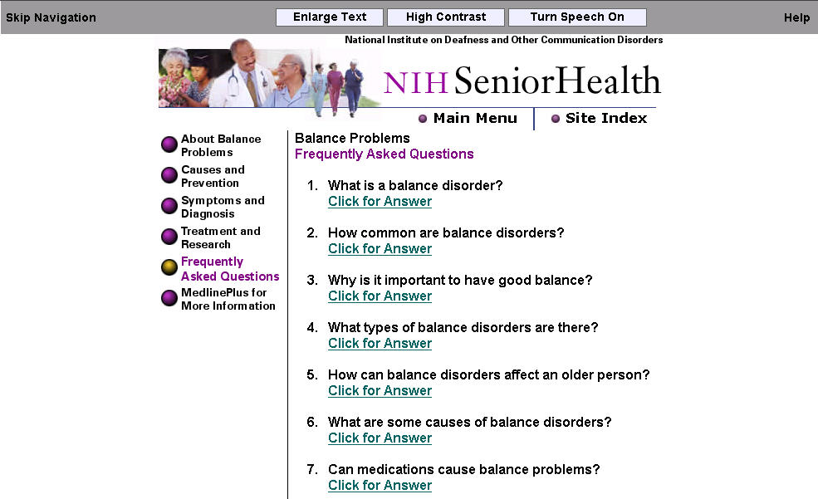
Numerous FAQs

Slide 15
New Topics from NIH
Diabetes
Macular Degeneration
Low Vision
Glaucoma
Cataracts
Diabetic Retinopathy
Osteoporosis
Paget’s Disease
Falls and Fractures
Oral Health and Dental Care
Sensory Loss Aphasia
Sleep and Aging
End-of-Life Care
Stroke
Congestive Heart Failure
Heart Disease
Complementary and Alternative Medicine
Dietary Supplements
Shingles
About Medicare and Medicaid*
*Topic courtesy of CMS

Slide 16


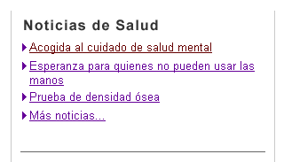
New to MedlinePlus!
Easy to Read pages
Low vision pages
Medicinas en Español
Noticias de Salud en Español
Notes:
As you probably know, NC Health Info is the first go-local participant. They’ve already been getting about 12,000 visits a month to over 30,000 pages.
Not bad for just having launched in February.
The “go local” model is that the state provide health services information and map it to medlineplus health information topics
Users can link between the sites through the vocabulary mappings.

Slide 17
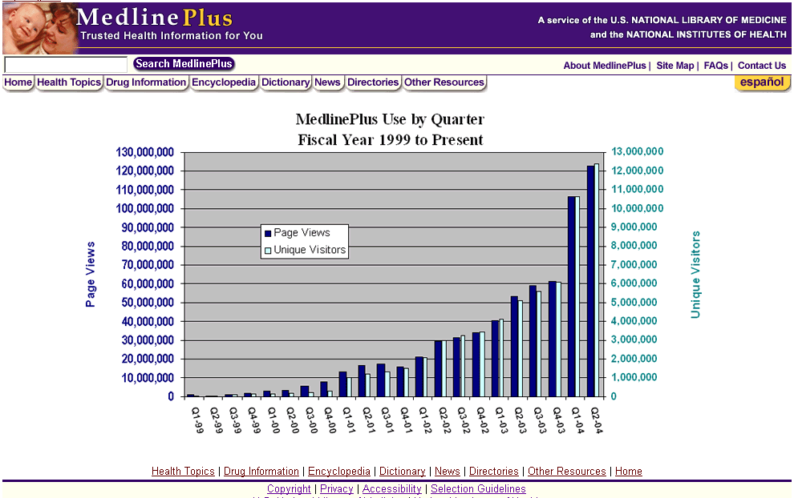
MedlinePlus usage

Slide 18
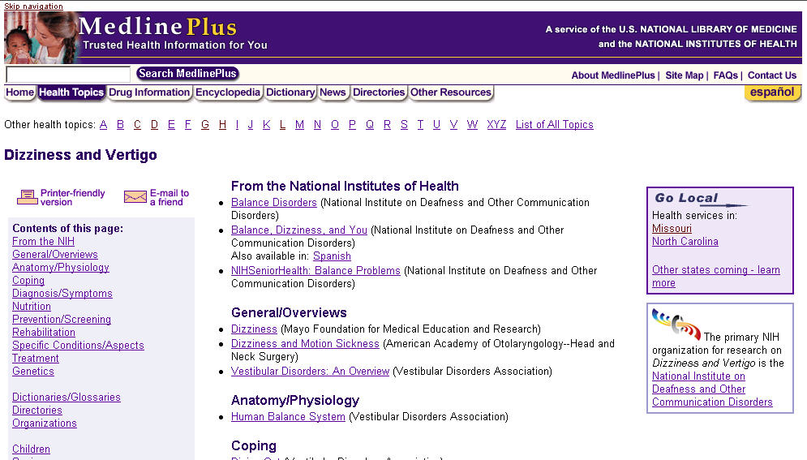


MedlinePlus - Go Local
Missouri
Community Connection
North Carolina
NCHealthInfo
Notes:
As you probably know, NC Health Info is the first go-local participant. They’ve already been getting about 12,000 visits a month to over 30,000 pages.
Not bad for just having launched in February.
The “go local” model is that the state provide health services information and map it to medlineplus health information topics
Users can link between the sites through the vocabulary mappings.

Slide 19
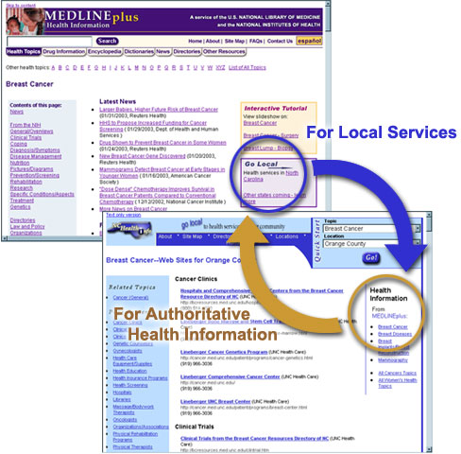

Go Local Partners
Go Local project links local services from health topics
Currently partnered with the University of North Carolina and the University of Missouri Extension
Notes:
As you probably know, NC Health Info is the first go-local participant. They’ve already been getting about 12,000 visits a month to over 30,000 pages.
Not bad for just having launched in February.
The “go local” model is that the state provide health services information and map it to medlineplus health information topics
Users can link between the sites through the vocabulary mappings.

Slide 20
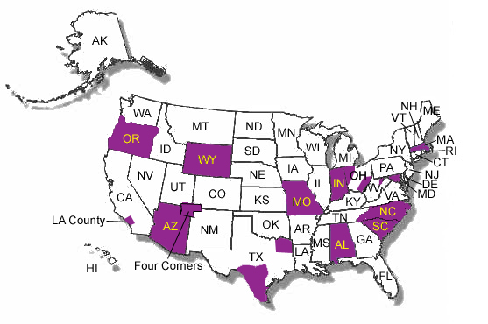
Go Local Expansion
NLM plans to host sites across the country
Projected release date: Spring 2005
Currently 14 new participants
Notes:
As you probably know, NC Health Info is the first go-local participant. They’ve already been getting about 12,000 visits a month to over 30,000 pages.
Not bad for just having launched in February.
The “go local” model is that the state provide health services information and map it to medlineplus health information topics
Users can link between the sites through the vocabulary mappings.

