Slide 1

Oral Health and Wellness Program
Kevin Avery, DMD
Regional Dental Consultant
Atlanta Health and Wellness Conference
September 20, 2006

Slide 2
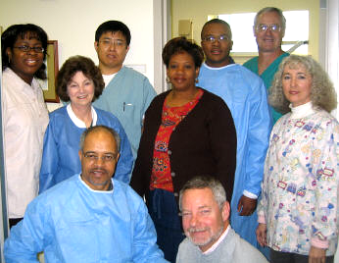
Oral Health Staff
DDS/DMD
  Contract/scope of work
  4 hours per 100 students
  Dental license
  DEA permit
  Professional liability insurance
Registered Dental Hygienist
  4 hours per 100 students
  Dental hygiene license
  Liability insurance
Dental Assistant
  6 hours per 100 students
  Radiology certificate

Slide 3
PRH Requirements
Cursory Dental Exam
  Pen light
  Throat stick
  2 x 2 gauze
Mandatory Oral Exam
  45-75 days
  Bite-wing x-rays
  Treatment priorities
Oral Hygiene/Preventive Care
Oral Prophylaxis
Restorative Dental Treatment
  Amalgam and composite fillings
  Non-surgical extractions
  Root canals in anterior teeth
  Replacement of anterior teeth
Orthodontic Care
  Financial responsibility
  Location of orthodontist
  Retainers

Slide 4
PRH Requirements
Wisdom Teeth
  Symptomatic vs.
  non-symptomatic
  Impacted vs. erupted
  Medicaid payment
Facilities and Equipment
  Two operatories
  Replacing equipment
  Government sources
Infection Control
  Bloodborne Pathogens Exposure Control Plan
  CDC/ADA recommendations
  Biological monitoring of the autoclave
High Risk Students
  HIV positive students
  Pregnant students
  Diabetic students
  Students with untreated caries
  “Meth Mouth”

Slide 5


Oral Health Education/Prevention
 |  | Oral

Slide 6
Dental Productivity
Dental Productivity Data
  Broken appointment rate
  Initial exams per hour
  Other DDS visits per hour
  Excel program on Job Corps Health & Wellness website

Slide 7
Program Description
  Job Corps Website
    http://www.jobcorpshealth.com
  TAG A: Oral Health and Wellness Program

Slide 8
Contact Information
Kevin Avery, RDC
Email: Ktavery33@aol.com
  Phone: (508) 563- 5424 until 11/1/06
  (405) 271- 4919
  Cell: (405) 426-2006

