Slide 1
Determine the Feasibility of Establishing a US National Twin Registry and Three Disease Specific Twin Registries
Type 1 diabetes
  13-70% concordance in MZ twins, 0-14% in DZ twins
  US prevalence is ~1.3 million
Systemic lupus erythematosus
  24-69% concordance in MZ twins, 1-2% for DZ twins
  US prevalence is ~1.4 million
Multiple Sclerosis
  25-30% concordance in MZ twins, 2-5% in DZ twins
  US prevalence is ~300,000

Slide 2
Background
Powerful tool for investigating the relative contributions of genetic susceptibility and environmental influences to complex traits and disease
Advantages
  Increase study power due to sharing between co-twins
  MZ pairs - eliminate genetic confounders
  MZ/DZ pairs - eliminate environmental and age confounders
Twin pairs needed for estimating genetic contribution
Martin, Boomsa, and Machin. Nature Genetics 1997;17:387-392.
  200 pairs for traits of high heritability
  Several thousand pairs for traits of low to moderate heritability
International (national population-based) Twin Registries
  Limited access
  Not representative of US population

Slide 3
Polycystic Ovary Syndrome (PCOS) Twin Study
Major cause of infertility
  Type 2 diabetes, high blood pressure, dyslipidemias, CVD, and CA
Mid-Atlantic Twin Registry
Cohort of MZ and DZ twins with PCOS
  Concordance rates and heritability estimates
  Identify environmental risk factors
  Monitor discordant pairs for incident cases
  Monitor discordant MZ twins over time to see whether concordance rates approach 100%
Investigating other twin resources for the study

Slide 4
Maternofetomicrochimerism as a
Risk Factor for Type 1 Diabetes
Persistence of maternal cells in the child’s circulation after birth
British Diabetic Twins Study – Dr. David Leslie, St. Bartholomew’s Hospital, London, UK
Discordant MZ twins and their mothers
  Nonshared HLA genotypes between mothers and their MZ twins (offspring)
  Genotype CD3+ cells in the offspring to determine if there are any cells of maternal origin
  Quantitate maternal DNA in offspring using standard real-time PCR techniques

Slide 5
Tasks 1 and 2 – Describe the Current
US Twin Populations
Task 1 – Analyze and describe the current overall US twin population
  No systematic attempt to estimate and analyze the US twin population to date
  Total numbers of twins
  Zygosity, age, gender, race/ethnicity, SES, region, etc.
  Five year projection
Task 2 – Analyze and describe US twin populations with type 1 diabetes, SLE, and MS
  Define phenotype(s) of each condition
  Totals and demographics
  Numbers justify the effort - cost/benefit point of view?
Estimate numbers of twins that are currently enrolled in existing twin registries and/or research programs
  Literature review
  Survey existing twin registries, disease foundations, etc.

Slide 6
Survey of Existing Twin Registries
Registry characteristics
Registry experience
Demographics of twin population
Human Subjects Protections
Data collection
Tissue collection
Retention
Data sharing policies
Survey for disease specific registries and disease foundations
Estimate the willingness of twins to participate in registries and research programs

Slide 7
Task 3 – Ethical, Legal, and Social Issues
Explore the ethical, legal and social issues (ELSI) that could impact establishing and operating a national US twin registry and the three disease-specific registries
Separate panel of ELSI experts (twin research, minorities/underrepresented populations, privacy, genetic issues, other areas)
Hold a special ELSI workshop (November 2005)
  Privacy and confidentiality
  Informed consent
  Participation and recruitment – overall, children, minorities, underrepresented subgroups
  Ethics review
  Research
  Genetics
Focus groups of representative populations
Literature reviews

Slide 8
Task 4 – Potential Size and Composition of the Proposed National Twin Registries
Estimates from tasks 1 and 2
Surveys of existing twin registries, foundations, studies, etc.
Literature reviews
Take current ELSI issues into account
Methods for twin ascertainment, tracing, recruitment and retention
  Overall twin population
  Twins with disease
  Minorities, children, underrepresented groups, etc.

Slide 9
Tasks 5, 6 and 7
Task 5 - Alternatives to a National US Twin Registry
  Consortium of already existing registries
  One or more smaller population-based registries
  Pilot registry
Task 6 - Alternatives to the disease-specific twin registries
  Expand existing resource
  Subgroup twins within the National US Twin Registry
Task 7 - Compare alternatives with national registries
  Advantages and disadvantages of the various options
  Draft summary report
  Convene second panel expert meeting (June 2006)
  Make recommendation to NIEHS Directors

Slide 10
Tasks 8, 9, and 10
Tasks 8 and 9 - Devise final methods and implementation plans for establishing the Twin Registries or their alternatives.
  Ascertainment, tracing, recruitment and retention methods
  Surveillance methods (disease specific registries)
  Database development
  Data and sample collection from twins
  Registry policies
  Timelines
Task 10 -Estimate infrastructure and costs
Final Expert Panel Meeting (Oct 2006)
  Final report and recommendations

Slide 11
Project Team
NIEHS - Co-Project Officers/ NIEHS Co-PIs
Patricia C. Chulada, PhD, MHS
Perry Blackshear, MD, DPhil
Virgina Commonwealth University
Linda Corey, PhD - Major PI
Phillip Morris USA
Lenn Murrelle, MSPH, PhD – Consultant
Alpha-Gamma Technologies, Inc.
Vani Vannappagari, PhD, MBBS – Lead Epidemiologist
Teji Rakhra-Burris, MA - Project manager
Reese Howle, BA – Project director
Atif Hasan, MS – Database specialist
Tom Bensman, BA – Logistical support
Research Triangle Institute
Nedra Whitehead, PhD, MS – Medical Geneticist
Paul Levy, MA, Sc.D. –Biostatistician
Fengyu Zhang, PhD – Demographer, Statistician
Paul Pulliam, BS – Survey specialist
Ariana N. Napier, MA – Survey specialists
David Rein, PhD – Research economist
UNC School of Public Health
Robert C. Millikan, DVM, MPH, PhD – Consultant
University of Virginia
Paul Lombardo, JD, PhD, MA – Medical Bioethics

Slide 12
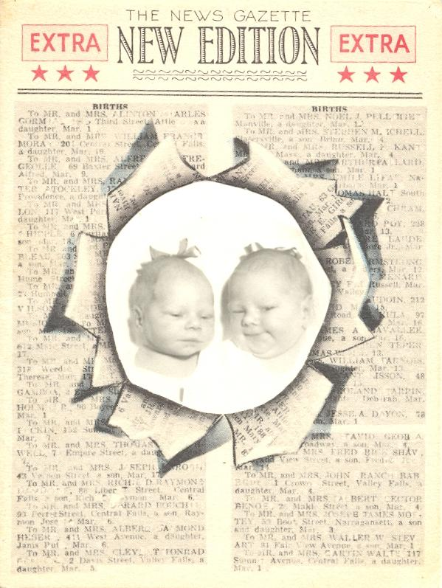
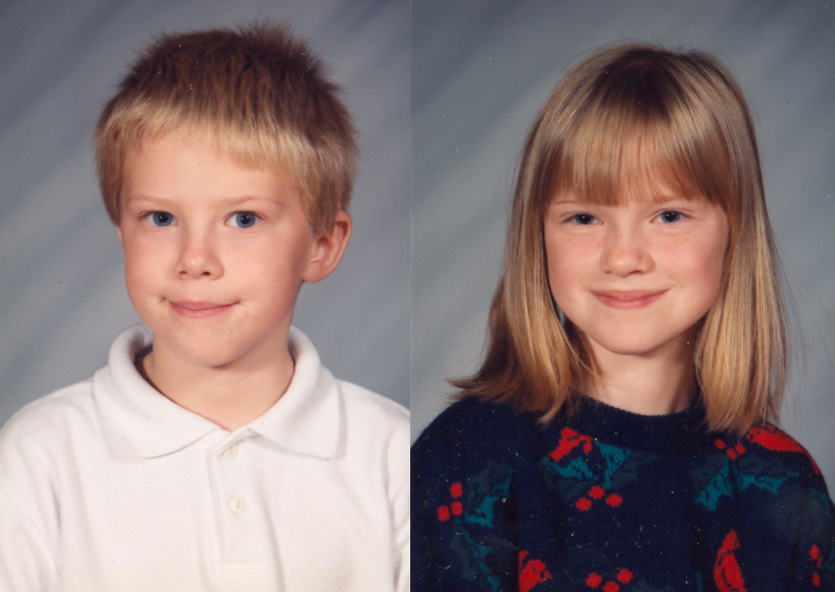
Twins Beget Twins

