Slide 1

Renewing the Public Private Diabetes Research Partnership
Cynthia Rice, Director of New Technology Access
Juvenile Diabetes Research Foundation
10th Congressional District Diabetes Summit
October 8, 2007

Slide 2

The Costs of Diabetes are Staggering
Diabetes effects millions of Americans
  More than 20 million Americans have diabetes
  1 in 3 Americans born in 2000 are expected to develop the disease in their lifetimes
  Diabetes is a leading cause of heart attacks, strokes, amputations, blindness, and kidney failure
Costs of diabetes are staggering
  $132 billion a year to the nation
  Health costs for people w diabetes are nearly 5 times higher
  1 in 3 Medicare dollars is spent on people w diabetes

Slide 3

Life with Diabetes is Very Difficult
As these families told Rep. Kirk when they met with him in August, living with diabetes is very hard
  Painful glucose tests and insulin injections many times a day
  Middle of the night blood checks
  Lows interfere with sports and other activities
  Threat of seizures and comas
  Threat of complications such as stroke, heart attack, blindness, and kidney failure
  Constant stress – never a vacation

Slide 4
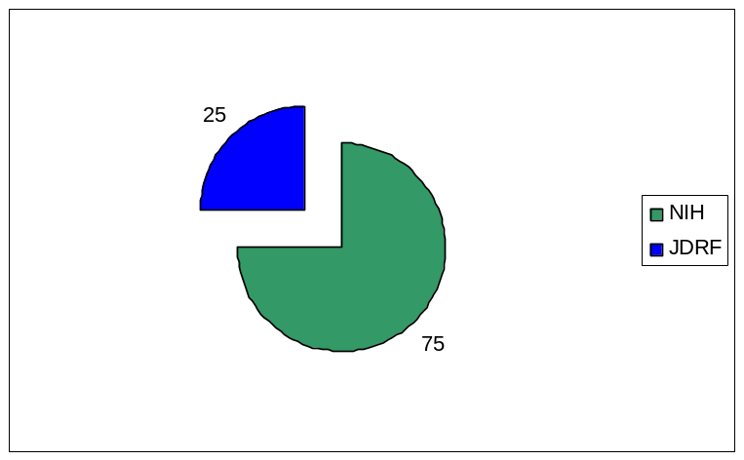
Strong Public-Private Partnership for Diabetes Research
Diabetes research a strong public private partnership
  National Institutes of Health (NIH) funds 75% of type 1 diabetes research ($433 million in 2005)
  JDRF funds 25% of type 1 diabetes research ($110 million)

Slide 5

Public-Private Partnership is Moving Us Closer to A Cure
This research partnership is making great strides:
  New technologies – Development and evaluation of continuous glucose monitors
  Prevention – Testing promising approaches to prevent or delay type 1 diabetes
  Complications – Development of new drugs to treat diabetes complications such as diabetic eye disease

Slide 6
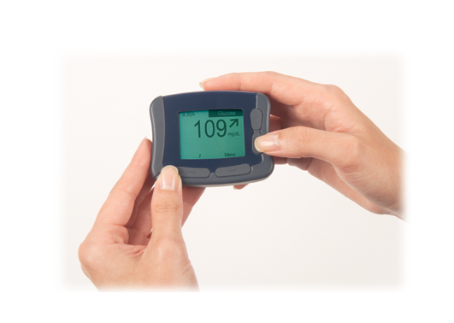
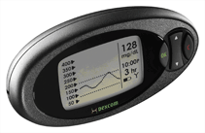
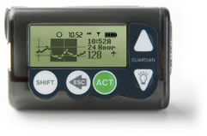
The Promise of Continuous Glucose Monitors (CGM)
Continuous glucose sensors give patients new tools with which to control glucose
  Continuous readings – see effects of insulin, food, exercise
  Trends – information to ward off highs and lows
  Alarms – alert patient or family member
New studies validate that continuous glucose sensors enable patients to achieve better control
  26% more time in target glucose range
  Improved HbA1C, the clinical measure of glucose control

Slide 7


CGM an Example of the Public- Private Research Partnership
National Institutes of Health
  Initial scientific research which led to new and better glucose sensing technologies
  Testing of CGM in children
Companies
  Developed products
  Two now approved by FDA, one awaiting approval
JDRF
  Clinical trial to gather data needed for health plan reimbursement of CGM

Slide 8
Critically Important NIH Diabetes Program Set to Expire
Special Diabetes Program at NIH
  Funds clinical trials with 60,000 patients
  Was created in 1997 and has been renewed and expanded twice
  Evaluation report to Congress demonstrates extensive progress being made in key areas including
    Identifying genetic & environmental causes of type 1 diabetes
    Preventing or reverse type 1
    Developing cell replacement therapy
    Preventing or reduce hypoglycemia
    Preventing or reducing complications from diabetes
    Attracting new talent and apply new technologies
  Research helps those with type 1 and type 2 diabetes as well as autoimmune diseases such as lupus and rheumatoid arthritis

Slide 9
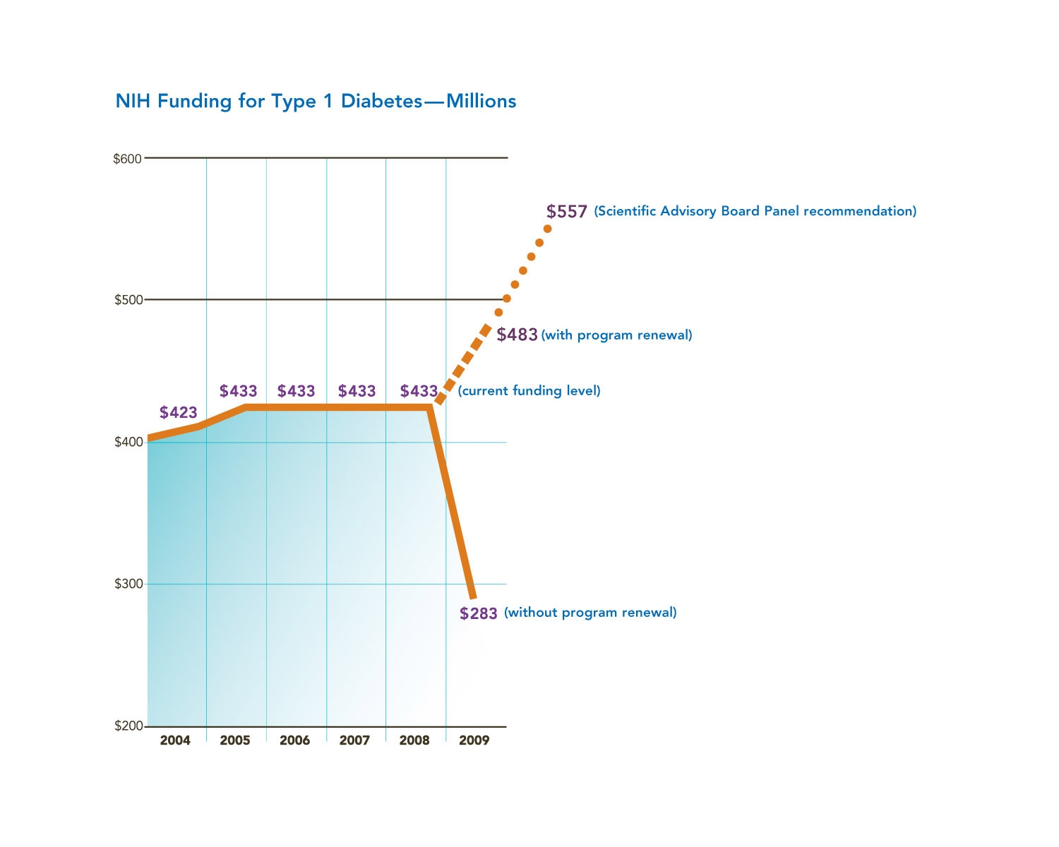
Without a Renewal, a 35% Cut

Slide 10
How You Can Help
Encourage your Representatives and Senators to co-sponsor legislation to renew the Special Diabetes Program (H.R. 2762 and S. 1494) and get it enacted this year
Sign up to be a JDRF advocate and encourage your friends and family to do so at www.jdrf.org/advocacy
Thank elected officials who support our cause
Get involved in your local JDRF chapter to help JDRF fund research for a cure

