Slide 1
Primer on Privacy
Dana B. Rosenfeld
Bureau of Consumer Protection
Federal Trade Commission
Notes:
Ari has laid out the foundation for why privacy should matter to you and what steps you can take to make sure your company is adhering to your privacy policy.
I’d like to talk to you about the FTC’s involvement in this rapidly evolving area.

Slide 2
Overview
Background
Privacy disclosures
Third-party data collection
Section 5 enforcement
Relevant privacy statutes
Tips and resources
Notes:
Here’s an overview of what I’m going to cover
Background – review of the FTC’s activities in the privacy area
Privacy disclosures – what we’ve learned about best practices, as well as some tips on what to avoid
Third-party data collection – the fact that third parties often collect information from consumers as they visit Web sites has become a hot issue. You may have read stories about “online profiling,” and we will cover this topic today.
Section 5 enforcement – as you’ve heard about throughout the day, the FTC has enforcement authority to prevent “unfair or deceptive practices.” I’ll talk about how the FTC has applied this enforcement authority in the online privacy context.
Relevant privacy statutes – while there is not currently a law that addresses online privacy for commercial Web sites generally, there are some new privacy laws that may apply to you, depending on the nature of your business, and I’d like to alert you to them.
Tips and resources – I’ll wrap up with some tips and resources that may assist you in developing and following your privacy policy.

Slide 3
FTC’s Privacy Initiative
Public workshops
Fair Information Practice Principles
  Notice, Choice, Access, & Security
Surveys of commercial Web sites
Annual reports to Congress since 1998
Enforcement actions
Consumer and business education
Notes:
- Since 1995, the FTC has been actively working with businesses and consumer groups to encourage the development of online privacy protection through our Consumer Privacy Initiative
A majority of the Commission, as well as the administration and members of industry, have advocated that online Web sites follow the Fair Information Practice Principles of Notice, Choice, Access and Security - the principles Ari just discussed
There is no federal law in the United States that currently requires commercial Web sites to adopt Fair Information Practices.
Note: other countries (EU, Australia, etc) have laws
Companies should monitor state legislation as well
But as Ari discussed, there are compelling business reasons to do so: build consumer confidence; prevent lost sales; international expansion

Slide 4
Audience Poll
  Do you post a privacy policy?
    Yes
    No
Notes:
** I’d like to begin our discussion of privacy disclosures with an instant survey:
Do you post a privacy policy on your Web site?
Select “A” for “YES”
Select “B” for “NO”
Please enter your response on your keypad now.
AFTER 8 SECONDS, A SLIDE WITH THE RESULTS WILL COME UP DISCUSS RESULTS
- Note: In our 2000 Survey, 62% of sites in our random sample posted a privacy policy

Slide 5
Audience Poll
  Where is your privacy policy?
    Hyperlink from home page
    Hyperlink where information is collected
    A and B
    None of the above
Notes:
Let’s do another instant survey, for all those of you that do post a privacy policy.
Where is your privacy policy (or the link to your privacy policy) located?
Select “A” if you link to the privacy policy from the Home Page
Select “B” if you link to the privacy policy at every place where information is collected
Select “C” if you link at all of these places
Select “D” for none of the above.
Please enter your response on your keypad now.
AFTER 8 SECONDS THE RESULTS WILL APPEAR
DISCUSS THE RESULTS
- Note: In our 2000 Survey, of those sites that posted a privacy policy, 76% linked from the home page

Slide 6
Privacy Disclosures:
Placement on Your Web Site
Clear and conspicuous
Hyperlink from home page to the complete privacy policy
Post disclosures or hyperlink again at the point of information collection
Notes:
Here’s what we have seen that we consider to be best practices with respect to where and how Web sites post a privacy policy on their sites . . .

Slide 7
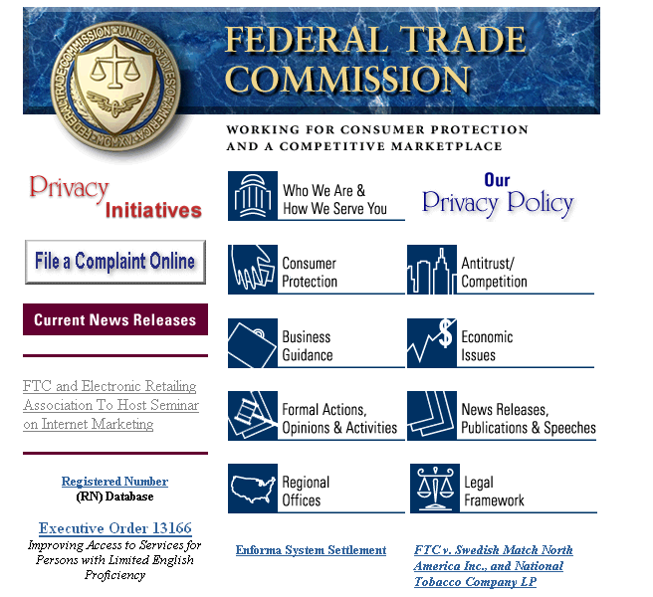
Notes:
Here’s a very good example of a clear and conspicuous link to a privacy policy from the home page . . .

Slide 8
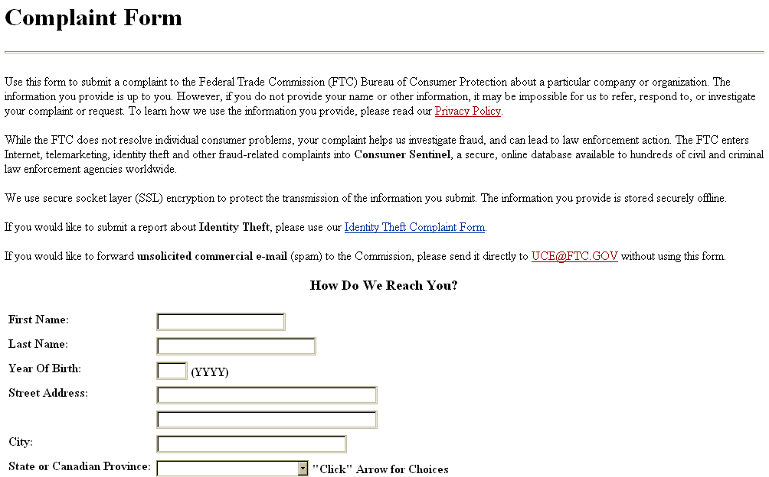
Notes:
Here’s another example from our Web site.
This is a complaint form, where we collect information from consumers. At the top of the form, before the consumer enters any personal information, we alert them to our privacy policy.
Note that we also include a statement about the security of the information the consumer is about to transmit.
** We’ve talked about best practices in terms of where your privacy policy should be. Now let’s get into best practices for what you should include in the privacy policy itself.

Slide 9
Privacy Disclosures:
You Should Disclose . . .
What information is collected
How information is collected
How information is used
Whether information is disclosed to others
How Choice, Access and Security are provided to consumers
Whether other entities are collecting information through the site
Notes:
These are privacy policy “do’s” – what you should include in your privacy policy.
What collected: identifying and non-identifying information
How collected: make sure you include passive collection (cookies)
How used: is it just to process an order? other internal uses?
Whether disclosed: this may be one of the areas that consumers are most concerned about, this is one of the key reasons why they refuse to provide information or abandon a purchase
Choice, Access, Security: good notice is essential to making the other fair information practices meaningful. Be clear and concrete.
Third-party data collection: disclose whether other entities – your business partners, advertisers, or Web site analysts – collect information at your site. This is an important issue for consumers, which we’ll talk more about in a few minutes.

Slide 10
Privacy Disclosures:
What to Avoid
Contradictory statements
Ambiguous language regarding choice
Applying new, inconsistent policies to previously-collected information
Notes:
** We’ve covered the topics that we suggest you include in your privacy policy, now let’s talk about some problems that, in our work in this area, we’ve observed – the things you should avoid.

Slide 11
Avoid Contradictory Statements
Example 1:
  “This site does not sell or rent user information to any third parties.”
  Followed 2 pages later by:
  “Information you disclose may be shared with our business partners and sponsors.”
Example 2:
  “Your privacy is important to us, so we don’t share information about our customers with others, except in the following limited circumstances.”
  Followed by:
  a long list of exceptions, including business partners, sponsors, and other third parties
Solution: clarity, brevity, consistency

Slide 12
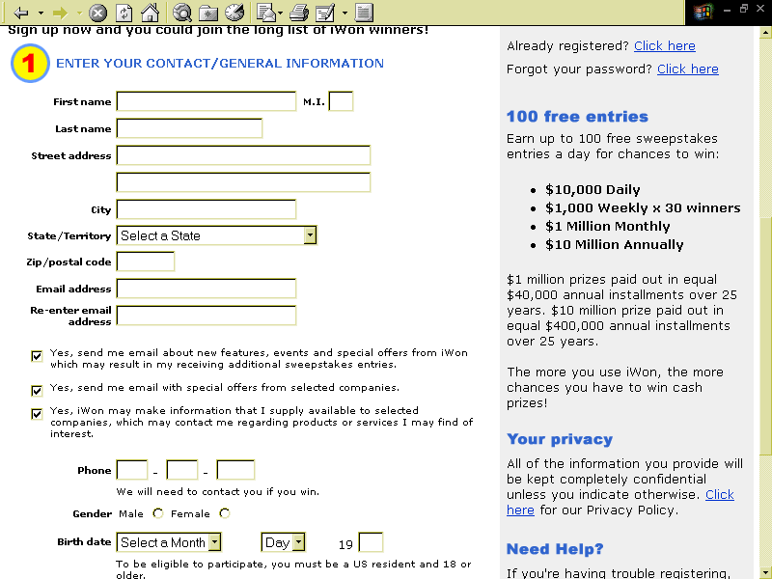

Avoid Ambiguous Language
All of the information you provide will be kept completely confidential unless you indicate otherwise.
Yes, make information that I supply available to selected companies, which may contact me regarding products or services I may find of interest.
Notes:
Compare these pre-checked boxes – which say “Yes” – use my information to send my stuff, and share it with others so they can send me stuff
With this statement on the right about “Your Privacy” – which tells consumers their information will be kept “completely confidential” unless they “indicate otherwise.”
The privacy policy suggests that the consumer must take an affirmative step before information will be shared
But in fact, consumers must take an affirmative step to prevent their information from being shared

Slide 13
Avoid Ambiguous Language
Example:
  Privacy Policy:
  “Personal information will not be used to contact you without your consent.”
  Bottom of Registration form:
  Yes! Send me information about other
  products I might like!
Solution: be clear about how consumers can exercise choice
Notes:
Here’s a similar example:
In the privacy policy, consumers are simply told that their information will not be used to contact them “without their consent.”
Consumers might look at that and think that their information will not be used in this way, unless and until the Web site specifically asks them and gets their affirmative approval.
But in fact, here’s how it works – at the bottom of a registration form is a pre-checked box. Information is going to be used to contact the consumer – unless the consumer notices and unchecks the box.
If you are going to use a pre-checked box, your privacy policy should be consistent with that

Slide 14
Avoid Material Changes Without Providing Notice or Choice
Example:
  “We will never share customer information with third parties.”
  But:
  “Our business changes constantly, so check back here frequently to learn of changes to our privacy policy.”
Solution: provide consumers notice and choice about whether changes shall apply to previously-collected information
Notes:
** That covers what we’ve observed as some examples of best and worst practices in privacy policies.
Now I’ll move into “third-party data collection”

Slide 15
Audience Poll
  Does a third party serve ads on your site?
    Yes
    No
    Don’t know
Notes:
Let’s start with another instant survey:
How many of you use an Internet advertising company – like DoubleClick, Engage, Matchlogic – to serve banner ads on your site?
Select “A” for “YES”
Select “B” for “NO”
And if you don’t know, select “C”
Enter your response on your keypad now.
AFTER 8 SECONDS, THE RESULTS WILL APPEAR
DISCUSS RESULTS

Slide 16
Third-Party Profiling:
What it is and How it Affects You
Third party’s use of cookies, Web bugs, etc., to track consumers across Web sites and develop extensive profiles to help deliver targeted ads
  Invisible to consumers
  No direct consumer relationship
FTC & Department of Commerce held public workshop in November 1999
Network Advertising Initiative (“NAI”) announced
  90% of network advertising industry (about 10 members)
  Developed self-regulatory principles
Notes:
Those of you that work with the banner ad companies may be familiar with the fact that they use cookies that are placed on your site to help target ads to consumers visiting your site.
At the FTC, we’ve studied this practice, which we’ve called “online profiling,” or “third-party profiling”
What is it? It is the use of . . .
We held a workshop to educate consumers, industry, and the government about this practice
At our workshop, a new self-regulatory initiative was announced

Slide 17
NAI Self-Regulatory Principles
Include Notice, Choice, Access, Security and Use Restriction for sensitive information
NAI members will require their clients to provide Notice and opportunity to exercise Choice
Notes:
The NAI principles include . . .
Now here’s the part that may matter to most of you: NAI members will require their clients (meaning Web sites) to provide consumers with notice and the opportunity to exercise choice.
Again, that’s because the banner ad companies don’t have a direct relationship with your consumers, but you do.
It also makes sense because from the consumers’ perspective, they are visiting your site, and they could be mad at you if they later find out that you’ve been allowing third parties to collect information about them while they visit your site.
** The NAI group has developed sample notice and choice language . . .

Slide 18
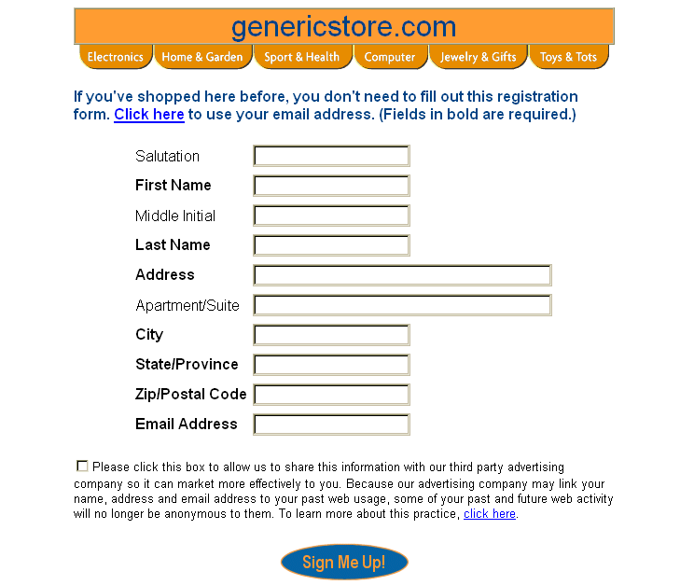
Sample Notice:
Sharing PII With Third Party
Notes:
** And here’s an example of one of the “mock ups”they’ve developed – the kind of thing you might find them requiring of you on your Web site.
In this example, we have a registration page, where PII, or “personally identifiable information” is collected, and the Web site wants to share that information with the ad company.
At that point, the ad company will be able to link a consumer’s name with her previous anonymous click stream data.
So NAI would require a disclosure, at the time of data collection, before the consumer actually registers.

Slide 19
More on Third-Party Data Collection
For more information about the NAI Principles, including sample notices:
  NAI Web site
  www.networkadvertising.org
  FTC Report to Congress: Online Profiling www.ftc.gov/os/2000/07/index.htm#27
Notes:
There are more examples available at these sites
Also, we have included a few additional slides in your handouts that may be helpful to you.
** OK, that covers privacy disclosures, including disclosures about the fact that third parties collect information through your site.

Slide 20
Say What You Do . . .
And Do What You Say
Section 5 prohibits deceptive practices
Deceptive practices include privacy statements that are misleading because
  They state or imply something that is not true about what information is collected or how it is used
  They omit information that is material in light of the statements made
FTC enforcement
Notes:
As we’ve discussed, it’s important to say what you do . . .
But you must also do what you say, and this is where FTC enforcement comes in.

Slide 21
FTC v. Liberty Financial
In connection with a survey about finances, Web site expressly stated that:
“All of your answers will be totally anonymous.”
In fact, Web site could identify individuals with their responses to the survey
FTC alleged these were deceptive practices under Section 5
Notes:
Claiming information is anonymous, when in fact it’s not, is a problem.

Slide 22
FTC v. Toysmart
Privacy Policy: “When you register with toysmart.com, you can rest assured that your information will never be shared with a third party.”
Conduct: Facing financial difficulties,Toysmart tried to auction off its customer database
Legal consequence: FTC filed lawsuit to block the sale; 40+ states filed objections
Notes:
Give update: Toysmart finally agreed to destroy the customer information.
I’m sure none of you are thinking that you will go out of business, but unfortunately, Toysmart is one of many dot coms that didn’t make it.
Privacy promises need to be kept, even in bankruptcy.
If you find yourself in such a predicament, you may want to consider what we talked about earlier – provide notice and choice for a material change such as a sale of customer information to another company.
Also, some companies have come up with creative ways to extract value from their customer list, without violating consumer privacy. For example, a company may be willing to pay you to send an email to customers, suggesting they visit the other site, where they will receive a discount if they register.

Slide 23
Relevant Statutes:
Children’s Online Privacy Protection Act
Who is covered by COPPA?
  Sites (or portions of sites) directed to children under 13
  Sites that knowingly collect personal information from children under 13
  Collection of anonymous information does not trigger the Act
What does COPPA require?
  Posted privacy policy and direct notice to parents
  “Opt-in” parental consent prior to collection of personal information
  Parental access to information
www.ftc.gov/kidzprivacy
Notes:
** As I mentioned at the beginning, while there is no general law in this country addressing online privacy for commercial Web sites, there are some laws on the books tailored to certain types of Web sites or industries that could affect you.
One of those is the Children’s Online Privacy Protection Act, or “COPPA” for short . . .

Slide 24
Relevant Statutes:
Gramm-Leach-Bliley Act
Who is covered by GLB?
  Financial institutions
  Entities “significantly involved in financial activities” (e.g., real estate appraisers, insurance companies, automobile leasing, companies that operate travel agencies in connection with financial services, retailers that offer credit cards directly to consumers)
What does GLB require?
  Notice
  Opt-out before information is shared with non-affiliated third parties
When must companies comply?
  Law went into effect November 13, 2000
  Full compliance required by July 1, 2001
Notes:
We are developing business guidance materials that should be available on our Web site, ftc.gov, soon.
**That covers the legal framework – at least as it is today – as you know, this is a rapidly evolving area!
I’d like to finish up with some tips and resources . . .

Slide 25
Tips for Writing (and Following) Your Privacy Policy
Make sure you know what information your company collects, how it is stored, and how it is used, and write your policy accordingly
Use a team approach, including representatives from legal, marketing, customer support, IT, and Web design to
  Determine current information practices
  Assess what laws may apply
  Develop and draft a clear privacy policy
Educate your employees, develop training materials
Notes:
We are often hearing from senior executives that they had no idea that certain information was being collected, used, or disclosed. It seems that it may often be a situation where the left hand doesn’t know what the right hand is doing.
It is essential that you know – and that all employees who deal with customer data know – what your information practices are.
We recently updated our Privacy Policy at the FTC – so we have some first hand experience with how this process works. We brought together a team of people, including our Web programmers, the general counsel’s office, and our marketing folks.

Slide 26
Privacy Policy Generators Can Help
DMA’s Privacy Policy Generator
  www.the-dma.org/library/privacy/creating.shtml
Microsoft bCentral Privacy Wizard
  privacy.linkexchange.com
OECD Privacy Policy Generator
  www.oecd.org
Secure Assure Privacy Profile Wizard
  www.secureassure.org
TRUSTe Privacy Statement Wizard
  www.truste.org/wizard
Notes:
This is a list of free services that help Web sites develop privacy policies.
They guide the user through a series of questions, and help Web sites generate privacy policies.
Remember, a privacy policy must be tailored to the companies actual practices, and should comply with fair information practices – something that none of these privacy policy generators can do for you
Helpful even just to use to review questions and make sure you know the answers

Slide 27
Other Resources
BBBOnline Privacy Seal Program www.bbbonline.org/privacy/index.asp
BetterWeb Seal Program
www.pwcbetterweb.com
CPA WebTrust Seal
www.cpawebtrust.org
TRUSTe Seal Program
www.truste.org
Platform for Privacy Preferences (P3P) Project www.w3.org/P3P
YOUpowered, Inc.
www.youpowered.com
Online Privacy Alliance Guidelines
www.privacyalliance.com
NAI Self-Regulatory Principles www.networkadvertising.org

Slide 28
FTC Privacy Resources
www.ftc.gov/privacy
www.ftc.gov/kidzprivacy
www.consumer.gov
FTC Report to Congress: Fair Information Practices in the Electronic Marketplace
(May 2000)
Advisory Committee on Online Access and Security – Final Report (May 2000)
FTC Report to Congress: Online Profiling, Parts 1 & 2 (June & July 2000)

Slide 29
Primer on Privacy
Dana B. Rosenfeld
January 30, 2001
Notes:
THE END

Slide 30
More about the NAI Principles

Slide 31
Collection of Non-PII
Network advertisers shall require that their clients:
  (1) post a privacy policy that clearly and conspicuously discloses (a) the customer's use of the network advertiser services for profiling; (b) the type of information that may be collected by the network advertiser; and (c) the consumer's ability to choose not to participate; and
  (2) provide a clear and conspicuous link to the Opt-Out Page of the NAI gateway educational site or to the network advertiser’s own opt out page

Slide 32
Sample Non-PII Notice Language
“We use third-party advertising companies to serve ads when you visit our Web site. These companies may place cookies on your machine and may collect certain anonymous information (not including your name, address, email address, or telephone number) about your visits to this and other Web sites in order to provide advertisements about goods and services of interest to you. Below we’ve provided links to these companies’ privacy policies where you can learn about their practices and the choices you may have to opt-out of having information used or collected by these companies.”
Company Privacy Policy
Adcompany 1 www.adcompany1.com/privacy
Adcompany 2 www.adcompany2.com/privacy

Slide 33
Collection of PII
Network advertisers will provide, through contractual arrangements with their clients, “robust notice” and choice before collecting PII or merging PII with non-PII
Choice varies:
  Opt-out for collection of PII
  Opt-out for merger of PII and non-PII prospectively
  Opt-in for merger of PII and previously-collected non-PII
  Opt-in for material change in how previously-collected PII or non-PII is used

Slide 34
“Robust Notice”
At the time and place information is collected (e.g., registration page)
Must disclose
  that the PII is shared with a network advertiser for purposes of profiling
  the type of information that may be collected and linked by the network advertiser
  the consequent loss of anonymity
  the consumer’s choices with respect to the data collection or merger of PII and non-PII

