Slide 1
A Sting of Love
Entomologist Gene Robinson:
Exploring the Social Lives of Bees

Slide 2
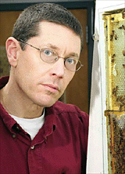
Gene Robinson Studies Bee Societies
He investigates how hormones and nerve circuitry influence honeybee social behavior.
Honeybees
Exhibit complex social behaviors
Cannot live without the social structure of a hive
Change social role behaviors based on needs and environment
Question:
What do bees have in common with vertebrates?

Slide 3
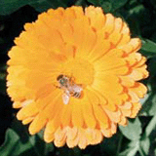
Answer: Hormones
Bees, like humans, are controlled in part by hormonal stimulation.
Bees exhibit many of the complex behaviors of vertebrates, such as foraging.

Slide 4
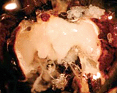
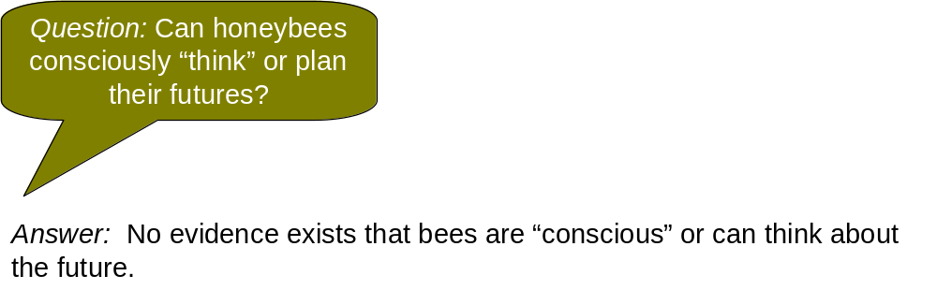
Do Honeybees Have Brains?
Yes. Although not as complex as human brains, bee brains appear to respond to the coordinated action of brain genes.
Honeybee brain.
Photo: Zachary Huang, http://cyberbee.msu.edu/

Slide 5

Hive as Laboratory
The beehive is a practical experimental system
Available in the wild or lab
Enables close watch of social behavior and signaling
Lets researcher alter hive’s social structure/environment to measure outcomes

Slide 6
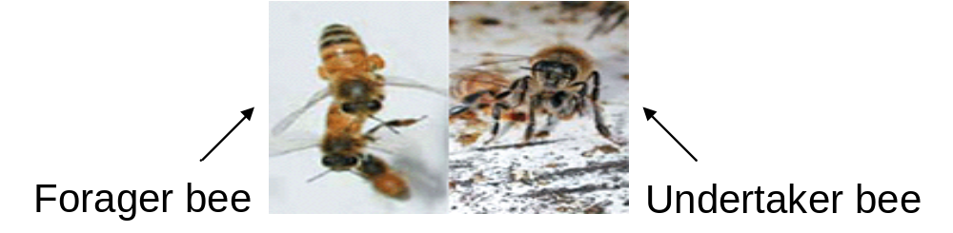
Clear, Flexible Division of Labor
.
3.

Slide 7
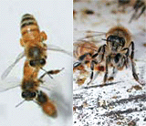
Can Environment Influence Genes?
Robinson discovers that environment changes honeybee job tasks and how fast bees grow up.
When forager bees are taken from the hive, younger “nurse bees” suddenly become active foragers.
Given a shortage of nurse bees, some bees never grow up, becoming “Peter Pans” that care for young bees.
Conclusion: Social regulation and environment affect brain genes and growth.

Slide 8
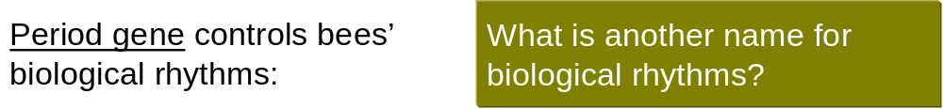
Rhythm in the Genes
Gene is socially regulated
Active in forager bees; inactive in nurse bees
Found in almost all animal species
Why might the period gene be more active in some bees than in others?
Which rhythmic activities might the period gene control in all species?

Slide 9
How Is a Gene Affected by Social Activity?
Hypothesis | What Might Happen | Type of Response
Bees detect food shortages. | With few foragers, hungry bees “gear up” to hunt. | Decentralized
Bees communicate by smelling pheromones. | Young bees detect absence of older bees through chemical signal systems. | Decentralized
Leader says, “Do It!” | Queen or select group of bees with access to environmental information puts out a call to the hive. | Centralized

Slide 10
Findings: Pheromones Trigger Changes
Decentralized hive activity—like stock market, in which individual actions affect stock prices, even though it appears that there is a general, integrated response.
Honeybees respond adaptively as an integrated unit, but it's not as if the queen or a “select committee” of bees in the know is sending out orders.
Robinson has found evidence that molecular signals, communicated via pheromones, cause direct changes in honeybee gene activity.

Slide 11
Research Applications
How might Robinson’s sociogenomic findings help answer the question: “What makes humans unique—nature, nurture, or both?

