Slide 1
CAPIT BRIEFING to the AMT
Update of Activity
Business Process Definitions for Consideration
Accountability in the Business Process
Single Tracking Database
Next Steps

Slide 2
Update of Activity
Recent meeting with Agreement Specialists and other interested parties
  Review of business process
  Roles and responsibilities
  Considerations for streamlining paperwork
Process analysis and considerations

Slide 3
The Cooperative Agreement Business Process
Attendees of meeting identified all business processes used
  Each program & each region had individual process
  Attendees identified those steps that were required for a uniform business process
  One process was agreed upon

Slide 4
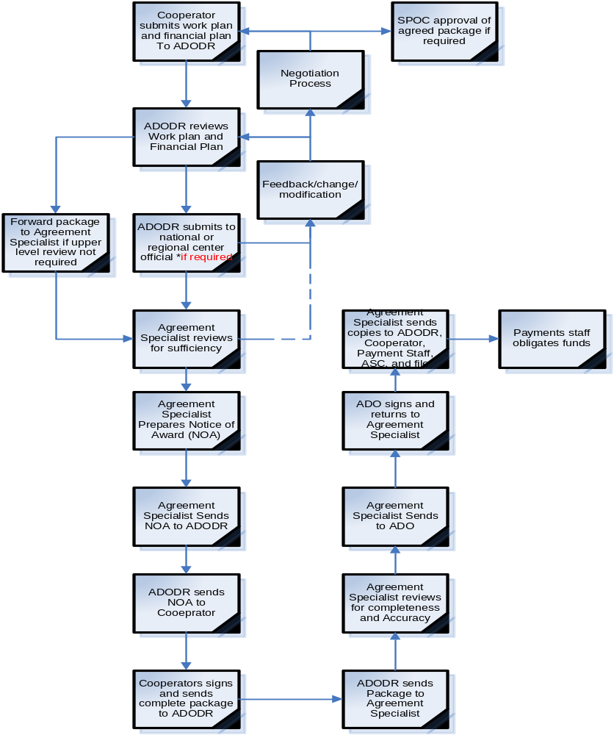
Mutually Agreed Process

Slide 5
Modified Process Using Email Backbone
Analysis of steps of agreed process
Opportunity to use email
  Means of sharing drafts with many people
  Speed up process
  Track process
  Measure performance
  Retains flexibility in individual program needs through concurrent reviews while maintaining performance requirements
Enable global view of operation from the ASC
  Monitor agreement process
  Uniform agreement numbering system
  Meet administrative expectations of unit
  Incorporate performance measurement

Slide 6
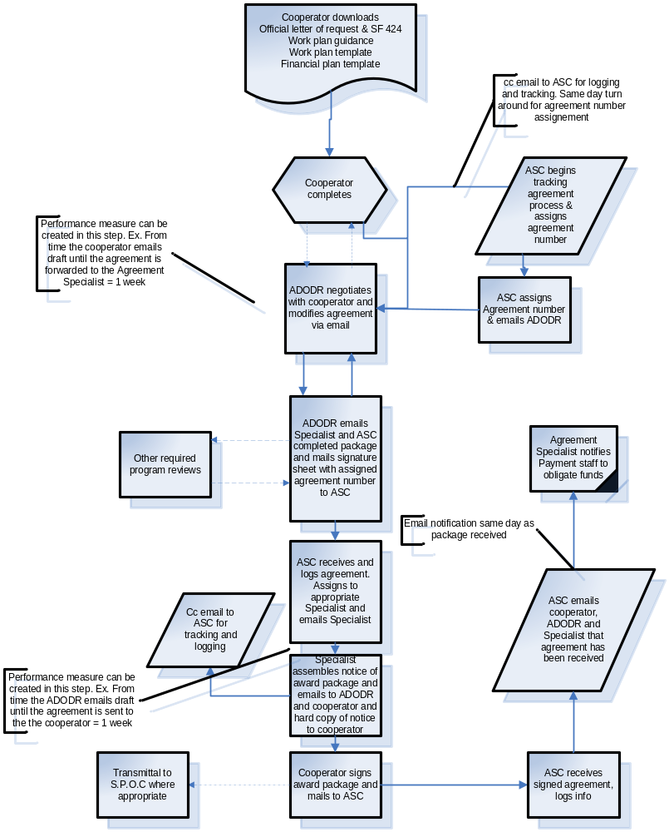
Modified Business Process based in email

Slide 7
AMT Consideration
CAPIT requests AMT to determine the business process best suited to APHIS needs
  Each process achieves a substantial streamlining and meets the objective of uniformity in the business process
  CAPIT is still pursuing a long term e-solution to processing. Primary consideration given to Ework (issues surrounding grants.gov)

Slide 8
Accountability
ASC is responsible for oversight of all agreements and grants, including cooperative agreements
ASC establishes Agency policy relating to agreements and grants
ASC does not have authority to ensure policy is adhered to

Slide 9
Considerations to Ensure Accountability
APHIS utilizes staff that have knowledge and expertise in agreements
Field staff are assigned and report to programs in the regions
  Work at the discretion of regional management
  Accountable to regional management
  Are not accountable to ASC

Slide 10
Examples of Problems Identified in Cooperative Agreements
Cooperative agreements of one program using other program authorities in agreements
Pen and ink changes made by specialists, not by signatory authorities
Using agreements incorrectly (contracts, grants, etc.)
Use of out of date language
Non-existent work plans
Not adhering to APHIS numbering policy
Notice of awards written by cooperator or APHIS administrative specialists

Slide 11
Accountability
Agreements are contracts
  Enforceable agreement between two parties
  An expectation between parties is established
Legal responsibility and accountability of Agency
Uniformity in how agreements are developed

Slide 12
Two Options to Ensure Accountability
Accountability should not be seen as a negative reinforcement
To achieve long run positive change in the cooperative agreement process accountability is required
OPTION 1: Centralize reporting and accountability under the ASC
OPTION 2: Formalize an accountability chain within APHIS programs and allow specialists to remain in programs

Slide 13
Centralization
All agreement specialists report to and are accountable to ASC
Specialists remain on duty location
Numerous pros and cons (see handout)
  Review of handout
With both options CAPIT is reviewing ADODR responsibilities

Slide 14
Accountability Chain
Agreement Specialists continue to report to current supervisors
ASC monitors activities
Any issues are discussed with appropriate chain of accountability
  Agreement Specialist
  Direct Supervisor
  Regional Director
  Deputy

Slide 15
Pros and Cons of Accountability Chain
Pros
  Addresses existing need for accountability
  Provides ASC with authority required to ensure Agency wide accountability
  Allows programs to retain control of Specialist position
  Customer service requirements are determined by program
  Low impact
Cons
  Accountability is more difficult
  All levels of program management may need to be engaged to ensure accountability
  Will not allow for work load reassignment if personnel are unable to complete work due to absence or other reasons

Slide 16
Single Database
VS Eastern Region developed a tracking database for agreements
Agreement Specialists reviewed database and agreed that it would beneficial to have as uniform system
VS is currently upgrading the database to be more powerful
CAPIT IT group is awaiting the conversion
  Will identify a server that for agency wide access
  Work with ITD and will manage the project of taking VS system and making it Agency wide
  Low or no-cost solution
System will enhance accountability and performance management
  Provide a powerful tool for Agreement Specialists
  Will be on a platform that will enable integration of an e-solution in the future

Slide 17
Next Steps. Tying it all Together
CAPIT will be assembling a sample of ADODRs to discuss their roles and responsibilities to determine a simplified set of responsibilities
Direction from AMT relating to the business process and accountability choices
Development of policies and procedures based upon decisions of AMT
Develop and provide appropriate training for all affected parties
Target start date for implementation January 1, 2006

