Slide 1
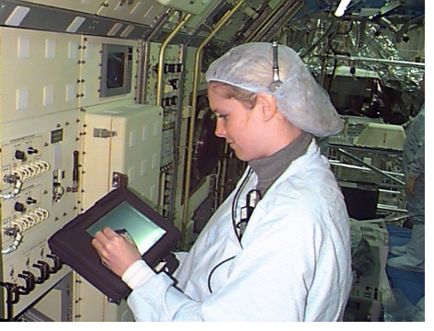
Electronic Portable Information Collection (EPIC) System
SENTEL Corporation, Alexandria, Virginia
Innovation
SENTEL and NASA jointly developed the Electronic Portable Information Collection (EPIC) system under an SBIR contract at Kennedy Space Center. The system was originally designed to assist in KSC’s migration to a paperless procedures systems for Space Shuttle and payload processing operations by producing a work authorization and quality inspection system based on electronic documents and digital signatures.
Accomplishments
EPIC represents a unique tool for workflow and process management. It can facilitate procedure execution, procedure documentation, process auditing, and quality inspections. In real time, it can also define a process, measure the workflow, and compare measurement results to established standards and goals.
SENTEL Corp. and NASA jointly designed, built, and tested prototype paperless work authorization procedures. Initially called the Quality Assurance Portable Data Collection System (QAPDC), this project was an important step towards reducing paper and increasing quality for the International Space Station Operations at KSC.
The QAPDC system won the NASA SBIR of the Year Award (software category) at Technology 2006.
The QAPDC system incorporated a handheld, pen-based computer platform with the capability to install a variety of data collection forms, record data against those forms, imprint controlled signature authority and quality inspector stamps, maintain the integrity of data collected, and relay the data to a computer network for analysis or archiving.
By combining the technologies and lessons learned from the QAPDC and the Wireless Information Network (WIN), another SENTEL SBIR contract project, EPIC proves secure and reliable document modification, review, and approval.
EPIC allows for direct incorporation of procedure modifications and deviations. It offers realtime workflow measurement and documentation, workgroup information sharing and collaboration, and reduced use of paper.
A Formative Evaluation study was conducted by an Auburn University professor for EPIC usability and performance enhancement.
Scheduled to be used in parallel with current procedures during International Space Station payload processing operations at KSC.
SENTEL teamed with Symbol Technologies and CM stat Corp. to provide a commercial process management system incorporating EPIC, called the Advanced Process Manager™.
Founded in 1987, SENTEL received its 8(a) certification from the U.S. SBA in 1989. Since its inception, SENTEL has enjoyed significant but controlled growth. The company has progressed from a single $33K subcontract in 1987 to its current $30 million plus in revenue.
EPIC System In Use at KSC
Commercialization
Two products: 1) EPIC, a standalone portable data collection system, developed jointly by NASA and SENTEL. 2) Advanced Process Manager™, a full-function product data management system.
Secondary markets are the Defense system lifecycle data management, product data management, supply chain management, and fleet maintenance management.
SENTEL has partnered with CMstat Corporation, Alexandria, Virginia, and Symbol Technologies, to develop Advanced Process Manager™. SENTEL interfaced EPIC with CMstat’s V5 configuration management product. For worker mobility, Advanced Process Manager features Symbol Technology’s Spectrum 24™ wireless networking technology.
Government/Science Applications
The EPIC project began as an SBIR contract initiated by the Safety and Mission Assurance Directorate at Kennedy Space Center. They teamed with the Payload Processing Directorate to jointly develop the project with SENTEL Corporation, which was awarded the SBIR contract. The prototype was tested and determined to be a viable option.
After the contract was completed, NASA KSC and SENTEL Corp. joined in a Nonreimbursable Space Act Agreement in 1997 to develop an operational version of the product, to be used to electronically execute Work Authorization Documents (WADs).
KSC and Ames Research Center are conducting joint research to apply EPIC in wireless communications and in developing smaller, lighter hardware to display EPIC portable data terminals in various KSC environments.
Points of Contact:
NASA: Darcy Miller 407-867-3523
www.ksc.nasa.gov/payload/projects/qapdc
SENTEL: Kevin Jackson 703-739-0084
www.sentel.com
1998 SBIR Phase II; NAS10-12118
NASA Field Center: Kennedy Space Center
Date of Update May, 1998
Success Story # 10-001

