Slide 1
Using Java Graphics to Display Ocean Observations in NOAAServer
D.W. Denbo
Joint Institute for the Study of Ocean and Atmosphere (JISAO),
University of Washington, Seattle, WA
“http://www.epic.noaa.gov/NOAAServer/sgt”
(JISAO is a joint institute of the University of Washington and the National Oceanic and Atmospheric Administration's Pacific Marine Environmental Laboratory)

Slide 2
Introduction
NOAAServer Project was created to provide a view of NOAA’s on-line information free of organizational boundaries.
To accomplish this goal NOAAServer applies a combination of World Wide Web and network computing technologies.
Java graphics enables highly interactive client-side graphics.
NOAAServer Project was established by and is managed out of the
Environmental Services Data and Information Management (ESDIM) office.

Slide 3
Design Goals
Allow graphics developer flexibility and freedom
GIS style layer approach
Support several display types
  X-Y plot
  2-D contour and “pixel” plots
  Vector plot
  Point-Value plot
Develop a framework that can be easily extended

Slide 4
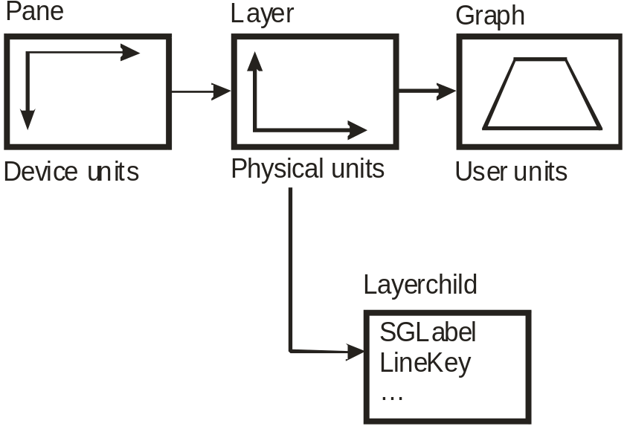
Implementation
Two coordinate systems
  physical
  user
Three main components
  Pane
  Layer
    LineKey
    SGLabel
  Graph
    Axes
    Renderer

Slide 5
Mouse Events
Mouse events are pre-processed by Pane
Events passed to user are
  Object selection
  Zoom rectangle selected
Events processed by sgt are
  Object move
  Line hi-lighting

Slide 6
Graphics Data Model
Data model needs to
  support X-Y, contour, raster, vector, and point plots
  be compact and “light-weight” for client-server Web
Accomplish the above by
  supporting “plottable” objects
    one- and two-dimensional arrays
    coordinate information
    units and titles
  data models implemented using java interfaces

Slide 7

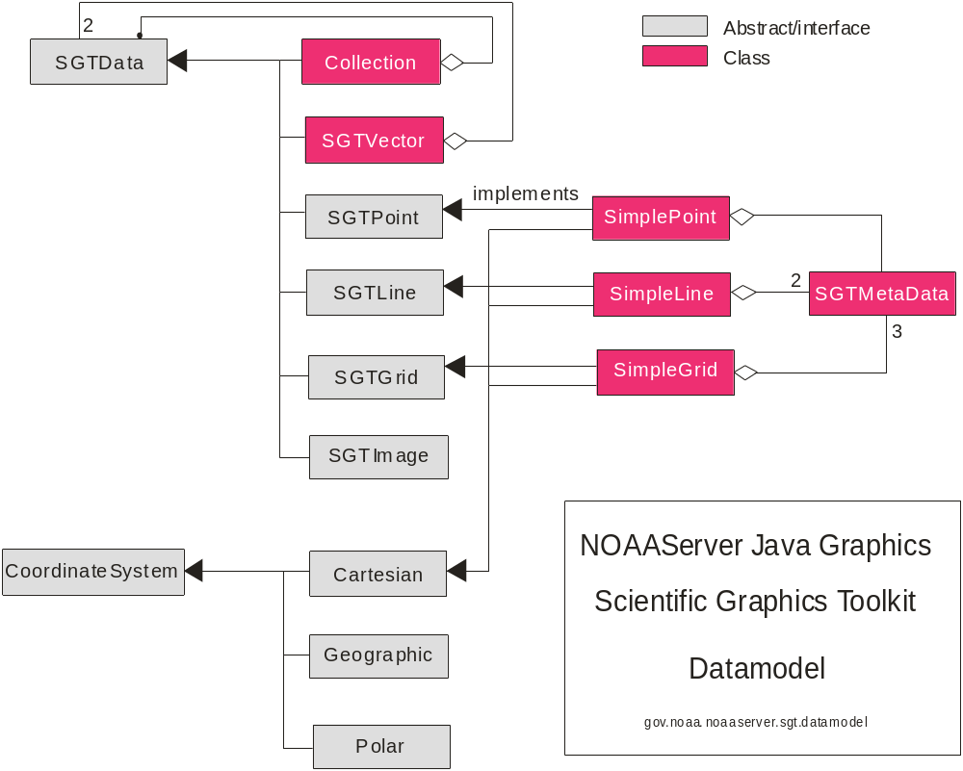
Graphics Data Model
Primitive Data Types
  SGTPoint
  SGTLine
  SGTGrid (2-dimensional)
  SGTVector (2-component)
  SGTImage
SGTMetaData
  getName()
  getUnits()
  isModulo()
  getProperties()

Slide 8
NOAAServer Application
Client allows user to
  select a remote dataset
  navigate through the dataset
  receive the data request
  graphically display the data
SGT used to display data in an independent window
Layouts construct a graph, manage zooming, and add datasets to the graphs

Slide 9
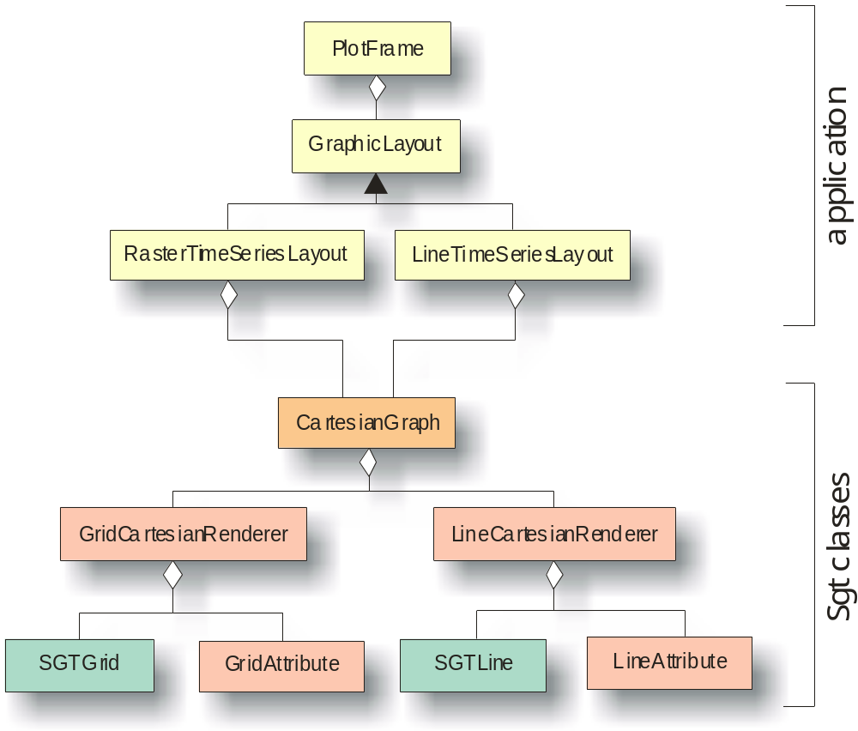

Slide 10
Station Locations
Uses StationPlotLayout with
  LineCartesianRenderer
  Multiple SGTLine objects
  LineAttribute set for MARK style
    Layout uses different plot marks for each set of stations
  LineKey used to identify each set of stations
  Supports zooming

Slide 11
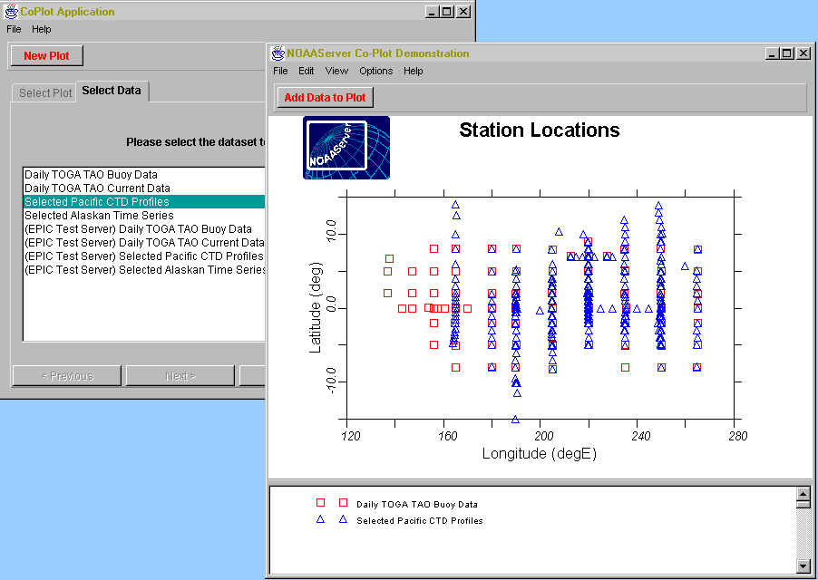

Slide 12
Time Series Plot
Uses LineTimeSeriesLayout
  LineCartesianRenderer
  Multiple SGTLine objects
  LineAttribute set for SOLID lines
    Layout uses different pen colors for each line
  LineKey used to identify each station
  Supports zooming

Slide 13
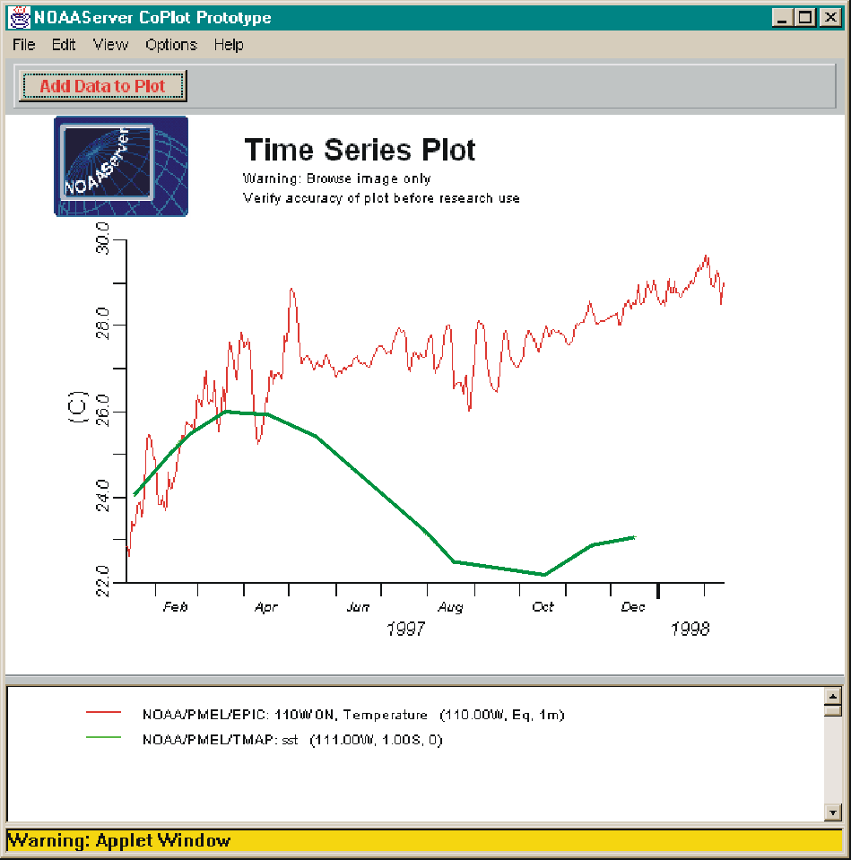

Slide 14
Raster Time Series Plot
Uses RasterTimeSeriesLayout with
  RasterCartesianRenderer
  Single SGTGrid object
  ColorMap used to map temperature to a color
  ColorKey graphically displays the mapping

Slide 15
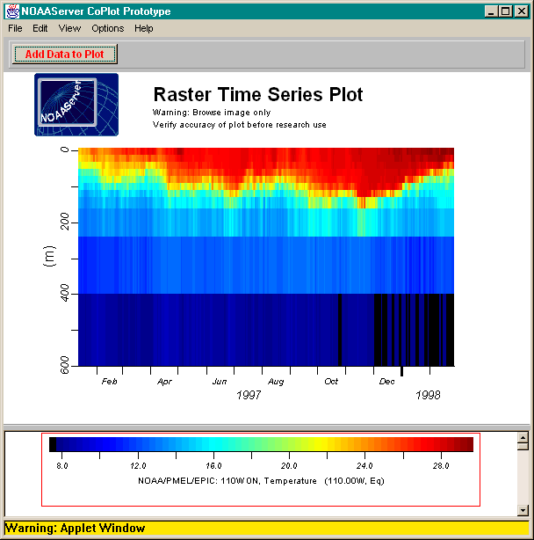

Slide 16
Future Directions
Next major version will include Java2D capabilities
  Line widths
  Dash styles
  More font control for Labels
  Arbitrary rotated text
Implement MapGraph and supporting classes

Slide 17
References
Brazille, W., D.W. Denbo, and W.H. Zhu, 1997. NOAAServer Version 2 Co-plotting Prototype. Presented at NOAA WebShop97, October 22-23, 1997, Silver Spring, Maryland.
Denbo, D.W., 1998. Scigraph: Object-Oriented 2D Scientific Graphics Library. Presented at the 14th International Conference on Interactive Information and Processing Systems for Meteorology, Oceanography, and Hydrology, January 12-16, 1998, Phoenix, Arizona.
Denbo, D.W., 1997. NOAAServer Graphics Engine Architecture. Presented at NOAA WebShop97, October 22-23, 1997, Silver Spring, Maryland.

