Slide 1
The Fallacy Of COTS Economics For Space Applications
Steve Strickler Space Products Marketing Mgr
Intersil Corp.
PO Box 883
Melbourne, FL 32902
Ph: (321) 729-5869
Fax: (321) 729-5516
sstrickl@intersil.com
© Copyright 2001 Intersil Americas,Inc All Rights Reserved

Slide 2
Background & Status
20+ Years Ago-Low Risk/Hi Reliability
5 Years Ago-COTS- Higher Risk/Lower Reliability
Now-Mixed Risk-Combination of devices
COTS Usage evolved from Technology To Technology & Cost
And what did we get-Problems!!—Better, Faster, Cheaper & Problems
© Copyright 2001 Intersil Americas,Inc All Rights Reserved

Slide 3
COTS Drivers
Technology
  New generation parts may not be available as Hi Rel/Rad Hard
  Much broader portfolio of COTS devices
  Cannot continue to modernize design with only RH devices
Cost
  Originally believed to be cheaper
  With less complex & well characterized devices, may be true
  The Pendulum is swinging in that it is now accepted that on more complex devices it is not cheaper!
© Copyright 2001 Intersil Americas,Inc All Rights Reserved

Slide 4
What is a COTS Upscreen?
A Commercial or Military device
Characterized for a specific application
Rad characterized to a specific level
Derated as necessary
Blessed by Reliability/Survivability
  Or
Used out of its Specified Range
and
Blessed by your Reliability/Survivability
© Copyright 2001 Intersil Americas,Inc All Rights Reserved

Slide 5
Fallacies About COTS for Space
Are just as reliable because
  They are made on a commercial SPC controlled line
  Can be upscreened without a problem
  Automotive Flow will yield parts as good as Hi Rel ones
  Can be derated and will work fine
BUT
  SPC will only give control within design parameters
  Cannot be upscreened indiscriminately
  Automotive Flow Fallacies-volume vs portfolio
  Derating & Upscreening have risks that are not always comprehended
© Copyright 2001 Intersil Americas,Inc All Rights Reserved

Slide 6
What Are The COTS Problems When Upgrading/Upscreening?
Little or no support from the Manufacturer
Commercial Fab Processes
  Cost reduction is constant-so are changes
  Neither Process nor Design Change is communicated to users
    Constantly shrinking geometry
    What you get today will not be the same tomorrow
  Die - will element eval qualify the parts?
Upscreening
  Is the performance of the part completely tested? How do you know?
  Non-uniformity – lot to lot and fab to fab variations
  What will be the long term effect of using the part beyond it’s design range?
© Copyright 2001 Intersil Americas,Inc All Rights Reserved

Slide 7
The Intangible Cost Of COTS Reliability
Can you test reliability in? COST?
Are all units uniform for performance-Can you prove this?
Will all units meet the radiation specification?
  How will you know? What Price uncertainty?
Customer Oversight
  How much cost does this add?
  What additional testing will convince your customer? – How much will that add to the cost?
Who takes the risk? What don’t you know?
© Copyright 2001 Intersil Americas,Inc All Rights Reserved

Slide 8
The Real Costs
What Are They?
  Processing costs
    DPA
    Upscreen plan
    Radiation evaluation
  Intangible costs
    Schedule delays
    Is it really reliable?
Who pays these costs?
  Sometimes buried in a corporate account
  Few people know the true costs
© Copyright 2001 Intersil Americas,Inc All Rights Reserved

Slide 9
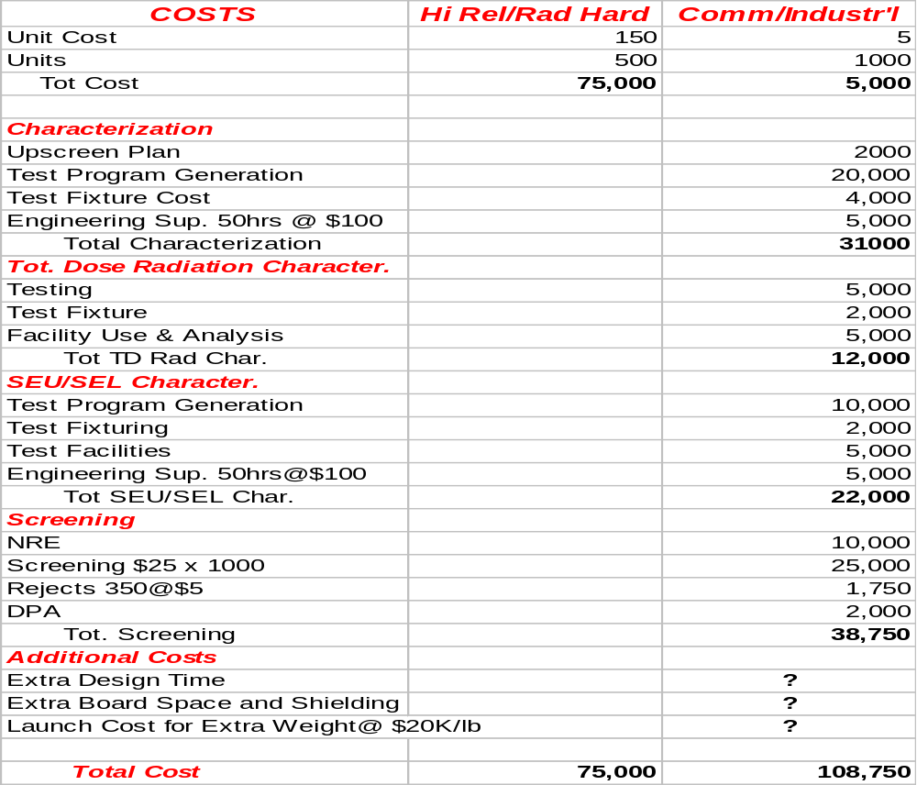
COTS Costs
© Copyright 2001 Intersil Americas,Inc All Rights Reserved

Slide 10
COTS Costs(con’t)
Does not take into account any extra reliability tasks
Does not contain any upside for increased launch costs because of extra weight for shielding & redundant circuitry
Does not take into account that when you buy the next lot you have to do it again!
© Copyright 2001 Intersil Americas,Inc All Rights Reserved

Slide 11
Summary/Conclusion
Pick the device carefully
Pick the Manufacturer carefully
Pick the up-screener carefully
COTS may be the only path to get the technology you need
    You have to use COTS parts
    BUT
      It is neither cheaper nor better
        May be better technology
      It may be as good if done correctly
      And it could be faster if not done correctly
COTS FOR SPACE IS NOT CHEAPER!!
© Copyright 2001 Intersil Americas,Inc All Rights Reserved

