Slide 1
Flexible Coils for NCSX:
Status and Near-Term Plans
S. P. Hirshman (ORNL)
representing NCSX Coil Design group
NCSX PAC-4
August 1-2, 2000

Slide 2
Topics
Coil design selection criteria
  Results will be shown for N_{p} = 3 reference design
Saddle coils (+ 1/R background)
Modular coils
Saddle coil + alternate background coils
Reconstruction from saddles and modulars
Coil flexibility assessment

Slide 3
Significant Progress Made Since Previous PAC Meeting
c82 coil designs were limited by high current coil current density
  limited flat-top: restricted experimental conditions
  limited flexibility: current swings had to be small
new, improved coils for N_{p} =3 reference plasma
  lower current densities (by factors ~2-3)
    LN₂ coil designs which allow current variations for flexibility
    water-cooled copper modular coils almost realized
  improved physics reconstruction

Slide 4
NCSX (N=3) Coil Reference Design: Goals
Physics Objectives
  Maintain QA-ness (NC transport) and kink, ballooning, Mercier stability at <β> = 4% for reconstructed surfaces
  Attain good surfaces and plasma performance for a range of <β> and currents (flexibility)
Engineering Objectives
  J^{max} < 20 kA/cm² at B = 2T for LN₂
    J^{max} < 10 kA/cm² (water-cooled copper) is desirable
  Maximize access and flexibility to achieve physics goals

Slide 5
Progress in Coil Design: Synergy with Physics Optimization
Reduced high current density in coils
  Plasma configurations were obtained by the physics
    targeted reduced current-sheet J^{max} and coil complexity directly in the optimization process
  Developed, improved tools to lower J^{max} for discrete coils
  Used tools to explore alternate coil configurations
Achieved coils with realizable bend radii
Codes now target improved accessibility directly
  Coil-coil separation, real-space blocking for ports and diagnostics

Slide 6
NESVD and GA Used to Lower J for Saddle Coils
NESCOIL + SVD (Valanju, Pomphrey)
  Scan of SVD coefficients for current potential coefficients yields smoother coils, reduced J^{max} and increase coil-plasma separation
Genetic Algorithm (Miner, Valanju) - UTA GACoil code
  Uses SVD-smoothed current potential contours
  Automated way to select optimized subset of coils with lower J^{max} compared to equal contour selection scheme

Slide 7
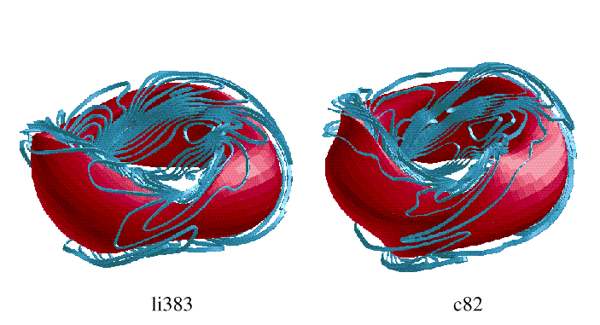
Saddles for NCSX N=3
J^{max} < 22 kA/cm² (2T)
J^{max} > 25 kA/cm²
GA-reduction of current for li383 to < 17 kA/cm² has been obtained

Slide 8

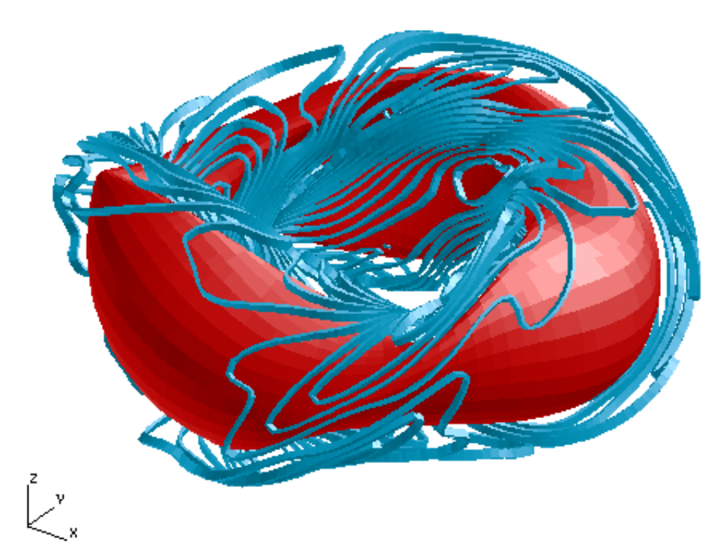
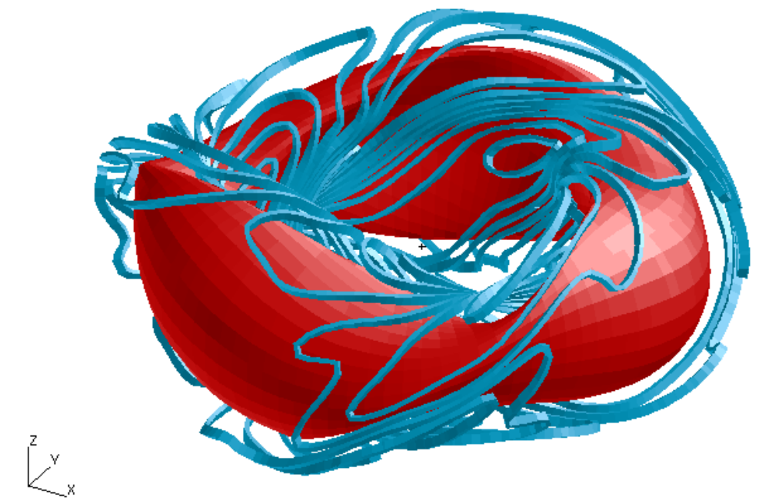
Uniform vs. GA-Cut Saddles

Slide 9
New Codes for Designing Modular Coils
SurfOpt Code (Berry)
  Use Levenberg optimizer to generate conformal winding surfaces (initial guess for CoilOpt)
CoilOpt code (Strickler, Berry, and Whitson)
  Produces desirable modular coils
    J^{max} lower than achieved for saddles (so far)
    Relatively smooth coils (realizable bend radii)
    Large plasma-coil separations

Slide 10
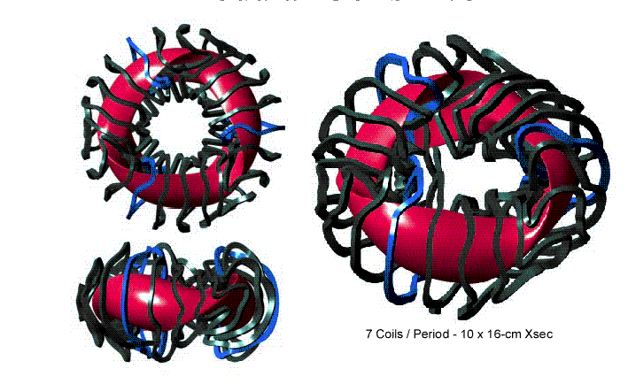
Modular Coils for NCSX
(7 coils/per, J^{max} < 12 kA/cm²)

Slide 11
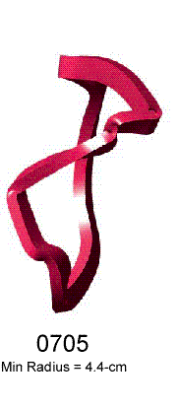
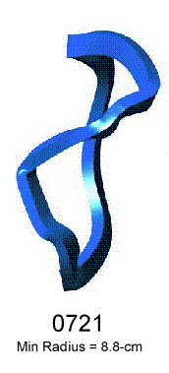
Smoothing Coils Bends with CoilOpt
Minimum Impact on reconstruction and J

Slide 12
Alternate Background Field Coils Yield Lower J^{max}
TiltOpt Code (Brooks, Reiersen)
  better fit to helical field reduces conformal coil current
  reduces J^{max} in conformal coils for c82 by factor ~2 compared to simple 1/R background field
  background coils are simple (planar) coils
Some unacceptable properties arose
  large stray magnetic fields - impact NBI
  added complexity: saddles spread to outboard side - reduces access

Slide 13
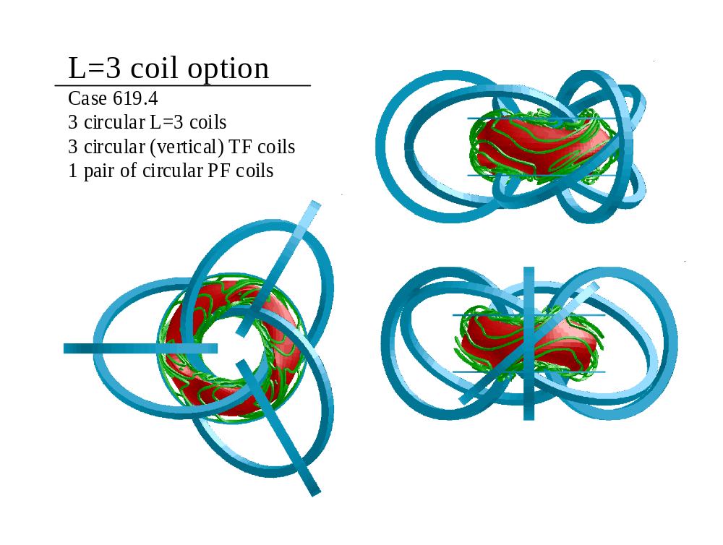

Slide 14
Reconstruction of Reference N_{p}=3 Plasma From Coils
VMEC free-boundary
  First level of reconstruction (done)
    determine how well fixed boundary surfaces are reproduced
  Next check physics targets (done)
    chi-sq values do not exceed fixed boundary values in reconstructed plasma
PIES
  Next level of reconstruction (focus for near term)
    preserve volume of good surfaces (compared to fixed boundary)
    increase volume of good surfaces (Wooley, Hudson) by reducing low-order island widths (surface, coil modifications)

Slide 15
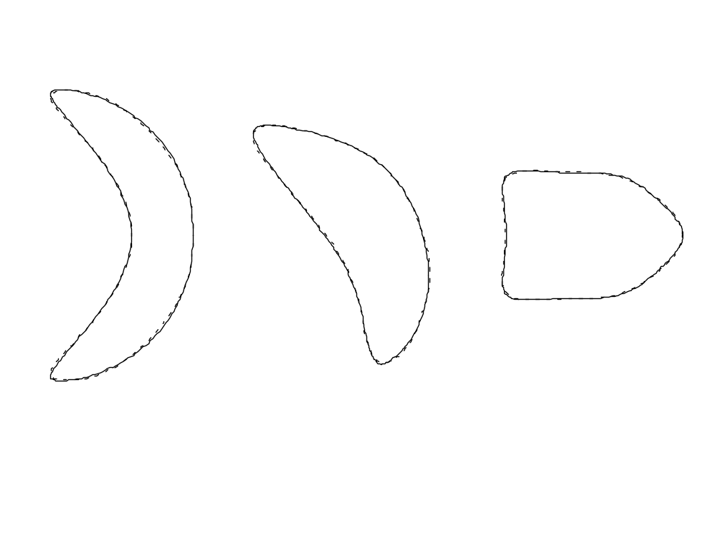
Excellent Reconstruction of Full Beta & Current Design Point Achieved from Saddle Coils (+1/R + multipoles)
Solid: Original Target Dashed: Free Boundary Reconstruction

Slide 16
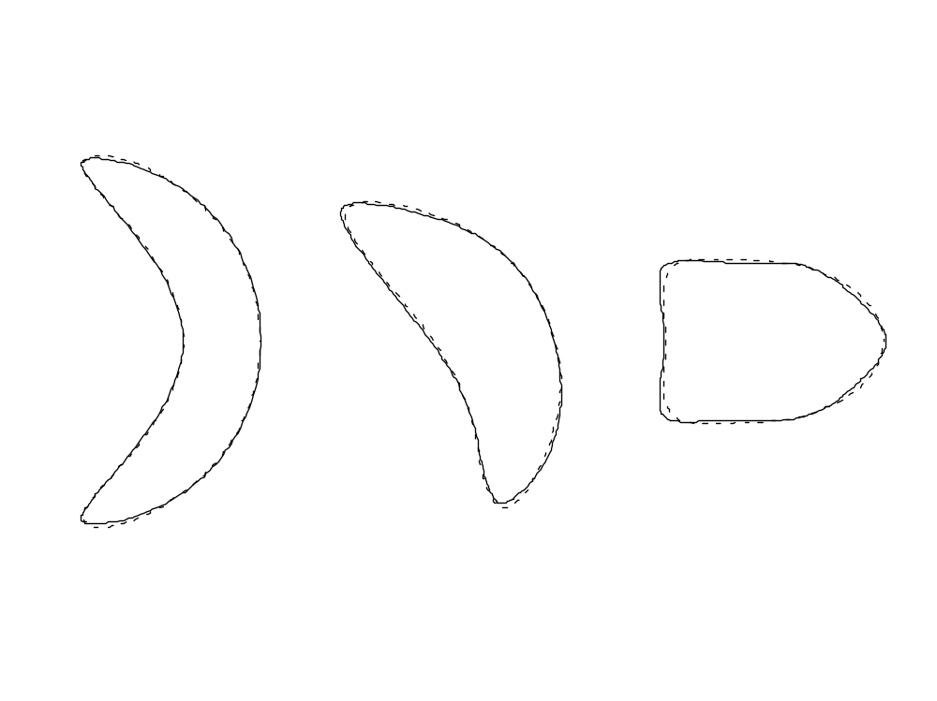
Good Reconstruction Using Modular Coils
(also with multipolar fields)

Slide 17
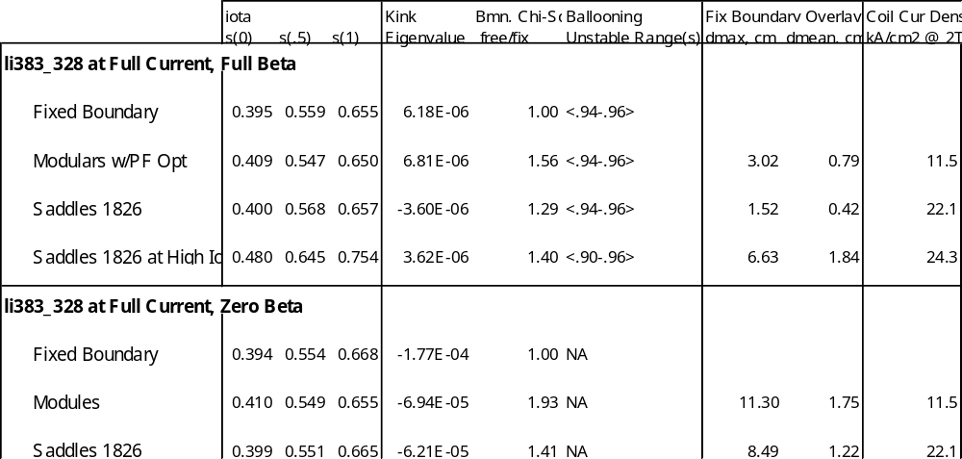
Summary of Modular/Saddle Comparison for Li383

Slide 18
Coil Robustness and Flexibility
Robustness
  ability of coils to support equilibria with a wide range of assumed internal profiles (pressure, current)
Flexibility
  ability of coils to produce changes in the plasma shape which correspond to desired changes in physics properties

Slide 19
Coil Flexibility: Philosophy
Design coils to fit full beta, full current design point as well as possible
  Using these coils, use free-boundary optimizer to vary coil currents to fit physics at other plasma states
  Scope flexibility of these coils + axisymmetric PF (multipole moments)
If necessary, redesign basis coil set to build in more flexibility
  Use GA to find set of coils matching a variety of plasma states on “average”

Slide 20
Coil Flexibility: Free-boundary optimizer
CUROPT code (Brooks)
  Previously, determine coil currents for a fixed set of coils to minimize B_{norm} on fixed boundary (from full β, I_{p}) at other values of β, I_{p} – plasma physics properties not necessarily optimal this way
Free-boundary, VMEC-based optimizer
  Find coil currents now by optimizing plasma properties directly, rather than matching to a fixed boundary shape
  Indispensable for flexibility studies

Slide 21
Start-Up Flexibility for Coils
S1, S2, S3: define flexibility range
  S1: zero beta, zero current (vacuum)
  S2: zero beta, full current
  S3: nominal design point, full beta, full current
Reproduce these states with reference coils
  S3 by definition must be reconstructed with coils
  use CurOpt code to get initial guess
  apply free-boundary optimizer to match physics criteria for the S1, S2 states
  verify flux surface quality

Slide 22
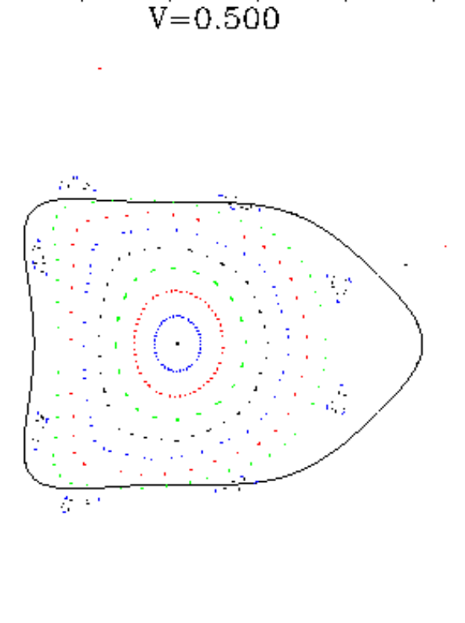
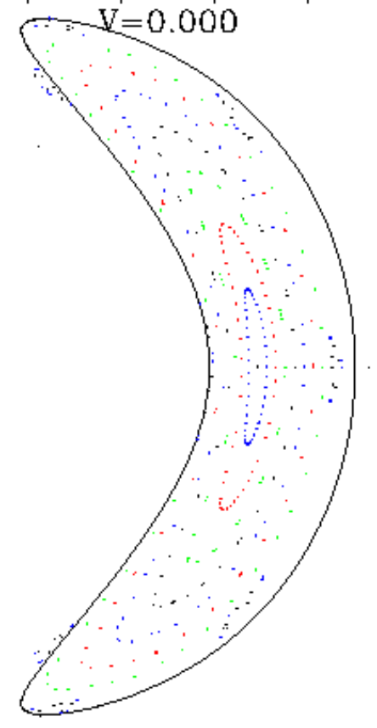
S1 (vacuum) Reconstruction with N=3 Saddle Coils
Full beta Currents

Slide 23
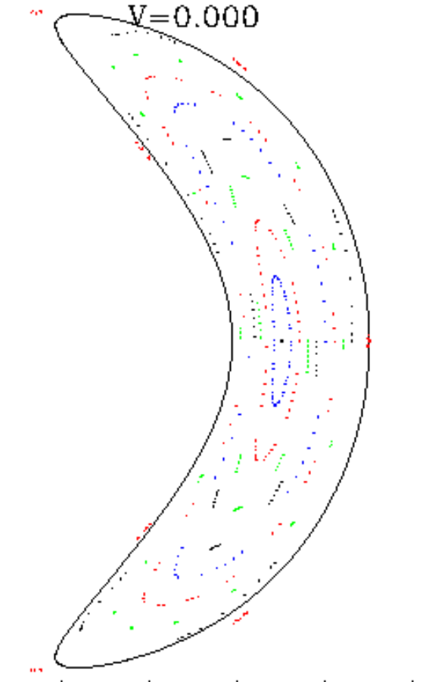
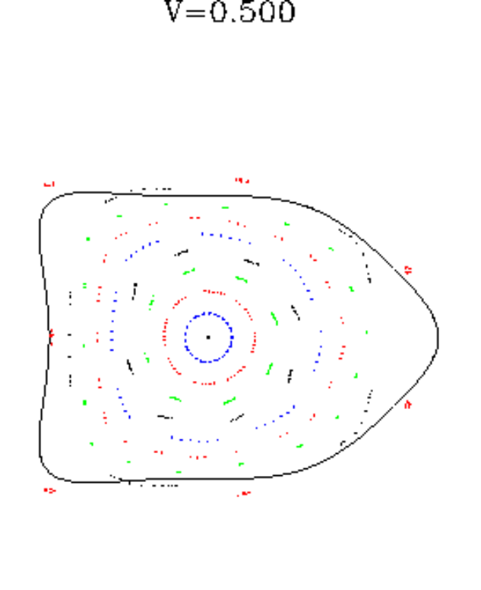
S1 (vacuum) Reconstruction with N=3 Modular Coils
Full beta Currents

Slide 24
Profile Robustness Studies
Robustness Studies (Pomphrey, Hatcher)
  Used Free-Boundary VMEC
  Fixed coil currents in N=3 modular set
  Considered various pressure and current profiles
    Fixed TOTAL current and beta (results shown here)
    Varied current, beta for fixed N=3 reference profiles
Results show a marked degree of robustness

Slide 25
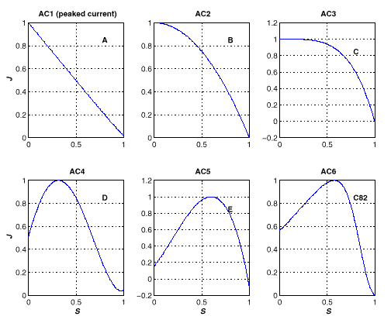
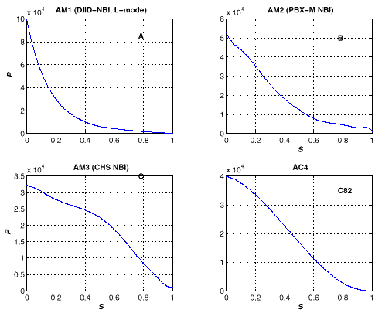
Plasma Profiles for Robustness Studies of NCSX
current
pressure

Slide 26
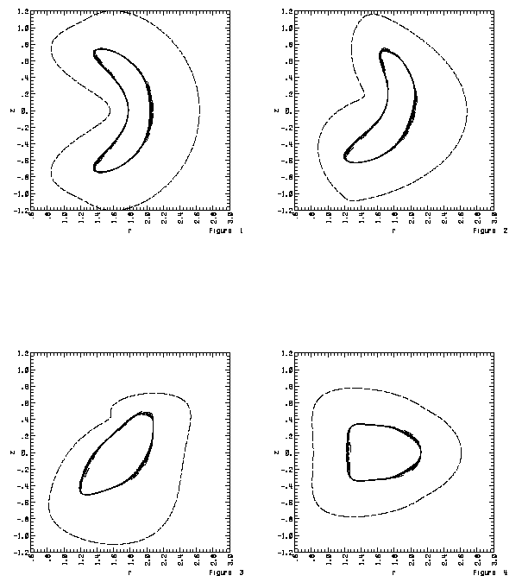
Robustness Reconstructions
(I = 150 kA, β = 4%)
Modular coil currents held fixed at reference values
Physics criterion not fixed, though

Slide 27
Demonstration of Flexibility for Modular Coils (+weak 1/R TF)
Transport “experiment”
  Vary modular coils currents (+4 axisymmetric multipoles) to “dial” a desired value of ι_{edge}, while optimizing neoclassical χ²
Reference case has nc χ² = 1.7

Slide 28
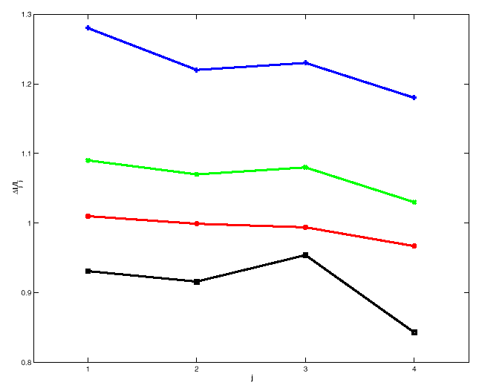
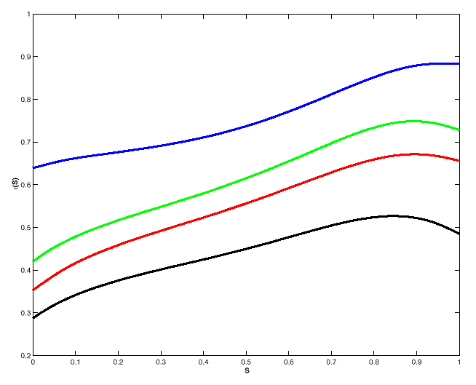
Results of Flexibility Experiment
δI_{j}/I_{j}
Modular coil index
Iota profile vs. flux (s)

Slide 29
Near Term Plans
Complete PIES reconstructions for candidate coils
  determine advantages of saddles vs. modulars
  decide if coil modifications are needed to suppress islands for surface quality maintenance
Complete flexibility comparison for candidate coils
Support coil effort needed to decide between N_{p} = 2,3 physics candidates
  Initial coils for N_{p} = 2 have higher errors than tolerable for good physics reconstruction

Slide 30
Summary of Achievements
Code developments have yielded new capabilities sufficient to design coils for the candidate physics configuration. They preserve the physics properties much better than the coils for c82
Coils using LN₂ cooling have been obtained for two coil configurations. They have lower currents than the c82 saddles and therefore provide an adequate margin for flexibility
  water-cooled copper modular coils may be feasible
On-track for a December PVR

