Slide 1

The Benefits of
Standards in Healthcare
Homer L. Chin, MD, MS
Medical Director for Clinical Information Systems
Kaiser Permanente Northwest
NCVHS: Workgroup on Computer-based Patient Records
Washington, DC
December 8 & 9, 1998

Slide 2
Outline
Kaiser Permanente Northwest
  Organizational structure
  Strategic advantages: Integrated comprehensive healthcare
Information Systems
  Defacto standards
  Results of our information systems development
Data Standards in Healthcare
  Prioritization of various standards

Slide 3
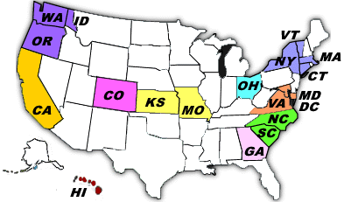
Kaiser Permanente
18 states and D.C.
31 hospitals
337 medical offices
15,000 group-practice physicians
100,000 non-physician employees
9.1 million capitated lives (members)
America's largest not-for-profit group practice health maintenance organization
An integrated health care system: Insurance, administration and healthcare “under the same roof”

Slide 4
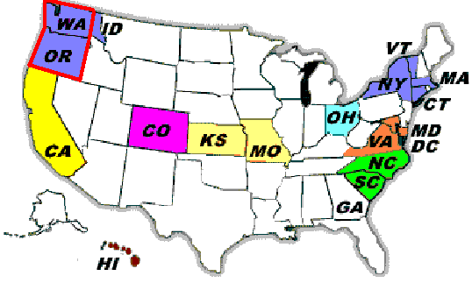
Kaiser Permanente
Northwest
OR and WA
Own + 6 affiliated hospitals
24 medical offices
600 physicians
4000 non-physician employees
430,000 members -- 2 million visits / year
*Integrated healthcare system

Slide 5

Integrated Nature of
Kaiser Permanente
An integrated health delivery system with a close partnership between Health Plan and Medical Groups
Full responsibility for providing medical care is assumed by the Permanente Medical Groups.

Slide 6
Kaiser Permanente Northwest:
Integrated Information Systems
Single member identifier
Single organization delivering comprehensive healthcare
Single organizational ownership of systems
Defacto “standards”
  Single systems
  Comprehensive healthcare = Complete clinical information on members

Slide 7
KPNW Clinical Systems
(Circa 1992)
Pathology/
Cytology
ADT and
Appointment
Tumor
Registry
RIM
(Radiology)
TOPS
(Pharmacy)
STAR
(Transcription)
LIS
(Lab)
MIPS
(Membership)

Slide 8
KPNW Results Reporting:
Leveraging information in existing systems
(1993)
Pathology/
Cytology
ADT and
Appointment
Tumor
Registry
RIM
(Radiology)
TOPS
(Pharmacy)
STAR
(Transcription)
Results
Reporting
LIS
(Lab)
MIPS
(Membership)

Slide 9
KPNW Results Reporting:
Leveraging information in existing systems
(1993)
Pathology/
Cytology
Outside
Reports
ADT and
Appointment
Tumor
Registry
RIM
(Radiology)
TOPS
(Pharmacy)
STAR
(Transcription)
Results
Reporting
LIS
(Lab)
MIPS
(Membership)
CLINICIAN

Slide 10
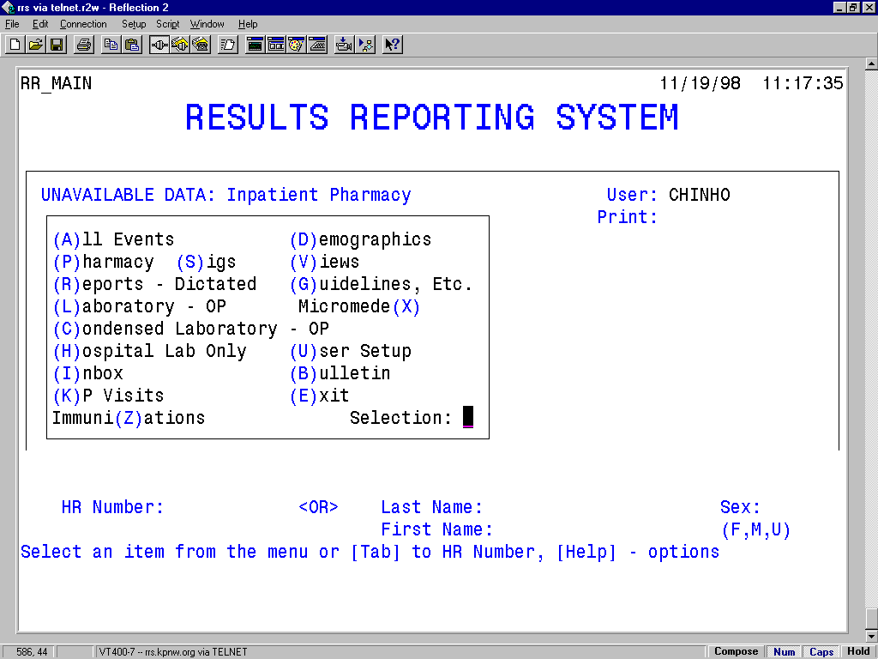

Slide 11
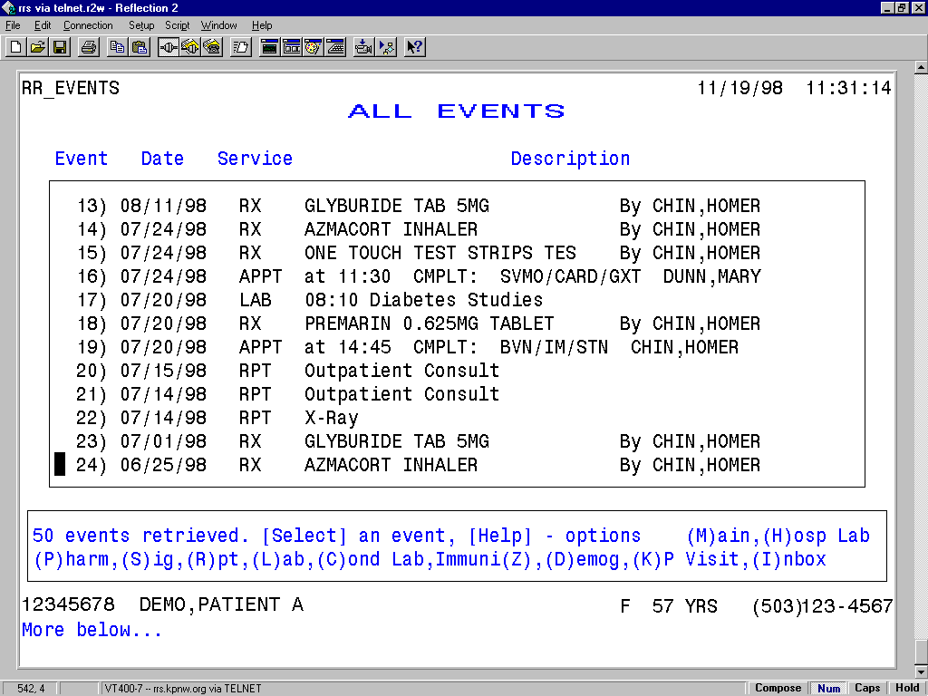

Slide 12
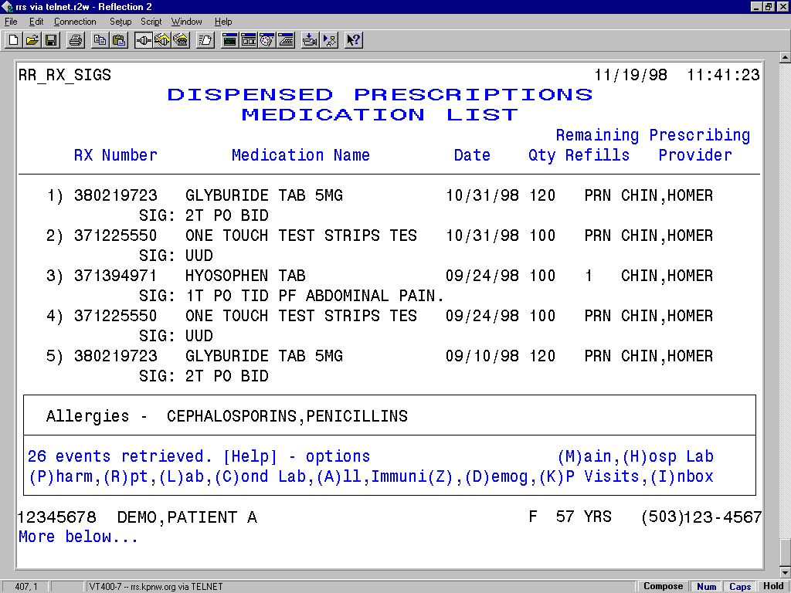

Slide 13
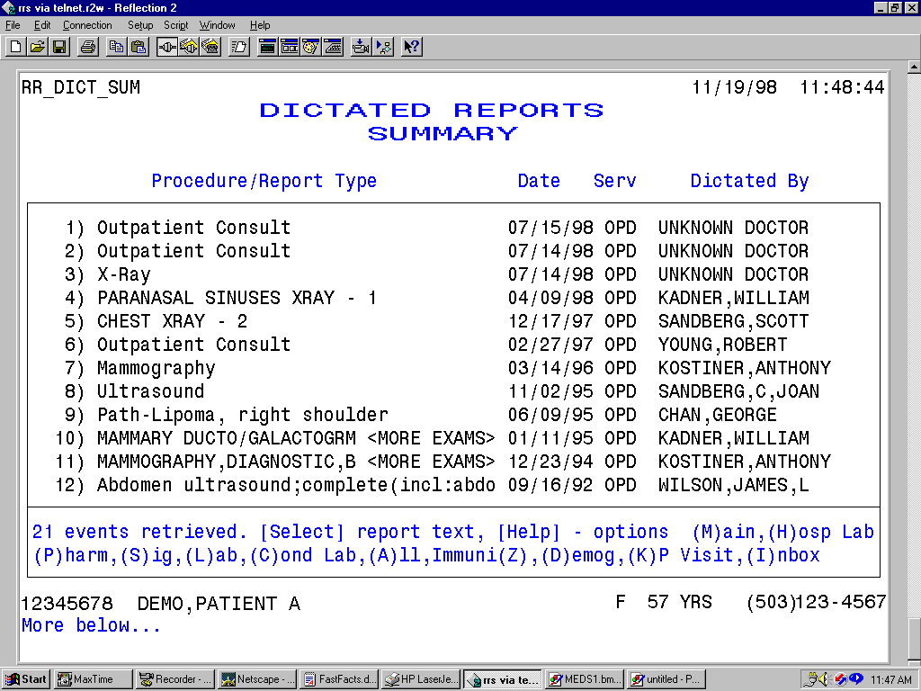

Slide 14
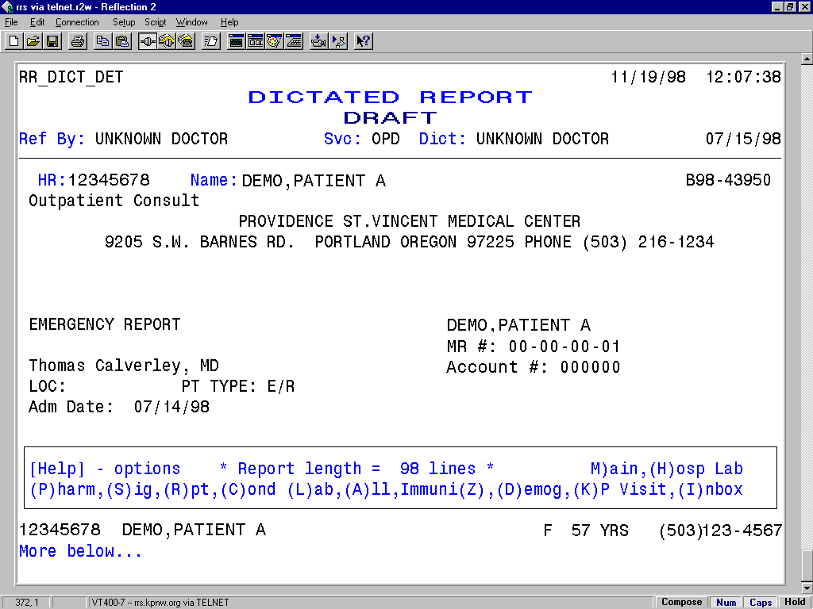

Slide 15
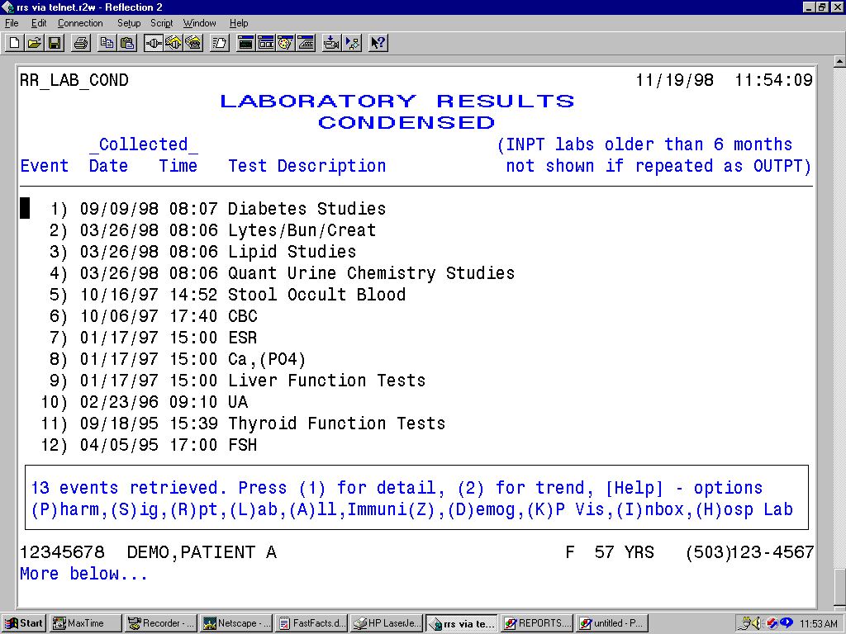

Slide 16
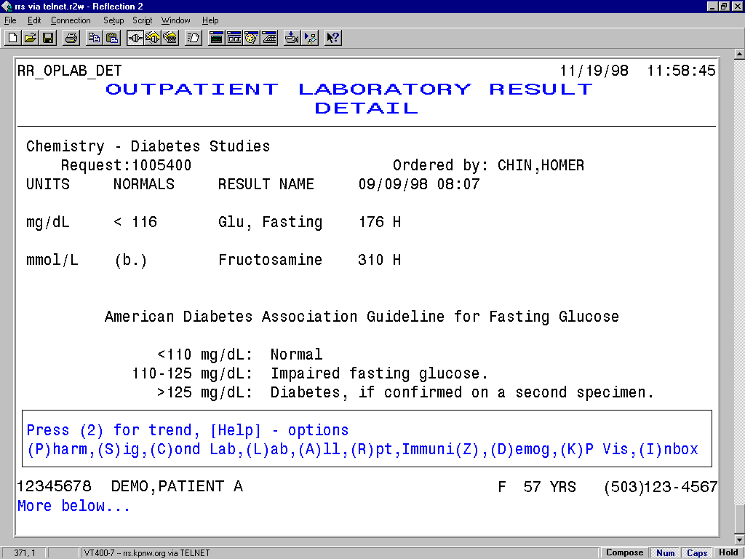

Slide 17
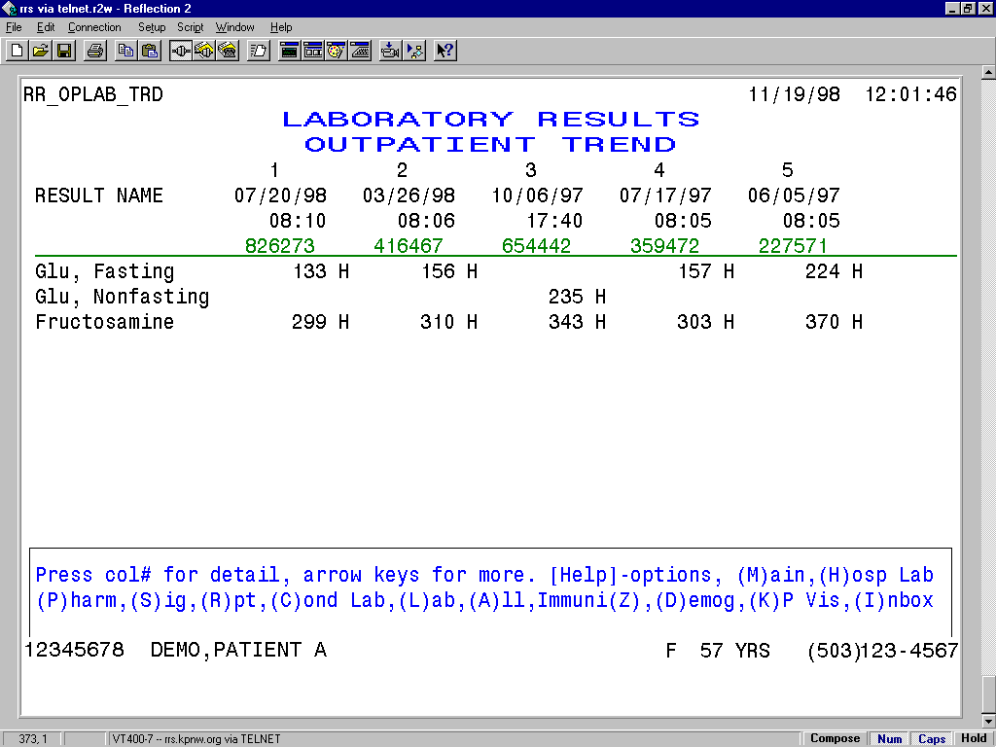

Slide 18
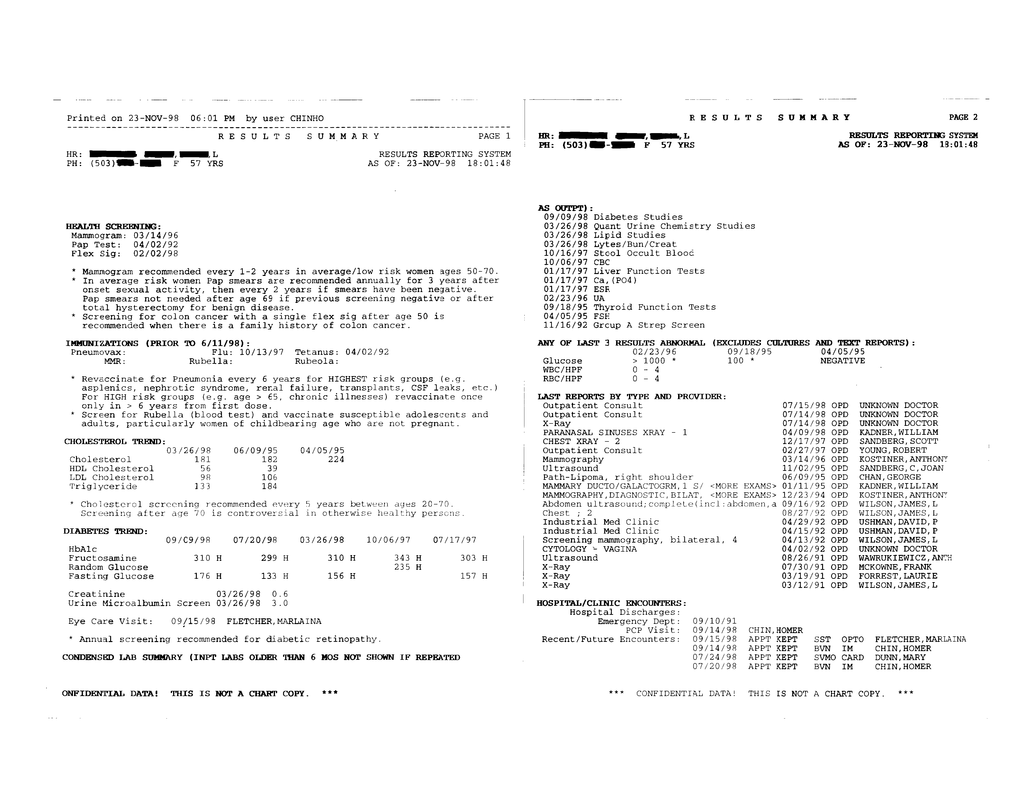
Summary Printouts from RRS

Slide 19
RRS: Summary View (1)
Health Prevention Section - With Guidelines
HEALTH SCREENING:
Mammogram: 03/14/96
Pap Test: 04/02/92
Flex Sig: 02/02/98
* Mammogram recommended every 1-2 years in average/low risk women ages 50-70.
* In average risk women Pap smears are recommended annually for 3 years after
onset sexual activity, then every 2 years if smears have been negative.
Pap smears not needed after age 69 if previous screening negative or after
total hysterectomy for benign disease.
* Screening for colon cancer with a single flex sig after age 50 is
recommended when there is a family history of colon cancer.
IMMUNIZATIONS:
Pneumovax: Flu: 10/13/97 Tetanus: 04/02/92
MMR: Rubella: Rubeola:
* Revaccinate for Pneumonia every 6 years for HIGHEST risk groups (e.g.
asplenics, nephrotic syndrome, renal failure, transplants, CSF leaks, etc.)
For HIGH risk groups (e.g. age > 65, chronic illnesses) revaccinate once
only in > 6 years from first dose.
* Screen for Rubella (blood test) and vaccinate susceptible adolescents and
adults, particularly women of childbearing age who are not pregnant.

Slide 20
RRS: Summary View (2)
Cholesterol and Diabetes Section
CHOLESTEROL TREND:
07/17/97 06/09/95 04/05/95
Cholesterol 202 182 224
HDL Cholesterol 39 44
LDL Cholesterol 106
Triglyceride 184
* Cholesterol screening recommended every 5 years between ages 20-70.
Screening after age 70 is controversial in otherwise healthy persons.
DIABETES TREND:
10/06/97 07/17/97 06/05/97 01/17/97 11/15/96
HbA1c
Fructosamine 343 H 303 H 370 H 319 H 290 H
Random Glucose 235 H 160
Fasting Glucose 157 H 224 H
Creatinine 01/17/97 0.7
Urine Microalbumin Screen 01/17/97 4.3
Eye Care Visit: 02/09/98 BOYER,JOHN
* Annual screening recommended for diabetic retinopathy.

Slide 21
RRS: Summary View (3)
Lab Summary Section
CONDENSED LAB SUMMARY:
10/16/97 Stool Occult Blood
10/06/97 Diabetes Studies
10/06/97 CBC
01/17/97 Quant Urine Chemistry Studies
01/17/97 Liver Function Tests
01/17/97 Ca,(PO4)
01/17/97 (Na,K,Cl,BUN),Creat
01/17/97 ESR
02/23/96 UA
09/18/95 Thyroid Function Tests
06/09/95 Lipid Studies
04/05/95 FSH
11/16/92 Group A Strep Screen
ANY OF LAST 3 RESULTS ABNORMAL (EXCLUDES CULTURES AND TEXT REPORTS):
02/23/96 09/18/95 04/05/95
Glucose > 1000 * 100 * NEGATIVE
WBC/HPF 0 - 4
RBC/HPF 0 - 4

Slide 22
RRS: Summary View (4)
Reports and Visit Section
LAST REPORTS BY TYPE AND PROVIDER:
CHEST XRAY - 2 12/17/97 OPD SANDBERG,SCOTT
Outpatient Consult 02/27/97 OPD YOUNG,ROBERT
MAMMOGRAPHY,SCREENING,BILAT,4 03/14/96 OPD KOSTINER,ANTHONY
ABDOMEN ULTRASOUND, COMPLETE 11/02/95 OPD SANDBERG,C,JOAN
Path-Lipoma, right shoulder 06/09/95 OPD CHAN,GEORGE
Mammography, diagnostic,bilat <MORE EXAMS> 12/23/94 OPD KOSTINER,ANTHONY
Abdomen ultrasound;complete(incl:abdomen,a 09/16/92 OPD WILSON,JAMES,L
Chest ; 2 08/27/92 OPD WILSON,JAMES,L
Industrial Med Clinic 04/15/92 OPD USHMAN,DAVID,P
Screening mammography, bilateral, 4 04/13/92 OPD WILSON,JAMES,L
CYTOLOGY - VAGINA 04/02/92 OPD UNKNOWN DOCTOR
Ultrasound 08/26/91 OPD WAWRUKIEWICZ,ANTH
X-Ray 03/12/91 OPD WILSON,JAMES,L
HOSPITAL/CLINIC ENCOUNTERS:
Hospital Discharges:
Emergency Dept: 09/10/91
PCP Visit: 11/10/97 CHIN,HOMER
Recent/Future Encounters: 04/09/98 APPT FUTURE BVN IM CHIN,HOMER
02/09/98 APPT KEPT BVN OPTO BOYER,JOHN
02/02/98 APPT KEPT WIN SURG PRIMIANO,PETER
12/29/97 APPT NOSHOW BVN IM CHIN,HOMER
12/17/97 APPT CANCEL BVN FP GERGYES,JOSEPH
12/17/97 APPT KEPT BVN IM BVT MED ADVICE RN

Slide 23
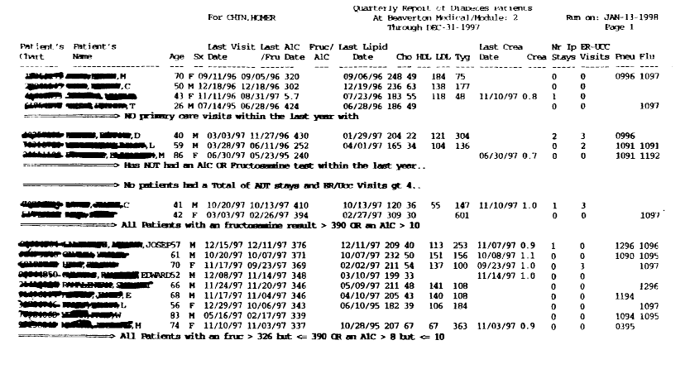
Population Management of our Diabetic Members

Slide 24
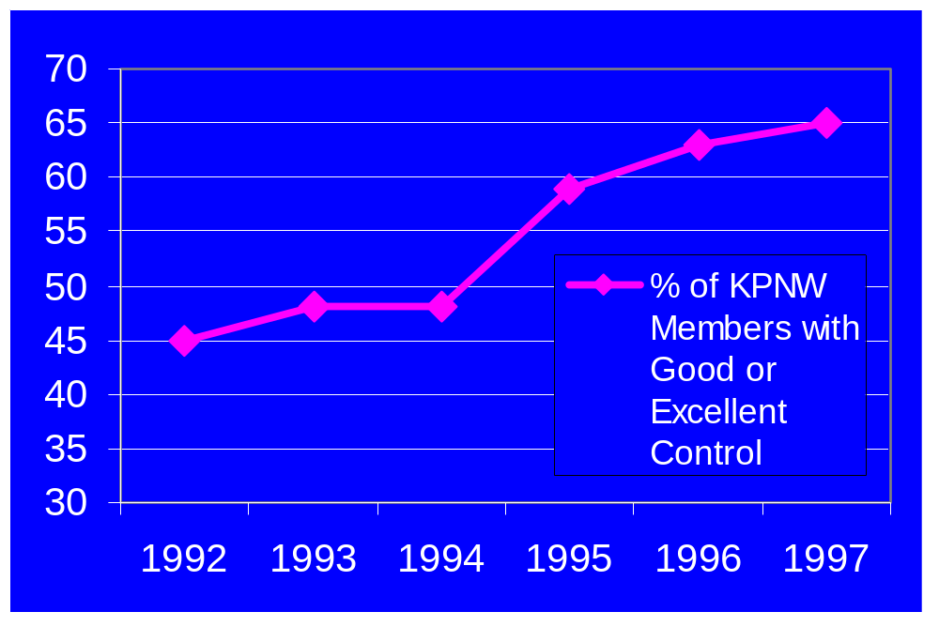
Diabetic Glucose Control

Slide 25
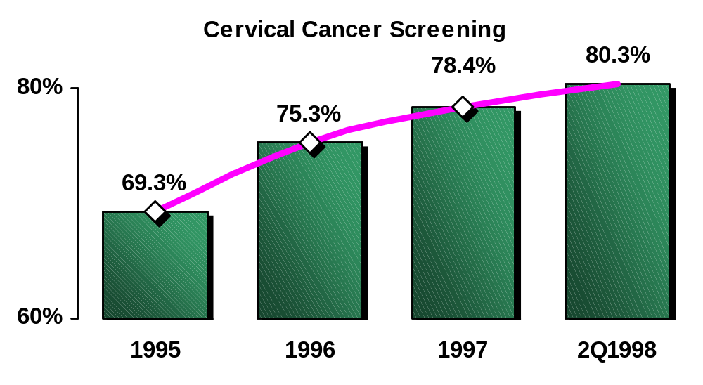
Disease Prevention: Pap Smear Rates

Slide 26
Components to the Computer-Based Patient Record in KPNW
Results Reporting (RRS): 1993
Prevention and Disease Registries
  Diabetes
  Pap Smears and Mammograms
  Lipid control of high risk members
EpicCare (Comprehensive Computer-Based Outpatient Record): 1995 - 1997

Slide 27
EpicCare: CPR and Outpatient Processes
Standard coding of all diagnoses, procedures, LOS ==> automatic bill generation
Problem list maintenance
Order communication (guidelines embedded)
  Pharmacy
  Lab, radiology
  Referrals
Messaging
Progress note
Patient instructions
Integrates decision support into the process of care

Slide 28
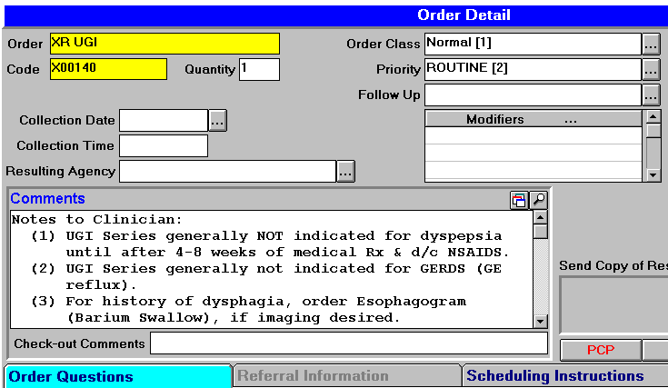
Embedding Guidelines: Imaging

Slide 29
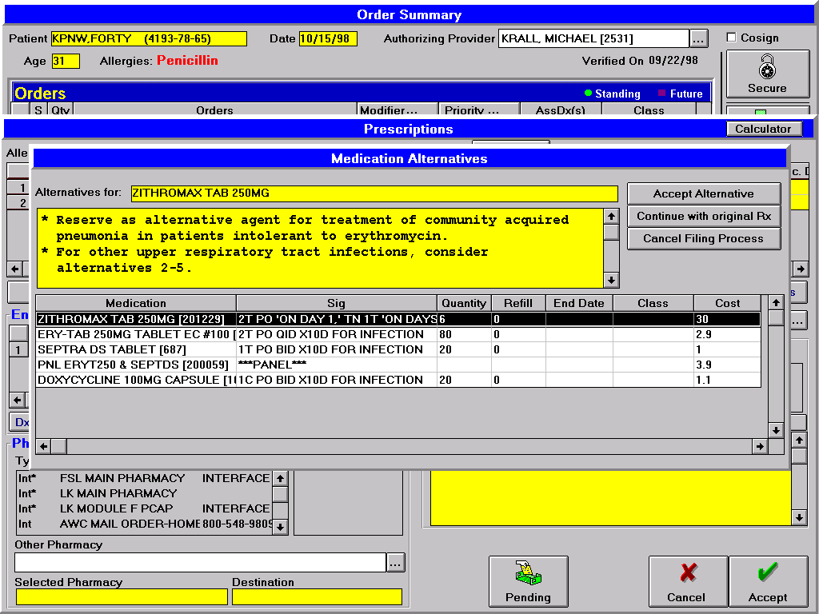
Embedding Pharmacy Guidelines

Slide 30
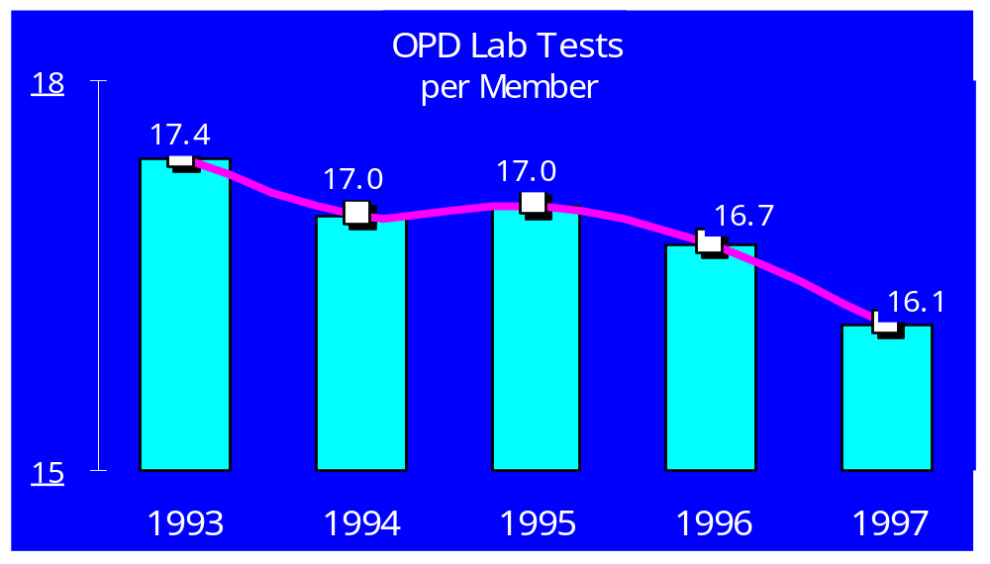
Results:
Laboratory Test Utilization

Slide 31
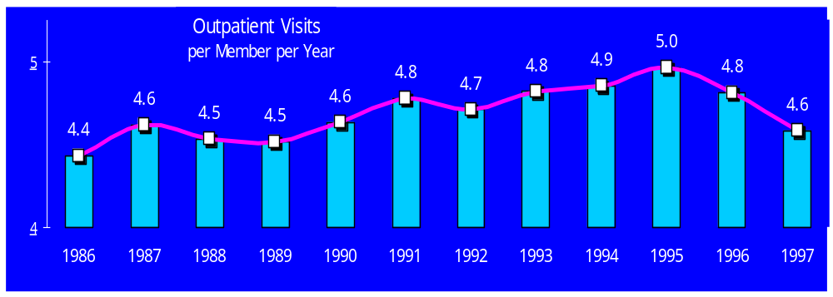
Outpatient Visits

Slide 32
Defacto Standards at KPNW
Single Patient Identifier
Single Systems
Complete Information on Our Members
Results of Defacto Standards:
  Ability to consolidate information
  Improved quality and appropriateness of care
  Decreased unnecessary variation in treatment
  Decreased outpatient office visits
  Population-based prevention and disease management
  Improve overall quality with less cost

Slide 33
Prioritization of Healthcare Data Standards
Unique Patient Identifier
  Consolidation of patient information from different systems
Test and Procedure Naming Standards
  Allows labeling of information for summary displays
Results Standards
  Allows consolidation of results on a particular test -- enables population-based prevention and disease management
Diagnosis Code Standards
  Consolidation of Problem Lists, Diagnoses from different systems
Other
  Data elements with known benefit in decision support, outcomes analysis

Slide 34
Kaiser Permanente Northwest:
A Glimpse into the Benefits of
Data Standardization in Healthcare

