Slide 1
CORS Industry Forum
CORS Information
Miranda Chin
&
CORS Data Management and Site Installation Team
March 2001

Slide 2

Topics
National CORS and Cooperative CORS
Ground Station
GPS Data – Rinex Format
Data Availability Profile
Meteorological Data
Technology Transfer

Slide 3
National CORS & Cooperative CORS
National CORS | Cooperative CORS
- Station commits to a long-term and continuous operation | - Station operates at least 8hrs/day; 5days/week
- Data are available online via the NGS CORS web page | - Provides a link to the participant’s web page
- All data are permanently archived in NGS | - Minimum 7 days’ data online at the participant’s web site
- antenna position re-computed everyday | - antenna position re-computed every 90 days or less

Slide 4
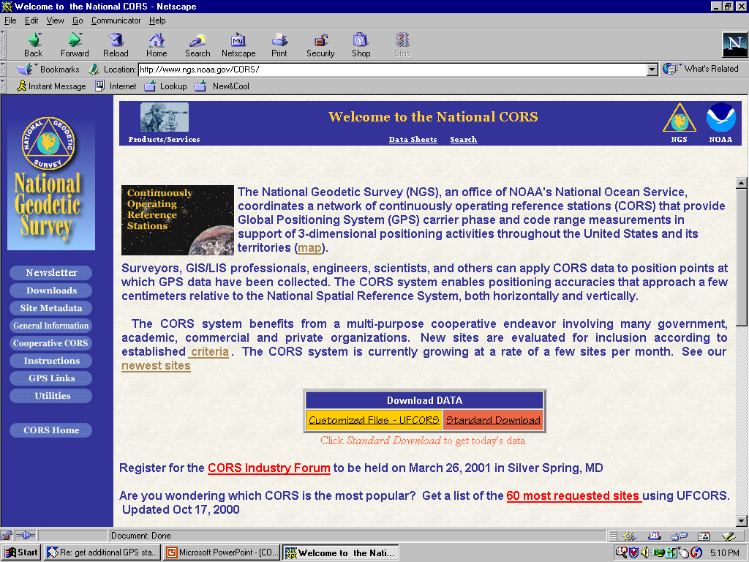

Slide 5
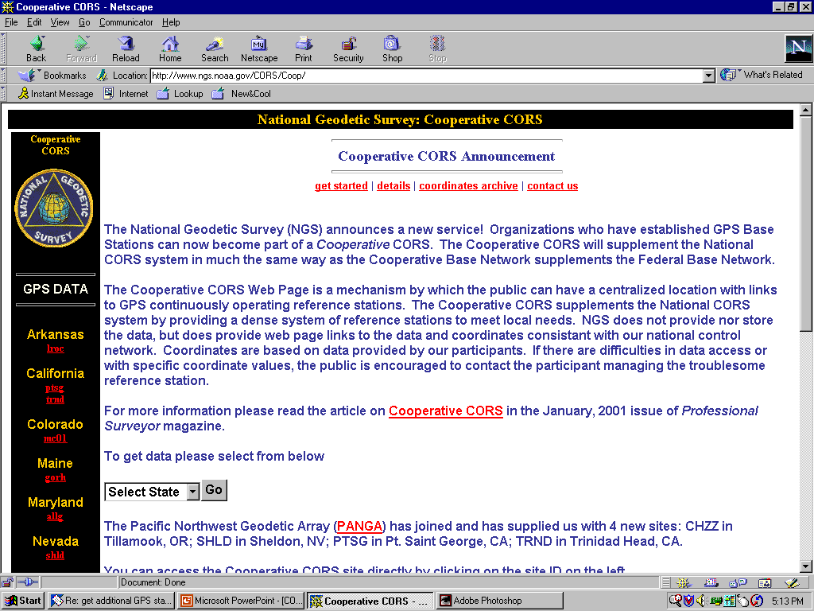

Slide 6
Ground Station
NGS Process Action Team (PAT) 20 has produced a “National CORS Site Monumentation” report:
  10ft below ground by 1.5ft diameter
  5ft above ground by 1.0ft diameter
  polymer Delrin antenna mount
  polymer C-Bar reinforcement assembly embedded into concrete

Slide 7
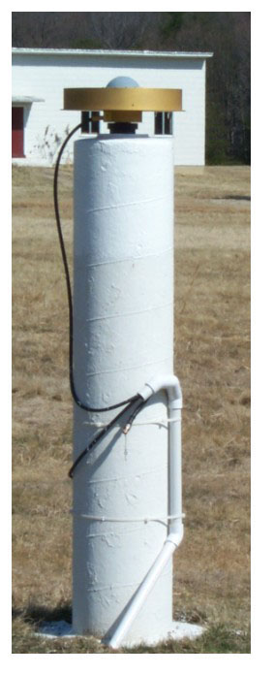
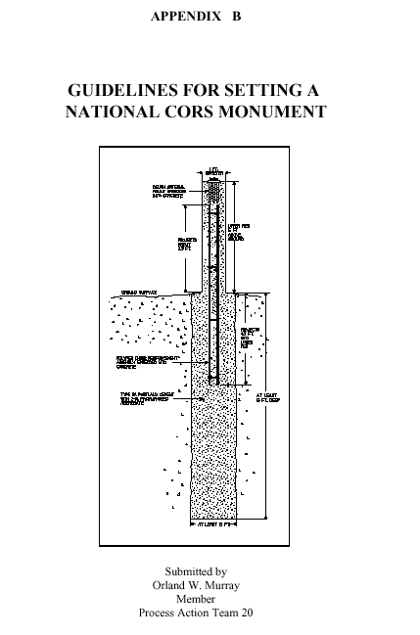

Slide 8
Ground Station (cont.)
Estimated cost to setup a CORS station:
Geodetic grade GPS receiver & chokering antenna and/or a high accuracy meteorological sensor (~ $14 - 20k)
Antenna monument construction (~ $1 – 3k)
Antenna cable conduit and a low lost antenna cable for underground installation (~ $0.5 – 3k)
PC, electrical power backup system, Internet connection, and accessories (~ $3k)
Total ~ $19 – 29k

Slide 9

GPS Data – Rinex Format v2.10
Data file spans
  hourly, daily, customized (UFCORS)
Data rates
  *1sec, **5sec, 15sec, and 30sec
Data file life-time
  hourly: 2 days + today
  daily: permanently
*WAAS/NSTB and special projects
**DGPS/NDGPS in the process of changing to 5sec

Slide 10
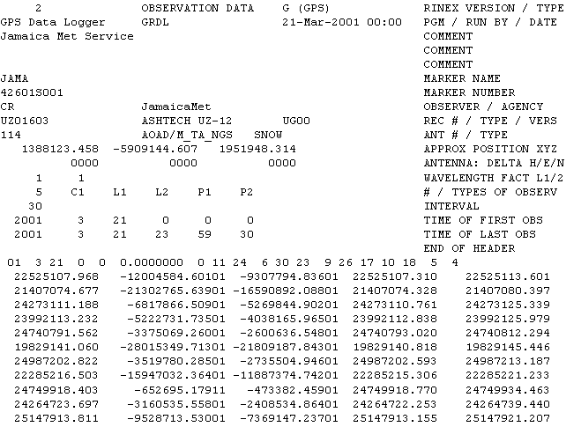

Slide 11
Data Availability Profile
To display online data availability
  By station: user specify which station
  By days: user selects # of days to display
  UTC and local time zone

Slide 12
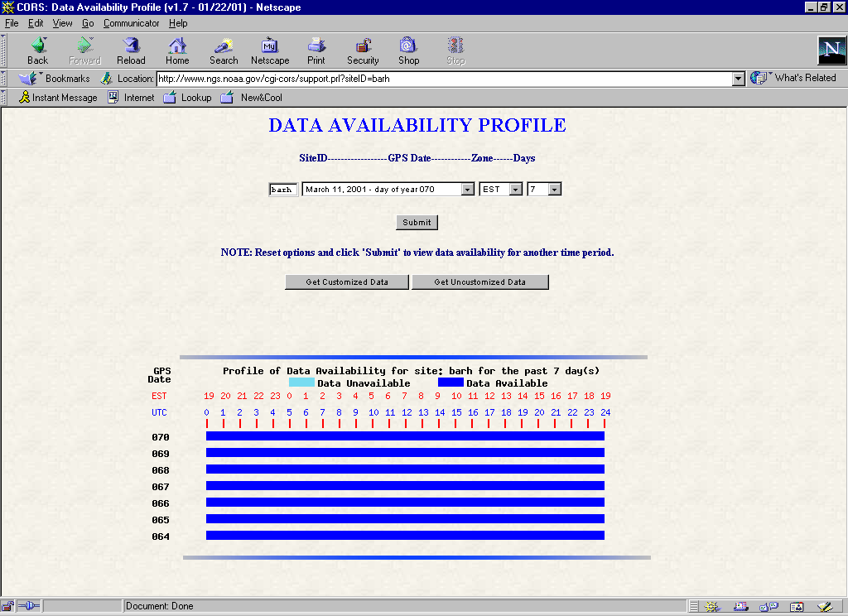

Slide 13
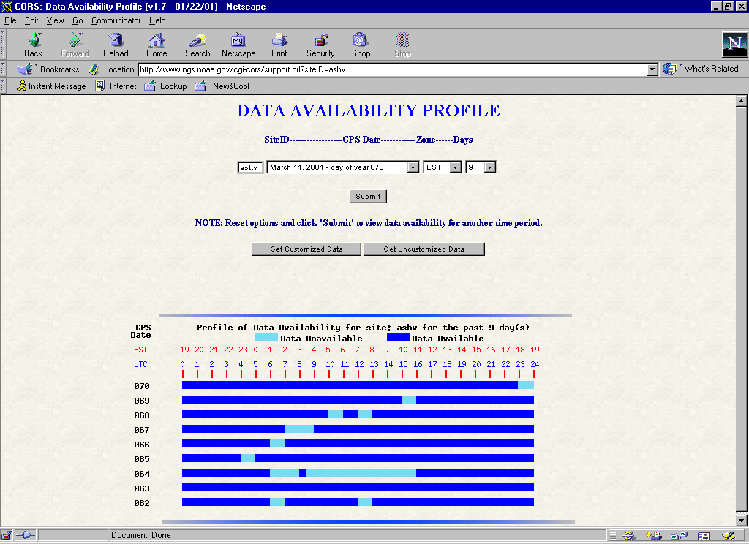

Slide 14

Meteorological Data
Instrument:
  Accuracies: 1.0% humidity; 0.1 mbar pressure; 0.5 deg C temperature.
  Data frequency: 5 minutes
Met instrument operated by:
  Forecast System Lab/NOAA
  NGS
# of stations: currently 52; will grow rapidly

Slide 15
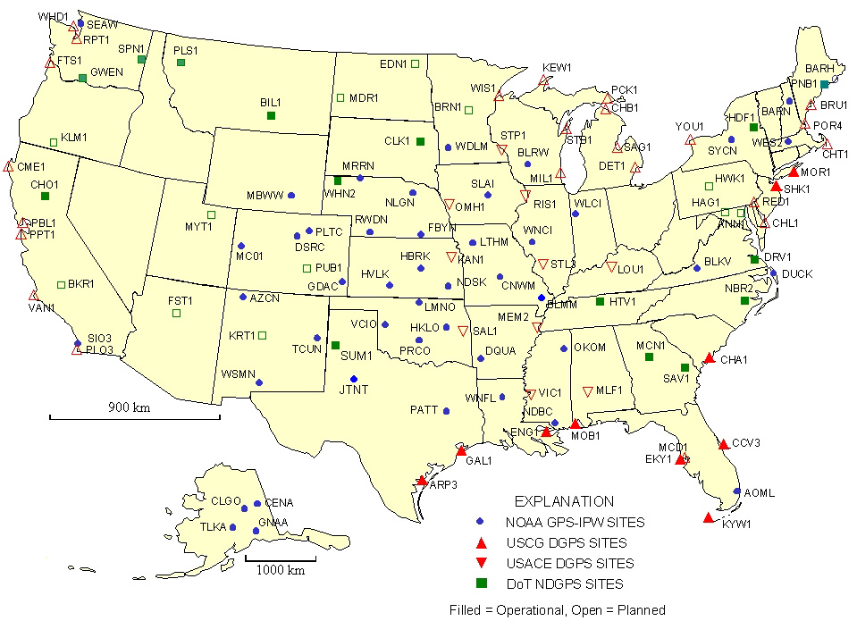
Sites with “Met” Sensors
Forecast Systems Laboratory & NGS

Slide 16

Technology Transfer
Web page: www.ngs.noaa.gov/CORS
Email to cors@ngs.noaa.gov
Newsletter: updated daily; on-line & emailed weekly to ~ 600 people
National CORS:
Jim.Drosdak@noaa.gov
Cooperative CORS:
Julie.Prusky@noaa.gov

Slide 17

Technology Transfer (Cont.)
CORS Workshop
  Has been presented in conjunction with several surveyor conferences
  Four-hour lecture presentation
  Continuing education credits offered
  Topics
    GPS & CORS overviews
    Positioning with CORS

Slide 18
Technology Transfer (Cont.)
CORS Workshop
  Topics (cont.)
    Accessing CORS Information
    Processing GPS Data
    Spatial Reference Frames

