Slide 1
Data Visualization
EPICS Extensions IDL Tools
Ben-chin K. Cha
Beamline Control & Data Acquisition

Slide 2
Introduction
Written in IDL/ezcaIDL to view real-time / post scan data
Packaged data browsers with complete mouse driven user interface
IDL interactive graphics and analysis tools
High quality interactive graphic Itools (IDL 6.X)
Packaged tools support license free IDLVM 6.0
Platforms: Unix , Win2000/XP, Linux
Object methods for easy post scan data array extraction and manipulation

Slide 3
Outline
Overview
System and setup requirement
ScanSee program user interface
Sharable visualization subprograms
Scan object methods and examples
EzcaIDL setup and examples
Notes:
Tools are implemented:
- User friendly and complete mouse driven
- Based on perceived functions desired in display and analysis of multi-lines and images
- Added new features requested by users
- User interface further improved by feedback from users

Slide 4
Scan Visualization Architecture
ScanSee:
Packaged IDL
Scan Visualization
Analysis Tools
ezcaIDL
EzcaScan/ezca
IOC
Controller
sscan
with
saveData
EPICS
CA
Save
MDA Data
MEDM
Scan Controls

Slide 5
Overview
Scan Visualization Tools
    scanSee – 85 detectors,1D/2D/3D scan (read MDA)
    catcher – 15 detectors,1D/2D scan (save/read 1D/2D files)
HDF Visualization Tools
    hdfb – HDF4 1D/2D/3D browser
    h5b – HDF5 1D/2D/3D browser
Common/sharable Visual/Analysis Tools http://www.aps.anl.gov/~cha/idl_html/list.html
    plot1d, ez _fit, overlay_1d
    plot2d_image, plot2d, image2d, view3D_2D
    calibration_factor, scan2d_roi, multiroi_pick
    panimage, scan2d_overlay, wd_readascii
Notes:
Image dim up to 400x400 garantee Good performance for scanSee

Slide 6
Input Forms
XDR catcher 1D/2D file
MDA 1D/2D/3D scan data
Nexus/HDF release 4 1D/2D/3D data
Nexus/HDF release 5 1D/2D/3D data
Arrays data
Fix format ASCII data

Slide 7
Output Forms
1D/2D graphic output
1D/2D ASCII report data
Graphic output: TIFF / PNG / PICT / PS
1D/2D ROI statistics reports
Flexible 3D to 2D, 2D to 1D sliced output

Slide 8
System Requirement
EPICS extensions built: ezca, EzcaScan, ezcaIDL, idl
    Scripts and executables installed under /usr/local/epics/extensions/bin/solaris-sparc for 3.14.X
    IDL programs installed under
    /usr/local/epics/extensions/idllib for 3.14.X
IDL 6.0 and IDLVM 6.0 installed
IOC sscan record properly configured by medm

Slide 9
Unix Setup Requirement
Set EPICS_EXTENSIONS
  setenv EPICS_EXTENSION /usr/local/epics/extensions
Access EPICS 3.14.X
  setenv EPICS_HOST_ARCH solaris-sparc
  set path=( /usr/local/epics/extensions/bin/solaris-sparc $path)

Slide 10
Packaged Unix Scripts for IDL Visualization Tools
scanSee – MDA viewer with real-time scanning
sscan – post scan viewer for MDA files
catcher – real-time scanning with data saving
viewer – post scan viewer for data catcher
hdfb – data browser for HDF4/Nexus files
h5b – data browser for HDF5/Nexus files
img – Tiff/Jpeg/Png/Ascii/Xdr image processor
idlvm – run IDLVM 6.0 with any IDL 6.0 saved programs

Slide 11
IDLVM 6.0
No license required for IDL 6.0 saved program
Document: http://www.aps.anl.gov/~cha/idlvm60.html
IDL 6.0 *.sav files:
    catcher.sav – for catcher
    viewer.sav – for viewer without CA
    sscan.sav – for scanSee R3.4 and later
    SB2.sav – for MDA reader without CA
    hdfb.sav – for HDF version 4
    h5b.sav – for HDF version 5
    Img.sav – image processor
Unix script methods:
    idlvm <pname>
  where <pname> can be any of the above name without ‘.sav’
Itools & data calibration not available in IDLVM 6.0

Slide 12
Unix Access Methods
IDLVM version (recommend unless calibration is desired)
    idlvm sscan (scanSee.R3.4 and later)
    idlvm catcher
Runtime version
    scanSee
    catcher
Developer Version (ITOOLS available)
    scanSee –D
    catcher –D

Slide 13
scanSee Flow Diagram
IOC (save scan MDA)
Save Scan
MDA Files
scanSee/Setup
MEDM
F
Scan
Updating
Pan Images
T
Visualization
Display/Analysis
Sub-Programs
Updating CA
Real-time Data
Get CA Arrays
F
T
F
T
1D
Read MDA

Slide 14
Files Used by scanSee
MDA scan files automatically saved by IOC
Restart Configuration file: DC.config
Saved output files:
  ASCII/*.txt - 1D/2D data files
  TIFF/*.tiff - TIFF image files
  PNG/*.png - PNG image files
  PICT/*.pict - MAC image files
  ROI/*.roi, *.rpt - various ROI files
  idl.ps,plot2d.ps … - saved various PS plot, report files

Slide 15
Features Access Restriction
ITOOLS
  Developer version only
  License free ITOOLS
    ‘readascii.sav’ (IDLVM 6.1)
  Idlvm readascii
1D/2D Calibration features
  Developer and Runtime versions

Slide 16
Invocation Problem
Problem of startup scanSee
    Due to MDA file not found in configuration file
    Wrong type or bad file picked
Resolve Invocation Problem
    Method 1
      Use File->Open to pick a new file
    Method 2
      Remove the ‘DC.config’ before run scanSee

Slide 17
General Widget Interfaces
Click LMB - selection of menu/button/cursor/slider/list
Text field - text entry must be ended with CR
Button… - a pop up window/subprogram associated with it
Multiple list selection
    Cntl+LMB – add/delete item to selection list
    Shift+LMB – select all items between current and last click
ROI Mouse buttons
    LMB – pick/drag ROI
    MMB – resize ROI
    RMB – accept ROI

Slide 18
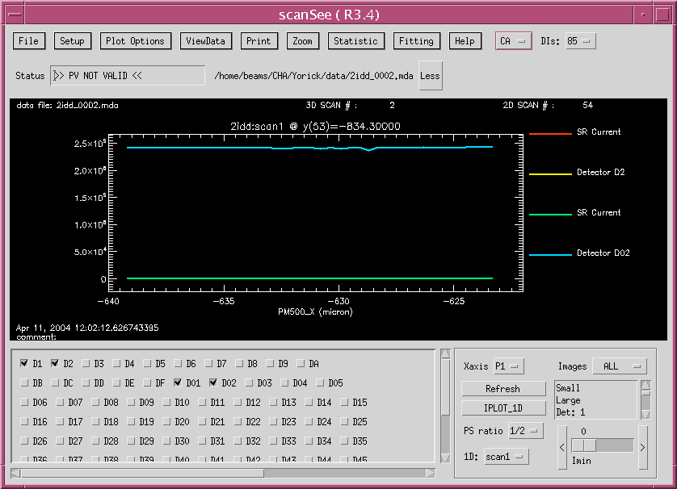
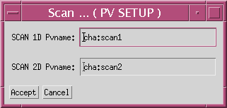
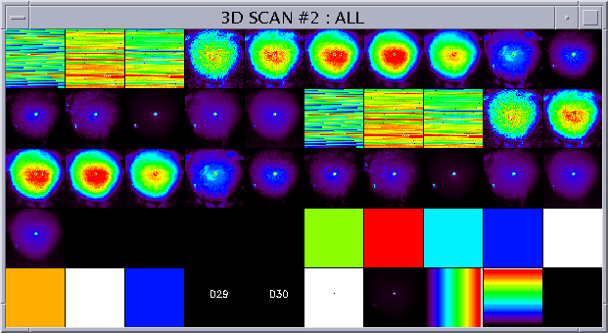
Acquisition->
Realtime->
TexWin->
Debug->
Scan…
Color…
Zoom in Box
Zoom Pan
Zoom In/Out
Calc Slopes
Zoom Off(AutoScale)
User Scale…
Ez_fit…
Binary
Open…
Printer…
Exit
Colors->
Lines->
Symbols->
Grid->
Err Bars->
Yscale->
Ranges…
Labels…
Plot
Report…
Version…
Release Note…
Help…
CA
MDA
85/70
Detectors
1D/2D…
IMAGE2D…
1D Overlay…
1D Calibra…
1D/2D/3D/4D sscan…
None
Peak/Centroid/FWHM on plot
PeakCentroid/FWHM…
FWHM on Y
FWHM on DY/DX
Average/Deviation…

Slide 19
ScanSee Features
Use file DC.config for easy restart
Flexible MDA file selection dialog
User settable monitor of 1D/2D scan record
Display near real-time 1D and 2D scanning data
Flexible 1D display in detectors, line texture, plot ranges and labels, zoom, FWHM, easy fitting, etc
Image data analysis, ROI statistics, calibrations
Easy access 1D/2D/3D post scan data and pass to appropriate subprograms
Easy ASCII/TIFF/PNG/PICT/ROI/PS output

Slide 20
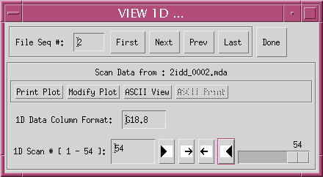
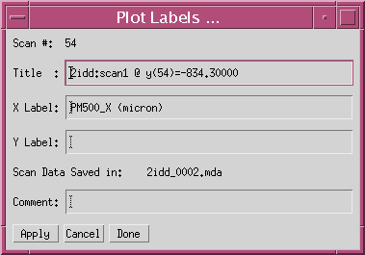
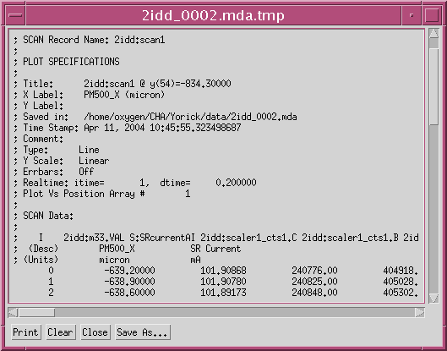
ViewData->1D/2D…

Slide 21
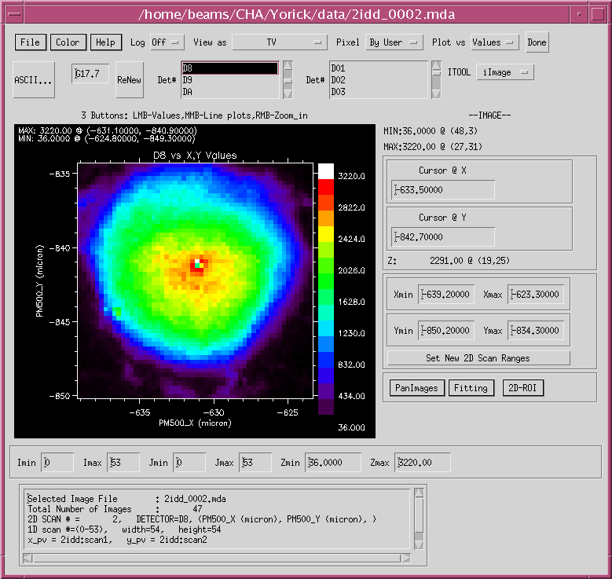
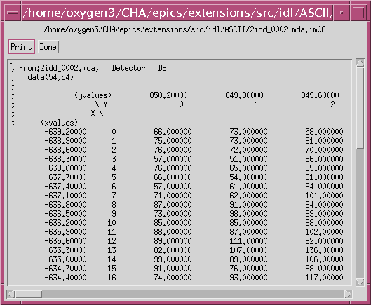
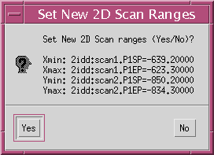
ViewData->
IMAGE2D…
Save Private Color Table
Load Private Color Table
Image Color Scaheme…
Change Color Table…
Color Bar Config…
Save Image for AIM
Save as PNG
Save as TIFF
Save as XDR
Printer…
Print
PS_close
Quit
TV
Eq TV AspRt
LIGHT_SHADE_SURF
CONTOUR
SHOW3
PLOT2D…
SHADE_SURF

Slide 22
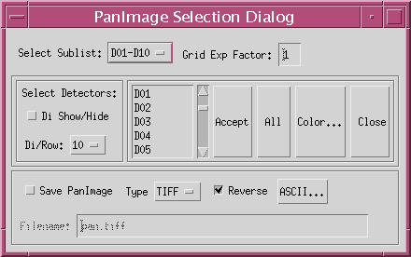
PanImage_sel Features
Panimage Select sub-list: D01-D10,D11-D20,…
Multiple detectors selection list, default All
Grid factor, default 1 (60x60)
Show/Hide detector names
Detectors per row, default 10
Accept, All, Color table dialog
Easy TIFF, PNG, PICT, ASCII panimage generation

Slide 23
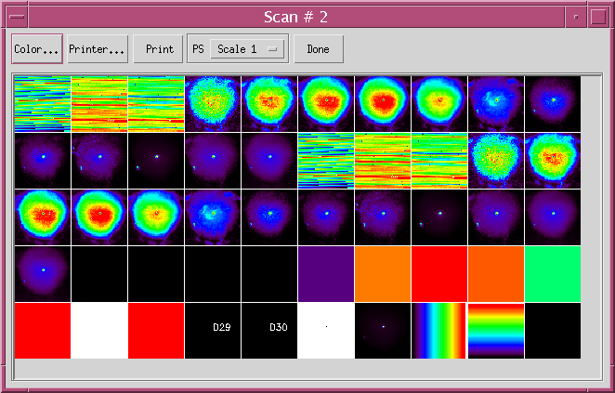
PanImage_sel Output

Slide 24
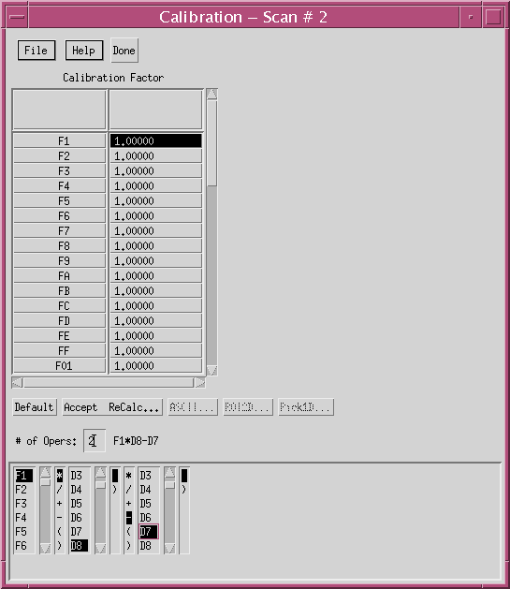
2D Calibration_factor Features
Calibration_factor table freely modifiable
File menu allows save/load factor file
User settable # of terms, math operations, detectors, resultant calibration function displayed
Accept & ReCalc, ASCII, ROI2D, Pick1D sub-programs

Slide 25
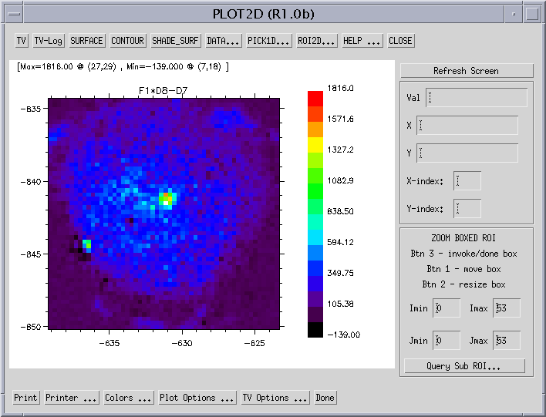
2D Calibra Result
Plot2d Features
Support TV, Surface, Contour, Shade_Surface
Access of ROI, Pick1D, ASCII data sub-programs
TV image mouse query and sub-region query
Dialog for various plot area configurations
Dialog for various TV manipulation features: sharp, smooth, hist_equal,

Slide 26
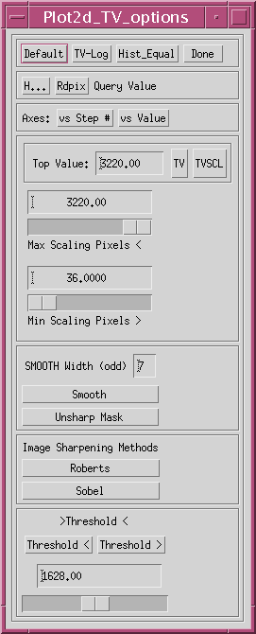
Plot2d_TV Options
TV-log, TV, TVSCL
Image query mode
Hist_Equl
Max/min filter value
Smooth/Unsharp Mask
Roberts/Sobel Sharpping
Threshold

Slide 27
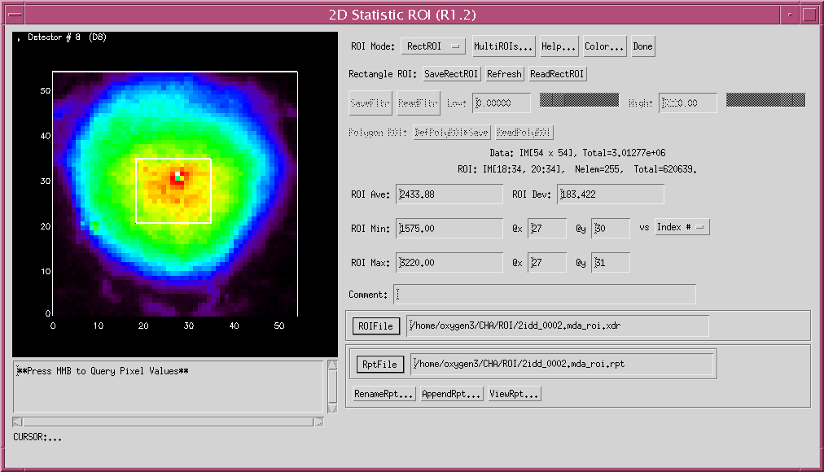
Scan2d_roi
ROI Features
Rect/Filter/Polygon/Multi mode of ROI
Various controls of different ROI mode
Mouse query / modify ROI
Display statistic summary results
User Settable ROI define and report filename
Dialogs save, display, manage ROI reports

Slide 28
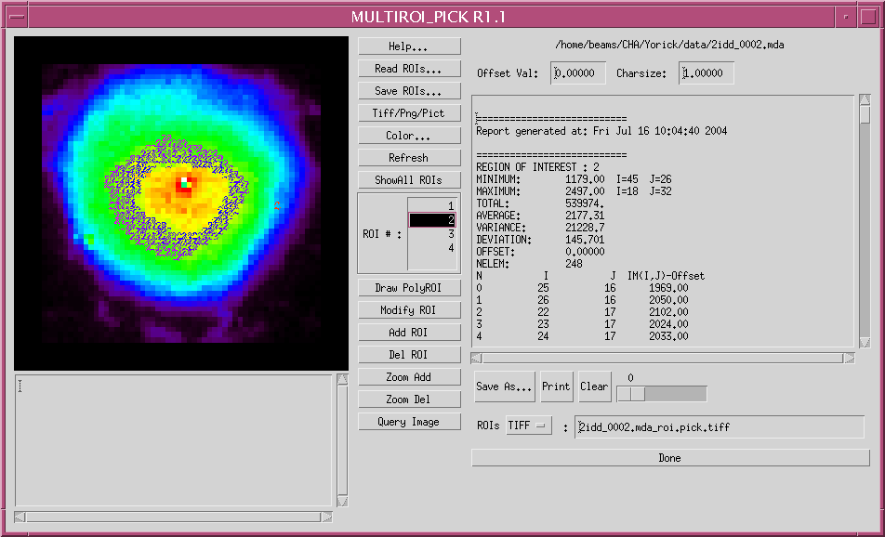
MultiROI_pick subprogram

Slide 29
Multi_ROI Features
Flexible Add/delete/modify ROIs
Free hand drawing of polygon ROIs
Display one/all statistic of ROIs
Save/load multi ROIs to/from a file
Manipulate/generate multi ROIs statistic report
Save ROIs as a TIFF/PNG/PICT file
Image query

Slide 30
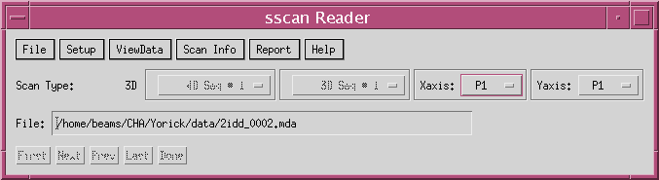
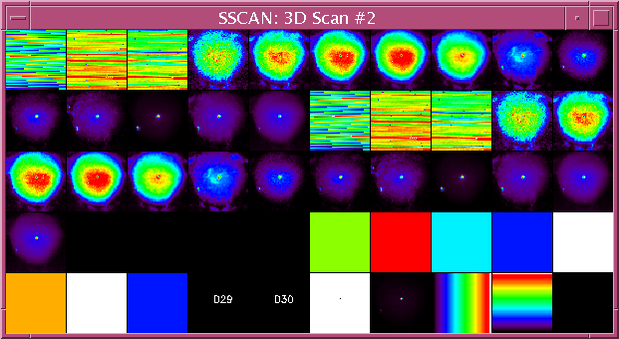
ViewData->SSCAN (1D/2D/3D/4D)…
More efficient than scanSee (without CA)
Use restart scanSee.config or MDA file selection dialog or file field
Extract 1D/2D/3D/4D data arrays to call plot1d, image2d, view3d_2d, view4d sub-programs
Query scan Info, scan header structure info
Report->Report… generation
First,Next,Prev,Last easy MDA file access

Slide 31
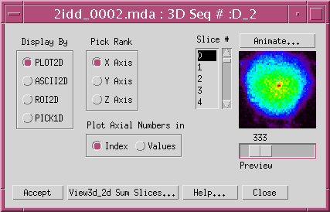
View3d_2d Slicer
Features
Plot2d/Ascii2d/ROI2d/Pick1d subprogram selection
Flexible axial rank selection for 2D slicer
Flexible 2D image animator or preview slider
2D image slice # selection
View3d_2d Sum ROI subprogram

Slide 32
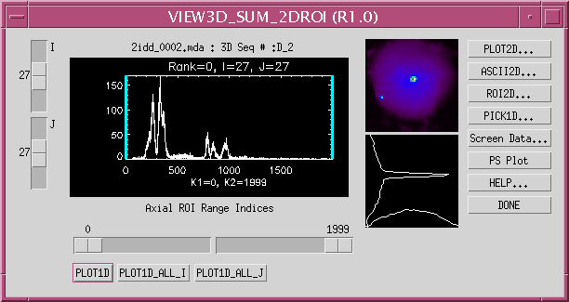
View3d_Sum_2DROI Features
Slider controls for I,J, axial range K1,K2
Spectrum plot at I,J with K1,K2 marked as blue lines
Option of PLOT1D, PLOT1D_ALL_I, PLOT1D_ALL_J specturm
Image of sum of 2D values bound by K1,K2
Plot of cross image line values at I,J
Option of Plot2d/Ascii2d/Roi2d/Pick1d/Data/PS plot

Slide 33
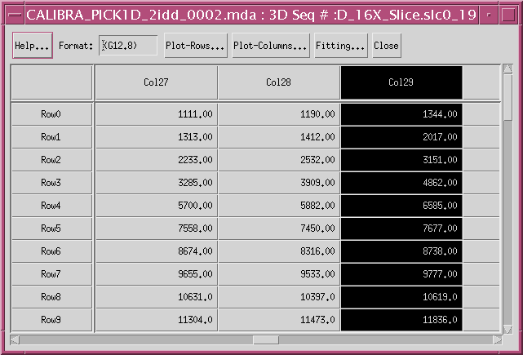
Pick1D Features
Calibra_pick1d
Dialog
Table display of 2D image value with format control
Column/Row selection pops up plot1d grogram
Plot all columns/rows with plot1d subprogram
Access ez_fit subprogram with image array

Slide 34
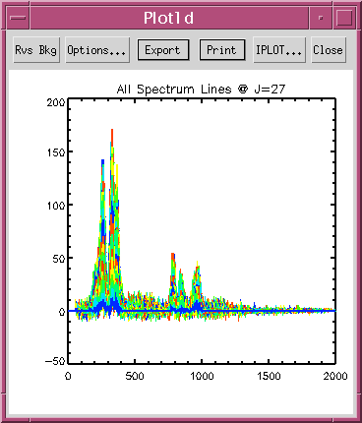
Plot All I-spectrum
Plot1d Features
Plot region resize with window size
Export ASCII, TIFF, PNG, PICT, PS file generation
Access of IPLOT of IDL 6.0 Itools (developer version)
Multiple lines plot program support scattering data
Options… Dialog for various line plot configurations, legend, statistic, fitting, FWHM,etc

Slide 35
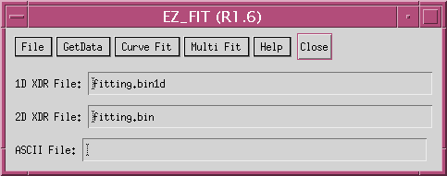
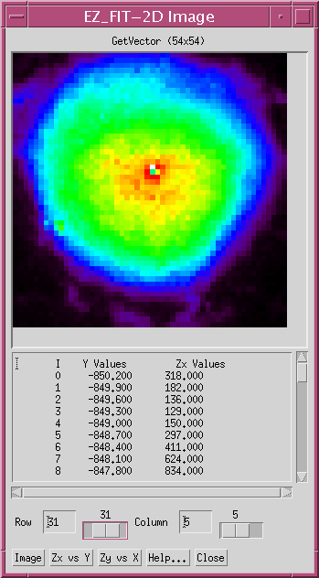
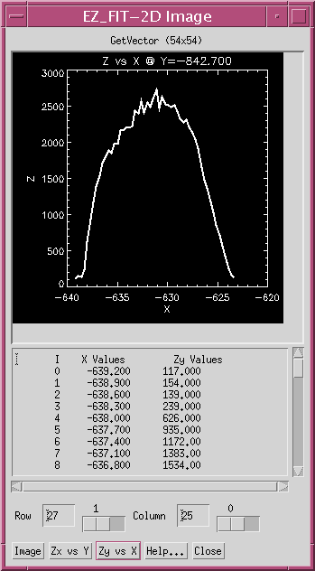
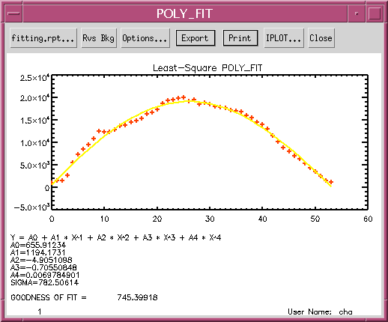
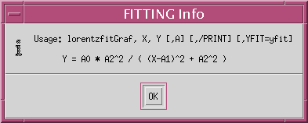
EZ_FIT Dialog
Open 1D…
Open 2D…
Open ASCII…
Printer…
Quit
COMFIT->
CURVEFIT
ERRORFIT
GAUSSFIT
LADFIT
LINFIT
POLYFITW
PLOYFIT
LORENTZIAN
SVDFIT
REGRESS
LORENTIAN
Vector X
Vector Y
Vector Zy
Vector Zx
2DImage
COMFIT
CURVEFIT
ERRORFIT
GAUSSFIT
LADFIT
LINFIT
POLYFITW
PLOYFIT
LORENTZIAN
SVDFIT

Slide 36
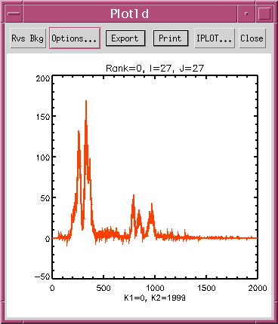
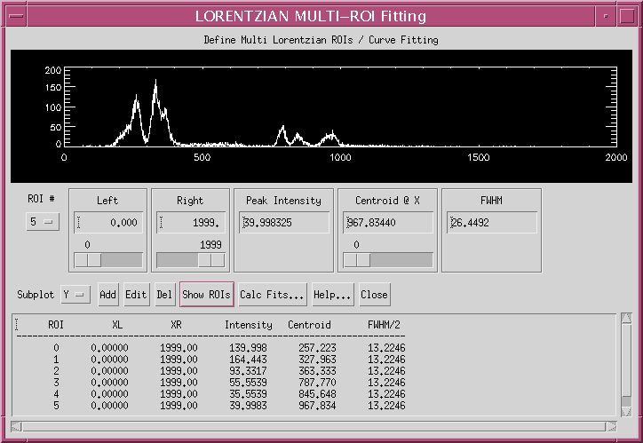
Options…->FITTING…
Muti Fit->LORENTZIAN
Click First Peak
Click Add Btn
Click Next Peak
Click Show ROIs
Click Calc Fits…

Slide 37
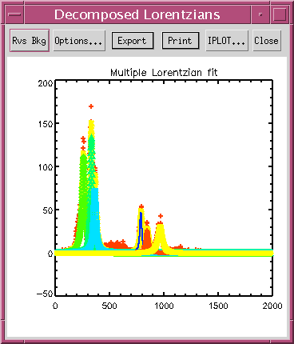
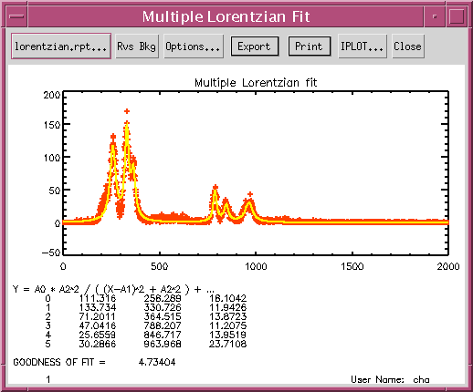
Calc Fits…

Slide 38
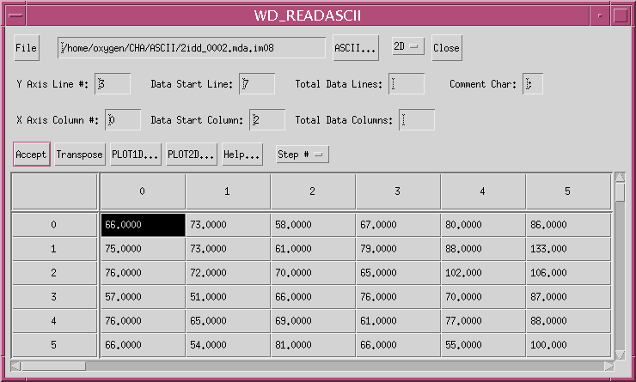
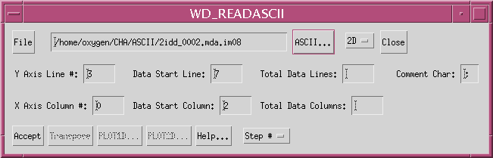
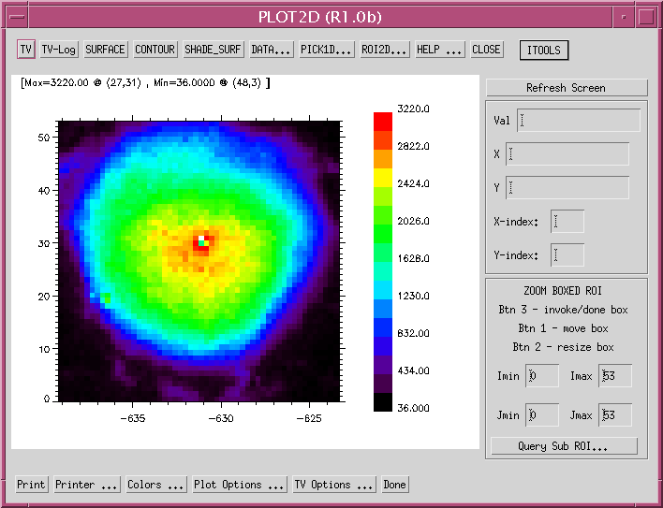
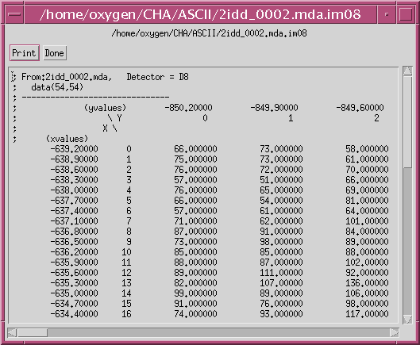
idlvm readascii

Slide 39
Use Sharable Programs
IDL Developer License Required
Common Visualization Tools Sharable by Any Other IDL Program
    Plot1d, plot2d, image2d,view3d_2d, panimage,…
IDL Startup Setup
  setenv IDL_STARTUP /usr/local/epics/extensions/idllib/viewer_startup.pro
Example
  idl
  IDL> loadct, 39
  IDL> da = dist(100)
  IDL> plot2d,da
  IDL> plot1d,da

Slide 40
Scan Object Files
Scan Object files with methods:
  sscan__define.pro (access MDA data)
  scan2d__define.pro (access catcher 2D image file)
  scan1d__define.pro (access catcher 1D file)
Object Access Setup :
  setenv IDL_STARTUP /usr/local/epics/extensions/idllib/viewer_startup.pro

Slide 41
Sscan Object Examples
Referring
  http://www.aps.anl.gov/~cha/idl_html/sscan_ObjectRef.html
Examples:
  idl
  IDL> file=‘/home/beams/CHA/Yorick/data/2ixm_0020.mda’
  IDL> V = obj_new(‘sscan’,file=file)
  IDL> V->image2d ; use object method
  IDL> V->view3d_2d ; use object method
  IDL> V->read,da1d=da1d,da2d=da2d,da3d=da3d,…
  IDL> view3d_2d,da3d ; call sharable program
  IDL> image2d,da2d ; call sharable program

Slide 42
Catcher: Scan1d Object Examples
Referring:
  http://www.aps.anl.gov/~cha/idl_html/scan1d_ObjectRef.html
Examples:
  idl
  IDL> file=‘/home/beams/CHA/Yorick/data/junk2’)
  IDL> .run scan1d__define
  IDL> V = obj_new(‘scan1d’,file=file)
  IDL> V->read,10,pa=pa,da=da,/plot ; read scan #10 in pa and ; da array also plot da
  IDL> V->plot,10,iy=‘4,5’ ; read scan # 10 and plot ; detector 4 & 5 only
  IDL> plot1d,da ; call sharable program

Slide 43
Catcher: Scan2d Object Examples
Referring:
  http://www.aps.anl.gov/~cha/idl_html/scan2d_ObjectRef.html
Examples:
  idl
  IDL> file=‘/home/beams/CHA/Yorick/data/junk2.image’)
  IDL> V = obj_new(‘scan2d’,file=file)
  IDL> V->print ; summary of image file
  IDL> v->panimage,2 ; access the 2nd scan
  IDL> v->images,2,im,def ; extract all images in 2nd scan
  IDL> image2d,im,id_def=def ; use image2d to view 2nd scan ; images

Slide 44
HDF4: NX Object Examples
Referring:
  http://www.aps.anl.gov/~cha/idl_html/NX_ObjectRef.html
Examples:
  idl
  IDL> file=‘/home/beams/CHA/Yorick/data/2xfm_0020.nexus’)
  IDL> .run NX__define
  IDL> v = obj_new(‘NX’,file=file)
  IDL> v->print ; dialog show file info, find num SDS
  IDL> for i=0,309 do begin v->sds,i,da,name=na & help,da,out=t & print,na,i,t & end ; get all SDS data name and array info
  IDL> retall
  IDL> v->sds,131,da,name=na ; read the 131th set of SDS
  IDL> view3d_2d,da ; pass 3D array to view3d_2d program
  IDL> v->sds,96,da,name=na ; read the 96th set of SDS
  IDL> plot2d,da ; pass 2D array to plot2d program
  IDL> hdfb ; call hdfb program

Slide 45
Access ezcaIDL functions
Reference Documents:
  http://www.aps.anl.gov/~cha/catcher/ezcaIDLRef.html
Unix Setup Requirement:
    source /usr/local/epics/extensions/bin/solsris-sparc/ezcaidl_setup
      ( LD_LIBRARY_PATH, EZCA_IDL_SHARE, IDL_STARTUP)
Examples:
  Idl -32
  IDL> r = caGetArray(‘cha:scan1.D1DA’,data,max=11)
  ; get 11 data points
  IDL> plot1D,data ; plot data array
  IDL> x = [‘chademoai1’,’chademoai2’] ; set x to two PVs
  IDL> r = caGetArray(x, y) & print,y ; get &print values
  IDL> newy = y+1. & r = caPutArray(x, newy) ; add & put values

Slide 46
Where to Get More Information
http://www.aps.anl.gov/aod/bcda/dataVis/index.php

