Slide 1

Categorizers (CAT) Team Workshop #2008-01
April 23, 2008
2:00 - 4:00
Brookhaven Center, South Room
Ed Sierra
ORPS Program Manager
Quality Management Office

Slide 2

Workshop Goals
A quote from one of the greats of Science
DOE Recurring Type ORPS Reports (2003 – 2007): A Narrative Study
ORPS Trending
Programmatic Bins
Proposed Revisions to ORPS Directives
Meeting Evaluation and Wrap-up

Slide 3

CAT Team Workshop
Workshop Goals:
  To EVALUATE and CONTINUOUSLY IMPROVE the BNL Occurrence Reporting Program.
  To MAINTAIN a baseline categorization process such that reportability decisions are both VALID and CONSISTENT.
  To REVIEW/ EVALUATE data to determine if repeat events should be identified as potentially RECURRING occurrences.
  To PROMPT (via accurate categorization) DEEP and LASTING value-added CHANGE, which results in new ways of THINKING and ACTING.
    CAT

Slide 4

“And though your good opinion has, as it were, honoured me with a rank similar to that of a general, I shall be always happy to act as a private soldier in the ranks of science.”
Sir Humphry Davy
(1778 - 1829 )

Slide 5
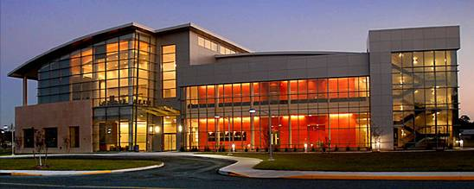

DOE Recurring Type ORPS Reports
(2003 – 2007): A Narrative Study
Energy Facility Contractors Group
- ORPS Task Group
- Feedback & Improvement Subgroup
Oak Ridge National Laboratory
March 25 & 27, 2008
Quality Management ffice
E. Anthony Sierra, BNL
(631) 344-4080

Slide 6

Seven Research Questions
Are there any positive or negative trends?
What initiates an “R” Report?
What are the “R” report topics?
Is the ISM field of any value?
What causal analysis methods are used?
What is the freq of Human Performance cause coding & couplets?
Are any novel corrective actions being implemented?

Slide 7

Study Big Picture
Type of ORPS Reports: Recurring Final Reports
Time Period: 2003 - 2007
Number of Reports: 73
Number of Sites Reporting: 24
Total Number of Causes Cited: 411
Total Number of Corrective Actions: 671

Slide 8
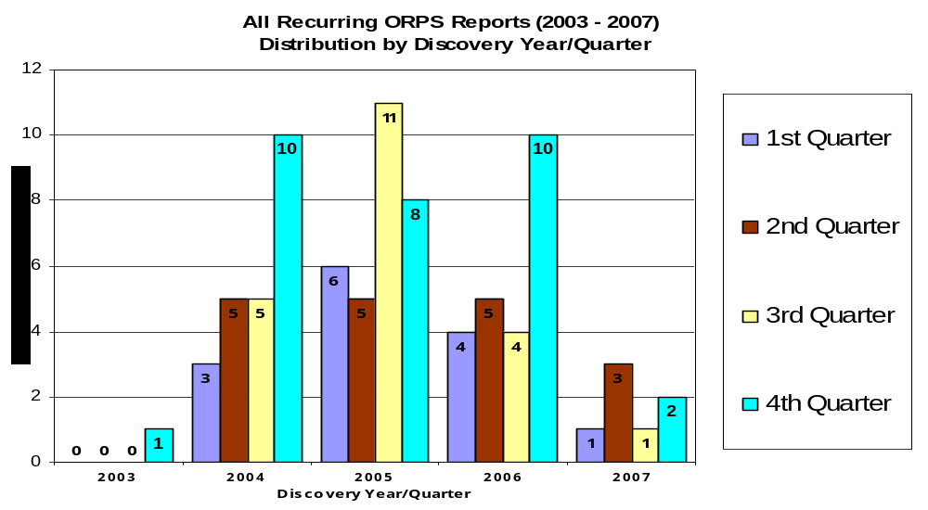
Is “R” ORPS Reporting on the Decline?

Slide 9
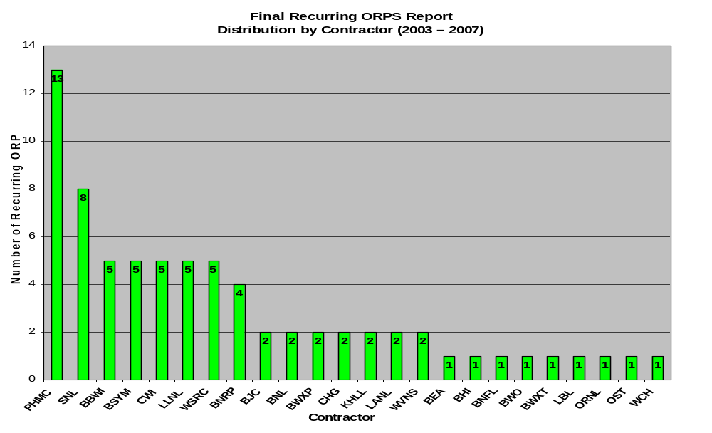
“R” Report Contributors

Slide 10
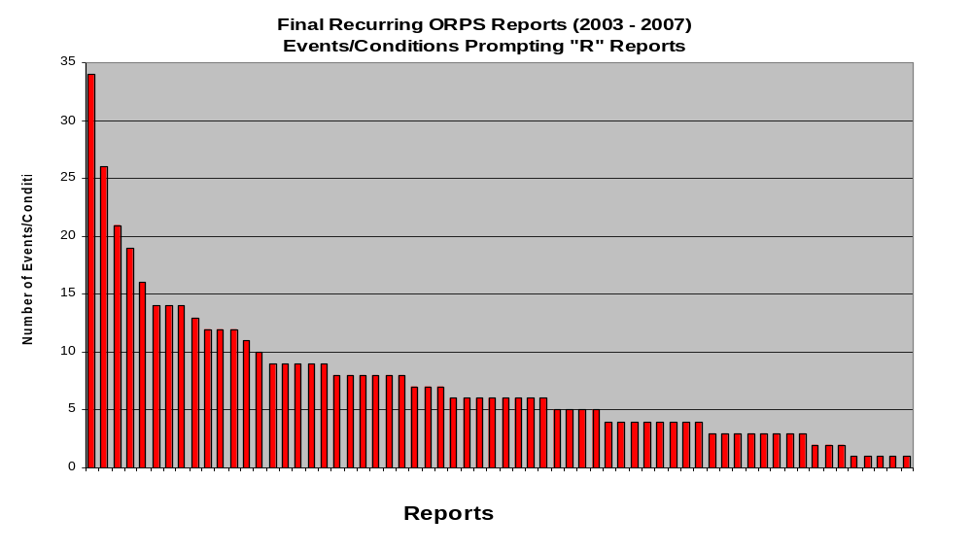
When Do We Declare "R" Reports?

Slide 11
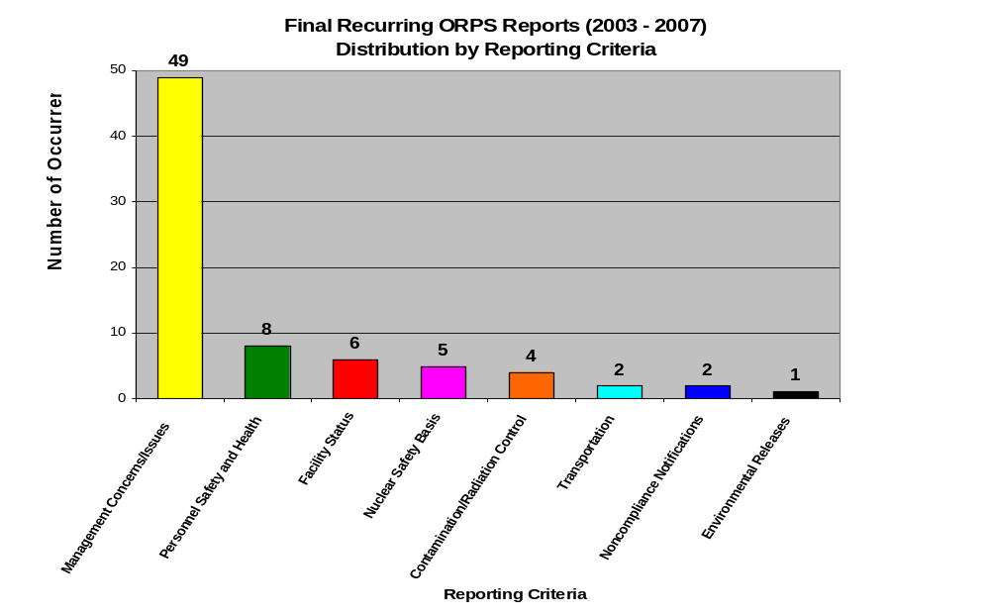
Distribution by Reporting Criteria

Slide 12
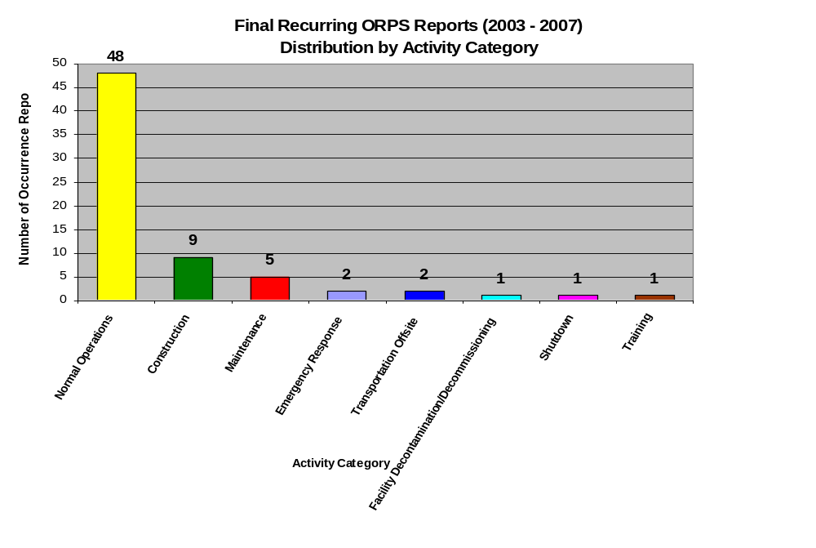
Distribution by Activity Category

Slide 13
Top Five Repeat “R” Reports by Topical Area
Hazardous Energy Control
Radiation/Contamination Control
Heavy Equipment/Material Handling
Technical Safety Requirements
Work Controls

Slide 14

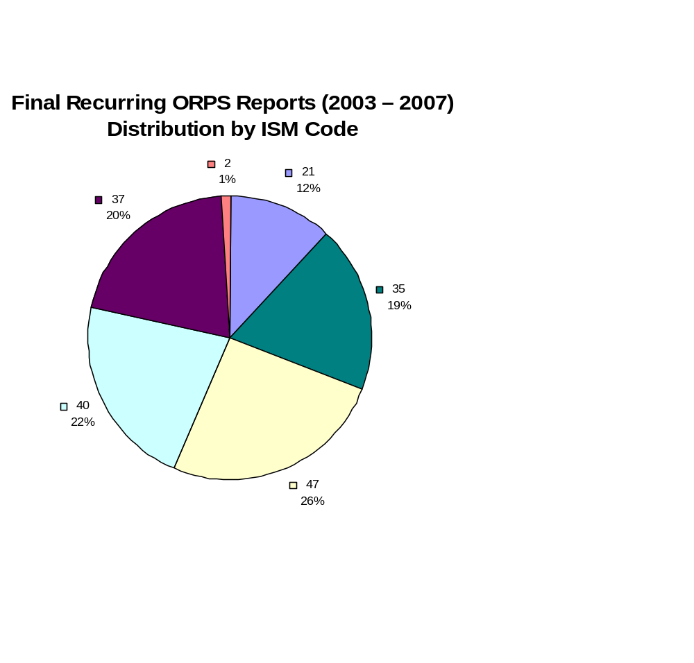
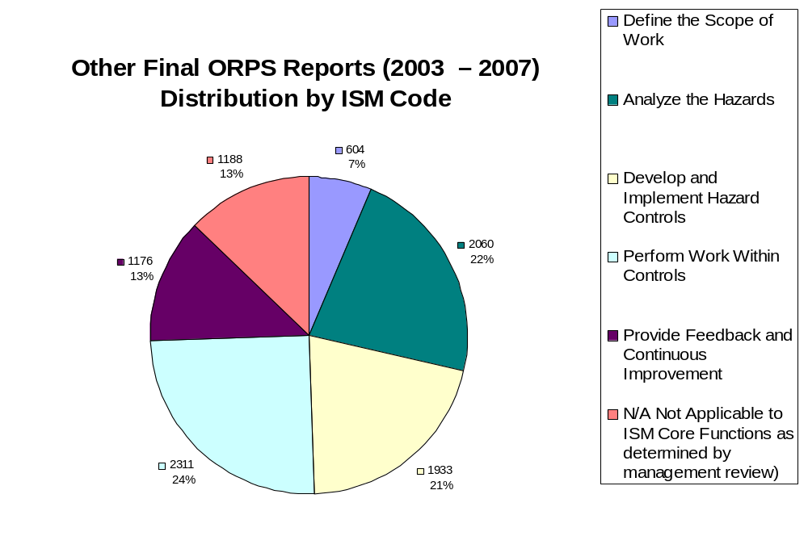
Integrated Safety Management
Coding: A Comparison

Slide 15
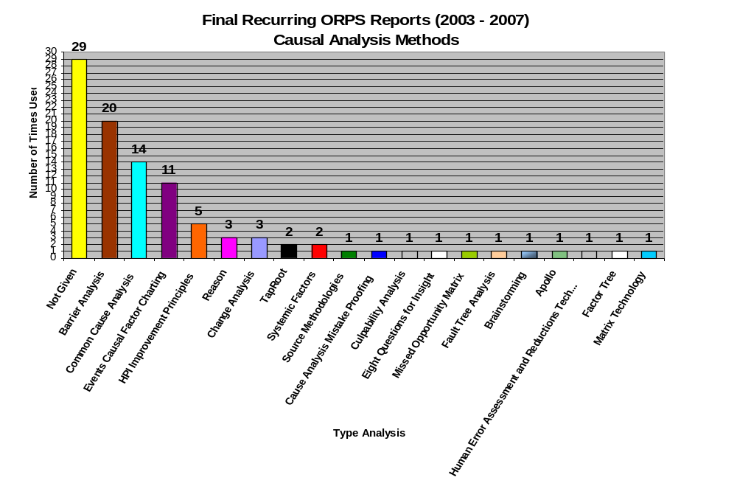
What “Causal” Analysis Methods are Used and Are We Getting to the Root?

Slide 16
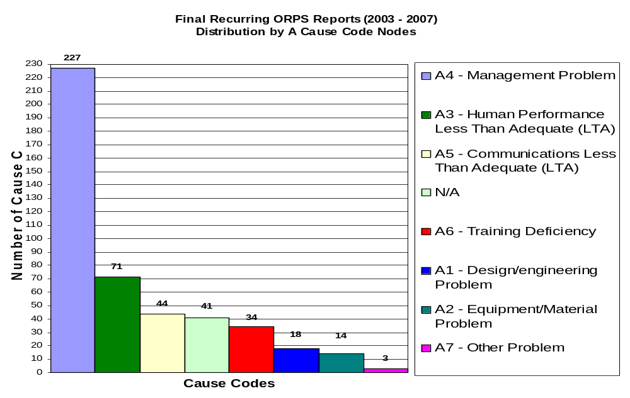
Are A3 Cause Codes & Couplets Underreported?
411 Causes Cited
17% are A3 Causes
Only 48% of the Final “R” Reports cited an A3 Cause Code
Only 49% of those Reports cited a Cause Code Couplet

Slide 17
Are We Really Getting to the Root Cause(s)?
“Root causes reside in the values and beliefs of an organization.
  Until the analysis moves to this level, an organization has not begun to grapple with root causes.”
“An appropriate rule of thumb for knowing how deep to dig in conducting a root cause analysis is to dig until you reach the point of admitting something really embarrassing about the organization.”
Dew, John R., “The Seven Deadly Sins of Quality Management,” Quality Progress, September 2003

Slide 18
21st Century Cause Codes:
It’s Time to Dig Deeper
Placing budgetary considerations ahead of quality
Placing schedule considerations ahead of quality
Placing political considerations ahead of quality
Being arrogant
Lacking fundamental knowledge, research or education
Pervasively believing in entitlement
Practicing autocratic behaviors, resulting in “endullment”
Dew, John R., “The Seven Deadly Sins of Quality Management,” Quality Progress, September 2003

Slide 19
“R” Report Action Plans that Truly Result in Change are LTA
The Majority of Actions are Procedure and/or Communication Based
Why we need to implement Physical (Mistake Proofing) Corrective Actions:
  Best at minimizing human error
  No learning curve
  Difficult to bypass or work around
  Only defensible choice as single barrier

Slide 20
“R” Report Corrective Action Plans
Only 29% of Reports Included an Action to Check Action Effectiveness
Only 12% of Reports Included an Action to Issue a Lessons Learned Communication to the Complex
9 Reports had 1 Action

Slide 21

Proposed Path Forward
Improve Criteria for “R” Reporting
Effectiveness Corrective Action – Prewritten (Mistake Proof)
Complex Lessons Learned Corrective Action – Prewritten (Mistake Proof)
Drop Down Menu for Root Cause Analysis Method (Mistake Proof)
Training on Performance Modes
Inclusion of Action Plan – (Mistake Proof)
Drop Down Menu of 21st Century Cause Codes (Mistake Proof)
The Elephant in the Room; do “R” Reports Minimize the Risk of Recurrence?

Slide 22

ORPS Report Writing
It is Hard Work!
“Even when the facts relevant to a problem still exist, finding them amid the flotsam of confounding information and assembling them into a cogent argument can be forbiddingly tough.”
        - John Rennie
        editor in chief
        Scientific American, March 2008

Slide 23
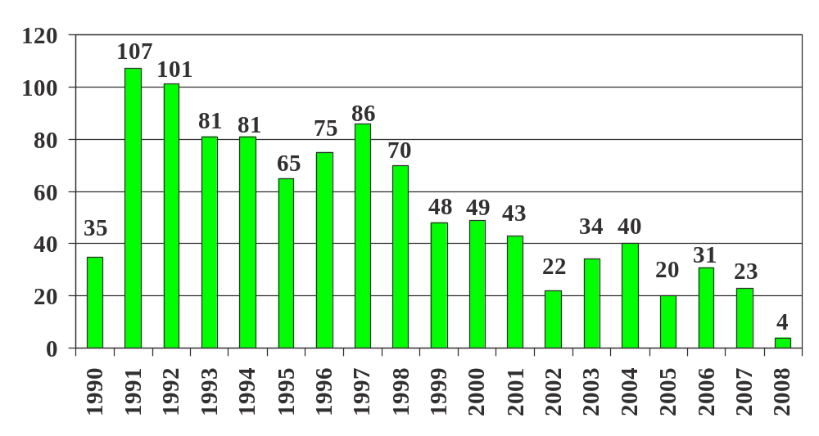
BNL ORPS by Calendar Year Report Submitted
As of 3/31

Slide 24
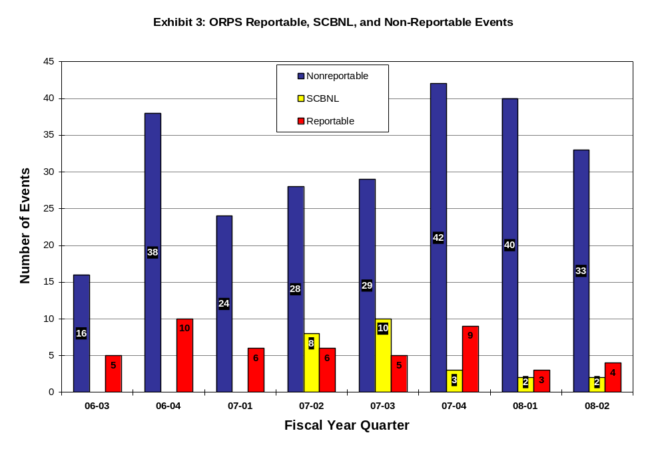
Event Categorizer Electronic Entries

Slide 25
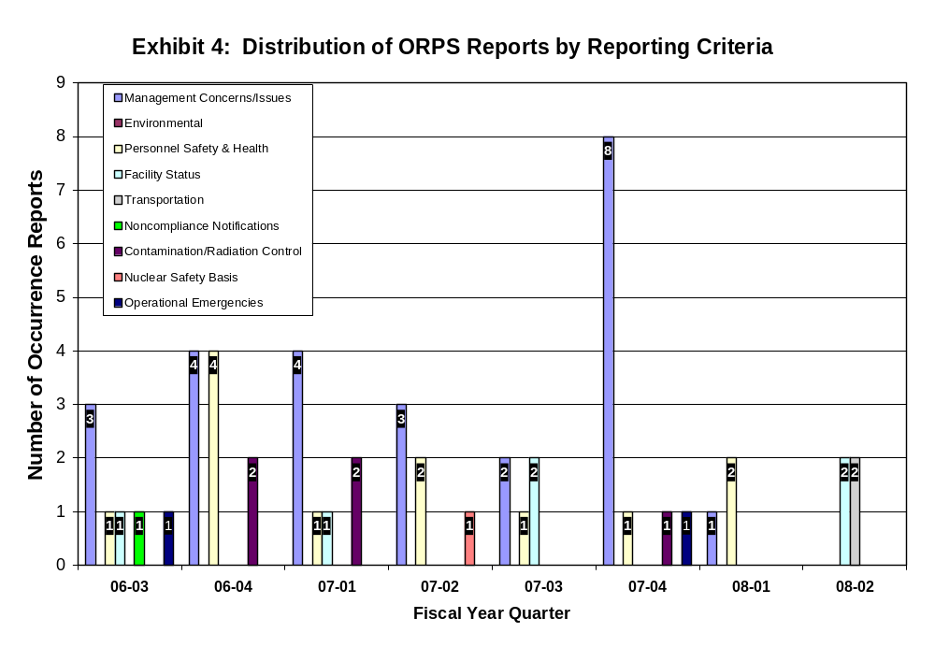
4th Qtr FY 07

Slide 26
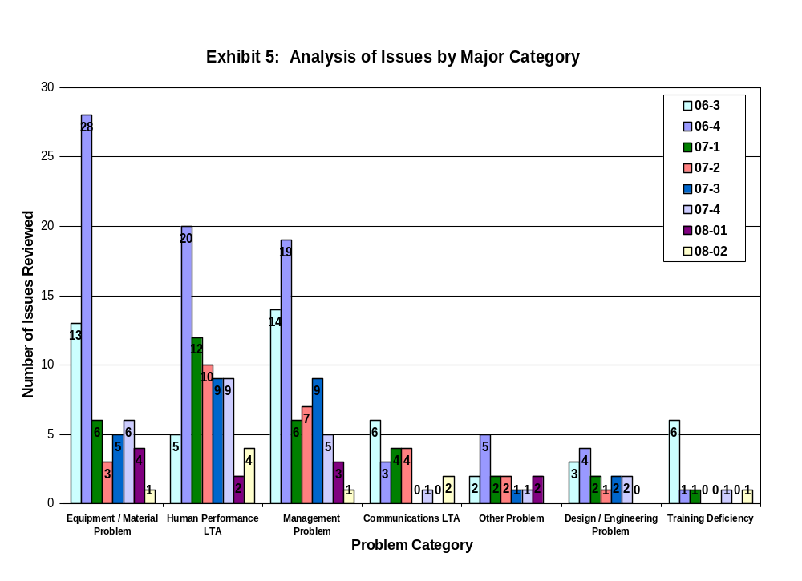
4th Qtr FY 07

Slide 27
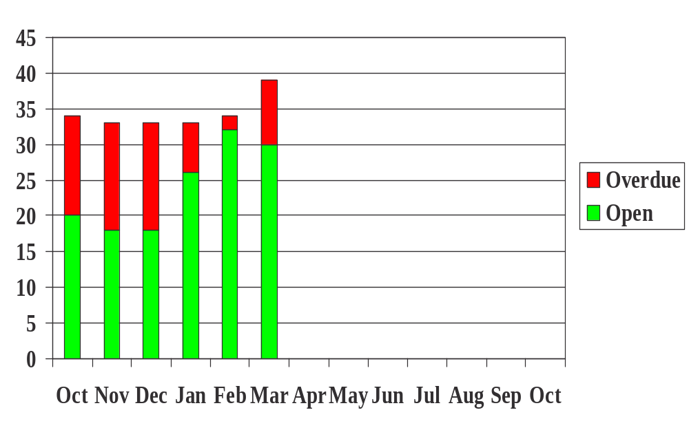
ORPS Corrective Action Status
FY 2008 (End of Month)

Slide 28

CAT Electronic Entries
12/07 – RK, Hand Injury from Tripping on Rail Track
12/07 – RK, Employee walked into bucket and hurt knee
12/07 – RK, CFN Redundant Sprinkler Feed Valve Found Shut
12/10 – RK, ~ 1 Gallon Hydraulic oil spill from garbage truck
12/12 – KK, < 1 Gallon oil spill in the parking lot of B-930
12/12 – KK, MRI Occupational Exposure Exceed Agreed Upon Exemption Limits, SC3
12/14 – KK, < 1 Gallon Transmission Fluid Spill to Pavement
12/14 – KK, Failed Interlock on Shepherd 89 Irradiator
12/20 – SM, Heating Coil Pinhole Leak in Bldg 750
12/20 – SM, "Article 12" Tanks in Bldg 750 w/Labeling Issues
12/24 – MD, Employee Falls to Ground While Exiting Delivery Boxtruck
01/08 – MZ, Grad student receives cryogenic helium 2nd degree burn on hand
01/08 – MZ, Three 9011 railcars arrive in Utah - 2 with damaged tarps, 1 with tarp missing
01/09 – MZ, Tenderness in wrist and thumb
01/15 – AL, Off-site Transport of Radioactive Material Less Than Adequate, SC3
01/16 – AL, BGRR one line drawings were not kept up to date
01/16 – AL, Employee transported to hospital due to illness
01/18 – AL, Electrician strains lower back while working on eight foot ladder
01/18 – AL, plumber lacerates the back of his hand on condenser coil fins
01/25 – AP, Minor wrist sprain from packaging activities
01/25 – AP, Card reader latch mechanism failure

Slide 29
CAT Electronic Entries
01/28 – RK, 110V/208V Breakers Inadvertently Open at B50 While Performing Work
01/28 – RK, U-Conn heat transfer fluid spill from B902 helium compressor
01/29 – RK, Slip on BGRR stair - No injury
01/30 – RK, Malathion Spill on 1st floor of B911
01/31 – RK, Contractor strains hand while using drill
02/01 – RK, Fall from truck injures neck
02/04 – RK, Minor antifreeze spill in the apartment area
02/05 – SM, Discovery of Power MOSFET Counterfeit IXYS Components, SC4
02/07 – SM, Steam Leak to Condensate Return Line in B902
02/07 – SM, Power Supply Capacitor fails at NSLS generating smoke
02/08 – SM, Waste Mgmt NCR on Improperly Filled out Rad Waste Control Forms, SC4
02/11 – KK, Groundwater Samples Sent to Wrong Analytical Laboratory
02/12 – KK, B-490 Diesel Generator Fails During Routine Testing
02/13 – KK, Slight Injury to Knuckles
02/13 – KK, Employee Walks Into Glass Door Resulting in Cut Above Eye
02/19 – KK, Contractor Fractures Finger While Using Drill, SCBNL
02/25 – KS, Configuration Control Deficiencies Identified at HFBR
03/04 – MZ, Slugs shipped to BNL from ORNL in 1950-51 may be fuel
03/05 – MZ, Contractor injures wrist

Slide 30
CAT Electronic Entries
03/05 – MZ, Domestic water leak at HFBR AC cooling towers
03/06 – MZ, Loss of SBMS Web Service
03/06 – MZ, Small Fire in Outdoor Waste Receptacle at B-400, SCBNL
03/07 – MZ, Employee Sustains Laceration Removing Placard
03/07 – MZ, Inst shipped offsite w/ Ni63 source w/o going through I & SM
03/10 – ES, Raccoon Taken From BNL Expires
03/12 – AL, Inspection of Rigging Equipment Reveals Suspect/counterfeit items, SC4
03/24 – RK, Minor cut to forehead when contact made with plastic cable tray
03/28 – RK, Shoulder injured while closing file cabinet
04/03 – SM, Minor Injuries to FF/EMTs during High Risk training
04/03 – SM, Trane Solution Removal Procedure Clarification at HFBR
04/03 – SM, HEMO Lacerates Finger while repairing forklift cylinder
04/04 – SM, WM Tech Receives Tingle Sensation from Contact with Electric Conduit, SC2
04/04 – SM, Incomplete Understanding of Details of Lessons Learned Procedure
04/07 – SM, Painter Suffers Twinge in Shoulder
04/08 – KK, Custodian Injures Head
04/16 – MD, Fluorine-18 contamination on wrist and personal clothing, SC4
04/18 – SM, Forklift Driver Bumps Head
04/18 – ES, Electrician Incurs Neck Muscle Strain
04/18 – ES, Carpenters Finger Contacts Point of Nail
04/22 – KS, HFBR Instrument Deficiencies

Slide 31
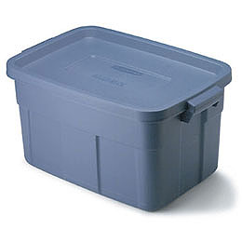
Programmatic Bins
Personnel Contamination
Medical Department
NSLS
Physics
CA-D
BGRR Project
Plant Engineering
Utilities Struck
Haz Material Transportation
Electrical Shock Hazards
Material Handling Issues
Waste Management
Chemistry
Environmental Restoration
Railroad Tracks
New Construction
Noise
Site Fire Alarm System
Butt Fires
CFN

Slide 32

Programmatic Review
Personnel Contamination – 2006
  02/23 – Personnel Cont at Building 901
  03/22 – Cont Detected on Employee's Shoes at PET
  03/28 – Cont of two workers at B-801 during removal of BLIP target filter
Personnel Contamination – 2007
  04/26 – F-18 finger contamination at PET
  09/28 – Researcher Contamination at PET, B-901 (Nitrogen -13), (SC4)
Personnel Contamination – 2008
  04/16 – Fluorine-18 contamination on wrist an personal clothing, (SC4)

Slide 33

Programmatic Review
Medical department, 2006
  03/07 – Rad Cont Outside a Controlled Area at B-490, (SC3)
  03/10 – Survey Meter/Frisker Taken Outside Controlled Area @ B490
  03/13 – PB, Shock from terminal in legacy installed light timer, (SC4)
  03/28 – Cont of two workers @ B801, during removal of BLIP target filter
  05/19 – Cont found outside a posted area @ B490
  07/31 – Trit cont on unposted benchtop in a posted RMA at B490
  08/24 – Painter's spackling knife contacts aband live electrical wiring @ 490, (SC3)
  11/16 – KK, Contamination at PET Facility, (SC3)
  10/31 – BLIP cooling water leak detection system did not function during testing

Slide 34
Programmatic Review
Medical department, 2007
  04/26 – F-18 finger contamination at PET
  05/16 – Medical Student Passes Out after seeing blood at B-490
  05/16 – Employee lacerates arm while cleaning a microtome at B-490
  05/22 – First-degree chemical burn due to small hole in glove @ B-490
  07/05 – Building 801 D Tank Leak, ~5mL
  09/12 – Exposed Wiring Electrical Hazard in Building 490, (SC3)
  09/24 – Empty sharps container found in animal bedding during disposal
  09/28 – Researcher Contamination at PET, B-901(Nitrogen -13), (SC4)
Medical department, 2008
  12/12 – MRI Occupational Exposure Exceed Agreed Upon Exemption Limits, (SC3)
  02/08 – Waste Mgmt NCR on Improperly Filled out Rad Waste Control Forms, (SC4)
  04/16 – Fluorine-18 contamination on wrist an personal clothing, (SC4)

Slide 35

Programmatic Review
NSLS, 2006
  02/21 – X17C Laser Procedure Violation (Door left open while laser in operation)
  05/08 – Improper work sequence during lead shielding removal at beam line
  06/09 – XSXD Power Supply Shut-off Failure
  07/17 – Chemical Spill in Wet Chemistry Laboratory, (SC3)
  08/21 – AL/ES, Accidental cutting of energized power tool line cord, (SC3)
  11/16 – Spent Fluorescent Bulbs Found Outside Waste Storage Area
NSLS, 2007
  05/03 – Minor fire in ventilation system, (SCBNL)
  06/12 – Aluminum plate pinches beamline User finger tips
  07/03 – Employee Sustains Injury to Ankle Tripping on Stairs
NSLS, 2008
  01/08 – Grad student receives cryogenic helium 2nd degree burn on hand

Slide 36

Programmatic Review
Physics, 2006
  07/07 – Employee fractured metatarsal after tripping over rug/mat
  08/09 – Stop Work Order issued due to antennae at edge of B510 roof
Physics, 2007
  06/11 – Improper Status provided by Laser/Shutter Indicators at ATF, (SC3)
  10/01 – Trip/fall when walking in grass results in ankle fracture, (SC3)

Slide 37

Programmatic Review
CA-D, 2006
  03/06 – Discovery of Radiation Monitor in Interlock-Bypass-Mode, (SC3)
  03/29 – Lack of admin approval (non-safety related) for NASA NSRL experiment
  04/14 – 400 Amp Electrical Switch Failure, (OE, SC2, SC4)
  05/04 – CA-D Chipmunks read high and alarms at a lower dose rate than intended
  06/02 – < 6 oz of tritiated magnet water splashed onto the workers pant-leg @ RHIC
  06/09 – 3 gals of heat transfer fluid (oil) spilled on Storage Yard pavement by B-924
  07/20 – Pulling cable along floor results in back strain
  08/14 – ~ 200 gal spill from 902 Cooling Towers to parking lot and grass
  08/21 – Leg laceration while descending ladder at B1005
  09/05 – Non-standard installation of elect disconnect temp wiring, (SC3)
  09/13 – Trip on stairs results in ~ 1 qt. spill of H2SO4 from battery at B901A
  10/12 – Worker hit in head/injured by shelf while moving a workbench
  11/02 – Fire Protection Impairment Process Not Properly Followed @ B1004B
  11/06 – Man lift damaged during tree cutting operations
  11/08 – Loose 120 VAC wires on a terminal block results in sparking
  11/27 – Minor finger laceration

Slide 38
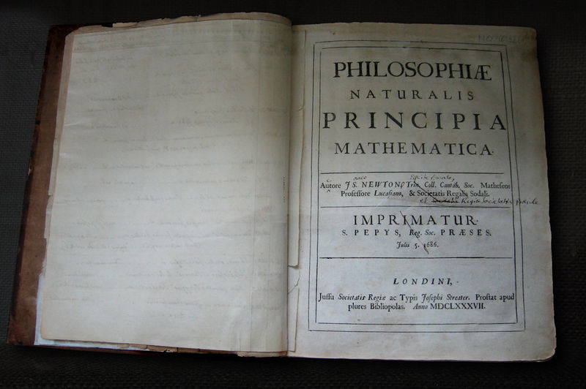
Programmatic Review
CA-D, 2007
  05/02 – Minor brush fire in Front of building 911
  05/10 – Power Supplies for Booster to AGS trip
  05/15 – Microwave fire in Building 1005, (SC3)
  08/09 – Hand caught in freight elevator door at 911, (SC4)
  09/19 – Employee injures hand closing elevator at 911
  11/18 – Contractor rigger climbs over rad shielding wall at C-AD
  12/04 – RK, Worker falls walking on wooden pallet & bruises elbow outside B1000P
CA-D, 2008

Slide 39

Programmatic Review
BGRR Project, 2006
  08/03 – Removal of fuel anchor (BGRR) not approved by work procedure
  09/26 – Cont (80, 000 dpm) found outside the BGRR RCA, (SC3)
BGRR Project, 2007
  07/20 – 5,000dpm found on Workers Glove at BGRR

Slide 40

Programmatic Review
Plant Engineering, 2006
  01/27 – Burning Cotton Apron In PPE/Tool Bag Causes Evac @B197, (SC3)
  05/10 – Vehicle window damaged during concrete sidewalk removal work, (SC3)
  06/16 – Asbestos discovered during demolition of B-422
  10/13 – Silica Exposure During Concrete Crushing Machine Operation, (SC3)
  12/05 – PE groundskeeper received a minor injury to the chin
  12/13 – Pump leak results in 100 gal spill of propylene glycol @ B729
Plant Engineering, 2007
  09/21 – Lawn Maintenance Results in AC unit Falling onto Mower, (SC3)

Slide 41

Programmatic Review
Utilities struck, 2006
  08/08 – Fiber-Optic Cable inadvertently severed at B707A, HFBR pump house swgear
Utilities struck, 2007
Utilities struck, 2008

Slide 42

Programmatic Review
Material Transportation, 2007
Material Transportation, 2008
  01/08 – Three 9011 railcars arrive in Utah - 2 with damaged tarps, 1 with tarp missing
  01/15 – Off-site Transport of Radioactive Material Less Than Adequate, (SC3)
  03/07 – Inst shipped offsite w/ Ni63 source w/o going through I & SM

Slide 43

Programmatic Review
Electrical Shock, 2006
  03/13 – Shock from terminal in legacy installed light timer, (SC4)
  09/06 – AP, Table lamp electrical fault at apartment 4B results in finger tingle
Electrical Shock, 2007
  07/20 – Tech receives minor electrical shock when B-452 struck by lighting
  11/21 – Shock, Near miss to an occupational injury, (SC3)
Electrical Shock, 2008
  04/04 – Tech receives tingle sensation from contact with electric conduit, (SC2)

Slide 44
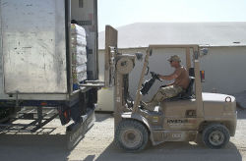
Programmatic Review
Material Handling Issues, 2006
  01/17, Tennelec smear counter falls during transport, (SC3)
  06/30, Computer server unit falls out of BNL box truck grazing workers leg, (SC3)
  07/20, Pulling cable along floor results in back strain
  08/28, During transport a forklift dropped a secured aerial lift, (SC3)
Manual Material Handling Issues, 2007
  09/28 – Motor pool worker injures back while lifting a forty pound starter, SCBNL
  11/30 – Minor Back Strain from Material Handling in B-479

Slide 45

Programmatic Review
Waste Management, 2006
  01/20 – USQ on rusting HEPA exhaust stack @ B860, (SC3)
  02/22 – Lapse in USQ training qualification
  08/04 – HFBR Dumpster alarms BNL Radiation Truck Monitor, (SC3)
  08/16 – Walk through of HFBR identifies rad/non-rad items that are not segregated
Waste Management, 2007
Waste Management, 2008
  02/08 – SM, Waste Mgmt NCR on Improperly Filled out Rad Waste Control Forms, (SC4)

Slide 46
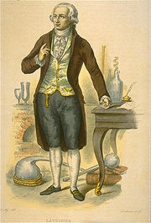
Programmatic Review
Chemistry, 2006
  01/17 – Energ ckt disc in cut conduit in floor slab @ B555, (SC3)
  02/23 – Personnel Cont at Building 901
  03/22 – Cont Detected on Employee's Shoes at PET
Chemistry, 2007
  08/02 – BNL employee trips on asphalt lip near B-555 and bruises knee
  10/08 – Suspicious suit case outside B555 - precautionary evacuation
  11/14 – Condensate Tank Motor Fire at B-555, SCBNL

Slide 47

Programmatic Review
Environmental Restoration Projects, 2006
  09/22 – HFBR air conditioning water pump seal leak, (SC3)
  10/30 – Flaw in ERP calculation of total recordable injury statistics
  11/30 – SM, Failure to Maint Config Control of DOE-SER specified Documents, (SC3)
Environmental Restoration Projects, 2007
  05/01 – Contamination in HFBR fuel vault
  06/14 – Tool Bag at HFBR Measures above Rad Release Limits
  07/09 – Untrained Personnel Entry into Confined Space at HFBR
  07/17 – Inappropriate Change to Work Procedure at HFBR
  08/23 – Work Proceeds at HFBR Without BHSO Approval
Environmental Restoration Projects, 2008
  02/25 – Configuration Control Deficiencies Identified at HFBR

Slide 48

Programmatic Review
Railroad Tracks, 2007
Railroad Tracks, 2008

Slide 49

Programmatic Review
New Construction, 2006
  04/21 – Sub incurs severe laceration of leg at CFN, (SC3)
  07/31 – A/C mechanic cuts arm at RSB Construction Site
New Construction, 2007
New Construction, 2008

Slide 50

Programmatic Review
Noise, 2006
  01/18 – Noise over exposure per ACGIH TLV @ B902, (SC3)
  03/07 – Over-exposure to noise hazard @ Motor Pool Repair Facility, (SC3)
Noise, 2007
  09/12 – Worker Exposure to Excessive Noise During Vacuuming
Noise, 2008

Slide 51

Programmatic Review
CFN, 2007
  05/04 – Disc of smoldering mulch bed on south side of CFN
  08/01 – Rain water intrusion into CFN
  09/14 – Installation Error in Manufactured Modular Wall Assembly
CFN, 2008
  12/07 – CFN Redundant Sprinkler Feed Valve Found Shut

Slide 52
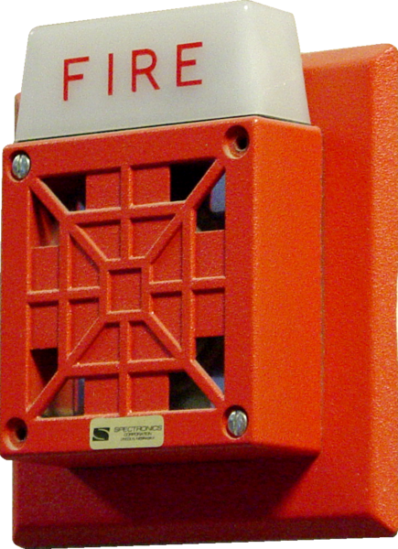
Programmatic Review
Site Fire Alarm System
  06/14 – Site-wide Fire Alarm Communications Malfunction, (SC4)
  07/05 – Site Fire Alarm System Loop 1 Bldgs not Reporting
  08/17 – Loss of BNL Fire Alarm Loops to Firehouse
  09/12 – Partial Loss of Site Fire Alarm System, (SC3)

Slide 53

Programmatic Review
Butt Fires, 2007
  05/02 – Minor brush fire in Front of building 911
  05/04 – Discovery of smoldering mulch bed on south side of CFN
  05/15 – Fire in Building 120 Butt Stop
  05/24 – Brush fire at remote location in the SE corner of site
  06/15 – Issued Fact-finding/Causal Analysis/Preventive Actions No.: QMO-2007-0001, ATS 3788
  06/28 – Butt Can Fire at Building 153
  10/08 – RK, Brush Fire (cause unknown) at North side of RHIC Ring
Butt Fires, 2008
  03/06 – MZ, Small Fire in Outdoor Waste Receptacle at B-400

Slide 54

Proposed Rev to ORPS Directives
Clarified Apparent Cause Analysis Process description, and added modified flow diagram (taken from DOE ORPS CAT CBT module)
Generic Error Modeling System (GEMS) diagram (taken from new INPO HPI reference manual)
Other definitions of HPI-, error- and causal-analysis-related terms

Slide 55
Apparent Causal Analysis Process
Develop causal factors
For each causal factor:
  If CF involves human, start with A3 node. Then find process/system causes to couple it.
  If CF does not involve human, most likely will be equipment/material related (A1 or A2).
Note: “N/A” as a pseudocouplet in ORPS software is not a defined code, yet shows up as a code in reports.

Slide 56
Generic Error Modeling System (GEMS)
High
?
Δ
Yes
Problem-solving mode:
Recall mental model. Apply observed symptoms & fundamental principles to update mental model.
Is task proceeding OK?
Identify available symptoms or other familiar analogy
If:
familiar situation?
Identify available symptoms
Recognize problem situation
No
No
Yes
Subsequent Attempts
No
Then:
Apply known action
Solved?
Attention (to task)
Yes
Select problem solution:
Develop corrective action. Apply to problem situation. Observe results.
Is task proceeding OK?
Knowledge-based Performance
Analysis of unfamiliar problem situation using stored knowledge
Rule-based Performance
Pre-packaged actions determined by recognition of familiar problem situations
Skill-based Performance
Routine actions in a familiar situation
Low
Low
Familiarity (with task)
High

Slide 57
New Definitions
Error
Causal analysis
Cause
Couplet
Human performance
Skill-based / Rule-based / Knowledge-based error
Violation

Slide 58
CAT Human Performance Node (A3)
Complete restructuring of A3B1 node (skill-based errors) based on research:
  Norman, Donald A. “Categorization of Action Slips,” Psychological Review, Vol. 88 [1981], pp. 1-15.
  Norman, Donald A, “Design rules based on analyses of human error,” Communications of the ACM (Association for Computing Machinery), Vol. 26 No. 4 [April 1983], pp. 254-258.

Slide 59
Skill-Based Error Codes
FROM:
A3 Human Performance LTA
B1 Skill-Based Error
C01 Check of work was LTA
C02 Step was omitted due to distraction
C03 Incorrect performance due to mental lapse
C04 Infrequently performed steps were performed incorrectly
C05 Delay in time caused LTA actions
C06 Wrong action selected based on similarity with other actions
C07 Omission/repeating of steps due to assumption for completion
TO:
A3 Human Performance LTA
B1 Skill-Based Error
C01 Description error
C02 Data-driven activation
C03 Associative activation
C04 Loss of activation
C05 Mode error
C06 Capture error
C07 Misordering, omission or repeating of steps

Slide 60
DOE M 231.1-2
ORPS Manual
Change notion of “prevent” recurrence to “reduce risk of” recurrence.
Expansion of section 1.5 Occurrence Investigation and Analysis:
  Incorporate HPI and ISM principles
  Purpose and goals of an investigation (not to place blame; opportunity to learn)
  Information-gathering methods
  Forming investigation teams

Slide 61
ORPS Manual (contd.)
Critique described
Graded approach for investigation should be based on potential as well as actual consequences.
Eliminate use of antiquated cause terms (direct, root, contributing)

Slide 62
ORPS Reporting Criteria Proposed Rev:
Loss of Categorizer Accident (LOCA)?
An event, condition, or series of events that do not meet any of the other reporting criteria, but is determined by the Facility Manager or DOE/contractor line management to be a safety concern for that facility or other facilities or activities in the DOE complex. The significance category assigned to the management concern should be based on an evaluation of the potential risks and associated corrective actions.
Review WORD file

Slide 63


CAT Team Workshop
CAT Team Action Item Review
Meeting Evaluation and Wrap-Up

