Slide 1
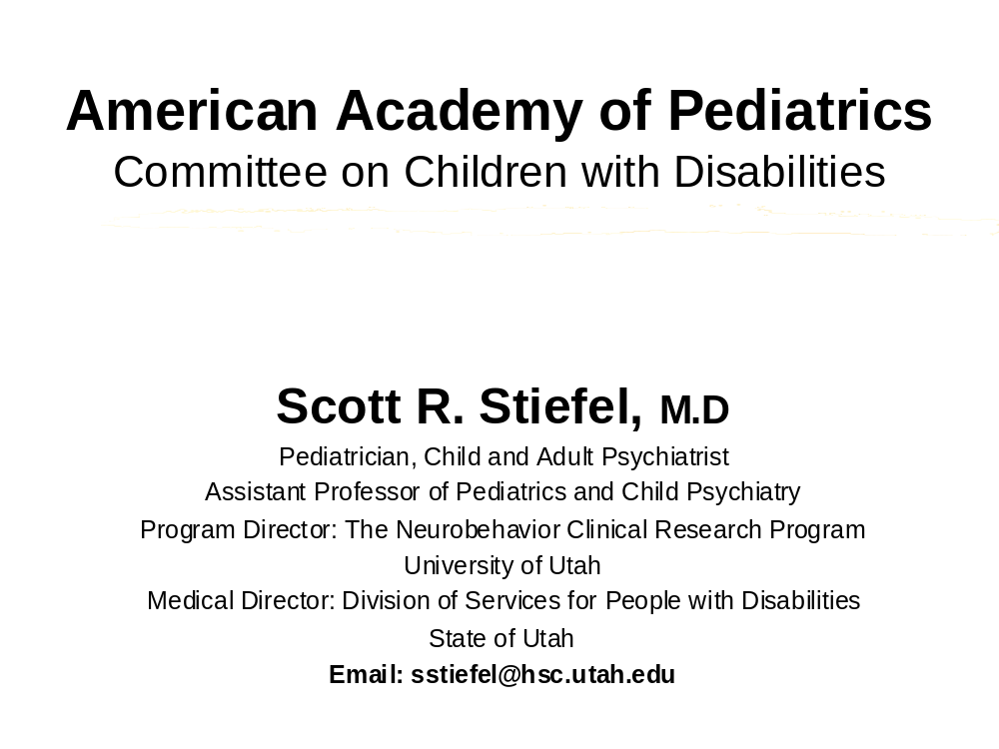

Slide 2
American Academy of Pediatrics
Committee on Children with Disabilities
Perspective on
The Use of Antimuscarinics for the Control of Drooling in Children with Cerebral Palsy and Other Neurologic Deficits

Slide 3
The Big Picture
We strongly support meaningful studies of all medications used in children, particularly vulnerable children with special needs
Indications for children without special needs are not always applicable to children with disabilities

Slide 4
In general, studies must address
Dosing
Delivery and formulation
Pharmacokinetics
Adverse effects, which must be presented in a developmental context.
In children with developmental disabilities a paradigm shift must be made.

Slide 5
Studies must also address
Subgroup differential response
Issues of polypharmacy
How to make choices between medications in same class
How to make choices between different therapies
Multiple ethical issues

Slide 6
This topic presents an unusual and complex set of issues
Efficacy of these agents in reducing saliva production and drooling is not the major issue - this is well documented.
A Zen like balance must exist between inhibition of saliva production and adverse effects.
The literature largely lacks scientific rigor and provides little comparison between intervention efficacy.
These children need complex pathological and adaptive function assessment. There are many etiologies and mechanisms which create subgroups.

Slide 7
Issues continued
There are no truly quantifiable measurement techniques.
        Sochaniwskj 82
There exists a general pessimism about pharmacological management.
        Arnold and Gross 77,Brody 77, Guerin 79, Bailey and Wadsworth 85, Crysdale 89
Many logistic and ethical issues are involved in the study of children with disabilities.
There are many issues regarding long term utility and effects on overall health.
We need clear definition of our outcome measures.
Issues surrounding polypharmacy

Slide 8
Long-standing anecdotal knowledge use of anticholinergics in pediatric populations
Infants and young children are especially susceptible to toxic effects.
There is a need for close supervision of infants and children with CP and other forms of brain damage when given these medications.
Increased response to anticholinergics has been consistently reported in children with disabilities and dosage adjustments are required.

Slide 9
ASSESSMENT
Anterior Drooling represents only one element in the continuum of oral performance impairment
Sialorrhea
Speech problems
Feeding and swallowing difficulties
Structural and motor problems
Upper respiratory congestion
Aspiration

Slide 10
Factors that need to be assessed to determine etiology
Degree of global functional impairment in the child’s life secondary to drooling
Amount of health care maintenance problems caused be drooling
Integrity of the oral structure
Oropharyngeal motor function
Orofacial sensory perception and feedback
* Rate of saliva secretion*
Cognitive appreciation of salivary spill
        Blasco 1992

Slide 11
Therapies
Hierarchical, least invasive first
Behavior Modification
Biofeedback
Oral Motor Therapy
Speech Therapy
Medication Therapy
Orofacial Regulation Therapy
Surgery
        Crysdale 1992, Nunn 2000

Slide 12
What does this population actually look like?
Cerebral Palsy 0.2 to 0.5% Lipkin 91
  10% to 37% have drooling problems significant enough to interfere with daily global function
        Ekedahl et.al. 74, Sochaniwskj 82, Blasco 92, Nunn 2000
Severe/Profound Mental Retardation 0.2% to 0.7%
  An unknown percentage of these children are further handicapped by drooling
        Harris and Purdy 87, Crysdale and White 89, Limbrock et al 90

Slide 13
The gap between incidence and prevalence of DD/MR is closing
This translates into increasing
Numbers of children
Complexity
Lifespans
Integration into our communities with increasing expectations

Slide 14
Increasing Complexity
Most of the children we see that need these agents have
CNS developmental problems or damage that translates into a developmental disability or mental retardation. In addition they have a combination of
  other chronic CNS illnesses such as Epilepsy or Movement Disorders
  multiple chronic general medical illnesses
  sensory or communication challenges
  co-morbid mental illness
  and severe behavior problems

Slide 15
These kids have
FRAGILE BRAINS

Slide 16
The average child referred to us
Is on 6 to 8 medications which have central nervous system activity - POLYPHARMACY
2 to 4 of these medications have significant additive anticholinergic activity
70% have 2 or more medical problems that contribute to their behavior presentation
1.5% to 5% are on drooling medications
        Stiefel et al (variation due to subgroups)

Slide 17
General medical issues related to the use of antimuscarinics
Dental - increased caries
Gastrointestional - constipation and worsening of gastroesophageal reflux
Pulmonary - increased problems with secretion clearing and pulmonary function
CNS - Irritability, agitation, sedation, hyperexcitability, confusion, decreased attention and concentration, decreased memory
Cardiac - increased heart rate
Impaired temperature regulation - decreased sweating
Genitourinary - retention
Sleep - impaired regulation and architecture
Psychiatric - the full spectrum of symptoms
        References available at sstiefel@hsc.utah.edu

Slide 18
How can adverse events be assessed in this population?
Adverse events often manifest as behavior changes or problems.
Assessment must first provide understanding of the child’s learning strategies or degree of cognitive disability.
We must first establish a relationship and shared communication strategy with the child. -Fension 93
We must objectively be able to assess pain and discomfort
        Giusiano et al. 95, Collignon et al. 95, McGrath 96
Studies must be of sufficient length to evaluate long term outcomes and adverse events - disease cycles

Slide 19
BEHAVIOR how do you quantitatively assess?
Behavior Equivalents
Symptom of pain or discomfort
Symptom of general medical condition
Symptom of mental illness
Symptom of side effect (iatrogenic)

Slide 20
Behavior Assessment and Rating Scales
All children in studies must have a
Multidisciplinary evaluation that includes a
  Medical evaluation
  Developmental analysis
  Functional analysis of behavior
  Use of rating scales to provide data and evidence of change
    ABC, Reiss, DBC, Auchenbach, Connors, etc.

Slide 21
Do not just study children with Cerebral Palsy without cognitive disability or language problems

Slide 22
Safe and ethical conduct of studies
This is a vulnerable population, it is our responsibility to protect - part of this responsibility is in demanding meaningful studies.
Need for multidisciplinary team assessment throughout the process. - Crysdale and White 89
Need for agreement of description of etiology, pathology and subgroups - this forms the database of a consortium. -Blasco and Allaire 92
  Including subgroup response patterns
  Must study population across the spectrum of etiologies and complexity

Slide 23
Safe and ethical conduct continued
Increased length of time of the study to address
  use of outcome based research tools
  general medical adverse effects take time to develop
  long term follow-up
  tolerance
Establishment and support for/of research and consortiums.
Consent and study subject selection issues.

Slide 24
Safe and ethical conduct continued
IRB’s should include individuals with expertise in disabilities and children
  Ethicists
  State/Local disability Human Services rights oversight
  Clinicians and multidisciplinary teams that are aware of the issues in this population and have the expertise to monitor for adverse events
It is critical to use independent assessors, not just caregivers
Always include the child, adolescent or young adult in the process

Slide 25
Other recommendations for studies
Need for consensus definition and assessment of significant impairment and etiology
Quantification of volumes
  Chin Dry System and the consortium, weighing bibs, etc.
  Rating tools and inter-rater reliability
        Sochaniwskj 82, Blasco 92, Teacher’s Drooling Scale, etc.
Consensus of other necessary measures and degree of impairment caused by drooling
Determination of subgroups with high likelihood of response

Slide 26
Other recommendations continued
Identify medications with good efficacy and good side effect/benefit ratios
Identify and support need for NIH,NIMH, etc. studies regarding therapy choice, drug choice in medications of the same class, and polypharmacy

Slide 27
Pediatric Formulations
Delivery
  oral forms, many of these children have swallowing difficulties
  transdermal - risk of chewing, rashes
  many safety issues
Pharmacokinetics
  absorption - quaternary amine 10 to 25%
  metabolism and clearance is different in children
  tolerance

Slide 28
Pediatric Formulations Continued
Blood-Brain Barrier
  many of these children have ongoing insults - the blood brain barrier is variably intact ( E.g.. Hydrocephalus, Epilepsy, Immune Disorders, Self Injurious Behavior, Traumatic Brain Injury, etc.)
Need for broad titration and dosage latitude
  usually addressed retrospectively
These medications should not be extemporaneously formulated
Issues of polypharmacy

Slide 29
Guidance for dosing and management on product labels
Discussion of
Adverse events
  Discussion that behavior changes may herald adverse effects
Subgroups are the most likely to respond
Additive polypharmacy
Chronic general medical and psychiatric problems
Possible tolerance cycle
    Camp-Bruno 89, Reddihough et al. 90
A conservative titration schedule

Slide 30
Discussion continued
Other therapies (a hierarchical approach)
Dental recommendations for surveillance and intervention - Arnup and Crossner 90, Hallet et al. 95
Interface with electronic management software - is there an opportunity?

Slide 31
Thank you for your kind attention and consideration of these recommendations

