Slide 1
FUEL CELL OPERATION ON LANDFILL GAS
R. J. Spiegel
For presentation at the EPA Fuel Cell Workshop
to be held in Cincinnati, Ohio on June 26-27, 2001
U.S. Environmental Protection Agency
National Risk Management Reseach Laboratory
Air Pollution Prevention and Control Division
Research Triangle Park, NC 27711

Slide 2
DEMONSTRATION OF FUEL CELLS TO RECOVER
ENERGY FROM WASTE METHANE GAS
Objective is to demonstrate that fuel cell energy recovery from waste
methane is economically and environmentally feasible.
Involves two field demonstrations using phosphoric acid fuel (PAFC)
power plants to produce electricity from landfill gas (LFG) and one
from anaerobic digester gas (ADG)
- EPA regulations require LGF collection and control equipment
- Wastewater treatment sludge is processed in anaerobic digesters
which produce waste methane
Major R&D Issue
- development of a waste methane gas treatment system that cleans the
gas suitable for fuel cell use

Slide 3
U.S. LANDFILL GASS EMISSIONS
Contribute 1-2% of total worldwide methane emissions
Produce 5-15% of atmospheric buildup of the last 10 years
Add about 1% to annual increase in radiative forcing or
(greenhouse effect)

Slide 4
LANDFILL GAS DEMONSTRATIONS
(Schedule of project events)
Penrose Power Station in Sun Valley, CA
- Conceptual design, cost, and evaluation study addressing
technical and economic issues
- Completed 1992
- Design, constuction, and testing of landfill gas pretreatment system
- Completed 1994
- Field test of the 200 kW phosphoric acid fuel cell
- Completed 1995
Groton, CT Landfill
- Moved equipment from Penrose and set-up gas pretreatment system
and fuel cell
- Completed 1996
- One year field test of fuel cell energy recovery system
- Completed 1997

Slide 5
POTENTIAL POWER THAT CAN BE PRODUCED
FROM FUEL CELLS AT U.S. LANDFILLS
Site Power Rating (kW)
<200
201-400
401-1000
1001-1500
1501-2000
2001-2500
2501-3000
>3000
Total
Number of Landfill Sites
3700
1100
1700
380
220
90
60
230
7480
Total Estimated Power
Output (MW)
220
330
1010
480
380
190
160
1600
4370

Slide 6
METHANE MITIGATION/RECOVERY
Modest methane emission reduction can result in large
reductions in the atmospheric rise
1-2 Tg annually of landfill methane are currently being
collected and used for energy or flared (converted to CO₂)
Recovery methods
- combustion combined with heat recovery
- conversion to electricity
- conversion to pipeline gas
- conversion to vehicular fuel

Slide 7
COMPARISON OF LANDFILL GAS AT PENROSE
AND GROTON LANDFILLS
Item
Gas Consumption
CH₄
CO₂
N₂
O₂
Higher
Heating Value
Contaminants
Total Halides (as CL)
Organic Sulfur (as H₂S)
Hydrogen Sulfide
Units
%
%
%
%
Kcal/SL
ppmV
ppmV
ppmV
Penrose (CA)
44.0
38.0
17.6
0.4
3.98
45 to 65
11
100
Groton (CT)
56.95
41.34
1.29
0.41
5.22
7 to 45
1
181

Slide 8
SOME TYPICAL RAW LANDFILL GAS CONTAMINATES
Raw Gas Concentration Level (ppm - by volume)
95
963
198
297
81
2
13
1
35
22
0.5
3
3
12
5
0.6
70
6
1.4
103
5
5
8
0.02
Landfill Gas Trace Contaminates
Hydrocarbons
Isobutane
Isopentane
n-Pentane
Hexane
Octane
Aromatics
Benzine
Ethylbensene
Chlorobenzene
Toluene
Xylenes
Styrene
Halogenated Hydrocarbons
Dichloroethene
Dichlorethane
Methylene Chloride
Cis-1, 2-Dichloroethane
Trichlorofluoroethane
Tricloroethylene
Tetrachlorethylene
Vinyl Chloride
Sulfides
Hydrogen Sulfide
Methyl Mercaptan
Ethyl Mercaptan
Dimethyl Sulfide
Dimethyl Disulfide

Slide 9
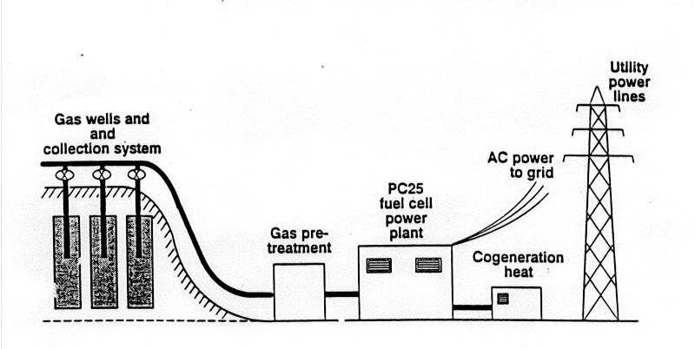
LANDFILL GAS DEMONSTRATION
Landfill Gas
Methane and NMOC mitigration
Low-Btu fuel
Heavily contaminated
Contaminant Removal
Remove sulfur and halides
Energy Conversion
Energy sold offsite
- operating revenue
- energy offset
- environmental benefit
Very low emissions at site

Slide 10
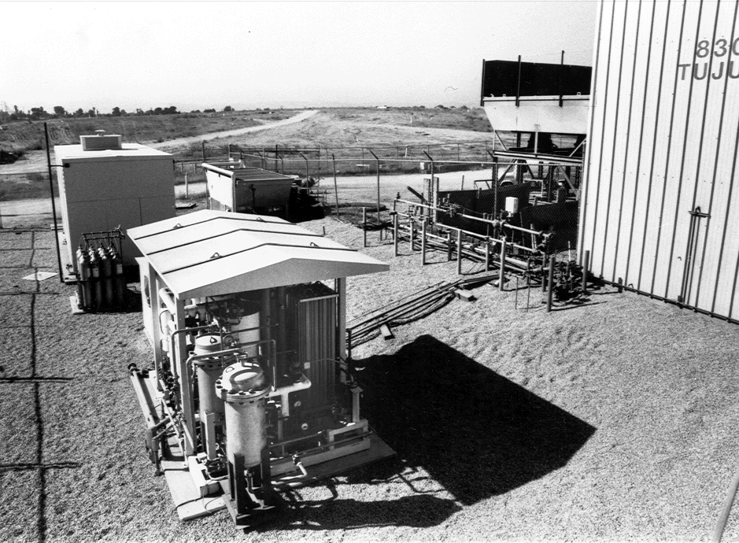
PENROSE LANDFILL

Slide 11
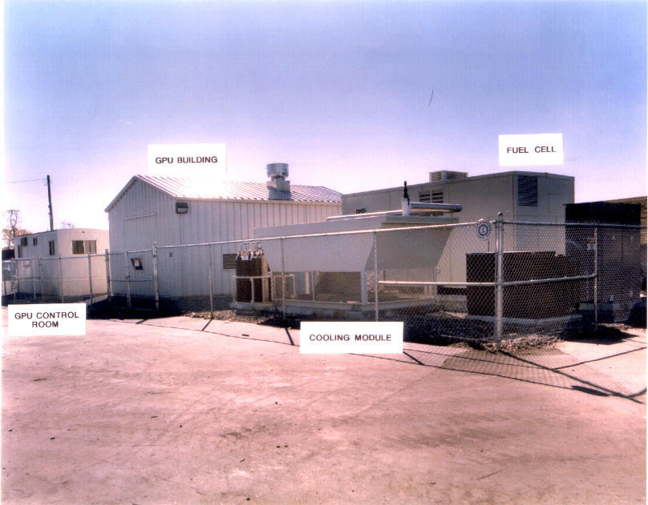
GROTON LANDFILL

Slide 12
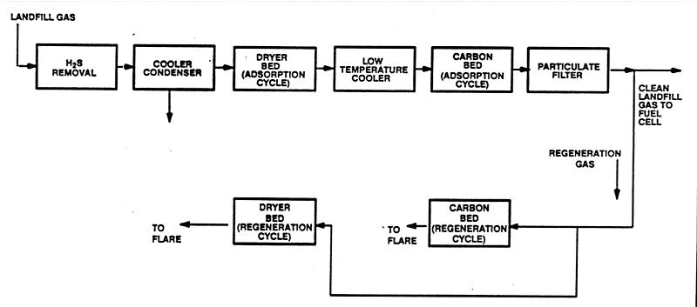
LANDFILL GAS CLEANUP SYSTEM

Slide 13
LANDFILL GAS CLEANUP SYSTEM
Unit tested at Penrose and Groton landfill sites
Component functions
- H₂S removal bed (nonregenerable)
- cooler/condenser to remove water and hydrocarbons
- dryer bed to remove water to -50⁰C dew point (regenerable)
- low temperature cooler to cool carbon bed
- carbon bed to remove sulfur and halogen compounds (regenerable)
- filter to remove particulates

Slide 14
TEST PROCEDURES FOR GAS PRETREATMENT UNIT
At specific times Tedlar bag samples were collected
at the inlet and outlet
Bag samples were analyzed off-site
- Gas chromatography/mass spectrometry (GC/MS)
analysis for the volatile organic compounds (VOCs)
- Gas chromatography/Flame photometric detedtion
(GC/FPD) analysis for sulfur compounds
Detection Limits
- GC/MS above 0.002 ppmV
- GC/FPD above 0.004 to 0.010 ppmV

Slide 15
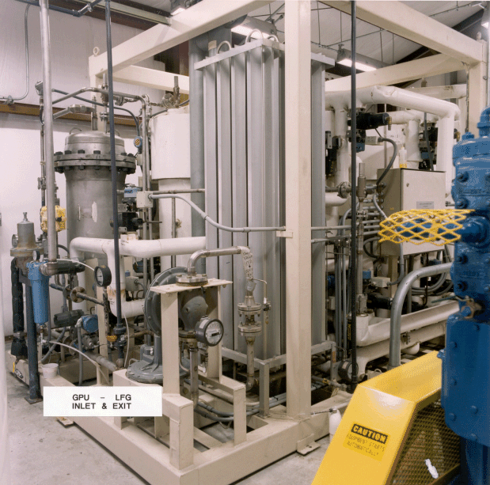
LANDFILL GAS CLEANUP SYSTEM

Slide 16
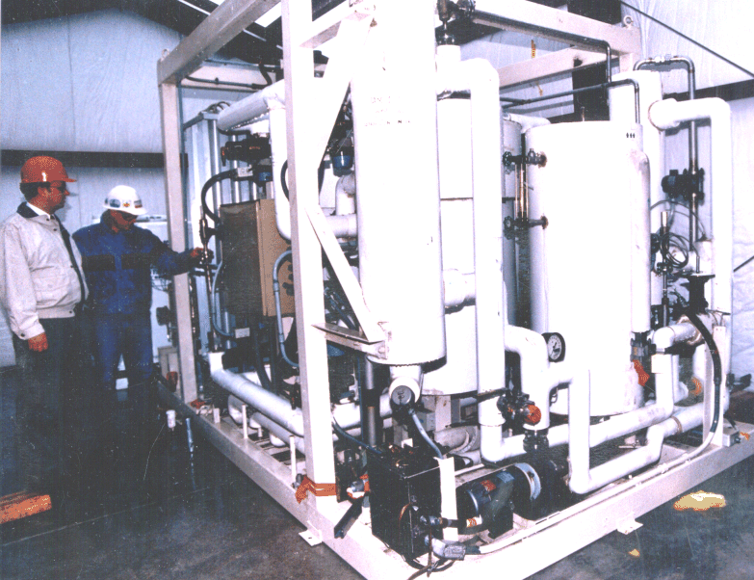
LANDFILL GAS CLEANUP SYSTEM

Slide 17
PERFORMANCE SUMMARY OF
LANDFILL GAS CLEANUP SYSTEM
Units
Penrose (CA)
Groton (CT)
Exit Total Sulfur (as H₂S)
Exit Total Halides (as Cl)
Flare Emissions:
1. NO_{X}
2. CO
3. NMOC
4. Destruction Efficiency
of Sulfur Compounds
5. Destruction efficiency
of VOCs
6. Particulate Matter
Total Duration of Operation
on Landfill Gas
Longest Continuous Run
Adjusted Availability
ppmv
ppmv
ppmv
ppmv
ppmv
%
%
grains/dscf
hours
hours
%
0.022
0.014
No data taken
4,168
827
45 (total)
70 (last 6 months)
0.047
0.032
7.5 to 14.9
1.6 to 5.8
6.8 to 11.7
>99
>99
0.013
2,297
342
87.3

Slide 18
SUMMARY OF FUEL CELL PERFORMANCE
Maximum Power Output
Stable Power Output
Efficency at Stable Output
Total Duration of Output
Adjusted Availability
Exhaust Emissions:
SO₂
NO_{x}
CO
Units
kW
kW
%
hours
%
ppmV
ppmV
ppmV
Penrose
137
120
36.5
707
98.5
<0.23
0.12
0.77
Groton (CT)
165
140
38.0
3,313
96.5
No data taken

Slide 19
CONCLUSIONS
Large potential landfill gas market, but economically difficult
- Environmental regulations may “push” market
Fuel cells are capable of being sited in NO_{X} and CO nonattainment areas
No major technical hurdles
- Commercial fuel cell technology available
- Gas clean-up system works well

