Slide 1

Tevatron Progress:
Operational, Instabilities, and Diagnostics Update
Fermilab Seminar
April 29, 2003
Mike Martens -- Operational
C. Y. Tan -- Instabilities
Jim Steimel -- Diagnostics

Slide 2
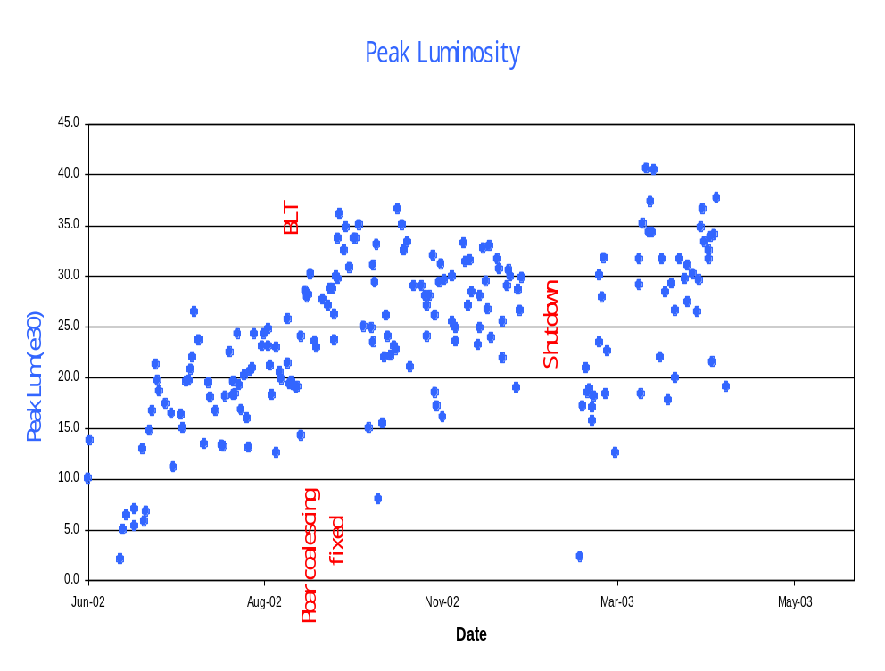
Luminosity Since June 2002
151 HEP stores
160 pb⁻¹ to each detector
Increase in luminosity from 15e30 to 40.5e30
Run I record of 25.0e30 broken on 7/26/2002
Run II record of 40.5e30 set on 3/20/2003

Slide 3
Goals and Current Performance
Current FY03
Parameter Status Goal
Typical Luminosity 3.5e31 6.6e31 cm⁻²sec⁻¹
Integrated Luminosity 6.0 12.0 pb⁻¹/week
Protons/bunch 200e9 240e9
Antiprotons/bunch 22e9 31e9
Higher intensity ⇒ Fundamental physics limitations
  Beam-Beam Effects
  Instabilities
  Beam Halo and Lifetimes
Understanding/Solving these issues requires …
  Stable Tevatron Lattice
  Diagnostics
  Study Time

Slide 4
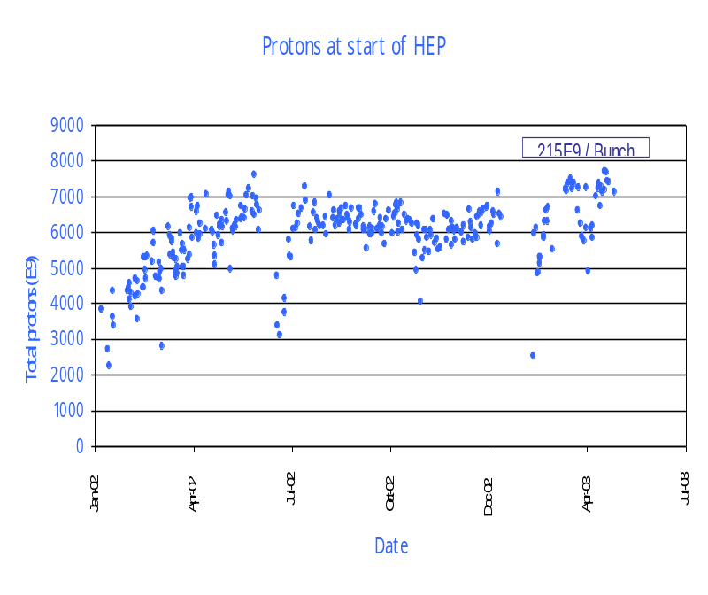
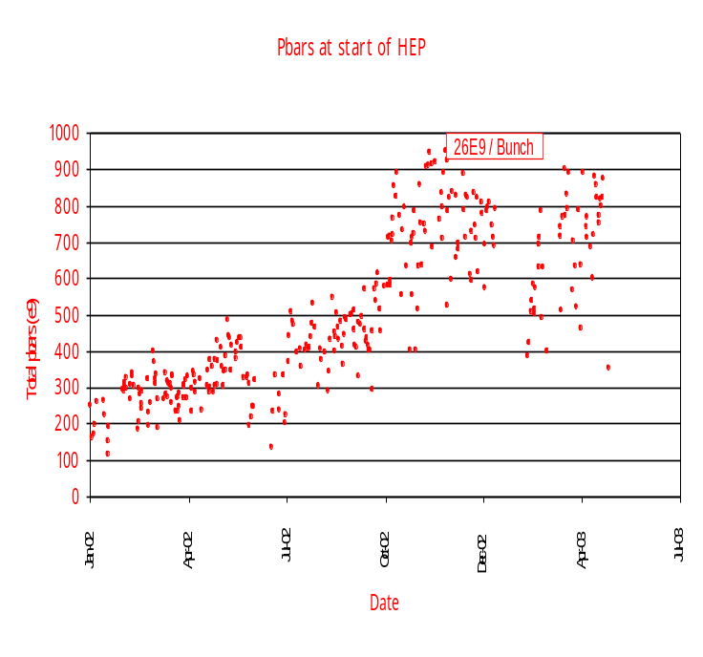
Beam Intensities
Number of protons
Mostly steady
in the 200e9 range
Number of antiprotons
Increase factor of 2.5 Oct ⇒ March
from 9e9 ⇒ 22e9 per bunch

Slide 5
Tevatron Emittance
General comments on emittance blow-up from Flying Wire measurement**
(95%, normalized emittances):
< 1π - 2π at proton injection
~ 5π - 6π at pbar injection
< (negative) 2π - 3π protons at 150 (scraping)
~ (negative) 0π -3π pbars at 150 (scraping)
4π -7π blowup on ramp (prots and pbars)
occasional instability, 5π – 50π, at 980 Gev
** There remains uncertainty of FW emittance measurements. (See later slides)

Slide 6
Reasons for L-progress Since Jun’02
“Shot lattice” AA x 1.40
Pbar emittance at injection Tev/Lines x 1.20
Pbar coalescing improvement MI x 1.15
Shoot from larger stacks x 1.10
Improved Tev Pbar efficiency x 1.10
More Protons at Low Beta x 1.10
total x 3.3
….plus additional improvements in the Tevatron:
Tunes/coupling/chromaticities at 150/ramp/LB
Orbit smoothing
Longitudinal dampers to stop σ_{s} blowup
Transverse dampers improves 150 Gev lifetime
F11 vacuum

Slide 7
Tune/coupling/chromaticity/orbits
Tune up is essential for consistent operations …
  Much effort during “Studies Periods” is actually maintenance (orbit smoothing and tune/coupling/chromaticity adjustments)
… and for understanding more complicated physics
  Beam-beam effects, instabilities and dampers, beam lifetimes, beam halo rates, etc. are more difficult to understand when machine parameters drifting.
Some troubles:
  Tune/coupling drifts at 150 Gev. (Now compensated.)
  Tune/coupling snapback on the ramp. (Now compensated.)
  Chromaticity snapback? (Was measured. Is OK.)
  Orbit drifts. (Started BPM and smoothing improvements)

Slide 8
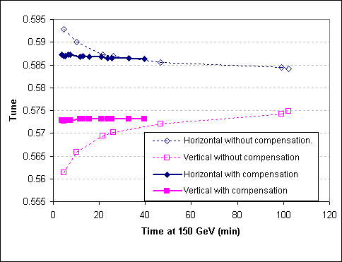
Tune Drift @ 150 Gev
M.Martens, J.Annala

Slide 9
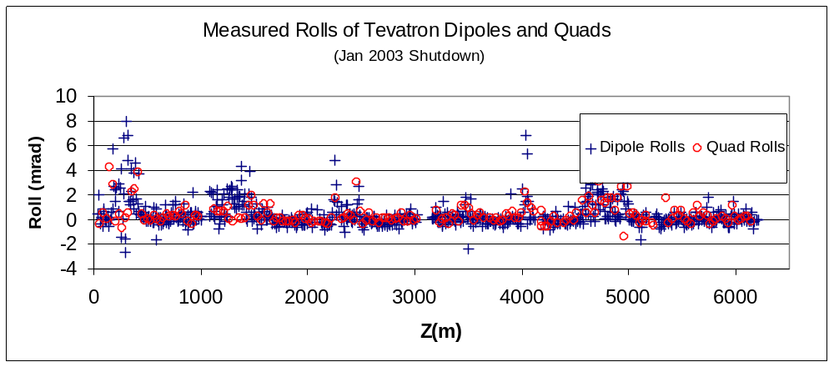
Tevatron Magnet Alignment
Measured rolls of dipoles and quads during Jan 2003 shutdown.
Used “portable tilt-meter” for quick measurements
Data roughly consistent with vertical dipole corrector strengths
Dipoles rolled 4 mrad gives ~0.5 mm “scalloped” vert orbit
Coupling from one quad rolled 4 mrad gives min tune split ~0.0025

Slide 10
Beam-beam Interaction As Major Factor
Pbar transfer efficiency strongly depends on N_p, helix separation, orbits, tunes, coupling, chromaticity and beam emittances at injection
Summary of progress with beam-beam since March 2002:
Mar’02 * Oct’02 ** Jan’03 ***
Protons/bunch 140e9 170e9 180e9
Pbar loss at 150 GeV 20% 9% 4%
Pbar loss on ramp 14% 8% 12%
Pbar loss in squeeze 22% 5% 3%
Tev efficiency Inj→low beta 54% 75% 75%
Efficiency AA→low beta 32% 60% 62%
* average in stores #1120-1128 ** average in stores #1832-1845
*** average in stores #2114-2153 (9 stores)

Slide 11
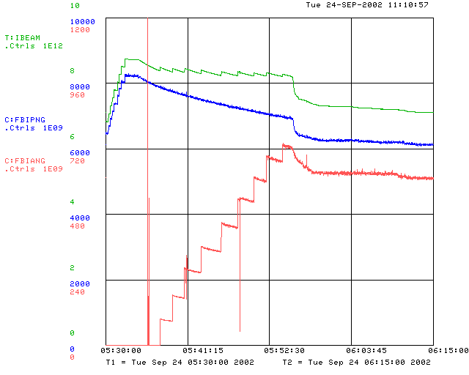
Tevatron Efficiencies
Open helix
ramp
proton
injections
poor lifetimes
≈10% bunched
beam loss in ramp
and squeeze
pbar
injections

Slide 12
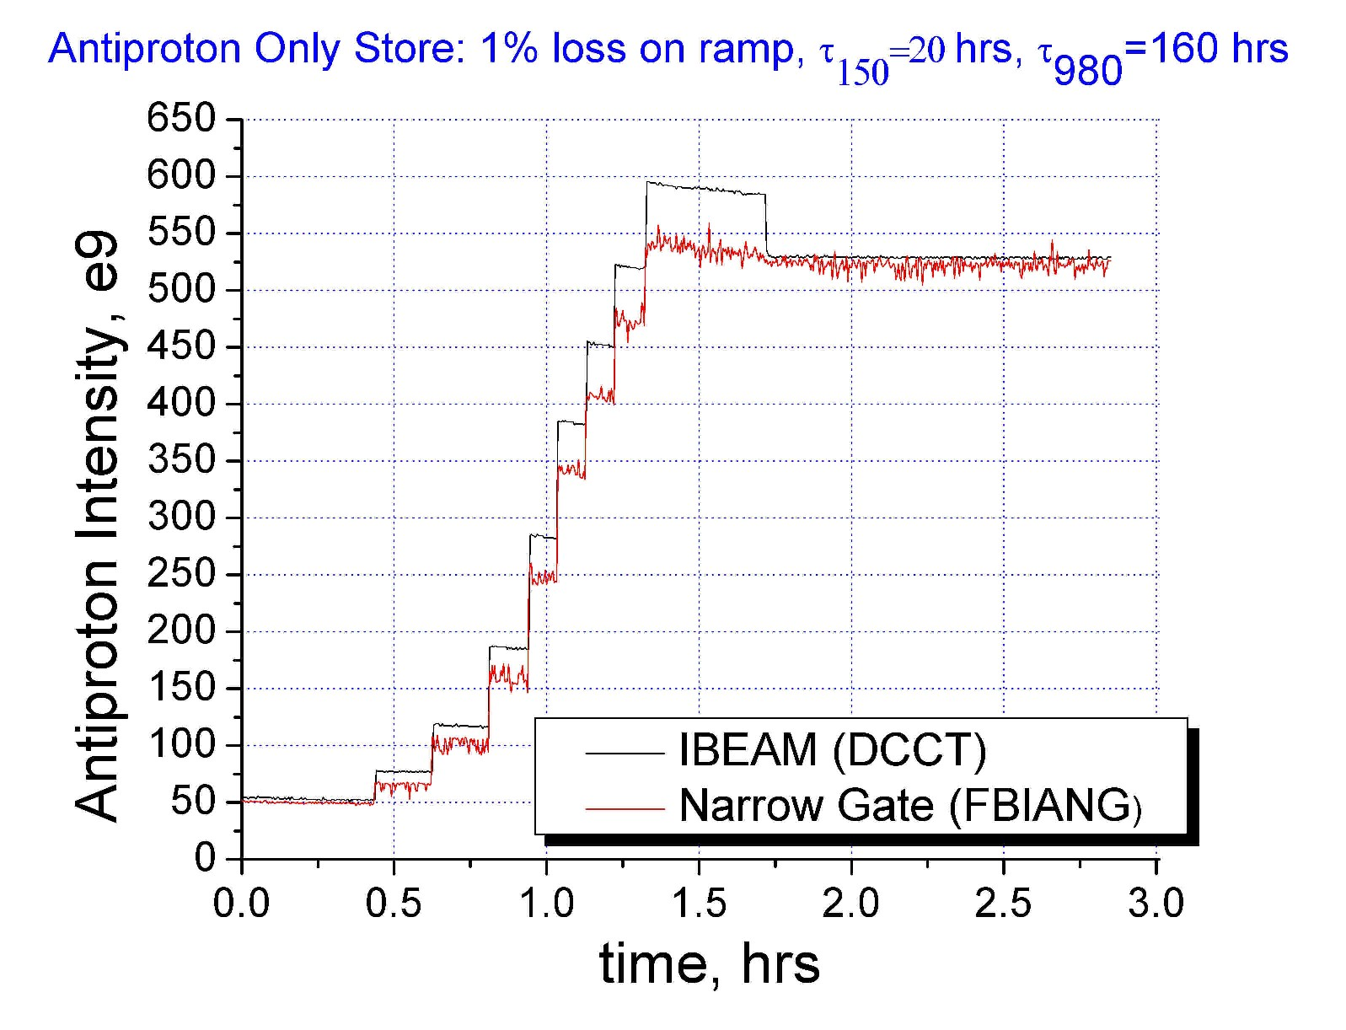
Beam-beam Effects: Pbar Only
8% loss on ramp – DC beam (depends on MI tuneup)

Slide 13
Lifetime Issues at 150 Gev
Poor Pbar lifetime at 150 Gev
  Depends on emittances, N_{p}, ξ, and bunch number
  Lifetime ~ 0.5-1.0 hrs => ~3 hours
  Original injection helix has been modified, separation increased and optimized to fit tight C0 aperture (“new-new helix”)
  Replace lambertsons @ C0 – gain 25 mm vertically
Poor proton lifetime on helix
  depends on chromaticity
  Instability prevented lower chromaticity (now 8)
  Dampers now allow us to lower chromaticity
  Lifetime ~2 hours => ~ 3-4 hours (on a good day)

Slide 14
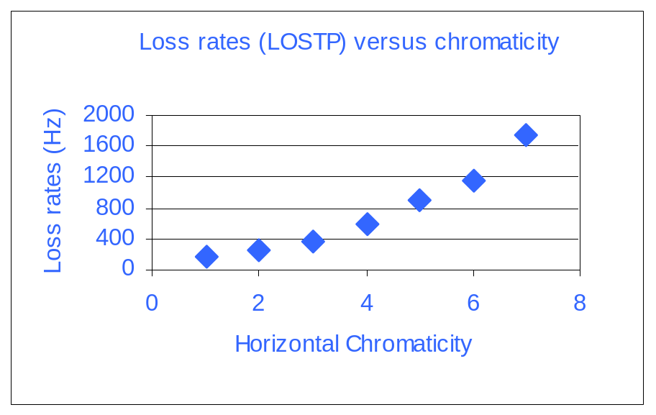
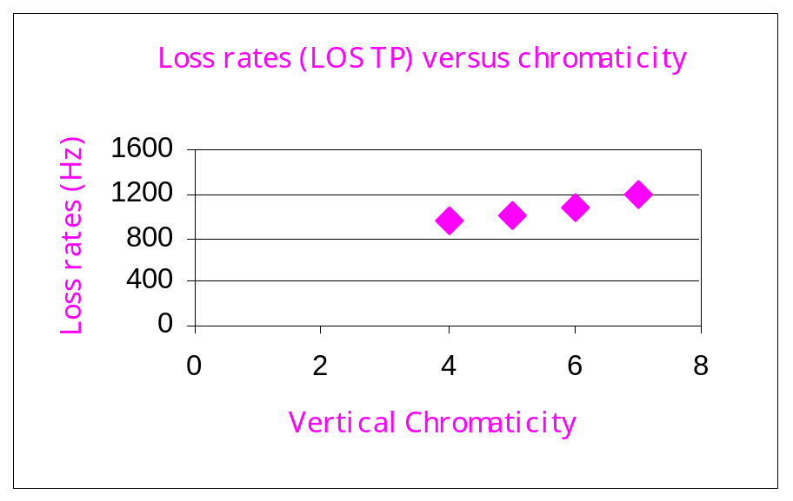
Lifetime and Chromaticity at 150 Gev
Measured loss rates as function of chromaticity
(with protons on the pbar helix)
Lower chromaticity is better for lifetime
Instabilities appear ξ < 3-4
Run with ξ_{H} = 8, ξ_{V}=8 to avoid instabilities
Dampers allow us to lower chromaticity and improve lifetime

Slide 15
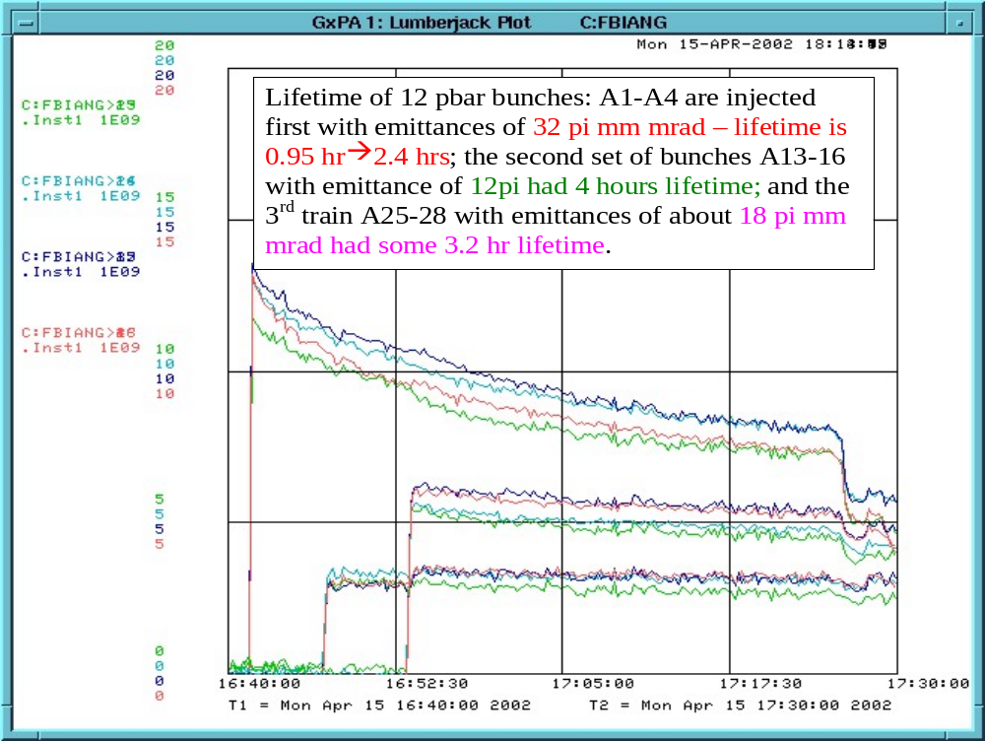
Beam-beam @ Injection Vs Emittance
M.Martens

Slide 16
Attacking the Beam-beam Effects
Smaller emittances from AA (“AA shot lattice” )
Reduced injection errors
  Beam Line Tuner
Better control of orbits / tunes / coupling
  Tunes up the ramp
  Tune and coupling drift at 150 Gev
  Orbit smoothing
Larger injection helix
  C0 Lambertson replacement
  New Separator settings

Slide 17
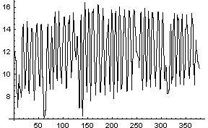
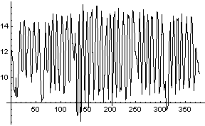
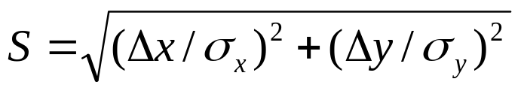
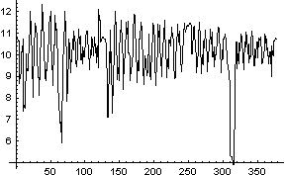
Helix Improvement
current helix
Diagonal separation S
Current helix
Proposed helix
Distance from B0
Distance from B0
Aperture limitation at C0
Increasing proton/pbar helix separation
  Replace C0 Lambertson with MI magnets
  Increase vertical aperture at C0 from ~15mm -> 40 mm (but only ~30% larger helix due to other aperture limitations.)
  Modify helix to increase min separation, S_{min}, from 5.5 to 6.6
proposed helix
old helix opened vertically 130%
old helix opened vertically 130%

Slide 18
January 2003 Shutdown
C0 Lambertson Replacement
  Increases aperture at C0
  Leads to increased proton/antiproton helical orbit separation.
Schottky monitor
  Measure chromaticity non-destructively
  Measure tunes of individual bunches
CDF Shielding
  Add steel around low beta quads.
  Should reduce backgrounds in muon chambers by factor of 5.
New TEL electron gun.
  Gaussian shaped emittance of electron beam
Alignment Work

Slide 19
Tevatron Projects in FY’03
Priority
project
Leader
Date
N_P
N_A
emm
1
Transverse dampers
Steimel
Nov’02

1
Pbar emittance at injection: BLT,A1 line, inj.damper
Scarpine Lebedev
Steimel
Nov’02
Dec’02
Feb’03







1
C0 Lambertson replacement
Garbincius
Feb’03

1
Tev Lattice (A0)
Martens
Feb’03

1
Daily operations
TeV coord
daily



1
Operational orbit smoothing
Martens
Dec’02


1
Beam-beam studies and calculations
Sen
Sep’03




Slide 20
Tevatron Projects in FY’03 (Cont’d)
Priority
2
Instability studies
Ivanov
Dec’02


2
150 GeV tunecoupling drift compns; b2 unwind
Martens
Oct’02

2
TEL
Shiltsev
Feb’03


2
Schottky detector at E17
Pasquinelli
Feb’03

2
Tevatron alignment
Stefansky
Mar’03

2
Longitudinal dampers
Steimel
Apr’03

3
Tevatron vacuum
Hanna
Feb’03


3
Losses/collimators
Moore
Feb’03

3
DC Beam/RF noise
Lebedev
Apr’03

3
SBD/FBI/FW (BPMs)
Pordes
Dec’02



3
SynchLite
Cheung
Dec’02



3
Chromaticity measurement
Still
Dec’02

3
Orbit motion spectrometer
Zhang
Dec’02


3
Pbar tunemeter, feedback
Tan
Mar’03


