Slide 1
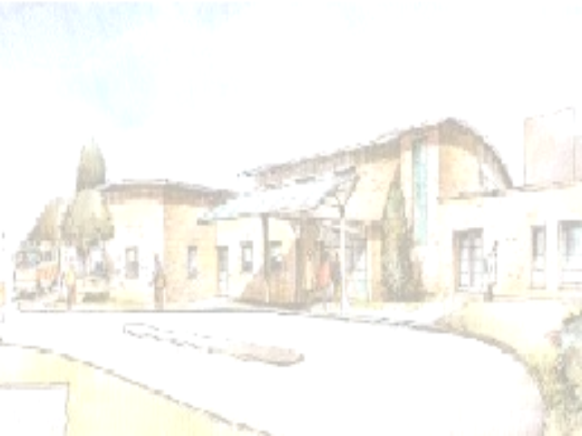
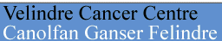
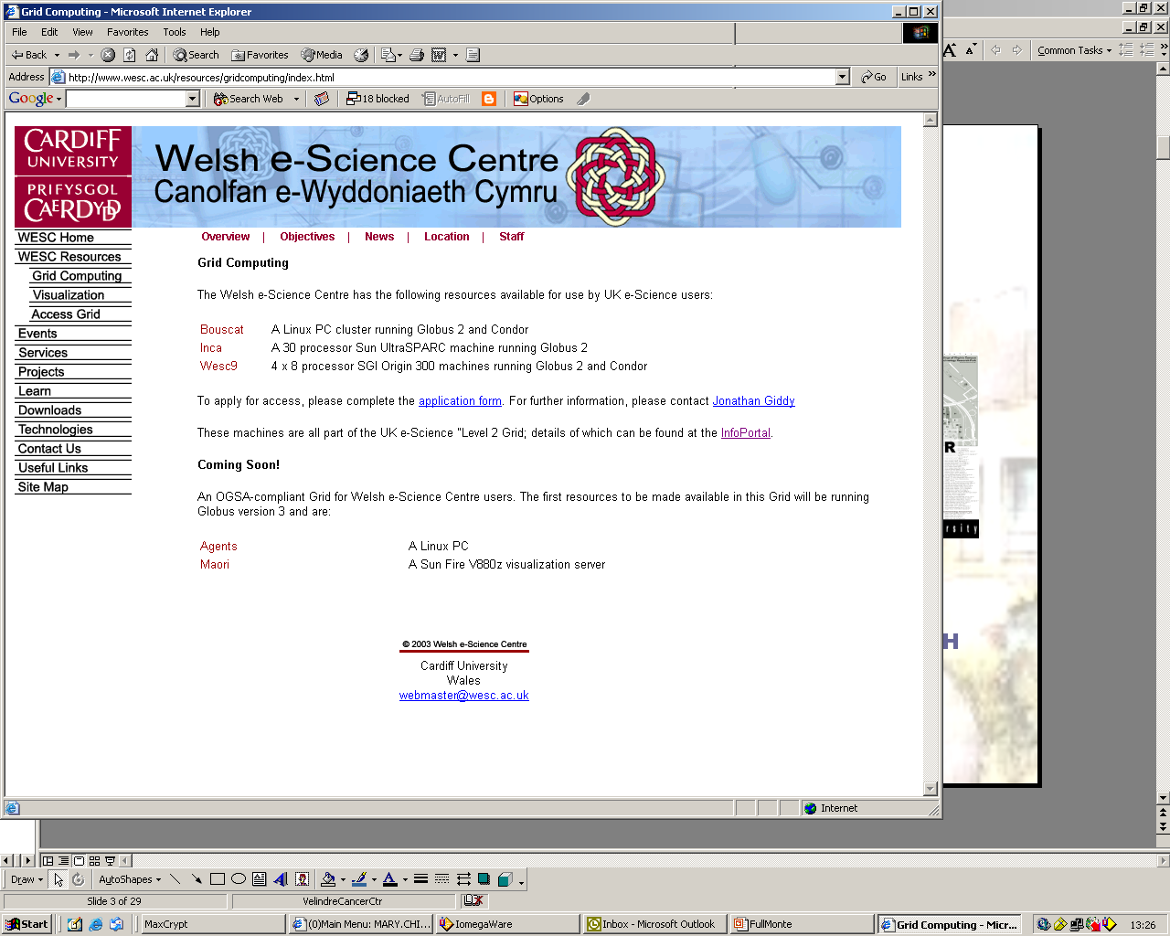
A MONTE CARLO SOLUTION
FOR EXTERNAL BEAM PHOTON
RADIOTHERAPY VERIFICATION
PW CHIN¹, DG LEWIS¹ & J GIDDY²
¹
²
mary.chin@physics.org

Slide 2
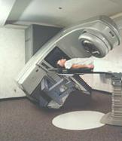
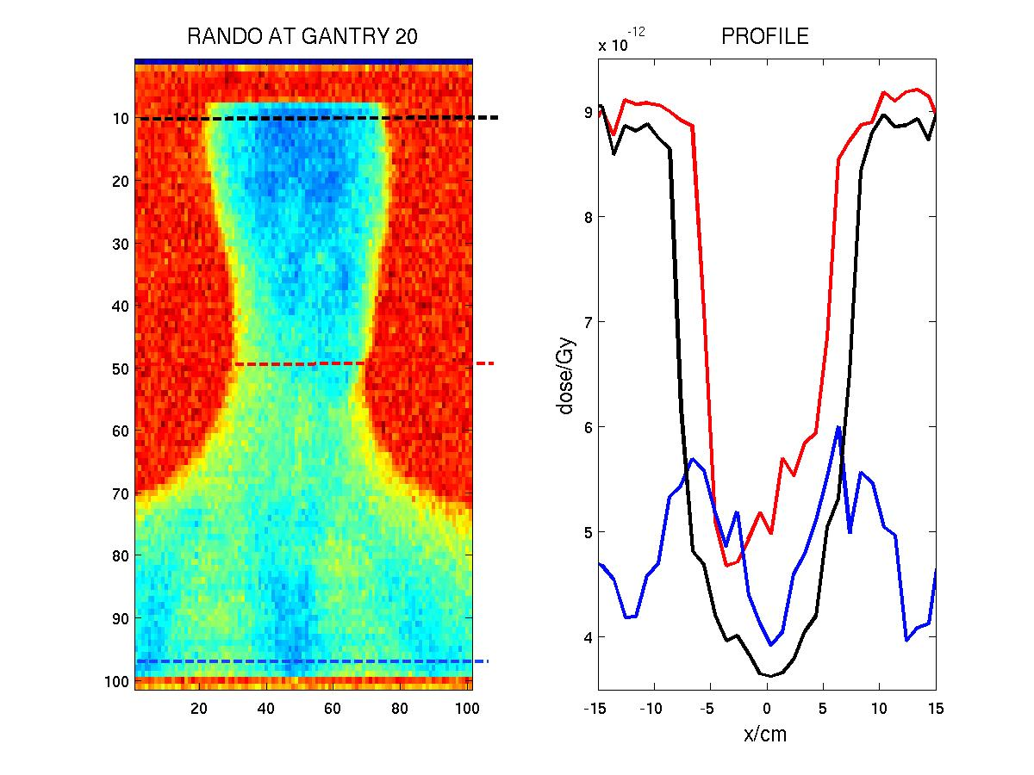
RADIOTHERAPY: how it works
gantry can be rotated to get oblique beams
linear
accelerator
radiation
cancer cells get killed
imager
to check treatment,
no diagnostic purpose
portal image
Notes:
A quick introduction. That’s the medical linac. That’s the gantry. That’s the imager. That’s the portal image for checking treatment. Why is it so important to check the treatment? Because many things can go wrong!

Slide 3
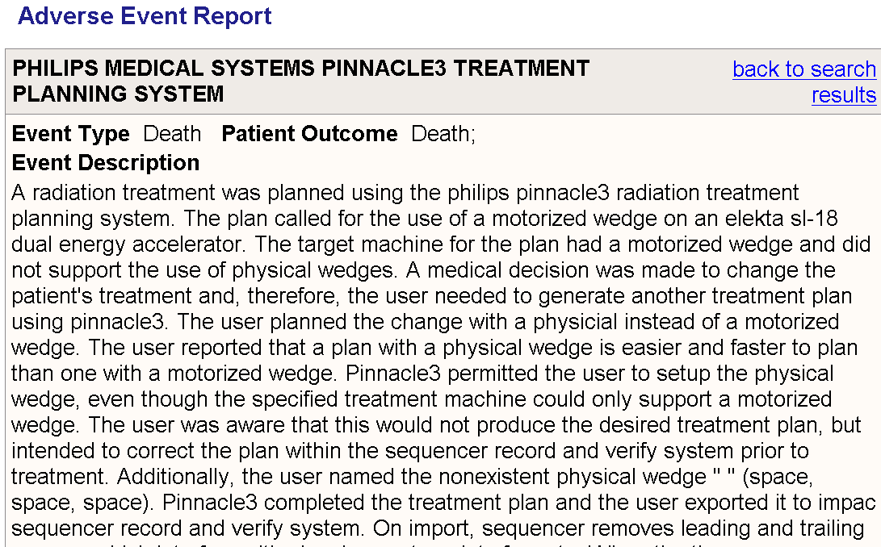
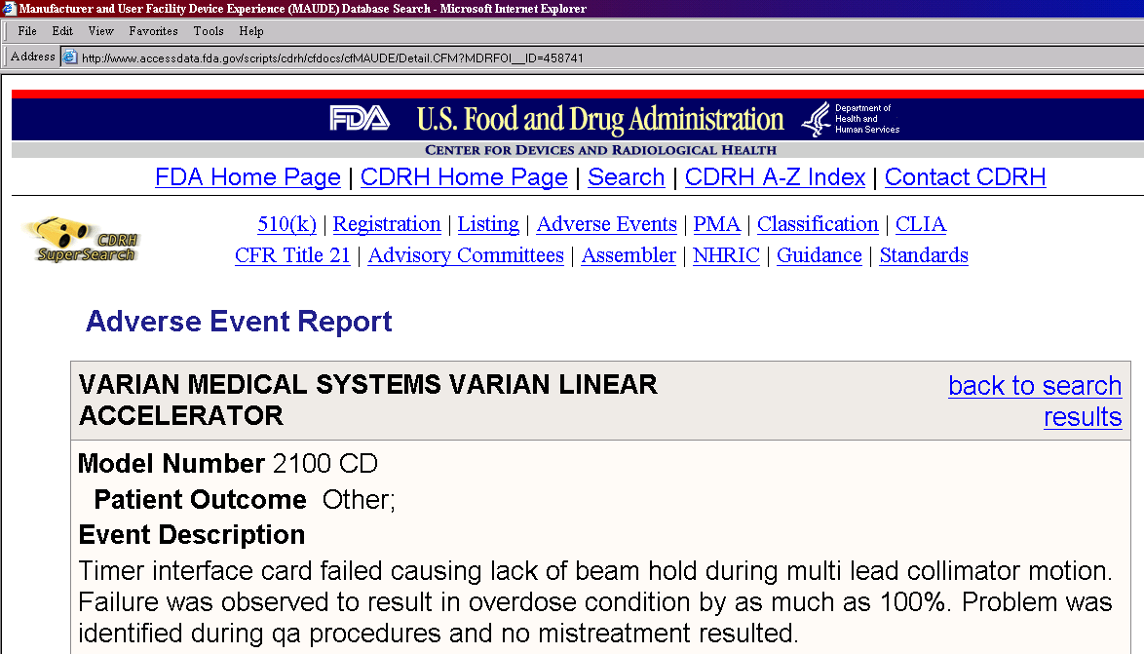
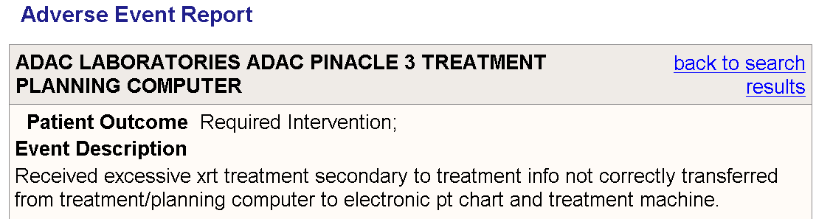
MANY THINGS CAN GO WRONG…
SOME HORROR STORIES
Notes:
Here are some reports from the FDA website: a 100% overdose, info not correctly transferred. It can be as serious as causing death.

Slide 4
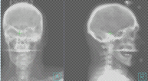
THERAPY VERIFICATION
DOSIMETRIC
GEOMETRIC
hitting the right area?
giving the right dose?
Notes:
To prevent all these from happening, we need both geometric and dosimetric verification.

Slide 5
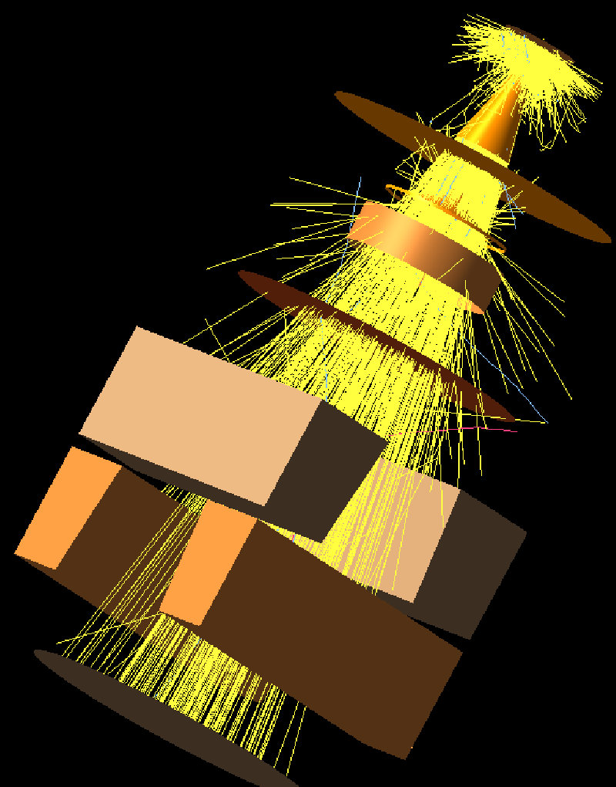
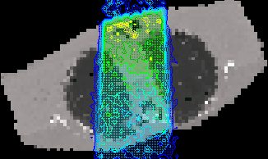
MONTE CARLO SIMULATIONS
BEAMnrc
DOSXYZnrc
polystyrene
air
rohacell (foam)
iso-octane
pmma/glass (pcb)
plastoferrite
Notes:
To verify the treatments, we use MC simulations. The linac is simulated using BEAMnrc. The patient and the imager are simulated using DOSXYZnrc.

Slide 6
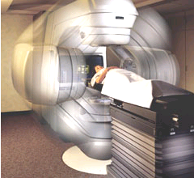
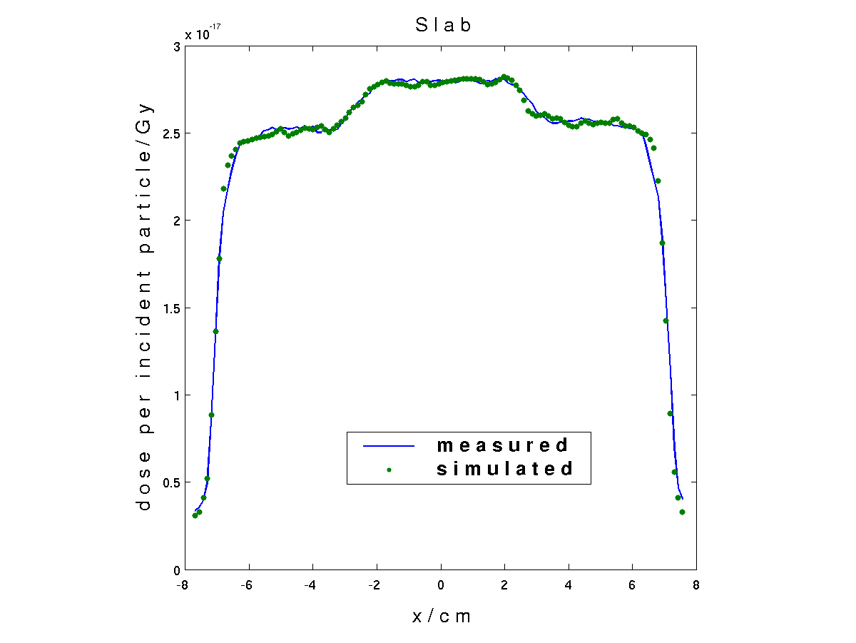
MONTE CARLO PORTAL DOSIMETRY
MEASURED IMAGE
SIMULATION GEOMETRY
bulging effect correction³
(SLIC EPID)
.egsphant
off-axis calibration¹
.egsphsp1
TWIZ&GLU²
grayscale to dose mapping¹
DOSXYZnrc
¹Spezi & Lewis 2003 PMB 47(3) ²Chin et al 2003 PMB 48(16)
³Chin et al 2004 PMB 49(8)
additional requirements for oblique beams
Notes:
Here is the verification chain. The meaasured image is put thru a series of calibrations so that dose info may be derived from it. An identical geometry is simulated using phantom specification and source input files. Dose profiles on the two images can then be compared. If there is a disagreement, that means the beam has not been delivered as planned. Oblique beams require 2 extra steps.

Slide 7
DEMONSTRATIONS
BEAM / FIELD SIZE
PATIENT – IMAGER DISTANCE
SOURCE – PATIENT DISTANCE
GANTRY ANGLE
Notes:
Next, I will demonstrate MC portal dose prediction under a wide range of known clinical ranges. Different … different …

Slide 8
VARYING FIELD SIZE
PERSPEX
IMAGER
Notes:
First, we look at portal dose predicting for varying field sizes.

Slide 9
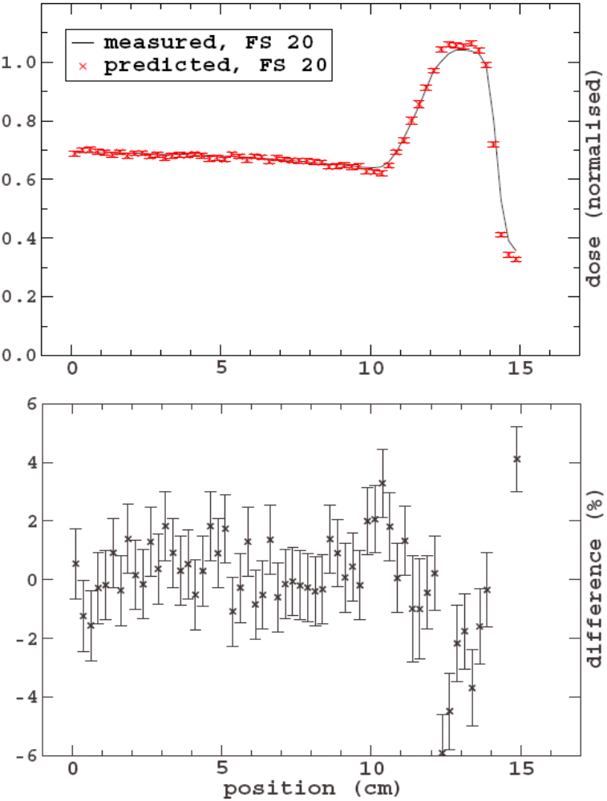
PERSPEX
IMAGER

Slide 10
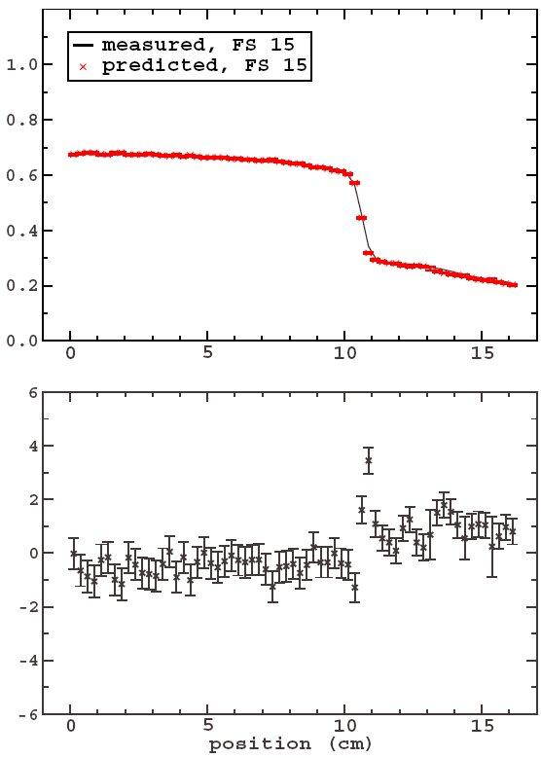
PERSPEX
IMAGER

Slide 11
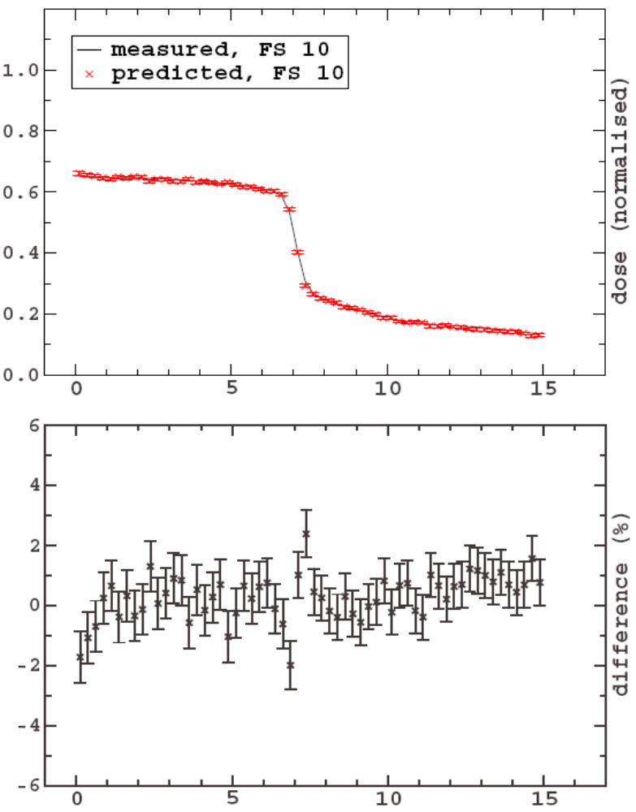
PERSPEX
IMAGER

Slide 12
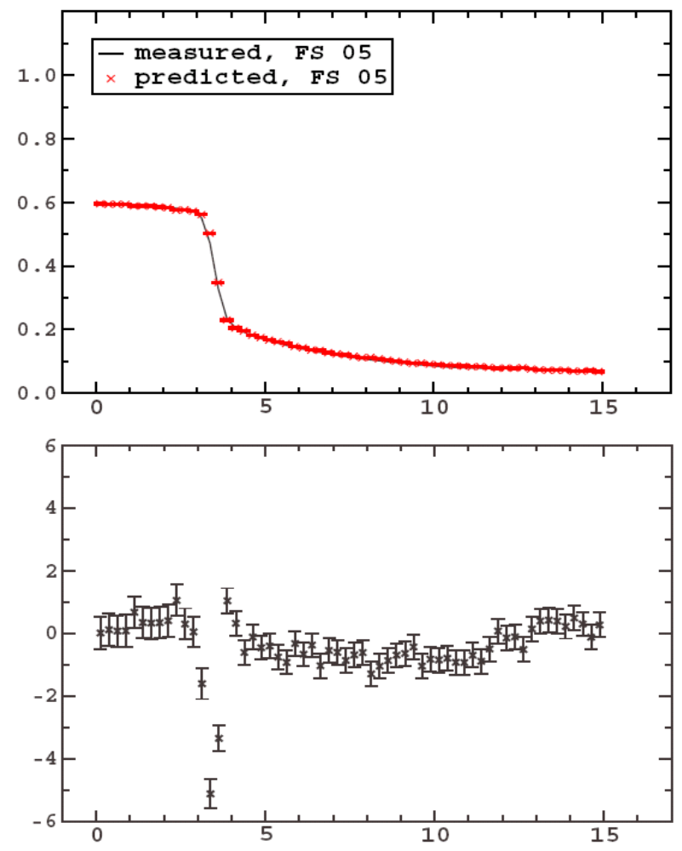
PERSPEX
IMAGER

Slide 13
VARYING AIR-GAP DISTANCE
INHOMOGENEOUS PHANTOM
INHOMOGENEOUS PHANTOM
INHOMOGENEOUS PHANTOM
IMAGER

Slide 14
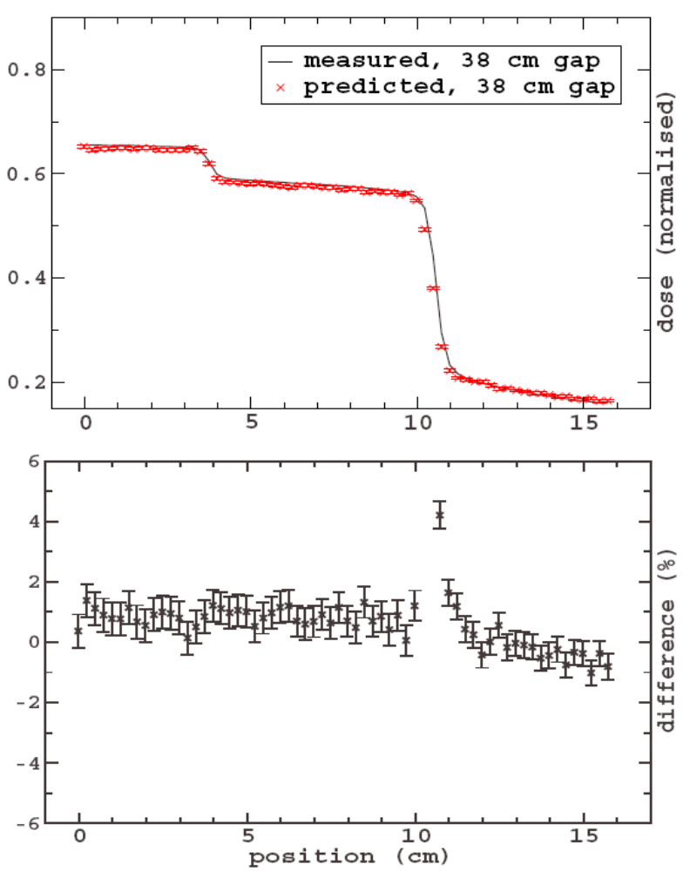
PERSPEX
AIR
IMAGER

Slide 15
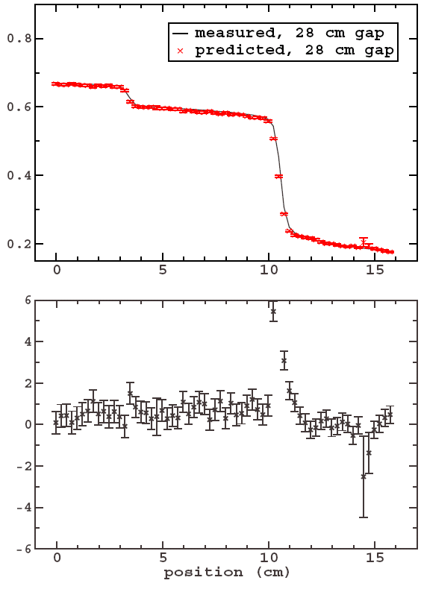
PERSPEX
AIR
IMAGER

Slide 16
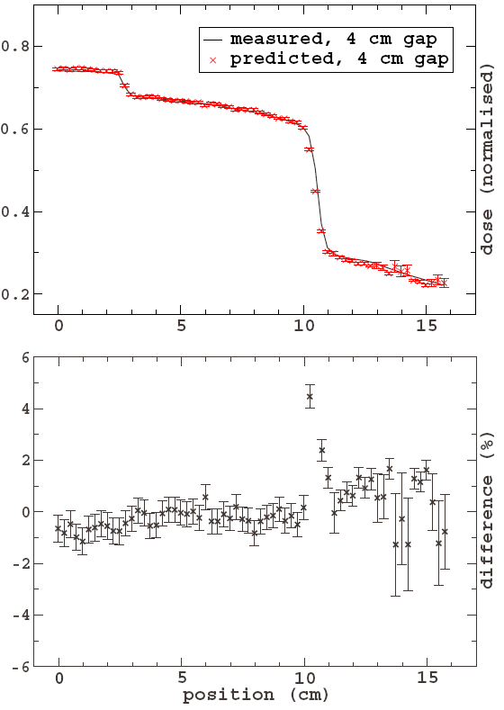
PERSPEX
AIR
IMAGER
Such are the conditions where convolution/ superposition methods fail
Notes:
… This is strength of MC. …

Slide 17
VARYING GANTRY ANGLES
Notes:
Next, we look at portal dose prediction at …

Slide 18
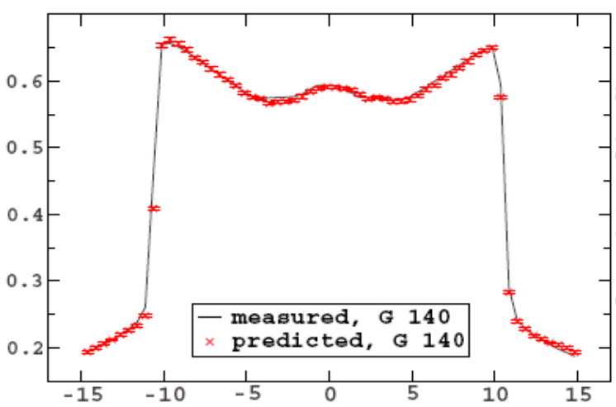
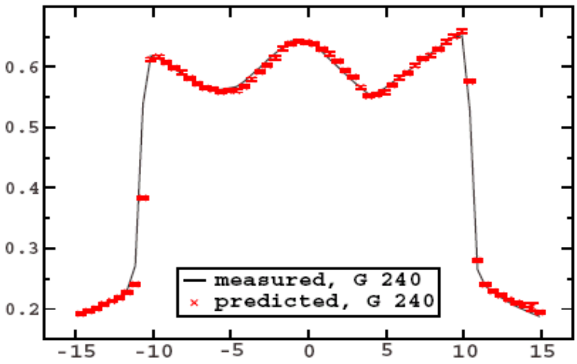
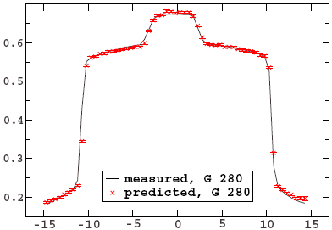
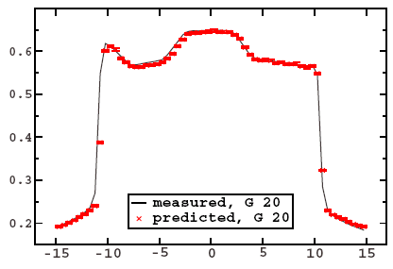
PERSPEX
AIR
Notes:
… Agreement was consistently within 2% / 2mm.

Slide 19
DETECTOR STUDIES

Slide 20
liquid ion chamber detector
POLYSTYRENE
AIR
FR4 (PCB)
converts photons to electrons
ROHACELL
(FOAM)
PLASTOFERRITE
CONVERTER
FR4 (PCB)
ISO-OCTANE
DETECTOR
FR4 (PCB)
detects ionisation for image formation
ROHACELL
(FOAM)
FR4 (PCB)

Slide 21
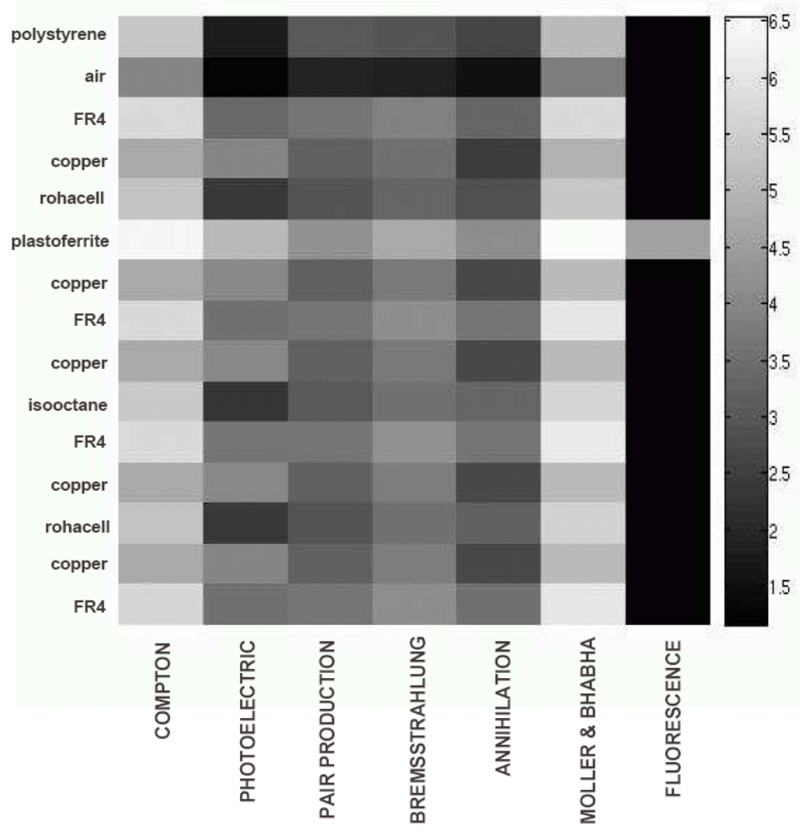
SLIC
CONVERTER
Z=38
DETECTOR
Notes:
This shows the event count for each interaction in each layer of each detector. The brighter the grayscale the higher the event count.

Slide 22
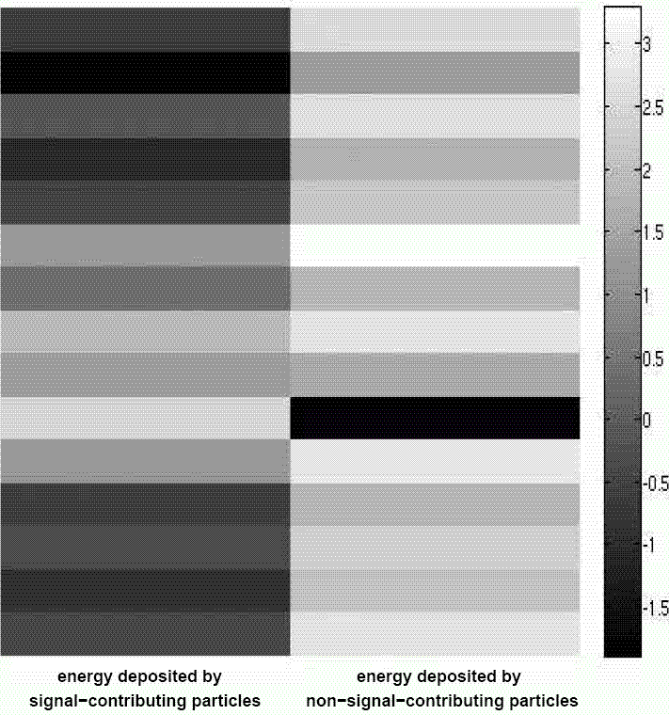
SLIC
mix them all up!
buildup / converter
mask low-E scatter
keep main backscatter contributor
low contribution
waste lots of time
design simplified models

Slide 23
ORIGINAL MODEL
POLYSTYRENE
AIR
FR4 (PCB)
ROHACELL
(FOAM)
PLASTOFERRITE
FR4 (PCB)
ISO-OCTANE
FR4 (PCB)
ROHACELL
(FOAM)
FR4 (PCB)

Slide 24
SIMPLIFIED MODELS
SPECIAL MATERIAL
RUN TIME HALVED
PLASTOFERRITE
ISO-OCTANE
FR4 (PCB)

Slide 25
COMPARISON WITH OTHER TECHNIQUES
vs

Slide 26
MOST PORTAL DOSE PREDICTION TECHNIQUES ASSUME
=
AMORPHOUS SILICON DETECTOR
WATER SLAB
What is the implication?

Slide 27
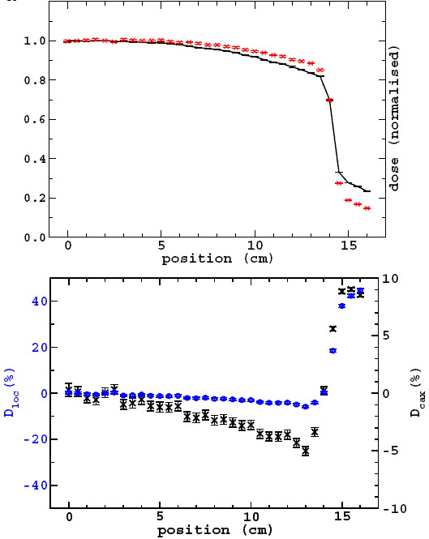
PHANTOM / PATIENT
IN BEAM (on-treatment verification)
water slab
amorphous silicon detector model
point-to-point difference
difference wrt CAX

Slide 28
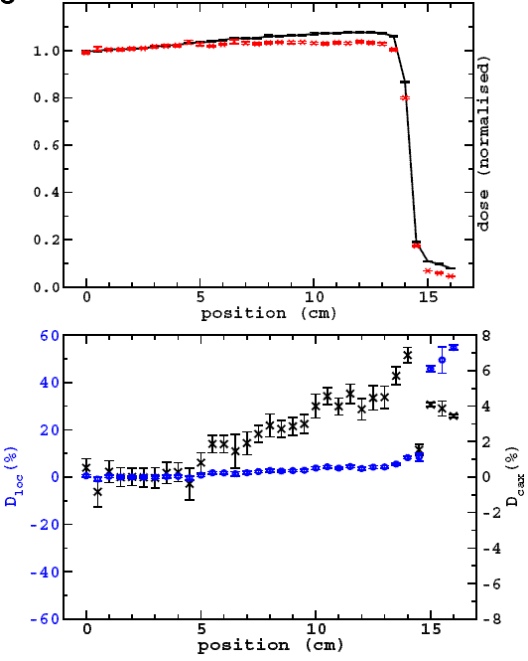
amorphous silicon detector model
NO PHANTOM / PATIENT
IN BEAM (pre-treatment verification)
water slab

Slide 29
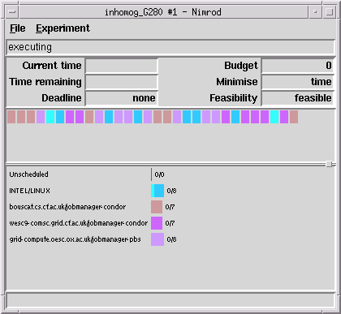
HIGH THROUGHPUT COMPUTING
“CLUSTER OF CLUSTERS”
WELSH e-SCIENCE
OXFORD
MANCHESTER
LEEDS

Slide 30
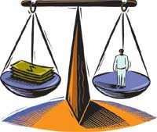
HIGH-THROUGHPUT COMPUTING
1. BEOWULF @ University of Surrey
2. SGI pool @ Welsh e-Science Centre
WHICH?
3. Non-dedicated pool of 500+ desktops
4. NGS (UK National Grid Service)
we take care of the science
they worry about the computers
www.nurseweek.com
e-Science
Notes:
We have enabled 4 levels of HTC. A remote Beowulf cluster. Beowulf clusters use cheap processors, cheap OSs and cheap networks. An SGI pool, this isn’t Beowulf because it is very expensive. A non-dedicated pool where we make use of idle times. And the UK National Grid Service which is part of the UK e-Science program. What does e-Science means? … We have enabled 4 levels of HTC. The choice of using one, or a combination of a few, is to be decided based on capital, maintenance and manpower costs.

Slide 31
HTC FROM VELINDRE HOSPITAL
NIMROD not only decides which processor to submit a job, but also which site.
job split into 30 parts
WELSH e-SCIENCE
SGI / IRIX
“CLUSTER OF CLUSTERS”
OXFORD
MANCHESTER
INTEL / LINUX
LEEDS
HETEROGENEOUS &
MULTI-PLATFORM.
ENABLED!
Notes:
Here’s a screenshot of how we run simulations. We use a cluster of clusters. The resource broker not only … but also whether to submit to … according to availability. At the wesc, the archi is SGI, the OS is IRIX. At O, M & L, the archi is Intel and the OS is Linux. So we have enabled MC simulations on a heterogeneous & MP environment.

Slide 32

Conclusion
2% / 2 mm accuracy: portal dose prediction at various clinical setups.
Run time halved: simplified detector models.
60% deviation: non-MC (water-based) techniques.
Enabled: several levels of High Throughput Computing
Acknowledgement
Thanking IPEM for travel award; and
Cancer Research Wales & Yr Ysgol Uwchradd Tregaron for PhD support.

Slide 33
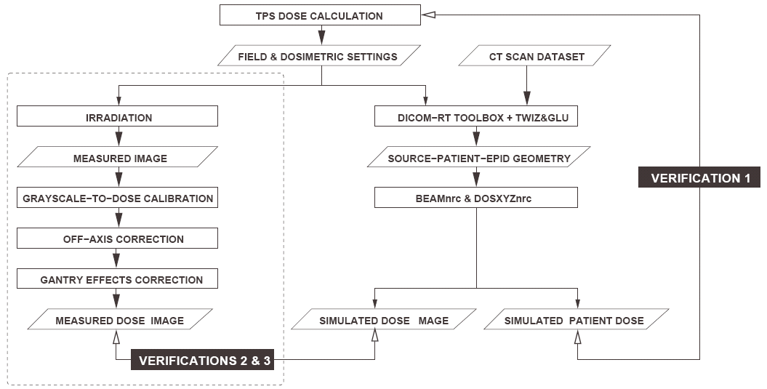

Slide 34
POLYSTYRENE
AIR
FR4 (PCB)
ROHACELL
(FOAM)
PLASTOFERRITE
FR4 (PCB)
ISO-OCTANE
FR4 (PCB)
polystyrene
air
ROHACELL
(FOAM)
rohacell (foam)
iso-octane
pmma/glass (pcb)
FR4 (PCB)
plastoferrite

Slide 35
polystyrene
air
rohacell (foam)
iso-octane
pmma/glass (pcb)
plastoferrite

