Slide 1
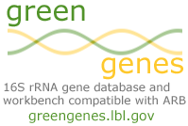






Databases
Services
16S
Trim
Align
Classify
Trim-away poor quality
data from a batch of
sequences.
Align a batch of
sequences. Find
near-neighbors.
Classify a queried sequence within a selected database.
18S
ITS
LSU
Distance
Export
Download
Calculate a distance matrix.
Export records from
the prokMSA.
Download database,
presentations,
and supplemental data.

Slide 2
Microbial Databases
Coverage | Region | Records Total | Records Core | Width
Archaea, Bacteria | 16S | 188,324 | 4,938 | 7,682
Fungi | 18S | 26,930 | 5,201 | 19,663
Fungi | LSU (25/28S -D1D2) | 15,998 | 558 | 2,019
Fungi | ITS | 212,367 | NA | NA
Monthly updates

Slide 3
Database Example: 16S rRNA gene -
Total versus Core Set.
Total
  From Genbank or special collections (Norm Pace, Coral Reefs)
  Keep only 16S genes >= 1,250 bases post-NAST alignment and vector removal - short reads alter tree topology.
Core Set
  Start by collecting a large set:
    All matching GOLD (genomesonline.org) organisms
  AND
    All meeting specific criteria
      ≥ 1300 nt.
      ≤ 2 homopolymers
      ≤ 0.3% ambiguity
      ≤ 30 “small gap intrusions” - bases not supported by the 2° structure.
      Non-chimeric
  De-replicate at >56% common 7mers (~94% similarity).
  4,938 genes represents the presently known 16S diversity.
Download either to screen your contigs for 16S content...

Slide 4
Curation
Taxonomy
  by independent organizations (JGI, RDP, NCBI, etc.)
  Fungal nomenclature (CBS, MSA, FESIN)
Core Sets
  Non-cultured novel diversity is only added after similar sequences are reported by multiple studies.

Slide 5
Error probability: scan and trim
>actb24
TTTTGGGATTCGCTCCGCCTCGCGGCATCGCAGCCCTTTGTACCGGCCAT TGTAGCACGTGTGCAGCCCAAGACATAAGGGGCATGATGATTTGACGTCG TCCCCACCTTCCTCCGAGTTGACCCCGGCAGTCTCCTGTGAGTCCCCGAC ATTACTCGCTGGCAACACAGAACAAGGGTTGCGCTCGTTGCGGGACTTAA CCCAACATCTCACGACACGAGCTGACGACAACCATGCACCACCTGTACAC CGACCACAAGGGGGCTGATATCTCTACCAGTTTCCGGTGTATGTCAAGCC TTGGTAAGGTTCTTCGCGTTGCGTCGAATTAAGCCACATGCTCCGCTGCT TGTGCGGGCCCCCGTCAATTCCTTTGAGTTTTAGCCTTGCGGCCGTACTC CCCAGGCGGGGAACTTAATGCGTTAGCTGCGGCACCGACGACGTGGAATG TCGCCAACACCTAGTTCCCAACGTTTACGGCGTGGACTACCAGGGTATCT AATCCTGTTCGCTCCCCACGCTTTCGCTCCTCAGCGTCAGTAATGGCCCA GAGATCCGCCTTCGCCACCGGTGTTCCTCCTGATATCTGCGCATTTC..
>actb24
..19 10 11 9 8 8 8 15 9 9 10 9 13 8 10 10 10 16 18 16 16 10 9 11 7 8 8 12 14 25 15 15 6 6 6 6 12 10 14 22 25 21 21 8 10 9 12 11 9 9 17 20 29 29 22 20 11 11 7 7 9 17 13 20 20 31 30 23 23 11 9 9 9 7 7 13 15 25 25 24 21 17 17 17 21 24 24 29 25 25 29 40 32 31 19 19 10 10 9 20 20 25 18 18 25 25 19 19 21 21 23 28 28 29 29 32 22 22 22 32 27 29 25 27 27 22 25 15 15 18 27 27 33 33 33 40 40 47 47 47 32 32 32 32 29 35 40 40 40 40 40 40 31 31 40 32 29 21 21 25 31 26 29 30 30 33 28 31 31 26 26 25 22 22 29 31 28 26 28 27 29 33 25 25 18 27 30 42 37 42 35 35 35 40 40 40 40 42 42 34 34 42 44 47 47 47 47 42 47 42 42 42 42 42 ..
Phred | Error probability |  | conf.
20 | 1 in 10^{2.0} | 1/100 | 99%
15 | 1 in 10^{1.5} | 1/32 | 97%
10 | 1 in 10^{1.0} | 1/10 | 90%
5 | 1 in 10^{0.5} | 1/3 | 66%
qual files should follow sequences throughout pipeline.

Slide 6
NAST align against the core set.
Template: ATAC-----GTA-AC----GTA---C---G-T-AC-GG
Candidate:CACGTTAAACGTCGTACCCGG
(A) pair-wise alignment (BLAST/Infernal)
Template: ATACGT-A-ACGTACGTAC-GG
Candidate:C-ACGTTAAACGT-CGTACCGG
(B) Re-introduce template spacing
Template: ATAC-----GT-A-AC----GTA---C---G-T-AC--GG
Candidate:C-AC-----GTTAAAC----GT----C---G-T-ACCCGG
(C) Identify template-extending insertions
α β
Template: ATAC-----GT-A-AC----GTA---C---G-T-AC--GG
Candidate:C-AC-----GTTAAAC----GT----C---G-T-ACCCGG
NAST
(D) Search for nearest alignment spaces
(hyphens) in candidate
Template sequence
(E) Gap at nearest search terminus in
candidate removed
(F) Gap in template removed
Template: ATAC-----GTA-AC----GTA---C---G-T-AC-GG
Candidate:C-AC----GTTAAAC----GT----C---G-TACCCGG
Example of NAST (Nearest Alignment Space Termination) compression of a BLAST pair-wise alignment using a 38 character aligned template. Template and candidate is extended to 40 characters after BLAST gap insertion (A) and retention of original template spacing (B). Nucleotide insertions in the candidate relative to the template which force additional characters to be added in the template are identified at positions α and β (C). A bi-directional search for the nearest alignment space (hyphen) relative to the insertion terminates at the positions indicated by the black arrows (D). The leftward search from the α position was shorter in distance compared to the rightward, thus the space left of ‘GT’ was removed. The search from the β position encountered the alignment edge on the right, thus the position to the left of ‘AC’ was removed (E). Lastly, the two template-extending spaces are deleted from the template (F). Notice that sequence data is not added to nor overwritten in the candidate. The NAST removal of two characters from both sequences allowed local misalignments (underlined) while preserving the 38 character format of the global multiple sequence alignment.
trimmed
retained sequence
trimmed
Candidate sequence
Finds and extracts 16S portion from any sequence (tags, reads, contigs or entire genomes).

Slide 7
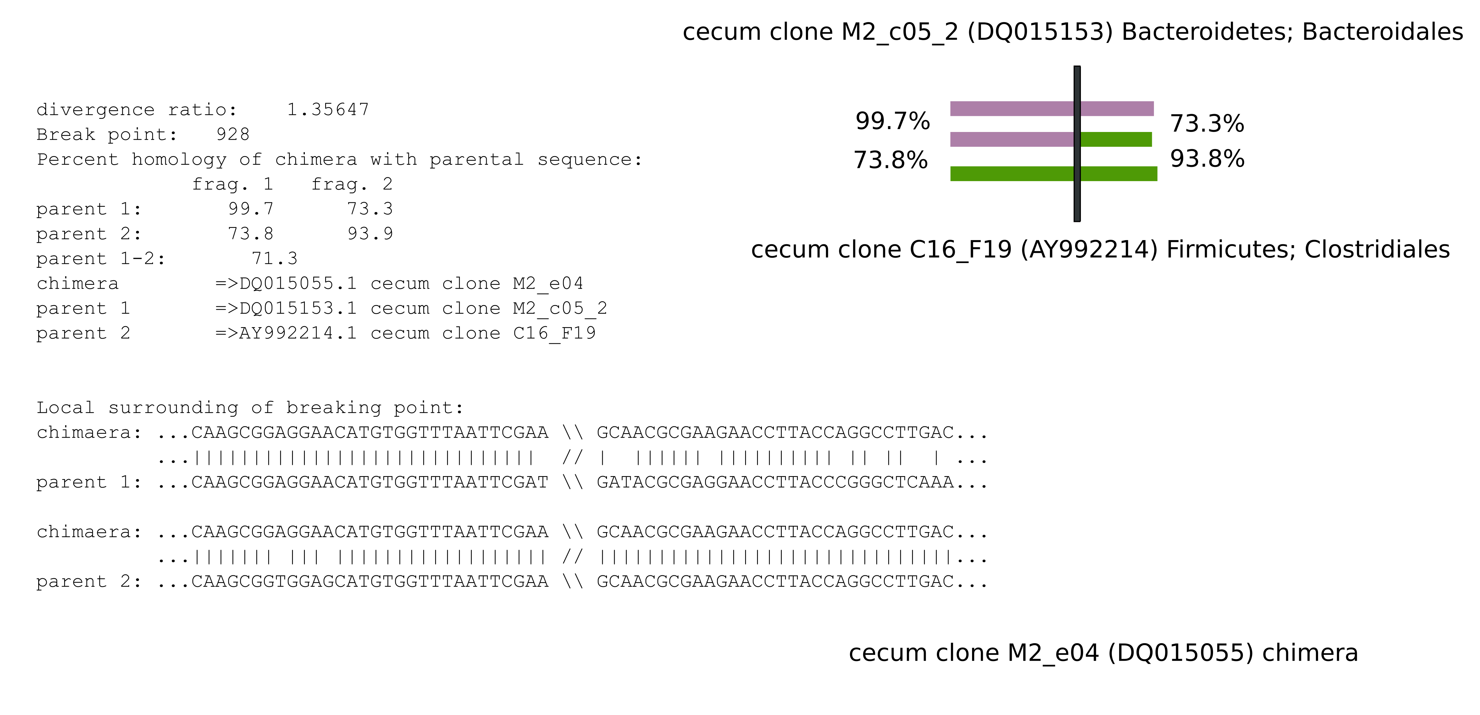
Chimera Detection by Bellerophon
- Enabled by aligning all data to a standard format.
Checks libraries internally and against the Core Set.
Simple plain-text table delivered.
Figure 4. Chimeras can be detected within large data sets using modifications to the existing software, Bellerophon (Huber et al, 2004). In this example a chimera (clone M2_eO4) was found in a 16S rRNA gene clone library prepared from cecal samples. The modified Bellerophon is able to search for parents over intra-library (putative parent M2_c05_2) and inter-library (putative parent C16_F19) sequences. The divergence ratio of 1.36 indicates the parents are 36% more divergent from each other than the chimeric fragments are from their respective parents. Further investigation placed the parents in distinct phyla.

Slide 8
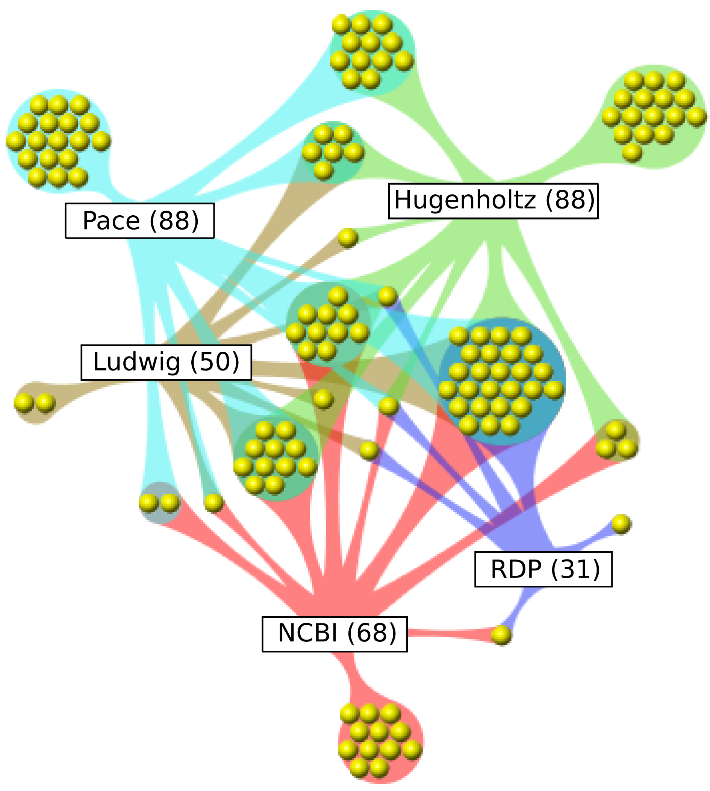
Taxonomy in Flux
Each yellow dot represents a named phyla
Incongruent taxonomic nomenclature even at phylum level.
Making multiple taxonomic classifications available through Greengenes will aid in standardizing classification, particularly for environmental lineages.
Greengenes integrates each, allowing a balanced approach to nomenclature of newly discovered organisms.
EXAMPLE: Halanaerobium salsugo
  Hugenholtz=Bacteria; Haloanaerobiales; Haloanaerobiaceae; Haloanaerobium/ Haloincola
  Ludwig=Bacteria; Haloanaerobiales; Haloanaerobiacae; Haloanaerobium
  Pace=Bacteria; Haloanaerobiales; Haloanaerobiaceae; Haloanaerobium/ Haloincola
  RDP=Bacteria; Firmicutes; Clostridia; Halanaerobiales; Halanaerobiaceae; Halanaerobium
  NCBI=Bacteria; Firmicutes; Clostridia; Halanaerobiales; Halanaerobiaceae; Halanaerobium
Only a fraction of the phyla are recognized by all five major curators.

Slide 9
LBL Proposed Standardized Taxonomy
Domain | Bacteria | Bacteria
Phylum | Spirochaetes | Proteobacteria
Sub-Phylum | Leptospirales_SP | AlphaBetaGammaproteobacteria
Class | Leptospirales_CL | Alphaproteobacteria_CL
Order | Leptospirales | Bradyrhizobiales
Family | Leptonemaceae | Xanthobacteraceae
Sub-Family | sfB | sfA
OTU | 17158 | 12947
Sequence | Leptonema illini str. 3055 | Xanthobacter flavus str. JW/KR-1
The Sub-Phylum containing Leptospirales
“Rank” initials as helpers.
>100K full-length high-quality sequences

Slide 10
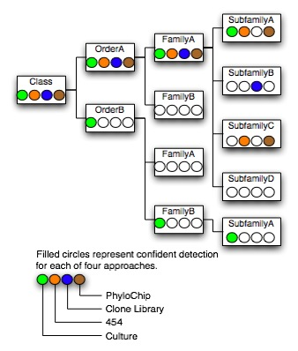
Classification Strategy
Standard
  Apply lane mask.
  Find F84 distance to near-neighbors in each taxonomic system.
Short reads
  Alignment is not the best approach for short tags from hyper-variable regions.
  K-mer approach is preferred
    de-replicate
    Make confidence-based assignment based on “Observed Node Diversity” empirically derived from region amplified.

Slide 11
Scalability
Simple job received by web server, processed by appropriate module of pipeline software and returned by web server.

Slide 12
Scalability
Compute intensive job received and staged by web server.
Grid resource processes job.

Slide 13
Scalability
Configuration 1:
DACC identifies 16S data. Greengenes processes the data according to consortium standards and returns results.

Slide 14
Scalability
Configuration 2:
Individual sequencing centers adopt pipeline software.
Centers are free to configure thresholds and modify algorithms to suit their hardware.

Slide 15
Scalability
Configuration 2:
Individual sequencing centers adopt pipeline software.
Centers are free to configure thresholds and modify algorithms to suit their hardware.
DACC reconciles discrepancies.

Slide 16
end

Slide 17
Automation (API)
REST interface - web service
  Representational State Transfer
  Uniform interface: all resources are accessed with a generic interface (HTTP) using verbs (GET, POST, PUT, DELETE).
  Returns JSON,XML,YAML…

Slide 18
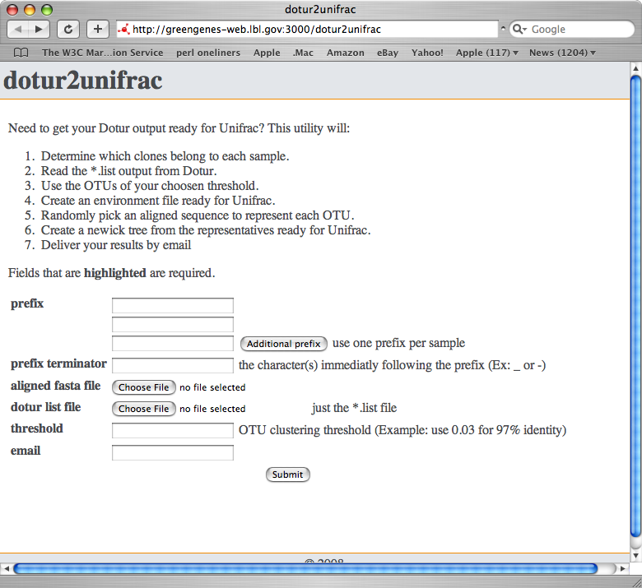
Intra- and Inter-sample Diversity

Slide 19
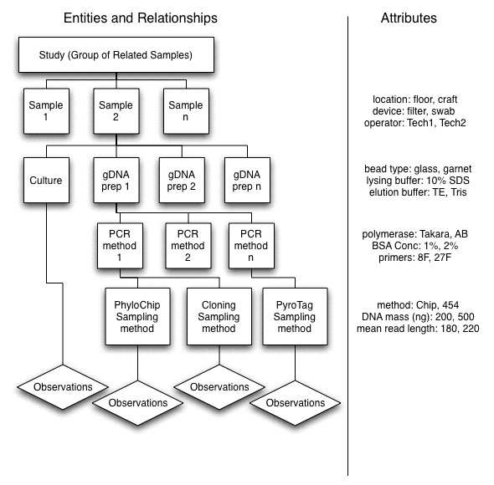
Metadata

