Slide 1
Detection of chimeric sequences from PCR artefacts
Thomas Huber
huber@maths.uq.edu.au
Computational Biology and
Bioinformatics Environment
ComBinE
Departments of Biochemistry & Mathematics
The University of Queensland

Slide 2
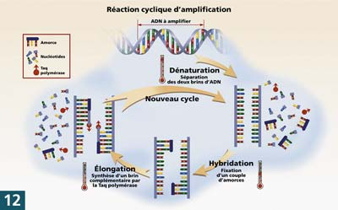
What are PCR-generated chimeric sequence?
Prematurely terminated amplicon
Re-annealing with foreign DNA
Copied to completion in following PCR cycle
Artificial sequence from 2 parent sequences
From: http://www.gnis-pedagogie.org

Slide 3
Are chimeric sequence a problem?
Culture independent surveys of microbial communities
  Chimeric sequences suggest non-existing organisms
  ≈0.5-5% of all sequences are PCR artefacts
Why bother with such a small artefact?
  Signal vs Noise
    100 times repetition of same survey (5% chimeras): ratio of existing:non-existing organisms = 1:5

Slide 4
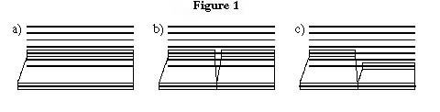
Detection of chimeras:
1. Alignment to reference sequences
Each target sequence in turn
  Align to ref. sequences
  if alignment to a single sequence gives better match then alignment to two sequences:
    No chimera
  else:
    Chimera !!
(Cole et al., 2003; Komatsoulis and Waterman, 1997, …)

Slide 5
Problems
Database contamination
  More and more chimeras accumulate
Database coverage
  Parent sequences are not necessarily in database

Slide 6
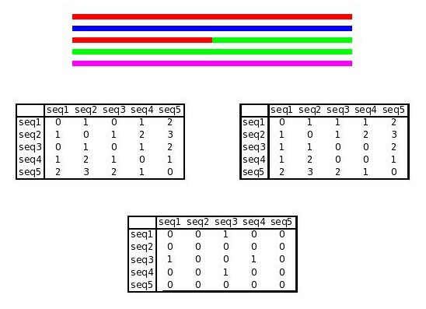
2. Partial tree building approach
Align sequence to existing sequences (build MSA)
Divide MSA at postulated conversion point
Construct 2 trees
Compare consistency of phylogeny
(Wang and Wang, 1997; Hugenholtz , 2003)
4
4
3
5
5
2
2
1
1
3

Slide 7
3. Bellerophon approach
Just like “partial tree building”, but:
  MSA from PCR library
    More likely to contain parent sequence
  No trees are actually built
  All possible conversion points are tested

Slide 8
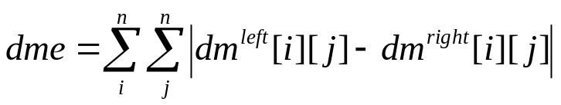
How Bellerophon works
Compute MSA
for each conversion point:
  2 windows left/right
    Calculate all “distances” between sequence
  Instead of comparing trees, compare distance matrices

Slide 9
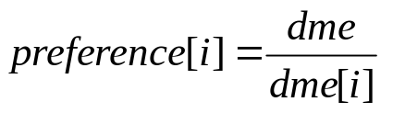
How Bellerophon works (cont.)
Chimeric sequence will result in large Δdme
Chimera detection:
  Exclude sequence
  Observe change of dme

Slide 10
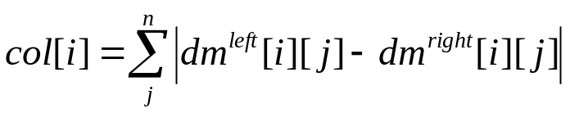
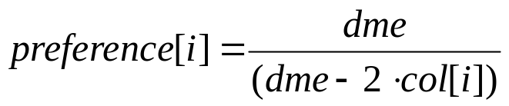
How Bellerophon works (cont.)
Chimeric sequence will result in large dme
Chimera detection:
  Exclude sequence
  Observe change of dme
Expensive to calculate (O(n³))
Speedy way

Slide 11
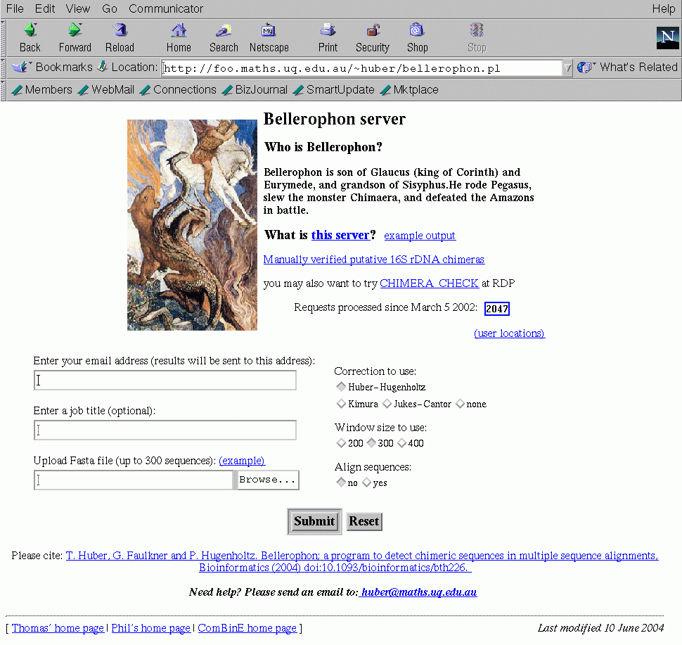
Bellerophon user interface

Slide 12
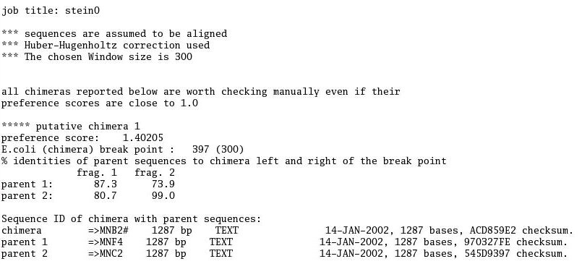
Example output
Title line

Slide 13
Example output
Title line
Job parameter

Slide 14
Example output
Title line
Job parameter
!! Advice !!
Chimera output

Slide 15
Example output
Title line
Job parameter
!! Advice !!
Preference score (only relative)
Conversion points
Chimera output
Sequence identities across windows
IDs of chimera and parents

Slide 16
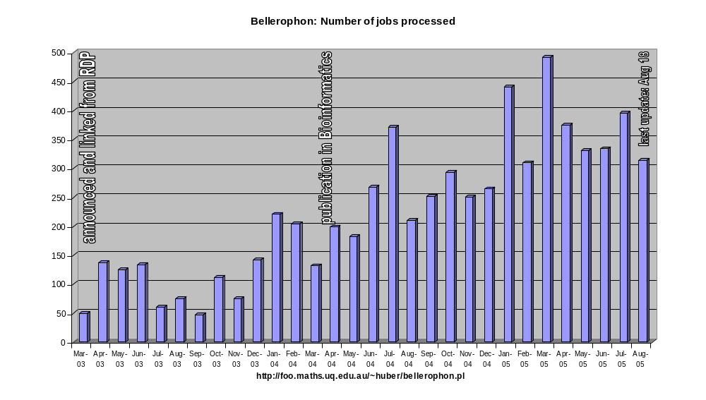
Server usage

Slide 17
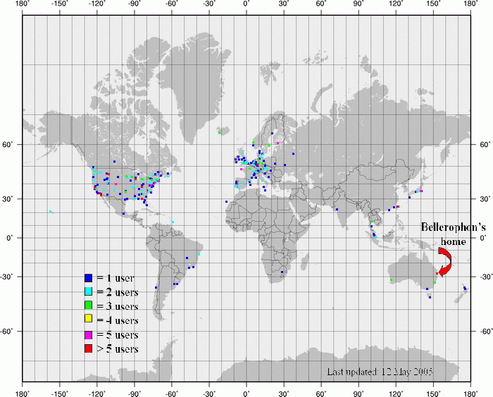
Who uses Bellerophon?

Slide 18
What Bellerophon does/does not do!
Bellerophon does not determine chimeric sequences !!
It merely indicates putative chimeras
You must confirm them !

Slide 19
Current developments
Bellerophon 2
  For large PCR libraries (or single sequences)
    A smaller library of related sequences is selected for each target sequence
      Cost reduction from O(n³) to something more tractable
  Cleaning up sequence databases
Web services
Large scale data statistics on chimeras

Slide 20
Bellerophon web services
Sporadic user (web page interface)
  Interactive / manual use
  Easy to understand, convenient to use
Large scale users have different needs
  E.g. JGI’s microbial ecology pipeline
  Easy to implement/use interface that allows automatic submission and processing of data
  Web services
    Standardised protocol (SOAP, WSDL)
    Remote service calls from own scripts and programs
    Not a mirror. All Bellerophon services are maintained in Brisbane

Slide 21
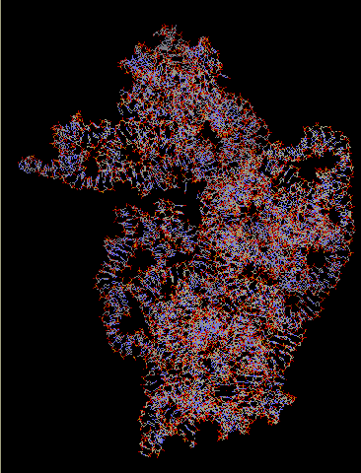
Large scale data statistics on chimeras
How much chimeras to expect in a PCR library
  Differences in phyla?
Is recombination in 16S rRNA a random event?
  Structural bias?

