Slide 1
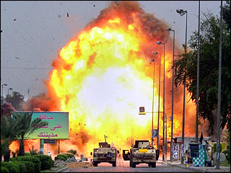
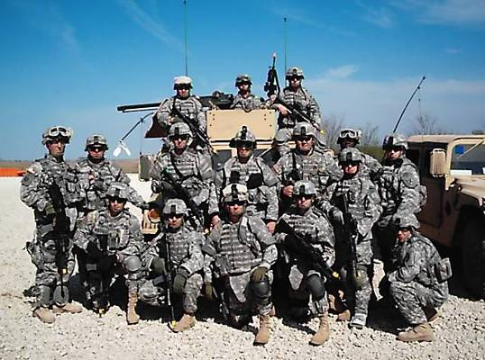
What we “know” about
OEF/OIF vets
Joseph Constans, Ph.D.
Acting ACOS / R, SLVHCS
MIRECC Site Director, New Orleans

Slide 2
Presentation Aims
What we know…
  Review DoD deployment statistics
  Discuss consequences of deployment
    MHAT-V (Feb, 2008)
VA clinical response
What we need to know?
  Research Initiatives
  Intersections between rural theme, VA clinical response, research agenda

Slide 3
How many have served?
1.6 mil served during OEF/OIF
  ~ 751,253 (current veterans)
  ~ 35% accessed VA
513,000 troops in Iraq since 2003
  ~ 158,000 currently in Iraq
  ~ 197,000 more than one TOD
  ~ 53,000 deployed 3 x’s

Slide 4
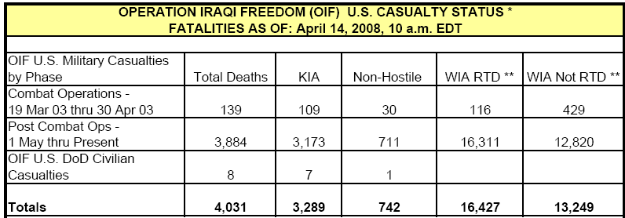
KIA – Killed in Action
WIA – Wounded in Action
RTD – Returned to Duty
Source: http://www.defenselink.mil/news/casualty.pdf

Slide 5
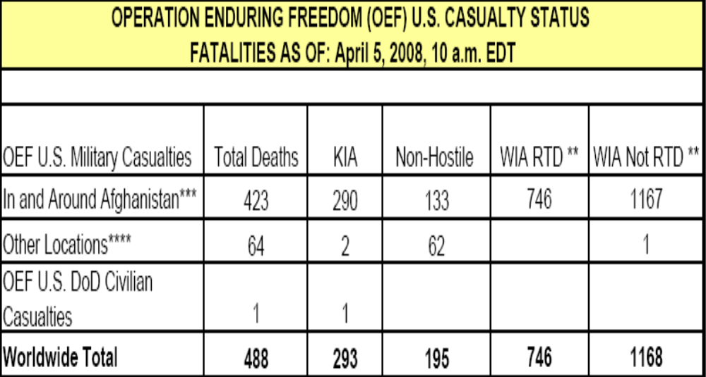
KIA – Killed in Action
WIA – Wounded in Action
RTD – Returned to Duty
Source: http://www.defenselink.mil/news/casualty.pdf

Slide 6
Demographic variables of KIA

Slide 7
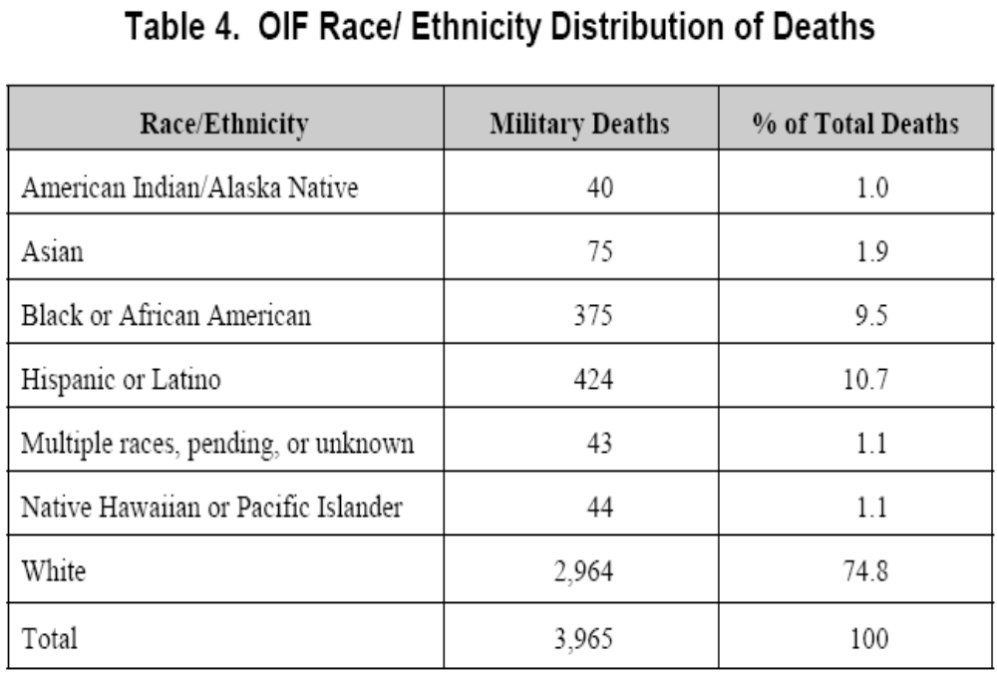
Note: 97% of the deaths were males

Slide 8
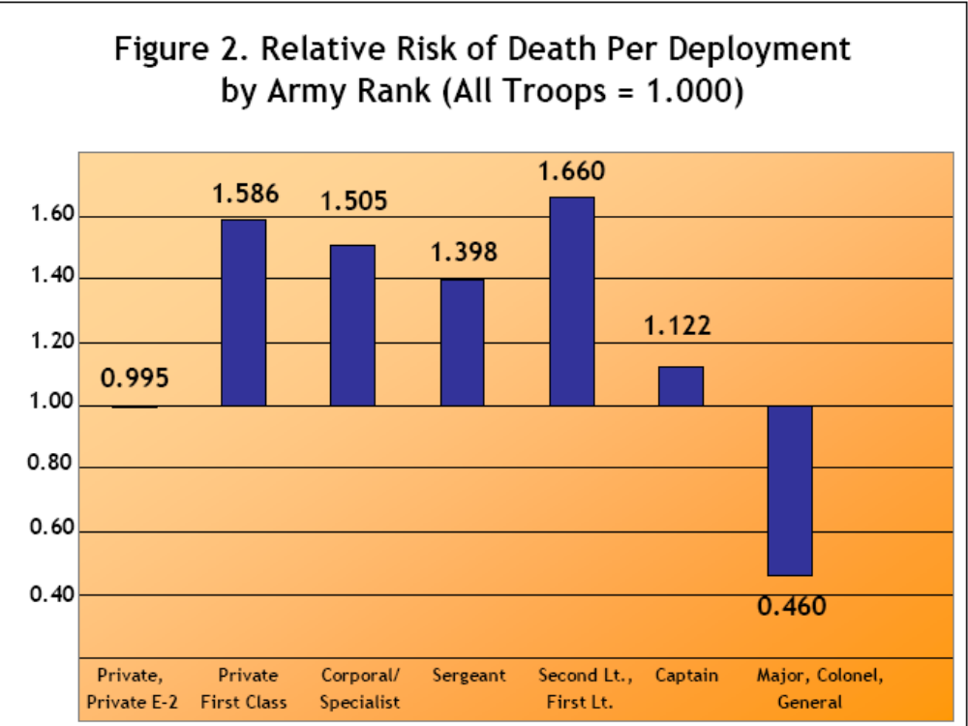

Slide 9
How does this conflict compare with other wars?

Slide 10
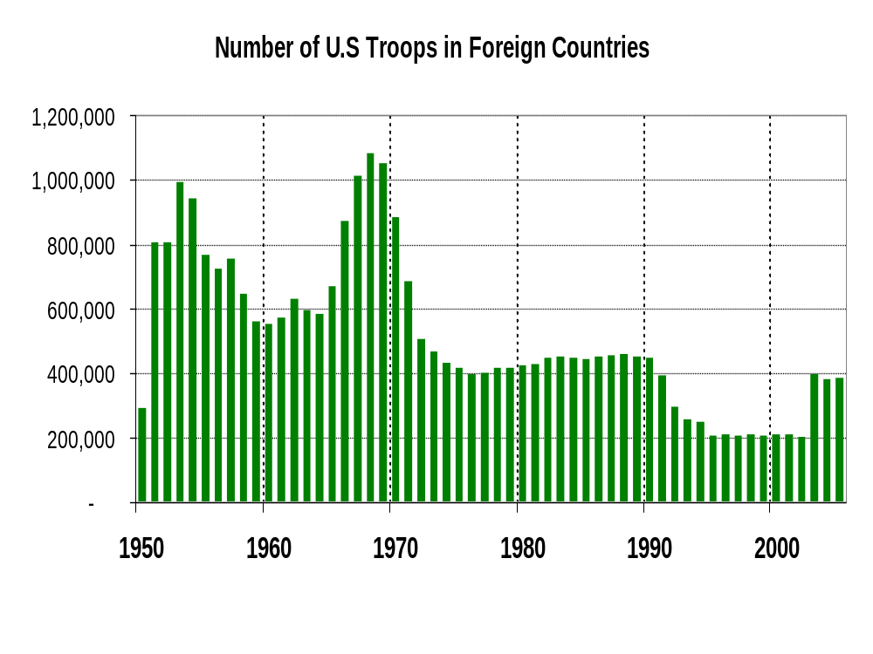

Slide 11
Unique features of OIF
56,838 deaths in VN
Death rate
  VN (21.56 per 1000)
  OIF (3.92 per 1000)
Death / injury ratio
  VN (.24)
  OIF (.13)
OIF troops more likely to survive attack
    - armor
    - medical care

Slide 12
Consequences of OIF:
Amputation
1013 amputees (Feb, 2008)
730 amputations involved major limb
Service Branch
  Army (78%)
  USMC (19%)
  Navy (2%)
  Air Force (1%)

Slide 13
Consequences of OIF:
Traumatic Brain Injury (TBI)
5503 TBI (Feb, 2008)
Service Branch
  Army (77%)
  USMC (20%)
  Navy (2%)
  Air Force (1%)
10% of deployed troops

Slide 14
Consequences of OIF:
Suicide
Suicide in Iraq
  113 completed suicides since 2003
2007 suicide in the military
  121
  20% increase since 2006
Suicide attempts
  2100 in 2007
  350 in 2002
Suicide Rate
  17.5 suicides per 100,000 active-duty soldiers in 2006
  9.8 per 100,000 active-duty soldiers in 2001

Slide 15
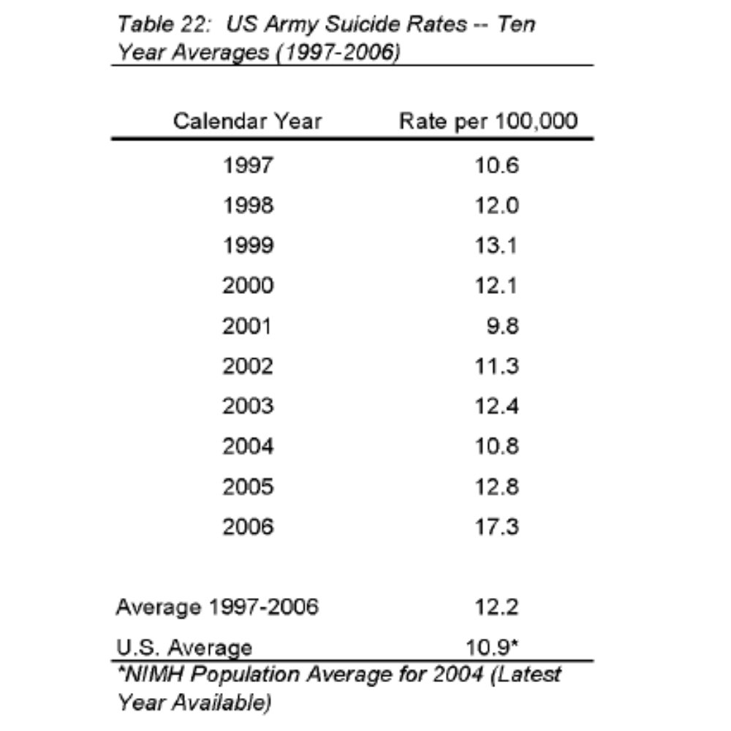

Slide 16
What is our future in Iraq?

Slide 17
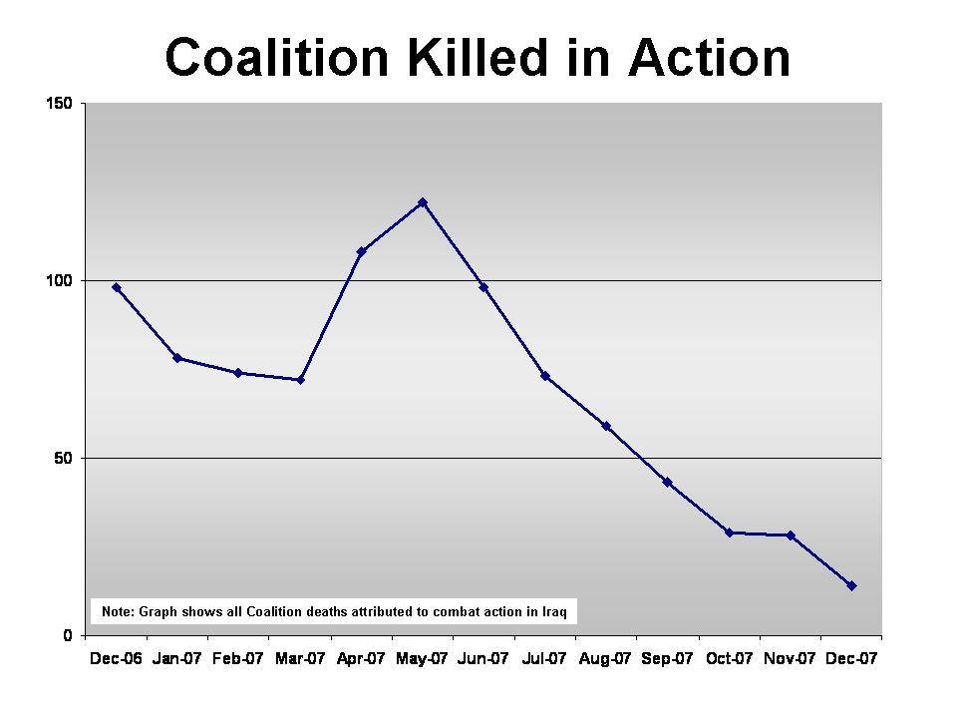

Slide 18
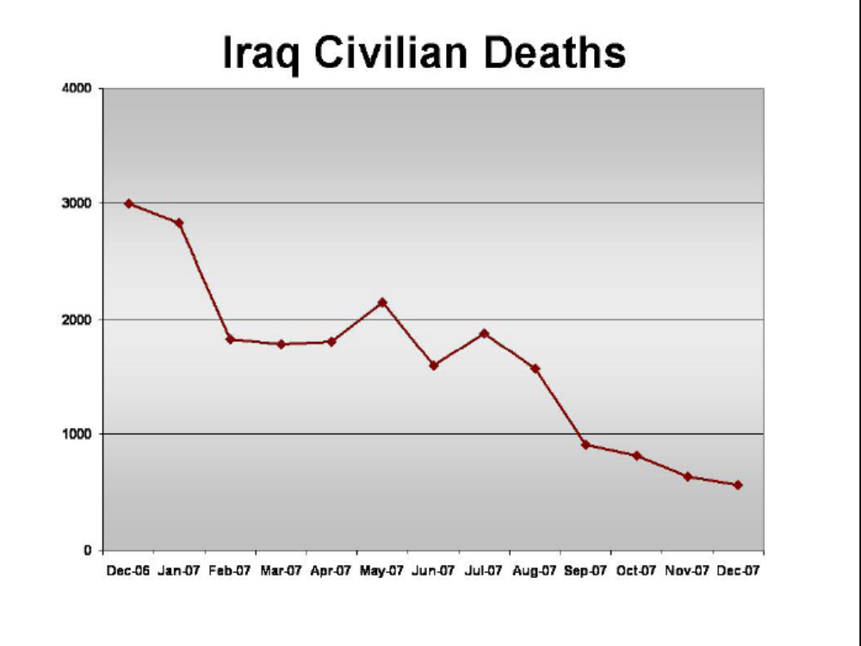

Slide 19
What do we know about active duty troops?
Mental Health Advisory Team (MHAT) V

Slide 20
What is MHAT V?
Established by Office of US Army Surgeon General.
Team designed to assess health of US deployed troops.
Comprised of Walter Reed personnel.
http://www.armymedicine.army.mil/news/mhat/mhat_v/MHAT_V_OIFandOEF-Redacted.pdf

Slide 21
What is MHAT V?
Survey and interview based assessments.
Separate reports for OEF and OIF.
2295 Soldier Well Being assessments conducted on OIF troops.
  2279 anonymous surveys in Oct 07

Slide 22
What is MHAT V
Sampling Strategy?
8 Brigade Combat Teams
  8 line companies
  2 support companies
  25 individuals
    Selected by leadership based on mission considerations
    Respondents primarily enlisted or NCO (90%)
Limitations
  Line companies in greater danger
  Respondents may be selected because they are either highly symptomatic or minimally symptomatic

Slide 23
What does the survey assess?
Behavioral Health
  PTSD, anxiety, depression
  Divorce
  Suicide
  mTBI
  Drug / Alcohol
Risk Factors
  Combat experiences
  Non-combat deployment concerns
  Deployment Length
Protective Factors
  Leadership
  Training
  Behavioral Health Care / Access

Slide 24
What are the
Behavioral Health outcomes?

Slide 25
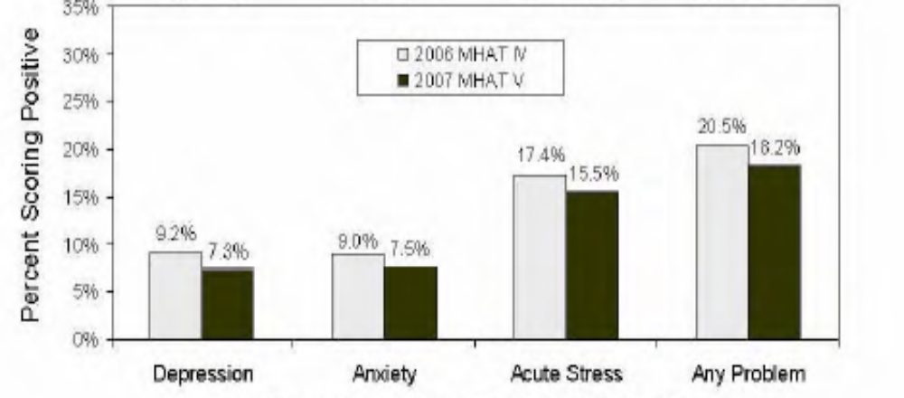
Behavioral Health
Used standard scales (PCL; PHQ-9)
1 in 5 meet criteria PTSD, GAD, or MDD.
PTSD estimates consistent across time.

Slide 26
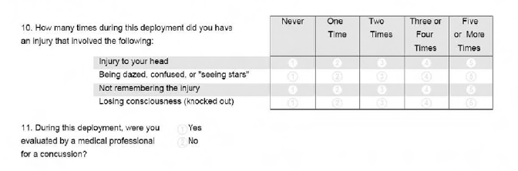
Behavioral Health
TBI

Slide 27
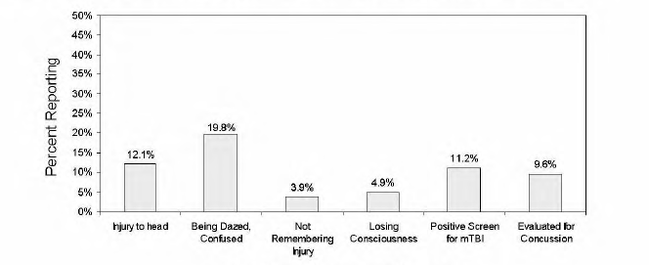
Behavioral Health - mTBI

Slide 28
What are the Risk Factors for
Negative Behavioral Health outcomes?

Slide 29
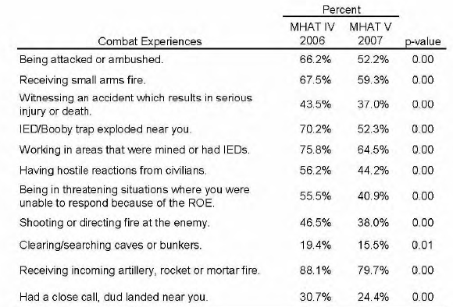
Risk Factors – Combat exposure

Slide 30
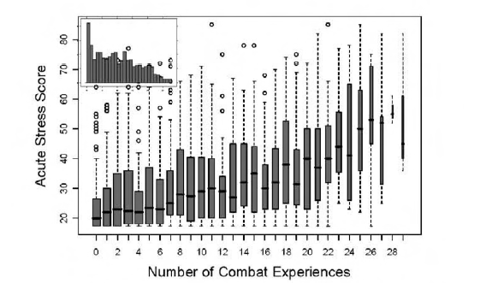
Risk Factors – Combat Exposure

Slide 31
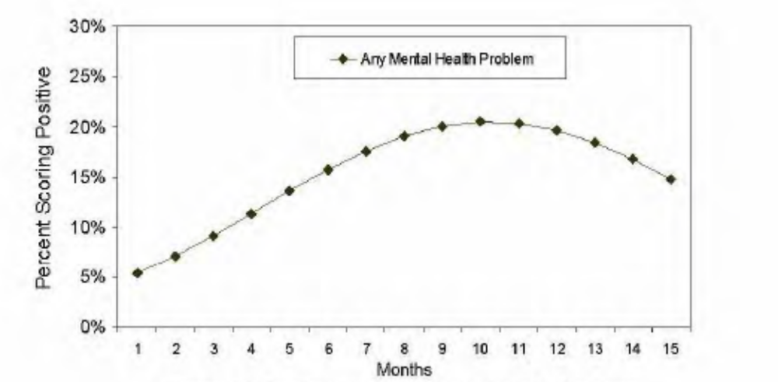

Risk Factors
Deployment Length and Mental Health
+ Relationship mediated by combat experiences

Slide 32
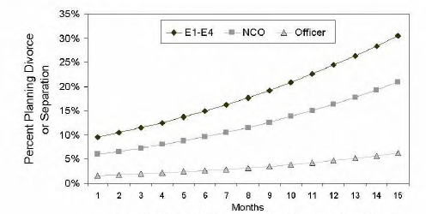
Risk Factors
Deployment Length and Separation

Slide 33
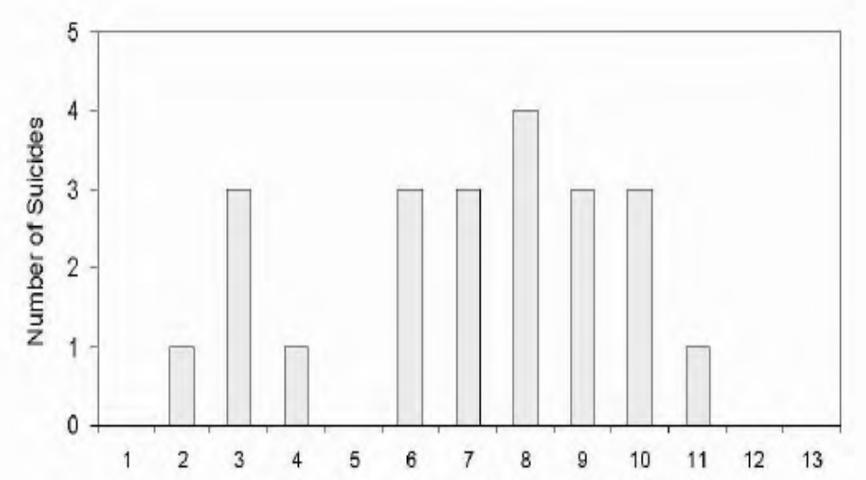
Risk Factors
Deployment Length and Suicide

Slide 34
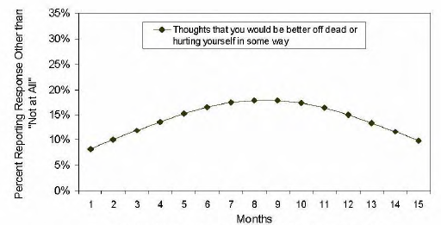
Risk Factors
Deployment Length and Suicide Ideation

Slide 35
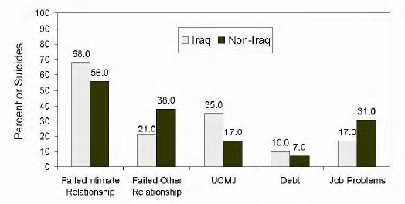
Risk Factors
Separation and Suicide

Slide 36
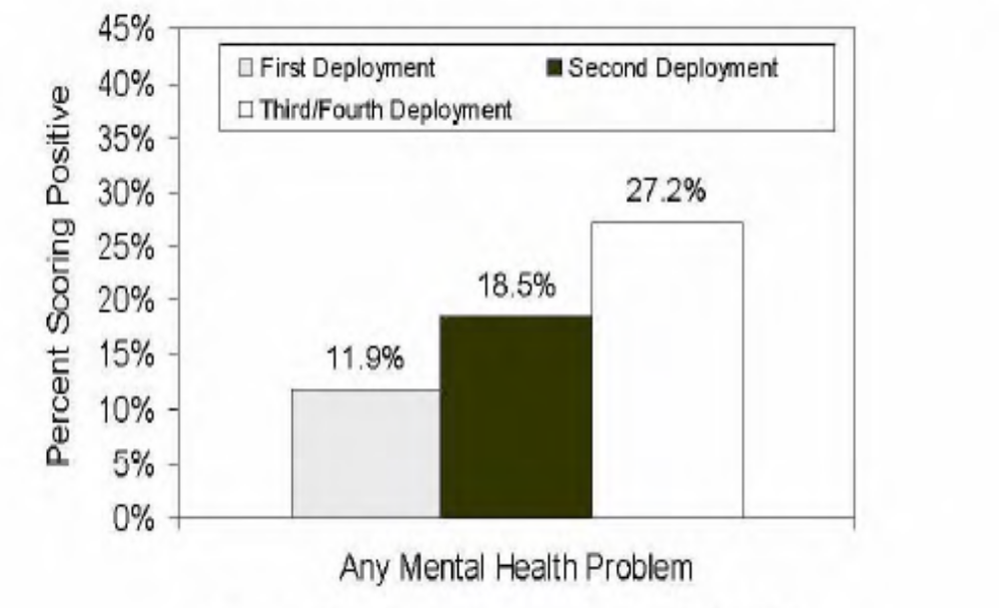
Risk Factors
Number of Deployments / Stress Disorder

Slide 37
What factors impact accessing care (protective factor)?

Slide 38
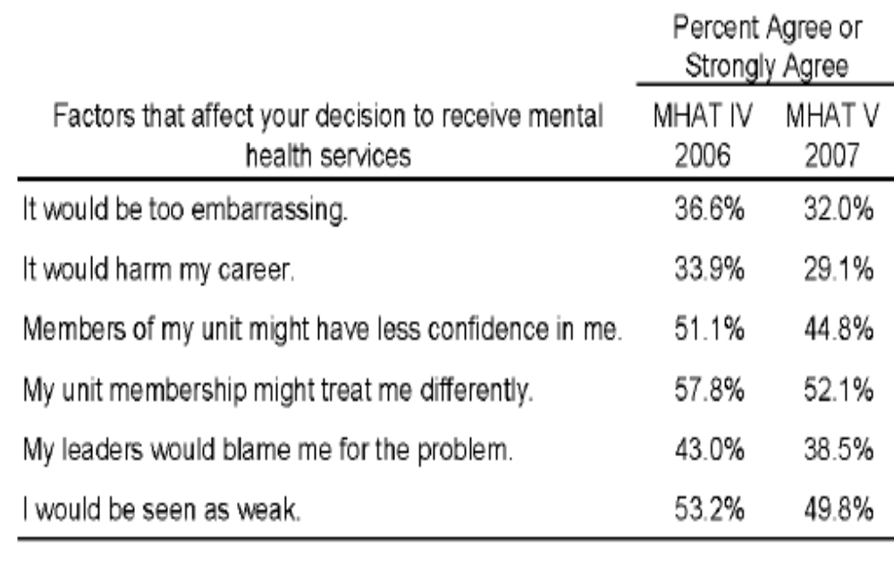
Protective Factors – Access to Care
Stigma Issues

Slide 39
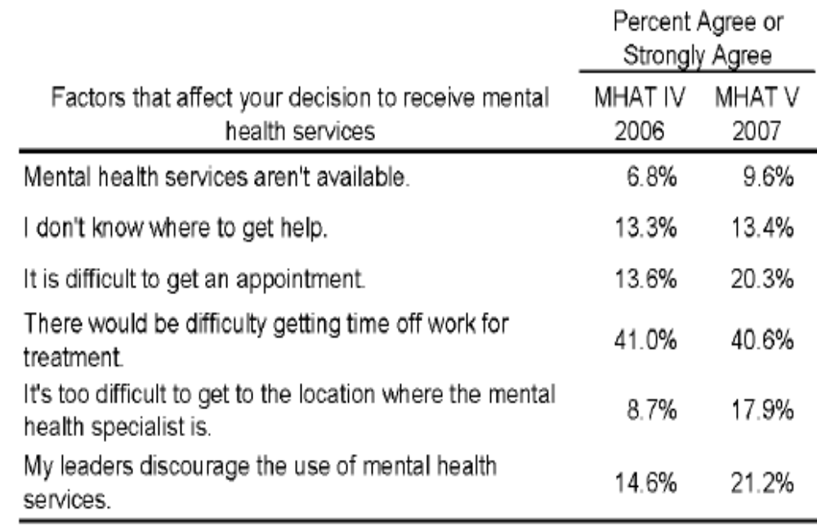
Protective Factors – Access to Care
For those positive for a mental health problem

Slide 40
MHAT V Summary
1 in 5 Emotional Disorder (PTSD: 1 in 7)
PTSD Risk Factors
  Combat experiences
  Number of deployments
12% TBI
Suicide low probability event but increasing
  Loss is a risk factor

Slide 41
VA Clinical response

Slide 42
Who is eligible for VA care?
751,273 OIF and OEF veterans who have left active duty and become eligible for VA health care since FY 2002
  48% (362,237) Former Active Duty troops
  52% (389,036) Reserve and National Guard
  VHA Office of Public Health and Environmental Hazards

Slide 43
Who is accessing VA services?
Among all 751,273 separated OIF/OEF Veterans
  35% (263,909) of total separated OIF/OEF veterans have obtained VA health care since
  FY 2002 (cumulative total)
    96% (253,730) of 263,909 evaluated OIF/OEF patients have been seen as outpatients only by VA and not hospitalized
    4% (10,179) of 263,909 evaluated OIF/OEF patients have been hospitalized at least once in a VA health care facility

Slide 44
VA Health Care Utilization for FY 2002-2007 (3rd QT) by Service Component
362,237 Former Active Duty Troops
  36% (132,194) have sought VA health care since FY 2002 (cumulative total)
389,036 Reserve/National Guard Members
  34% (131,715) have sought VA health care since FY 2002 (cumulative total)

Slide 45
Increasing VA Use
Call Center (Contractor) Will Help VA Inform GWOT Veterans of Health Services, Benefits
Begin May 1,2008
The Combat Veteran Call Center Initiative will contact by telephone two distinct populations of veterans of the war in Iraq and Afghanistan.
Initially target an estimated 17,000 veterans identified as possibly having health care needs.
Veterans will be provided with information about services available to them and specific contact information for the VA medical facilities nearest to them.

Slide 46
Who are the OEF/OIF veterans using the VA?

Slide 47
Frequency Distribution of OIF and OEF Veterans According to the VISN Providing the Treatment
OIF-OEF Veterans
Treated at a VA Facility*
Treatment Site Frequency %
VISN 1 VA New England Healthcare System 12,336 4.7
VISN 2 VA Healthcare Network Upstate New York 7,460 2.8
VISN 3 VA New York/New Jersey Healthcare System 10,255 3.9
VISN 4 VA Stars & Stripes Healthcare System 12,709 4.8
VISN 5 VA Capital Health Care System 6,981 2.7
VISN 6 VA Mid-Atlantic Healthcare System 14,437 5.5
VISN 7 VA Atlanta Network 18,941 7.2
VISN 8 VA Sunshine Healthcare Network 22,107 8.4
VISN 9 VA Mid-South Healthcare Network 15,527 5.9
VISN 10 VA Healthcare System of Ohio 7,310 2.8
VISN 11 Veterans in Partnership Healthcare Network 9,462 3.6
VISN 12 VA Great Lakes Health Care System 16,031 6.1
VISN 15 VA Heartland Network 9,310 3.5
VISN 16 South Central VA Health Care Network 22,950 8.7
VISN 17 VA Heart of Texas Health Care Network 16,181 6.1
VISN 18 VA Southwest Healthcare Network 13,586 5.2
VISN 19 VA Rocky Mountain Network 11,176 4.2
VISN 20 VA Northwest Network 15,249 5.8
VISN 21 VA Sierra Pacific Network 12,050 4.6
VISN 22 VA Desert Pacific Healthcare Network 21,559 8.2
VISN 23 VA Midwest Health Care Network 14,903 5.7
* Veterans can be treated in multiple VISNs. A veteran was counted only once in any single VISN but can be counted in multiple VISN categories. The total number of OIF-OEF veterans who received treatment (n = 263,909) was used to calculate the percentage treated in any one VISN.

Slide 48
Demographic Characteristics of OIF and OEF Veterans Utilizing VA Health Care
% OIF/OEF Veterans
(n = 263,909)
Sex
Male 88 %
Female 12
Age Group
<20 5
20-29 52
30-39 23
≥40 20
Branch
Air Force 12
    Army 65
Marine 12
Navy 11
Unit Type
Active 50
Reserve/Guard 50
Rank
Enlisted 92
Officer 8

Slide 49
Frequency of Possible Diagnoses Among OIF and OEF Veterans
Diagnosis (n = 263,909)
(Broad ICD-9 Categories) Frequency * %
Infectious and Parasitic Diseases (001-139) 28,665 10.9
Malignant Neoplasms (140-208) 2,193 0.8
Benign Neoplasms (210-239) 9,129 3.5
Diseases of Endocrine/Nutritional/ Metabolic Systems (240-279) 50,968 19.3
Diseases of Blood and Blood Forming Organs (280-289) 5,086 1.9
Mental Disorders (290-319) 100,580 38.1
Diseases of Nervous System/ Sense Organs (320-389) 83,273 31.6
Diseases of Circulatory System (390-459) 39,633 15.0
Disease of Respiratory System (460-519) 49,464 18.7
Disease of Digestive System (520-579) 81,427 30.9
Diseases of Genitourinary System (580-629) 25,561 9.7
Diseases of Skin (680-709) 38,791 14.7
Diseases of Musculoskeletal System/Connective System (710-739) 117,424 44.5
Symptoms, Signs and Ill Defined Conditions (780-799) 93,093 35.3
Injury/Poisonings (800-999) 48,736 18.5
*These are cumulative data since FY 2002, with data on hospitalizations and outpatient visits as of June 30, 2007; veterans can have multiple diagnoses with each healthcare encounter. A veteran is counted only once in any single diagnostic category but can be counted in multiple categories, so the above numbers add up to greater than 263,909.

Slide 50
Frequency of Possible Mental Disorders Among OIF/OEF Veterans since 2002*
Disease Category (ICD 290-319 code) Total Number of SW
Asian War Veterans**
PTSD (ICD-9CM 309.81)+ 48,559
Nondependent Abuse of Drugs (ICD 305)++ 40,320
Depressive Disorders (311) 32,815
Neurotic Disorders (300) 25,746
Affective Psychoses (296) 18,069
Alcohol Dependence Syndrome (303) 8,062
Sexual Deviations and Disorders (302) 4,550
Special Symptoms, Not Elsewhere Classified (307) 4,581
Drug Dependence (304) 3,613
Acute Reaction to Stress (308) 3,130
* Note – These are cumulative data since FY 2002. ICD diagnoses used in these analyses are obtained from computerized administrative data. Although diagnoses are made by trained healthcare providers, up to one-third of coded diagnoses may not be confirmed when initially coded because the diagnosis is “rule-out” or provisional, pending further evaluation.
** A total of 100,580 unique patients received a diagnosis of a possible mental disorder. A veteran may have more than one mental disorder diagnosis and each diagnosis is entered separately in this table; therefore, the total number above will be higher than 100,580.
⁺ This row of data does not include information on PTSD from VA’s Vet Centers and does not include veterans not enrolled for VHA health care. Also, this row of data does not include veterans who did not have a diagnosis of PTSD (ICD 309.81) but had a diagnosis of adjustment reaction (ICD-9 309).
++ 81% of these veterans (32,700) had a diagnosis of tobacco use disorder (ICD-9 305.1).

Slide 51
How has VA addressed issues of OEF/OIF veterans?
Clinical Reminders
Clinical Initiatives

Slide 52
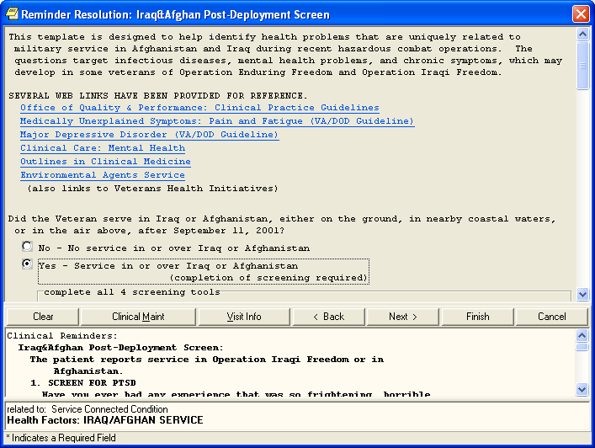
If the patient did serve in the combat arena in Iraq or Afghanistan, then the answer to this question is ‘Yes’ and the user must complete all questions that follow:
PTSD Screen
Depression Screen
Alcohol Screen

Slide 53
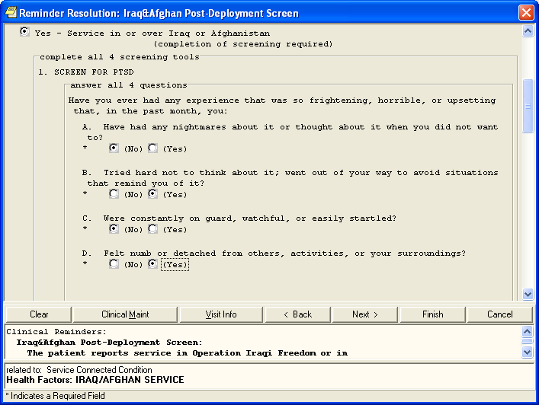
The first of the 4 types of questions (screening tools) relate to PTSD. Answer all 4 of these PTSD questions. Then count the number of questions to which the patient gave a ‘Yes’ answer.

Slide 54
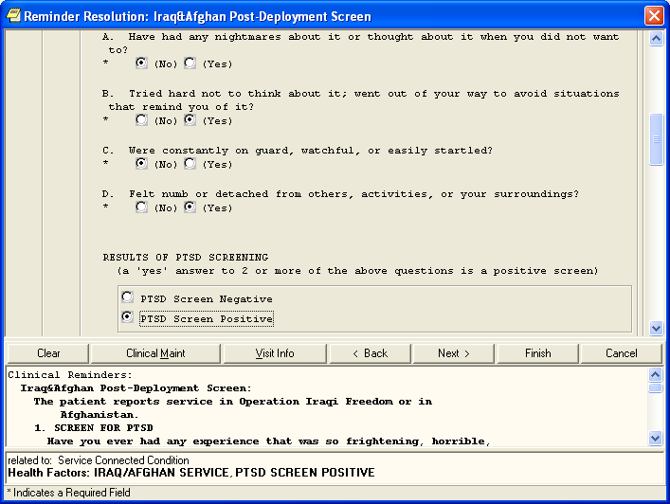
Enter the results of the PTSD Screening: If the patient gave a ‘Yes’ answer to 2 or more of the 4 PTSD questions, then the screening was positive. Check the ‘PTSD Screen Positive’ option. Otherwise check to indicate that the PTSD screen was negative.

Slide 55
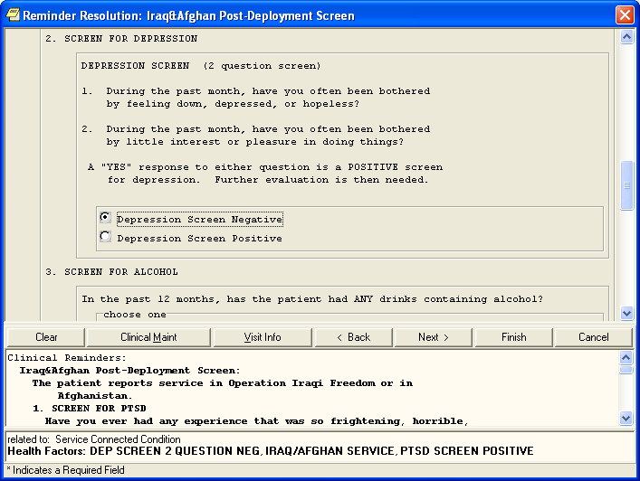
The second set of questions relate to depression. Ask the patient both questions. If the patient answers ‘Yes’ to either one of the 2 questions, then the screening is positive and you should check that option. Otherwise check the option to indicate that the depression screen is negative.

Slide 56
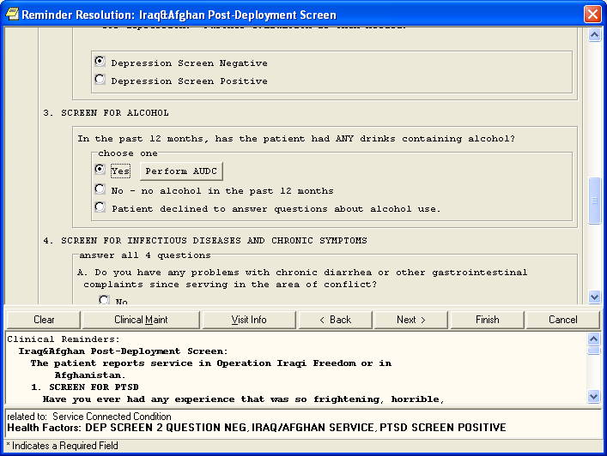
The third set of questions are designed to screen for high risk alcohol use. If the patient has had even one drink of alcohol in the past year, then answer yes to the question and then click on the button to perform the AUDIT-C screening for high risk alcohol use. There are 3 questions in the AUDIT-C screen and the score is automatically recorded when the questions are answered.

Slide 57
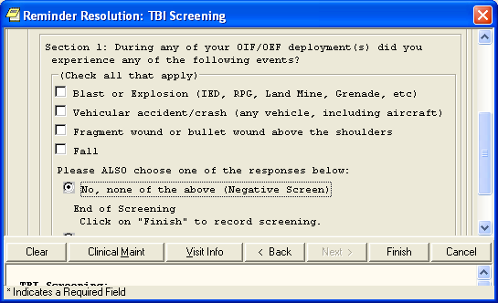
TBI Screening

Slide 58
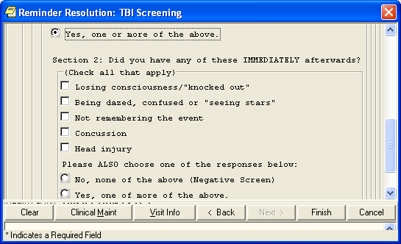
TBI Screen

Slide 59
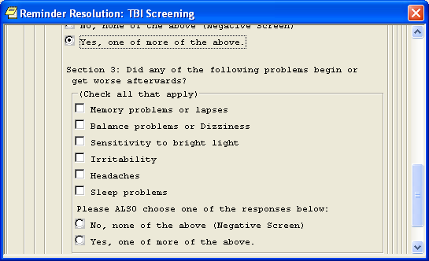
TBI Screen

Slide 60
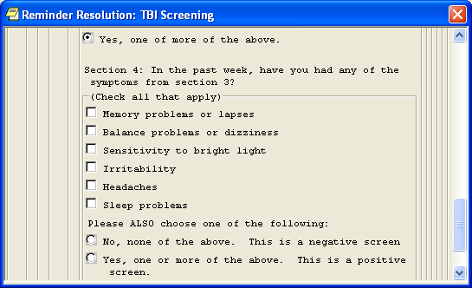
TBI Screen

Slide 61
VA Clinical Initiatives related to OEF/OIF veterans
PTSD program enhancement awards (2005)
Returning Veterans Outreach, Education and Care Programs (RVOEC / 2005)
Suicide Prevention Coordinators
Family psychoeducational programs
OEF / OIF programs (2007)
  Transitional care; case management

Slide 62
What are the research priorities?
“Mapping the Landscape of Deployment Related Adjustment and Mental Disorders: A Meeting Summary of a Working Group to Inform Research”
Recent RFPs
Opinions

Slide 63
PTSD Risk Assessment

Slide 64
PTSD Risk Assessment
Clinical Science R&D Service, in joint collaboration with the National Institute of Mental Health, announces a new opportunity for funding, "Networks for Development PTSD Risk Assessment Tools". This solicitation will utilize electronic submission of proposals to NIH via the R21 mechanism. Details are described in the following link: http://grants.nih.gov/grants/guide/rfa-files/RFA-MH-09-060.html

Slide 65
PTSD risk assessment
This RFA provides VA investigators an opportunity to compete for funding from VA and NIMH to identify clinically useful metrics for PTSD risk assessment that will inform early intervention research, emergency medicine, and other clinicians about who might benefit most from early intervention after trauma. It will be important to have research and clinical decision tools that are sensitive to and meaningful for diverse populations of trauma survivors. Applicants are strongly encouraged to consider the potential impact of multiple socio-demographic characteristics and other factors in choosing data sets for exploration.

Slide 66
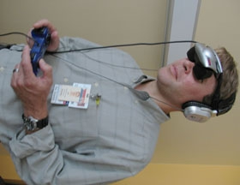

Slide 67
PTSD risk assessment:
Ideas and possibilities
Genetic risk
  FKBP5 Polymorphism (Binder et al., 2008)
Cognitive risk
  Hurricane study
  Interaction impact of rural status on belief systems
Social networks
  Impact of rural status
Rural status
  Combat MOS
  Resilience
  Childhood risk factors
  Experience of trauma

Slide 68
PTSD risk assessment:
Ideas and possibilities
Genetic risk
  FKBP5 Polymorphism (Binder et al., 2008)
Cognitive risk
  Hurricane study
  Interaction impact of rural status on belief systems
Social networks
  Impact of rural status
Rural status
  Combat MOS
  Resilience
  Childhood risk factors
  Experience of trauma

Slide 69
Deployment Health Conditions
(and interactions with stress disorders)
Support
  DoD mechanisms

Slide 70
Deployment Health Conditions
TBI
  Signature “medical” condition of OIF
Issues
  Assessment
  Interaction with PTSD (Hoge et al., 2008)
  Interaction impact of rural status on “experience” of TBI

Slide 71
Deployment Health Conditions
Other Health Outcomes
Issues
  Why is PTSD associated with poor health?
    Stress on body
    Self-care

Slide 72
Interventions for Stress Disorders

Slide 73
Interventions for Stress Disorders
IOM report
Funding
  CSR&D – Clinical Trial Program
  DoD Defense Center of Excellence for Psychological Health and Traumatic Brain Injury
    “studies on Complementary and Alternative Medicine”

Slide 74
Interventions for Stress Disorders
Modality
  Provider
  Mechanism
    Internet (Litz et al., 2007)
    VR
Content
  Exposure and ….
Content and Modality
  Cognitive training studies

Slide 75
Interventions for Stress Disorders
Interventions for risk factors
Interventions for related conditions (TBI)
Medication x psychotherapy interactions
Interventions on related systems
  family

Slide 76
Occupational, family, and social adjustment

Slide 77
Occupational, Family, Social
    MHAT data
      Negative mental health outcomes associated with perceived impaired performance.
        Rural occupations????
      Negative family outcomes associated with mental health problems (increased suicidal behavior).
        Rural social support systems??

Slide 78
Healthcare Systems

Slide 79
Healthcare Systems
Economic analyses
Dissemination / Implementation
Barriers to care
  Stigma
Epi studies
  Rural veterans

