Slide 1


ICC: Using Information to Link Providers and Patients in a Region
Paul Gionfriddo Executive Director
HCAP Meeting January 2004
are
pgionfriddo@icc-centex.org

Slide 2
Common Eligibility:
Medicaider/Case Tracker

Slide 3

Medicaider
Common Eligibility Tool, Screens for Medical Assistance and Charitable Programs
In use since August 2002
37,179 interviews of uninsured people completed by January 1, 2004
Current average: 6,000 screens per month
Average screening time: 3.1 minutes

Slide 4
Medicaider Process
Uninsured patient is screened anonymously by provider or service agency at the time of encounter.
After screening, Medicaid/SCHIP eligible patients are asked to provide name and phone number to receive application assistance.
Medicaider information is saved in Case Tracker.
Insure-a-Kid outreach worker logs on to Case Tracker from central location and follows up with patient.

Slide 5
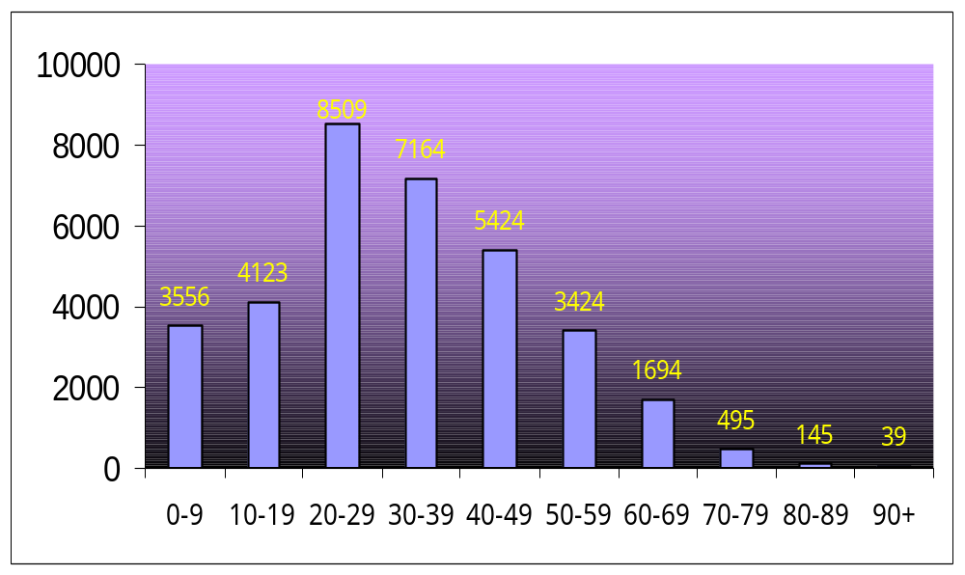
Uninsured Patients Screened by Age thru 2003

Slide 6
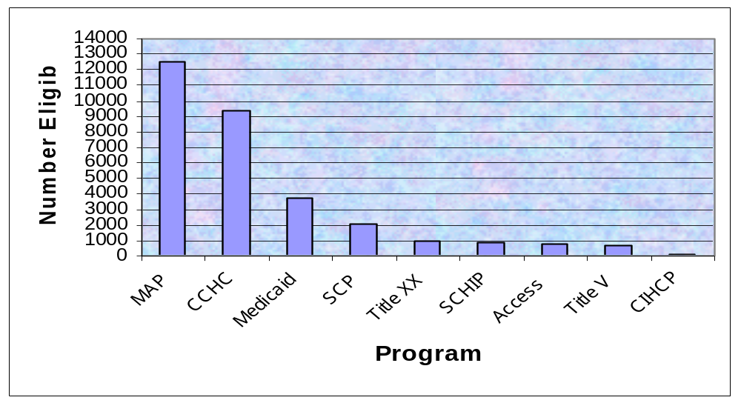
Eligibility of Uninsured Patients Screened through December 2003

Slide 7
Impact: Medicaider and Case Tracker
Since July 1, 2003, ICC members have been reducing the number of uninsured people in Central Texas by over 100 per month using Medicaider and Case Tracker.

Slide 8
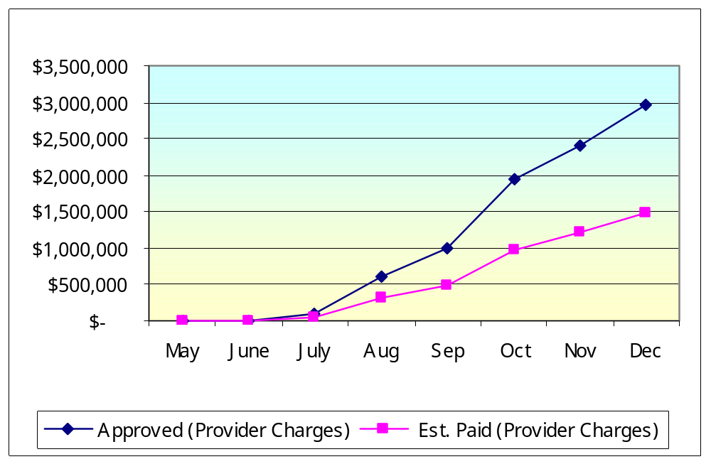
Safety Net Provider Benefits from Medicaider (Cumulative)

Slide 9
are

Slide 10
I-Care System Structure
I-Care is a Master Patient Index (MPI) and Clinical Data Repository (CDR).
ICC contracts with EPIC and Ascension ISD for software and ASP services.
Electronic interfaces are constructed with existing safety net provider electronic databases to build a shared health record.
Record includes encounter codes (ICD9, CPT), some pharmacy, and will have lab.
No duplicate data entry.

Slide 11

MPI/CDR Status:
January 9, 2004
251,025 patients in MPI/CDR (93% uninsured).
  161,907 patients with at least one encounter.
  29,586 patients with authorizations (18% of those with encounters).
491,311 visit encounters.
43,697 pharmacy encounters.

Slide 12
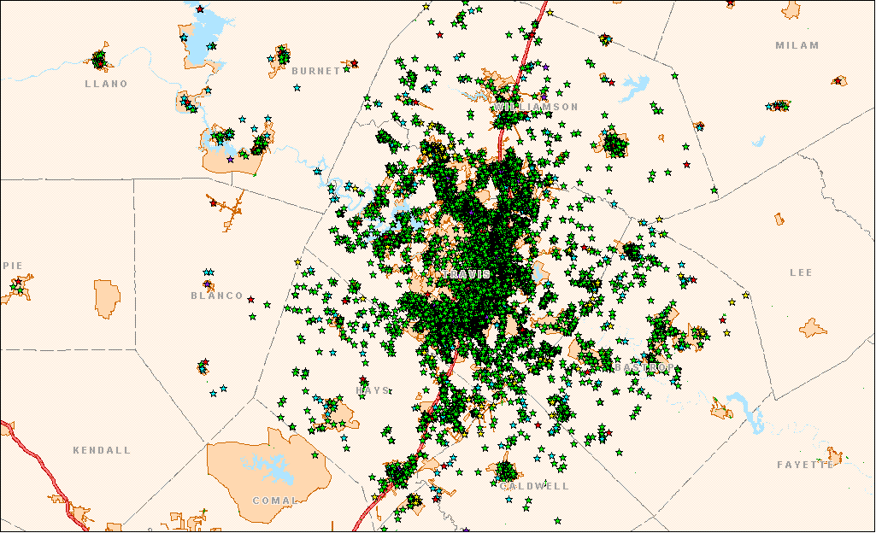
MPI: Patient Mapping – System Wide and by Subgroups
Source: ICC Master Patient Index, 2003

Slide 13
CDR 2003: For What Do Uninsured People Use a System of Care?
In 2003, The Top 50 Diagnoses Accounted for 57% of all Diagnoses.
Women’s Reproductive Health, and Chronic Conditions, Dominated the Diagnoses List, with Acute Disease and Child Health Following.

Slide 14

Flu Patients, Oct/Nov 2003, Seton Topfer Clinic v. Seton NW Hospital
Blue Star = Patient Using Topfer
= Patient Using NW

Slide 15
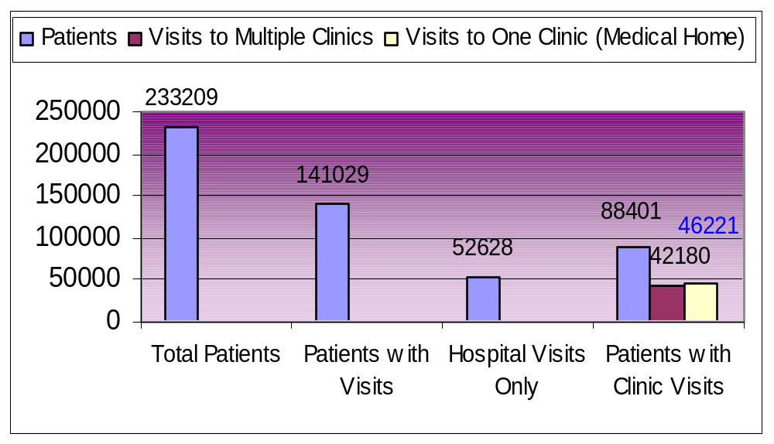
Medical Home Analysis through November 2003

Slide 16
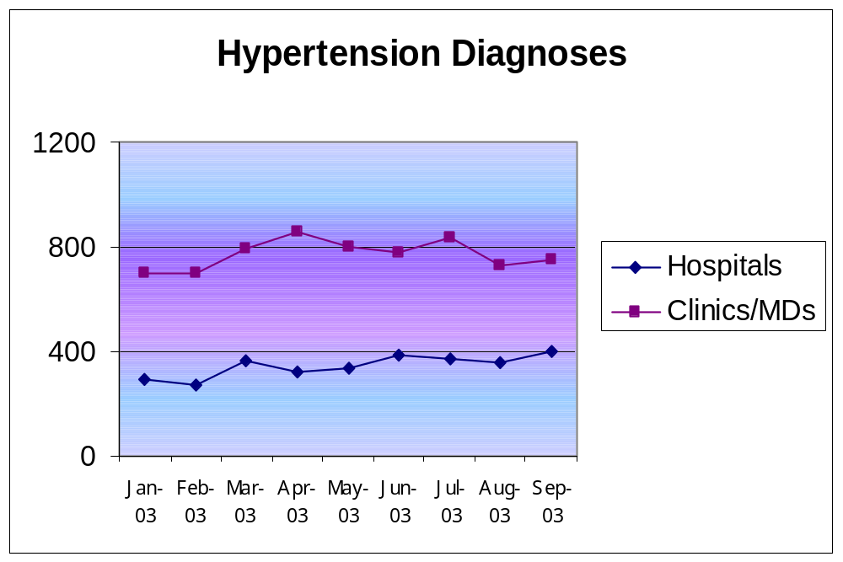
CDR: Demonstrating Relationships between Clinic and Hospital Care

Slide 17
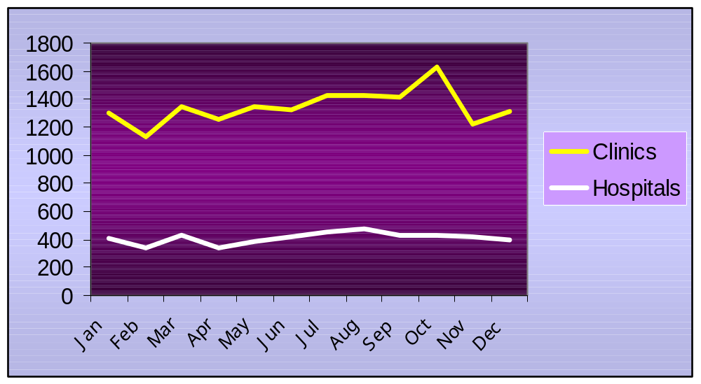
Diabetes: Documenting the Differing Trends in Diagnoses

Slide 18
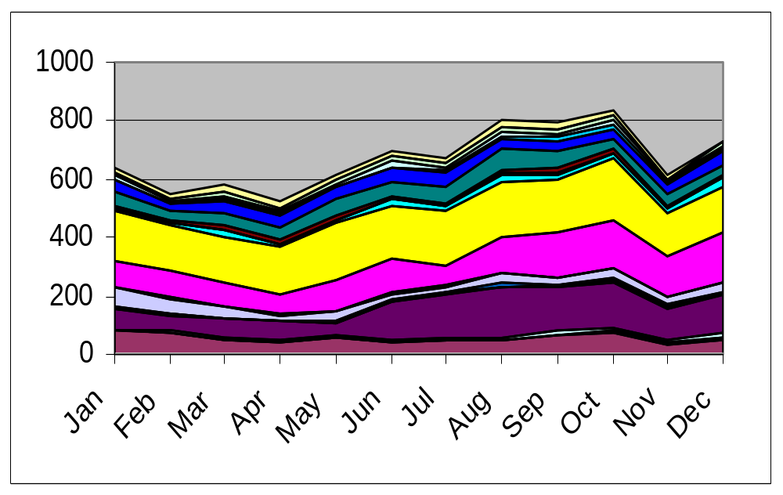
Mental Health: Measuring the Effects of Policy Changes
State Cuts in MH Funding
2003 Mental Health Diagnoses, All Local Providers

Slide 19
Using the MPI/CDR To Evaluate Effectiveness of Interventions
“It is worth noting that the patient who reported going to the ED eleven times within the past 3 months, had actually ‘only’ been in the ED seven times between April and June 2003, according to the ICC’s MPI/CDR data warehouse. However, the patient had been seen an additional 9 times since December 2002, for a total of 16 ED visits between December 2002 and June 2003. This patient was referred into the EMerge program on June 23, 2003 and since that time, has only had one ED visit in August.”
ICC Emerge Evaluation, 10/03

Slide 20
MPI/CDR: Patient Histories Across Providers
Date of Service and Diagnosis: Location:
2/12/2003
780.79-OTHER MALAISE AND FATIGUE SETON NORTHWEST
789.00-ABDOMINAL PAIN UNSPEC SITE SETON NORTHWEST
5/18/2003
E968.2-ASSAULT-STRIKING W OBJ SETON NORTHWEST
813.43-FX DISTAL ULNA-CLOSED SETON NORTHWEST
1/14/2003
305.90-DRUG ABUSE NEC-UNSPEC BRACKENRIDGE
311-DEPRESSIVE DISORDER NEC BRACKENRIDGE
3/22/2003
305.90-DRUG ABUSE NEC-UNSPEC BRACKENRIDGE
300.9-NEUROTIC DISORDER NOS BRACKENRIDGE
311-DEPRESSIVE DISORDER NEC BRACKENRIDGE

Slide 21
Building a Health Record through Merging Patient Encounters
3/7/03 Contraceptive Management ATCOH
7/7/03 Abdominal Pain ATCOH
7/10/03 Ovarian Cyst Brack
7/21/03 Abdominal Pain,
Contraceptive Management ATCOH
8/14/03 Administrative Encounter Brack
8/27/03 Ovarian Cyst SSW
9/15/03 Contraceptive Management,
Ovarian Cyst ATCOH
9/23/03 Pain in Joint,
Abnormality of Gait St David’s
10/1/03 Plica Syndrome,
Ankylosis-Lower Leg SNW

Slide 22
Predicting and Altering the Future?…
12/31/02 355.8 - Mononeuritis Leg NOS Brackenridge Hospital
1/5/03 729.5 - Pain in Limb Brackenridge Hospital
1/15/03 355.2 - Femoral Nerve Lesion ATC Manor
1/16/03 728.9 - Muscle/Ligament Dis NOS Brackenridge Hospital
719.70- Difficult Walk NOS
355.9 - Mononeuritis
2/14/03 355.9 - Mononeuritis ATC Manor
4/18/03 729.5 - Pain in Limb ATC Manor
4/30/03 977.8 - Poisoning-Medicinal Brackenridge Hospital
305.90- Drug Abuse NEC-Unspec
5/13/03 975.2 - Poisoning-Skelet Muscle Seton Medical Center
E950.4- Suicide – Drug/Med NEC
…..As of 2/2003, also an ATCMHMR Center Patient

Slide 23
MPI/CDR: What We’ve Learned
Focus equally on technical, legal, and business operations.
Don’t require duplicate data entry.
It takes time and money to build clinical data repositories – but they can be built quickly.
The system data are only as good as the data that are sent (maybe a little better).
The system should have in it something useful (i.e., something they’ll pay for) for the customers who will eventually pay.

