Slide 1
Strategic Habitat Conservation (SHC) is an adaptive management approach to conservation planning, implementation, and evaluation.

Slide 2
The results of Strategic Habitat Conservation is conservation of species and the ecological processes that sustain them.

Slide 3

Strategic Habitat Conservation
(SHC)
4 elements
Biological
Planning
Conservation
Design
Monitoring
And
Research
Delivery of
Conservation Actions
Notes:
Biological
Biological Planning

Slide 4
Strategic Habitat Conservation is
It’s a tool to aid decision making in the pursuit of achieving our mission objectives;
It employs science to plan, implement and evaluate conservation actions;
It can be applied at many scales.
It represents a form of adaptive management specifically tailored to habitat conservation.

Slide 5
Strategic Habitat Conservation
No reorganization involved in SHC
Program functions remain intact
Cross program coordination is a product of SHC
SHC designs and implements conservation
SHC invites US Geological Survey participation and other essential Partners

Slide 6
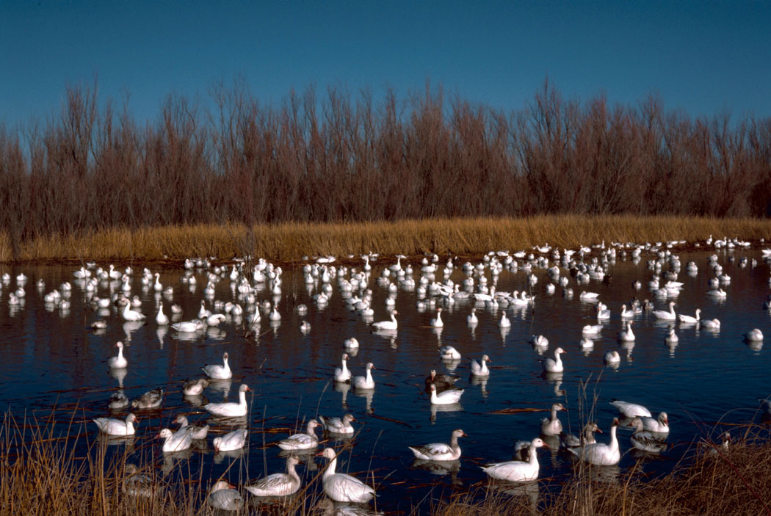
Regional Milestones
Education of the FWS workforce about SHC
Identification of focal areas
Formation of Scoping Teams for focal areas

Slide 7
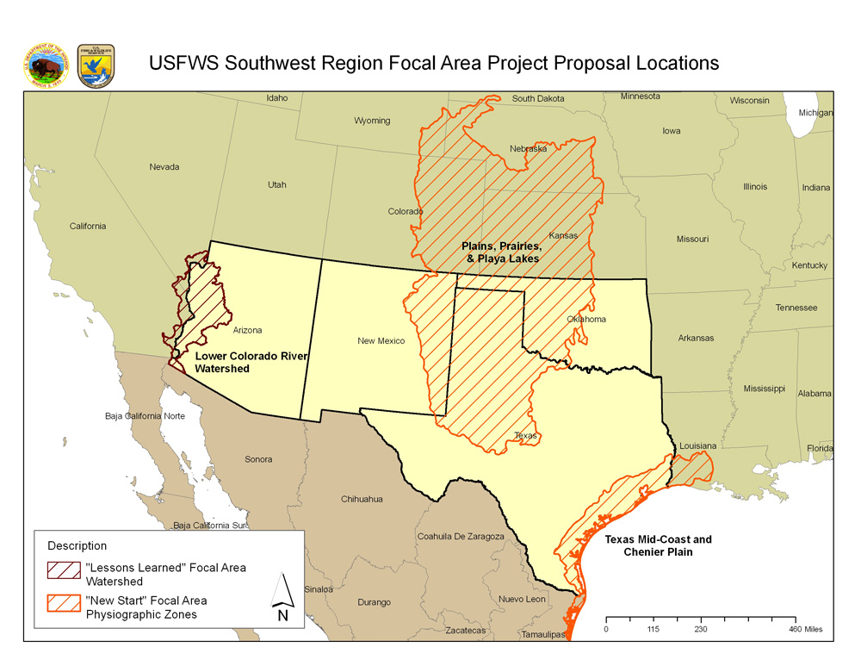
Focal Areas
Plains, Prairies & Playa Lakes
Texas Mid-Coast and Chenier Plain
Lower Colorado River Watershed

Slide 8
Region 2 Implementation Team
Todd Jones, DRD (Chair)
Brian Hanson, ES (Co-chair)
Nancy Gloman, ARDES (Acting)
Chris Pease, ARDNWR
Greg Pratschner, ARDFR
Nicholas Chavez, SAC
David Yazzie, ARDBA
Charna Lefton, ARDEA
Charlie Ault, RSO
Alisa Shull, Austin ES
Brian Millsap, NM State Admin, ES
Kathy Granillo, NWR
Mark Kaib, Fire Management
Steve Cullinan, DNR, NWR
Chris Botnick, ES
Jim Dick, NWI, ES
Elizabeth Slown, EA
Bob Anderson, DFA
Patrick Donnelly, HAPET
Greg Esslinger, NAWMP
Joy Nicholopoulos, Texas State Admin, ES
Art Needleman, NWR

Slide 9
The Strategic Habitat Conservation document can be accessed at:
http://www.fws.gov/southwest/es/Documents/R2ES/Strategic_Habitat_Conservation_FINAL_Report_of_Eco_Assess_July2006.pdf

