Slide 1

Patch Occupancy Dynamics: Estimation and Modeling Using “Presence-absence” Data

Slide 2
Patch Occupancy: The Problem
Conduct “presence-absence” (detection-nondetection) surveys
Estimate what fraction of sites (or area) is occupied by a species when species is not always detected with certainty, even when present (p < 1)

Slide 3
Patch Occupancy: Motivation
Extensive monitoring programs
Incidence functions and metapopulations
Disease modeling
Surveys of geographic range and temporal changes in range

Slide 4
Key Design Issue: Replication
*Temporal replication: repeat visits to sample units
Spatial replication: randomly selected subsample units within each sample unit
Replicate visits occur within a relatively short period of time (e.g., a breeding season)

Slide 5
Data Summary: Detection Histories
A detection history for each visited site or sample unit
  1 denotes detection
  0 denotes nondetection
Example detection history: 1 0 0 1
  Denotes 4 visits to site
  Detection at visits 1 and 4

Slide 6
Model Parameters and Assumptions
The detection process is independent at each site
No heterogeneity that cannot be explained by covariates
Sites are closed to changes in occupancy state between sampling occasions

Slide 7
Model Parameters and Assumptions
ψ_{i} -probability site i is occupied
p_{ij} -probability of detecting the species in site i at time j, given species is present

Slide 8
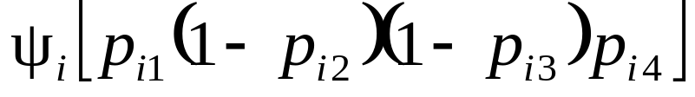
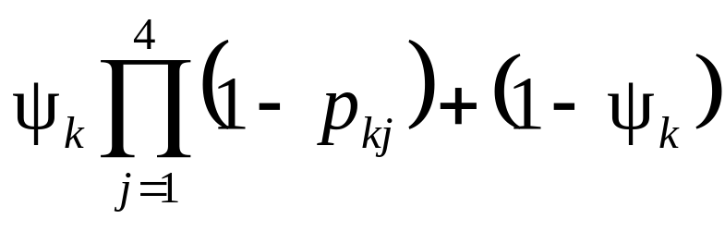
A Probabilistic Model
Pr(detection history 1001) =
Pr(detection history 0000) =

Slide 9
A Probabilistic Model
The combination of these statements forms the model likelihood
Maximum likelihood estimates of parameters can be obtained
However, parameters cannot be site specific without additional information (covariates)
Suggest non-parametric bootstrap be used to estimate SE

Slide 10
Software
Windows-based software:
  Program PRESENCE (Darryl MacKenzie)
  Program MARK (Gary White)
Fit both predefined and custom models, with or without covariates
Provide maximum likelihood estimates of parameters and associated standard errors
Assess model fit

Slide 11
Example: Anurans at Maryland Wetlands (Droege and Lachman)
FrogwatchUSA (NWF/USGS)
Volunteers surveyed sites for 3-minute periods after sundown on multiple nights
29 wetland sites; piedmont and coastal plain
27 Feb. – 30 May, 2000
Covariates:
  Sites: habitat ([pond, lake] or [swamp, marsh, wet meadow])
  Sampling occasion: air temperature

Slide 12
Example: Anurans at Maryland Wetlands (Droege and Lachman)
American toad (Bufo americanus)
  Detections at 10 of 29 sites
Spring peeper (Hyla crucifer)
  Detections at 24 of 29 sites

Slide 13

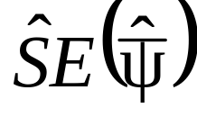
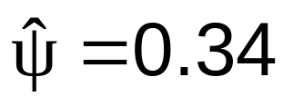
Example: Anurans at Maryland Wetlands (B. americanus)
Model | ΔAIC
ψ(hab)p(tmp) | 0.00 | 0.50 | 0.13
ψ(.)p(tmp) | 0.42 | 0.49 | 0.14
ψ(hab)p(.) | 0.49 | 0.49 | 0.12
ψ(.)p(.) | 0.70 | 0.49 | 0.13
Naive

Slide 14
Patch Occupancy as a State Variable: Modeling Dynamics
Patch occupancy dynamics
Model changes in occupancy over time
Parameters of interest:
  λ_{t} = ψ_{t+1}/ ψ_{t} = rate of change in occupancy
  ε_{t} = P(absence at time t+1 | presence at t) = patch extinction probability
  γ_{t} = P(presence at t+1 | absence at t) =
  patch colonization probability

Slide 15
Pollock’s Robust Design: Patch Occupancy Dynamics
Sampling scheme: 2 temporal scales
  Primary sampling periods: long intervals between periods such that occupancy status can change
  Secondary sampling periods: short intervals between periods such that occupancy status is expected not to change

Slide 16
Robust Design
Capture History
History : 10 00 11 01
↑primary(i) ↑secondary(j)
10, 01, 11 = presence
Interior ‘00’ =
  Patch occupied but occupancy not detected, or
  Patch not occupied (=locally extinct) yet recolonized later

Slide 17
Robust Design Detection History
History : 10 00 11 01
↑primary(i) ↑secondary(j)
Parameters:
  1-ε_{t}: probability of survival from t to t+1
  p*_{t}: probability of detection in primary period t
  p*_{t} = 1-(1-p_{t1})(1-p_{t2})
  γ_{t}: probability of colonization in t+1 given absence in t

Slide 18
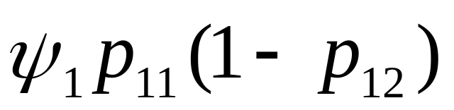
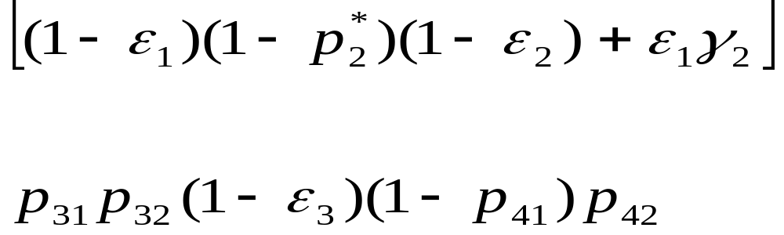
Modeling
P(10 00 11 01) =

Slide 19
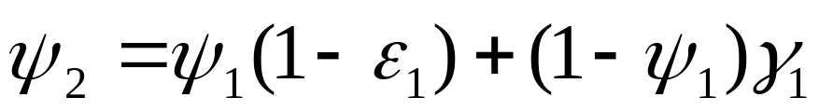
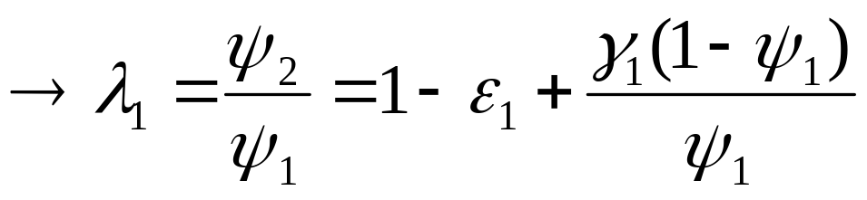
Parameter Relationships: Alternative Parameterizations
Standard parameterization: (ψ₁, ε_{t}, γ_{t})
P(occupied at 2 | ψ₁, ε₁, γ₁) =
Alternative parameterizations: (ψ₁, ε_{t}, λ_{t}), (ψ₁, λ_{t}, γ_{t}), (ψ_{t}, ε_{t}), (ψ_{t}, γ_{t})

Slide 20
Main assumptions
All patches are independent (with respect to site dynamics) and identifiable
  Independence violated when subpatches exist within a site
No colonization and extinction between secondary periods
  Violated when patches are settled or disappear between secondary periods => breeding phenology, disturbance
No heterogeneity among patches in colonization and extinction probabilities except for that associated with identified patch covariates
  Violated with unidentified heterogeneity (reduce via stratification, etc.)

Slide 21
Software
PRESENCE: Darryl MacKenzie
  Open models have been coded and used for a few sample applications.
  Darryl is writing HELP files to facilitate use.
MARK: Gary White
  Implementation of one parameterization of the open patch-dynamics model based on the MacKenzie et al. ms

Slide 22
Example Applications
Tiger salamanders (Minnesota farm ponds and natural wetlands, 2000-2001; Melinda Knutson)
  Estimated p’s were 0.25 and 0.55
  Estimated P(extinction) = 0.17; Naïve estimate = 0.25
Northern spotted owls (California study area, 1997-2001; Alan Franklin)
  Potential breeding territory occupancy
  Estimated p range (0.37 – 0.59); Estimated λ=0.98
  Inference: constant P(extinction), time-varying P(colonization)

Slide 23
Example: Range Expansion by House Finches in Eastern NA
Released at Long Island, NY, 1942
Impressive expansion westward
Data from NA Breeding Bird Survey
  Conducted in breeding season
  >4000 routes in NA
  3-minute point counts at each of 50 roadside stops at 0.8 km intervals for each route
Occupancy analysis: based on number of stops at which species detected – view stops as geographic replicates for route

Slide 24
House Finch Range Expansion: Modeling
26 100-km “bands” extending westward from NY
Data from every 5th year, 1976-2001
Model parameterization: (ψ₁, ε_{t}, γ_{t}, p_{t})
Low-AIC model relationships:
  Initial occupancy, ψ₁ = f(distance band)
  P(colonization), γ_{t} = f(distance*time)
  P(extinction), ε_{t} = f(distance)
  P(detection), p_{t} = f(distance*time)

Slide 25
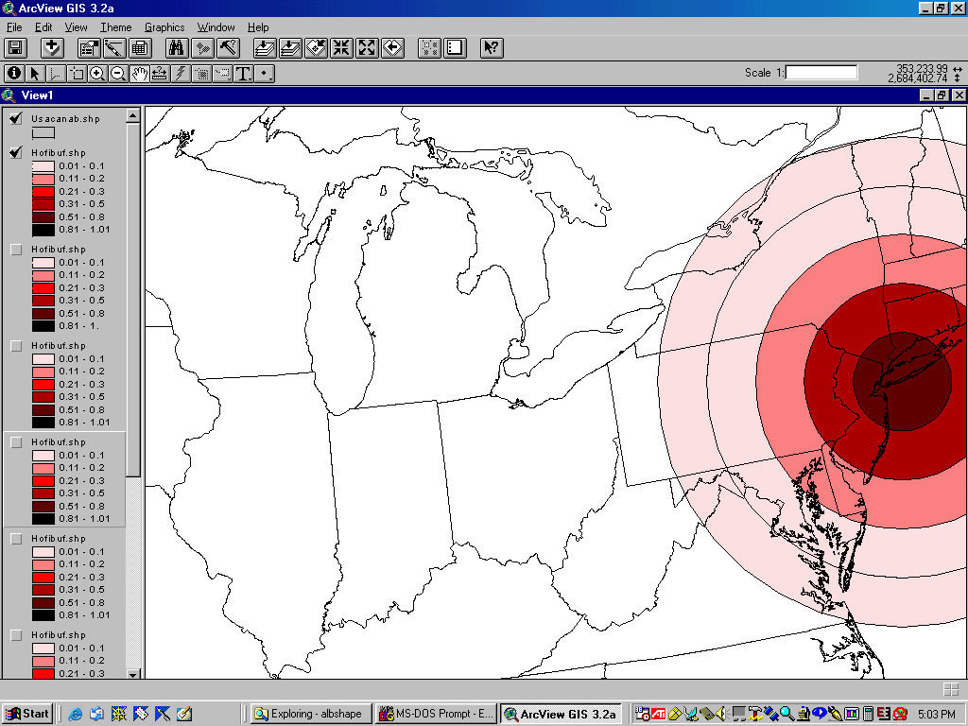

Slide 26
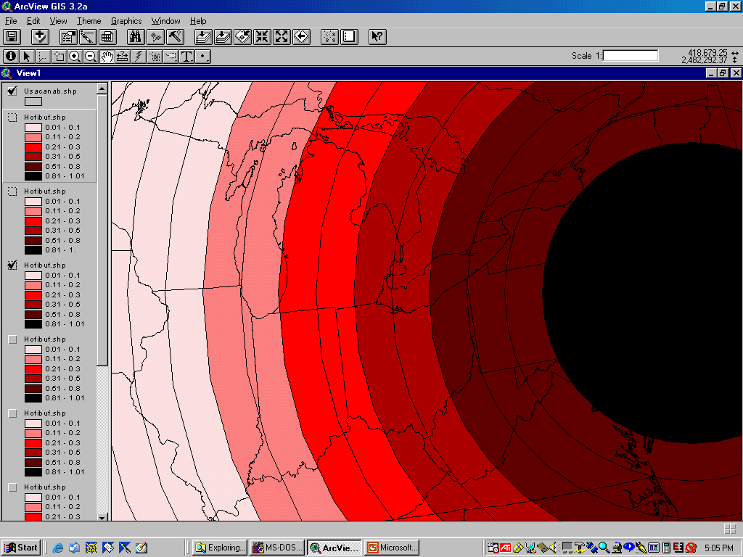

Slide 27
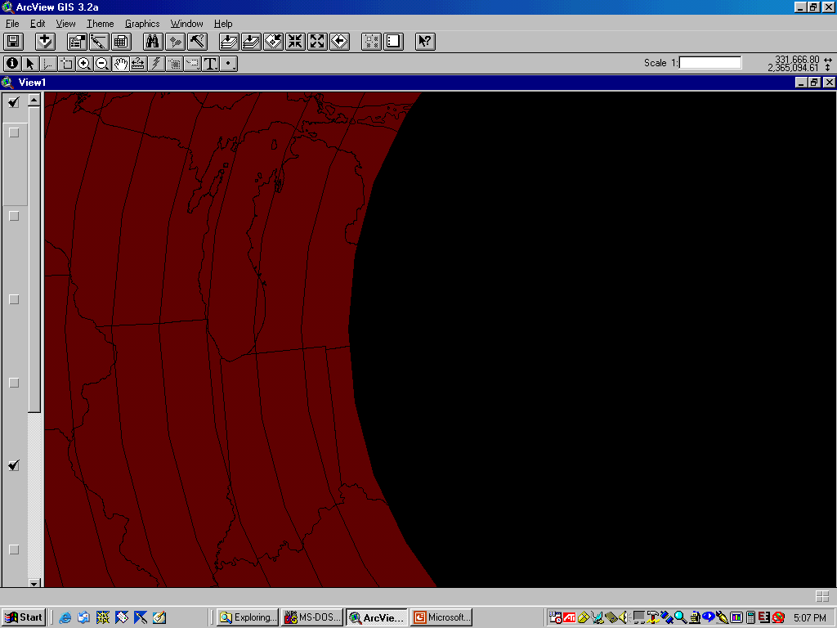

Slide 28
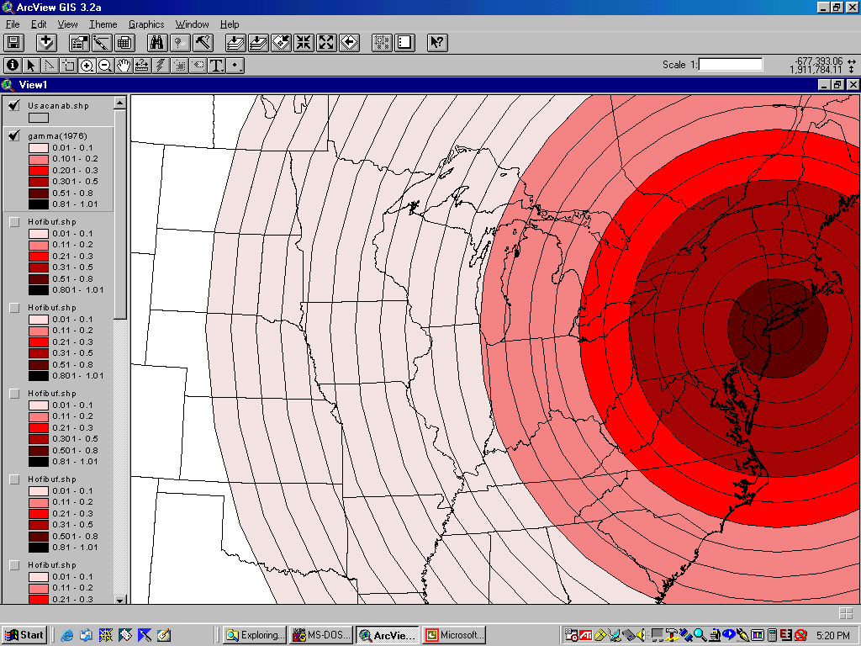
Gamma(1976)

Slide 29
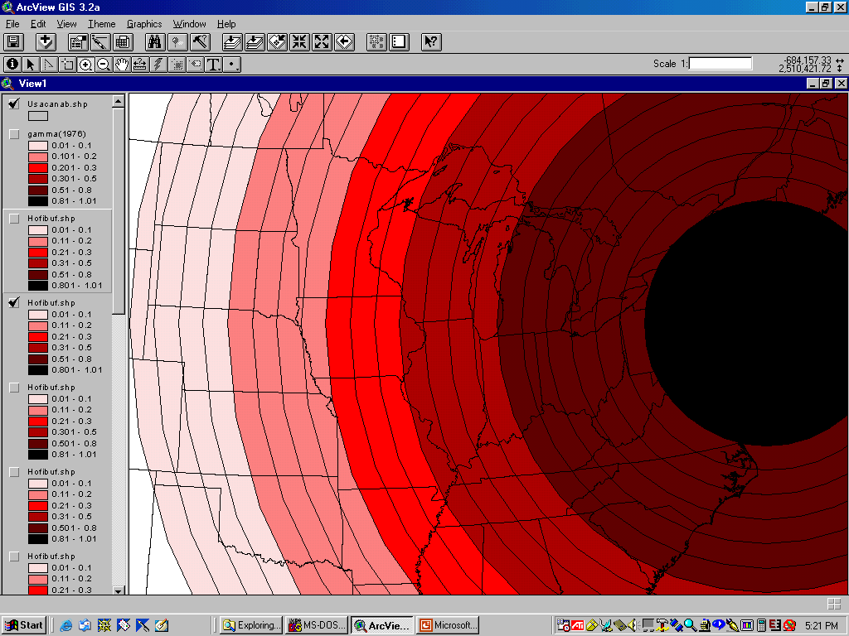

Slide 30
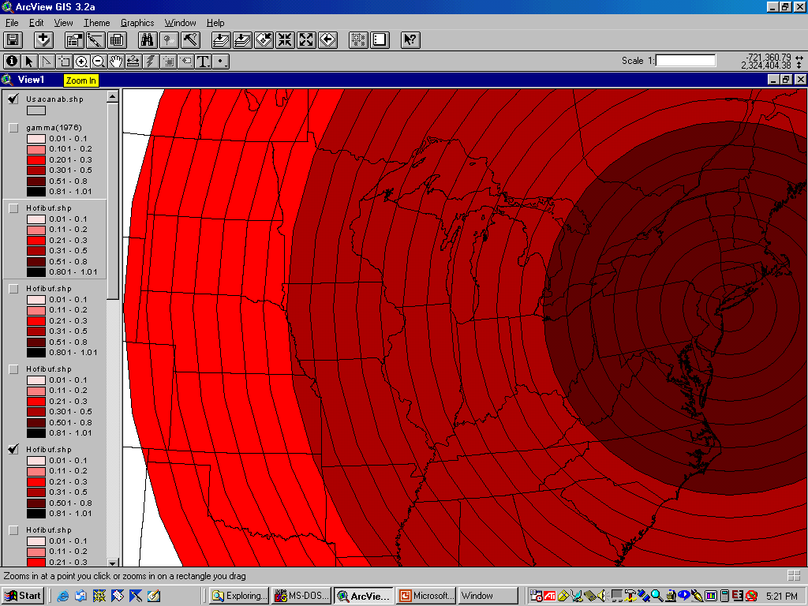
Gamma(1996)

Slide 31
Purple Heron, Ardea purpurea, Colony Dynamics
Colonial breeder in the Camargue, France
Colony sizes from 1 to ≈300 nests
Colonies found only in reed beds; n = 43 sites
Likely that p < 1
breeds in May => reed stems grown
small nests (≈ 0.5 m diameter ) with brown color (similar to reeds)

Slide 32
Purple Heron Colony Dynamics
Two surveys (early May & late May) per year by plane (100 m above ground) covering the entire Camargue area, each lasting one or two days
Since 1981 (Kayser et al. 1994, Hafner & Fasola 1997)
Study area divided in 3 sub-areas based on known different management practices of breeding sites (Mathevet 2000)

Slide 33
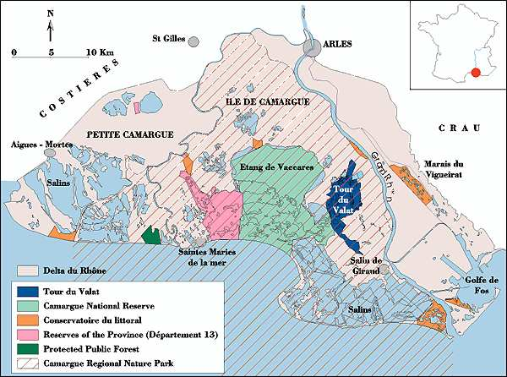
Purple Heron Study Areas
East:
protected
West:
disturbance
Central:
DISTURBANCE

Slide 34
Purple Heron Colony Dynamics: Hypotheses
Temporal variation in extinction\colonization probabilities more likely in central (highly disturbed) area.
Extinction\colonization probabilities higher in central (highly disturbed) area?

Slide 35
Purple Heron Colony Dynamics:
Model Selection
Model | AICc | np | χ² | df | P
[ε_{g*t}, γ_{g*t}] | 405.6 | 114 | - | - | -
[ε_{g*t}, γ_{t}] | 352.5 | 76 | 40.6 | 38 | 0.36
[ε_{g*t}, γ_{g}] | 357.1 | 60 | 81.8 | 54 | 0.009
[ε_{g*t}, γ] | 356.9 | 60 | 80.2 | 54 | 0.012
[ε_{t}, γ_{t}] | 348.5 | 38 | 109.5 | 76 | 0.006
[ε_{w=e(.) c(t)}, γ_{t}] | 308.0 | 39 | 78.4 | 75 | 0.38
[ε_{g}, γ_{t}] | 310.4 | 22 | 108.8 | 92 | 0.11
LRT [ε_{g*t}, γ_{t}] vs [ε_{g}, γ_{t}] : χ²₅₄ = 80.5, P = 0.011

Slide 36
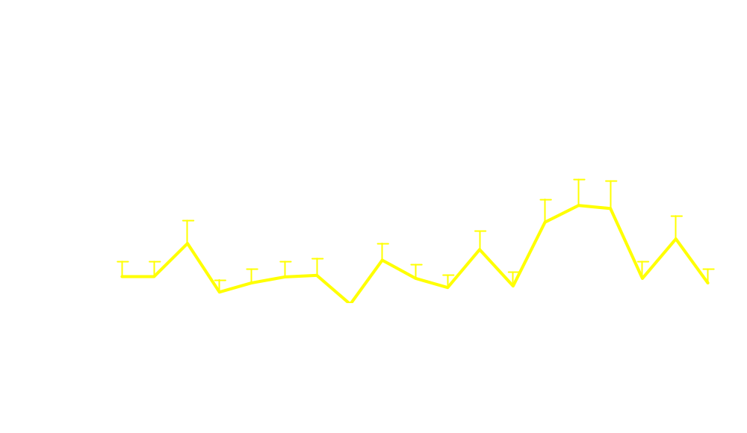
Purple Heron Colonization Probabilities

Slide 37
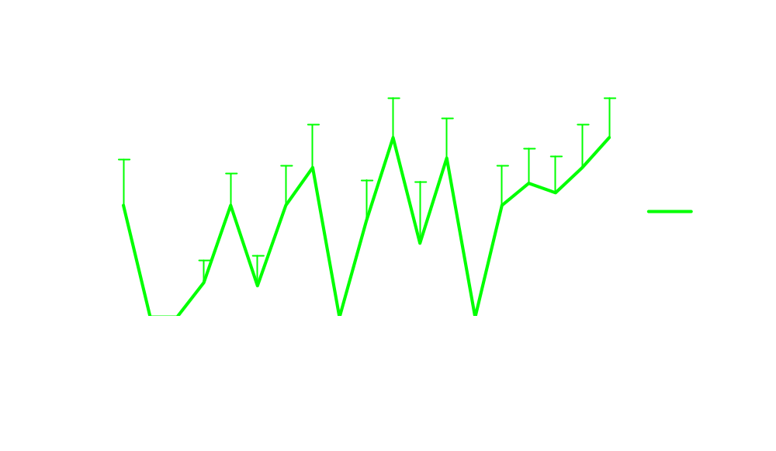
Purple Heron Colony Extinction Probabilities
Extinction west = east = 0.137 ± 0.03

Slide 38
Purple Heron Colony Dynamics
Is colonization of sites in the west or east a function of extinction in central?
Linear-logistic models coded in SURVIV:
γ_{w} = e^{(a + b × φc)}/(1+e^{(a + b × φc)})
γ_{e} = e^{(a + b × φc)}/(1+e^{(a + b × φc)})
a = intercept parameter
b = slope parameter
φ = 1-ε

Slide 39
Purple Heron Colony Dynamics Model Selection
Model | AICc | np | χ² | df | P
[φ_{w=e(.) c(t)}, γ_{t}] | 308.0 | 39 | 78.4 | 75 | 0.38
[, γ_{w=f(φc)}] | 315.2 | 41 | 80.0 | 73 | 0.27
[, γ_{e=f(φc)}] | 319.1 | 41 | 86.7 | 73 | 0.13
Intercept = -0.29 ± 0.50 (-1.27 to 0.69)
Slope = -3.59 ± 0.61 (-4.78 to –2.40)

Slide 40
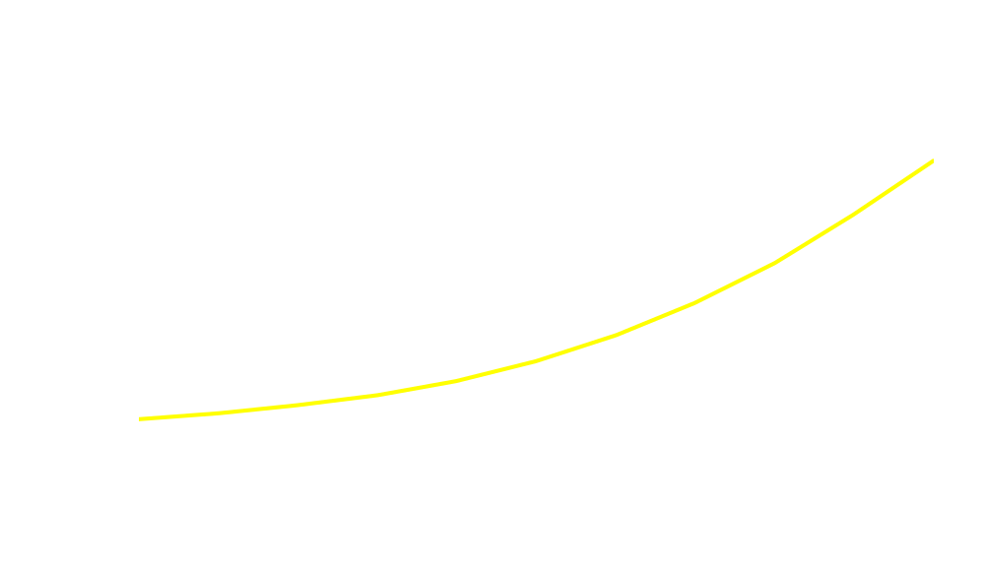
Purple Heron Colony Dynamics

Slide 41
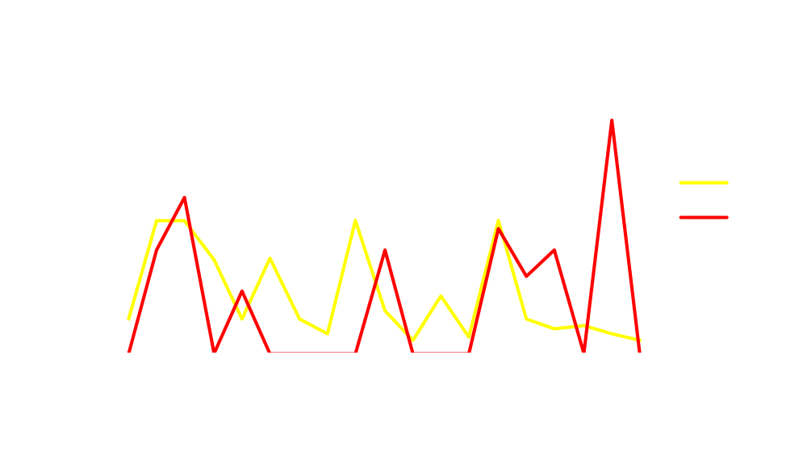
Purple Heron Colony Dynamics

Slide 42
Conclusions
“Presence-absence” surveys can be used for inference when repeat visits permit estimation of detection probability
Models permit estimation of occupancy during a single season or year
Models permit estimation of patch-dynamic rate parameters (extinction, colonization, rate of change) over multiple seasons or years

Slide 43
Occupancy Modeling
Ongoing and Future Work
Heterogeneous detection probabilities
  Finite mixture models
  Detection probability = f(abundance), where abundance ~ Poisson
Multiple-species modeling
  Single season
  Multiple seasons
Hybrid models: presence-absence + capture-recapture
Study design optimization

