Slide 1

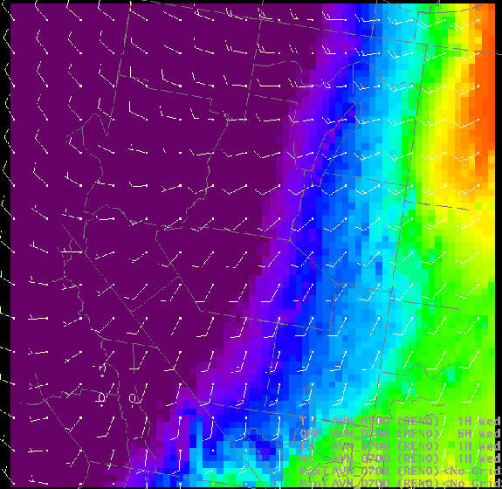
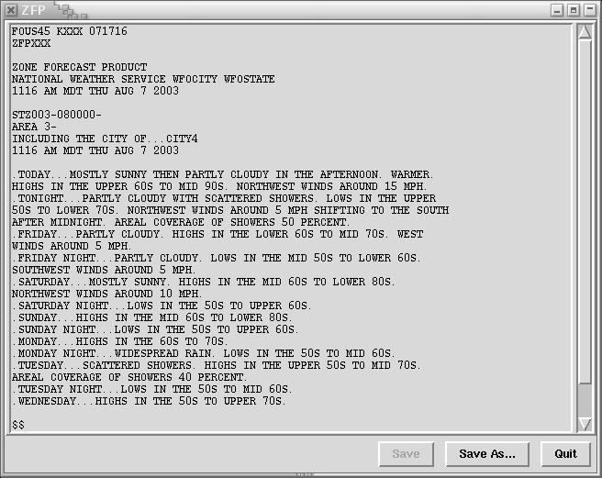
Grids to Text

Slide 2
Inception 9/98
Exploration
GFESuite
Text Products
Multiple
versions
Backward
Compatible
Local Formatter
Infusion Plan 8/02

Slide 3
Rapid Prototype Process
NWS Text Product
DIRECTIVES
GFESuite
BASELINE CODE
Bug Reports
Enhancements
LOCAL
APPLICATION
CODE

Slide 4

Grids to Text
Partly cloudy.
Highs in the 50’s.

Slide 5

Grids to Text
Chance of rain and
patchy fog in the morning.
Chance of rain in the
afternoon.
Chance of rain. Patchy fog in the morning.

Slide 6
Grids to Text
Chance of rain and drizzle
in the early evening.
Chance of rain and drizzle mixed with patchy fog in the late evening.
Chance of rain and drizzle
mixed with blowing snow
after midnight.
Chance of rain and drizzle. Patchy fog in the evening then blowing snow after midnight.

Slide 7
“Holographic” Processing
Narrative Tree
Component
Today
Component
Tonight
Phrase
Wind Phrase
Phrase
PoP Phrase
Phrase
Wx Phrase
north
40 to 45 mph
chance of
snow 20
percent
slight chance
of snow

Slide 8
Holographic” Processing
Narrative Tree
Component
Today
Component
Tonight
Phrase
Sky Phrase
Phrase
Wind Phrase
Phrase
PoP Phrase
Phrase
Wx Phrase
southeast
5 to 15 mph
north
40 to 45 mph
chance of
snow 20
percent
slight chance
of snow

Slide 9
Holographic” Processing
Narrative Tree
Component
Today
Component
Tonight
Phrase
Wind Phrase
Phrase
Sky Phrase
Phrase
PoP Phrase
Phrase
Wx Phrase
southeast
5 to 15 mph
north
40 to 45 mph
chance of
snow 20
percent
slight chance
of snow

Slide 10
Rapid Prototype Process
GFESuite
BASELINE CODE
Text
Creation
Rules and
Dependencies
FORECASTER
FEEDBACK

Slide 11
Standardized Local
Products 6/03
Inception 9/98
Consolidation
Exploration
Integrating
Versions
GFESuite
Text Products
Multiple
versions
Changing
Infrastructure
Backward
Compatible
Local Formatter
Infusion Plan 8/02

Slide 12
Grids as Source of
NWS Products
GFESuite
Text
Product
Software
NATIONAL
TEXT PRODUCTS
NOAA
WEATHER RADIO
NEW LOCAL
TEXT PRODUCTS

Slide 13
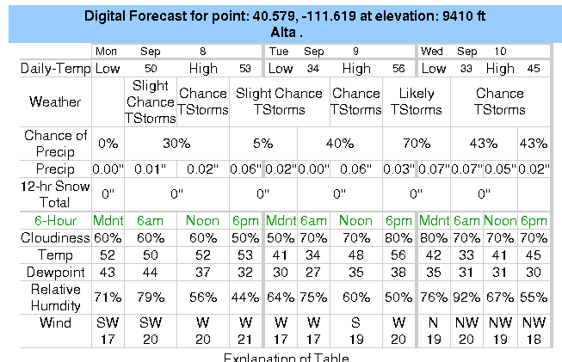
Grids as Source of
NWS Products

Slide 14
Grids as Source of
NWS Products
GFESuite
Text
Product
Software
NATIONAL
TEXT PRODUCTS
NOAA
WEATHER RADIO
NEW LOCAL
TEXT PRODUCTS

Slide 15
Improve Quality of Grids by
Injecting SCIENCE into the Forecast Process
RPP Focus Group
Innovative Processing Techniques

