Slide 1
OVI Absorption in the Local Interstellar Medium
Bill Oegerle (NASA/GSFC)
A review of 2 OVI surveys of the LISM conducted with the Far Ultraviolet Spectroscopic Explorer:
Oegerle, Jenkins, Shelton, Bowen & Chayer (2005)
Savage & Lehner (2006)

Slide 2
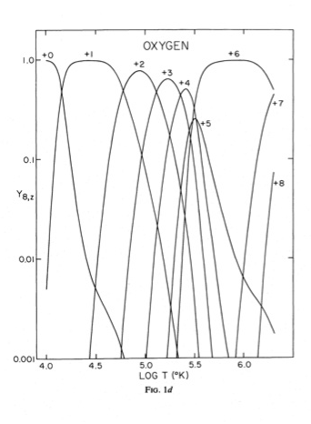
OVI is an important diagnostic of Hot Gas in the ISM
Ionization energy to convert OV to OVI is 114eV.
Hence, OVI in the ISM is created largely by electron collisions, and not by photoionization.
Peak fractional abundance in CIE is ~0.22 at T=2.8e5 K
Collisonal Ionization Equilibrium, Shapiro & Moore 1976

Slide 3
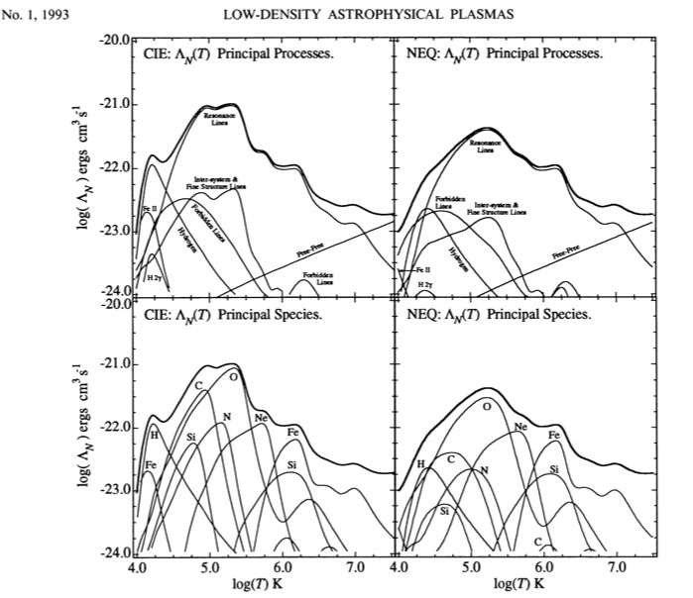
OVI is the dominant coolant in transition temperature gas at 300,000 K
Sutherland & Dopita 1993

Slide 4
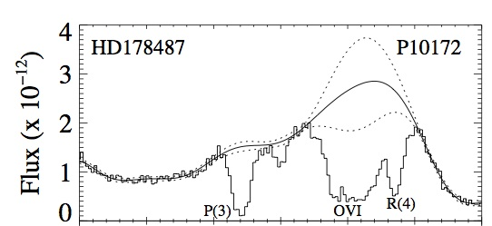
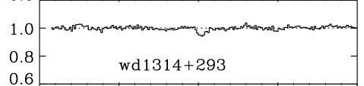
LISM = A Local Laboratory for studying physics of 3-phase medium
Short (~100 pc) path lengths provide relatively uncomplicated lines of sight - no HD, weak or no H2, few cloud components
Nearby DA white dwarfs provide background sources for absorption line studies:
compared to OB stars, their continua are easily determined
No stellar wind lines
In most cases, no photospheric metal lines
1031 1032
OVI
Normalized flux
0
500
velocity

Slide 5
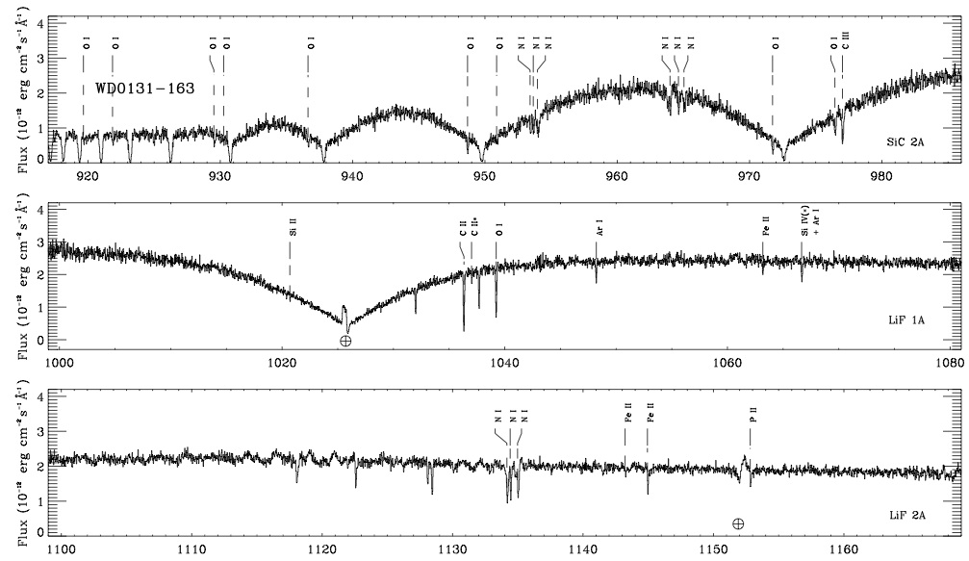
Far-UV spectrum of DA WD
Lehner et al 2003

Slide 6
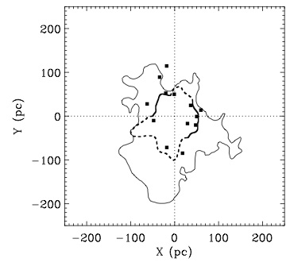
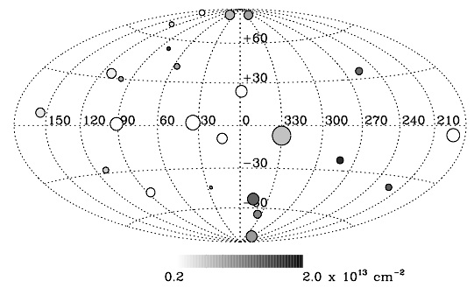
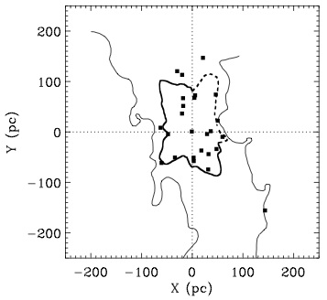
FUSE Surveys of OVI in LISM
Oegerle, Jenkins, Shelton, Bowen & Chayer (2005) survey:
29 DA white dwarfs, d = 35 - 200 pc
4 stars rejected due to strong photospheric lines
2σ detections of OVI along 12 sight lines (48%)
Galactic plane
Meridional plane

Slide 7
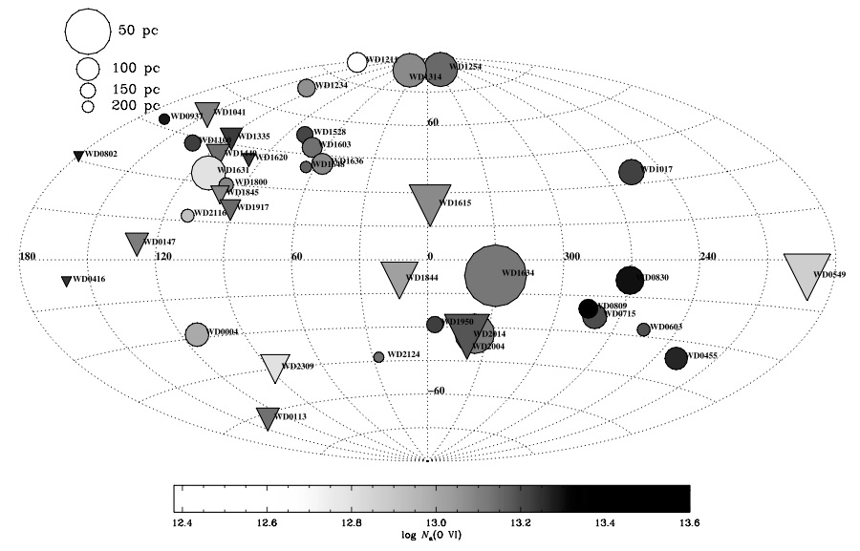
FUSE Surveys of OVI in LISM (contd)
Savage & Lehner (2006) survey:
46 DA white dwarfs, d = 37 - 235 pc (includes Oegerle et al sample)
7 stars rejected due to strong photospheric lines
> 2σ detections of OVI along 24 sight lines (61%)
Triangles: non-detections
Circles: > 2σ detections

Slide 8
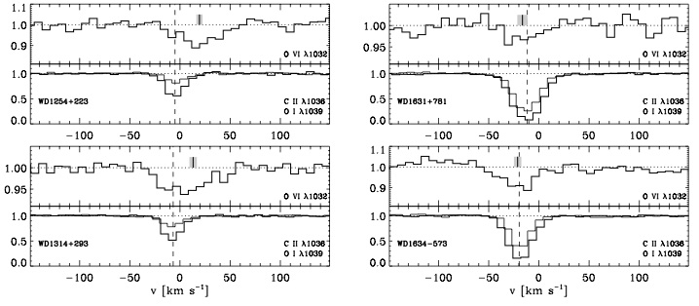
Examples of OVI 1032 absorption lines
plotted over CII 1036 and OI 1039 for reference
Savage & Lehner 2006

Slide 9
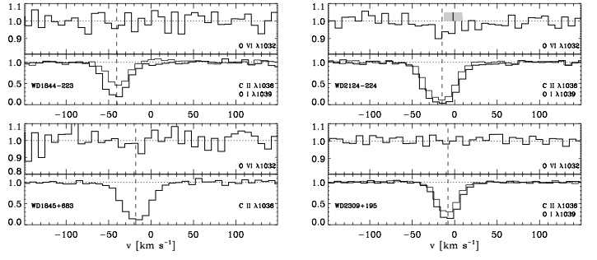
Examples of OVI 1032 absorption lines
plotted over CII 1036 and OI 1039 for reference
No detection
No detection
No detection
Savage & Lehner 2006

Slide 10
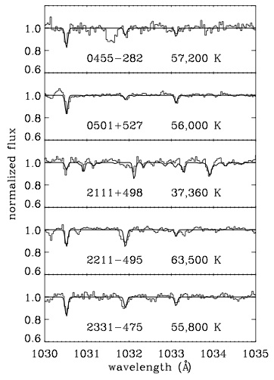
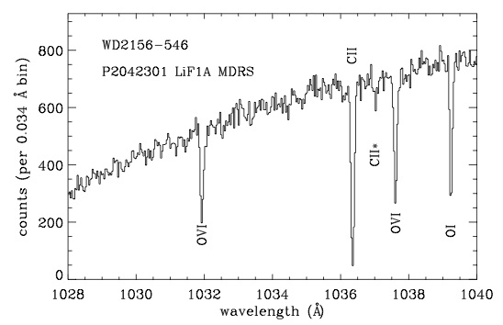
Photospheric OVI
DA white dwarfs are not all pure hydrogen atmospheres
Non-LTE atmosphere models indicate that stars with T<~50,000 K and log(O/H)<-7 should not have measurable stellar OVI 1032
Lines in the OVI 1032 region include PIV 1030.5, 1033.1, Fe III 1030.9, 1032.1, 1033.3
Stars with metal lines are either eliminated from the survey or corrected if possible

Slide 11
Properties of OVI absorption in LISM
In general, the ISM OVI lines are broad and relatively weak. The distribution on the sky is “patchy” with no OVI detected in about half the lines of sight.
Column densities: logN(OVI) = 12.3 - 13.6, with median value of 13.1
Volume density: <N(OVI)/d> ~ 3.6e-8 cm⁻³. ~2x higher than, but remarkably similar to value over much longer Galactic sightlines (Bowen, Jenkins et al 2008)
Line widths: average FWHM ~ 38 km/sec. Some lines as narrow as FWHM=30 km/s are observed, which appear to be single component lines at T=300,000 K. Broader lines are often asymmetric
Line velocities: well correlated with cool cloud velocities as traced by CII and OI.

Slide 12
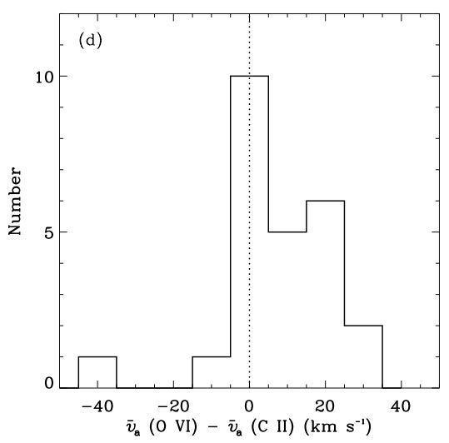
Where does the OVI absorption originate?
The OVI absorption is strongly correlated with the ISM CII line which traces velocity of cool clouds, and is consistent with OVI being formed in the interface region between hot external gas and cool cloud gas.
The broad and often asymmetric OVI lines and association with cool clouds argue against a photospheric origin.
Savage & Lehner 2006

Slide 13
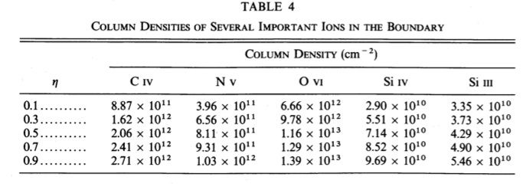
Where does the OVI absorption originate?
Column densities are consistent with models of conductive interfaces by Slavin (1989) and Borkowski et al (1990)
These authors included effects of magnetic fields at the interfaces. Fields parallel to the surface inhibit heat flow across the surface, and result in lower OVI production. Such “magnetic quenching” of conduction could explain patchiness of OVI.
Slavin (1989)
= 1 - B²_{T}/B²,
B_{T} = tangential component of B

Slide 14
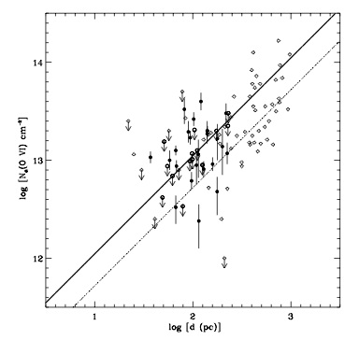
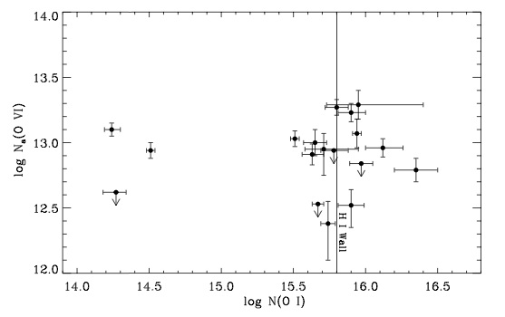
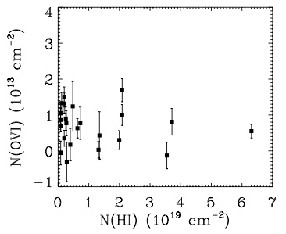
Where does the OVI absorption originate?
Savage & Lehner 2006
HI wall
No strong evidence for big leap in N(OVI) at LB wall.
A few WDs near or beyond wall have very low N(OVI)
A few WDs beyond wall have slight excess N(OVI) of ~ 10¹³ cm⁻²
Again, evidence of patchiness

Slide 15
Conclusions
OVI exists in the Local Bubble.
The OVI 1032 lines are relatively weak (<~10¹³ cm⁻²) and generally broader than expected for T=300,000K implying multiple unresolved components
OVI appears to be “patchy” (not seen along all sightlines)
The strong correlation with CII velocities is consistent with OVI being formed at cloud interfaces.
Patchiness may be due to magnetic quenching of conduction at cloud interfaces
Numerous cases with (v(OVI)-v(CII)) = +10-20 km/sec are observed, which Savage & Lehner (2006) have speculated may be evidence of evaporative outflow from the cloud interface.
Evidence for OVI in a condensing flow at the HI cavity wall is weak, but the effect may be diluted by patchiness
The overall properties of local OVI appear to be similar to those derived for the Galactic disk (Bowen, Jenkins et al 2008)

