Slide 1
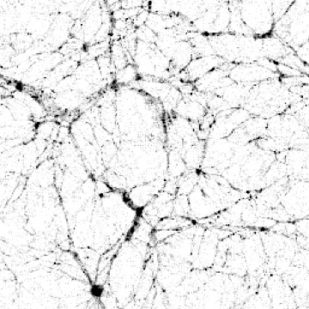
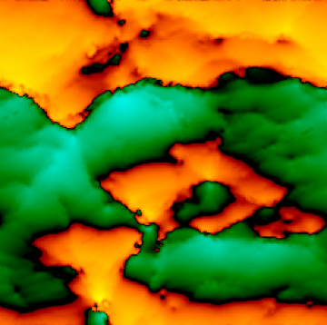

new techniques for the kSZ
Simon DeDeo (KICP)
x

Slide 2

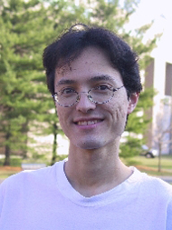
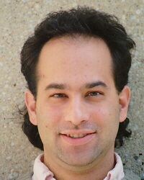
collaborators
Shirley Ho
Ed Sirko
David Spergel
(high-z)

Slide 3

physics of the kSZ
the “first order” brother to the tSZ:
tSZ: hot gas, random motion:
second order term in relativistic doppler shift;
non-thermal spectrum, parametrize with “y”
traces pressure
kSZ: non-relativistic bulk flows; thermal spectrum
(though second-order corrections may be required)
traces momentum

Slide 4
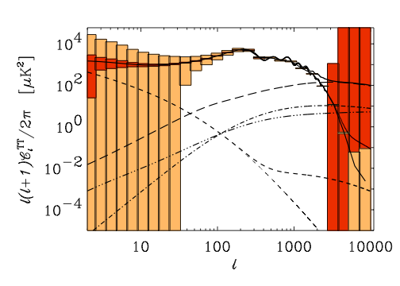
issues for the CMB experiments
1. detecting it at all — a very small signal
2. “cleaning” off the tSZ — a much stronger signal
3. resolution to push past the “damping tail”
ACT? SPT? — both can in
principle detect it.
(4. patchy reionization?)
kSZ
tSZ

Slide 5

two ways of looking at the kSZ
1. the “classical” version (Ostriker & Vishniac, 1987)
• extract from a survey in Fourier space
2. the “modern” fashion (e.g., Jimenez, 2005)
• “circle clusters, look behind”

Slide 6
the classical version (1)
problem: in the linear regime, velocity flows are linear
in the Limber approximation, should be no signal!
(Kaiser, 1984)
line of sight (up the screen) velocity
green, towards; orange, away
flows are gradient;
v and k are aligned:

Slide 7

the classical version (2)
insight (Ostriker & Vishniac, 1987):
kSZ traces the momentum; so look to the non-linear:
pure gradient
“curl” component emerges
velocity averages out, but not momentum; projected power of momentum “curl” gives CMB
fluctuations

Slide 8
important “global” questions
• how does ionization fraction evolve over time?
(feeds into cosmological parameters — viz. Doré talk)
• how does gas trace matter?
(effective, redshift-
independent smoothing
length is a good [1-5%]
guess.) — approx
400 kpc scale.

Slide 9
three ways to detect the kSZ
1. correlate the a_{lm}s
DeDeo, Trac & Spergel (2005)
2. circle the clusters
Jimenez et al. (2005)
3. reconstruct the velocity field
DeDeo & al. (2006, in prep)

Slide 10

1. correlate the a_{lm}s
DeDeo, Trac & Spergel (2005)
Slightly tricky: galaxies can be moving towards or away.
Hence: must correlate velocity squared:
Need to know the matter bispectrum to determine
cosmological parameters.
Do simple “tomography”: ∆z ≈ 0.1

Slide 11
2. “circle the clusters”
Look for velocity correlation function
Jiminez et al., many others
(note: cannot just stack as in the tSZ because velocities will average down)

Slide 12
3. reconstruct the velocity field
DeDeo & Spergel (2005, in prep)
Ambitious — exciting: why not use the density field on large scales to reconstruct the velocity field?
need ∆z ≈ 0.01
predicted velocity
CMB temperature

Slide 13
3. reconstruct the velocity field
DeDeo & Spergel (2006, in prep)
Advantages: more information. Get a handle on the phase of the velocity, as well as a direct (intuitive) study of both the evolution of gas, and the acceleration of flows.
• how well can we determine the velocity field?
⇒ Poisson noise
⇒ avoid small-scale non-linearity
• how well can we filter and model?

Slide 14
3. reconstruct the velocity field
DeDeo & Spergel (2005, in prep)
Advantages: more information. Get a handle on the phase of the velocity, as well as a direct (intuitive) study of both the evolution of gas, and the acceleration of flows.
• how well can we determine the velocity field?
⇒ Poisson noise
⇒ avoid small-scale non-linearity
• how well can we filter and model?

Slide 15
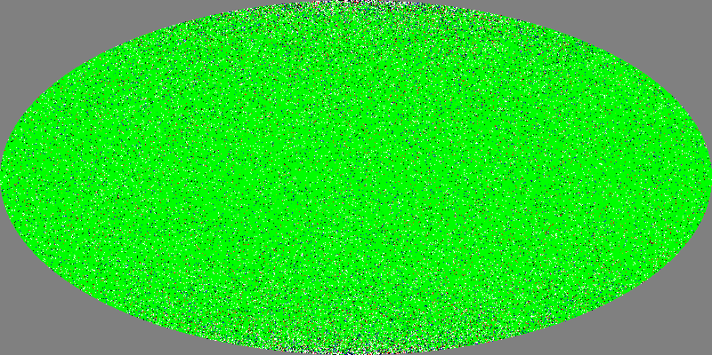
reconstruction (1)
• could just use the Tully-Fisher relation to subtract off
the Hubble flow — use this to make a template to tell you where to look in WMAP
Shirley Ho

Slide 16
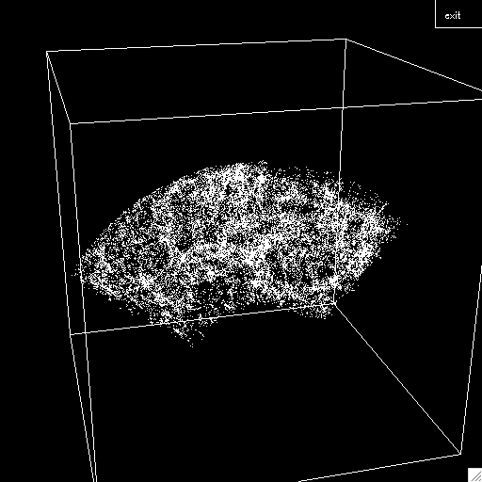
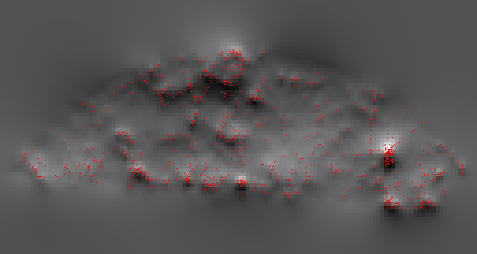
reconstruction (1I)
• use the linear density-velocity relationship — take the
density, pad, and transform
SDSS volume-limited reconstruction
Ed Sirko

Slide 17
“Simple” thoughts:
1. the kSZ is out there, detectable, and will not strain a good galaxy survey.
2. the information is rich enough to constrain both physics and cosmology.
3. the “technology” is in place, and being improved.
4. another source of constraint as a check on systematics.
5. different dependence on H and D: seek the truly strange.

