Slide 1



NCEP Regional Reanalysis
Fedor Mesinger¹, Geoff DiMego², Eugenia Kalnay³, Perry Shafran⁴, Wesley Ebisuzaki⁵, Yun Fan⁶, Robert Grumbine², Wayne Higgins⁵, Ying Lin², Kenneth Mitchell², David Parrish², Eric Rogers², Wei Shi⁶, Diane Stokes², and Jack Woollen⁴
¹NCEP/EMC and UCAR, ²NCEP/EMC, ³Univ. Of MD, ⁴NCEP/EMC and SAIC/GSO, ⁵NCEP/CPC, ⁶NCEP/CPC and RSIS

Slide 2
Motivation
Create long-term set of consistent climate data on a regional scale on North American domain
Use of the GR to drive the Regional Reanalysis (RR) system
Superior to NCEP/NCAR Global Reanalysis (GR) due to:
  use of a regional model (the Eta model)
  Advances in modeling and data assimilation since 1995, especially:
    Precipitation assimilation
    Direct assimilation of radiances
    Land-surface model updates

Slide 3
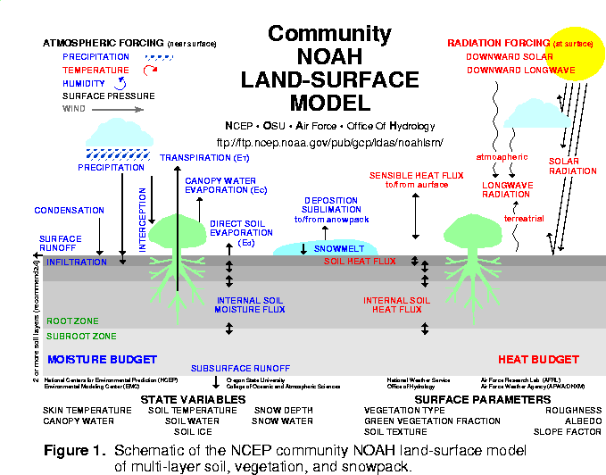
ETA / NOAH LAND-SURFACE MODEL UPGRADES: 24 Jul 01
- assimilation of hourly precipitation
-- hourly 4-km radar/gage analysis (Stage IV)
- cold season processes(Koren et al 1999)
-- patchy snow cover
-- frozen soil (new state variable)
-- snow density (new state variable)
- bare soil evaporation refinements
-- parameterize upper sfc crust cap on evap
- soil heat flux
-- new soil thermal conductivity
(Peters-Lidard et al 1998)
-- under snowpack (Lunardini, 1981)
-- vegetation reduction of thermal cond.
(Peters-Lidard et al 1997)
- surface characterization
-- maximum snow albedo database
(Robinson & Kukla 1985)
-- dynamic thermal roughness length
refinements
- vegetation
-- deeper rooting depth in forests
-- canopy resistance refinements
NOAH LSM tested in various land-model
intercomparison projects, e.g., GSWP, PILPS
2a, 2c, 2d, 2e, Rhone, and (near-future) DMIP.

Slide 4
System Design
Fully cycled 3-hr EDAS
Lateral boundary conditions supplied by Global Reanalysis 2
Free forecasts will be done out to 72 hr every 2.5 days
Pilot resolution: 80-km, 38 layers
Production resolution: 32-km, 45 layers
RR time period: 1979-2004 (continued later in near-real time, as in CDAS)

Slide 5
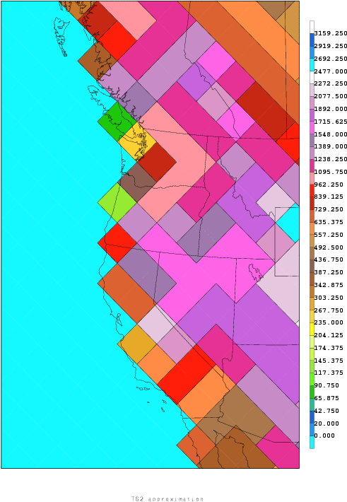
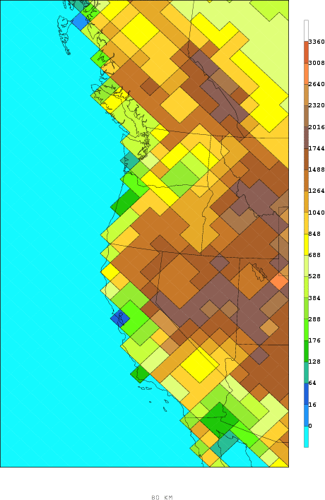
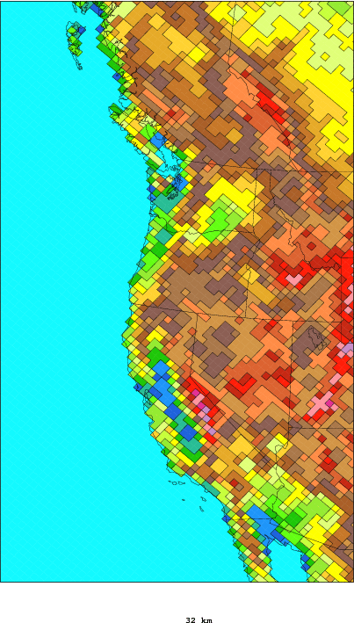
180 km 80 km 32 km
For the Eta, a 32 km run takes 178 times the work of a 180 km run!

Slide 6
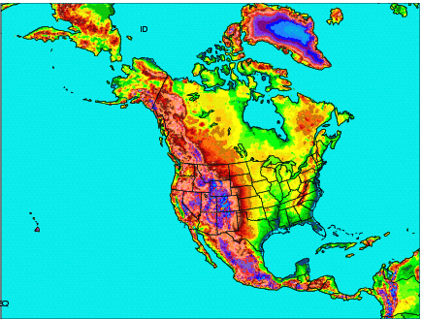
Domain Coverage of NARR

Slide 7
Data Used in Global Reanalysis and Regional Reanalysis
Dataset | Details | Source
Radiosondes | Height, temperature, winds, moisture | NCEP/NCAR Global Reanalysis (GR)
Dropsondes | Same as above | GR
Pibals | Wind | GR
Aircraft | Temp. and wind | GR
Surface | Pressure | GR
Cloud drift winds | Geostationary satellite | GR

Slide 8
Data Added or Improved Upon for Regional Reanalysis
Dataset | Details | Source
Precipitation | CONUS (with PRISM), Mexico, Canada, CMAP over oceans | NCEP/CPC
TOVS-1B radiances | Winds, precipitable water over oceans | NESDIS
Surface | Temperature, wind, moisture | GR
COADS | Ship and buoy data | NCEP/EMC
Air Force Snow | Snow depth | COLA and NCEP/EMC
SST | 1-degree Reynolds, with Great Lakes SSTs | NCEP/EMC, GLERL
Sea and lake ice | Contains data on Canadian lakes, Great Lakes | NCEP/EMC, GLERL, Canadian Ice Center
Tropical cyclones | Locations used for blocking of CMAP Precipitation | Lawrence Livermore National Laboratory

Slide 9
Results: Upper-Air
Compared both GR and RR against fits to raobs
Root-mean-square (RMS) analysis fits significantly better for temperatures and vector wind speeds for RR
Wind speed improvement greatest in the upper troposphere, especially in winter
First guess (3-hr forecast, pre-3DVAR) temperatures not as favorable for RR compared to GR, winds improved
Relative humidity improved for RR for both analysis and first guess
Note: July 1988 results are at present inadvertently without precipitation assimilation

Slide 10
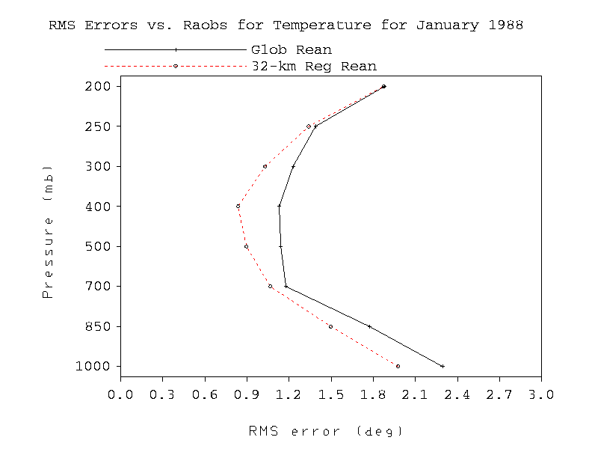
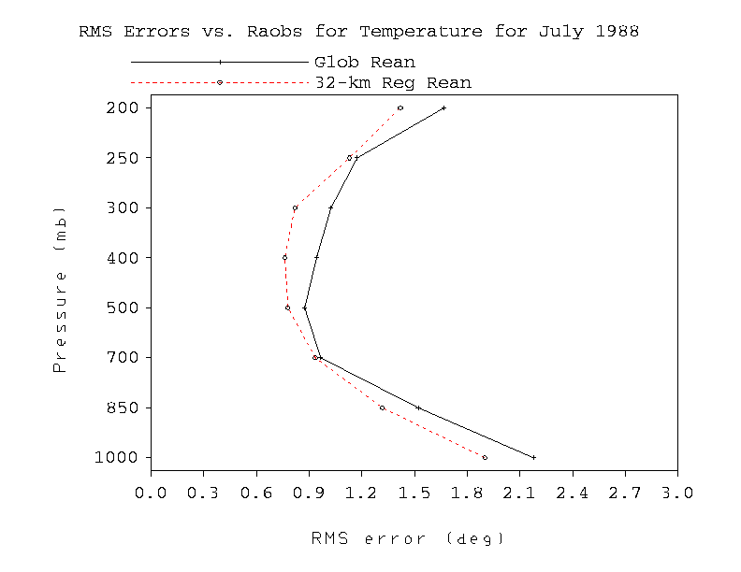
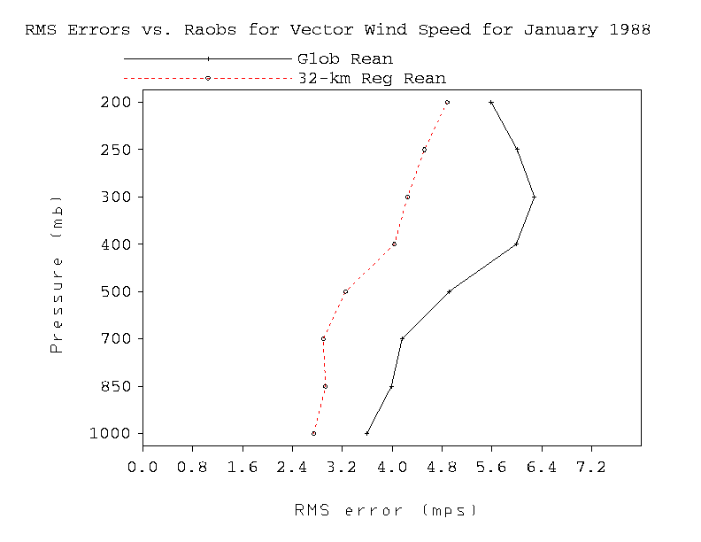
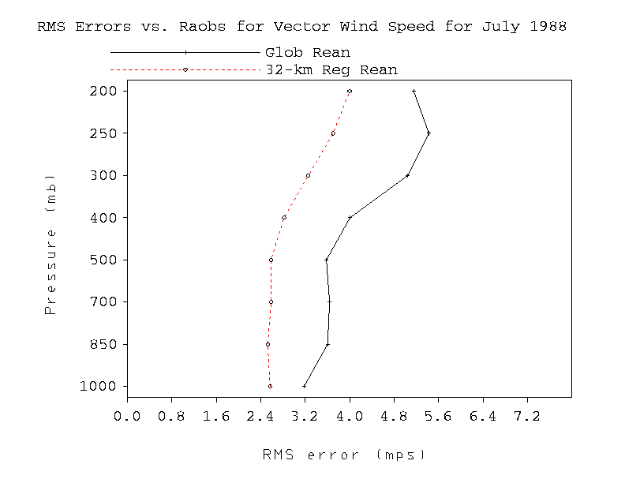
Analysis
July 1988
January 1988
T
T
T
VWND
VWND
VWND

Slide 11
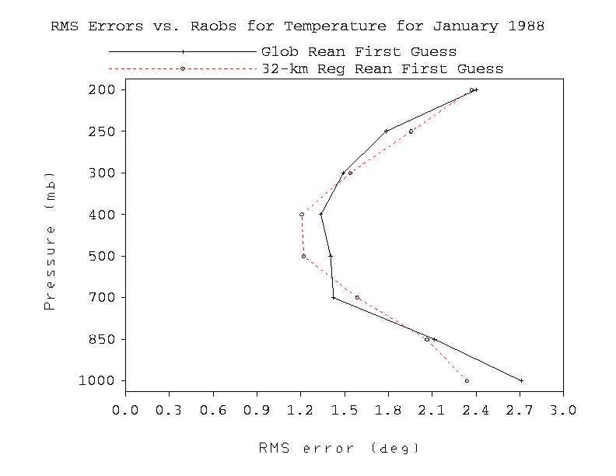
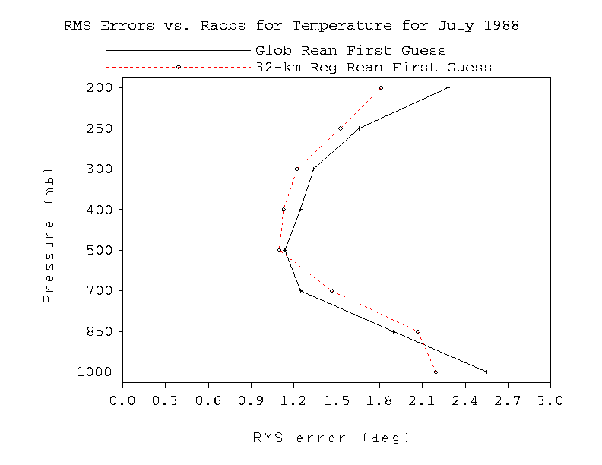
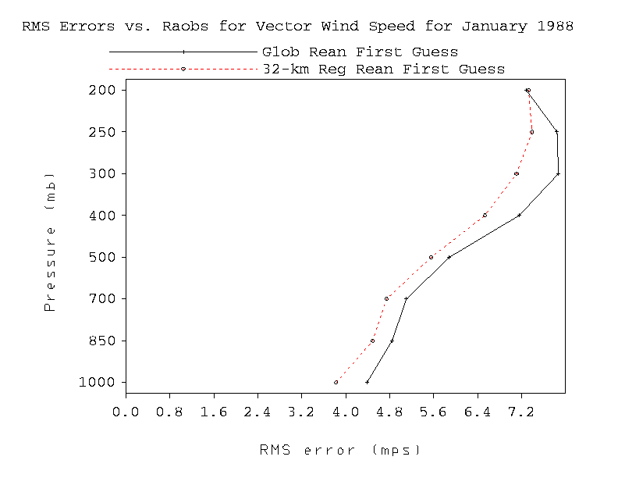
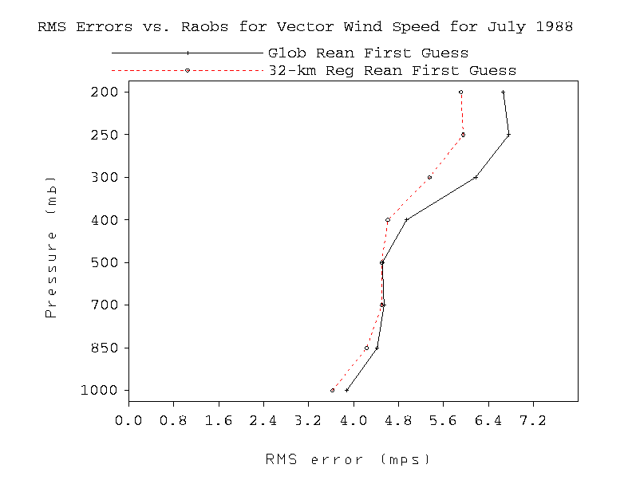
January 1988
First Guess
July 1988
T
T
VWND
VWND

Slide 12
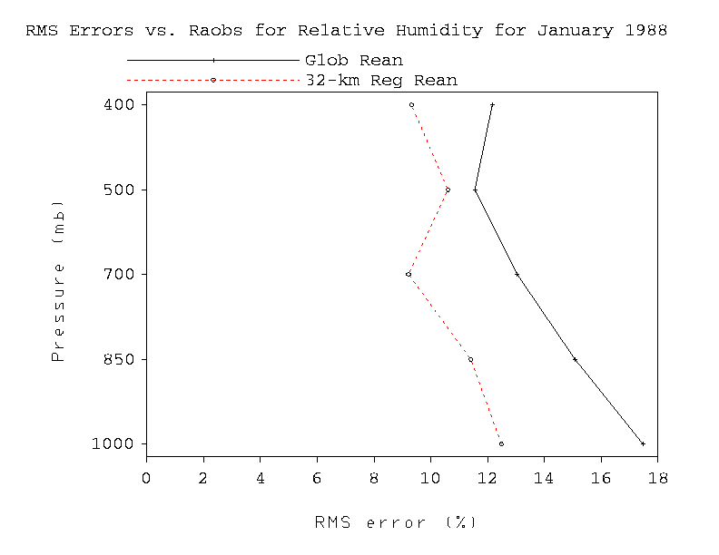
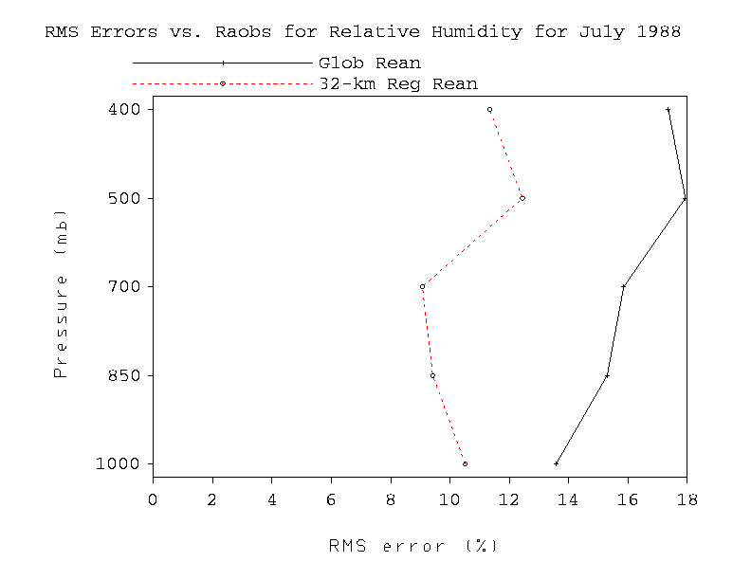
Relative Humidity Analysis
January 1988
July 1988
RH
RH

Slide 13
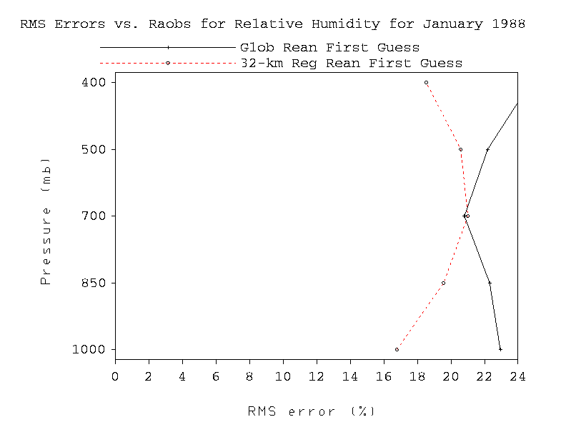
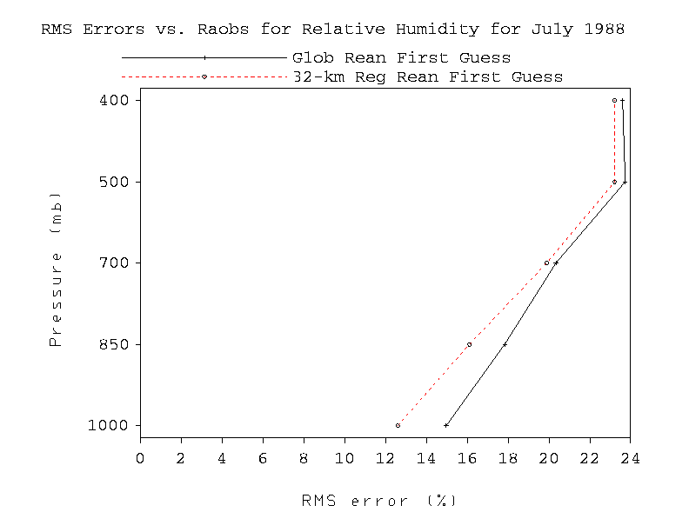
Relative Humidity First Guess
January 1988
July 1988
RH
RH

Slide 14
Results: Near Surface
Surface temperatures RMS favorable for RR in both winter and summer
Temperature RR biases closer to zero and little diurnal variation problem in summer
10-m wind RMS in RR analysis a little better, 1st guess neither better nor worse compared to GR (remarkably similar!)
Slow wind biases improved in RR in both seasons
RR advantage greater in analysis than in the first guess

Slide 15
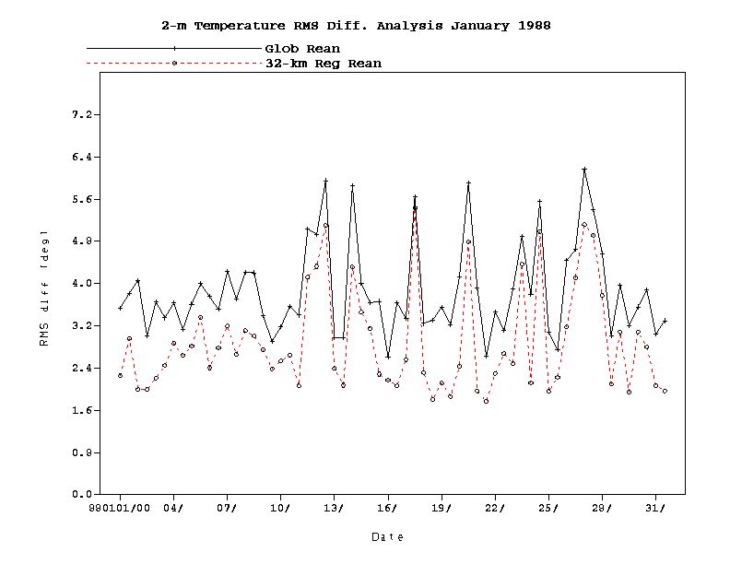
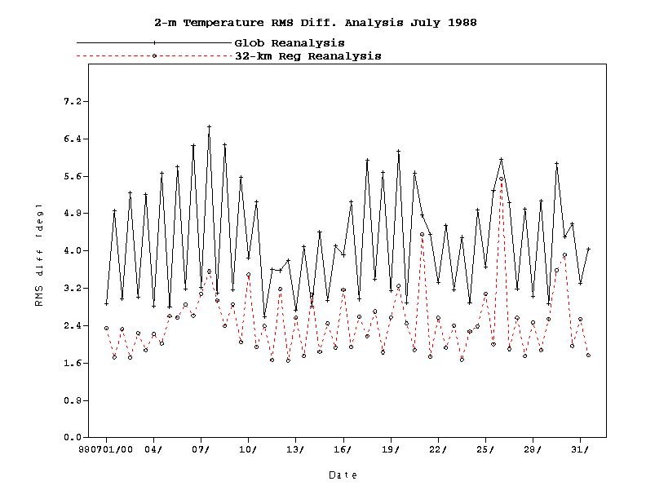
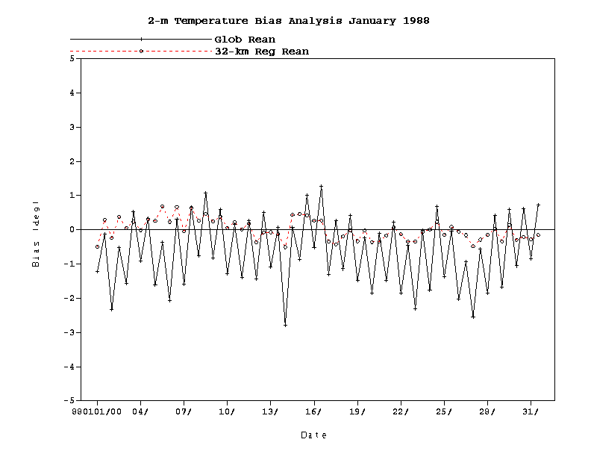
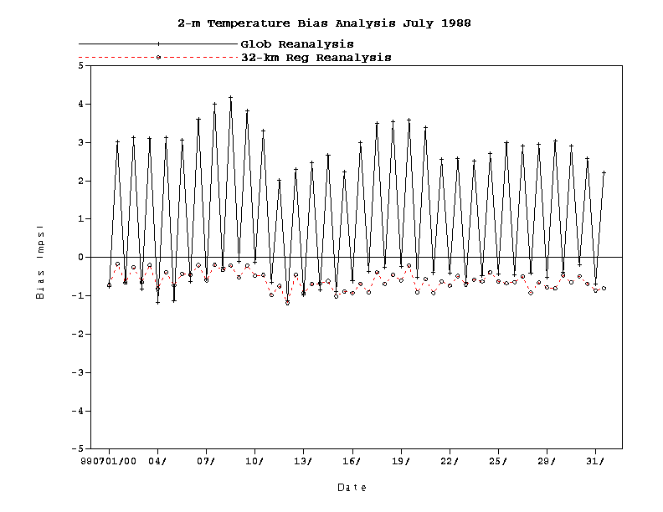
January 1988
2-m Temperature Analysis
July 1988
RMS
RMS
Bias
Bias

Slide 16
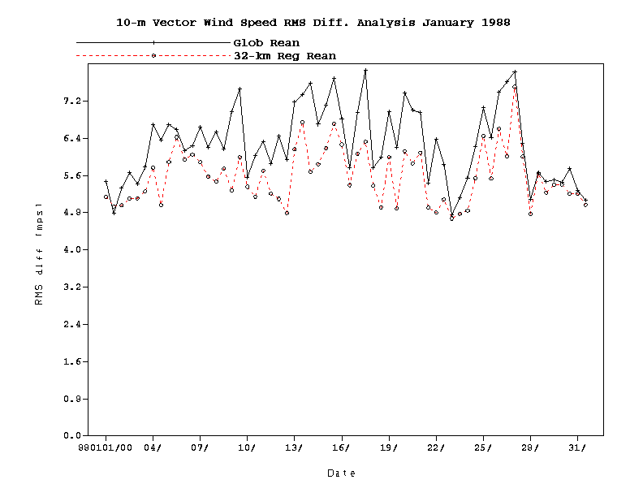
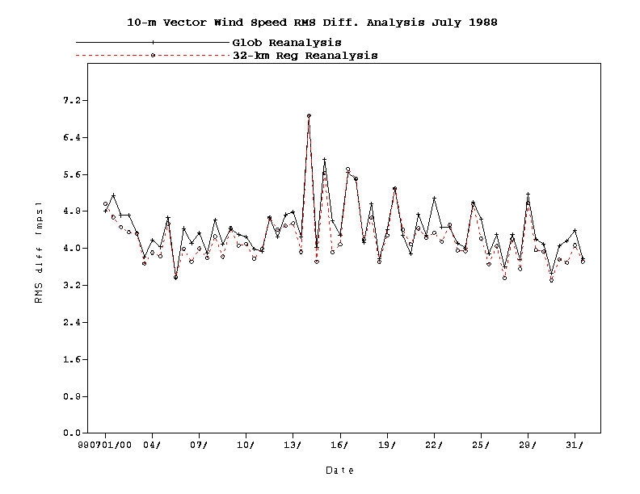
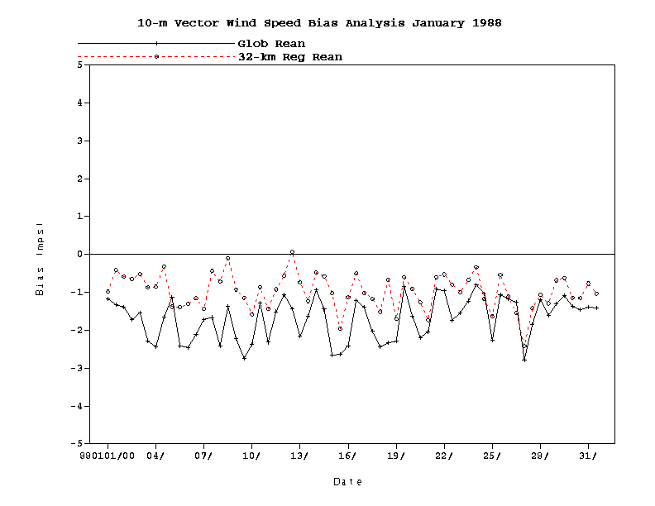
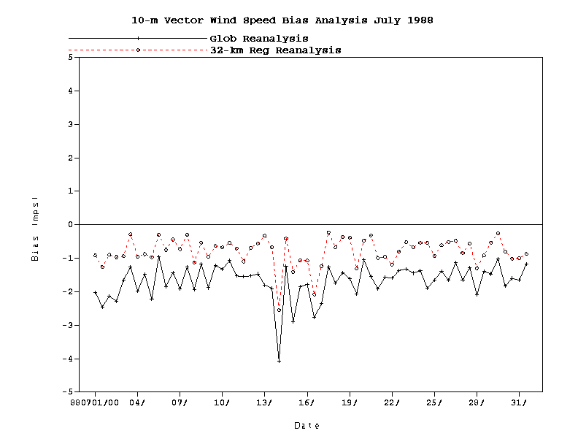
January 1988
10-m Vec. Wnd Speed Analysis
July 1988
RMS
RMS
Bias
Bias

Slide 17
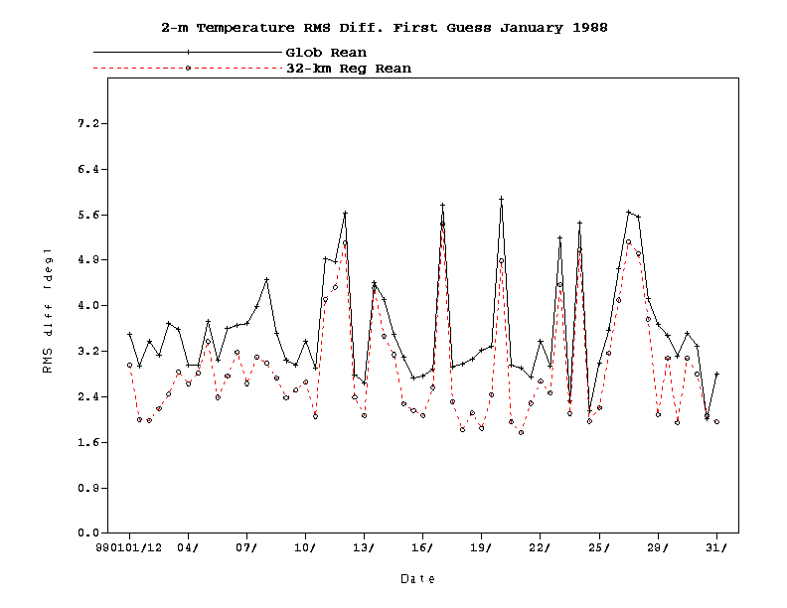
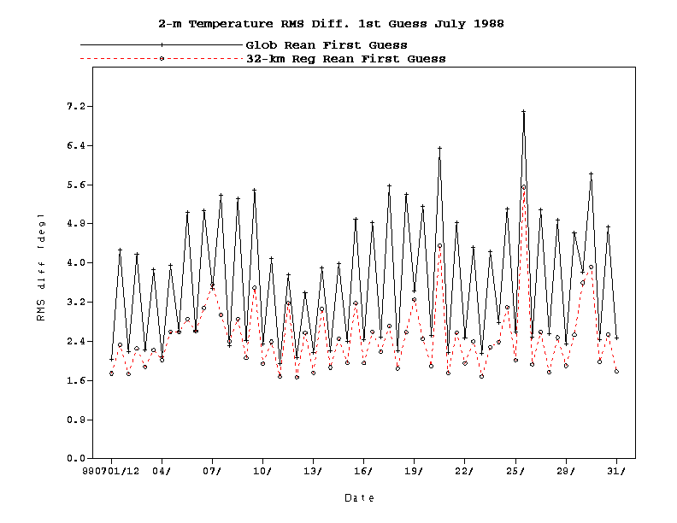
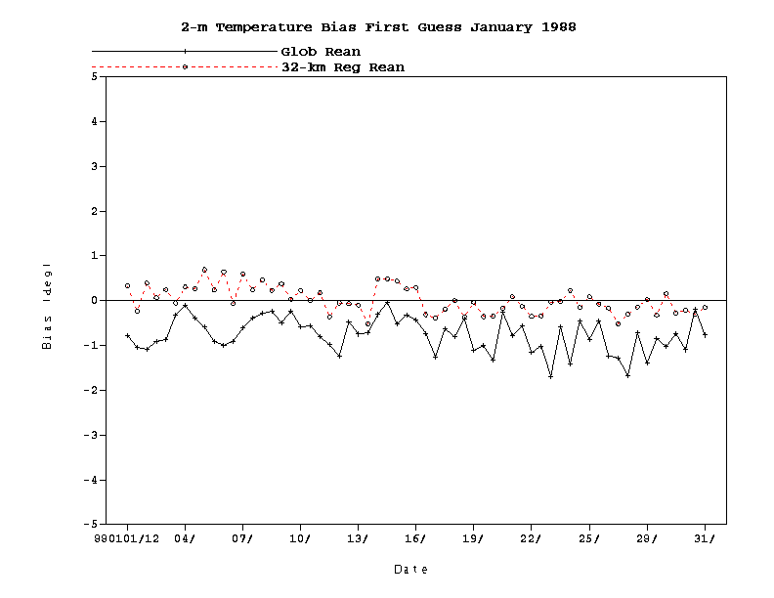
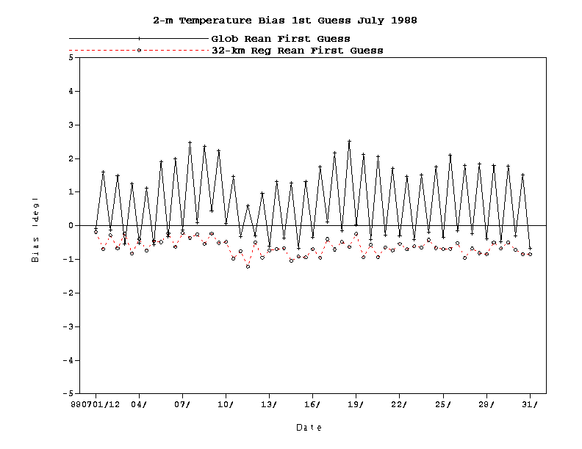
January 1988
2-m Temperature 1st Guess
July 1988
RMS
RMS
Bias
Bias

Slide 18
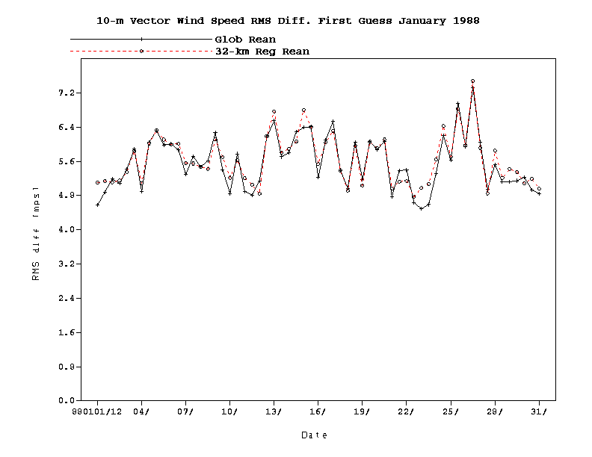
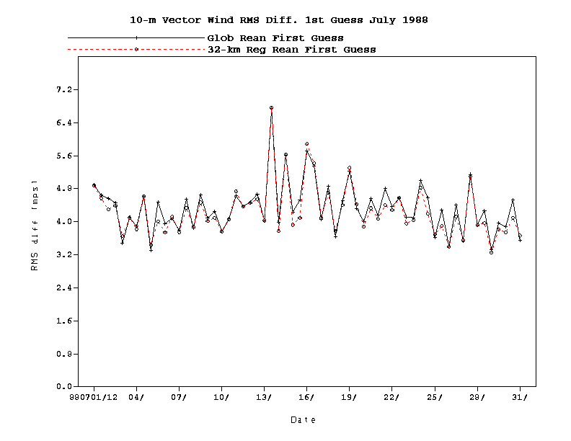
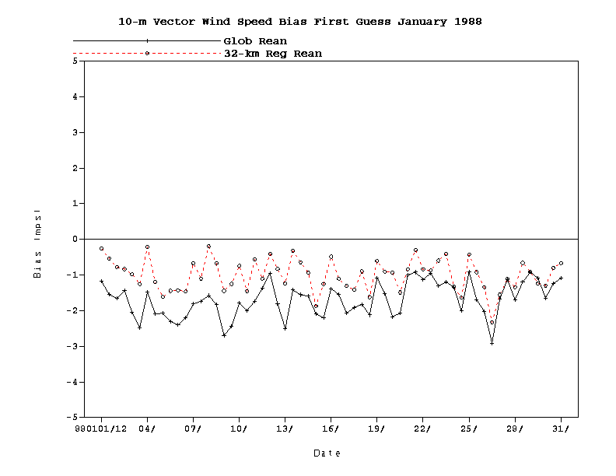
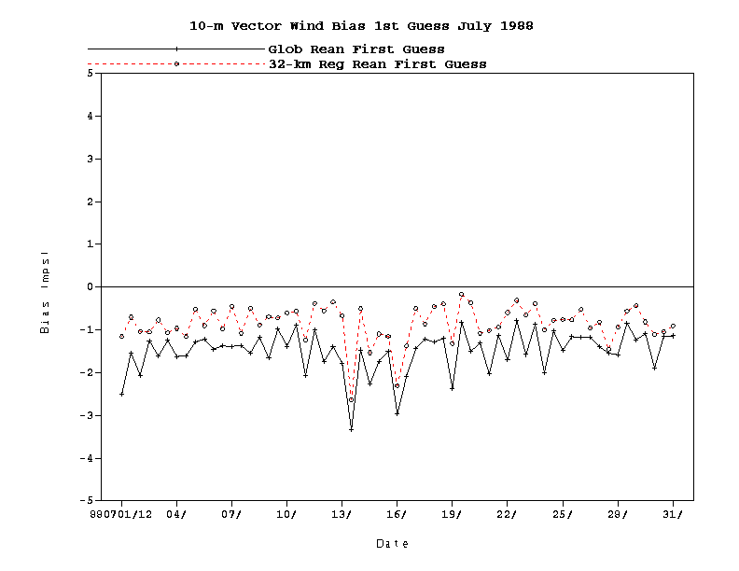
January 1988
10-m Vec. Wnd. Spd. 1st Guess.
July 1988
RMS
RMS
Bias
Bias

Slide 19
Results: Precipitation
Several sources of precipitation
  CONUS data with PRISM (Mountain Mapper) to improve orographic effects
  Canada
  Mexico
  CMAP (combination of satellite and gauge data) over oceans; CMAP is blocked:
    Near central areas of hurricanes (7.5 by 7.5 deg)
    Observed precipitation > 100 mm/day
    North of 50 degrees North

Slide 20
Results: Precipitation (cont’d)
Precipitation observations used to prescribe the latent heat profile in Eta model
Model uses given latent heat profile to simulate precipitation
Resulting precipitation pattern looks very much like the observed precipitation pattern in both summer and winter

Slide 21
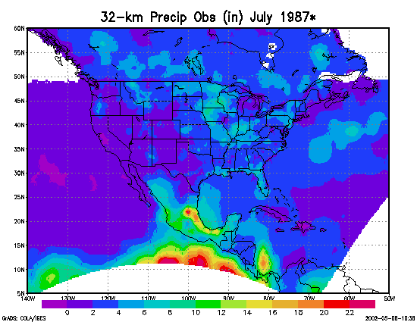
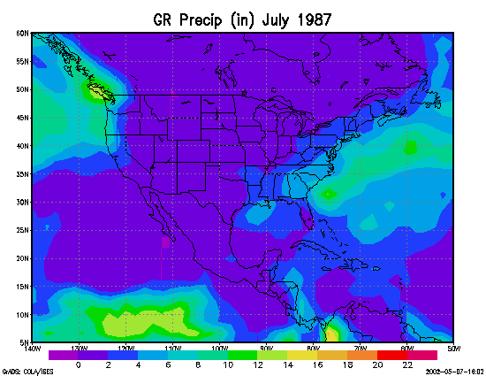
July 1987 Precipitation Results

Slide 22
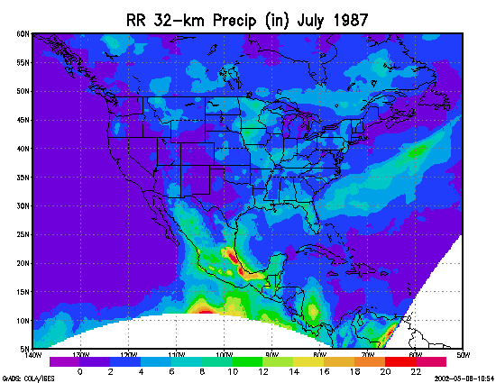
July 1987 Precipitation Results

Slide 23
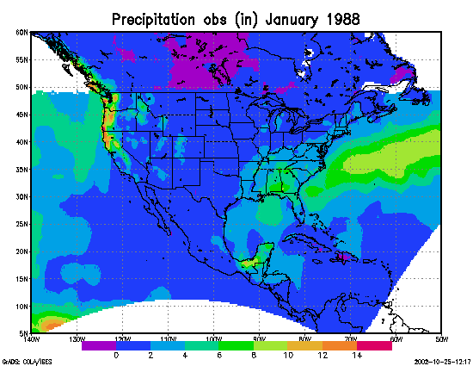
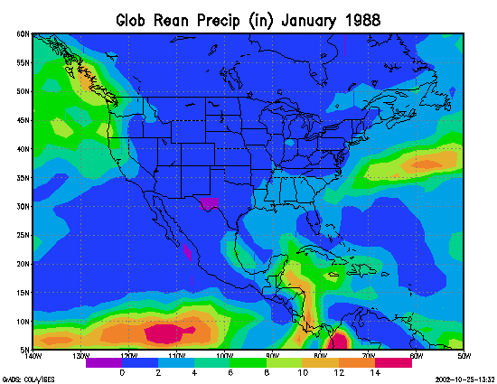
January 1988 Precipitation Results

Slide 24
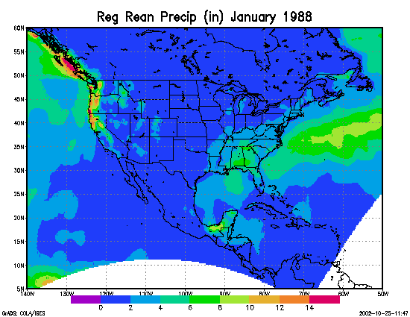
January 1988 Precipitation Results

Slide 25
Achievements: RR System/Development
Precipitation assimilation in EDAS
Revised 3DVAR to run using the satellite bias corrections for all the satellites
Updated the land-surface model
Converted RR system from 80-km pilots to 32-km production mode
Acquired computing resources to run RR in production mode

Slide 26
Achievements: Data acquisition/processing
Acquired precipitation dataset with use of PRISM (Mountain Mapper); disaggregated data to hourly
Acquired TOVS-1B data for 1979-1997 time period
Acquired Air Force snowdepth dataset
Created a high-resolution sea-ice field

Slide 27
Achievements: RR runs
Completed numerous 80-km pilots
Completed 18 months of 32-km RR on SGI Origin 3000
Re-running the 32-km RR on SGI using precipitation assimilation

Slide 28
Achievements: Outreach
Presented RR-related work at several conferences
  AMS Annual Meeting in Orlando, FL, in January
  GEWEX Mississippi River Hydrology & Climate Conference in New Orleans, LA, in May
Numerous contacts with potential users

Slide 29
Work in Progress
Creation of a monitoring system that will alert of problems in the running of the RR
Data processing is ongoing so that all the data is processed before the production RR runs
Production is in progress; two streams will be running on Class VIII machine once available

Slide 30
Goals for Next Year
Complete most of the production by 31 August 2003, the last day that Class VIII machine will be available
Transition plan for continuation in post-IBM Class VIII time
RR presentations at the AMS Meeting and Climate Diagnostics Workshop
RR Users’ Workshop

