Slide 1
Subtype of VaD: SIVD
Subcortical Ischemic Vascular Disease
Helena Chui, M.D.
University of Southern California
Rancho Los Amigos
National Rehabilitation Center

Slide 2
VIIs Alzheimer disease a good model for
Vascular Dementia?
Risk Factors ➔ Alzheimer Disease ➔ NFT and NP ➔ Progressive Dementia
Risk Factors ➔ Many CVD(s) ➔ Several types of brain Injury ➔ Many syndromes

Slide 3
Steps Leading from Risk Factors to VaD
Risk Factors ➔ Atherosclerosis ➔ Ischemic Brain Injury ➔ VaD
Arteriolosclerosis ➔ focal deficits
Heart disease ➔ clinically silent
Vascular dementia is not a disease, but only one possible phenotypic expression of vascular brain injury.
Cerebrovascular disease sometimes leads to dementia, AD invariably does. There are many types of CVD, leading to variable clinical course and symptomatic expression.
Unlike AD, we already know a lot about vascular risk factors and how to treat them; focusing on vascular dementia is an arbitrary and late choice.

Slide 4
Can vascular dementia be clearly defined in a clinical setting? Yes, but is this useful given its heterogeneity?
Are there valid criteria for the diagnosis of vascular dementia? Not if pathology is the gold standard; unlike AD, severity of pathology does not correlate strongly with severity of VaD.
Can vascular dementia be distinguished from AD and other causes of dementia? We can define vascular brain injury. Although we cannot rule out concomitant AD, does this matter?
What outcome measures should be used in clinical trials?
What features should be included in design of clinical trials?

Slide 5
VaD is not a useful concept for treatment
Too broad
Too many different types of CVD
Too many pathophysiological mechanisms
Akin to neurodegenerative dementia (AD, FTD, DLB)
Atherosclerosis, arteriolosclerosis, amyloidosis, thromboembolism
Ischemia (occlusion, hypoperfusion), hemorrhage

Slide 6
VaD is not a useful concept for treatment
Too many clinical phenotypes or syndromes
Major hemispheral syndromes (aphasia, neglect, akinetic mutism)
Lacunar state (apathy, depression, slowing, dysexecutive function)
Clinical course: abrupt onset, step-wise progression, slowly progressive

Slide 7
VaD is not a useful concept for treatment
Non-interchangeable clinical criteria
No Gold Standard for pathological diagnosis
Hachinski Ischemic Score
DSM - IV
ICD - 10
NINDS-AIREN
ADDTC

Slide 8
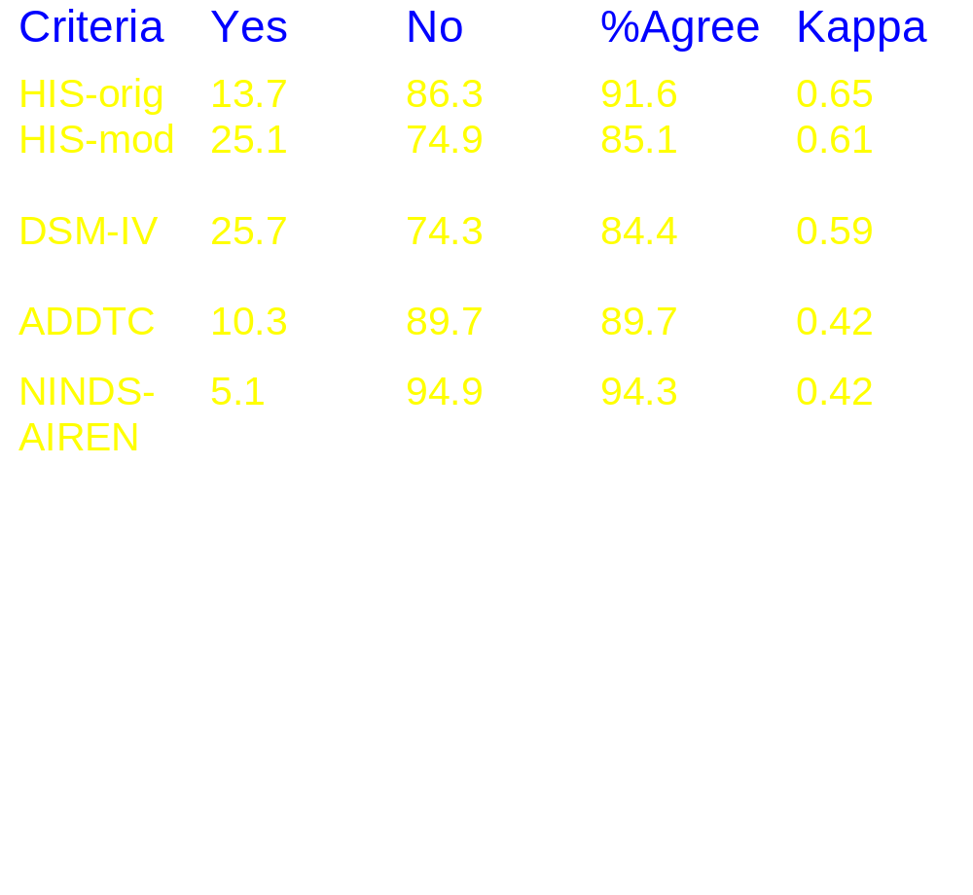
Inter-Reliability of Diagnosis of VaD among 7 ADDTC
Percentage of 25 cases with pathological VaD=24%

Slide 9
Clinical Criteria for Vascular Dementia
Ischemic brain injury
Dementia
Clinical
Signs & Symptoms
Causal
Cognitive
Impairment
Relation?
Structural
Imaging

Slide 10
Subtype of VaD: SIVD
Subcortical Ischemic Vascular Dementia
Subcortical Vascular Dementia
Small-artery Ischemic Vascular Disease
Subcortical Ischemic Vascular Disease

Slide 11
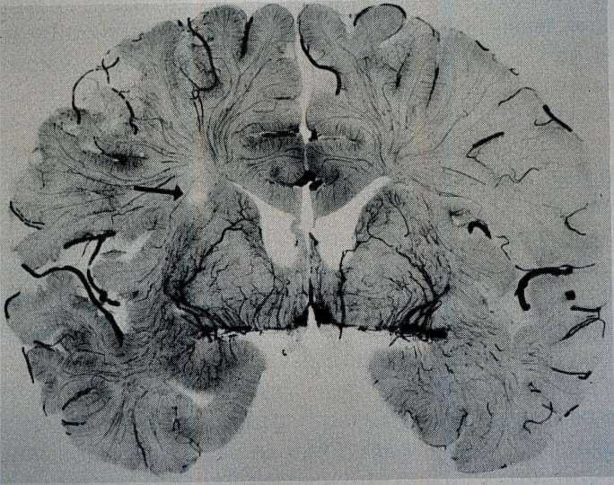
Ishii et al. 1986

Slide 12
Steps Leading from Risk Factors to SIVD
HTN, DM ➔ SIVD ➔ Ischemic Brain Injury ➔ dementia due to SIVD
SIVD is a term that can be used for either the subtype of cerebrovascular disease or for a dementia syndrome.
SIVD represents a more homogeneousclinical-pathological entity, a more useful target for treatment. (drill down□)
By using neuroimaging findings as a surrogate marker for ischemic brain injury, we can shift the focus of treatment to the left, earlier in the disease process. (shift left )

Slide 13
Can SIVD be clearly defined in a clinical setting?
Are there valid criteria for the diagnosis of SIVD?
Can SIVD be distinguished from AD and other causes of dementia?
What outcome measures should be used in clinical trials of SIVD?
What features should be included in design of clinical trials of SIVD?

Slide 14
SIVD:
Two pathophysiological mechanisms
Occlusion ➔ Lacune ➔ Lacunar State
Hypoperfusion ➔ WML ➔ “Binswanger” Syndrome

Slide 15
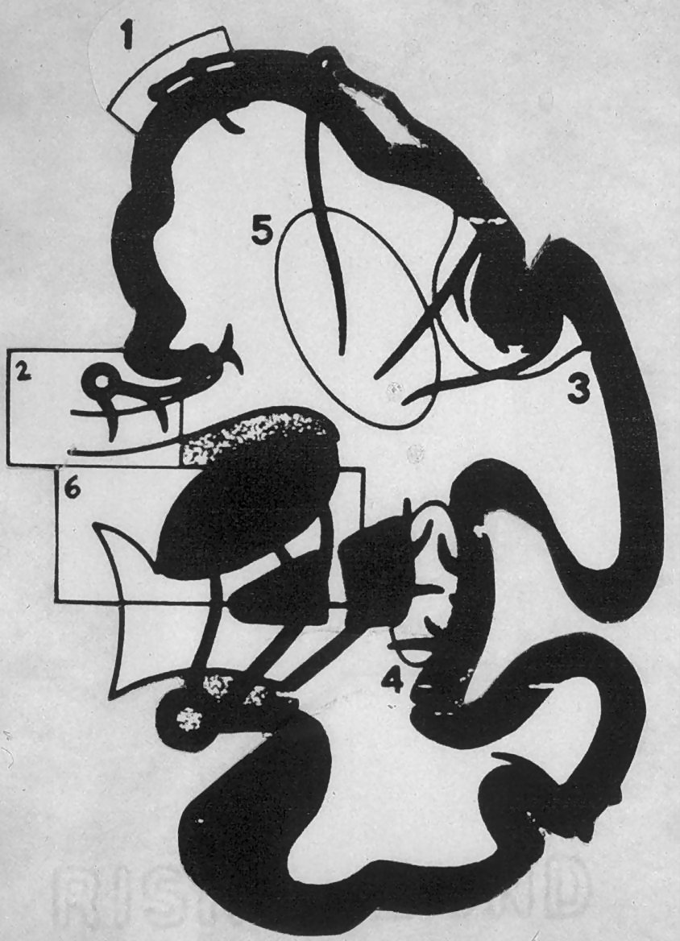
Moody et al.

Slide 16
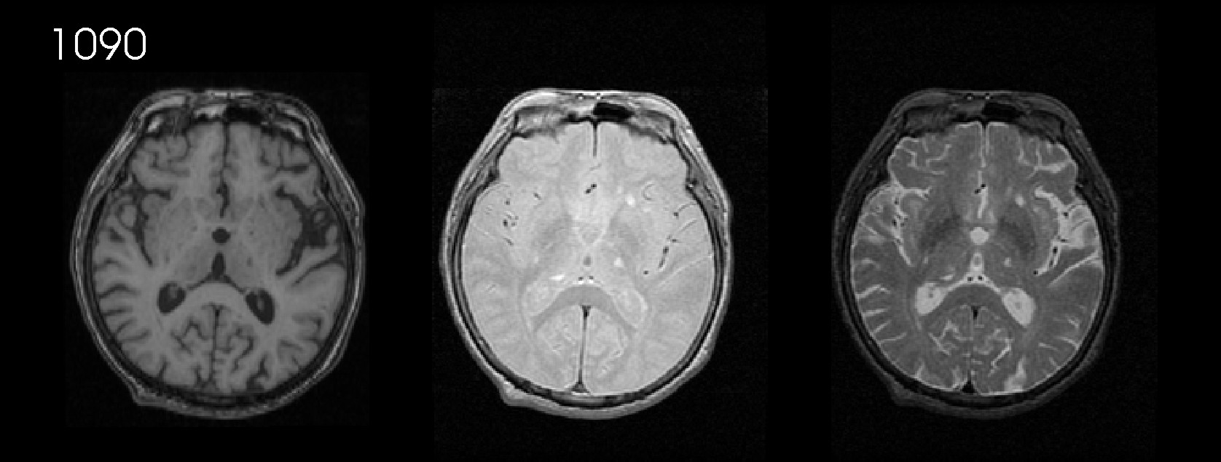
Perivascular space
Lacunes
T1 Proton Density T2

Slide 17
Definition of Lacune
Proton density MRI
CT
Bright round lesion
3 -15 mm
in subcortical gray or white matter
Dark round lesion
3 - 15 mm
in subcortical gray and white matter

Slide 18
Moody et al.

Slide 19
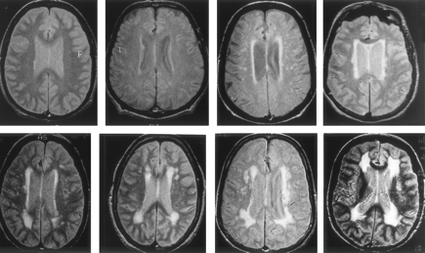
Severity Ratings for White Matter Lesions
1 2 3 4
5 6 7 8
Longstreth et al., Stroke 1996; 27: 1276

Slide 20
Periventricular and Deep
White Matter Lesions
Proton density and T-2 MRI (WML)
CT
(leukoaraiosis)
Patchy or confluent symmetrical areas of bright signal
Patchy or diffuse symmetrical areas of low attenuation

Slide 21
Subcortical Ischemic Vascular Dementia
Ischemic brain injury
Dementia
Pure motor or sensory stroke
Focal neurologic signs
Dysexecutive syndrome
Better recognition memory
Multiple or strategic lacunar infarcts
Confluent WML
TreTreatment
TreTreatment

Slide 22
Clinical Criteria for
Subcortical Vascular Dementia (SVD)
Cognitive syndrome including
  dysexecutive and
  memory deficit (recognition memory relatively spared).
Cerebrovascular disease (CVD)
  relevant evidence on neuroimaging
  presence or history of neurologic signs
Erkinjuntti et al. J Neural Transm 2000; 59: 23-30.

Slide 23
MRI Criteria for SVD
Extensive periventricular and deep WML:
  caps or halo (> 10 mm)
  diffusely confluent hyperintensities (> 25 mm),
  lacunes in the deep grey matter OR
Multiple lacunes (e.g., > 5) in the deep gray matter and at least moderate WML.
Absence of cortical infarcts, hemorrhages...
Erkinjuntti et al. J Neural Transm 2000; 59: 23-30.

Slide 24
CT Criteria for SVD
Extensive periventricular and deep white matter lesions and at least one lacunar infarct.
Absence of cortical or cortico-subcortical non-lacunar territorial infarcts, hemorrhages, signs of normal pressure hydrocephalus, and specific causes of white matter lesions (e.g., multiple sclerosis, sarcoidosis, irradiation).
Erkinjuntti et al. J Neural Transm 2000; 59: 23-30.

Slide 25
SIVD: Mental Status Examination for Diagnosis and Outcome
I
Working memory
Recognition memory
Executive function
Speed

Slide 26
Considerations for Design of
Clinical Trials of SIVD
Include Structural Neuroimaging
  MRI (preferred)
  CT
Qualitative imaging for diagnosis
Quantitative imaging for outcome (surrogate marker for disease progression)

Slide 27
Can SIVD be clearly defined in a clinical setting? Yes, and may be more meaningful for treatment. □
Are there valid criteria for the diagnosis of SIVD? Published, but not yet validated. Pathogically confirm ischemic vascular injury, not dementia.
Can SIVD be distinguished from AD and other causes of dementia? Yes. Cannot rule out concomitant AD, but does this matter? 
What outcome measures should be used in clinical trials of SIVD? Add executive and recognition memory. □
What features should be included in design of clinical trials of SIVD? Structural neuroimaging. 

