Slide 1
Bumps in the afterglow of GRB 030329:
An evidence for baryonic ejecta and internal shocks?
Franck Genet
Institut d’Astrophysique de Paris
Supervisors:
Robert Mochkovitch
Frédéric Daigne

Slide 2
Summary
The optical afterglow of GRB 030329
Origin of the bumps
Late energy injection from slow shells
Afterglow calculation
Discussion and conclusion

Slide 3
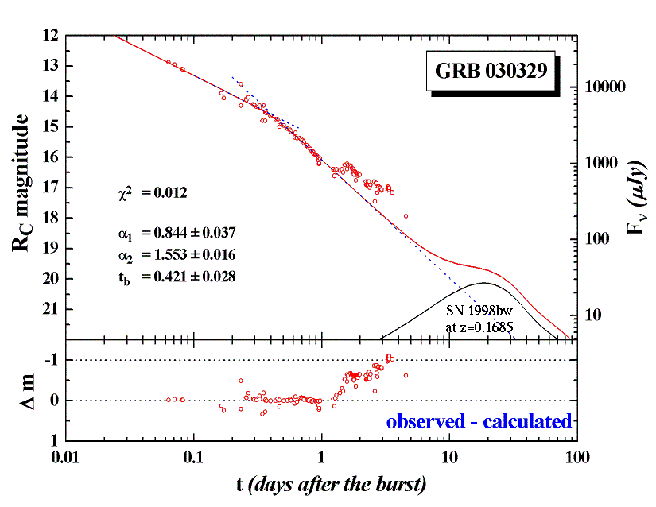
The optical afterglow of GRB 030329
(BAIT data, Li et al.)

Slide 4
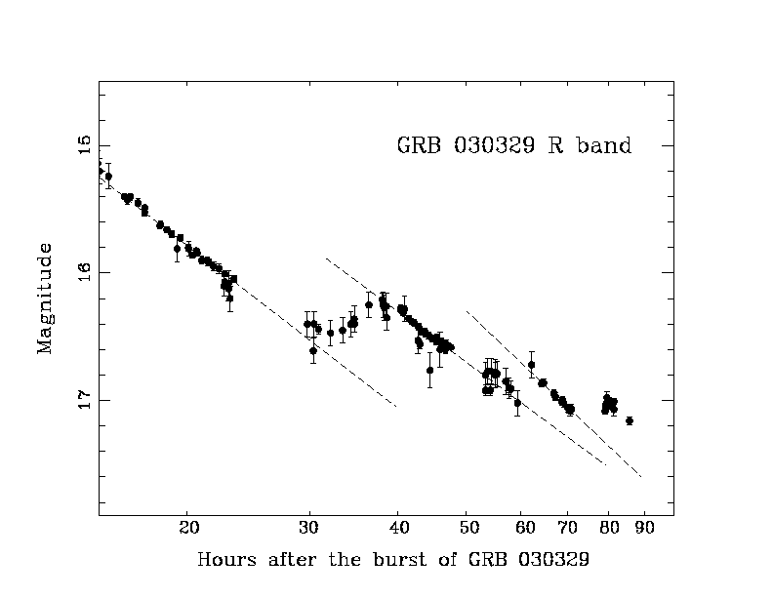
The optical afterglow of GRB 030329
(BAIT data, Li et al.)

Slide 5
The optical afterglow of GRB 030329
t_{break} ~ 0.45 day (and also 5 days)
→ double jet model (Berger et al. 2003)
First bump:
  t_{bump} ~ 1.3 day
  Δt_{bump} ~ 0.6 day
  Jump in afterglow flux: ~ factor of 2
  Same slope after the bump
Several other bumps up to t ~ 8 days
Γ~10
Γ~100
Δθ₂
Δθ₁

Slide 6
Origin of the bump(s)
Double jet model: 1st bump explained by emerging second component (wider jet)
Granot, Nakar and Piran, 2003 :
  Density clumps in external medium
  increase of density in discret steps: unlikely
  Patchy shell
  no significant fluctuation after jet break
  Refreshed shock: late energy injection from a slow shell

Slide 7
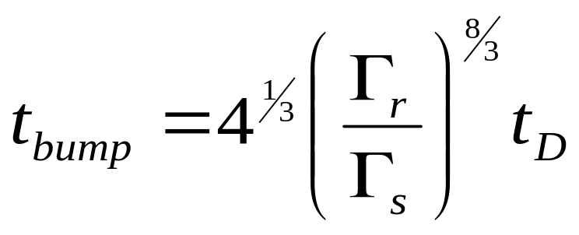
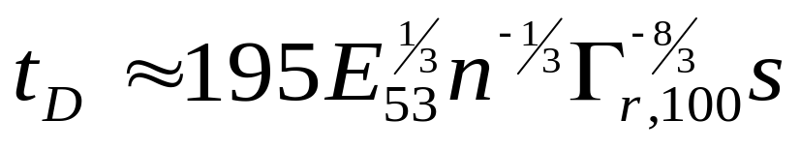
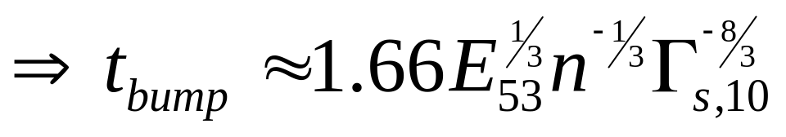
Late energy injection from slow shells
with
days
For E₅₃=1 and n=1, t_{bump} = 1 day for Γ_{s}≈12

Slide 8

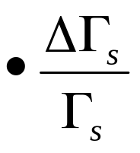
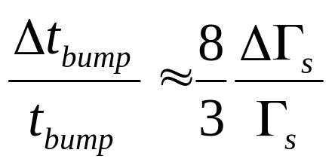
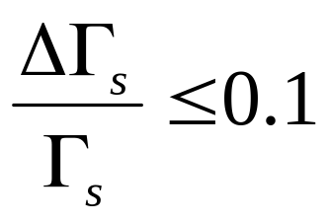
Late energy injection from slow shells
GRB 030329: conditions for Δt_{bump}< t_{bump}
    t_{bump} > t_{break} (Granot, Nakar, Piran, 2003)
    → Δt_{bump} ~ t_{break} (before break Δt_{bump} ~ t_{bump} )
small
=>

Slide 9
Afterglow calculation
Δθ_{r}
Δθ_{s}
θ₀
Simplifing assumption:
Δθ_{r}
Δθ_{s}
θ₀

Slide 10
Afterglow calculation: parameters
Γ_{r} = 100
Γ_{s} = 7.5±0.2
E_{r,53}=1.15x10⁻¹
E_{s,53}≈ E_{r,53}
n=2 cm⁻³
θ₀=0°
Δθ_{r}=6°
Δθ_{s}=4°
p=2.1
α_{b}=2.1x10⁻⁴
α_{e}=10⁻¹

Slide 11
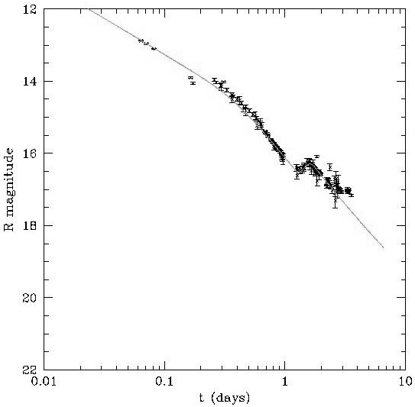
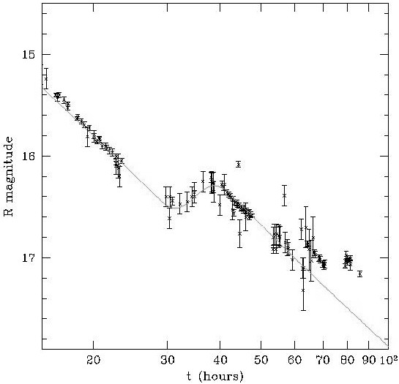
Afterglow calculation: results
α₁=0.811 (0.844±0.037)
α₂=1.538 (1.553±0.016)

Slide 12
Discussion
Fitting the data imposes ΔΓ_{s}/ Γ_{s} small:
Just what is expected following Internal Shocks!
Γ_{s}
Γ_{s}
Γ₁ ≤ Γ₂ ≤ Γ₃
10
M
M
Before IS
After IS

Slide 13
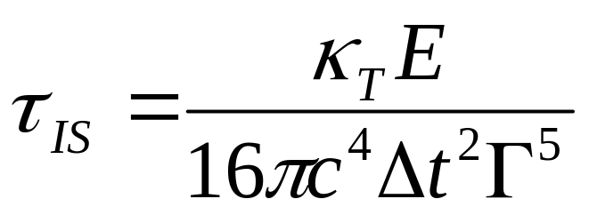
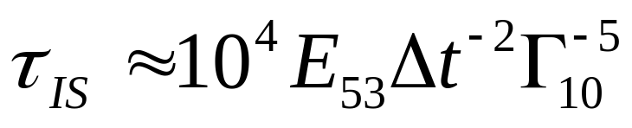
Discussion
In Γ ~ 10 material internal shocks generally occur before transparency:
→ IS in slow material not observed
A comment:
In EMM (Blandford and Lyutikov), late energy injection implies late activity of central source (~1day after the main event)
Is it realistic?

Slide 14
Conclusion
Bumps in GRB 030329 well explained by late energy injection from a slow shell
→ baryonic ejecta rather than purely EM
Requires slow shell with ΔΓ_{s}/ Γ_{s} small
→ an evidence for previous internal shocks?
Two jet model:
  does not explain late variability
  but compatible with the refreshed shock model

