Slide 1


NCEP Regional Reanalysis
NARR
Glenn K. Rutledge
NOMADS PI
NESDIS Data Archive Board Briefing
17 March 2004

Slide 2
Briefing Overview
NARR Informational Briefing
  NARR Overview
  Improvements over Global Reanalysis
  Domain / Resolution / Frequency
  NCDC NARR: Ingest/Archive/Access

Slide 3
North American Regional Reanalysis (NARR): Background
The NARR is an improved long term re-analysis of basic meteorological fields on a high resolution gird, that for the first time on any scale, includes precipitation.
NCDC has agreed to archive most of these new data.
This is an informational briefing for the DAB for
  NARR availability with background information
  Provide access information

Slide 4
NARR: Purpose
Create a long-term set of consistent climate data on a regional scale on a North American domain
Superior to NCEP/NCAR Global Reanalysis (GR) due to:
  use of a regional model (the Eta model)
  Advances in modeling and data assimilation since 1995, especially:
    Precipitation assimilation
    Direct assimilation of radiances
    Land-surface model updates

Slide 5
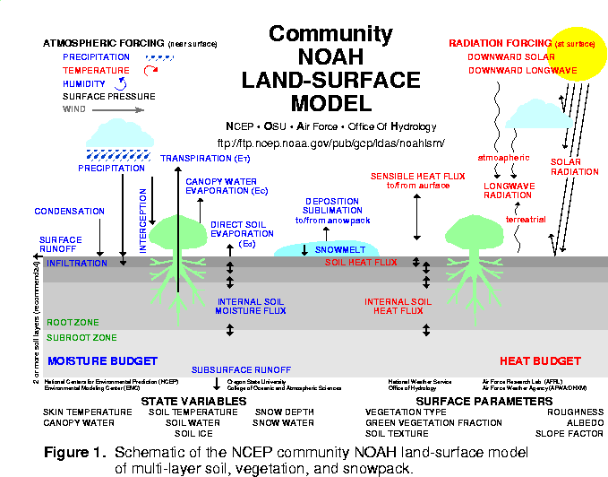
ETA / NOAH LAND-SURFACE MODEL UPGRADES:
- Assimilation of Hourly Precipitation
-- hourly 4-km radar/gage analysis (Stage IV)
Cold Season Processes (Koren et al 1999)
-- patchy snow cover
-- frozen soil (new state variable)
-- snow density (new state variable)
- Bare Soil Evaporation Refinements
-- parameterize upper sfc crust cap on evap
- Soil Heat Flux
-- new soil thermal conductivity
(Peters-Lidard et al 1998)
-- under snowpack (Lunardini, 1981)
-- vegetation reduction of thermal cond.
- Surface Characterization
-- maximum snow albedo database
(Robinson & Kukla 1985)
-- dynamic thermal roughness length
refinements
- Vegetation
-- deeper rooting depth in forests
-- canopy resistance refinements

Slide 6
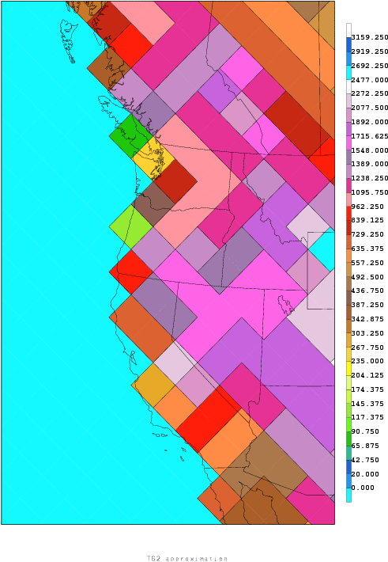
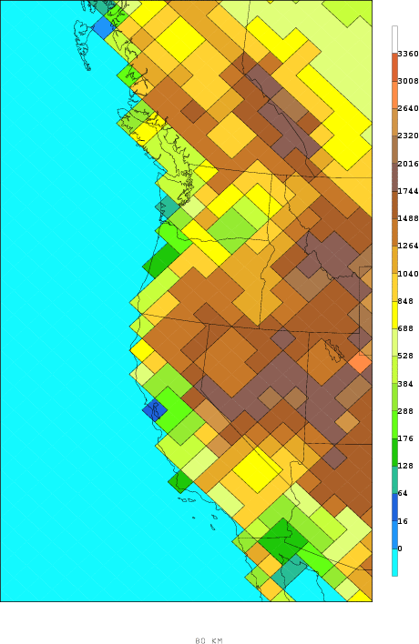
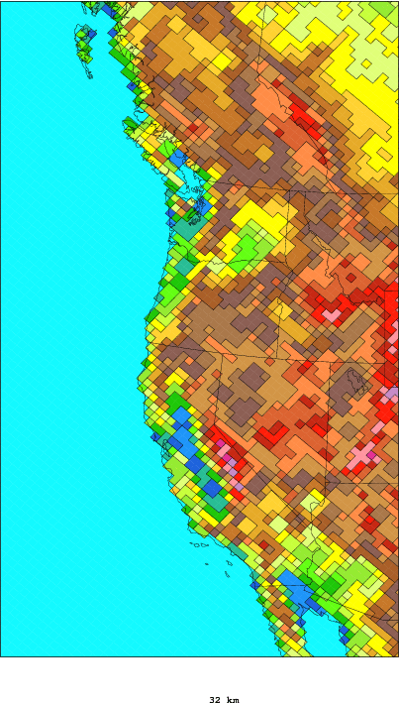
180 km 80 km 32 km

Slide 7
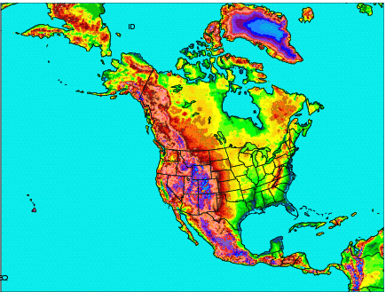
Domain Coverage of NARR

Slide 8
NARR: Data for Global
Dataset | Details | Source
Radiosondes | Temperature, winds, moisture | NCEP/NCAR Global Reanalysis (GR)
Dropsondes | Same as above | GR
Pibals | Wind | GR
Aircraft | Temp. and wind | GR
Surface | Pressure | GR
Cloud drift winds | Geostationary satellite | GR

Slide 9
NARR: Data for Regional
Dataset | Details | Source
Precipitation | CONUS (with PRISM), Mexico, Canada, CMAP over oceans | NCEP/CPC
TOVS-1B radiances | Winds, precipitable water over oceans | NESDIS
Surface land | Wind, moisture | GR, TDL
COADS | Ship and buoy data | NCEP/EMC
Air Force Snow | Snow depth | COLA and NCEP/EMC
SST | 1-degree Reynolds, with Great Lakes SSTs | NCEP/EMC, GLERL
Sea and lake ice | Contains data on Canadian lakes, Great Lakes | NCEP/EMC, GLERL, Canadian Ice Center
Tropical cyclones | Locations used for blocking of CMAP Precipitation | Lawrence Livermore National Laboratory

Slide 10
NARR Results: Upper-Air
Compared both GR and RR against fits to raobs
Root-mean-square (RMS) analysis fits significantly better for temperatures and vector wind speeds
Wind speed improvement greatest in the upper troposphere, especially in winter
First guess (3-hr forecast, pre-3DVAR) temperatures not always as favorable for RR compared to GR
Relative humidity improved for RR for both analysis and first guess

Slide 11
NARR Results: Near Surface
First guess, 1997: for temperatures, comparison against ship/buoy only. Surface temperature RMS improved both in winter and in summer
1998: Surface temperatures RMS favorable for NARR in both winter and summer. RR biases closer to zero and little diurnal variation problem in summer
10-m winds: RMS in NARR neither better nor worse compared to GR (remarkably similar!)
Slow wind biases improved in NARR: just a little in winter, visibly in summer

Slide 12
NARR Results: Precipitation
Several sources of precipitation
  CONUS data with PRISM (Mountain Mapper) to improve orographic effects
  Canada
  Mexico
  CMAP (combination of satellite and gauge data) over oceans; CMAP is blocked:
    Near central areas of hurricanes (7.5 by 7.5 deg)
    Observed precipitation > 100 mm/day
    A 15-degree “blending belt” between 27.5 and 42.5 N, with no CMAP north of 42.5 N

Slide 13
NARR Results: Precipitation (cont)
Precipitation observations used to prescribe the latent heat profile in Eta
Model uses given latent heat profile to simulate precipitation
Resulting precipitation pattern looks very much like the observed precipitation pattern in both summer and winter

Slide 14
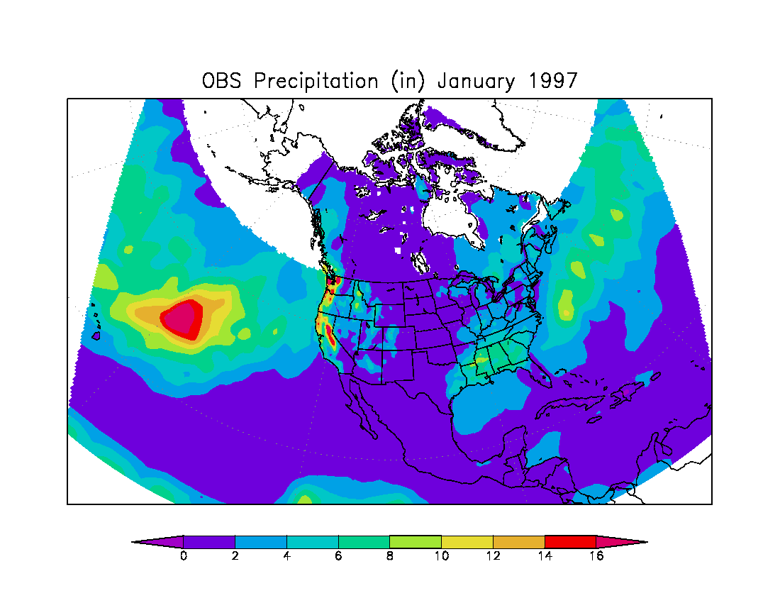
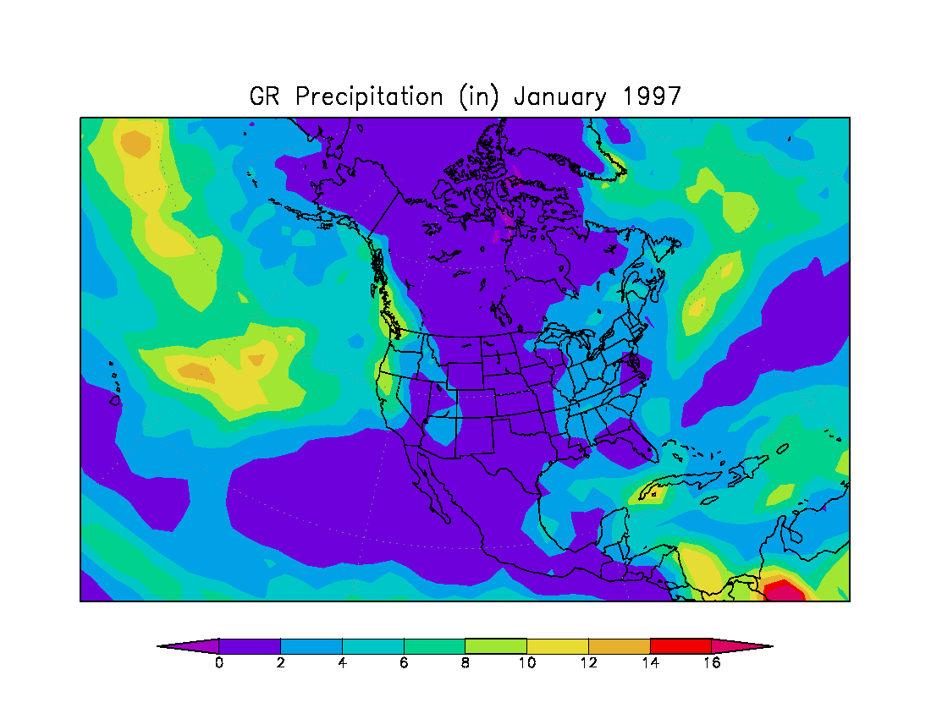
January 1997 Precipitation Results

Slide 15
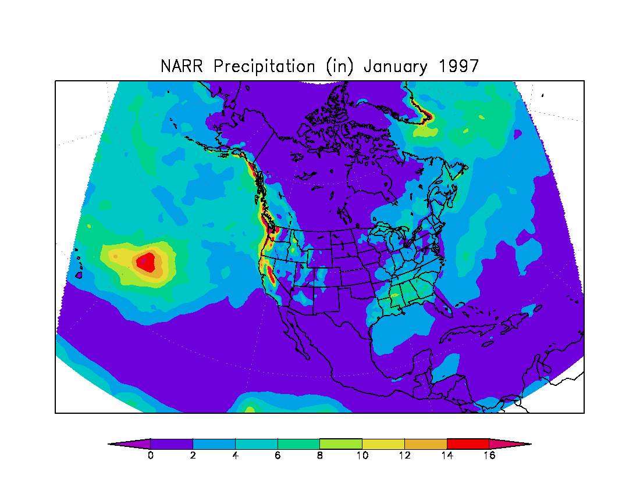
January 1997 Precipitation Results

Slide 16
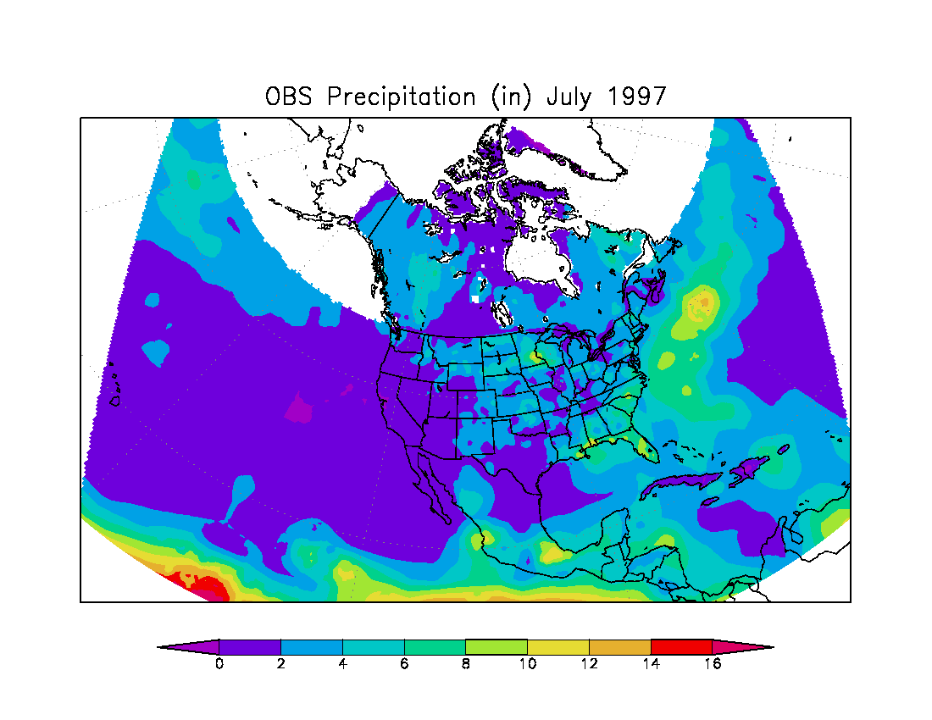
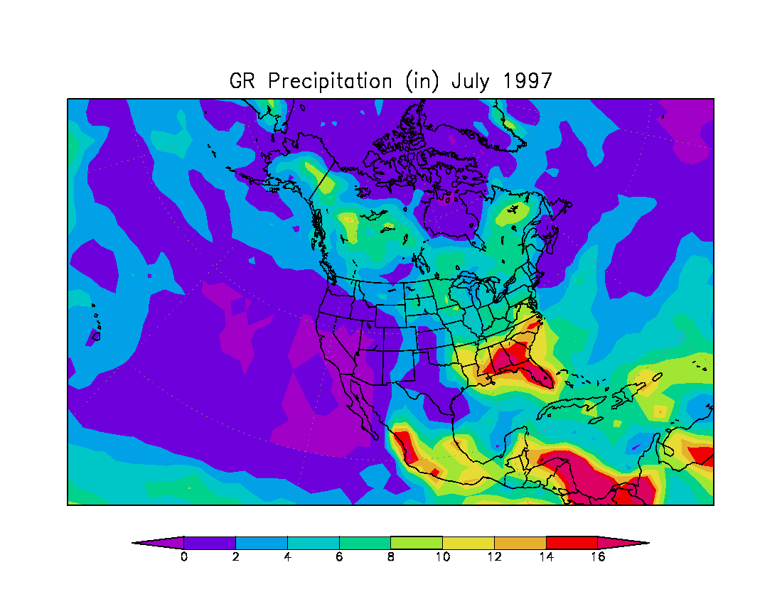
July 1997 Precipitation Results

Slide 17
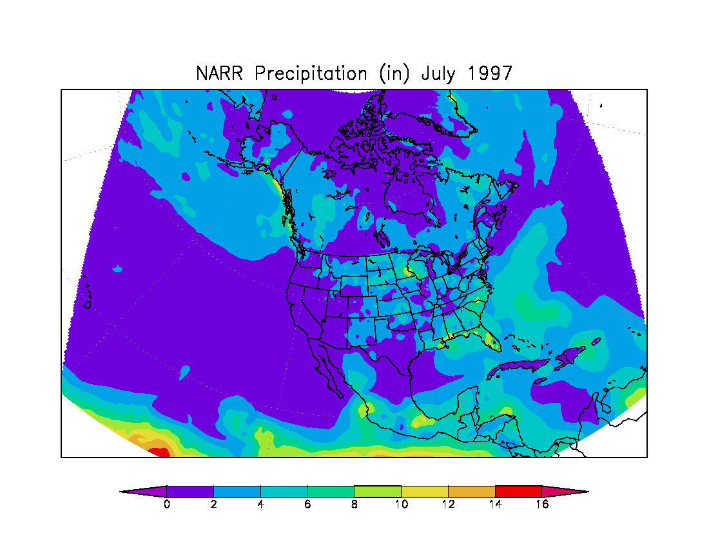
July 1997 Precipitation Results

Slide 18
NARR: Analysis System
Precipitation assimilation in EDAS
Revised 3DVAR to run using the satellite bias corrections for all the satellites
Updated the RR’s land-surface model
Ported the RR pilot system from the SGI Origin 3000 to the IBM-SP

Slide 19
NARR: System Design
Fully cycled 3-hr EDAS
Lateral boundary conditions supplied by GR2
Forecasts to 72 hr every 2.5 days, using GR2 forecast boundary conditions
Resolution: 32-km, 45 layers
NARR time period: 1979-2003 Updated monthly

Slide 20
NARR: Data Acquisition and Processing
Acquired precipitation dataset with use of PRISM (Mountain Mapper); disaggregated data to hourly
Acquired TOVS-1B data for 1979-1997 time period
Acquired Air Force snowdepth dataset
Created a high-resolution sea-ice field

Slide 21
NARR: Archiving Overview
Several archiving centers
  National Climatic Data Center (10TB)
  National Centers for Atmospheric Research *
  San Diego Supercomputing Center **
  Perhaps University of Maryland
  * 7TB
  ** Ambitious amounts

Slide 22
NARR: Archive Data Volumes
Archive a) and b) only: 7.8TB
+ 2.2TB of restart= 10TB
AWIPS Grid 221
a) analysis files
52 Mb single file
420 Mb daily (8 times per day, every 3 hr)
12.6 Gb monthly
151 Gb yearly
3.7 Tb entire RR period (25 years)
b) 3-hour first-guess forecast files
58 Mb single file
464 Mb daily (8 times per day, every 3 hr)
14 Gb monthly
168 Gb yearly
4.1 Tb entire RR period (25 years)
c) Restart files
265 Mb single file
4.1 Gb daily (16 files per day; 8 analysis and 8 first-guess files, every 3 hr)
130 Gb monthly
1.5 Tb yearly
37 Tb entire RR period (25 years)

Slide 23
NCDC: Data Ingest and Archive
10TB on HDSS and 7.8TB on NOMADS
  No off-site backup
Metadata: FGDC, COARDS, and XML
  Dynamic XML and GrADs via NOMADS Infrastructure
Serviced thru NOMADS – NOMADS is “NARR Ready”
  Traditional ftp or Web browse/plot via NOMADS Web
  NOMADS Distributed Access Services

