Slide 1
Lotronex ®
Presentation to
GI Advisory Committee
June 27, 2000
Hugo E. Gallo-Torres MD, PHD
Medical Team Leader
DGICDP
CDER, FDA

Slide 2
Lotronex®-Associated
SAEs of the GI Tract

Slide 3
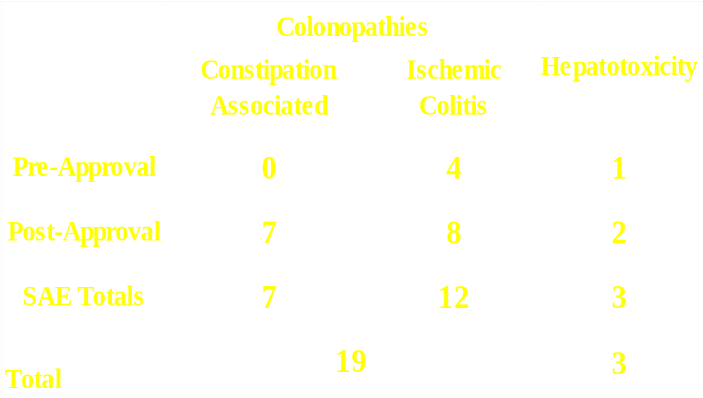
Summary

Slide 4
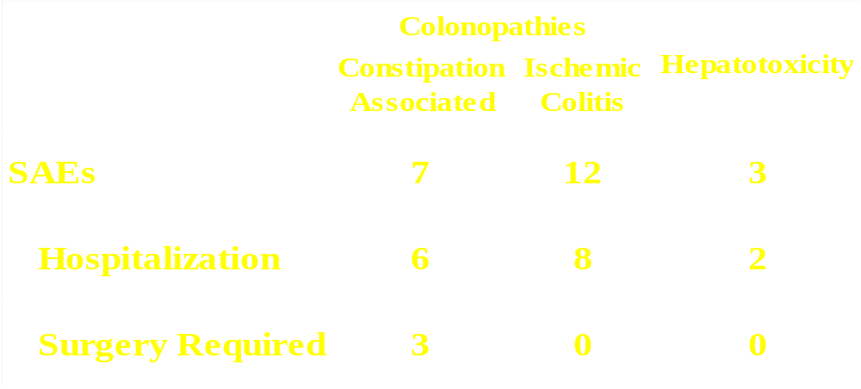
Summary of
Lotronex®-Associated SAEs of the GI Tract

Slide 5
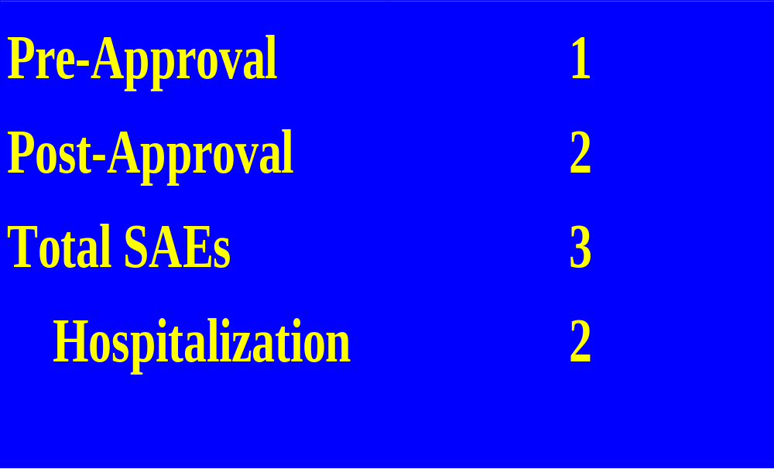
Hepatotoxicity SAEs

Slide 6
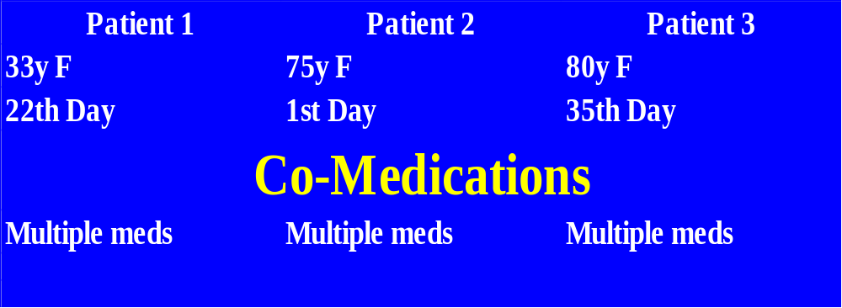
Hepatotoxicity

Slide 7
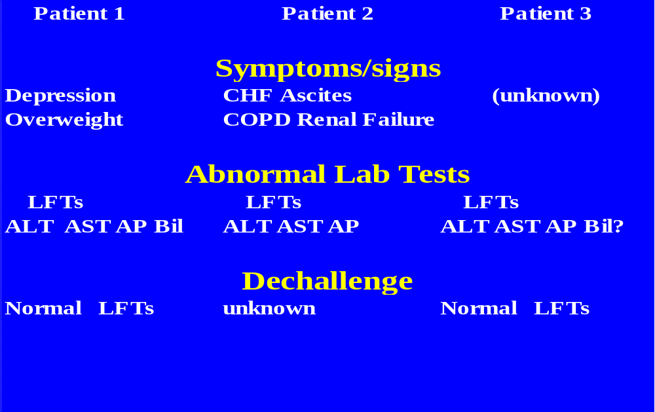
Hepatotoxicity

Slide 8
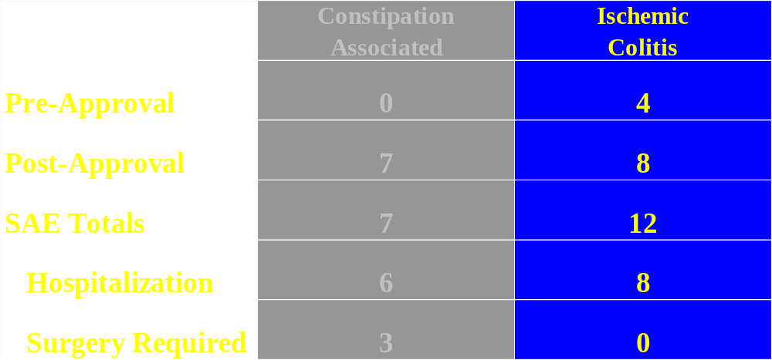
Colonopathies

Slide 9
Ischemic Colitis
      Female 53y - Diarrhea type IBS A0120828A
      History: Diverticular disease (Sigmoidoscopy one week prior)
      Meds: Ciprofloxacin (for suspected diverticulitis)
      Treatment : Alosetron 1 mg BID for 2 days
      Hospitalized 2-3 days: Rectal bleeding
      Abdominal CT: Thickening splenic flexure
      (colitis or ischemic colitis)
      Histopathology: Ischemic colitis
Colonoscopy: Confirmed Ischemic colitis

Slide 10
Lotronex® and Ischemic Colitis
      Presentation and diagnostic criteria :
        Rectal bleeding
        Abdominal pain
        Bloody diarrhea
      Duration of Treatment at Onset: 2 to 54 Days
      Abdominal CT Scan:
      Mural thickening of varying degrees of severity in small and large bowel

Slide 11
Lotronex® and Ischemic Colitis
(cont.)
      Colonoscopy-patchy, friable, ischemic or hyperemic, edematous mucosa with erosions that later
      become necrotic, ulcerated and hemorrhagic
      with mucosal sloughing
      Histopathology: Mild edema of lamina propria, focal coagulation necrosis of superficial crypts
      Normal architecture and spacing of deeper crypts

Slide 12
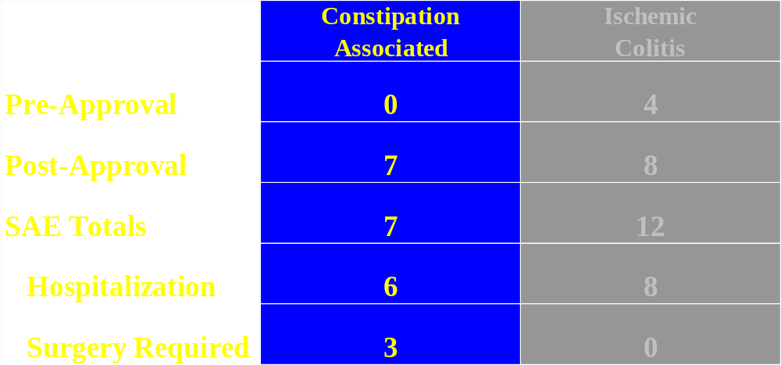
Colonopathies

Slide 13
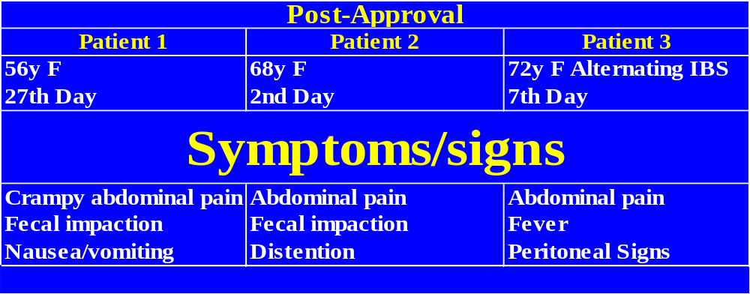

Surgical Complications of Constipation

Slide 14
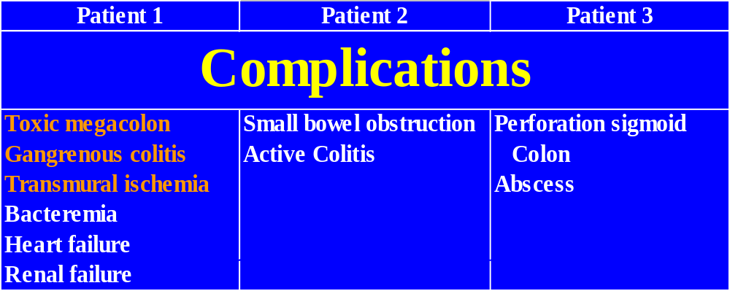
Surgical Complications of Constipation

Slide 15
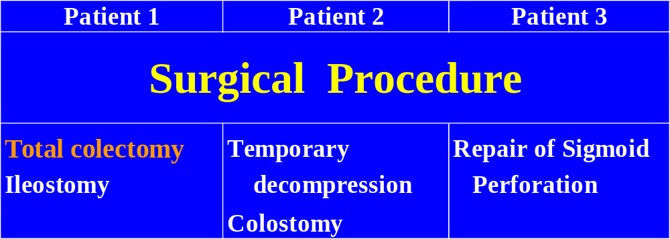
Surgical Complications of Constipation

Slide 16
Lotronex® and Constipation Fecal Impaction [n=7]
Fecal Impaction
  Not requiring hospitalization: [n=1]
  Abdominal pain, Constipation

Slide 17
Lotronex® and Constipation
Fecal Impaction [n=7]
Fecal Impaction
Hospitalized without Surgery:[n=3]
  Abdominal pain, Constipation
  Abdominal pain, Small bowel obstruction
  Abdominal pain, Bowel obstruction,
    Distal transverse colon ulcer,
    Ischemic ulceration

Slide 18
Lotronex® and Constipation
Fecal Impaction [n=7]
Fecal Impaction, hospitalized and required surgery: [n=3]
  Small bowel obstruction
    Required temporary decompression colostomy
  Perforation sigmoid colon with Abscess
    Required surgical repair of perforation
  Toxic megacolon, Gangrenous colitis
    Required total colectomy with Ileostomy

Slide 19
Lotronex® Treatment for IBS
Palliative (not curative)
Symptomatic
Not shown to prevent
  progression of symptoms

Slide 20
Irritable Bowel Syndrome
Functional Gastrointestinal Disorder
Natural history is not associated with:
    Life threatening sequelae
    Progression to colonic organic disease
Ischemic colitis
Constipation that may require surgery

