Slide 1

Mosquito Control In California – Is It Working?
Craig Downs, General Manager
Contra Costa Mosquito & Vector Control District

Slide 2
Origins of mosquito control in California
From California Folklore…
“In the Gold Rush period, mosquitoes in the San Francisco area wore pants made from the sails of ships lying idle in the Bay. On the east coast, sailors did not mind the Jersey mosquitoes, but whenever they were attacked by mosquitoes wearing sailcloth pants, there was panic aboard, for the sailors recognized them as roving bands of mosquitoes from San Francisco.”

Slide 3
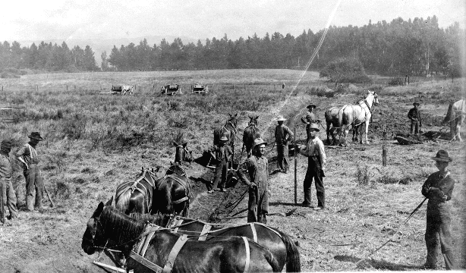
Origins of mosquito control in California - 1915
Many historical accounts state that areas of the SF Bay Area were often uninhabitable
First mosquito abatement district was established in Marin Co., in 1915, to combat salt marsh mosquitoes, followed closely by San Mateo Co. in 1916

Slide 4
Origins of mosquito control in California - 1917
Another mosquito abatement district was formed in Bakersfield to control endemic malaria
Two more districts were formed in the Northern Sacramento Valley; Tehama Co. in 1917 and Shasta Co. in 1919

Slide 5
Origins of mosquito control in California - 1930
In the summer of 1930, a major epizootic of encephalomyelitis developed in horses in the San Joaquin Valley (WEE)
Another twelve districts were formed in the 20’s and 30’s

Slide 6
Legislative Intent origin 1915, rev’d 2002
H&SC Section 2001 recognizes that:
  California’s climate and topography supports the development of human disease vectors and nuisance pests.
  Some vector-borne diseases may be fatal.
  California’s international connections increase the opportunity for vector and disease introductions.
  WNV and the Asian Tiger Mosquito are specifically identified as recent introductions.

Slide 7
Legislative Intent
H&SC Section 2001 declares that:
Personal protection against mosquitoes is only partially effective.
Protection is best achieved by organized public programs.
Protection against vector borne diseases is an essential service that is vital to public health
Mosquito abatement and vector control districts have served this role starting in 1915.

Slide 8
Goal of Mosquito Control
To maintain populations of mosquitoes and other vectors at “acceptable levels” (thresholds) within a geographic area or region
to prevent disease transmission
to maintain the quality of life for the members of the community

Slide 9

Integrated Pest Management
IPM is an ecosystem-based strategy which focuses on long term prevention of mosquito-borne disease and damage through a combination of physical, biological and chemical methods
Our goal is not to eradicate mosquitoes but to keep the population below levels that affect public health
Pesticides are used when surveillance indicates they are necessary, and treatments are made with the goal of reducing mosquitoes while minimizing risks to people, wildlife, and the environment

Slide 10
IPM: Basic components
Surveillance
Treatment thresholds
Control
  Habitat manipulation
  Water management practices
  Biological
  Chemical, including a pesticide resistance management component
Training and certification
Compliance with environmental regulations

Slide 11
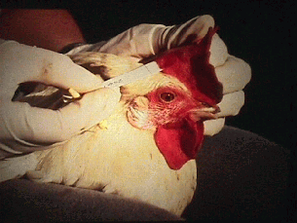
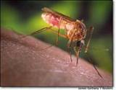
Encephalitis virus Surveillance
Sentinel chickens tested for antibodies twice monthly May-October
Mosquito samples (500 per site) tested weekly July-October
Dead birds tested in-house and sent to DHS for confirmation
Part of statewide surveillance network coordinated by CDHS/VBDS

Slide 12
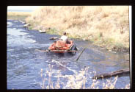
Larval control
Larval control preferred
Choice of method based on:
  Habitat
  Species/life stages present
  Population density
  Nuisance/disease potential
  Presence/absence of natural predators
  Presence/absence of sensitive species
  Water conditions

Slide 13

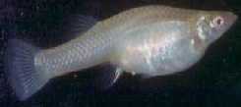
Larval control
  We use a combination of methods:
    Source reduction (eliminating the water or restoring natural flow)
    Biological control: mosquito-eating fish
    Pesticides
      Biological larvicides
      Insect growth regulator
      Larvicidal oils
      Monomolecular surface film
      Organophosphate
Mosquito larvae
mosquitofish
ATV spray operation

Slide 14
How do we know treatments are effective for larval control?
Visual inspection
Pre and post treatment larval dipping counts
Emergent jars (insect growth regulator only)

Slide 15
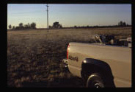
Controlling adult mosquitoes
When larval control is not possible or has been used to the fullest extent possible, adult mosquito control may be required to suppress populations
Once there are adult mosquitoes in an area, killing larvae will not reduce biting or disease transmission.
Truck mounted ULV application

Slide 16
Controlling adult mosquitoes
Adult mosquito control products may be applied either using ground-based equipment, fixed wing airplanes, or helicopters.
Available products include natural pyrethrins and synthetic pyrethroids, such as resmethrin, sumithrin, and permethrin; and the organophosphates, malathion and naled.

Slide 17
Ground-based (vehicle mounted)adult mosquito control operations
Where road access is adequate, such as in urban and suburban residential areas, good coverage may be achieved.
Applications can be done throughout the night, thereby targeting night-active mosquito species.
Applications are prone to skips and patchy coverage in areas where road coverage is not adequate or in which the habitat contains significant barriers to spray dispersal and penetration.
http://www.cdc.gov/ncidod/dvbid/westnile/resources/wnv-guidelines-aug-2003.pdf

Slide 18
Aircraft-based adult mosquito control operations
Capable of covering larger areas in shorter time periods than a ground-based application.
Less prone to patchy coverage than ground-based application in areas where road coverage is not adequate.
http://www.cdc.gov/ncidod/dvbid/westnile/resources/wnv-guidelines-aug-2003.pdf

Slide 19
How do we know treatments are effective for adult control?
Pre- and post spray vector mosquito densities inside and outside control area
  Landing counts
  Trap counts
  Caged mosquito
Weather conditions during application (temperature, wind speed, direction).

Slide 20
2004 California Activities
53 member agencies comprise MVCAC
Majority incorporate adult control w/ efficacy component
Various suburban/urban areas throughout state sprayed (ultra low volume) without any reported incidents

Slide 21
Environmental compliance
Comply with FIFRA, CWA, and CEQA regulations
Report pesticide usage to County Dept. of Agriculture and Regional Water Resources Control Board
Subject to inspections by Agriculture Department
Operate under M.O.U. with California Dept. of Health Services which also administers certification and training

Slide 22
Pesticide Use for Mosquito Control – Safety Record
No reported pesticide exposure related cases in CA 2003 – 2004.
pers. com. Dr. V. Kramer, Chief, Vector-Borne Disease Section, CA DHS.
Surveillance for Acute Insecticide-Related Illness Associated with Mosquito-Control Efforts – Nine States, 1999-2002
CDC, Morbidity and Mortality Weekly Report, July 11, 2003/52(27);629-634.

Slide 23
The findings in this report indicate that serious adverse outcomes potentially related to public health insecticide application were uncommon. When administered properly in a mosquito-control program, insecticides pose a low risk for acute, temporary health effects among persons in areas that are being sprayed and among workers handling and applying insecticides.
Dr. Arthur L. Craigmill, Extension Toxicologist reports in the September 2003 issue of Environmental Toxicology Newsletter, Cooperative Extension, University of California, Davis

Slide 24
Pesticide Environmental Stewardship Program
Administered through U.S. EPA
American Mosquito Control Association member since May 1996
Mosquito and Vector Control Association of CA is one of seven state and regional associations that participate through AMCA

Slide 25
Pesticide Environmental Stewardship Program
a voluntary program that forms partnerships with pesticide users to reduce the health and environmental risks associated with pesticide use and implement pollution prevention strategies

Slide 26
Pesticide Environmental Stewardship Program –
AMCA 2004 goals
Public lands – IPM
CE programs for mosquito control workers
Public Education programs
Proper surveillance for effective, targeted responses

Slide 27
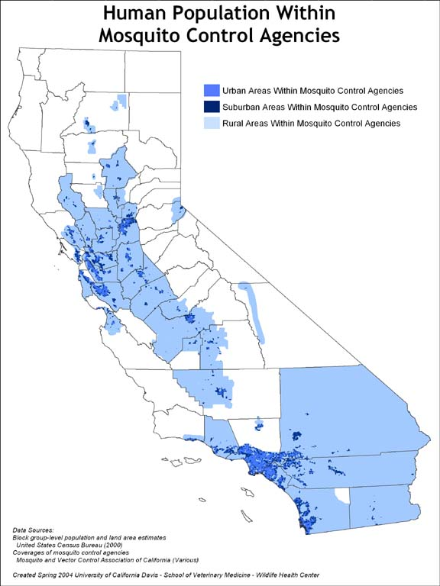

Slide 28
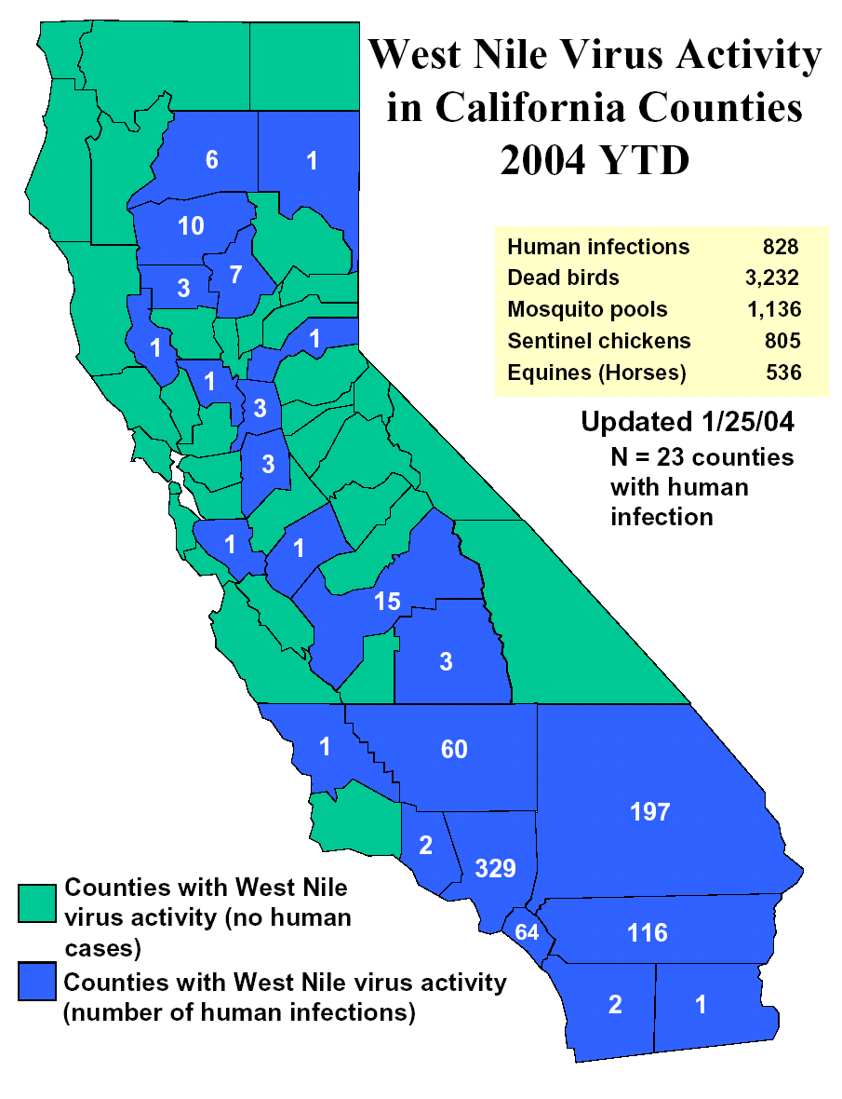

Slide 29
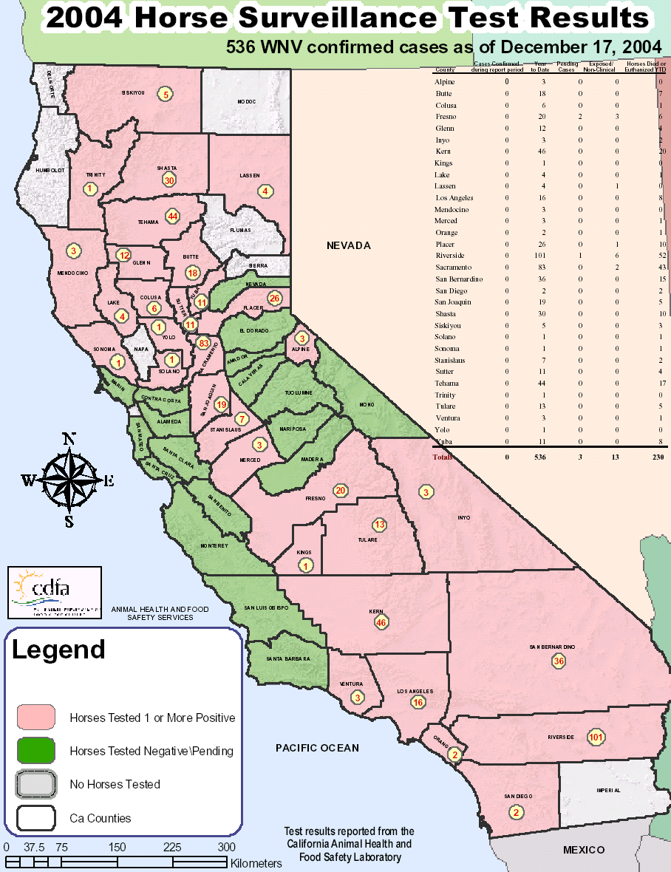

Slide 30
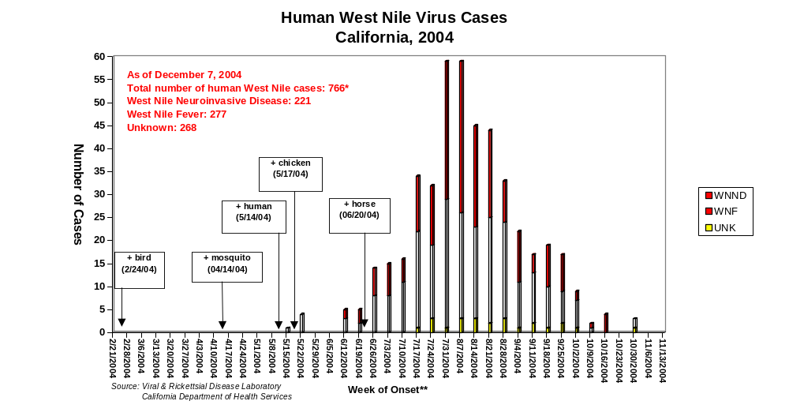





5/17
6/12
5/14
4/14
2/24
FEB MAR APR MAY JUNE JULY AUG SEP OCT NOV
Week of Onset
Onset dates not available for all patients
Birds, mosquitoes: date of collection
Chickens: date of probable seroconversion

Slide 31
Importance of WNV Dead Bird Surveillance Program
Dead bird surveillance was important for early WNV detection
  Earliest indication of WNV activity in 91% (53/58) of California counties in 2004
Dead bird surveillance system widely used by public / education tool
Dead bird reports also gave an indication of WNV activity

Slide 32
Importance continued
Only surveillance element that covered ALL 58 counties
  Mosquito pool and sentinel chicken testing limited to only those areas with established mosquito control programs.
There were 22 counties that had dead birds as the only evidence of WNV activity in 2004.

Slide 33
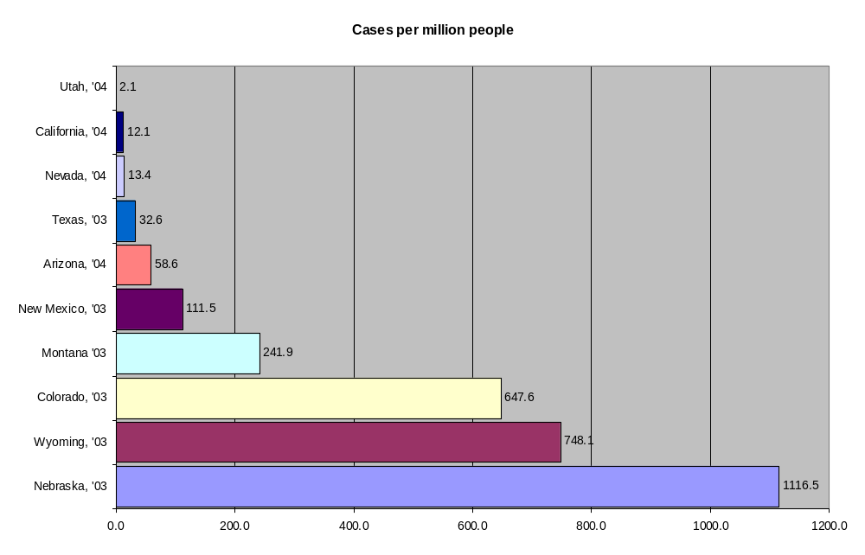

Slide 34
County | Population (in millions | Human Case | Incidence per 100,000
Maricopa, AZ | 3.07 | 346 | 11.27
San Bernardino, CA | 1.86 | 197 | 10.59
Riverside, CA | 1.78 | 115 | 10.59
Los Angeles, CA | 9.87 | 328 | 3.32
Orange, CA | 2.97 | 64 | 2.15

Slide 35
In Summary
Mosquito control agencies have been effectively protecting public health for many years; WNV has brought programs back to forefront
California has a comprehensive mosquito-borne disease surveillance program that has monitored mosquito abundance and mosquito-borne virus activity since 1969
Public’s continued ability to work and enjoy the outdoors with very low incidence of disease is testimony of programs success

Slide 36
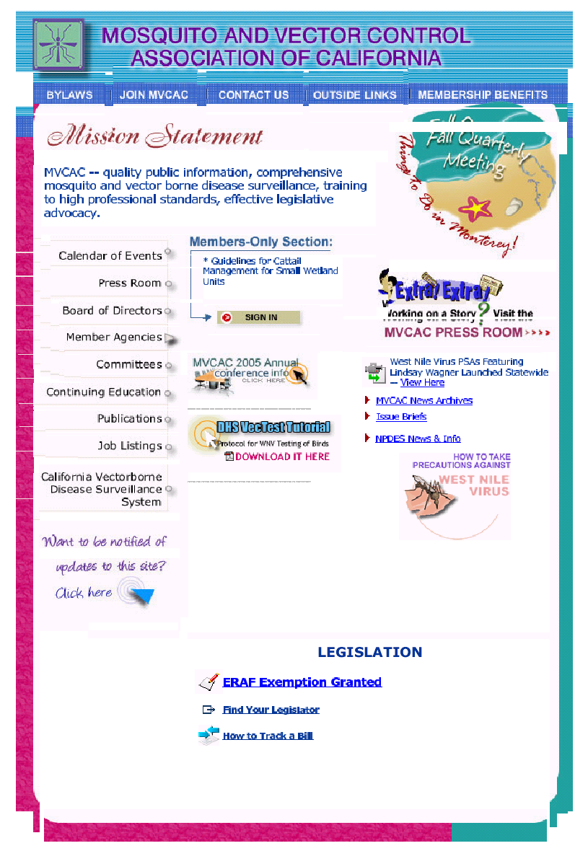
MVCAC
660 J Street, Suite 480
Sacramento, CA 95814
(916) 440-0826
Mvcac@mvcac.org
www.mvcac.org
Chris Voight - Executive Director

Slide 37
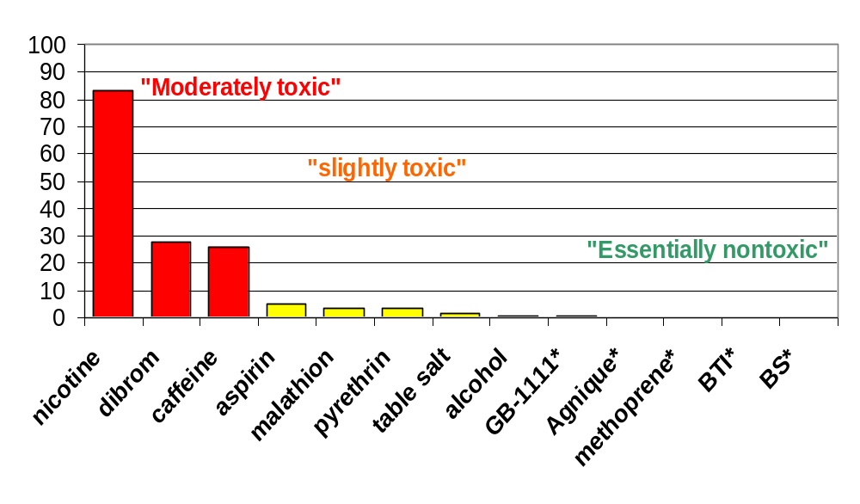
How toxic are the pesticides we use?
Adulticides
Larvicides

