Slide 1

Getting Behind The TAF
Kris Kimmons
Continental Airlines

Slide 2

Aviation User’s View Of Weathermen & The Weather

Slide 3
Cloaked In Your CAPEs & Lurking Behind A Theta-E Ridge

Slide 4
TAF Offers Limited Information
Covers 5 mile radius
Does not convey forecaster confidence
Low Visibility
What Does VCTS “Really” Mean?
Aviation Users Decidedly Deterministic
“Gap” Between TAFs & Mesoscale Products

Slide 5
Using The AFD In Aviation Planning
Addresses Forecaster Confidence
Addresses Problems Outside Of TAF Radius
Gives Users Better Understanding Of Forecast Process

Slide 6
KEWR 021152Z 021212 24006KT 6SM BR VCSH SCT014 BKN080 TEMPO 1213 5SM BR OVC014 FM1500 18005KT 6SM HZ VCSH BKN020 BKN250 FM1800 17005KT 6SM -SHRA OVC025 FM0000 VRB04KT 6SM -SHRA BR OVC010CB TEMPO 0105 2SM TSRA BR FM0500 03010KT 3SM RA BR OVC007=

Slide 7
AREA FORECAST DISCUSSION
NATIONAL WEATHER SERVICE UPTON NY
456 AM EDT FRI JUN 2 2006
NEAR TERM (TODAY)...
REGION MAINLY IN A BRIEF LULL IN THE PRECIP THIS MORNING...AS MARINE INFLUENCE ACTED AS A SHIELD OVERNIGHT...REALLY KNOCKING DOWNCONVECTION APPROACHING FROM THE WEST. HOWEVER MORE PRECIP IS EVIDENT ON RADAR TO THE WSW AND HEADED OUR WAY...AND WITH IMPACTOF SOLAR HEATING (EVEN WITH CLOUD COVER)...SHOULD REDUCE INFLUENCEOF MARINE INFLUENCE AND ALLOW SHOWERS TO REACH CWA...WITH A RUMBLE OF THUNDER
DEFINITELY WITHIN THE REALM OF POSSIBILITIES…
RESULT IS THAT EXPECT TODAY TO START OF WITH SCAT SHOWERS
SHRA AND PATCHY FOG WITH MORE NUMEROUS W/EMBEDDED
TSTMS DEVELOPING FROM W TO E BY LATE MORNING AND
CONTINUING INTO THIS AFTERNOON

Slide 8
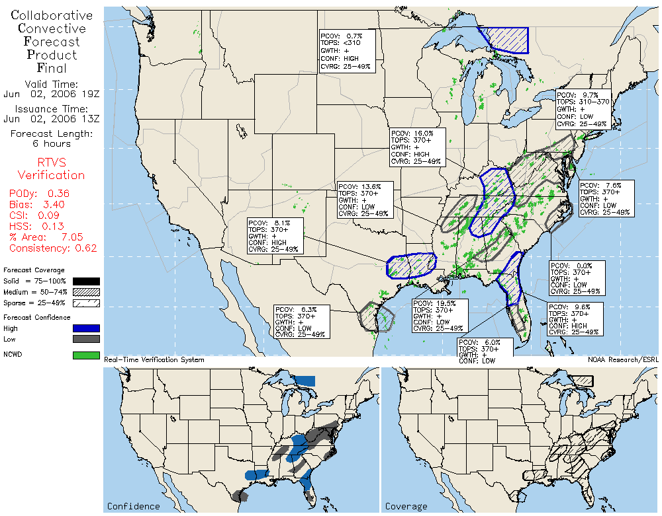

Slide 9
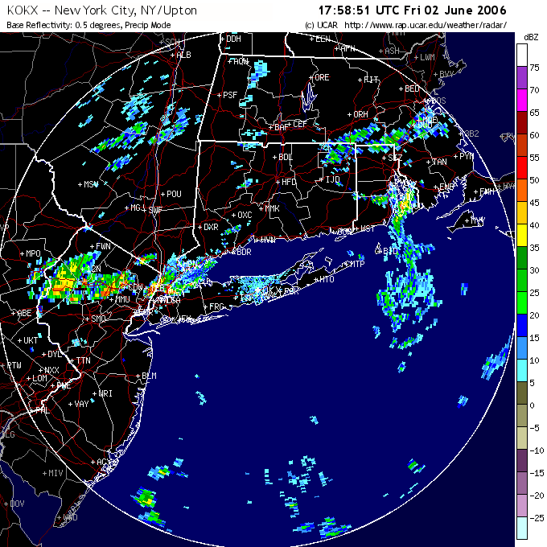

Slide 10
AIRPORT: EWR ADL TIME: 1806Z GROUND STOP PERIOD: 02/1800Z - 02/1900Z SCOPE: (Manual) ZAU ZMP ZID ZMA ZJX ZOB ZBW ZTL ZNY ZDC CYHZ CYOW CYUL CYYZ PREVIOUS TOTAL, MAXIMUM, AVERAGE DELAYS: 130/55/16.2 NEW TOTAL, MAXIMUM, AVERAGE DELAYS: 472/106/59.0 REASON: WEATHER, TSTMS PROBABILITY OF EXTENSION: MEDIUM REMARKS: TSTMS IMPACTING THE TERMINAL AREA

Slide 11
KEWR 021751Z 19009KT 6SM HZ SCT034 SCT043CB BKN100 BKN250 28/20 A2982 RMK AO2 SLP097 CB NE MOV E T02780200 10278 20222 58017
KEWR 021851Z 19010KT 7SM FEW034 SCT043CB BKN100 BKN250 28/19 A2981 RMK AO2 SLP093 CB N-NE MOV E T02780189
KEWR 021951Z 04008KT 10SM FEW020 BKN035CB OVC140 24/18 A2982 RMK AO2 WSHFT 1911 SLP097 CB NE-SE MOV E VCSH NE-SE T02390183
KEWR 022051Z 06009KT 7SM -RA FEW015 SCT039 OVC050 22/19 A2982 RMK AO2 RAB1959 SLP097 VIS LWR N-E P0003 60003 T02220194 53000=

Slide 12
Conclusions & Recommendations
NWS Reorganization Efforts Underway
New Products/Procedures Several Years Away
High Ingenuity vs High Tech
Aviation Users Can Gain Much From NWS Public Products In The Near Term

