Slide 1

Floodplain Management
Session 13
Biology
Management and restoration of floodplain ecology
Prepared by
Susan Bolton, PhD, PE
Notes:
Title slide for session 13

Slide 2
Management and Restoration of
Floodplain Ecology
Objectives:
13.1 Explain critical concepts for effective river/floodplain restoration
13.2 Describe ways that rivers and their associated floodplains can be ecologically improved.
13.3 Give examples of successes and failures in floodplain restoration projects
13.4 Discuss management and restoration functions within the context of case study floodplains
Notes:
Slide outlines the objectives for session 13

Slide 3
Management and Restoration of
Floodplain Ecology
Objective 13.1:
Explain critical concepts for effective river/floodplain restoration
Notes:
Slide introduces objective 13.1

Slide 4
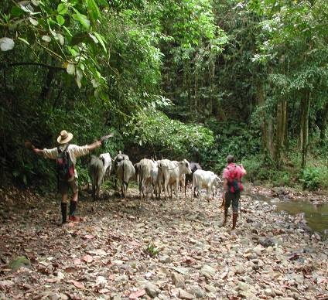
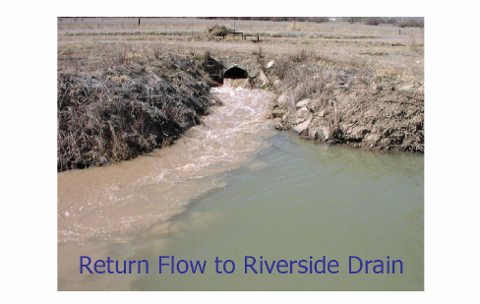
Principles for Ecological Restoration of Floodplains
Identify relationships between human activities and key ecological processes
Slide from Dave Cowley and Jon Boren
New Mexico State University
Notes:
Slide exhibits the relationship between human activities and ecological processes. The first picture shows a herd of cattle walking alongea river channel. The second picture shows a culvert draining an agricultural field. The sediment laden water flowing from the field is a different color than the stream

Slide 5
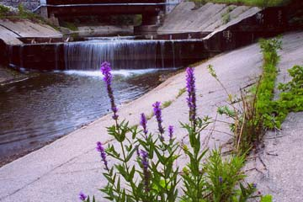
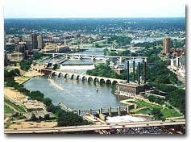
2. Identify ecological limitations that may constrain restoration (e.g. alterations in hydrologic regime due to human actions such as dams, diversions, urbanization, etc.)
Notes:
The slide illustrates ecological limits that may constrain restoration. The left slide is of a river flowing through a concrete channel. The right slide shows many bridges, dams and a large city around a major river.

Slide 6
  Recognize the system’s inherent limitations: climate, physiography, biogeography, hydrology, etc.
  Wherever possible, reconnect the longitudinal, lateral, and vertical components of the river and floodplain.
  Do not expect find ‘a smoking gun.’ Causes and cumulative effects that damage rivers and floodplain ecosystems are complex and pervasive. Response to restoration can be complex and unpredictable.
Notes:
Slide lists 3 more critical principles for restoration

Slide 7
  Eliminate the causes of degradation rather than addressing symptoms of the degradation.
  7. Fully evaluate engineering fixes for ecological ramifications. Enhancing natural recovery processes is usually cheaper and more likely to be successful in the long-term.
Notes:
Slide lists two more critical restoration principles

Slide 8
8. Riverine systems are highly variable in space and time even under natural conditions. Restoration should not seek to homogenize the system.
Notes:
Slide shows another principle.

Slide 9
Restoration projects need to have specific and measurable goals
Vague goal, hard to measure
    Improve fish habitat
Better goal, easier to measure
  Increase spawning habitat by 20%
Notes:
Slide gives examples of poor and better goals.

Slide 10
Ecological engineering principles for floodplain restoration
Take advantage of ecosystem properties
  Ecosystems are diverse, patchy, complex and self-organizing
  Floods are a normal and vital ecological process
    Strive to permit flooding within reasonable boundaries
  Rivers in floodplains are mobile
    Strive to allow the river to move in a natural fashion
Notes:
Slide discusses ecological engineering principles.

Slide 11
Questions to ask yourself
What is here?
What will nature allow us to do here?
What will nature help us do here?
What can local communities contribute to design awareness?
How can we design safe-fail not fail-safe systems?>
Notes:
Slide lists important questions to ask before restoration.

Slide 12
Management and Restoration of
Floodplain Ecology
Objective 13.2:
Describe ways that rivers and their associated floodplains can be ecologically improved
Notes:
Slide outlines objective 12.2

Slide 13
Anacostia Watershed Restoration Agreement, 1988
170 square mile watershed
Population > 800,000
Identified 7 ecologically-based restoration goals
Notes:
Slide gives information on the Anacostia Watershed

Slide 14
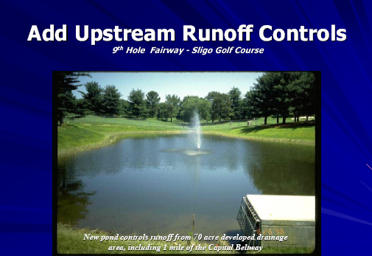
Anacostia River Restoration
Reduce pollutant loads of toxics, sewage, sediment and debris
  (improves water quality)
Notes:
Slide lists goal of reducing pollutant loads. Picture is of a water hole surrounded by a golf course.

Slide 15
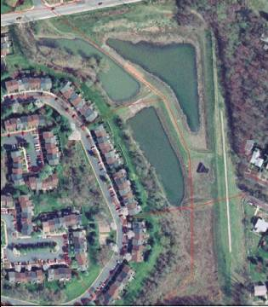
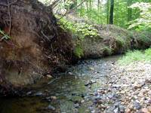
Anacostia River Restoration
Protect and restore ecological integrity of streams
  (reconnect floodplain components and control
  stormwater runoff)
New
Stormwater
Management
Facililty
Development in the upstream watershed
has increased channel discharge and
contributed to channel incision.
Notes:
Slide lists the goal of protecting ecological integrity. Left picture shows an incised channel. Right picture shows a stormwater management faciilty consisting of linked retention ponds.

Slide 16
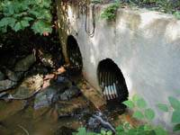
Anacostia
Restore spawning range of anadramous fish
  Remove fish barriers (improves transport of materials and restores longitudinal connectivity)
Culverts that impede fish passage
will be removed or modified
Notes:
Slide shows goal of restoring spawning range of migratory fish. Picture is of a perched culvert that is inaccessible to fish traveling upstream.

Slide 17
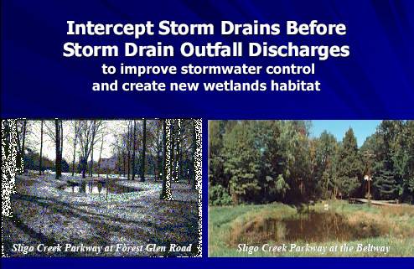
Anacostia
Increase quantity and quality of wetlands
  (improves connectivity, complexity and helps control floods)
Notes:
Slide talks about wetlands. The slide shows before and after pictures of a small wetland.

Slide 18
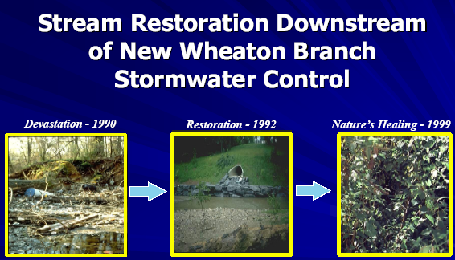
Anacostia
Increase forest cover in the watershed, especially along the rivers (provides shade, organic input, bank stability, habitat complexity)
Notes:
Slide talks about increasing forest cover along rivers. Pictures is a set of 3 photos showing the progress of a site from devegetation to restoration to revegetation.

Slide 19
Anacostia
Increase public awareness and involvement (includes human components of ecosystem)
Develop specific and quantifiable goals and targets by which to measure restoration progress
Notes:
Slide talks about other Anacostia goals.

Slide 20
Danube River Restoration
Approach is ecosystem not species oriented
Fosters hydrologic and geomorphic processes (let the river do the work)
Notes:
Slide introduces restoration on the Danube River.

Slide 21
Restoration of the Danube River
Regulation and alteration of Danube River started in 1875
Effects immediate and widespread
  Loss of off-channel habitat
  Reduced connectivity
  Lowered water table
  Reduced magnitude and frequency of geomorphic processes
  Concentration of erosive forces
Notes:
Slide gives history of alterations to the Danube River.

Slide 22
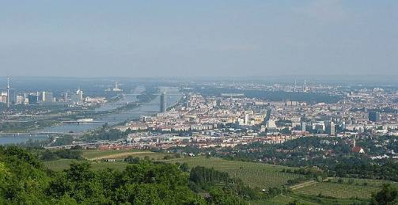
Danube River Restoration
Constraints are set by present day pollution and nutrient loads as well altered hydrologic and sediment regimes and concerns for protection against flooding of human structures and need to maintain shipping.
www.nationmaster.com/encyclopedia/Image:Wien040531w.jpg
Notes:
Slide discusses constraints to restoration of the Danube River. Photo is of Vienna and the Dabube River.

Slide 23
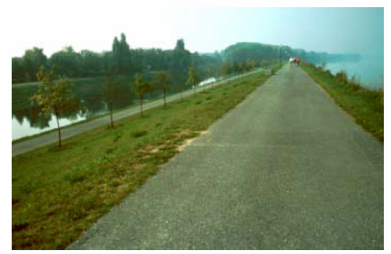
Danube River Restoration
Actions
Lower riverside embankments to increase lateral connectivity
Create more openings in embankments to allow more lateral connectivity
Impounded river with artificial dike
and drainage canal (left)
Photo: B. Lotsch
Notes:
Slide lists options for restoration of the Danube. Photo shows an impounded river with a dike and a drainage canal.

Slide 24
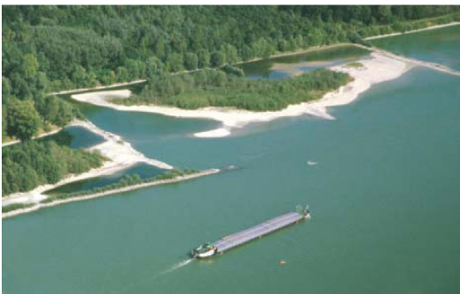
Danube River Restoration
Actions
Lower weirs on side channels to facilitate more natural water retention times and create a more continuous water course
Notes:
Slide lists another option for restoration. Slide shows dikes and weirs along the Danube River.

Slide 25
Danube River Restoration
Actions
Develop an extensive monitoring system to include hydrologic, geomorphic, biological indicators.
Notes:
Slide lists another restoration action.

Slide 26
Flooding is a natural and recurring process
Evidence from the Mississippi River indicate that flood control structures such as levees may have exacerbated the flood damage
Notes:
Slide talks about flooding as a natural process.

Slide 27
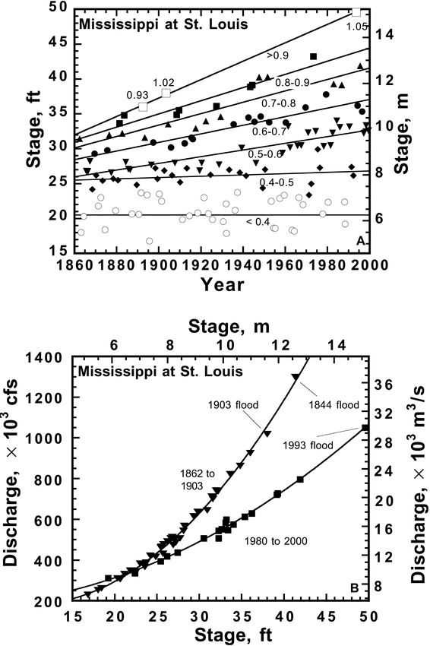
River Stage
Discharge
Comparisons
Lower graph shows that smaller
discharges
have higher stages now
than they did before- higher stage means more area is flooded
Notes:
Graph of river stage vs. time for annual peak floods at St. Louis. Different symbols represent different discharge ranges, from small, <11 325 m3/s, events (open circles) to major floods with >25 480 m3/s (large open squares; cf. Table 1 ). Linear regressions for all but smallest discharge ranges have positive slopes, indicating that flood stages have steadily increased. B: Correlations between discharge and stage, or rating curves, for annual floods before 1904 (top curve, triangles) and after 1980 (bottom curve, squares), illustrating profound changes in channel. If 1844 flow occurred today, river would top St. Louis levee by >1.5 m. All data are from U.S. Geological Survey.

Slide 28
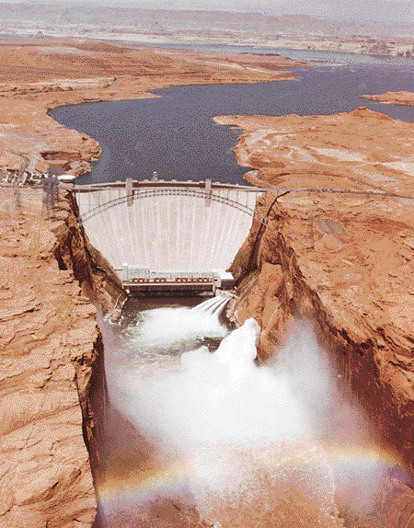
Using floods to restore ecology
In 1996 and 2004 controlled floods
were used on the Colorado River
below Glen Canyon Dam to redistribute downstream sediment, alter vegetation
patterns and increase native fish habitat
Notes:
Slide talks about using controlled floods to restore ecology. Photo is of the Glen Canyon Dam doing a flood release to restore downstream river habitat.

Slide 29
Common causes of failure in floodplain restoration
Incomplete understanding of ecological history of the area (what will nature allow you to do?)
Applying restoration efforts at the incorrect scale (trying to stabilize a cut bank in meandering river)
Treating the symptoms (e.g. floods, fishery declines, sedimentation) rather than the causes of the situation)
Notes:
Slide lists common failures in restoration.

Slide 30
Common causes of failure in floodplain restoration
Forgetting to integrate restoration effort with ecological principles
Inadequate definition of goals and objectives
Failure to monitor outcomes and adaptively manage
Notes:
Slide lists more types of failures in restoration.

