Slide 1
Winter Weather Workshop
October 2002
What’s new in NWP
Bill Bua, COMET NWP resource at NCEP
Bill.Bua@noaa.gov
Many thanks to Stephen Jascourt and Geoff DiMego for contributing slides. Some Global Forecast System slides have images taken from the T254 Technical Procedures Bulletin

Slide 2

OUTLINE
1. Global Forecast System changes
2. Eta model changes
3. Nonhydrostatic Mesoscale Model (NMM)
4. RUC-20
5. Short range ensembles (SREF)
6. COMET

Slide 3
Global
Forecast
System

Slide 4
2002 until Oct 29 Starting Oct 29, 2002
GFS
00, 06, 12, 18 UTC
“MRF” with late data cutoff is gone, fields labeled “MRF” are same as fields labeled “AVN”
T254
L64
T170
L42
T170
L42
T126
L28
T62 L28
2002 added hours
84h 180h 384h
3 ½ d 7 ½ d 16 d
84h 180h 384h
3 ½ d 7 ½ d 16 d
2002 (all year) Starting sometime 2003
T126
L28
T126
L28
Ensembles
T62 L28
T62 L28
84h 180h 384h
3 ½ d 7 ½ d 16 d
84h 180h 384h
3 ½ d 7 ½ d 16 d
11 members (1 control, 10 perturbations) 11 members (1 cont., 10 pert)
00 UTC, 12 UTC 00 UTC, 06 UTC, 12 UTC, 18 UTC

Slide 5
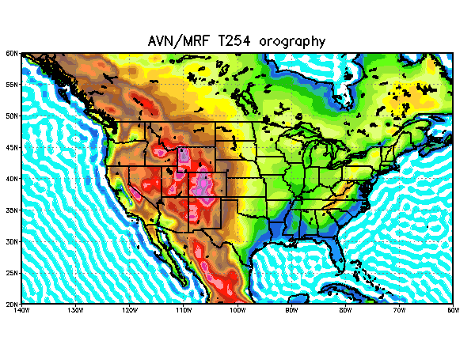

Slide 6
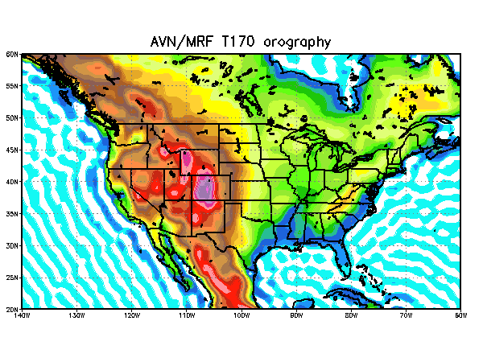

Slide 7
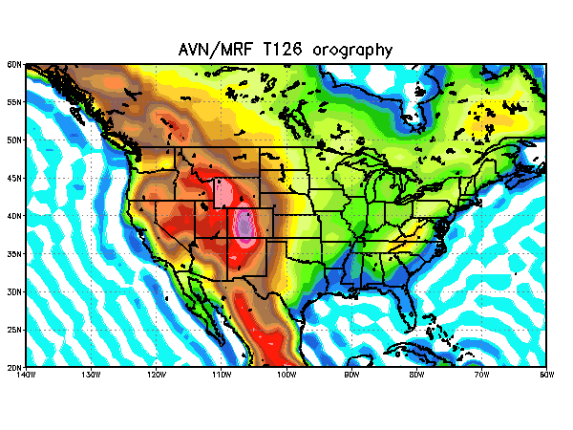

Slide 8
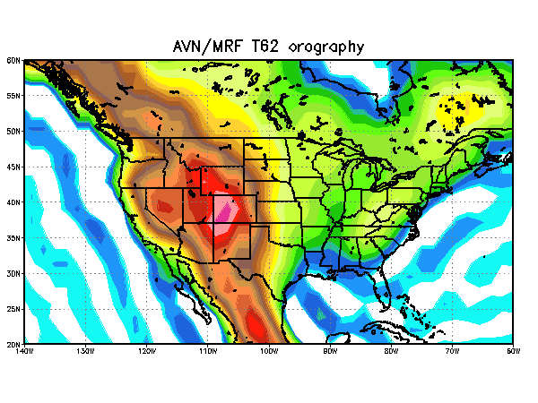

Slide 9
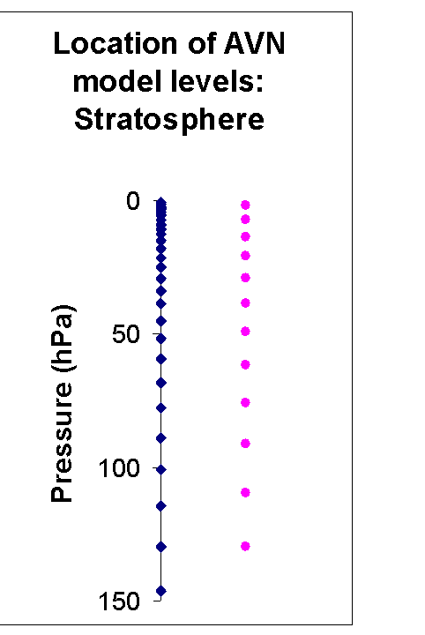
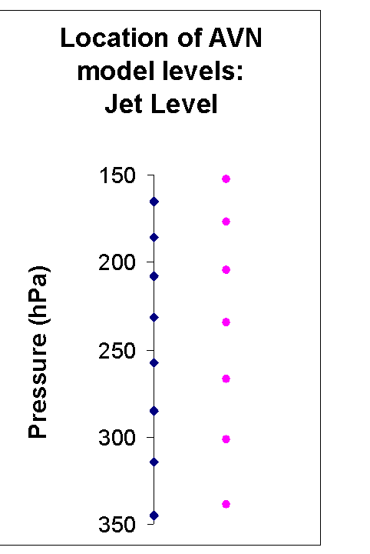
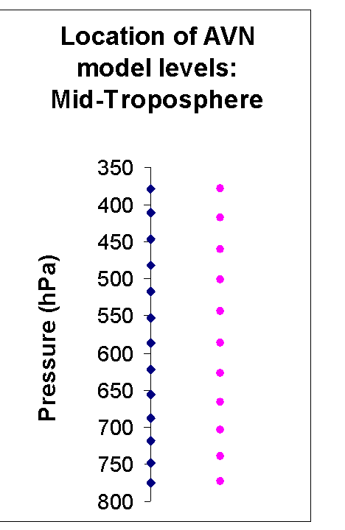
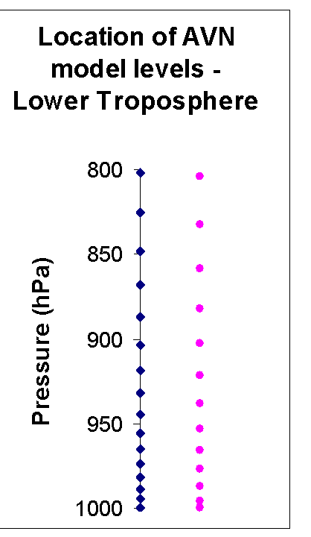
64L Eta 42L
60L
Better-resolved
PBL, low level moisture
Improved assimilation of satellite radiances

Slide 10
Concentration of new points in stratosphere and model top raised, to help better use…
MORE SATELLITE RADIANCES
NOAA 15 and NOAA 16 AMSU-A channels 12 and 13
HIRS from NOAA-16 (NOAA-14, 15 HIRS already was used)
Contrast with Eta stratospheric levels… Eta has been having problems with radiance assimilation because even channels peaking lower in troposphere have contributions from stratosphere

Slide 11
Reminder from last year May 2001 Implementation
Related to winter weather forecasts:
  Prognostic cloud water (similar to old Eta before Nov 2001)
  Direct tie-in of cloud water to radiation scheme through use in cloud fraction diagnostics
  Better QC on AMSU radiances going into data assimilation scheme (affects oceanic regions with high low-level winds)

Slide 12
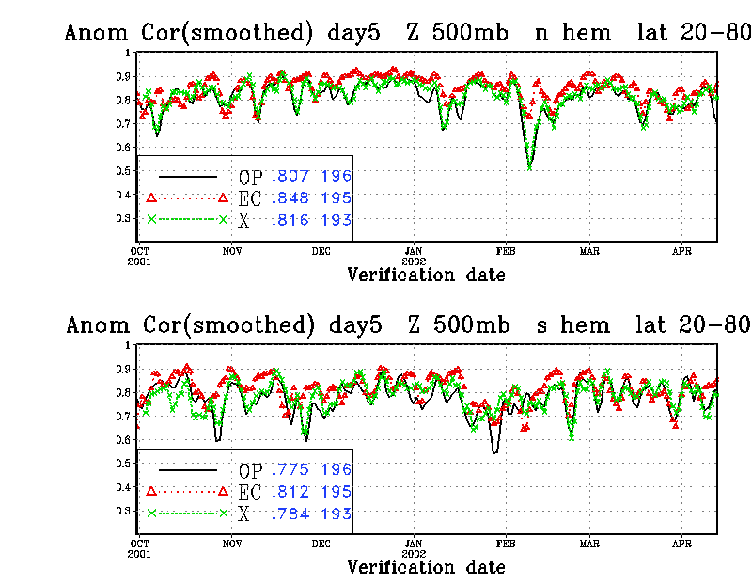
T170 T254
OCT ’01 JAN ’02 APR ’02
T170 and T254 track together, very slight improvement

Slide 13
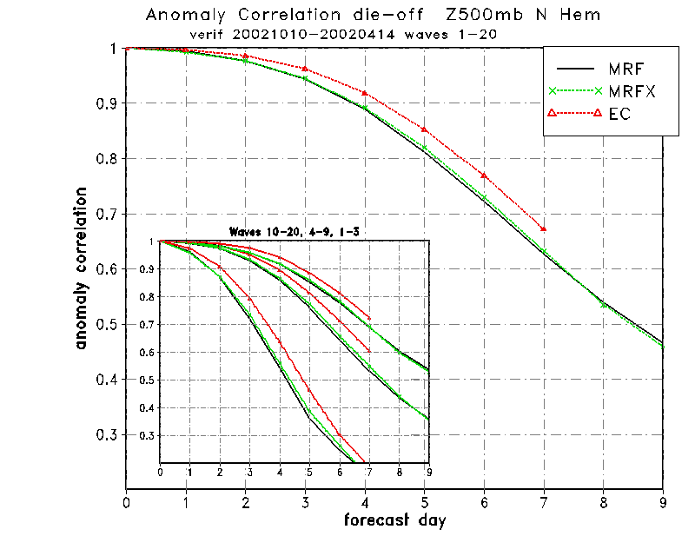

Slide 14
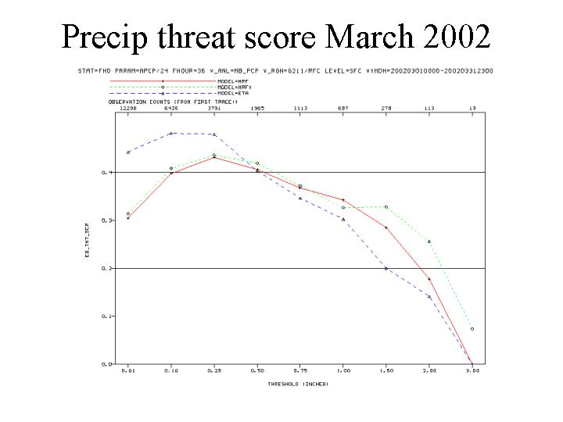
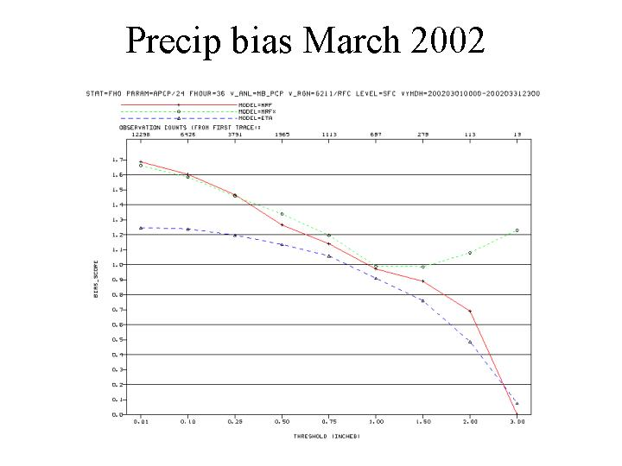
T254 improves over T170 heavy amounts
Eta better light amounts
.01 .10 .25 .5 .75 1.00 1.50 2.00 3.00
No bias
T254 higher bias for heavy precip

Slide 15
Fits to raobs nearly same for T170, T254 tests
MOS tested using T254 parallel MRF vs. T170 operational MRF 12/15/01 to 3/15/02
nearly identical but cold bias slightly worse
MOS tested using 00 UTC AVN vs. 00 UTC MRF 3/7/02 to 3/27/02
(only difference is data cutoff time – MRF runs later)
results essentially indistinguishable, extremely close

Slide 16
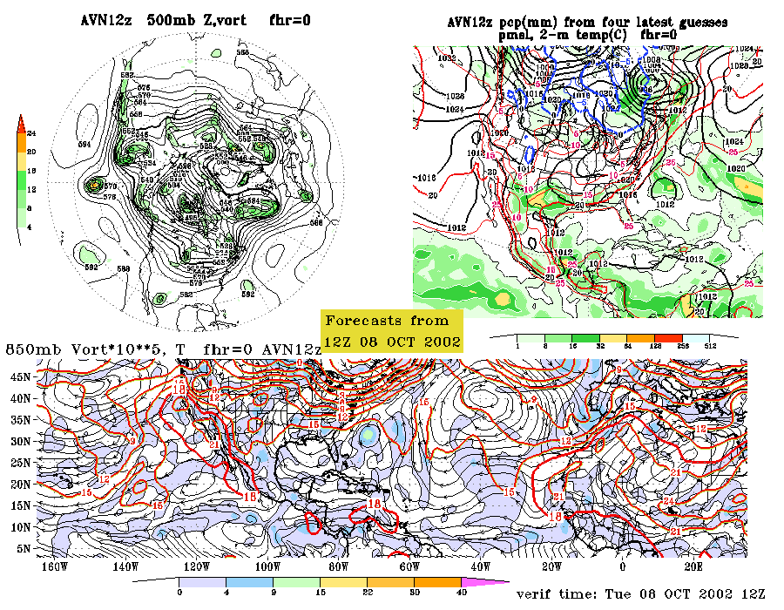

Slide 17
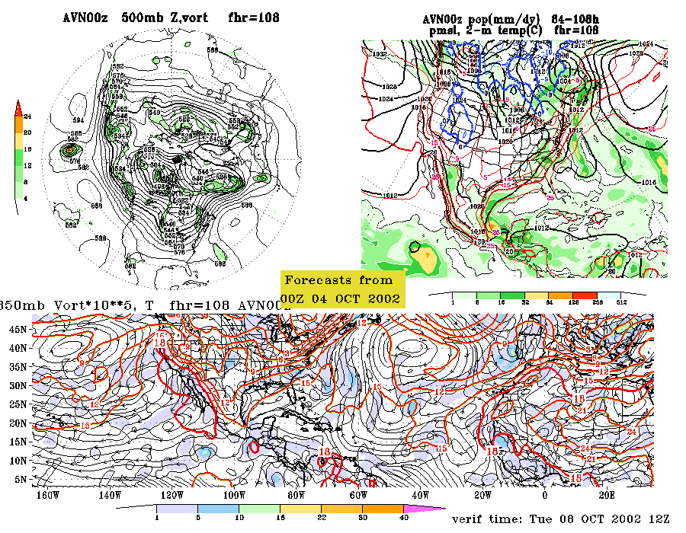

Slide 18
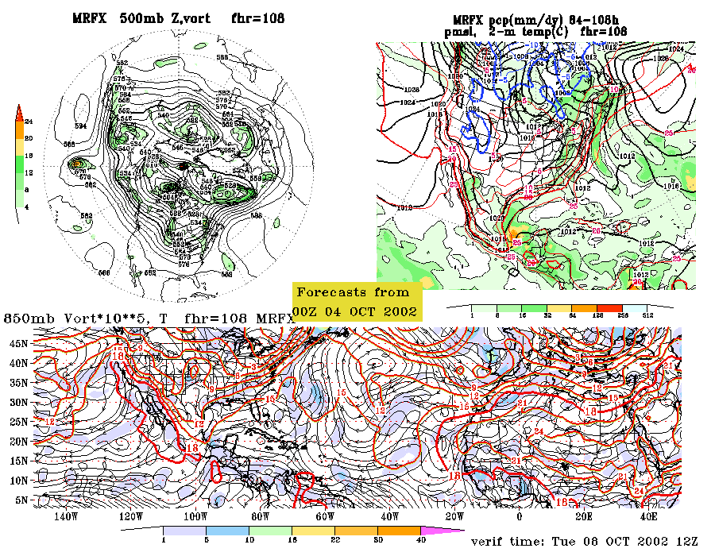

Slide 19
Eta
Model

Slide 20
Coming in early 2003
NEXRAD WINDS
Superobs (combining individual data points) to 1 km radial x 6°
  azimuth
Not used where VAD quality flag says bad data (including birds) or where radar beam runs into model topography
32 km test shows no forecast impact
10 km test but without assimilation cycling shows improved fits to raob initially but no overall forecast impact
2) Radiance processing
Upgrade to global model processing methods, including new emissivity model over land
Allows channels used over water to be used over land. GOES PW no longer used over land because redundant with radiance data
Hardly any overall forecast impact (32 km test)

Slide 21
Coming in early 2003 (continued)
3) Output and Radiation made consistent with the new (Nov 2001) cloud microphysics
Microphysics fields cycled
Long wave effects of clouds updated hourly instead of every 2 hours
Convective cloud fraction increased; shallow convection assumes 10% cloud cover
Formulation for cloud fraction from Xu and Randall (1996), instead of Randall (1994)
RH for cloud fraction calculated consistently with Nov 2001 microphysics
Cloud optical properties changed
FORECAST IMPACT in 32 km test:
<0.5” precip improved, >0.5” even drier
Improved slightly all forecast hours fit to raobs and 2-meter temperatures

Slide 22
Coming early 2003 (continued)
4) GOES cloud-top assimilation
  Remove moisture above observed cloud tops
  Add moisture at observed cloud levels
  Use as top anchor point for precip assimilation if have to add precipitating cloud
5) Output/postprocessing changes (related to clouds and precipitation)
Cloud water/ice, rain, snow, total condensate output separately
Cloud-base, cloud-top pressures from shallow non-precipitating and deep convection, and grid-scale clouds output separately
Visibility calculations changed to use new cloud fields, responding to mixing ratios of cloud water, cloud ice, rain, and snow
Low-level clouds in the lowest 100 mb and upper-level clouds above the tropopause no longer ignored

Slide 23
Changes last year affecting winter wx: what new have we learned?
Precip assimilation
EDAS adds water vapor and condensate where needed to make model precip during assimilation match radar and METAR reports
Improved cloud and precipitable water analyses
NOT performed where model temperatures cold enough for snow, because obs of precip rates unreliable for snow
2) Land surface model changes
Many improvements affecting performance with snowcovered ground
3) Grid-scale microphysics
Mixed-phase microphysics
Precip falls at realistic speeds, not instantly reaching ground
Precip advects while falling – snow can drift over peaks on way down
Deep isothermal 0ºC layers form, Baldwin precip type algorithm troubles
4) 12-km resolution and corresponding topography

Slide 24
Land Surface Model 2001 upgrade
Cold season processes (Koren et al 1999)
  Patchy snow cover
  Frozen soil (new state variable)
  Variable snow pack density (new state variable)
  Soil heat flux under snowpack (Lunardini 1981)
  New maximum snow albedo database (Robinson & Kukla 1985)
    Takes into account observed effect of vegetation on the albedo of grid box

Slide 25
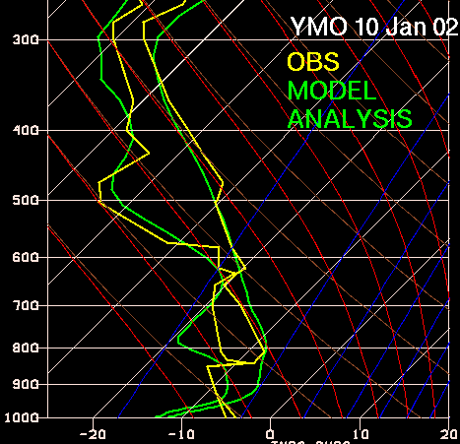
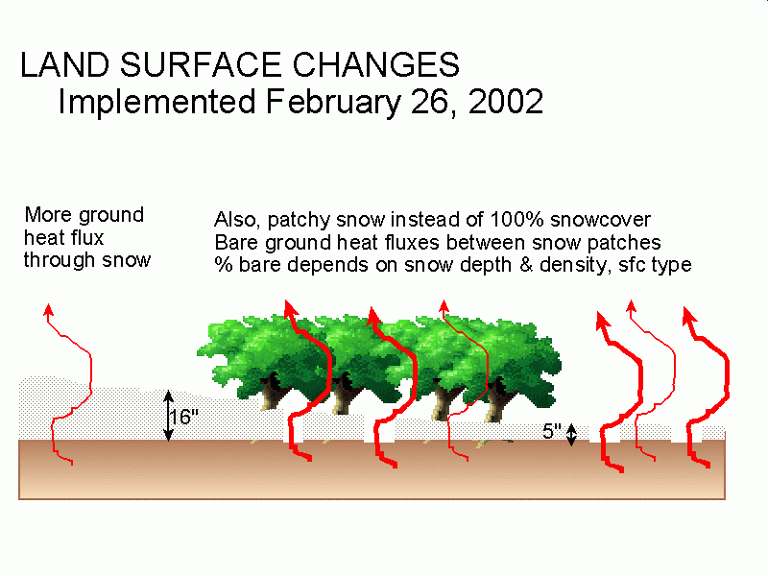
Too warm
Too cold

Slide 26
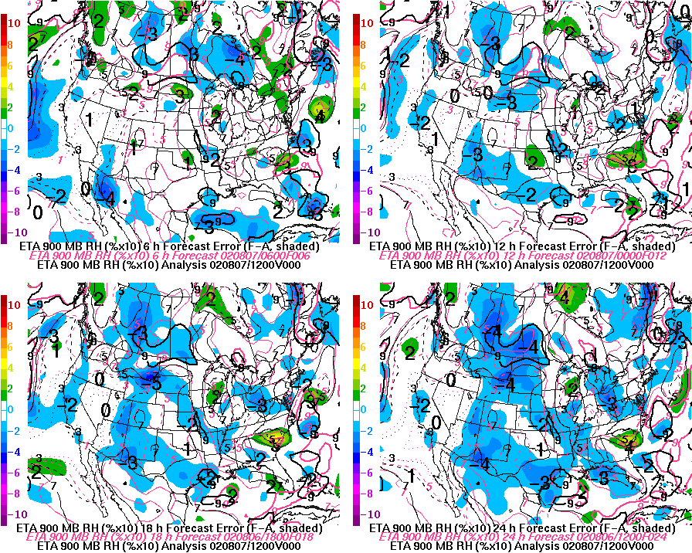
Model dries out during forecast, summer (winter too?)
6/12/18/24 h forecast 900 mb RH vs. analysis RH
Blue shades start at 10% too dry, color interval is 10%
6
12
This picture from Steve Silberberg’s AWC model verification page: http://www.awc-kc.noaa.gov/metdata/verify/models.html Problem is under investigation, cause not found yet
24
18
Notes:
Don’t know exactly what the cause is. May not apply to cold season, but certainly worth mentioning!

Slide 27
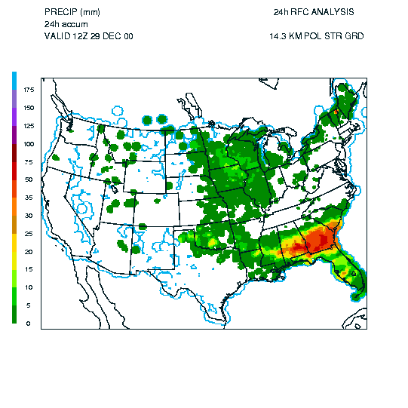
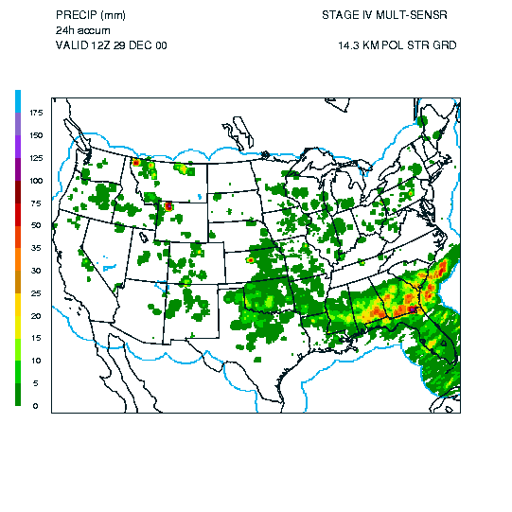
WHY NO PRECIP ASSIM FOR SNOW
Coop Daily versus Sum of Hourly Analyses Using Gage&Radar Estimates 29December
COOP
SUM
Generally poor agreement due to underestimation of snow.

Slide 28


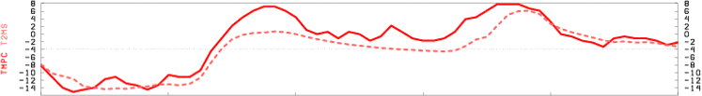
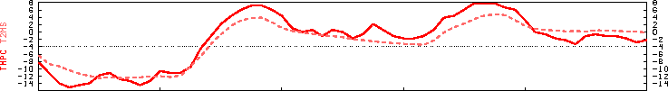
OLD: snowcover ground=freezing
NEW: snowcover - ground > freezing
SKIN TEMP
OBS
Model ≈ 0 C
2 m AIR TEMP
North Platt, Neb.
previous model formulation (until snow completely melts):
=> all incoming energy melts/sublimates snow => skin temp held at freezing
=> 2-m air temp held near freezing
Current formulation:
=> patchy snow cover for snow depth less than threshold depth (veg-type dependent) => reduces surface albedo => accelerates melting => more available energy at sfc
=> skin temp can exceed 0 C => 2-m air temp rises further above freezing.
0 C
18Z

Slide 29
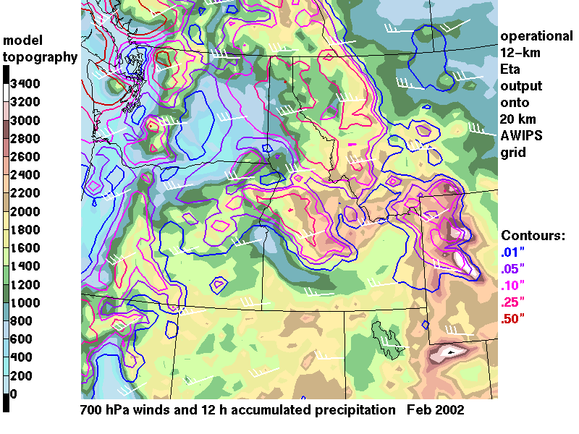
Snow drifting downwind while falling

Slide 30
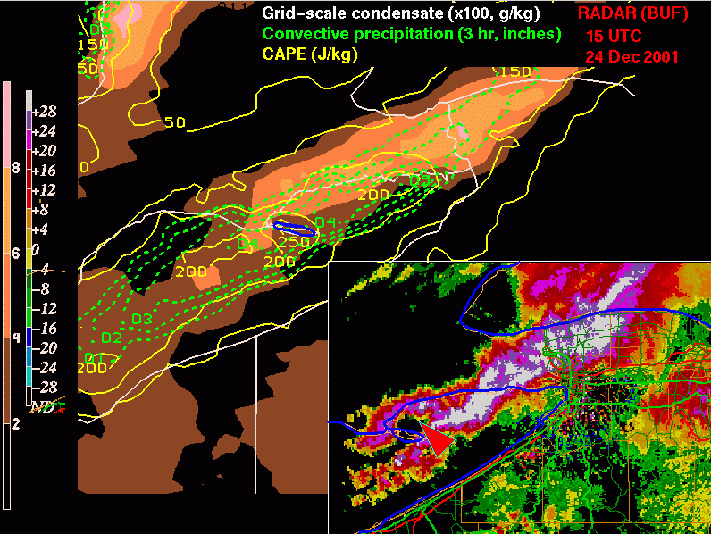
Notes:
Along-lake (large single band) lake effect snow band development and maintenance improved…good forecast up to about 18-24 hrs even on position of snowband in strongly forced events.

Slide 31
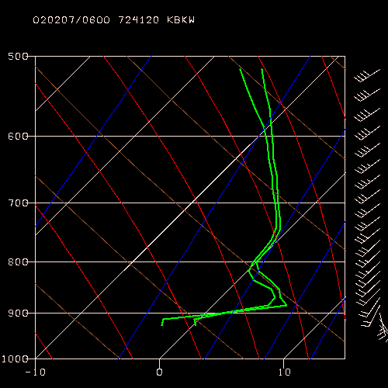
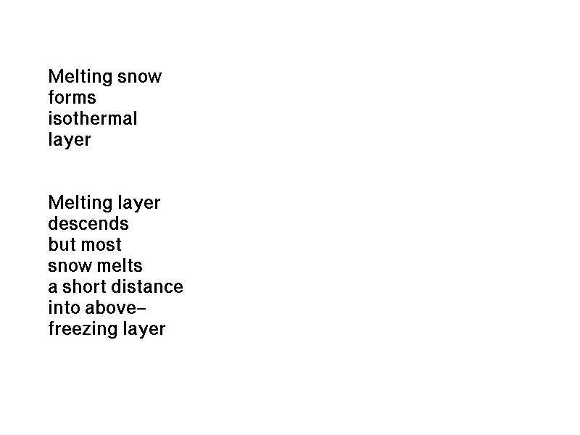

Slide 32
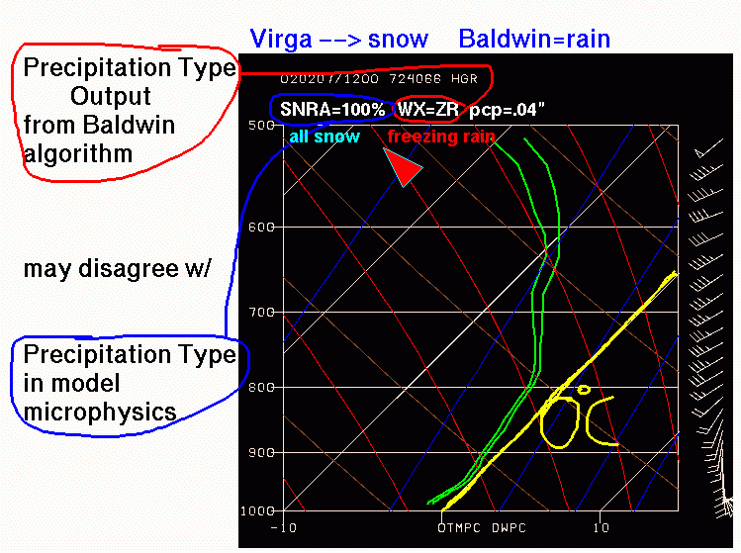
-4°C isotherm

Slide 33
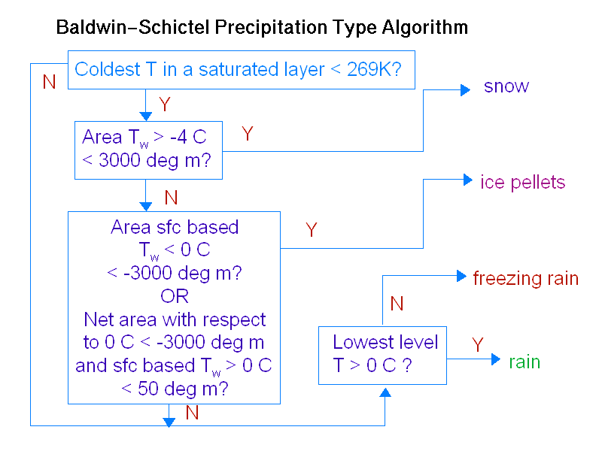
Precip type grids are not from model microphysics

Slide 34
Problems with precip type from Baldwin-Schictel:
New grid-scale scheme has 98% RH threshold versus 75% over land for old scheme algorithm set up to work with
Deep isothermal 0°C layers with new scheme
Model microphysics precip type = fraction of frozen precip not available in AWIPS
If interested in getting this, contact Ashley.Kells@noaa.gov, explain the operational need for this field. While you’re at it, may as well ask for the 3-d microphysics fields (rain, snow, cloud water, cloud ice)

Slide 35
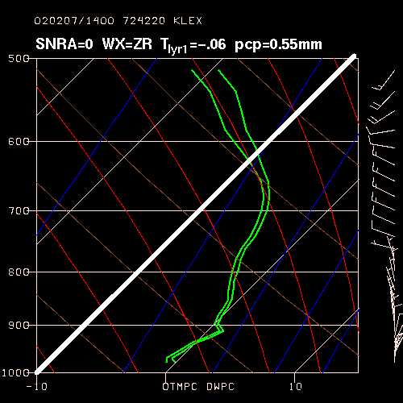
14z 2/7/02 Lexington KY Eta BUFR sounding, Baldwin prec type, model fraction of rain to snow

Slide 36
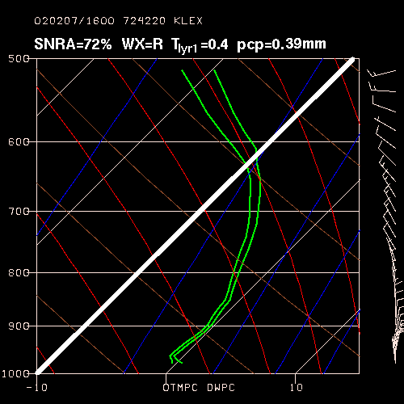
16z 2/7/02 Lexington KY BUFR sounding, same information as previous graphic.
NOTE: Changeover from rain to snow via model precipitation microphysics (cooling of layer through latent heat of fusion taken into account)!

Slide 37
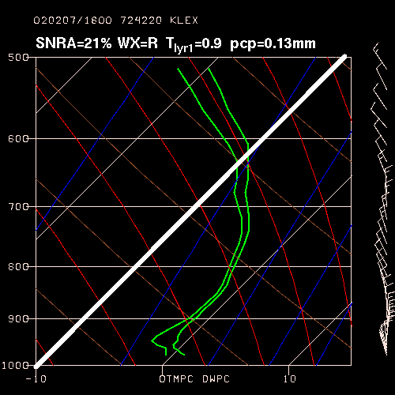

Slide 38
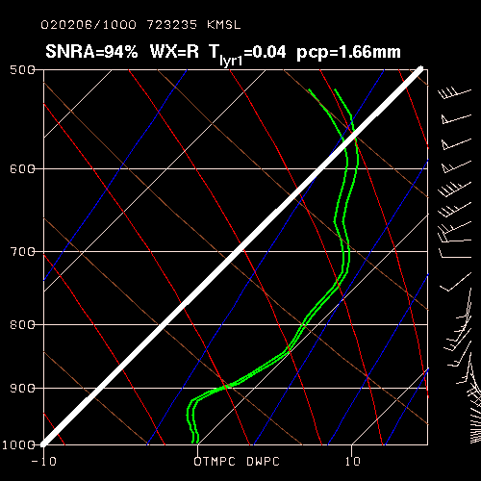

Slide 39
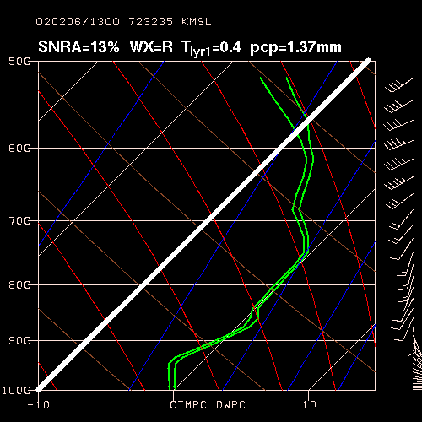

Slide 40
Miscellaneous:
FREEZING LEVEL
Will be extended below model topography using standard atmosphere lapse rate
12-km grids getting into AWIPS:
Testing began for a few fields distributing over SBN starting July 23
Next AWIPS build will have some fields on 12-km grid

Slide 41
NONHYDROSTATIC MESOSCALE MODEL (NMM)
New hybrid vertical coordinate
Replaced the Eta model for high-resolution windows runs
Similar physics to Eta
No assimilation cycling yet, starts with Eta-12 analysis
BEGINS THE TRANSITION TOWARD Weather Research and Forecasting (WRF) Model
  Modular design: different model options “plug in”
  WRF will allow collaborators outside NCEP to run the same model and to supply parameterizations that will more readily work in the NCEP operational environment (a great difficulty now)

Slide 42
8 km Nested Meso
Lateral boundary conditions (out to 48 hours)
  Generated by 12 km Eta run
  On model vertical levels
  Every hour of forecast
Initial conditions
  Interpolated from 12 km Eta run
  High resolution terrain incorporated
  Lynch digital filter speeds adjustment

Slide 43
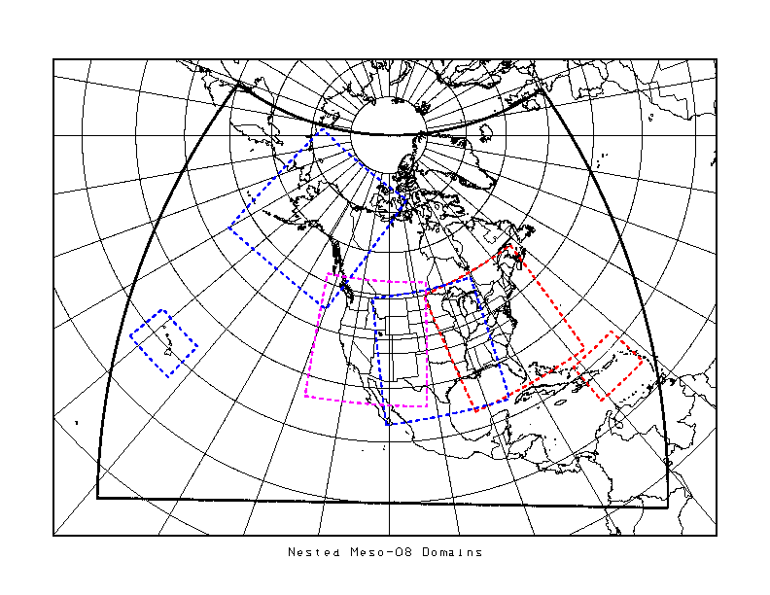
Large Fixed-Domain Nests

Slide 44
Nonhydrostatic Mesoscale Model
See Janjic, Gerrity,and Nickovic, 2001 for model equations, solution techniques & other test results [MWR,Vol. 29, No. 5, 1164-1178]
Highly refined version of nonhydrostatic option released in May 2000 upgrade to NCEP’s workstation Eta
NMM retains full hydrostatic capability
  Incorporate nonhydrostatic effects through ε where ε=(1/g) dw/dt
  Then split prognostic equations into:
    hydrostatic parts plus
    corrections due to vertical acceleration
  Set ε to zero to run in hydrostatic mode

Slide 45
Nonhydrostatic Mesoscale Model
Feature Comparison With Meso Eta
Feature | Meso Eta Model | Nonhydrostatic Meso Model
Horizontal grid | 12 km E-grid | 8 km E-grid (readily downscales when more computer power available)
Vertical coordinate | 60 step-mountain eta levels | 60 hybrid sigma-pressure levels
Terrain | Unsmoothed silhouette with lateral boundary set to sea-level | Unsmoothed grid-cell mean everywhere

Slide 46
Hybrid and Eta Coordinates
Ptop
Ptop
 = 0
Pressure domain
☞ = 0
Sigma domain
ground
ground
☞ = 1
MSL
 = 1

Slide 47
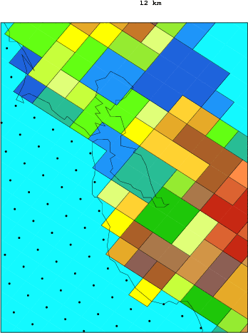
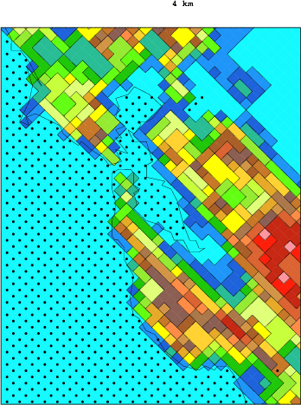
12 km Terrain 4 km Terrain
(not running at 4 km yet)
Dots represent water points Domain is San Francisco Bay

Slide 48
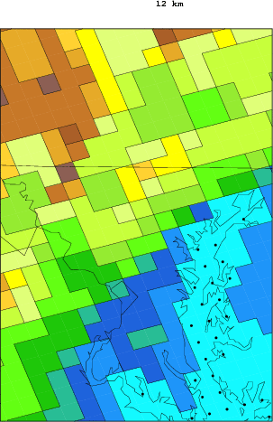
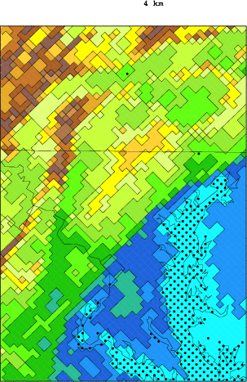
12 km Terrain 4 km Terrain
(not running at 4 km yet)
Dots represent water points Domain is Chesapeake Bay

Slide 49
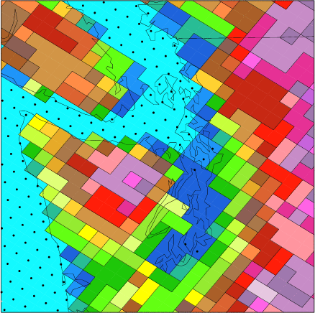
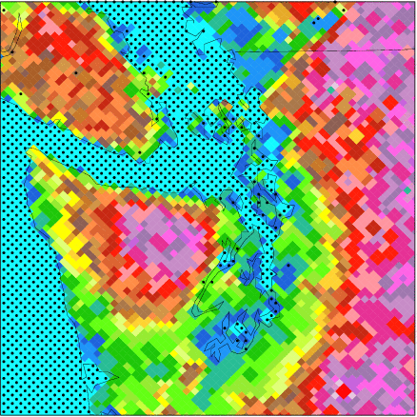
12 km Terrain 4 km Terrain
(not running at 4 km yet)
Dots represent water points Domain is Puget Sound

Slide 50
NMM improvements over Eta
Keep structures and their amplitudes more intact (NMM numerical calculations for advection are less damping than in Eta)
Various advection and PBL changes should allow for better moisture transport and evapotranspiration from surface moisture sources
Tweaks to B-M-J allow for more buildup of PBL moist static energy in NMM
No changes to radiation scheme, yet

Slide 51
Nonhydrostatic Mesoscale Model
Feature Comparison With Meso Eta
Feature | Meso Eta Model | Nonhydrostatic Meso Model
Dynamics | Hydrostatic | Hydrostatic plus nonhydrostatic corrections
HorizontalAdvection spatial scheme | Janjic conservative T, u, v, TKE; shape preserving for q and condensate | Janjic conservative T, u, v; shape preserving for TKE, q, and condensate

Slide 52
Nonhydrostatic Mesoscale Model
Feature Comparison With Meso Eta
Feature | Meso Eta Model | Nonhydrostatic Meso Model
Vertical Advection | Euler backward T, u, v, TKE; conservative q and condensate | Shape preserving T, u, v, TKE, q and condensate
Pressure gradient force | Forward backward | Forward backward with adjustment for sigma
Advective time scheme | Euler backward | Adams - Bashforth

Slide 53
Nonhydrostatic Mesoscale Model
Damping Feature Comparison With Meso Eta
Damping Features | Meso Eta Model | Nonhydrostatic Meso Model
Vertical advection | Euler backward is damping | Shape-preserving scheme is not damping
Advective time-step | Euler backward is damping | Adams - Bashforth is not damping
Divergence damping | Coeff = 6.5 Grid-coupling=1. | Coeff = 15 Grid-coupling < 0.5
Lateral diffusion | Coeff = .25 with no limit on deformation | Coeff = .50 with limit on deformation

Slide 54
Nonhydrostatic Mesoscale Model
Physics Features Comparison With Meso Eta
Physics Feature | Meso Eta Model | Nonhydrostatic Meso Model
Turbulent mixing | Mellor-Yamada Level 2.5 dry | Mellor-Yamada Level 2.5 including moist processes
Surface exchange | …+ Paulson functions | …+ Holtslag and de Bruin functions
Land-sfc | NOAH LSM | NOAH LSM
Gridscale | Ferrier | Ferrier
Convective | B-M-J | B-M-J’
Radiation | GFDL | GFDL

Slide 55
Dissemination
GRIB and BUFR data available for ftp
Fields do not go out over SBN
Model will not run if hurricane model needs to run (they share same time slot on computer)
How do I get it? (times in filename will change when schedule is implemented)
The model grib files are accessed the same as for the 10-km regional
nested runs, on ftp://ftpprd.ncep.noaa.gov/pub/emc/mmb/mmbpll/
(note new directories are all lower case letters)
new directory old directory
----------------- ----------------
alaska10.t00z Alaska12.t00z
central08.t12z Central10.t12z
east08.t18z East10.t18z
hi08.t00z hi10.t00z
hi08.t12z hi10.t12z
pr08.t06z pr10.t06z
pr08.t18z pr10.t18z
west08.t06z West10.t06z

Slide 56
RUC-20
Still uses Optimum Interpolation; the 3D-VAR analysis
is coming in early 2003 (yes it finally really is coming)
Complete model overhaul in April
See info on COMET NWP matrix page at
http://meted.ucar.edu/nwp/pcu2/index.htm and the
RUC page at http://maps.fsl.noaa.gov/
  Large improvement in error stats (precip, raobs, METARS, sensible weather, visibility, cloud patterns, everything!)
  2-level snow model
  GOES cloud top assimilation, boundary layer profilers
  many many model changes. Still uses theta-sigma hybrid coordinate.

Slide 57
Short-Range Ensemble Forecasts (SREF)
What?
5 Eta 48 km (control + 2 perturbation pairs)
5 Regional Spectral Model 48 km (control + 2 perturbation pairs)
[RSM has old AVN/MRF physics, not upgraded version]
5 Eta members using Kain-Fritsch convective parameterization
“Soon” 5 RUC members will be added
“Soon”? 5 ARPS (CAPS at Oklahoma) members may be added
When?
21, 09 UTC in time for your use with 00, 12 UTC Eta
Status?
To become officially operational NWS-wide fall 2002
Output might get into AWIPS sometime in 2003
New user-friendly web interface linked from SREF home page,
which is http://wwwt.emc.ncep.noaa.gov/mmb/SREF/SREF.html

Slide 58
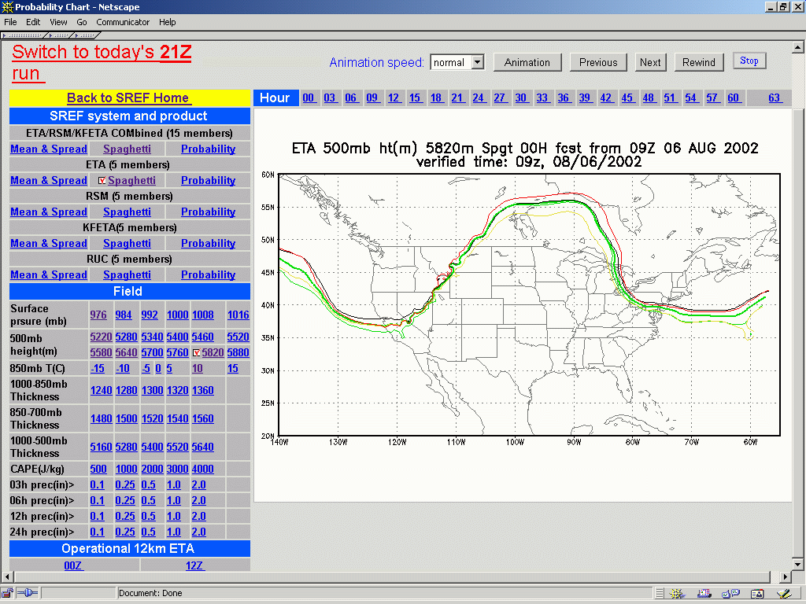
http://wwwt.emc.ncep.noaa.gov/mmb/SREF/SREF.html

Slide 59
COMET
Keeps you informed through the Eta and AVN newsgroups.
Read it like email, but it doesn’t get mixed up with your regular email
Post questions, get answers
Start at http://meted.ucar.edu/nwp/newsgroups/index.htm

Slide 60
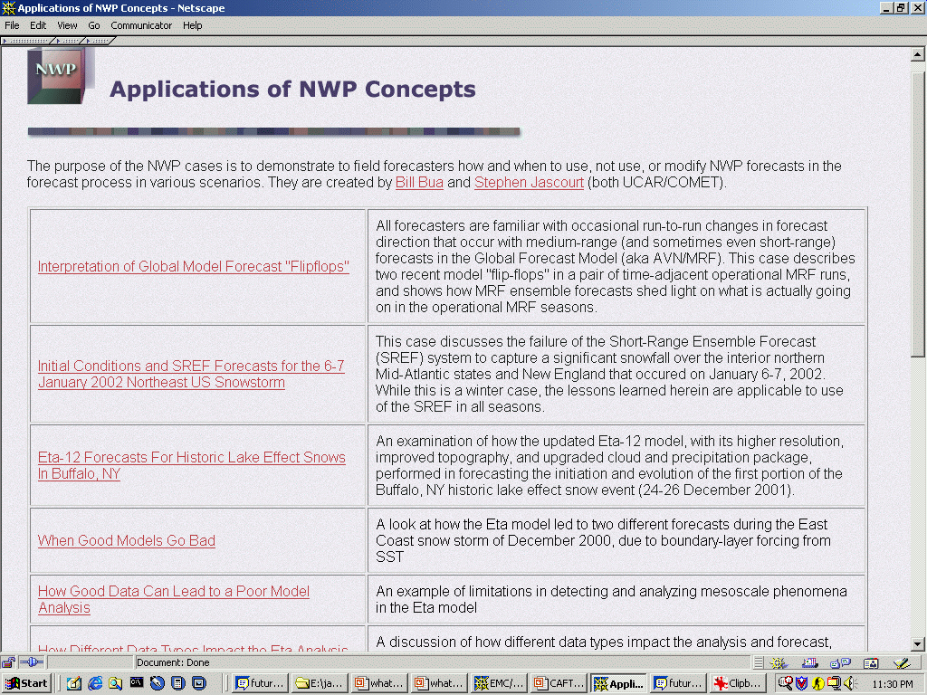
Http://meted.ucar.edu/nwp/pcu3/cases/
More cases being added monthly, many under development now

