Slide 1

NOAA’s
National Weather Service
NDFD Data Flow, Format, and Statistics
Tim Boyer
Meteorological Development Laboratory
National Digital Forecast Database Technical Workshop
August 13, 2003

Slide 2
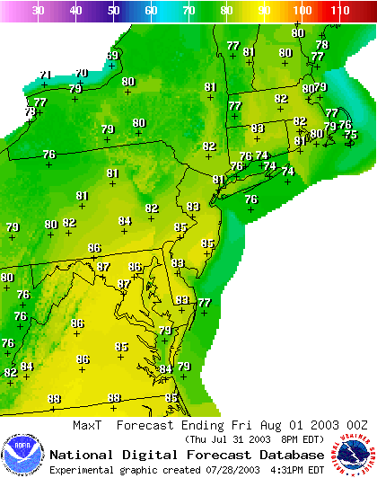
NWS Digital Forecasting
Overview
NDFD data flow
Timeliness of data
Dissemination of NDFD data
Data format details
Statistics tracked in the NDFD

Slide 3
NDFD Data Flow
NDFD System Architecture
NCF
NDFD
Stage &
Develop
NDFD
Central Server
Replicate
Server
WFO
(120+)
AWIPS
WAN
NCF LAN
NCEP/NC
(6)
NWS
Net
Database Push
TOC
I-2
Web Farm
FTP
Server
Products
(NWSTG)
Database
Server(s)
(Future)
Web Server
(Future)
HTTP Services
Regional
Web Farms
Regional
Headquarters
NCDC
FTP
Internet
Partners & Customers

Slide 4
NDFD Data Flow
NCF
Grids (Official Forecast)
NDFD
Central
Server
WFO
(120+)
AWIPS WAN
NCEP
(6)
Forecast grids are encoded in GRIB2 at WFOs and NCEP
Grids are decoded and stored to Informix RDBMS
NDFD mosaics are generated hourly from WFO grids

Slide 5
Timeliness of NDFD Data
WFOs send new forecast grids as they are updated
Gridded forecast data received from WFOs around the clock
WFO grids decoded at NDFD Central server every 5 minutes and stored to RDBMS
NDFD mosaics are generated hourly, starting at 10 minutes prior to the top of the hour
Mosaics are encoded in GRIB2 format and transferred to NWS Telecommunications Gateway (NWSTG).
Latest hour’s mosaics available for FTP download at NWSTG by 15-20 minutes past the top of the hour.

Slide 6
Timeliness of NDFD Data
NDFD Forecast Mosaics to 168 Hours (7 days)
Wed
Thu
Fri
Sat
Sun
Mon
Tue
Wed
Day 1
Day 2
Day 3
Day 4
Day 5
Day 6
Day 7
Day 8
At 1800 UTC every day, drop Day 1 and add new Day 7
Thu
Fri
Sat
Sun
Mon
Tue
Wed
Thu
Day 1
Day 2
Day 3
Day 4
Day 5
Day 6
Day 7
Day 8

Slide 7

Dissemination of NDFD Data
NCF
NDFD
Central
Server
The entire NDFD is updated at
the NWSTG every hour
Latest GRIB2 files can be found at:
http://weather.noaa.gov/pub
Files are arranged in directories
according to geographical region
GRIB2
(Mosaics)
Firewall
FTP Server
GRIB2
NWSTG
Internet
PARTNERS &
CUSTOMERS

Slide 8
Sample FTP Directory (CONUS)
Current directory is /SL.us008001/ST.expr/DF.gr2/DC.ndfd/AR.conus
WARNING
This is a United States Government (NOAA) computer system, which may be
accessed and used only for official Government business by authorized
personnel. Unauthorized access or use of this computer system may
subject violators to criminal, civil, and/or administrative action.
Please read the file README.TXT
it was last modified on Mon Aug 19 13:36:34 2002 - 345 days ago
Up to higher level directory
ds.maxt.bin 1674 Kb Tue Jul 30 17:18:00 2002 Binary Executable
ds.mint.bin 1397 Kb Tue Jul 30 17:19:00 2002 Binary Executable
ds.pop12.bin 1289 Kb Tue Jul 30 17:18:00 2002 Binary Executable
ds.qpf.bin 634 Kb Tue Jul 30 17:19:00 2002 Binary Executable
ds.sky.bin 3312 Kb Tue Jul 30 17:17:00 2002 Binary Executable
ds.snow.bin 152 Kb Tue Jul 30 17:19:00 2002 Binary Executable
ds.td.bin 7516 Kb Tue Jul 30 17:19:00 2002 Binary Executable
ds.temp.bin 8072 Kb Tue Jul 30 17:18:00 2002 Binary Executable
ds.waveh.bin 81 Kb Tue Jul 30 17:19:00 2002 Binary Executable
ds.wdir.bin 7437 Kb Tue Jul 30 17:18:00 2002 Binary Executable
ds.wspd.bin 3076 Kb Tue Jul 30 17:18:00 2002 Binary Executable
ds.wx.bin 1798 Kb Tue Jul 30 17:19:00 2002 Binary Executable

Slide 9
NDFD Data Format (some details)
Each file contains multiple GRIB2 bulletins for one
weather element
Each GRIB2 bulletin begins with a unique WMO header
Each GRIB2 bulletin contains data for a single weather
element for a single valid time
Temporal resolution is 3 hours for Days 1-3 and 6 hours
for Days 4-7
NDFD data issuance time (YYYYMMDDHH) is encoded
in each bulletin

Slide 10
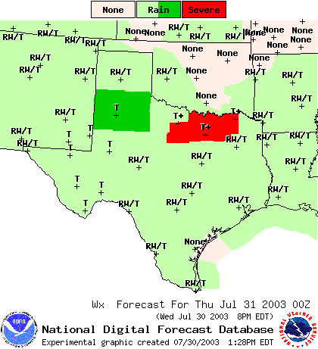
NDFD Data Format (some details)
Special case: Element = “Weather”
Weather is handled differently
in GRIB2 from other elements
Weather is a discrete parameter
type
A weather mosaic is defined by a
grid and a list of weather “keys”
In a GRIB2 bulletin, the weather
keys are contained within the
Local Use section (Section 2)

Slide 11
NDFD Weather
Weather Type Codes
Coverage/Probability Codes
Intensity Codes
NoWx | No Weather
A | Hail
T | Thunderstorms
RW | Rain Showers
L | Drizzle
ZR | Freezing Rain
ZL | Freezing Drizzle
S | Snow
SW | Snow Showers
IP | Ice Pellets
F | Fog
H | Haze
BS | Blowing Snow
K | Smoke
BD | Blowing Dust
FR | Frost
NoCov | No Coverage/No Prob
Iso | Isolated
Sct | Scattered
Num | Numerous
Wide | Widespread
Ocnl | Occasional
SChc | Slight Chance
Chc | Chance
Lkly | Likely
Def | Definite
Patchy | Patchy
Areas | Areas of
NoInten | No Intensity
-- | Very Light
- | Light
m | Moderate
+ | Heavy
Attribute Codes
FL | Frequent Lightning
GW | Gusty Winds
HvyRn | Heavy Rain
DmgW | Damaging Winds
SmA | Small Hail
LgA | Large Hail
OLA | Outlying Areas
OBO | On Bridges and Overpasses

Slide 12
NDFD Weather
Sample Weather Key | Meaning
Sct:SW:-:NoVis | Scattered snow showers
Ocnl:R:-:NoVis^Ocnl:S:-:NoVis^SChc:ZR:-:NoVis | Occasional light rain and snow, with a slight chance of freezing rain
Wide:FR:-:NoVis:OLA | Widespread frost in outlying areas
NoCov:NoWx:NoIntens:NoVis | No Weather
A weather Subkey can contain up to 5 weather attributes
A weather Key can contain up to 5 Subkeys (usually not more than 3)
Gridpoint values are integer indices into the list of weather keys
Every mosaic has it’s own unique list of weather keys
For more information on weather and encoding details of other NDFD elements, see http://www.nws.noaa.gov/datamgmt/doc/GRIB2_encoding.html

Slide 13
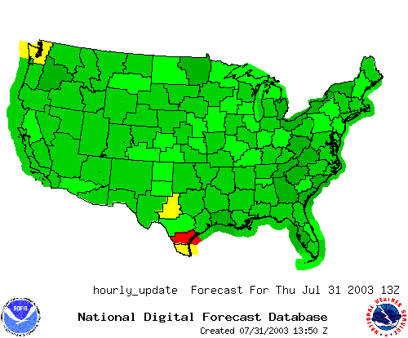
NDFD Statistics Tracking
Several different types of statistics are tracked on the NDFD (by WFO):
Latest receipt times of WFO forecast grids
Average forecast update frequency :
- daily
- weekly
- monthly

Slide 14
NDFD Statistics Tracking
By 1800Z each day, WFOs send in a new day’s worth of forecast grids
(new Day 7). NDFD statistics are compiled to track 18Z update timeliness:
WFO | Percentage of Day 7 grids received prior to 18Z
KABQ | 90.10
KABR | 88.24
KAKQ | 94.12
KALY | 100.00
KAMA | 47.06
KAPX | 100.0
KARX | 100.0
KBGM | 100.0
KBIS | 100.0
KBMX | 100.0
KBOU | 76.34
Keep track of daily, weekly,
monthly average statistics
Also track percentages of ALL
grids received by 18Z

Slide 15
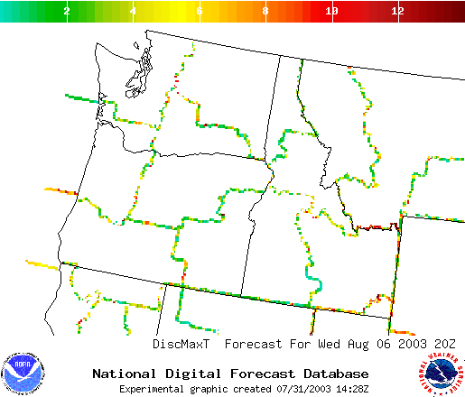
NDFD Statistics Tracking
WFO Border Consistency Statistics
Assists forecasters in tracking the coordination their of gridded forecasts
NDFD processes check (on an hourly basis) the consistency of forecasts across WFO boundaries for an average of adjacent gridpoints
Terrain effects are taken into account by including average elevational differences along WFO boundaries
Image as well as tabular output is produced as feedback to forecasters

Slide 16
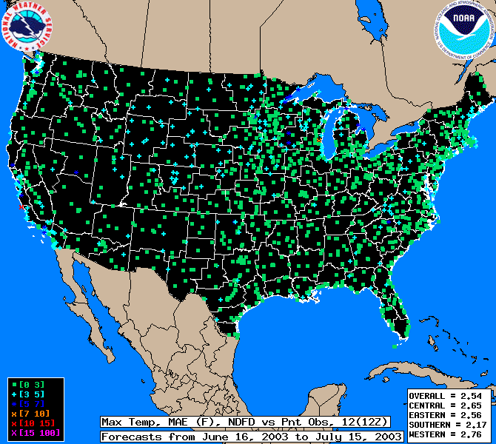
NDFD Statistics Tracking
NDFD Forecast Verification
Another source of feedback
to the forecaster to help
improve forecast quality
Statistics are updated
monthly based on previous
month’s NDFD forecasts
Tracks mean absolute error
and forecast bias

Slide 17
Future Directions
NDFD Database replication to web farms
Provide simple point forecast products via interactive web queries (i.e., click on an NDFD point)
- formatted text forecast out to 7 days
- meteograms
- NDFD data in XML
Web Service access to NDFD data via SOAP
More detailed tracking of NDFD data consistency statistics

