Slide 1
Advanced Audio Tutorial:
Part 2
Cabling & Mixing

Slide 2
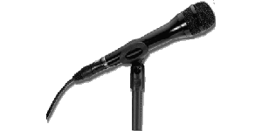
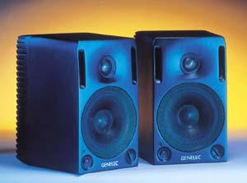
Quality Challenges
Echo Canceller
Mixer
Echo Canceller
Echo Canceller
Network Audio
Codec / Computer

Slide 3
Audio standards
Balanced audio
  3-wire cable: 2 wires for signal, one for ground
  Differential signal
  Excellent noise rejection
  Professional audio gear (Gentner, Midiman audio codec)
Unbalanced audio
  2-wire cable: one wire for signal, one for ground
  Little noise rejection
  Consumer-grade audio gear (standard PC audio codec)

Slide 4
A Digression on Units
Each mode of sound has a different unit of measurement
In air, we measure Sound Pressure Level, SPL, in Newtons per square meter
On the wire, we measure Volts
In the computer, we measure a fixed-point value at some resolution

Slide 5
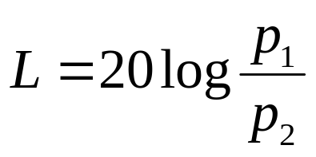
Decibels
Due to the large range of human hearing (6 orders of magnitude) a logarithmic scale is used
A decibel represents a ratio:
A doubling in intensity is a 3dB increase

Slide 6
Decibel measures
Since dB is a relative measure, we need absolute reference points
dB SPL reference is 0.000002 Newtons per square meter, the threshold of hearing
dBV relative to 1V RMS
dBu relative to .775V RMS (unloaded)
  Equivalent to dBv
dBm relative to 1 mWatt
dBFS relative to full scale representation (so all values are negative)

Slide 7
Why the dBu and dBV?
Professional gear uses a +4dBu voltage reference
Consumer gear uses –10dBV reference
Why? Just a choice; also stronger signal at +4dBu provides more protection against noise fields

Slide 8
Conversions
Professional audio gear: balanced, +4dBu reference
Consumer gear: unbalanced, -10dBV reference
To connect the two, need level and balance conversion hardware
Matchmaker MM100, lots of others
Also typically convert connectors (XLR on professional side, RCA on consumer side)

Slide 9
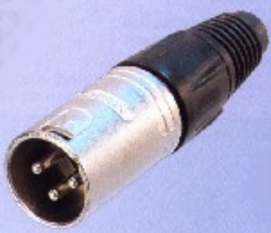
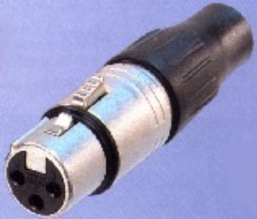
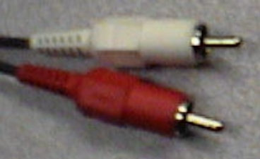

Cabling issues
Simple answer: buy quality cables, don’t make your own
Connectors:
  XLR for balanced connections
  RCA for consumer unbalanced
  Mini-plug for computer soundcards
  ¼” TRS (tip-ring-sleeve) for some balanced audio applications

Slide 10
Quality Challenges
Echo Canceller
Mixer
Echo Canceller
Echo Canceller
Network Audio
Codec / Computer

Slide 11
Review of Requirements
Natural high quality sound
Full Duplex
Hands free – microphones open

Slide 12
Full duplex
In order to support free communication, must be able to speak and hear at the same time
Implies bidirectional path through the entire hardware and software infrastructure

Slide 13
Hands-free Operation
For the tech to vanish, no click to talk
This introduces a major problem: Echo
Speaker
Multicast
Audio
Acoustic
Capture
Mixer
Network
Coupling
PC
Microphone

Slide 14
Methods for eliminating echo
Gain control
Separation of speaker and microphone
Room treatment
Click-to-talk
Active echo cancellation

Slide 15
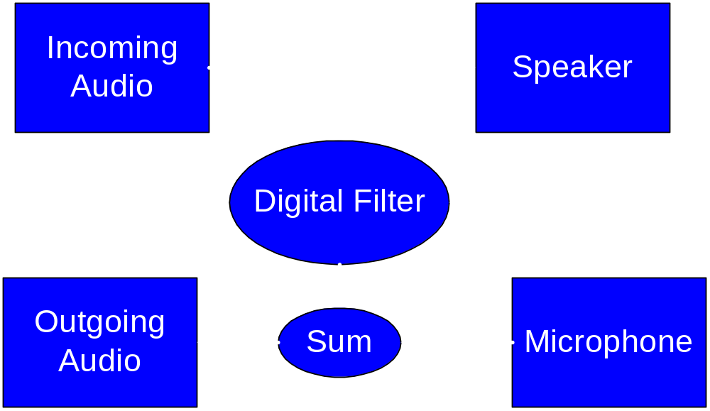
Echo Canceller
Computes estimate of echo return signal from speaker to microphone
Subtracts echo return estimate from microphone audio
Echo-free audio sent to output.

Slide 16
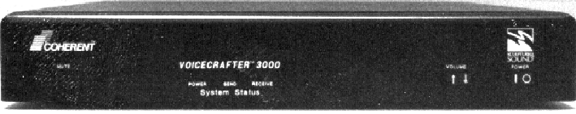
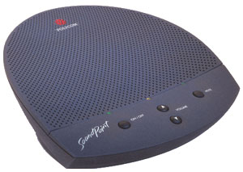
Commercial echo cancellation hardware (first generation)
Single echo canceller per device
  Coherent/Biamp Voicecrafter
    Intrusive whitenoise-burst for calibration
  Polycom Soundpoint
    Integrated mic/speaker
Drift over time
Multiple microphones required external mixer
Roaming (wireless) microphones posed problems

Slide 17

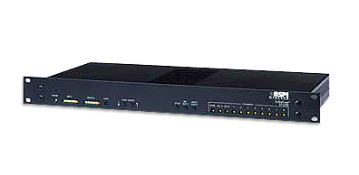
Commercial echo cancellation hardware (second generation)
Common devices:
  Gentner AP series (AP400, AP800)
  ASPI EF1210
Echo cancellation per microphone input
  “distributed echo cancellation”
Gentner adds matrix mixer, automixing
  Microphones only gate on when sound present
  Aids in feedback, echo control, phase problems
ASPI EF1210 requires external automixer
  But has noise cancellation

Slide 18
Digression: Matrix Mixers
Matrix of Inputs to Outputs
Controlled by settings at crosspoints
  On / Off / Gate
Some allow gain or attenuation adjustment at crosspoints
If not, must equalize levels at edges
  Gain adjustment point:
In upcoming diagrams, we draw a matrix mixer as distinct mixer per output, tightly bound to the device at the output
G
Σ
G
Speakers

Slide 19
Echo cancellation per input vs. External Mixer
Why can’t we just plug lots of microphones into a mixer, then plug the mixer into the EC box?
  The distributed echo cancellation on each input has to work harder and cannot converge quickly.
  When the microphones are gated "off" by the external mixer, the echo canceller has nothing to train to within the room.
It may appear to work, but under stress (multiple speakers, ambient noise, local reinforcement) it will fail
EC hardware works best when used as designed
Money spent on doing it right is money well spent
Driving non-microphone inputs through an external mixer to the EC box is not a problem (VCR, CD player, …)

Slide 20

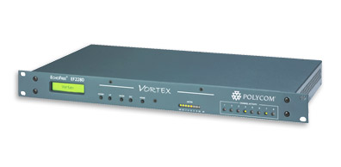
Commercial echo cancellation hardware (third generation)
Common devices:
  Gentner XAP series (XAP400, XAP800)
  ASPI Vortex EF2280
More advanced EC
Noise cancellation
Intelligent autogain
Effects processing (filtering, compression, etc)

Slide 21
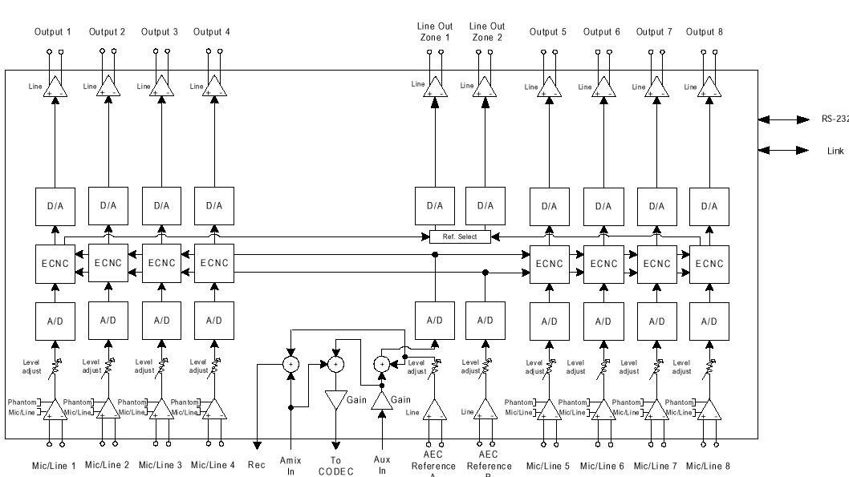
ASPI EF1210 Block Diagram

Slide 22
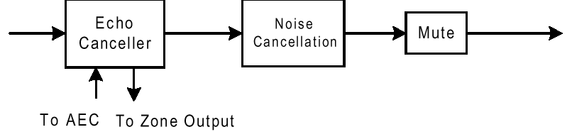
ASPI EF1210 Channel Processor

Slide 23
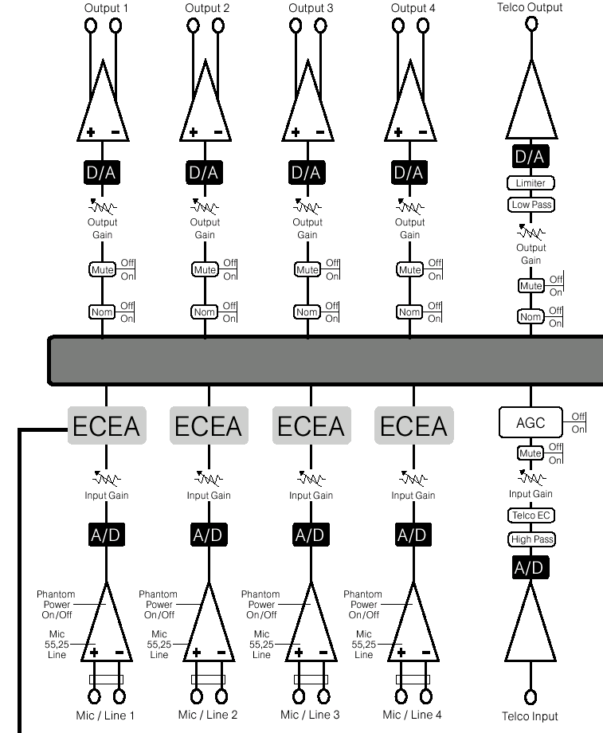
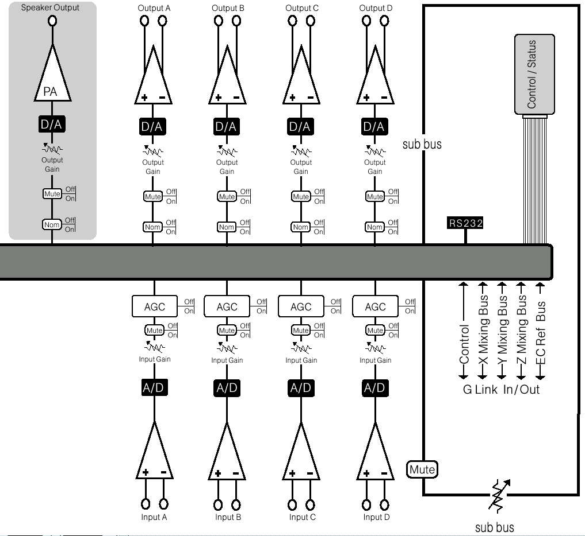
AP400 Block Diagram

Slide 24
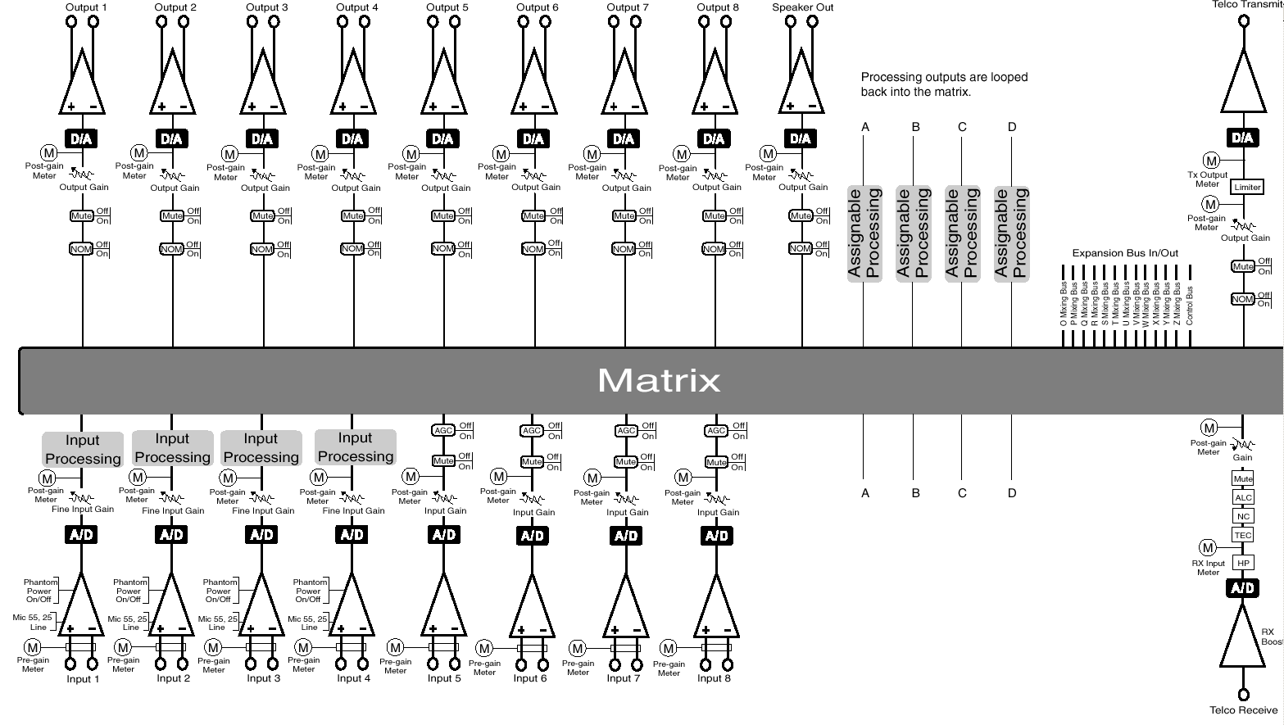
XAP400 Block Diagram

Slide 25
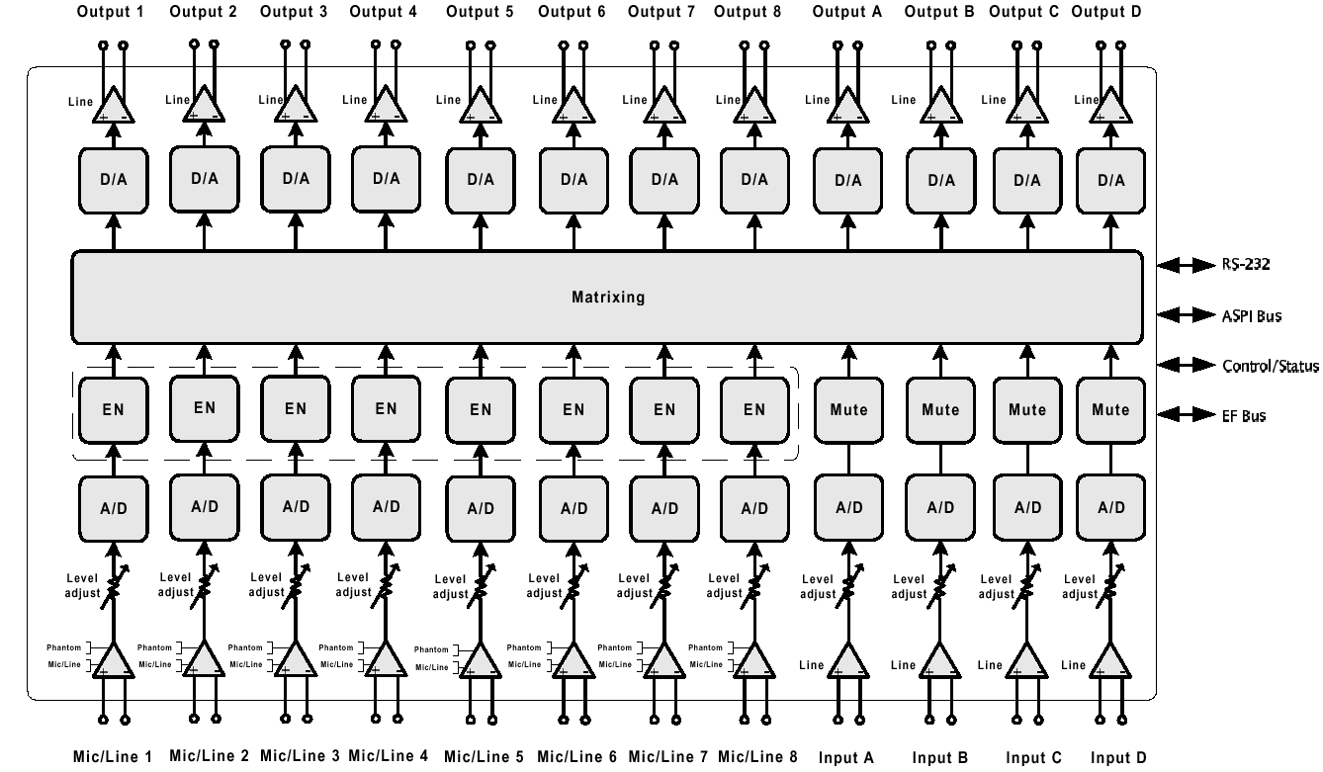
ASPI Vortex Block Diagram

Slide 26
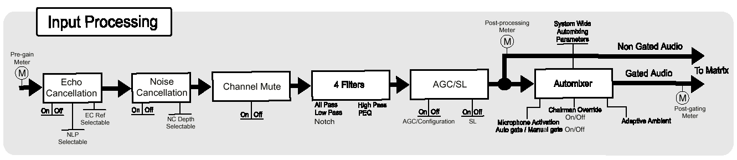
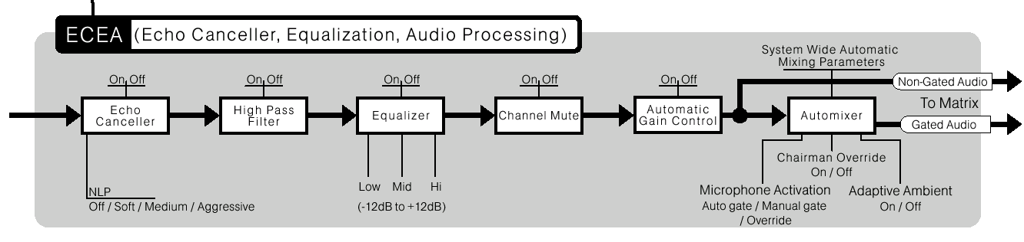
Gentner Channel Processors
XAP series
AP series

Slide 27
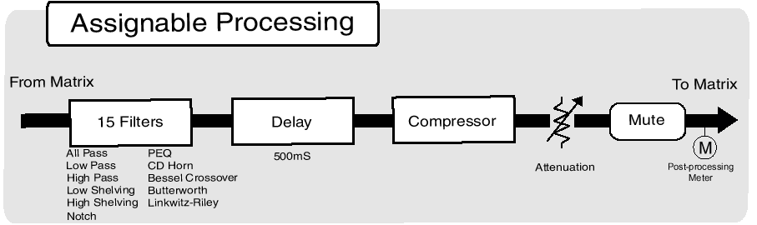
Gentner XAP Processing Unit

Slide 28
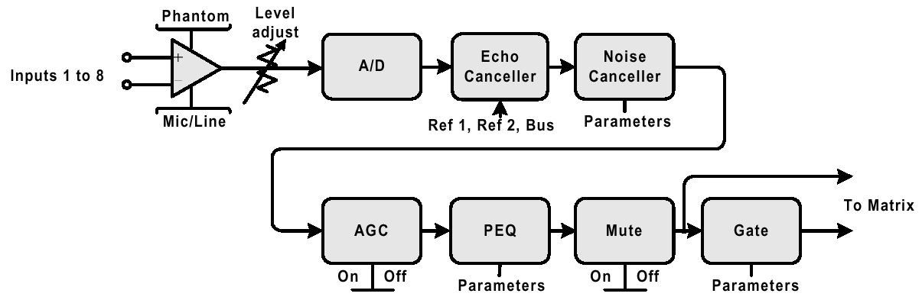
ASPI EF2280 Channel Processor

Slide 29
Issues in EC setup
EC Reference signal is key
Typically bound to a particular output on the EC device
EC Ref will be subtracted from the microphone inputs
Hence, do not route microphones to the EC reference output
If reference is correct, and levels are configured properly, EC will take care of itself!

Slide 30
Local Reinforcement
What if I want to feed my speakers from the microphones?
EC reference must not contain microphone inputs
Typical solution involves routing incoming network audio to an unused output for EC reference

Slide 31

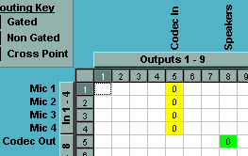
Normal Configuration
Σ
Mic In
G
Transmit to
Network
Σ
Mic In
G
G
Mic In
G
Recv from
Network
G
EC Reference Signal
G
Speakers

Slide 32
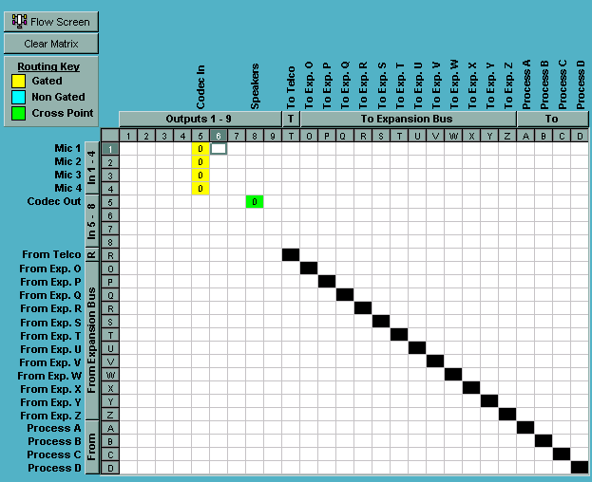
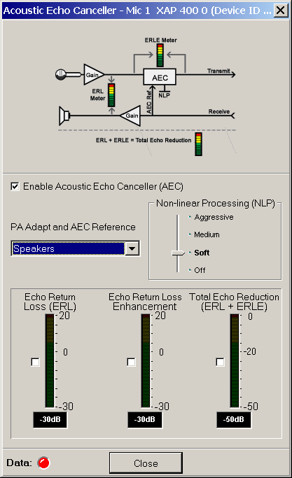

Slide 33
Local Reinforcement Configuration (BAD)
Σ
Mic
G
CODEC
G
Σ
Mic
G
EC
Ref
Mic
G
G
Speakers

Slide 34
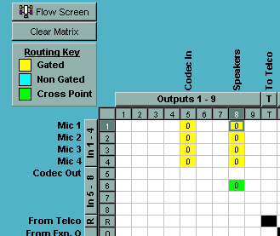

Slide 35
Why is that bad?
No independent adjustment of microphone levels
  Same level goes to codec as to local speakers
Echo cancellation will be wrong
  Generated audio will be patchy
  Local audio will be patchy
  Level adjustments will be difficult -- much less gain than you expect to have

Slide 36
Local Reinforcement
(distortion fixed, still bad)
Σ
EC
Ref
nothing
Σ
Mic
G
CODEC
G
Σ
Mic
G
Mic
G
G
Speakers

Slide 37
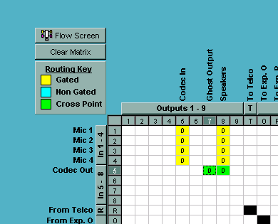
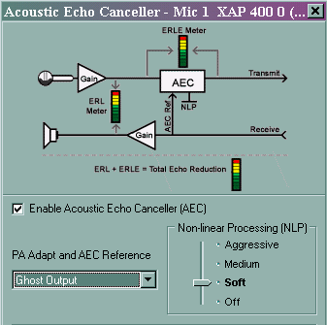

Slide 38
Why?
We’ve fixed our EC problem by configuring a “ghost” output as the EC reference.
We still have the microphone level problem, which will likely cause big problems in real life
  Feedback! The level at which the codec is being fed is likely far higher than the level you want fed to the speakers
  Want to be able to just “crack open” the microphone to the local speakers

Slide 39
Local Reinforcement
(practical)
Σ
EC
Ref
nothing
Σ
Mic
G
CODEC
G
Σ
Mic
G
Mic
Mic
G
Σ
Subbus
G
G
Speakers

Slide 40
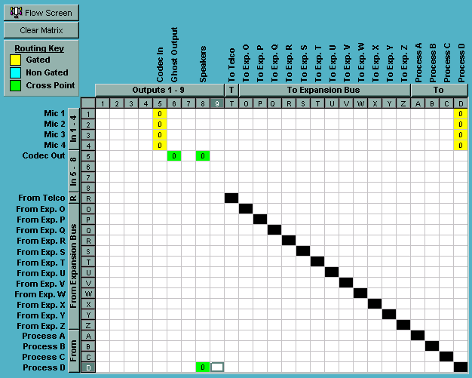
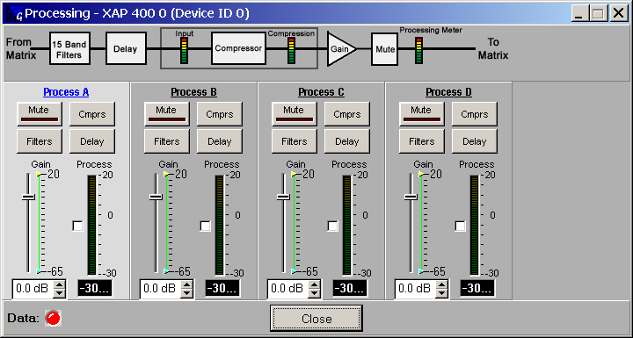

Slide 41
Second improvement
We are taking advantage of a subbus
Subbus is an independent mixing bus that can be hooked into the main mix matrix
We route all microphones that we will use for reinforcement to the subbus
Subbus level adjustment used to control amount of local reinforcement
Subbus mute used to enable/disable local reinforcement

Slide 42
Local reinforcement with crosspoint adjustments
Σ
EC
Ref
G
nothing
Σ
Mic
G
CODEC
G
Σ
Mic
G
Mic
G
G
G
G
Speakers

Slide 43
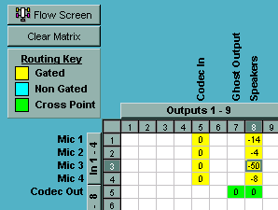
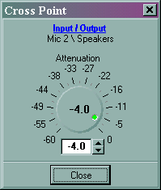
Crosspoint Adjustment

Slide 44
Local reinforcement with crosspoint adjustments & virtual reference (XAP)
Virtual
Reference
EC
Ref
G
Σ
Mic
G
CODEC
G
Σ
Mic
G
Mic
G
G
G
G
Speakers

Slide 45
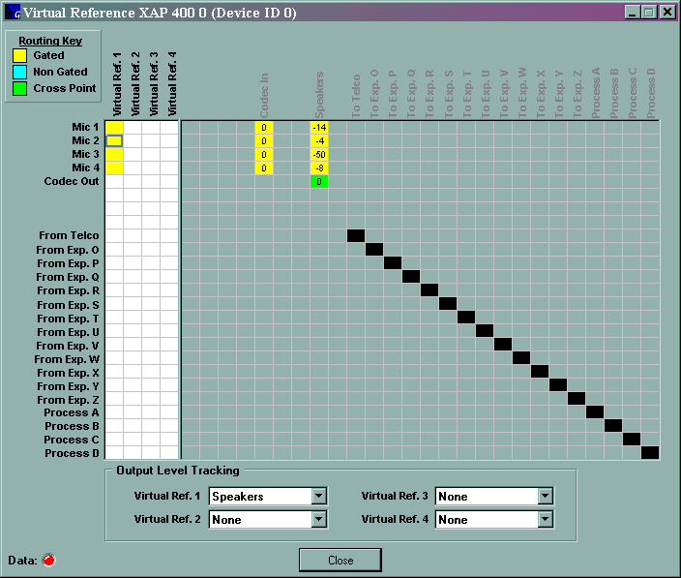
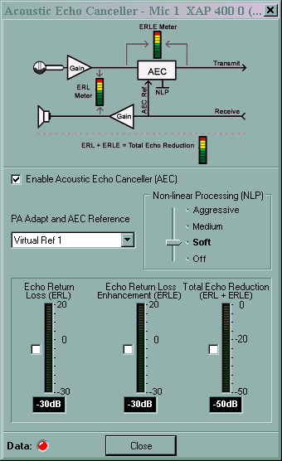

Slide 46
Crosspoint Adjustments
If the matrix mixer allows adjustments at the crossing points of the matrix, not just the outputs…
Then we don’t necessarily need the subbus.
Individual microphones can be adjusted for best reinforcement levels
More complex to maintain, however

Slide 47
Network / Telephone Bridging
Commonly used configuration for telco/network bridge
  Connect AG session to telecon
  Bridge in AG nodes with broken network
Balancing levels can be twitchy
  Microphone to network and microphone to telco
  Telco to speakers and telco to network

Slide 48
Telephone Balancing Act
Σ
Σ
Mic
EC
Ref
G
CODEC
In
CODEC
Out
G
G
Mic
G
Mic
G
G
Speakers
Σ
Telco
G
G

Slide 49
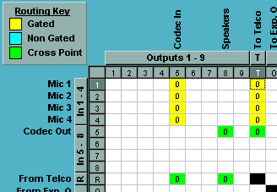

Slide 50
Balancing solutions
Normalize levels
  Adjust incoming gains so that levels within the matrix are nominally 0 dBu
  Then all output levels should be happy
  This can be twitchy to set up and maintain
  Doesn’t always do the right thing
Again, matrix crosspoint adjustments help a lot

Slide 51
Telephone balancing with crosspoint
Σ
Σ
Mic
EC
Ref
G
CODEC
G
G
G
Mic
G
Mic
G
G
G
G
G
Speakers
Σ
Telco
G
G

Slide 52
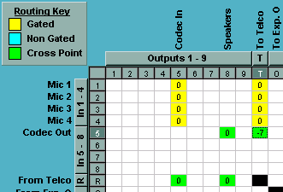
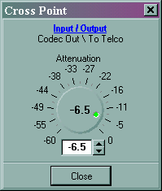
Network to Telco
Telco to Network
Telco to Speakers

