Slide 1
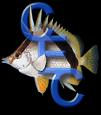

Potential food resources in the Suwannee River Estuary for juveniles of the threatened Gulf Sturgeon, Acipenser oxyrinchus desotoi.
Allen Brooks
Ken Sulak
Coastal Ecology & Conservation Research Group
U.S. Geological Survey

Slide 2
OBJECTIVES
Discuss the spatial distribution and abundance of benthos in the Suwannee River Estuary.
Discuss which areas within the estuary are potentially most important in providing food resources for juvenile Gulf Sturgeon.

Slide 3
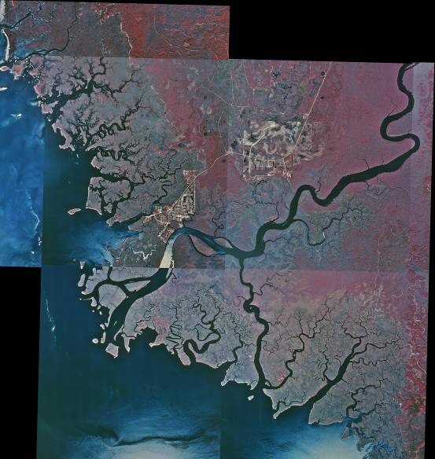
Suwannee River Estuary

Slide 4
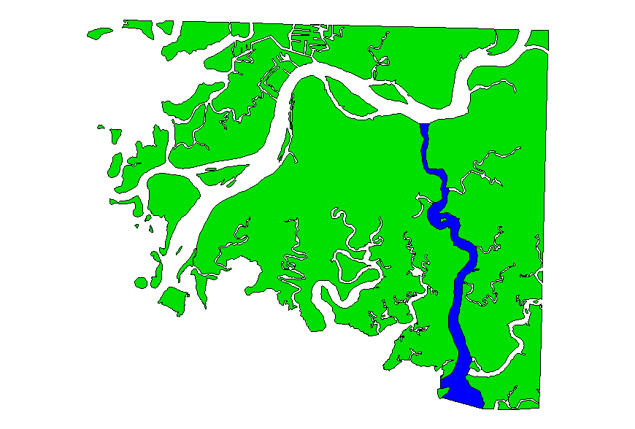
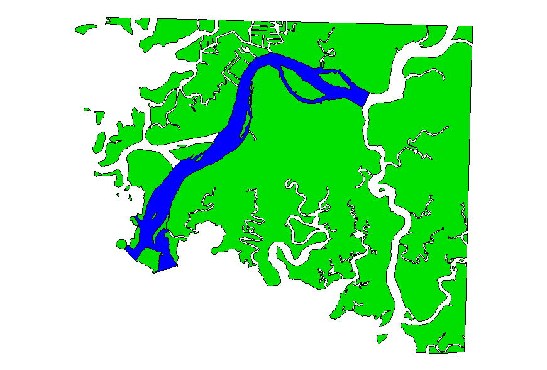
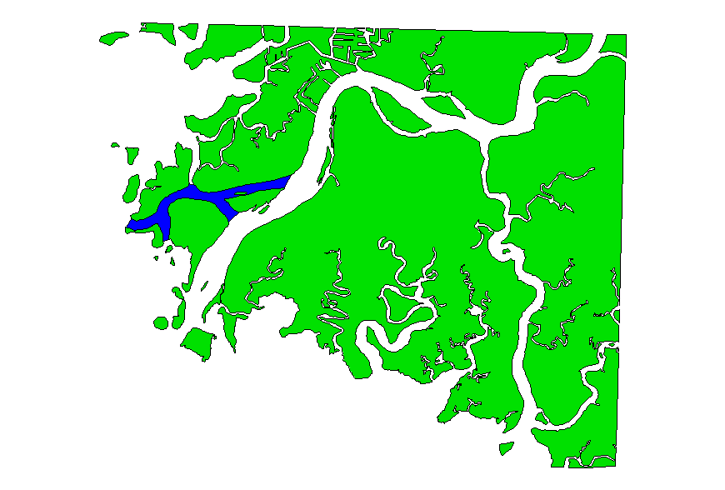
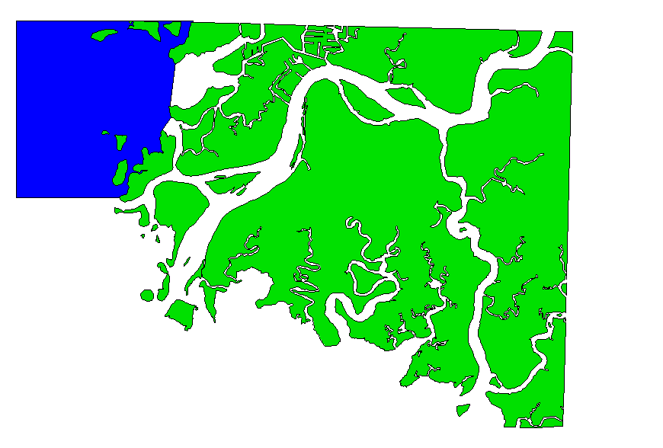
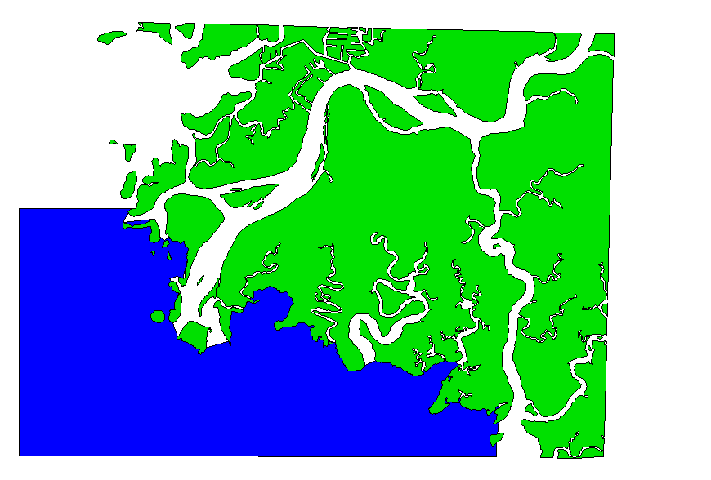
STUDY AREA
EAST PASS
WEST PASS
WADLEY PASS
NORTH SOUND
SOUTH SOUND

Slide 5
Sample Site Selection
A grid (100 m centers) was placed over the entire study area.
156 random sites were selected for sampling in
June-July 2002

Slide 6
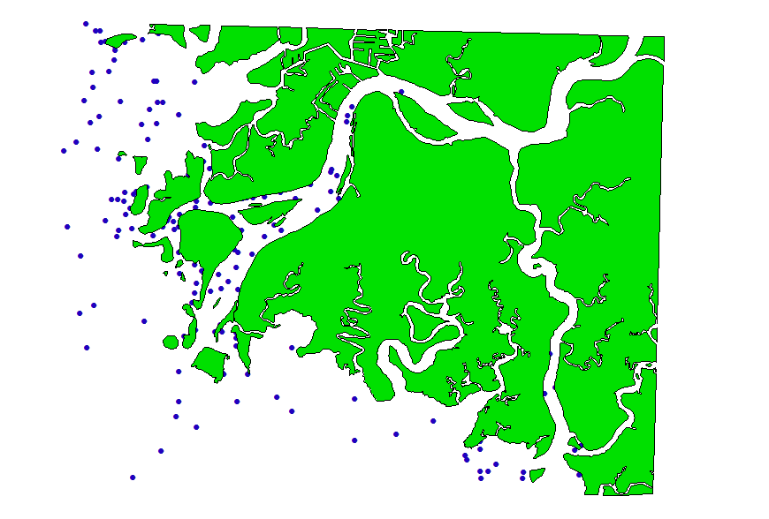
SAMPLING STATIONS
June 2002

Slide 7
Sampling Methods
Benthic Core
  15 cm in diameter (0.018 m²) and 15 cm deep
  0.5 mm mesh sieve
  Laboratory Methods
  Fauna abundance
  Sample dry wt. (60⁰ - 24 hrs)

Slide 8
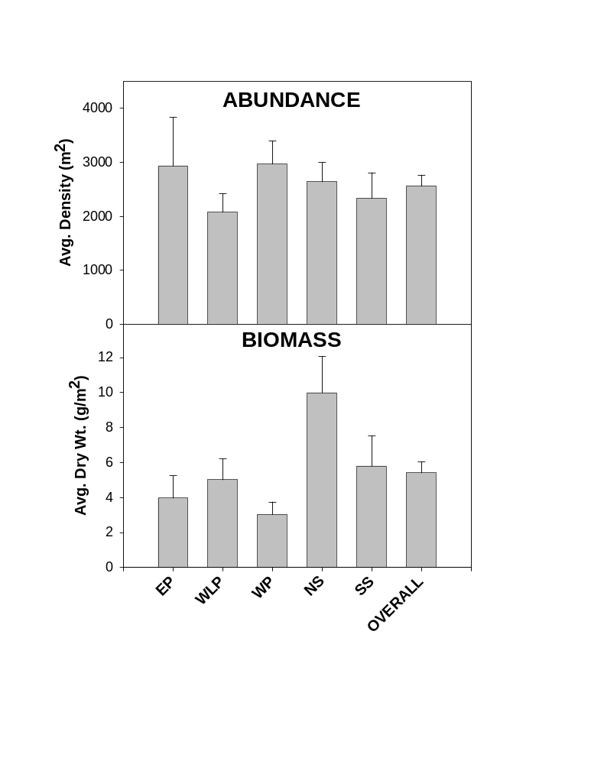
No Sig. Diff.
*

Slide 9
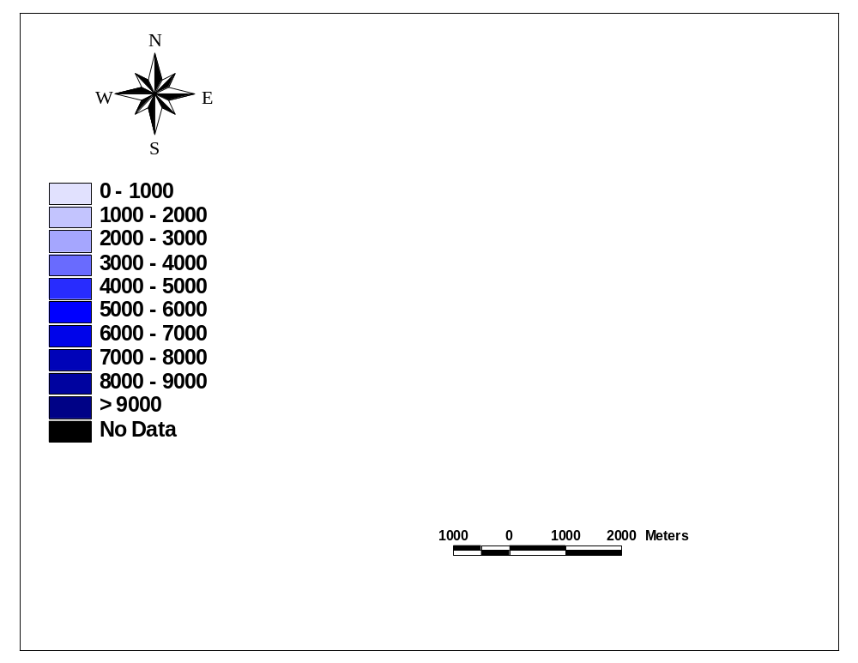
Benthos Density (m²)

Slide 10
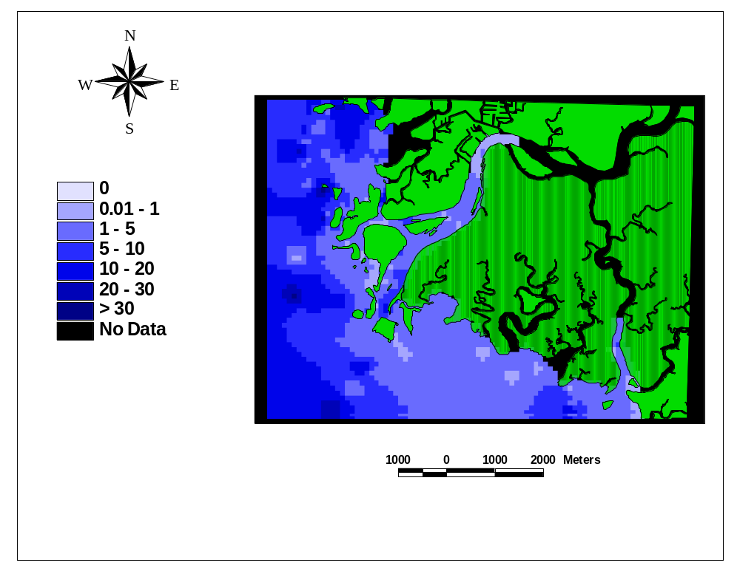
BIOMASS (g/m²)

Slide 11
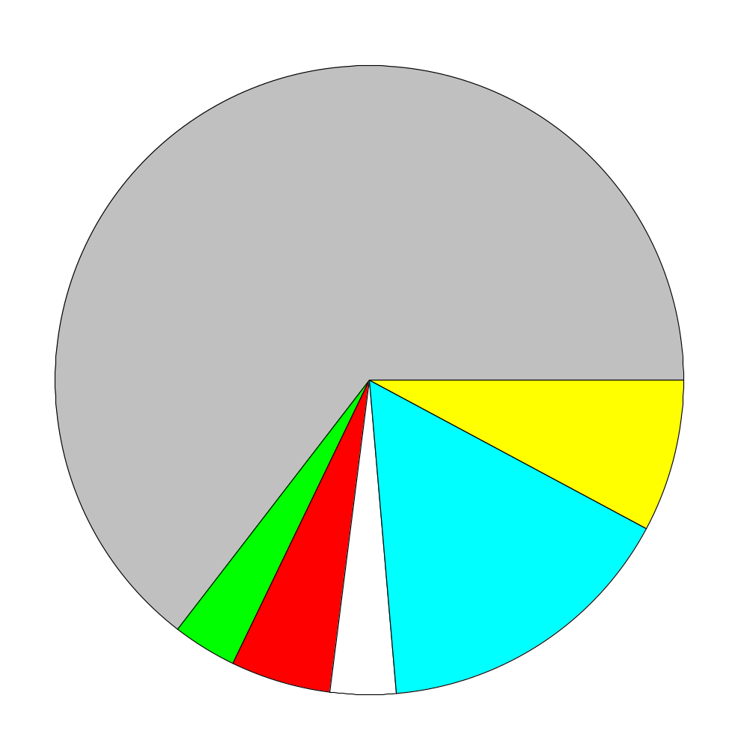
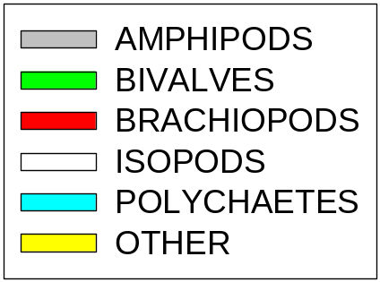
Percent Composition of Major Taxa
64.7%
7.6%
15.8%
3.3%
5.2%
3.4%

Slide 12
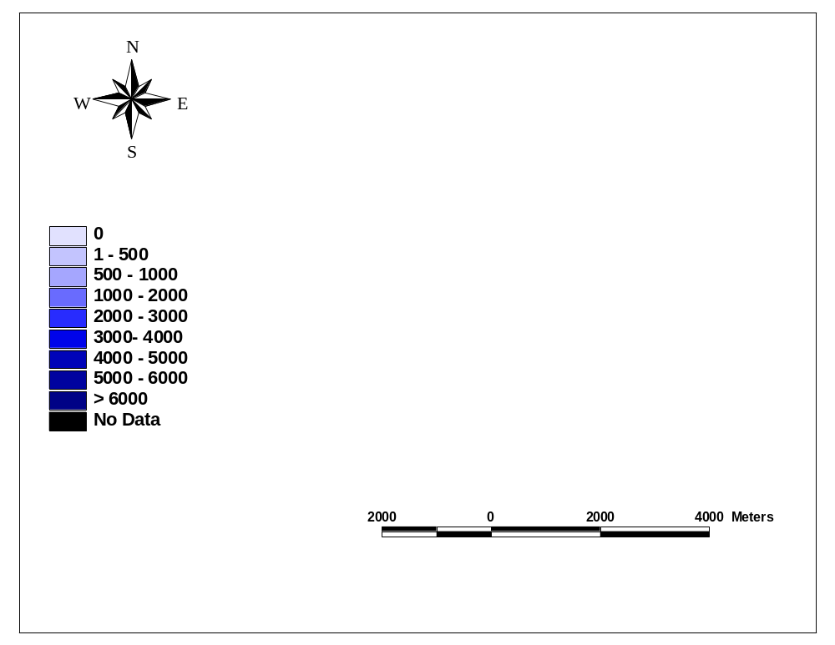
Amphipod
Density (m²)

Slide 13
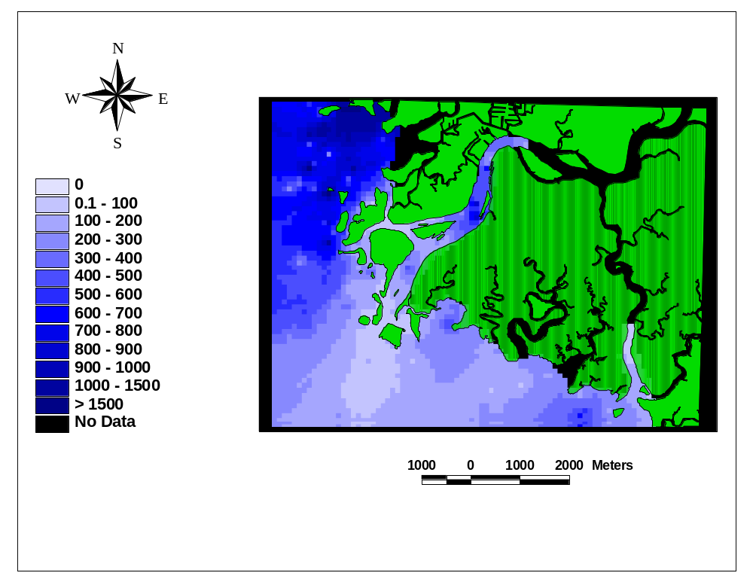
Polychaete
Density (m²)

Slide 14
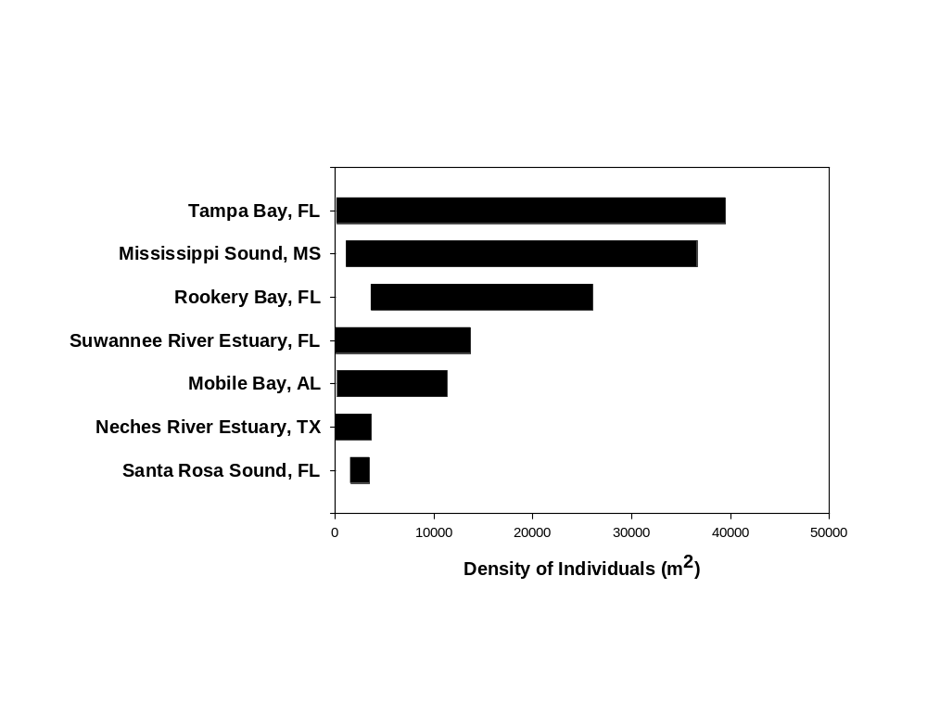
How Does the Suwannee Compare?

Slide 15
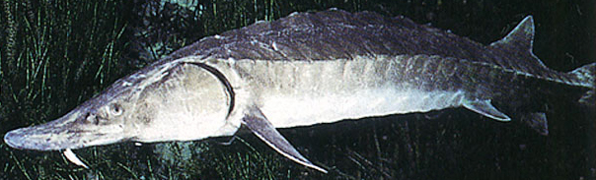
Objective 2:
WHAT’S FOR DINNER?

Slide 16
Principal Foods for Juvenile Gulf Sturgeon
  Huff, 1975
  - Prefer non-tube building amphipods, isopods, insect
  larvae and mud shrimps
  Mason & Clugston, 1993
  - Prefer non-tube building crustaceans and insect larvae
  - Do not prefer organisms with a hard carapace or shell
  Heard et al., 2002
  - Prefer non-tube building amphipods

Slide 17
Food Categories based upon Gut Content Analysis
Principal Foods:
Free Living Amphipods Shrimp
Isopods Oligochaetes
Insect Larvae Brachiopods
Secondary Foods:
Tube Dwelling Nemerteans
Amphipods
Polychaetes Nematodes
Cumaceans Anthozoans
Ostracods
Minor Foods*:
Ophuiroids Gastropods
Bivalves Decapods
* No taxa were excluded from all categories.

Slide 18
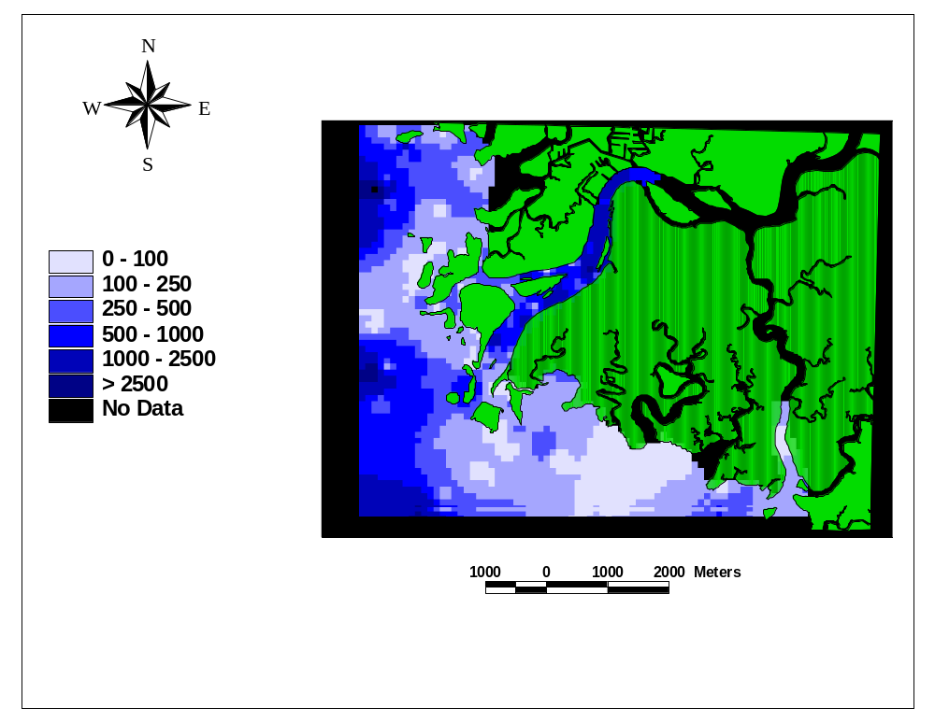
Principal Food
Density

Slide 19
Biased Density
Biased Density =
[(1.0*Principal Food/m²)+(0.66*Secondary Food/m²)
+(0.33*Minor Food/m²)]

Slide 20
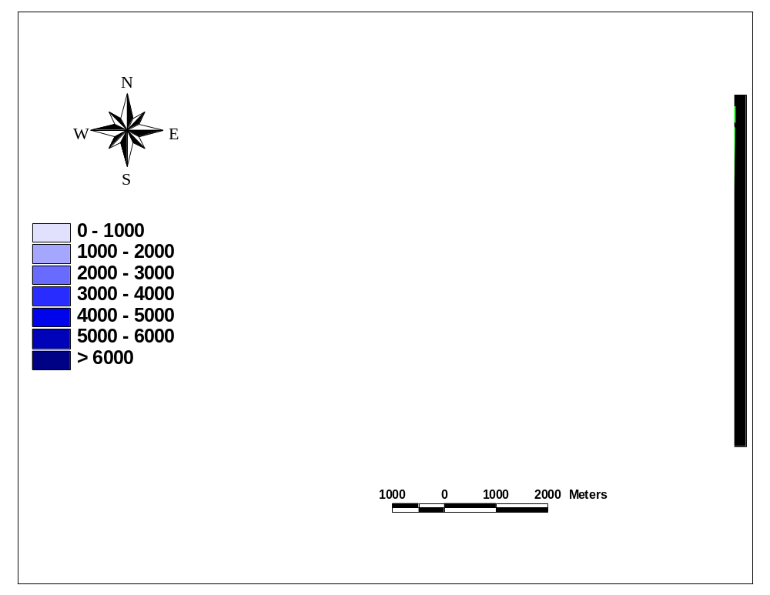
Biased Density

Slide 21
The goal is to include not only faunal density
but an idea of energy as well.
Food Index = Biased Density / Total Density
Adjusted Biomass = Overall Biomass* Food Index

Slide 22
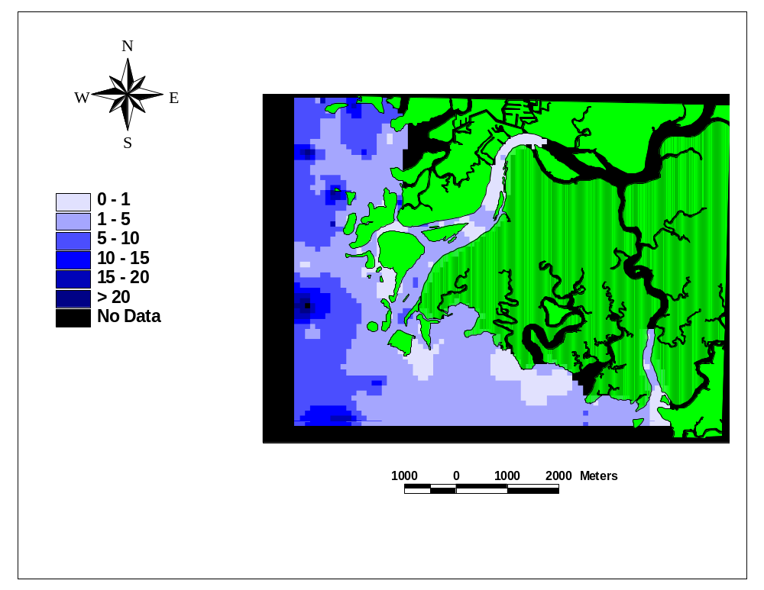
Adjusted Biomass

Slide 23
Conclusions
The density of benthic macrofauna in the Suwannee River Estuary is within the range of other estuaries around the Gulf of Mexico.
The distribution of taxa is patchy within the estuary.
The use of total density may not be the best method for predicting where juvenile sturgeon might be preferentially feeding.

Slide 24
Acknowledgements
Ken Litzenberger, Refuge Manager
Lower Swuannee National Wildlife Refuge,
U.S. Fish and Wildlife Service
Gerhard Pohle, Associate Director
Atlantic Reference Centre

