Slide 1
Transit Management Centers:
Human Factors Issues
TRB Human Factors Workshop
January 7, 2001
Federal Transit Administration
Office of Mobility Innovation
Advanced Public Transportation Systems Division
Volpe National Transportation Systems Center
Don Sussman
Mary Stearns

Slide 2
Transportation Management Center
  A facility housing the operations management centers for at least two transportation modes.
    It includes advanced technologies for various functions including highway congestion mitigation (e.g., assist in incident management), transportation information, and transit dispatching.
    Centers are also known as Traffic Control Centers, Central Control Centers, Traffic Information Centers, Transit Information Centers, Transit Control Centers and Transit Management Centers.
        *NTI/FTA sponsored course, “TRANSIT ITS AWARENESS SEMINAR”

Slide 3
TMC vs. TMC
Traffic Management Center
    Acquires and analyzes traffic data
    Provides guidance and coordination directly to the public as well as public and private agencies to maximize traffic throughput
Transit Management Centers
    Monitors transit system operations and traffic conditions
    Controls transit operations
    Coordinates with emergency service providers and other public and private agencies

Slide 4
Traffic Management Centers
Focus is on traffic management, a broad range of vehicle types, no direct control of individual vehicles
  Proactive responses based on analysis of a broad range of incoming data that is compared to “historical” patterns
  Communication with drivers mostly one way through broadcast (auditory or visual)
  Communication with traffic personnel only in emergency or other unusual condition
  Problem response usually accomplished through a limited choice of available solutions
  Information provided by sensors, sampling through instrumented vehicles (traffic probes), and volunteers

Slide 5
Transit Management Centers
Focus is on maintaining scheduled service for a limited range of vehicles with direct supervision of vehicles
  Two way and targeted communications with bus drivers and street supervisors
  Information shared within TMC and conducted interactively with drivers and street supervisors to accomplish problem-solving
  Information gathered through verbal interactions and sensors on vehicles and roadway sensors or cameras
  Requirements for communications with police and traffic personnel as needed rather than routine
  Most transit systems have existing TMC that have to be retrofitted or replaced rather than designed from scratch

Slide 6
Transit Management Center Requirements
TMC staff must
Support intermittent and scheduled services
Understand the capabilities of a variety of equipment (buses, light rail)
Guide drivers who are often new to the route and equipment
Remotely diagnose complex systems (lifts, fare boxes, air conditioning)
Interact with
  supervisors, bus drivers, support personnel, public safety personnel, members of unions, contractor employees, and sometimes customers
  a variety of service providers

Slide 7
Other Transit Considerations
Because transit provides a “linking” service, it is a creature of its environment
  Constraints include schedules, stops, and interfaces with other modes, and weather
  Enabling services include parking management, fare collection procedures, accessibility, terminal surveillance, real time schedule access

Slide 8
Denver RTD an Illustrative Example
  Initial Goals:
    Better (more efficient) fleet management
    Improved security
    Better emergency management
    Better passenger service

Slide 9
Denver RTD
System Description
  Real time vehicle location displayed on Automatic Vehicle Location (AVL) Computer using differential GPS
  TMC incoming data
    AVL Screen for bus location, Computer Aided Dispatch (CAD) screen for driver initiated voice communication
  TMC outgoing data
    CAD or directly initiated voice and canned text
    Targeted, narrow cast, or broad cast

Slide 10
Denver RTD
System Description
  Street supervisors equipped with voice and laptop based real time information
  Communication using 9 microwave channels (2 data, 7 voice) with pre-coded text message capability
  Security based on “silent alarm”
  Automatic archiving of operations information

Slide 11
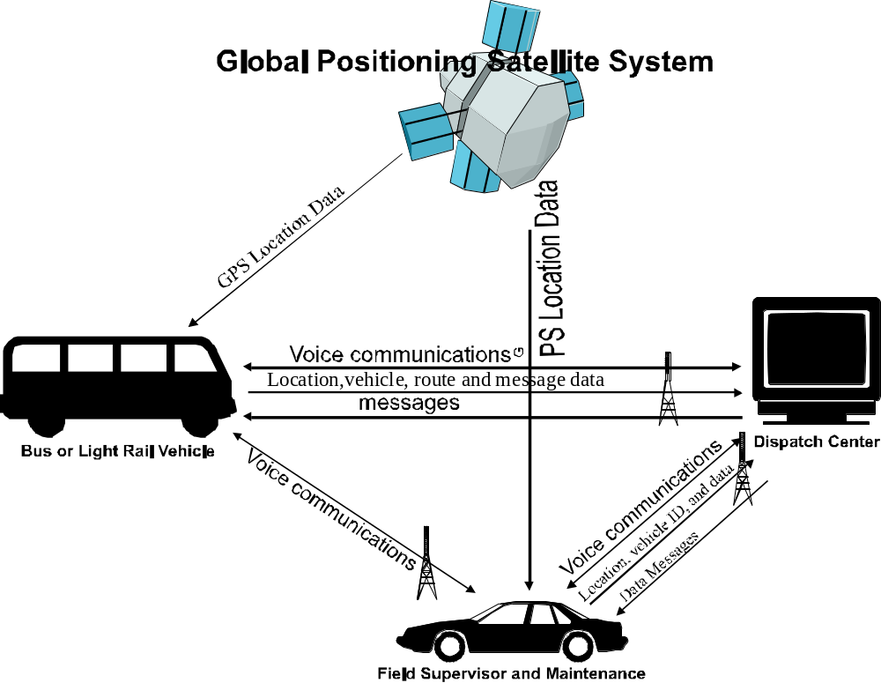
Denver RTD
Data/Information Flow

Slide 12
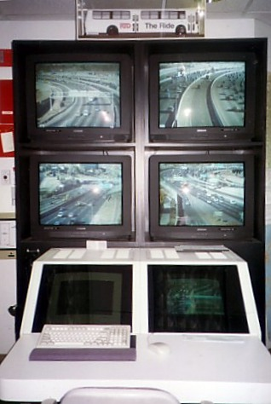
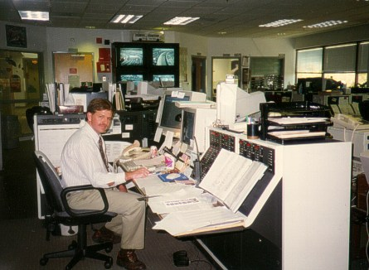
Lead Dispatcher
Denver RTD Dispatch Center
I-25 CC TV
Denver RTD Dispatch Center

Slide 13
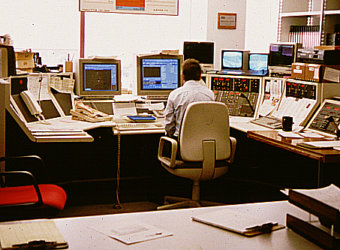
CAD / AVL Dispatch Console Denver RTD Dispatch Center

Slide 14
Lessons Learned
Fleet Efficiency *
Accurate accessible real-time vehicle location information resulted in improved
  Fleet distribution
  Deployment of support vehicles
  Management of connecting service, “connection protection”
Transit management data collection
  Collected in real time and automatically archived supports administrative as well as traffic needs
Message storage capabilities
  Reduced driver distraction in high workload environments e.g. heavy traffic
    *This project was the subject of two multiyear evaluations sponsored by the
    FTA the results are summarized in the following slides
Notes:
RTD provides public transportation for a metropolitan area that has a population of 2.3 million, encompasses forty-four municipalities, and covers 2,400 square miles. RTD operates the 12th largest transit bus fleet in the United States, as well as a light-rail line.
Regional Transportation District (RTD) acquired a CAD/AVL system that became fully operational in 1996. The CAD/AVL system added radio channels and covert alarms in buses, located vehicles in real time, and monitored schedule adherence
Dispatchers spend more time communicating about a greater variety of topics. The RTD dispatchers receive and transmit more calls as well as trace transit operations occurring both in real time and retrospectively. Having information, accurate in place and time, meant that the dispatchers could provide accurate information about on-street operations.
RTD initially expected that accurate representation of transit operations would reduce the number of street supervisors. Because the street supervisors access to real-time information from mobile data terminals (MDT) in their vehicles, they have assumed more duties.
As part of the CAD/AVL, the dispatchers acquired new equipment with enhanced capabilities. CAD/AVL added radio channels to alleviate the congested communication, displayed real-time vehicle location and schedule performance, and increased safety through accurate location of emergencies. Dispatchers also gained the capability to communicate directly with buses from other divisions, to receive and respond to covert emergency calls from buses, to “playback” past route performance of a particular bus, and to show the locations of buses out of service, for example, during snowstorms.
RTD’s dispatchers use dual computer screens (the CAD and AVL screens) that are located side-by-side. The CAD screen is the control center because it lists the radio calls by priority. The dispatchers see vehicles’ location on a scalable map on the AVL screen. Dispatchers access response options using “pull-down” menus and can select the desired level of detail to display on the AVL screen.
The street supervisors use laptop computers, Mobile Display Terminals (MDT), while they patrol their sector in a supervisor vehicle. They check out a MDT at the start of their shift and use it to access real time operating information. The MDTs are multitasking and have a windows operating system. The MDT has function keys for frequently used commands. The MDT design does not require street supervisors to recall data-entry commands because they can scroll through them.
RTD installed transit control heads (TCH) in every bus. Bus drivers use the TCH as their primary communication interface with the CAD/AVL system and the dispatchers. Bus drivers initiate communication with the Dispatch Center by selecting one of the precoded buttons to push.

Slide 15
Lessons Learned
Security
  Improved coordination with police through the use of accurate real time location data
  There was an initial reduction in perceived security due to use of “silent alarm” and pre-programmed communication lockout
  During the period of the project Passenger assaults decreased 33%

Slide 16
Lessons Learned
Passenger Service
AVL allowed the system to respond quickly to unusual service demands
  Operated “load and go” shuttles by real time location monitoring
  Handled increased (doubled) call volume in snow emergencies
  Accomplished rapid reassignments during incidents and accidents
AVL provided passengers with information that was authoritative, uniform and shared.
  E.g. GPS based system time

Slide 17
Lessons Learned
Emergency Management
Distributed information- resulting in a better informed field staff, that can marshal more internal resources to deal with emergencies
Better coordination with rescue, law enforcement, and fire services resulting in quicker, more effective rescue services

Slide 18
Lessons Learned
System Effectiveness
Over the five years of the project
Early bus arrivals deceased 12%
Late arrivals decreased 21%
Customer complaints deceased 26%

Slide 19
To Successfully Manage the Introduction of New Technology,
  Define critical prior elements / functional requirements.
  Establish a concept of operations
  Use cognitive task analysis to identify critical tasks.
  Identify the organizational elements and their internal formal and informal communication processes.
  Develop operational scenarios and talk them through with staff.
  Balance designer inputs with staff inputs
  Prototype the system for evaluation before committing to a full build.
Learn from the experience of other systems

Slide 20
All Management Centers
Issues:
  Upgrades are often technology driven
  Design to employees’ / maintainers’ needs and qualifications
  “Technology push, feature creep”
    Balance integration and modularity
    Avoid outdated technology but stay away from the”bleeding edge”
    Technology will continue to develop
  “Keep the best replace the rest”
    What is the value added?
  Anticipate unanticipated “local” application problems
    Buy the source code
    Beware COTS

Slide 21
Coordination Issues
Transit and Traffic Management centers
Map conventions differ
  Highway maps isomorphic
  Transit maps symbolic, nodes
Message propagation
  broadcast vs. narrowcast v.s. one to one
Inter-vehicle communication
Inter-system communication
  Both must deal with different frequencies patchy coverage, dead zones

Slide 22
Transit and
Traffic Management Centers
Employee Issues
Recognize the need to train, expect to find
  heterogeneous skills
  varying educations
  multiple employers
Assess how long it will take to learn, and what assistance will be required, to use new feature
You will need to “train more than you think”

Slide 23
HF Considerations in All TMCs
Work Environments
TMC staff works as a team,
  They should be able to scan the other work stations and communicate verbally with each other
Lighting / Sound
  “There will always be paperwork”
    Avoid “subdued” lighting
    Allow for personal preference for lighting
    Sound levels should be user adjustable
Consider worker schedules
  Long shifts are common
    Conveniences must be near at hand
Allow space for retention of some legacy systems

Slide 24
HF Considerations in All TMCs Interfaces
No display is too big
  AVL screens must display high levels of detail
  Pull down menus should not block important information
  System should have de-cluttering modes
  Color sets should be established through research rather than operator choice
  Field personnel want same picture as Management Center even though their displays will have lesser capabilities
No system is too fast
  The lag in displaying new information is very disruptive
  Limit the number of input devices

Slide 25
Specific HF Issues in
Transit Management Systems
System integration
  Provide redundant auditory cues for critical signals
  Displayed information (particularly calls) should be transferable between consoles
  End-to-end confirmation of message receipt is required
  Provide a convenient way of correcting data entries

Slide 26
Specific HF Issues in
Transit Management Systems
Training
Assume workers will have a wide range of skills, particularly computer skills
Assume that critical learning will take place through formal or informal apprenticeship and OJT

Slide 27
Integration questions
Given multiple types of management centers
      Traffic Control Centers, Central Control Centers, Traffic Information Centers, Transit Information Centers, Transit Control Centers and Transit Management Centers, and Emergency Response Centers, how should they be integrated?
How do we focus on the trip as opposed to the transit segment?
  How do we integrate traffic management, lane priority, parking lots, airports, sports events?
  What should the model be?
    Is there a model?
How do we introduce a new technology?
How do we incorporate the benefits of new technology and retain equipage flexibility?

