Slide 1
Spotlight Case March 2008
Back Again

Slide 2
Source and Credits
This presentation is based on the March 2008
AHRQ WebM&M Spotlight Case
  See the full article at http://webmm.ahrq.gov
  CME credit is available
Commentary by: Jon D. Lurie, MD, MS
Dartmouth Medical School
  Editor, AHRQ WebM&M: Robert Wachter, MD
  Spotlight Editor: Tracy Minichiello, MD
  Managing Editor: Erin Hartman, MS

Slide 3
Objectives
At the conclusion of this educational activity, participants should be able to:
Understand the evidence-based evaluation for patients presenting with low back pain
Identify important “red flags” for serious systemic illness presenting with low back pain
Recognize potential pitfalls in caring for patients with low back pain

Slide 4
Case: Back Again
A 34-year-old man came to the emergency department for evaluation of low back pain. He stated that the pain had been present for about one week and that he had an isolated episode of fever, which resolved with acetaminophen. Past medical history was significant for use of heroin and cocaine until one year earlier. Medications included methadone and ibuprofen. He had no allergies.

Slide 5
Case: Back Again
Physical examination revealed tachycardia and tenderness in the lumbosacral region; straight leg raising test was negative. X-ray of the lumbar spine was normal. The patient was discharged home on ibuprofen and advised to follow up with his primary physician the next day.

Slide 6
Low Back Pain (LBP)
Common problem
Typically benign and self-limited
Occasionally is presenting symptom
of serious illness (e.g., cancer, infection, surgical emergency)
Key to history is looking for “red flags”
Lurie JD. Best Pract Res Clin Rheumatol. 2005;19:557-575.
Notes:
Lurie JD. What diagnostic tests are useful for low back pain? Best Pract Res Clin Rheumatol. 2005;19:557-575. http://www.ncbi.nlm.nih.gov/pubmed/15949776

Slide 7

Evaluation of Low Back Pain
Assess likelihood of serious underlying systemic disease without over-testing those with benign musculoskeletal pain
History is usually key to early detection of serious causes of low back pain
Jarvik JG, Deyo RA. Ann Intern Med. 2002;137:586-597.
Notes:
Jarvik JG, Deyo RA. Diagnostic evaluation of low back pain with emphasis on imaging. Ann Intern Med. 2002;137:586-597. http://www.ncbi.nlm.nih.gov/pubmed/12353946

Slide 8
Causes of Low Back Pain
Regional mechanical low back pain (≥ 90%)
Mechanical low back pain with neurogenic leg pain (7%-10%)
Non-mechanical spine disorders (≤1%)
Other conditions: usually present with accompanying symptoms
Lurie JD. Best Pract Res Clin Rheumatol. 2005;19:557-575.
Notes:
Lurie JD. What diagnostic tests are useful for low back pain? Best Pract Res Clin Rheumatol. 2005;19:557-575. http://www.ncbi.nlm.nih.gov/pubmed/15949776

Slide 9
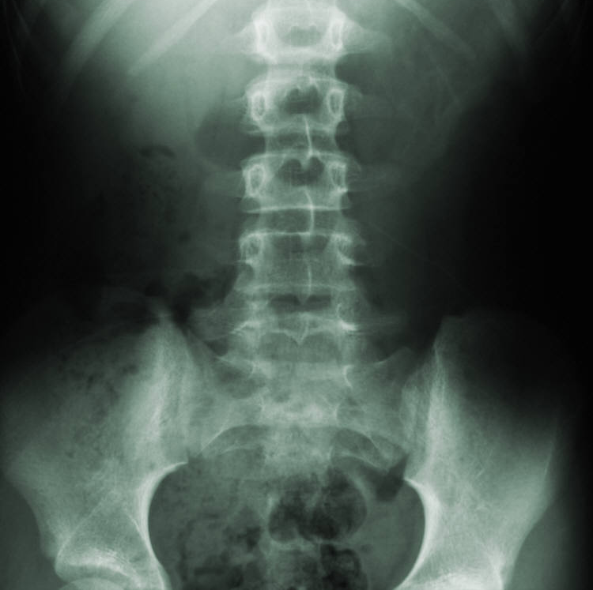
Causes of Low Back Pain
1. Regional mechanical low back pain
Non-specific mechanical low back pain (sprain, strain, lumbago, etc.)
Degenerative changes in discs and/or facet joints
Osteoporotic compression fractures
Traumatic fractures
Deformity (severe scoliosis, kyphosis, spondylolisthesis)
Lurie JD. Best Pract Res Clin Rheumatol. 2005;19:557-575.
Notes:
Lurie JD. What diagnostic tests are useful for low back pain? Best Pract Res Clin Rheumatol. 2005;19:557-575. http://www.ncbi.nlm.nih.gov/pubmed/15949776

Slide 10
Causes of Low Back Pain
2. Mechanical LBP with neurogenic leg pain
Intervertebral disc herniation
Spinal stenosis
Spinal stenosis associated with degenerative spondylolisthesis
Lurie JD. Best Pract Res Clin Rheumatol. 2005;19:557-575.
Notes:
Lurie JD. What diagnostic tests are useful for low back pain? Best Pract Res Clin Rheumatol. 2005;19:557-575. http://www.ncbi.nlm.nih.gov/pubmed/15949776

Slide 11
Causes of Low Back Pain
3. Non-mechanical spine disorders
Neoplasia (metastases, lymphoid tumors, spinal cord tumors, etc.)
Infection (infective spondylitis, epidural abscess, endocarditis, herpes zoster, lyme)
Seronegative spondyloarthritides (ankylosing spondylitis, psoriatic arthritis, reactive arthritis, Reiter’s syndrome, inflammatory bowel disease)
Lurie JD. Best Pract Res Clin Rheumatol. 2005;19:557-575.
Notes:
Lurie JD. What diagnostic tests are useful for low back pain? Best Pract Res Clin Rheumatol. 2005;19:557-575. http://www.ncbi.nlm.nih.gov/pubmed/15949776

Slide 12
Causes of Low Back Pain
4. Other causes…usually have accompanying symptoms
Pelvic (prostatitis, endometriosis, pelvic inflammatory disease)
Renal (nephrolithiasis, pyelonephritis, renal papillary necrosis)
Aortic aneurysm
Gastrointestinal (pancreatitis, cholecystitis, peptic ulcer disease)
Paget’s disease
Parathyroid disease
Hemoglobinopathies
Lurie JD. Best Pract Res Clin Rheumatol. 2005;19:557-575.
Notes:
Lurie JD. What diagnostic tests are useful for low back pain? Best Pract Res Clin Rheumatol. 2005;19:557-575. http://www.ncbi.nlm.nih.gov/pubmed/15949776

Slide 13

Important “Red Flags” for Serious Illness
General red flags on history:
  Pain worse at night or with recumbency (particularly when patients sleep in a chair to avoid pain) is very worrisome for malignancy or infection
  Suspicion should be particularly high in patients whose pain is unrelieved in any position
Other red flags can be disease specific
See Notes for References.
Notes:
Atlas SJ, Deyo RA. Evaluating and managing acute low back pain in the primary care setting. J Gen Intern Med. 2001;16:120-131. http://www.ncbi.nlm.nih.gov/pubmed/11251764
Lurie JD, Gerber PD, Sox HC. A pain in the back. N Engl J Med. 2000;343:723-726. http://www.ncbi.nlm.nih.gov/pubmed/10974137
Speed C. Low back pain. BMJ. 2004;328:1119-1121. http://www.ncbi.nlm.nih.gov/pubmed/15130982
Borenstein DG. A clinician's approach to acute low back pain. Am J Med. 1997;102:16S-22S. http://www.ncbi.nlm.nih.gov/pubmed/9217555

Slide 14
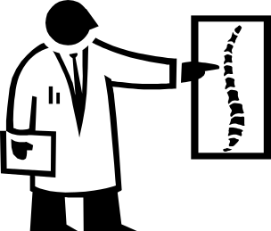
Causes of Low Back Pain:
“Don’t miss these diagnoses”
Malignancy
Infection
Compression Fractures
Other Acute Neurological Entities

Slide 15
1. Malignancy
Malignancy accounts for less than 1% of patients seeking care for low back pain
Risk factors or red flags include:
  Age > 50
  Previous history of cancer
  Unexplained weight loss (> 4.5 kg over 6 months)
  Failure to improve after 1 month of therapy
  No relief with bedrest
In patients with none of these red flags, probability of malignancy approaches zero
See Notes for References.
Notes:
Jarvik JG, Deyo RA. Diagnostic evaluation of low back pain with emphasis on imaging. Ann Intern Med. 2002;137:586-597. http://www.ncbi.nlm.nih.gov/pubmed/12353946
Bigos SJ, Bowyer OR, Braen GR, et al; for the Agency for Health Care Policy and Research. Acute low back problems in adults: assessment and treatment. Clin Pract Guidel Quick Ref Guide Clin. December 1994:iii-iv, 1-25. http://www.ncbi.nlm.nih.gov/pubmed/7987418
Deyo RA, Weinstein JN. Low back pain. N Engl J Med. 2001;344:363-370. http://www.ncbi.nlm.nih.gov/pubmed/11172169

Slide 16
2. Infection
Risk factors or red flags include:
  Fever
  Intravenous drug use
  Urinary tract infection
  Indwelling urinary catheters
  Skin infections
Note that fever is a suggestive but insensitive symptom, particularly if patient is taking acetaminophen
See Notes for References.
Notes:
Lurie JD, Gerber PD, Sox HC. A pain in the back. N Engl J Med. 2000;343:723-726. http://www.ncbi.nlm.nih.gov/pubmed/10974137
Bigos SJ, Bowyer OR, Braen GR, et al; for the Agency for Health Care Policy and Research. Acute low back problems in adults: assessment and treatment. Clin Pract Guidel Quick Ref Guide Clin. December 1994:iii-iv, 1-25. http://www.ncbi.nlm.nih.gov/pubmed/7987418

Slide 17
3. Compression Fractures
Make up about 4% of low back pain cases
Risk factors or red flags include:
  Age > 70
  Corticosteroid use (very specific to this diagnosis)
  History of trauma is not predictive
See Notes for References.
Notes:
Lurie JD. What diagnostic tests are useful for low back pain? Best Pract Res Clin Rheumatol. 2005;19:557-575. http://www.ncbi.nlm.nih.gov/pubmed/15949776
Jarvik JG, Deyo RA. Diagnostic evaluation of low back pain with emphasis on imaging. Ann Intern Med. 2002;137:586-597. http://www.ncbi.nlm.nih.gov/pubmed/12353946
Atlas SJ, Deyo RA. Evaluating and managing acute low back pain in the primary care setting. J Gen Intern Med. 2001;16:120-131. http://www.ncbi.nlm.nih.gov/pubmed/11251764

Slide 18
4. Important Neurological Entities
Cauda equina and spinal cord compression syndromes are surgical emergencies
Quite rare—an estimated 0.04% of low back pain cases
Symptoms/signs include:
  Unilateral or bilateral leg pain
  Numbness and/or weakness
  Urinary retention
Deyo RA, et al. JAMA. 1992;268:760-765.
Notes:
Deyo RA, Rainville J, Kent DL. What can the history and physical examination tell us about low back pain? JAMA. 1992;268:760-765. http://www.ncbi.nlm.nih.gov/pubmed/1386391

Slide 19
Issues in Present Case
Patient is young with little or no concerning features for malignancy
Report of fever is worrisome
  Lack of elevated temperature on examination is not reassuring, since patient reports taking acetaminophen
Significant red flag is history of probable injection drug use
  Might be misinterpreted as a red flag for “drug-seeking behavior” rather than a clue to serious systemic illness

Slide 20
Case (cont.): Back Again
The patient did not see his primary physician the next day. Instead, the day after that, he went to another ED with complaints of back pain and was again advised to use ibuprofen and follow up with his primary physician. The patient returned to the hospital again after 4 days with complaints of worsening back pain and new shortness of breath. Examination revealed bilateral rales, a systolic murmur in the mitral area, and track marks over flexor aspects of both upper extremities.

Slide 21
Work-up of Patients with “Red Flags”
Standard work-up
  Complete blood count
  Erythrocyte sedimentation rate (ESR)
  Urinalysis
  Plain radiography of the spine
In patients with one or more red flags, with either a worrisome X-ray or an ESR greater than 50, advanced imaging (MRI or bone scan) may be warranted
In patients with a personal history of cancer, directly obtaining an MRI is warranted
See Notes for References.
Notes:
Bigos SJ, Bowyer OR, Braen GR, et al; for the Agency for Health Care Policy and Research. Acute low back problems in adults: assessment and treatment. Clin Pract Guidel Quick Ref Guide Clin. December 1994:iii-iv, 1-25. http://www.ncbi.nlm.nih.gov/pubmed/7987418
Wipf JE, Deyo RA. Low back pain. Med Clin North Am. 1995;79:231-246. http://www.ncbi.nlm.nih.gov/pubmed/7877388

Slide 22

Summary of Test Characteristics
See Notes for definitions and references.
Notes:
Definition of Terms*
Sensitivity: the probability of testing positive if the disease is truly present; as the sensitivity of a test increases, the number of persons with the disease who are missed being incorrectly classified as test-negative (false negatives) will decrease.
Specificity: the probability of testing negative if the disease is truly absent; a highly specific test will rarely be positive in the absence of disease and will therefore result in a lower proportion of persons without the disease who are incorrectly classified as test-positive (false positives).
Likelihood Ratios: the probability that a particular test result will occur in patients with disease can be compared with the probability that the same test result will occur in patients without the disease. [Likelihood ratios can be used to convert pretest odds that a disease is present into posttest odds].
(*Hennekens CH, Buring JE. Epidemiology in Medicine. Philadelphia, PA: Lippincott Williams & Wilkins; 1987. ISBN: 9780316356367.)
Jarvik JG, Deyo RA. Diagnostic evaluation of low back pain with emphasis on imaging. Ann Intern Med. 2002;137:586-597. http://www.ncbi.nlm.nih.gov/pubmed/12353946
Lurie JD, Gerber PD, Sox HC. A pain in the back. N Engl J Med. 2000;343:723-726. http://www.ncbi.nlm.nih.gov/pubmed/10974137
Deyo RA, Rainville J, Kent DL. What can the history and physical examination tell us about low back pain? JAMA. 1992;268:760-765. http://www.ncbi.nlm.nih.gov/pubmed/1386391
van den Hoogen HM, Koes BW, van Eijk JT, Bouter LM. On the accuracy of history, physical examination, and erythrocyte sedimentation rate in diagnosing low back pain in general practice. A criteria-based review of the literature. Spine. 1995;20:318-327. http://www.ncbi.nlm.nih.gov/pubmed/7732468

Slide 23
Case (cont.): Back Again
Shortly after admission, the patient developed acute respiratory failure requiring intubation. He became hypotensive and laboratory results were significant for the presence of bandemia, thrombocytopenia, coagulopathy, acute renal insufficiency, and micro- and macro-hematuria. He was treated with fluid resuscitation, antibiotics, fresh frozen plasma, and platelets. Despite these efforts, the patient developed bleeding from his venipuncture sites, oral cavity, and rectum, along with refractory hypotension.

Slide 24
Case (cont.): Back Again
Aggressive resuscitation efforts, including red cell transfusion and vasopressor therapy, were initiated, but the patient died of overwhelming shock. The patient’s cultures subsequently grew methicillin-resistant staphylococcus aureus. Autopsy revealed a 2x1 inch tricuspid valve vegetation, bilateral patchy pneumonias, and multiple bilateral cortical infarcts in the kidneys. The final cause of death was “complications of infective endocarditis.”

Slide 25
What Happened?
In this case, the patient rapidly progressed to severe systemic infection, which may or may not have started as infective spondylitis
Increased attention (or concern) to his history of fever and injection drug use at the first two visits might have led to a more timely diagnosis with further diagnostic evaluation

Slide 26
Back Pain With Infective Endocarditis
Pathogenesis often not known but can include
  Septic embolization
  Renal or splenic infarction
  Myalgias/arthralgias related to the inflammatory response
  Infective spondylitis with or without epidural abscess
Frank infective spondylitis reported to be rare in endocarditis
  However, was present in 15% of cases in one recent study
See Notes for References.
Notes:
Le Moal G, Roblot F, Paccalin M, et al. Clinical and laboratory characteristics of infective endocarditis when associated with spondylodiscitis. Eur J Clin Microbiol Infect Dis. 2002;21:671-675. http://www.ncbi.nlm.nih.gov/pubmed/12373500
Cone LA, Hirschberg J, Lopes C, et al. Infective endocarditis associated with spondylodiscitis and frequent secondary epidural abscess. Surg Neurol. 2008;69:121-125. http://www.ncbi.nlm.nih.gov/pubmed/17720227

Slide 27
Care of Patients with Substance Abuse
Injection drug users are at high risk for serious infections
Extra care in the evaluation of their complaints is often warranted
  Respectful approach
  Understanding the medical and behavioral sequelae of addiction
  Use of multidisciplinary teams
  Refraining from moralistic judgments
Edlin BR, et al. Clin Infect Dis. 2005;40(suppl 5):S276-S285.
Notes:
Edlin BR, Kresina TF, Raymond DB, et al. Overcoming barriers to prevention, care, and treatment of hepatitis C in illicit drug users. Clin Infect Dis. 2005;40(suppl 5):S276-S285. http://www.ncbi.nlm.nih.gov/pubmed/15768335

Slide 28
Pitfalls in Back Pain Care
Many patients seek health care for simple back pain
Important to maintain proper vigilance for potentially “dangerous” causes of low back pain without performing unnecessary diagnostic work-ups
Physicians faced with decisions of diagnostic triage of low back pain in the acute setting can follow useful, highly relevant algorithms available in the Clinical Practice Guideline on “Acute Low Back Problems in Adults”
See Notes for References.
Notes:
Bigos SJ, Bowyer OR, Braen GR, et al; for the Agency for Health Care Policy and Research. Acute low back problems in adults: assessment and treatment. Clin Pract Guidel Quick Ref Guide Clin. December 1994:iii-iv, 1-25. http://www.ncbi.nlm.nih.gov/pubmed/7987418
Algorithms available at: http://www.ncbi.nlm.nih.gov/books/bv.fcgi?rid=hstat6.section.26862

Slide 29
Take-Home Points
Patients with mechanical low back pain and without red flags do not require extensive diagnostic work-up
Patients with a personal history of cancer, noted red flags on history, an ESR > 50, or with a worrisome lesion on lumbar radiographs should receive further evaluation, typically MRI
Fever, injection drug use, urinary tract infection, or recent skin infection are red flags for infection in patients presenting with low back pain

Slide 30
Take-Home Points (2)
Back pain is a common complaint in infective endocarditis, occurring in up to 43% of cases
Presenting a myriad of challenges for health care providers, injection drug users are at high risk for serious infections; therefore, extra care in the evaluation of their complaints is often warranted

