Slide 1
Potential Plan Responses to Genomics
Clinical Plan Decision Support Activities
Evolutionary Paths Forward
Genomics and Clinical Decision Support: A Health Plan Perspective

Slide 2
Plan Perspectives on Genomics and Personalized Health
Genomic Technology:
Genomics will likely transform the practice of medicine to a more individualized approach as this new knowledge base matures into clinical tools: Personalized Evidence Base
Plan Implication:
Transformation of medical practice may create fundamental changes to health plan operations and insurance functions
Genomics may make clinical processes more precise, specific to the Individual, and thus higher in quality. This will influence traditional plan based cost and quality management tools
Traditional tools such as contracting and formularies may become less effective as these strategies interact with genetic variation and individualized therapeutic approaches
Genomic tests and interventions are still in an early stage and their exact role in the clinical armamentarium is evolving
Plan processes such as Medical Policy and Technology assessments are focused on ensuring genomic tests produce actionable information
The size and scope of genomic medicine implications for health care
quality and costs requires a consideration of health plan perspectives
Notes:
Our vision is indeed to transform health care and become the most valued company in our industry.
Our mission is to improve the lives of the people we serve and the health of our communities.
We believe that achieving this mission is fundamental to all our success as a company.
Our Differentiating Strategies represent WellPoint’s best path to achieving our Vision and Mission.
We have chosen the Most Trusted Choice for Consumers and the Leader in Affordable Quality Care as our differentiating strategies.
I could tell that Larry is genuinely excited about our vision and mission, and so am I. What’s also exciting is that these are not just lofty words. We are moving forward quickly to achieve these goals, and we are measuring our progress with some very clear, well-defined metrics.

Slide 3
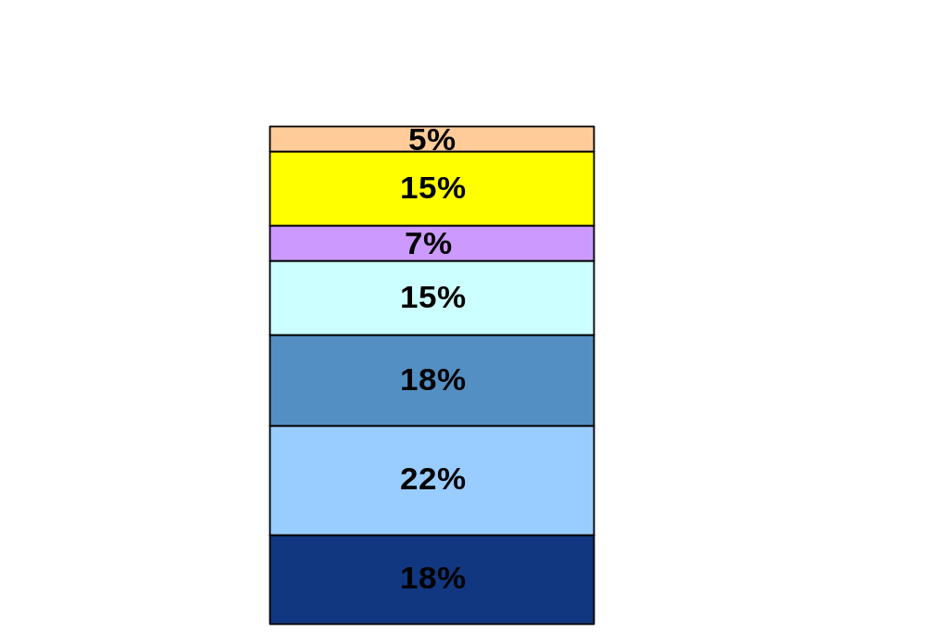
Health Plan Primary Challenge: Affordability
Innovations are a leading driver of premium inflation today.
Genomic Medicine may exacerbate this trend.
Additional Issues
Increased Consumer Demand
Litigation and Risk Management
Legislation
Rising Provider Expenses
Drugs, Medical Devices, and Other Medical Advances
General Inflation
Notes:
Anthem Midwest: 2002 Rate Increase Talking Points 2 of 18
Chart is on the increase in premiums, not how the health care dollar is spent
Re. how the healthcare dollar is spent:
Anthem-- approximately 82% is spent on claims, and the remainder 18% is administrative costs (4% on profit)
Administrative costs are lower than United (18.3%), Aetna (24.6%), and Cigna (29.8%), while Humana is slightly lower than Anthem at16.3%.
Don’t expect a slow down in health care delivery costs to have a big impact on premiums, since other factors (specifically legislation, inflation, and consumer demand) are more difficult to control.

Slide 4
Physician Challenge: Providing Quality Care
  According to leading health service and health policy researchers, there is a significant gap in the care that doctors provide and the care that the evidence base says they ought to provide*
      40% of people with chronic disease don’t get recommended care
      50% of people don’t receive recommended preventive care
      30% receive contraindicated acute care
      20% receive contraindicated chronic care
  “Increasing compliance with what we already know to be the right thing to do is a far bigger challenge than figuring what the right thing to do is”**
Genomics, by creating a much larger Personalized Evidence Base of ‘the right things to do’, could exacerbate this problem.
Clinical decision support tools from health plans have focused on improving evidence
base compliance and optimum management of health plan benefits by leveraging
claim data (and increasingly clinical data) and messaging physicians and members
*Schuster, McGlynn and Brook.
Milbank Quarterly.; 76(4) 1998: 517-563
*Earl Steinberg MD
CEO Resolution Health and noted John Hopkins Health Services Researcher.

Slide 5
Current Model:
Generalized Knowledge Applied to Episodic Care
Institutional Health Care
Generalized Research
↓
Generalized Knowledge
Generalized Clinical Evidence Base
“What ought to be done in general”
Dissemination & Training of Clinicians in Generalized CONTENT
Fragmentation of individual care = ineffective & inefficient care
Failure to apply general evidence base
 Application of Generalized Clinical Evidence Base by Clinician Episodic Care
Health IT should help:
integrate individual care across institutions
support use of generalized knowledge (CDS)
automate current processes
(BUT we can and do regrettably ‘muddle through without doing any of these.’)
Individual Health & Needs at the Time of Care

Slide 6


Moving Forward
Changing the Plan’s Role in Health Care Decision Making
TODAY, Plan care management functions influence physician and member behavior AFTER a care decision has been made.
Results: Member and physician dissatisfaction, admin costs, and sub optimal impacts to cost and quality
Physician-Patient Interaction
Plan Med Mgmt
Utilization Mgmt
Disease Mgmt
Formulary Mgmt
Radiology Mgmt
MUST COME SOON, Plan medical management activities to influence decisions AT THE TIME they are taken.
Results: Plan benefits via reduced admin costs, member satisfaction is improved and physician abrasion goes down. Quality and safety of care improves via clinical decision support algorithms at point of care.
Health I.T.
Clinical Decision Support for Members and Clinicians

Slide 7
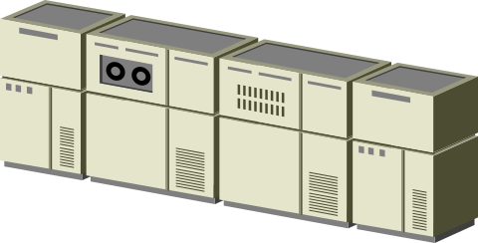

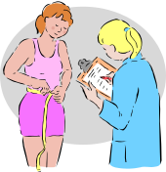




Moving Forward With Health I.T.
Plan Supported Components
Data Warehouse with clinical data enhancements: (lab, radiology, PHR, HRA, carve outs)
Outcomes Research
New Knowledge
Review of existing knowledge
Clinical Decision Support
Clinical & Financial
Algorithms
Tools to Support Health & Care Delivery
Member Components
Clinician Components
Transparency
(Toolsets)
PCN
(Personal Care
Notes)
PHR
Advanced EHR
Basic EHR
CPOE
Individual Health Record encompassing PHR, E-HR data sets linked to
associated functionality provides a foundation for clinical decision support

Slide 8
Clinical Decision Support: Proof of Effectiveness Today
E-Prescribing clinical decision support alerts (safety) are causing physicians to change the prescription for 2-10% of all alerts fired
E-prescribing formulary alerts and therapeutic alternative prompts are creating a 2% gain in generic utilization and formulary adherence rates
Clinical studies reviewing personal care notes mailed to members identifying evidence based care gaps caused an 11% gain in adherence to evidence based medicine practices in interventional group vs. controls
Health plans are building an evidence base that indicates clinical decision support;
even in relatively rudimentary forms can impact practice patterns

Slide 9
Decision Support: User Perspectives Today
  Clinical Decision Support is aimed at improving effectiveness and efficiency of current practice
  Lack of tool maturity, physician adoption, and inconsistent incentives are key challenges
  Clinical Decision Support is not yet a proven value generator for most health plans:
    Lack of accepted ROI but evidence pointing in right direction
    CDS funding amounts reflective of pilot status for most plans
    Greater funding emphasis on building infrastructure for data sharing, improving breadth and depth of solutions
    Health plans generally do not participate in basic research and only the largest health plans support applied research projects directly such as outcomes research projects
    Many health plans have launched demonstration projects however the number of these projects which include clinical decision support (excluding E-prescribing) is quite small

Slide 10
And Then Comes … Personalized Health Care
Genomics will allow for a Personalized Evidence Base for each of us
What works for ‘me’ and not just what works ‘in general’
Clinicians will need to have access to and act upon the Individual’s Personalized Health Evidence Base (the ‘record’)
Members will need to know and act upon their own Personalized Individual Health Evidence Base
This greatly increase the variants on what ‘ought to happen’
Information tools and decision support beyond today’s EHRs and PHRs will be necessary for the implementation of Personalized Health Care

Slide 11
Personalized Medicine Evidence Base Applied to Individual Lifestyle, Health and Care
Institutional Health Care
Genomic-based Research
↓
Genomic-based Knowledge
Dissemination & Training of Clinicians in HOW to Apply Personalized Evidence Base
Health IT MUST:
Maintain Personalized Evidence Base for each Individual
Manage application of Personalized Evidence by each Individual to his or her own health and lifestyle
Support application of Personalized Evidence at the time of Professional health care anywhere
We CANNOT ‘muddle through’ anymore in this scenario
 Application of Personalized Evidence Base by Clinician
“Episodic Care”
Individual Health
and Lifestyle
Personalized Genomic Evidence Base & Advice
“What you ought to do”
Application of Personalized Evidence Base by Individual
“What I am doing”
“Continuous Health”

Slide 12
User Perspectives on Decision Support for Personalized Health Care
  New (Health) Decision Support Tools are necessary for the implementation of personalized Health Care
  Key Steps Required:
    Expanded outcomes research studies to refine clinical value of Personalized Health Care
    A generally accepted Personalized Evidence Base that can be adopted into algorithms developed by broadly recognized entity
    Health Information Technology infrastructure deployed with solutions that meaningfully support personalized care processes for both clinicians and individuals, using a common platform, ontology, and concurrent rules monitoring
    Incentives for clinicians and individuals to adopt the health care and technical infrastructure needed to implement Decision Support

Slide 13
Use of Health IT
Current and What Must Come with Personalized Medicine
Current: Generalized Knowledge Applied to Episodic Institutional Care
  Integrate individual care across institutions – Interoperable Health Care
  Support use of generalized knowledge by Professionals (e.g. CPOE) and Members
  Automate current processes
Desirable to improve Effectiveness and Efficiency of Current Health Care
Desired: Personalized Evidence Base Applied to Individual Lifestyle, Health and Care
  Maintain Personalized Evidence Base for each Individual
  Manage application by Individual to own health and lifestyle
  Support application by Clinician at time of health care
  Assess results and revise Personalized Evidence Base
Necessary to the Viability of Personalized Health

Slide 14
Transition from Current State to Personalized Health and Care
Current
Personalized
Organization
Fragmented Institutional Care
Integrated Institutional Care
Individual-based Health & Care
Decision Making
Patchy Application of Generalized Evidence Base
Best-Practice Application of Generalized Evidence Base
Full Application of Personalized Evidence Base
Personalized Health and Care
Information
Professional and Individual Information Divide
Professional and Individual Exchanging Information
Professional and Individual Common Information Base

