Slide 1
NLM Sunrise Seminar
DOCLINE Update
Medical Library Association 2006
Phoenix, Arizona
Maria Elizabeth Collins
National Library of Medicine, NIH/HHS
Notes:
Good morning and thank you for joining us. My name is Maria Collins and I am the DOCLINE and Loansome Doc Team Lead.

Slide 2
Agenda
Recent enhancements
Upcoming development plans
System statistics
Notes:
This morning I’d like to present a brief update on the events of the past year and inform you of upcoming changes to DOCLINE and Loansome Doc. I will be presenting a more detailed review at the DOCLINE Update this afternoon at 3:30pm in the Tucson 40 room.

Slide 3
DOCLINE 2.5 (June 2005)
Loansome Doc redesign
  Improved interface
  Decrease learning curve
  Reduce customer service calls
  Add patron and library requested enhancements
Serial Holdings in MARC 21
Notes:
In June 2005, we released DOCLINE 2.5. The primary focus of the release was the redesign of Loansome Doc. The achievements of the redesign were an improved interface and the addition of many user and library requested enhancements. One of the key features was to make it easier for patrons to register with libraries. We achieved this, but made it a little too easy to register in some cases. I’ll come back to that topic a little later. Also included in DOCLINE 2.5, was the ability for libraries to request their serial holdings for download in the MARC 21 format. Primarily this will be used by libraries migrating from one integrated library system to another where holdings information cannot be transferred otherwise, or adding holdings to their integrated library system for the first time.

Slide 4
Loansome Doc Enhancements
Allow libraries to edit their LD patron records
Display library specific information to user during registration
Email registration confirmation to user
Login ID will be user’s email address
Password reset mechanism
Warn user requesting duplicate articles
Alert user to library’s holdings during order
Notes:
This is the list of major enhancements in the release and …

Slide 5
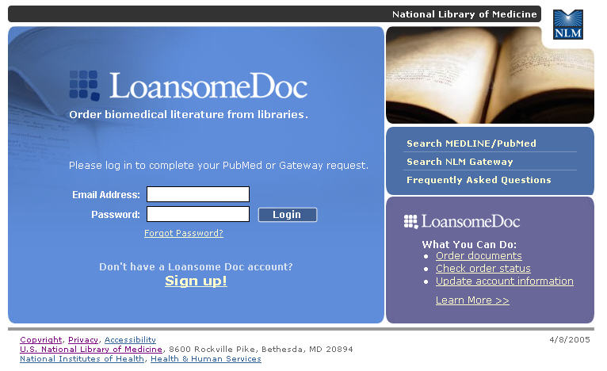
Loansome Doc Login
Notes:
…what the new Loansome Doc login page looks like today. As I mentioned, the interface was significantly revised. We moved to email address as the user’s login. We added a password reset feature, we improved ordering, and increased the visibility of user account maintenance and the status of requests – features that were largely unknown before this release.

Slide 6
DOCLINE 2.6 (Nov 2005)
ISO ILL Protocol
  ILL request structure
  Communication between ILL systems
  Messaging system
Vendors: OCLC ILLiad, RLG, Relais, VDX
First ISO ILL library
  University of Hawaii at Manoa
Notes:
In November of last year, we released the second ISO ILL compliant version of DOCLINE. In March of this year, our first DOCLINE library converted to using the ISO ILL protocol for exchanging DOCLINE request information with their local ILL system. We have a handful of additional libraries testing the protocol now.
We also have hundreds of libraries continuing to use 3rd party vendor systems to directly download requests into local systems.

Slide 7
DOCLINE 2.7 (March 2006)
Routing by library group
Adding “Other” libraries to Refer On
Routing with multiple delivery methods
Limit routing to EFTS participants
Service level (Urgent Patient Care, Rush, Normal)
Improved serial holdings searching
  New look
  New search limits (delivery method, ILL service, and format)
Notes:
In late March of this year, we released DOCLINE 2.7. This release added several significant improvements to the already powerful DOCLINE routing algorithm.
Routing by library group allows borrowers to add a library group, or collection of associated libraries, to their routing table. Prior to DOCLINE 2.7, libraries were able to establish a hierarchical list of up to 180 libraries to serve as potential lenders for their borrow requests. While this has proved very successful over the years, the changing landscape of ILL created new needs. Now that borrowers can add a library group to their routing table, it provides access to a wider pool of potential lenders. Our largest library group, FreeShare, consists of over 1,300 libraries. Thus, borrowers that belong to FreeShare now have access to every member of the group by adding the single library group entry into their routing table.
Another enhancement to routing was adding “Other” libraries to the end of the routing algorithm. “Other” libraries consist of special libraries and libraries in Canada. This optional routing choice adds over 700 libraries to the pool of potential lenders with over 3,200 unique serial titles. With these two changes, a borrower now has automated access to the collections of every single active DOCLINE library – truly fulfilling the promise of resource sharing among the National Network of Libraries of Medicine and our partnership with Canadian libraries.
With the widening of the pool of potential lenders, we also added a way for borrowers to limit the routing to those participating in the Electronic Fund Transfer System or EFTS – a centralized deposit system which eliminates billing individual libraries and reduces overhead.
Another significant change we introduced to routing is the ability for borrowers to define multiple delivery methods, reflecting the ongoing shift to electronic delivery and providing greater flexibility to borrowers.

Slide 8
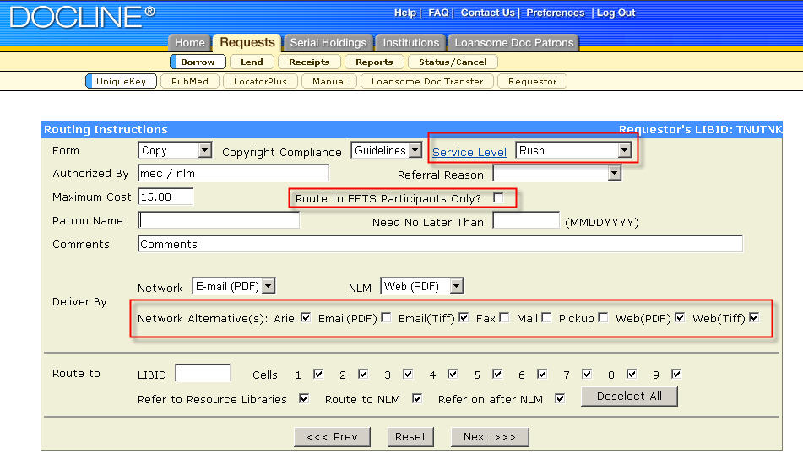
Borrow Enhancements
Notes:
This image of the borrow routing instructions screen shows several of the enhancements, including the new service level selection which allows borrowers to specify the urgency of the request. Also shown here is the new route to EFTS only and the multiple delivery method options I mentioned.
The routing instructions area marked in blue has no visual changes to the interface, but behind the scenes lies the significant changes I outlined previously. Prior to DOCLINE 2.7, borrowers were limited to a maximum of 221 lenders during automated routing of a request. This is a large number of libraries when we consider the intelligent routing of DOCLINE that has historically achieved a 91% fill rate for DOCLINE libraries. However, it has proved limiting when requesting titles held by a small percentage of libraries. Beginning with DOCLINE 2.7, borrowers that select all of the routing options have over 3,200 libraries in their pool of potential lenders during the automatic routing of a request.

Slide 9
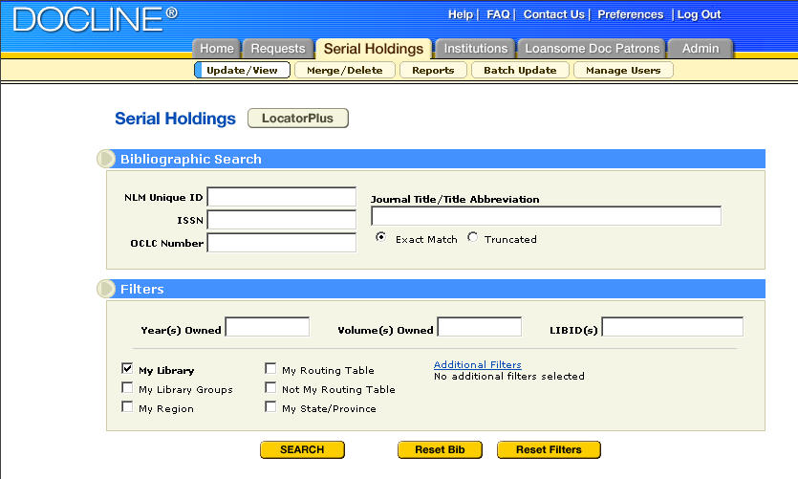
Serial Holdings Search
Notes:
This is the revised serial holdings search screen released with DOCLINE 2.7. It provides a cleaner, streamlined interface with the most popular search limits on the primary search screen.

Slide 10
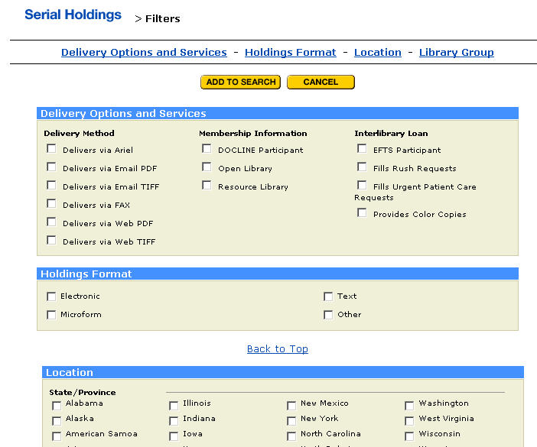
Serial Holdings Filters
Notes:
New search limits on ILL services, delivery methods, and holdings format are just a click away.

Slide 11
DOCLINE 2.8 (June 2006)
Improvements to Loansome Doc registration
  Limit search results to libraries serving the public
  Greater visibility to “Contact Library”
  Required authorization code
Cosmetic improvements to Ordering
Ability for libraries to remove patrons from their display
Notes:
Now back to the Loansome Doc release of a year ago. One of our goals was to make it easier for users to register with libraries. As I said, we were successful. Too successful for some libraries that had users that they could not serve sign up for service. We plan to release improvements to the improved Loansome Doc at the end of next month.
I’ll go into more detail about these changes this afternoon, but the primary change in Loansome Doc will be to add an optional prompt for an authorization code during registration.

Slide 12
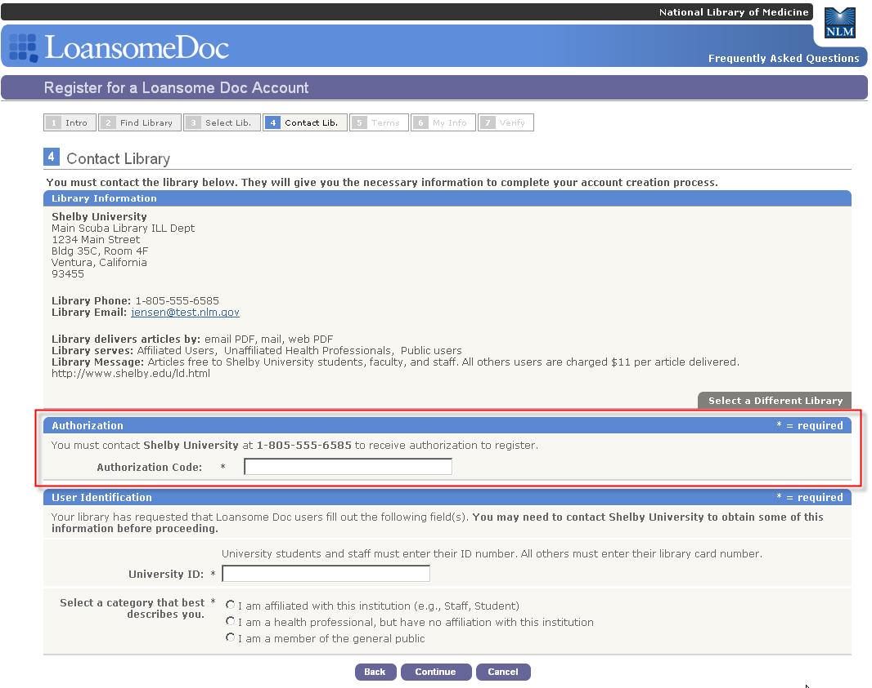
LD Registration
Notes:
Libraries will be able to require patrons registering with them to enter a code that library’s define in their institution record and can change as often as they like. The authorization code would ensure that the patron has contacted the library prior to registration if this is what the library needs. About a third of our Loansome Doc libraries request patrons contact them prior to registration.

Slide 13

Plans for the future
Notes:
Moving on to the future…

Slide 14
Coming Soon
LinkOut information in Borrow
Display library holdings in Borrow
Display PMC author manuscripts in Borrow
Ability to individually review retired requests
Annual report of titles filled by institution
Administrative items
Notes:
NLM will be releasing several new enhancements in the fall. We will add the display of a library’s LinkOut information during Borrow, as well as their serial holdings in DOCLINE. This will alert libraries to titles they have in their stacks or have online subscriptions to that might have been missed when checking their OPAC or could replace OPAC checking for some libraries. We will also be displaying links to author manuscripts in PubMed Central during Borrow. David will be talking about the author manuscripts in PMC in just a few minutes. In addition to other enhancements, we will be adding a new ranked list of serial titles filled by an institution as an annual report.

Slide 15
And beyond …
Requests & Serial Holdings Redesign
  Review screens and workflow
  Review requested enhancements
  Site visits with select libraries in Metro Washington area
  Design
  Usability testing
  Coding
  Testing
  Release
Notes:
Beyond the tweaking of the Loansome Doc registration process and the other enhancements I’ve highlighted for you, we are planning for the redesign of the Requests and Serial Holdings module. As we did with the institution record redesign, we will be reviewing all of the screens and workflows to figure out how to make it easier for you to perform serial holdings maintenance and the daily tasks of ILL. We will also be reviewing all of the enhancement requests libraries have sent us to-date. In addition, we plan to visit some libraries in the metro Washington area to observe their processes and learn from them what issues and concerns the software could possibly address so we can continue to bring you the best possible product.
Currently, there is no projected release date yet for the redesigned DOCLINE Requests and Serial Holdings module.

Slide 16

Those Numbers …
Notes:
As always, I’d like to end with just a few statistics

Slide 17
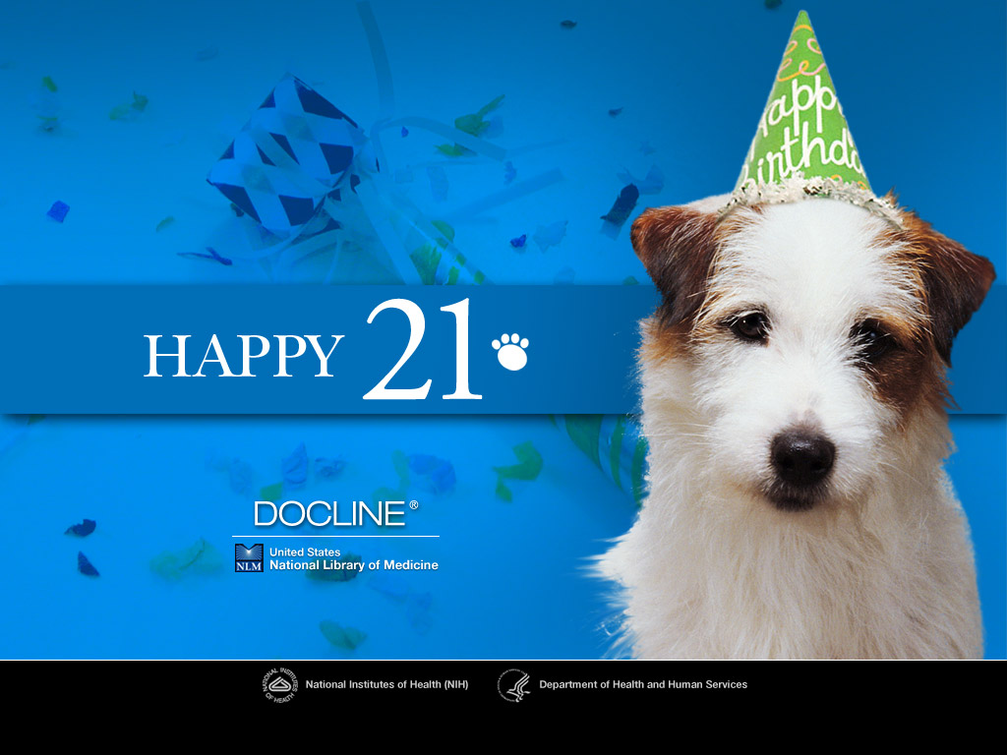
Notes:
The first number to mention is 21. On March 15th, DOCLINE marked its 21st year of service to the Network. We celebrated with a custom login page and this desktop wallpaper which is available to download at the DOCLINE website. We’d like to thank all of our users for their support as DOCLINE has grown and developed over the years.

Slide 18
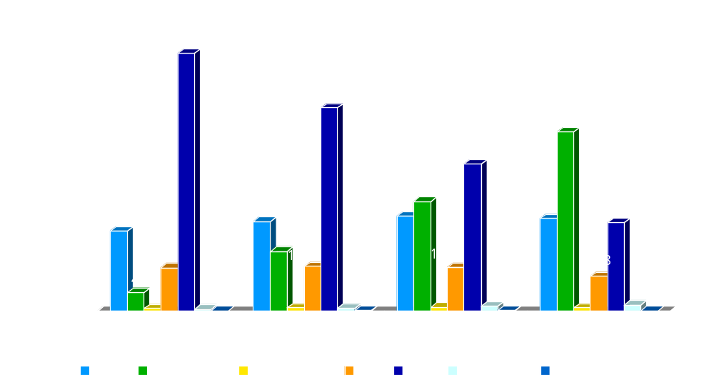
Network Delivery Methods
40 Day Snapshots
Notes:
This chart illustrates the ever increasing shift to electronic delivery of documents. These numbers reflect delivery by Network and Canadian libraries, excluding NLM. For the Network, you can see that mail delivery has dropped from 64% to just under 22% in three years. And email delivery has sky rocketed from 4.5% to 44.51%.
Ariel and fax delivery have been relatively flat in that same time period.

Slide 19
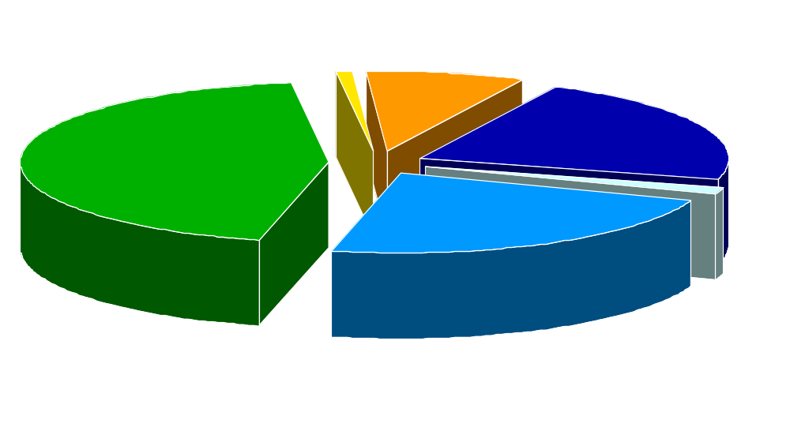
Network Delivery Methods
40 Day Snapshot
Notes:
To illustrate the trend another way, this shows the breakdown of delivery methods over the last 40 days for requests filled by Network members…

Slide 20
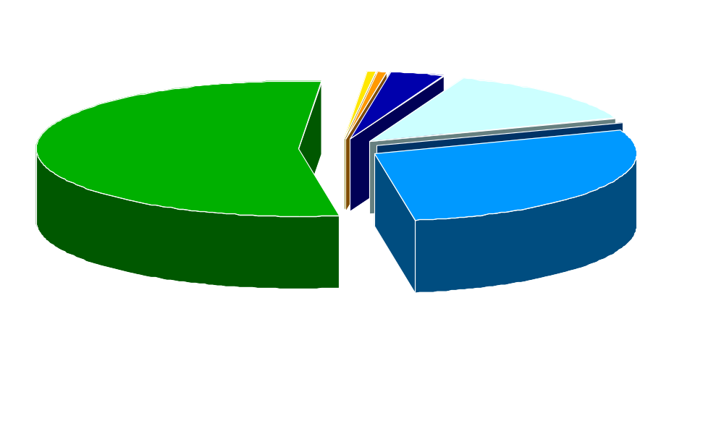
NLM Delivery Methods
40 Day Snapshot
Notes:
…and at NLM, where email is now over 53% of our deliveries. Delivery by mail has fallen to just 3.43%. Fax is less than 1%. All numbers that make the ILL staff at NLM very happy.

Slide 21
DOCLINE Routing
83% of requests completed on first route
96% of requests completed on second route
Only 4% of requests require more than 2 routes
Average number of routes = 1.24
Notes:
This is another statistic which has remained stable over the years. 83% of requests are completed on the first route, meaning it went to only one library. The average number of routes to complete a request is only 1.24.
Validated 5/14/2006

Slide 22
A Day in the Life …
9,229 requests were completed on 5/10/2006
24% were completed in less than 3 hours
37% were completed in less than 6 hours
68% were completed in less than 24 hours
91% were completed in less than 48 hours
Average time to fill a request = 0.934 days
Notes:
And just a little slice of life as we look at one day’s activity in DOCLINE. It shows that more than 9,000 requests were completed Wednesday May 10th. 68% were completed in less than 24 hours, and 91% were completed in less than 48 hours. The average time to fill a request was only 0.934 days.
The bottom line of these last two slides shows that DOCLINE gets the request to a library that should be able to fill it; and libraries are filling them quickly.
Thanks to everyone for this great turnaround.

Slide 23
Learn More About DOCLINE
Informal Meeting
  When: Monday, 3:30pm – 4:30pm
  Where: Tucson 40
NLM Booth
  Monday, 10am – 12pm
  Tuesday, 12pm – 2pm
Notes:
To close, I’d like to invite those interested in DOCLINE to the informal meeting today at 3:30pm in the Tucson 40 room. At the informal meeting, I’ll present a more in-depth review of DOCLINE 2.7 changes and discuss the upcoming Loansome Doc changes in more detail.
Deena Acton from the DOCLINE Team will be at the booth today from 10am to noon. I will be at the booth tomorrow from noon until 2pm. Please stop by with any comments or questions.
Thank you and I’ll turn it over to David.

