Slide 1
Continuous Renal
Replacement Therapy
Gregory M. Susla, Pharm.D., F.C.C.M.
Associate Director, Medical Information
MedImmune, Inc.
Gaithersburg, MD
Notes:
1

Slide 2
Definition of Terms
SCUF - Slow Continuous Ultrafiltration
CAVH - Continuous Arteriovenous Hemofiltration
CAVH-D - Continuous Arteriovenous Hemofiltration with Dialysis
CVVH - Continuous Venovenous Hemofiltration
CVVH-D - Continuous Venovenous Hemofiltration with Dialysis
Notes:
2

Slide 3
Indications for Continuous
Renal Replacement Therapy
Remove excess fluid because of fluid overload
Clinical need to administer fluid to someone who is oliguric
  Nutrition solution
  Antibiotics
  Vasoactive substances
  Blood products
  Other parenteral medications
Notes:
5

Slide 4
Advantages of Continuous
Renal Replacement Therapy
Hemodynamic stability
  Avoid hypotension complicating hemodialysis
  Avoid swings in intravascular volume
Easy to regulate fluid volume
  Volume removal is continuous
  Adjust fluid removal rate on an hourly basis
Customize replacement solutions
Lack of need of specialized support staff
Notes:
6

Slide 5
Disadvantages of Continuous
Renal Replacement Therapy
Lack of rapid fluid and solute removal
  GFR equivalent of 5 - 20 ml/min
  Limited role in overdose setting
Filter clotting
  Take down the entire system
Notes:
7

Slide 6
Basic Principles
Blood passes down one side of a highly permeable membrane
Water and solute pass across the membrane
  Solutes up to 20,000 daltons
    Drugs & electrolytes
Infuse replacement solution with physiologic concentrations of electrolytes
Notes:
3

Slide 7
Anatomy of a Hemofilter
blood in
Cross Section
dialysate
out
hollow fiber membrane
Outside the Fiber (effluent)
Inside the Fiber (blood)
dialysate
in
blood out

Slide 8
Basic Principles
Hemofiltration
  Convection based on a pressure gradient
  ‘Transmembrane pressure gradient’
    Difference between plasma oncotic pressure and hydrostatic pressure
Dialysis
  Diffusion based on a concentration gradient
Notes:
4

Slide 9
CVVH
Continuous Veno-Venous Hemofiltration
to waste
Blood In
(from patient)
Repl.
Solution
Blood Out
(to patient)
LOW PRESS
HIGH PRESS
(Convection)
Notes:
Note that this schematic indicates the addition of a REPLACEMENT FLUID. The replacement fluid-usually composed of approximate normal plasma values- enters the blood flow path as it circulates through the hemofilter. This not only has a dilutional effect on the blood but enables us to remove large volumes of water into the waste without dehydrating the patient or causing other hemodynamic shifts. Using the principles we discussed, pressures in the system can be adjusted to regulate ultrafiltrate volume. How much clearance of small/midsize molecules will be influenced both by the composition of the replacement fluid, and the amount of fluid we “replace” or force to cross the membrane into the waste collection. Note that replacement fluids may be administered pre or post filter. We will discuss these choices in a few moments.

Slide 10
CVVH
Continuous VV Hemofiltration
Primary therapeutic goal:
  Convective solute removal
  Management of intravascular volume
Blood Flow rate = 10 - 180 ml/min
UF rate ranges 6 - 50 L/24 h (> 500 ml/h)
Requires replacement solution to drive convection
No dialysate
Notes:
CVVH - Continuous veno-venous hemofiltration aims for maximizing convective removal of small and middle molecules. Replacement solutions are used to drive this convective transportation. This therapy can use 12-20 liters of fluid in a 24 hour period to achieve the desired clearance of solutes.

Slide 11
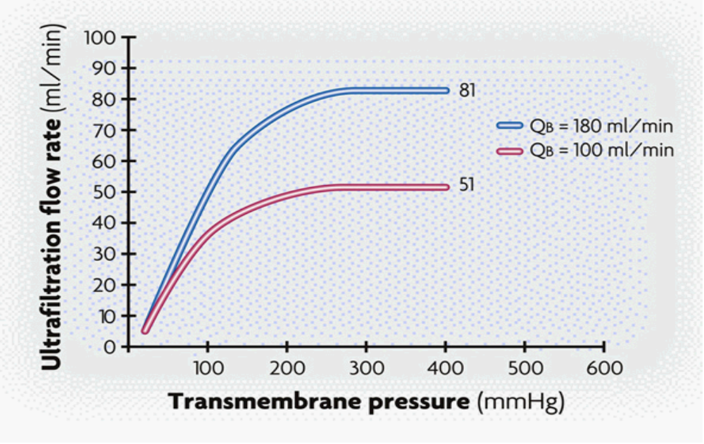
CVVH Performance
Continuous venovenous hemofiltration
“In vitro” ultrafiltration with blood (post-dilution)
(values ± 15%) (Bovine blood at 37° C, Hct 32%, Cp 60g/l)

Slide 12
CVVHDF
Continuous Veno-Venous Hemodiafiltration
to waste
Blood In
(from patient)
Dialysate
Solution
Repl.
Solution
Blood Out
(to patient)
LOW PRESS
HIGH PRESS
(Convection)
LOW CONC
HIGH CONC
(Diffusion)
Notes:
Describe flow paths on slide.
Note: Point out again that … Replacement fluids may be administered either pre or post filter.
We will discuss these options later in the program.

Slide 13
CVVHDF
Continuous VV Hemodiafiltration
Primary therapeutic goal:
  Solute removal by diffusion and convection
  Management of intravascular volume
Blood Flow rate = 10 - 180ml/min
Combines CVVH and CVVHD therapies
UF rate ranges 12 - 24 L/24h (> 500 ml/h)
Dialysate Flow rate = 15 - 45 ml/min (~1 - 3 L/h)
Uses both dialysate (1 L/h) and replacement fluid (500 ml/h)
Notes:
The next therapy for discussion is CVVHD - continuous veno-venous hemodialysis. This therapy uses a dialysate on the fluid side of the filter to increase solute exchange by diffusion. Replacement fluid is not administered with this therapy. UF rates are lower than with CVVH therapy. Dialysate is infused at 15-45 ml/min (1-3 L/ hour). The blood flow rate is maintained between 10-180 ml/min. This compares to intermittent HD that uses typical blood flow rates of 350-500 ml/min and dialysate flow rates of 500-800 ml/min. Unlike intermittent HD it is the dialysate flow rate rather than the blood flow rate that will determine clearances. The advantage of continuous therapies is that the 24 hour exposure to “renal replacement” makes up for the system efficiencies of the lower flows.

Slide 14
Pharmacokinetics of
Continuous
Renal Replacement Therapy
Notes:
9

Slide 15
Basic Principles
Extracorporeal clearance (Cl_{EC}) is usually considered clinically significant only if its contribution to total body clearance exceeds 25 - 30%
  Fr_{EC} = Cl_{EC} / Cl_{EC} + Cl_{R} + Cl_{NR}
Not relevant for drugs with high non-renal clearance
Only drug not bound to plasma proteins can be removed by extracorporeal procedures
Notes:
10

Slide 16
Determinants of
Drug Removal by CRRT
Drug Same as hemodialysis
        but increased MW range
Membrane Permeability
        Sieving Coefficient
Renal replacement Convection + diffusion Cl
technique Flow rates
Blood, Dialysate, UF
Duration of CRRT
Notes:
11

Slide 17
Sieving Coefficient (S)
The capacity of a drug to pass through the hemofilter membrane
S = C_{uf} / C_{p}
  C_{uf} = drug concentration in the ultrafiltrate
  C_{p} = drug concentration in the plasma
  S = 1 Solute freely passes through the filter
  S = 0 Solute does not pass through the filter
  CL_{HF} = Q_{f} x S
Notes:
12

Slide 18
Determinants of Sieving Coefficient
Protein binding
  Only unbound drug passes through the filter
    Protein binding changes in critical illness
Drug membrane interactions
  Not clinically relevant
Adsorption of proteins and blood products onto filter
  Related to filter age
  Decreased efficiency of filter
Notes:
13

Slide 19
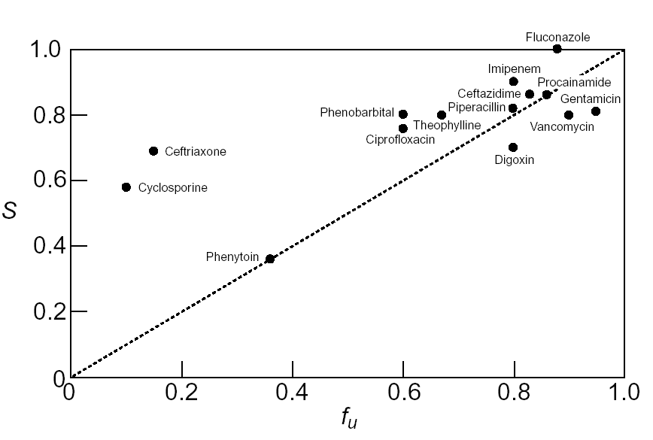
Relationship Between Free Fraction (fu) and Sieving Coefficient (SC)
SC

Slide 20
Dialysate Saturation (S_{d})
Countercurrent dialysate flow (10 - 30 ml/min) is always less than blood flow (100 - 200 ml/min)
Allows complete equilibrium between blood serum and dialysate
Dialysate leaving filter will be 100% saturated with easily diffusible solutes
Diffusive clearance will equal dialysate flow
Notes:
14

Slide 21
Dialysate Saturation (S_{d})
S_{d} = C_{d} / C_{p}
  C_{d} = drug concentration in the dialysate
  C_{p} = drug concentration in the plasma
Decreasing dialysate saturation
  Increasing molecular weight
    Decreases speed of diffusion
  Increasing dialysate flow rate
    Decreases time available for diffusion
  Cl_{HD} = Q_{d} x S_{d}
Notes:
15

Slide 22
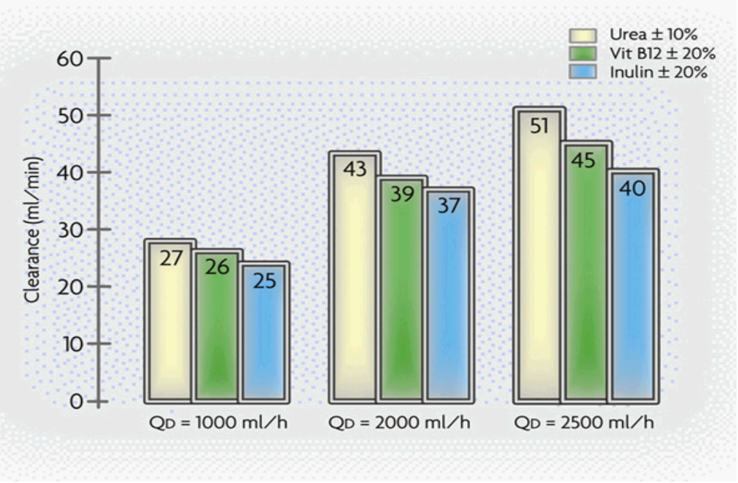
CVVHDF Clearance
Continuous venovenous hemofiltration - post dilution
QB = 150 ml/min - QD = 2000 ml/h (in vitro saline)

Slide 23
Extracorporeal Clearance
Hemofiltration clearance (Cl_{HF} = Q_{f} x S)
    Q_{f} = Ultrafiltration rate
    S = Seiving coefficient
Hemodialysis clearance (Cl_{HD} = Q_{d} x S_{d})
    Q_{d} = Dialysate flow rate
    S_{d} = Dialysate saturation
Hemodialfiltration clearance
  Cl_{HDF} = (Q_{f} x S) + (Q_{d} x S_{d})
Notes:
16

Slide 24
Case History
AP 36yo HM s/p BMT for aplastic anemia
Admitted to ICU for management of acute renal failure
CVVH-D initiated for management of uremia
ICU course complicated by pulmonary failure failure requiring mechanical ventilation, liver failure secondary to GVHD and VOD, and sepsis
Notes:
18

Slide 25
Case History
Antibiotic Management on CRRT
Gentamicin 180 mg IV q24h
Vancomycin 1 g IV q24h
Dialysis rate 1000 ml/hour
  12 hour post gentamicin levels: 3 - 4 mg/L
  12 hour post vancomycin levels: 20 - 23 mg/L
Dialysis rate increased to 1200 ml/hour
  12 hour post gentamicin levels: < 0.4 mg/L
  12 hour post vancomycin levels: < 4 mg/L
Notes:
19

Slide 26
Dosage Adjustments in CRRT
Will the drug be removed?
  Pharmacokinetic parameters
    Protein binding < 70 - 80%
      Normal values may not apply to critically ill patients
    Volume of distribution < 1 L/kg
    Renal clearance > 35%
How often do I dose the drug?
  Hemofiltration: ‘GFR’ 10 - 20 ml/min
  Hemofiltration with dialysis: ‘GFR’ 20 - 50 ml/min
Notes:
28

Slide 27
Drug Removal During CRRT
Recommendations not listed in PDR
Limited to case reports or series of patients
Different filter brands, sizes, flow rates
Limited information in many reports
  Rarely report % of dose removed
Many journals will not publish case reports
Artificial models and predictions have no clinical value
Notes:
27

Slide 28
Dosage Adjustments in CRRT
Loading doses
  Do not need to be adjusted
  Loading dose depends solely on volume of distribution
Maintenance doses
  Standard reference tables
  Base on measured loses
  Calculate maintenance dose multiplication factor (MDMF)
Notes:
29

Slide 29
Dosage Adjustments in CRRT
Frequent blood level determinations
  Aminoglycosides, vancomycin
Reference tables
  Bennett's tables or the PDR recommendations require an approximation of patient's GFR
  The CVVH ‘GFR’ is approximated by the ultrafiltrate rate (UFR), plus any residual renal clearance
  Using Bennett's or the PDR’s tables, in most CVVH patients, drug dosing can be adjusted for a ‘GFR’ in the range of 10 to 50 ml/min

Slide 30
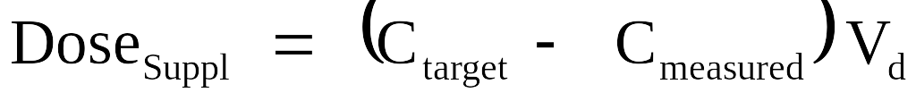
Supplemental Dose Based on Measured Plasma Level
Notes:
29

Slide 31
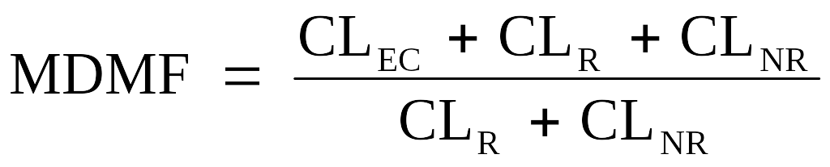
Adjusted Dose Based on Clearance Estimates
Notes:
29

Slide 32

COMPARISON OF DRUG REMOVAL BY INTERMITTENT HD AND CRRT
Notes:
33

