Slide 1

Stimulants and HIV
Interventions that reduce risk
Thomas Freese, Ph.D.
Pacific Southwest Addiction Technology Transfer Center
UCLA Integrated Substance Abuse Programs

Slide 2
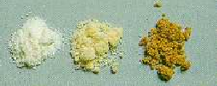
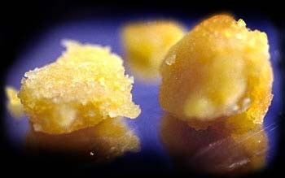
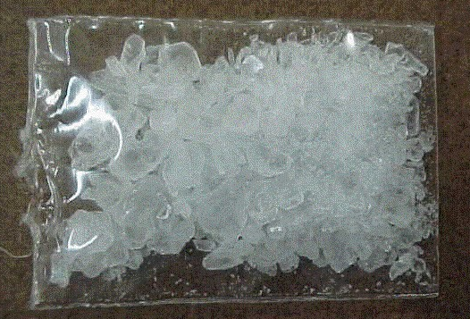
Forms of Methamphetamine
Methamphetamine Powder
Users’ Description: Beige/yellowy/off-white powder
Base / Paste Methamphetamine
Users’ Description: ‘Oily’, ‘gunky’, ‘gluggy’ gel, moist, waxy
Crystalline Methamphetamine
Users’ Description: White/clear crystals/rocks; ‘crushed glass’ / ‘rock salt’

Slide 3

Methamphetamine Addiction
The brains of people addicted
to Methamphetamine are
different than those of
non-addicts

Slide 4
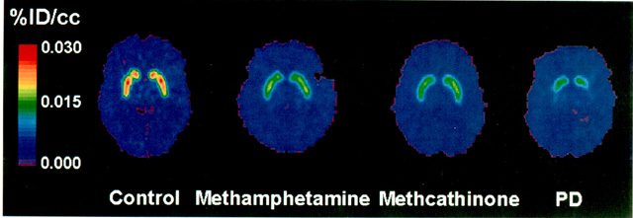
Decreased dopamine transporter binding in METH users resembles that in
Parkinson’s Disease patients
%ID/cc
0.030
0.015
0.000
Control Meth
Source: McCann U.D.. et al.,Journal of Neuroscience, 18, pp. 8417-8422, October 15, 1998.
Notes:
If DAT is decreased in young METH users (almost to that observed in Parkinson’s Disease), and DAT decreases with age, may we see an increase in the number of Parkinsonian patients over time?

Slide 5
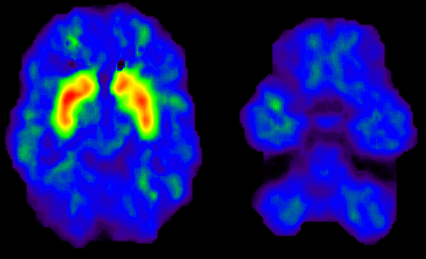
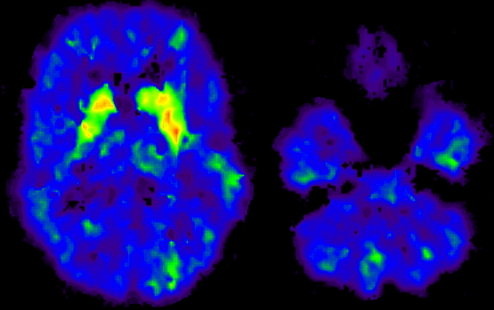
Dopamine Transporters in
Methamphetamine Abusers
Motor Activity
2.0
1.8
(Bmax/Kd)
1.6
Dopamine Transporter
1.4
1.2
Normal Control
1.0
7
8
9
10
11
12
13
Time Gait
(seconds)
2
Memory
1.8
1.6
Dopamine Transporter
Bmax/Kd
1.4
1.2
Methamphetamine Abuser
1
16
14
12
10
8
6
4
p < 0.0002
Delayed Recall
(words remembered)

Slide 6
Cognitive Impairment in Individuals Currently Using Methamphetamine
Sara Simon, Ph.D.
VA MDRU
Matrix Institute on Addictions
LAARC

Slide 7
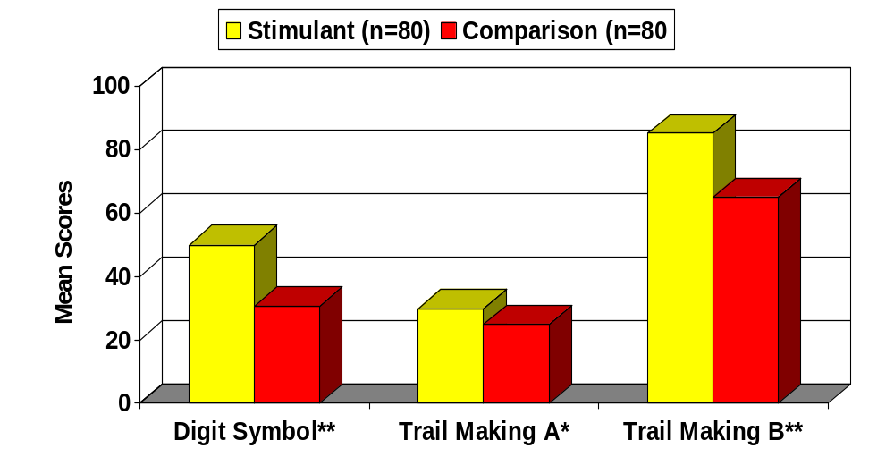
Differences between Stimulant and Comparison Groups on tests requiring perceptual speed

Slide 8
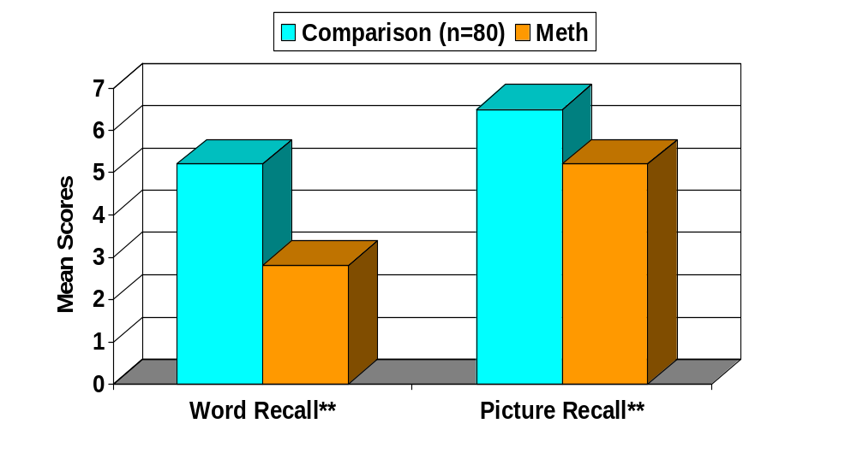
Memory Difference between Meth and Comparison Groups

Slide 9
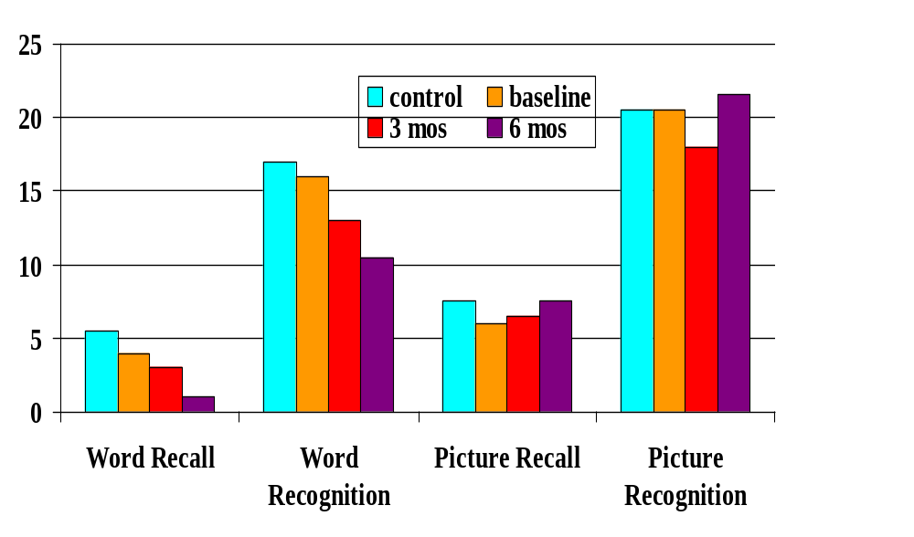
Memory Performance Across Time
number correct
test

Slide 10
Methamphetamine vs. Cocaine
Cocaine half-life: 2 hours
Methamphetamine half-life: 10 hours
Cocaine paranoia: 4 -8 hours following drug cessation
Methamphetamine paranoia: 7-14 days
Methamphetamine psychosis - May require medication/hospitalization and may not be reversible

Slide 11
Effects of Methamphetamine and Treatment Implications

Slide 12
Methamphetamine
Acute Physical Effects
Increases
Heart rate
Blood pressure
Pupil size
Respiration
Sensory acuity
Energy
Decreases
  Appetite
  Sleep
  Reaction time

Slide 13
Methamphetamine
Acute Psychological Effects
Increases
Confidence
Alertness
Mood
Sex drive
Energy
Talkativeness
Decreases
Boredom
Loneliness
Timidity

Slide 14
…and just when you thought it couldn’t get any better…

Slide 15


Slide 16
Methamphetamine
Chronic Physical Effects
Tremor
Weakness
Dry mouth
Weight loss
Cough
Sinus infection
Sweating
Burned lips; sore nose
Oily skin/complexion
Headaches
Diarrhea
Anorexia

Slide 17

Cardiovascular problems
↑ heart rate
Palpitations
Arrhythmia
↑ blood pressure
Chest Pain
Valve thickening

Slide 18

Neurological problems
Seizures
Stroke
Cerebral hemorrhage
Cerebral vasculitis
Mydriasis

Slide 19
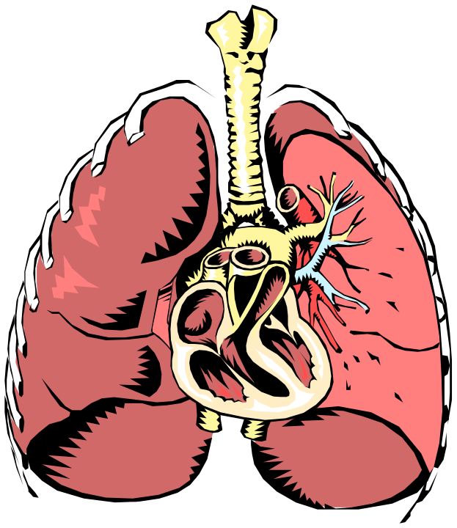
Respiratory problems
Dyspnea
Pulmonary hypertension
Pleuritic chest pain
COPD

Slide 20

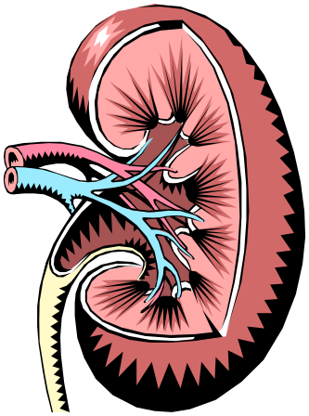
Renal / Hepatic Toxicity from MA Abuse
Renal failure
Hepatic failure

Slide 21
Other problems
Over-heating
Rhabdomyolysis
Obstetric complications (?)
Anorexia / weight loss

Slide 22


Severe weight loss/anorexia

Slide 23
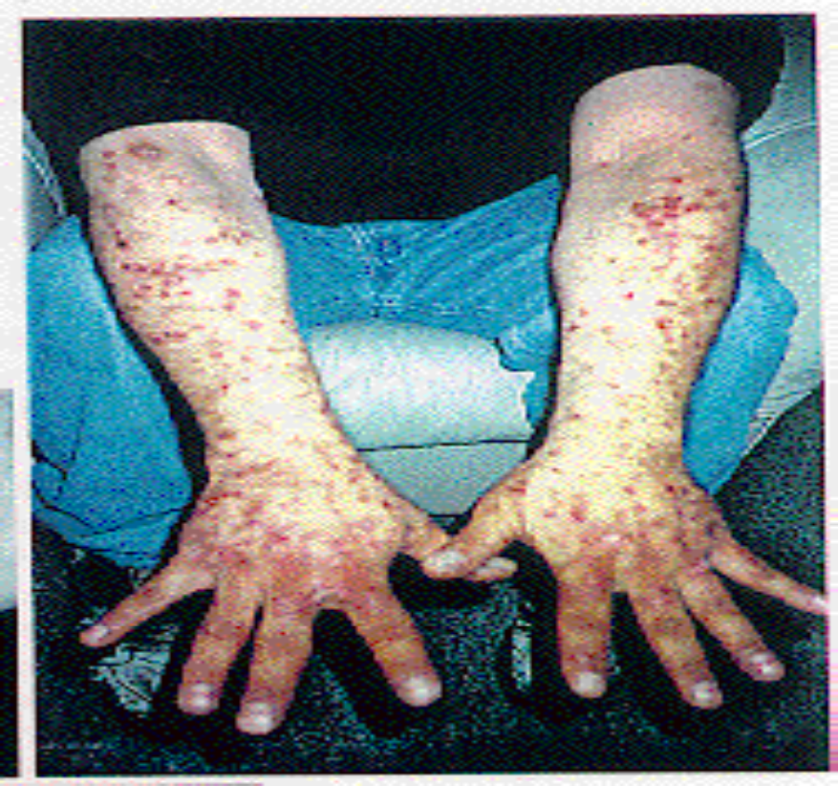
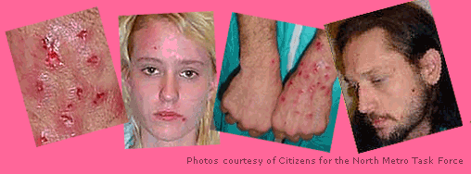
Speed Bumps

Slide 24


Faces of Methamphetamine
Speed Bumps
Images courtesy Multnomah County Sheriff’s Office

Slide 25
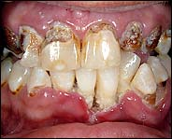
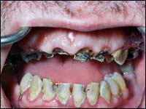
METH Use Leads to Severe Tooth Decay
Source: Richards, JR and Brofeldt, BT, J Periodontology,
August 2000.
“METH Mouth”
Source: The New York Times, June 11, 2005.

Slide 26

Trauma
Interpersonal trauma
  Assault
  Gunshot
  Knife
Motor Vehicles
Suicide attempts

Slide 27
Methamphetamine
Chronic Psychological Effects
Confusion
Concentration
Hallucinations
Fatigue
Memory loss
Insomnia
Irritability
Paranoia
Panic reactions
Depression
Anger
Psychosis

Slide 28
Acute MA Overdose
Slowing of Cardiac Conduction
Ventricular Irritability
Hypertensive Episode
Hyperpyrexic Episode
CNS Seizures and Anoxia

Slide 29
Acute MA Psychosis
Extreme Paranoid Ideation
Well Formed Delusions
Hypersensitivity to Environmental Stimuli
Stereotyped Behavior “Tweaking”
Panic, Extreme Fearfulness
High Potential for Violence

Slide 30
Treatment of MA Psychosis
Typical ER Protocol for MA Psychosis
  Haloperidol - 5mg
  Clonazepam - 1 mg
  Cogentin - 1 mg
  Quiet, Dimly Lit Room
  Restraints

Slide 31
Sexual Behavior and Methamphetamine

Slide 32
Methamphetamine and Sex Connection in Heterosexuals

Slide 33
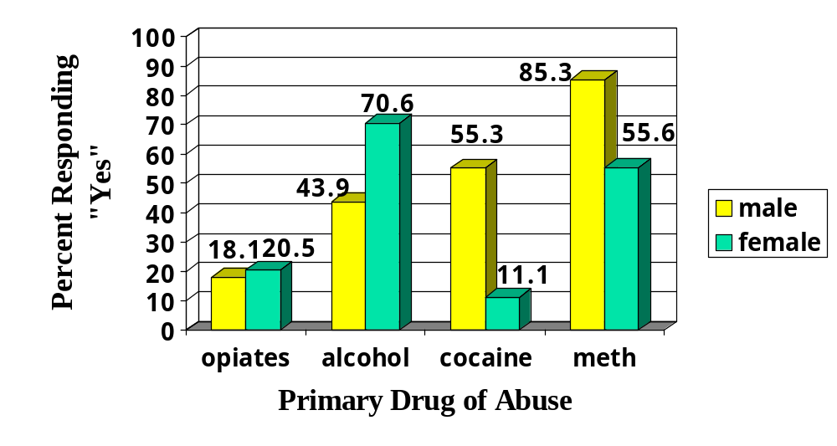
Q.2: My sexual drive is increased by the use of …

Slide 34
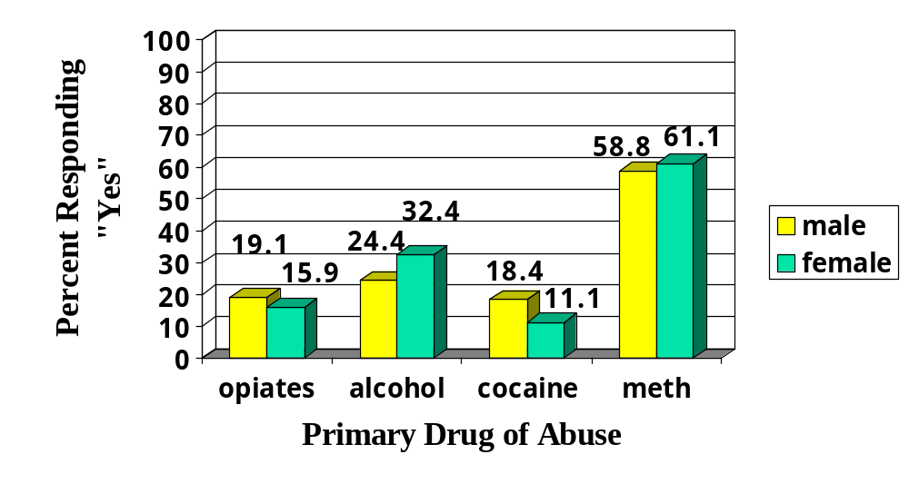
Q.4: My sexual performance is improved by the use of …

Slide 35
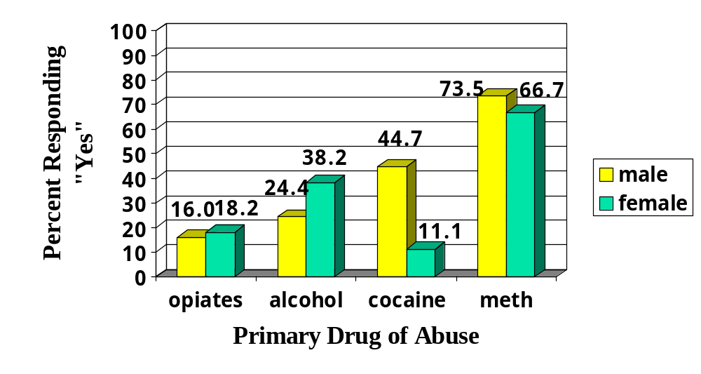
Q.6: My sexual pleasure is enhanced by the use of …

Slide 36
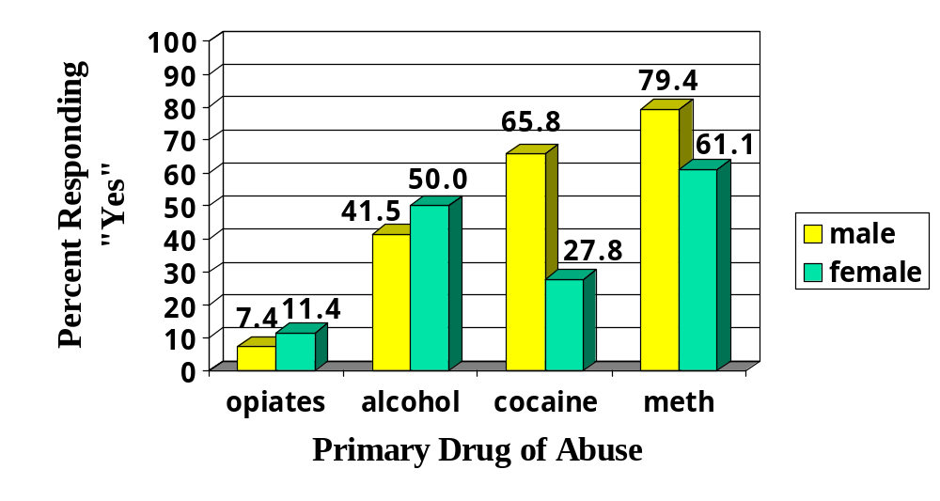
Q.10: I am more likely to have sex (e.g., intercourse, oral sex, masturbation, etc.) when using …

Slide 37
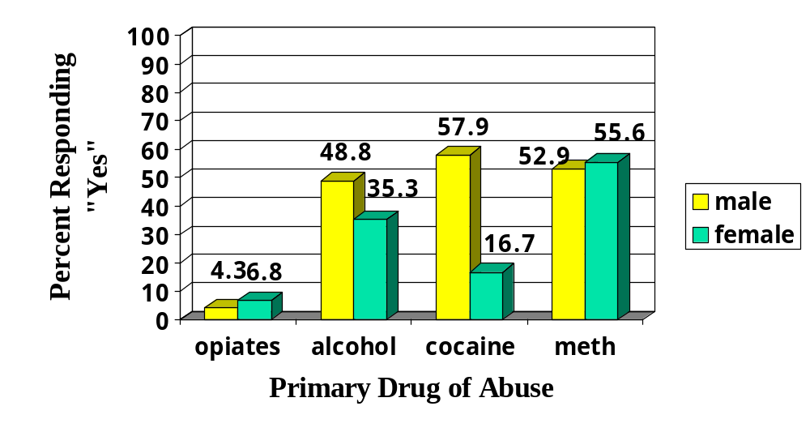
Q.12: I am more likely to practice “risky” sex under the influence of … (e.g., not use condoms, be less careful about who you choose as a sex partner, etc.)

Slide 38
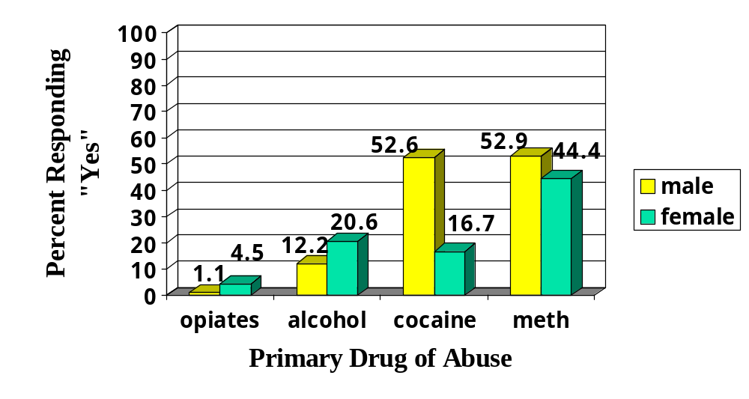
Q.13: I have become involved in sex acts that are unusual for me when I am under the influence of … (e.g., marathon masturbation, go to “peep” shows, cross-dress, voyeurism, expose yourself, etc.)

Slide 39
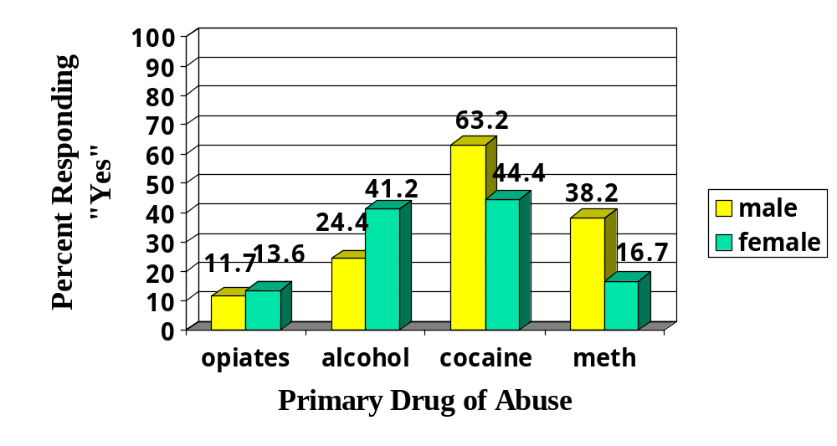
Q.20: My sexual behavior under the influence of … has resulted in feelings of depression.

Slide 40
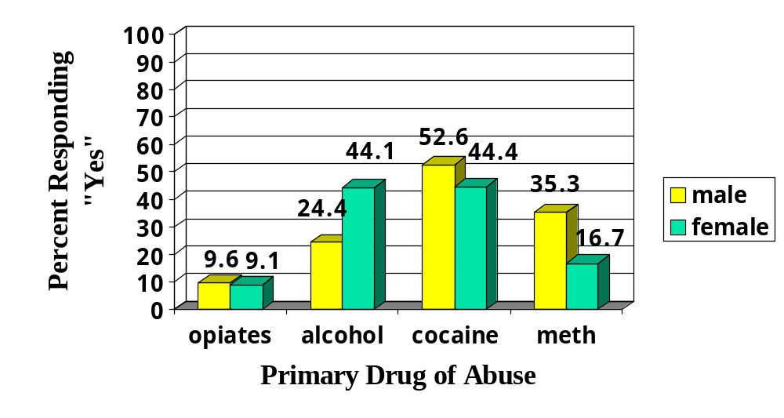
Q.21: My sexual behavior under the influence of … has resulted in feelings of shame/guilt.

Slide 41

Methamphetamine and HIV in MSM: Time-to-Response Association?
* Deren et al., 1998, Molitor et al., 1998; ** Reback et al., in prep, *** Reback, 1997; **** Shoptaw et al., 2002; ****VNRH, unpublished data

Slide 42
Outpatient Treatment for Methamphetamine Abuse

Slide 43
STAGES OF RECOVERY - STIMULANTS
OVERVIEW
DAY
0
DAY
15
DAY
45
DAY
120
DAY
180
Withdrawal
Honeymoon
The Wall
Adjustment
Resolution

Slide 44
Results from the CADDs Data System (2001)
*The statewide data collection system, CADDs has information on the relative usefulness of treatment for MA users, by comparing them to cocaine users.

Slide 45
Sample Size and Early Drop Out
Outpatient Treatment:
    MA users = 27,026
    COC users = 11,160
Early Dropout:
    Outpatient COC admissions were slightly more likely to drop out of treatment before 30 days (25.5%) as compared to MA admissions (24.1%). P = .003

Slide 46
Predictors (cont’)
Early dropout for both MA and COC users was associated with:
  Being disabled
  Chronic mental illness
  Daily use of primary drug
  Injection use
Early dropout is less likely for those under legal supervision, older age of first use of primary substance, and older age at admission.

Slide 47
Predictors of Retention in Treatment for more than 90 days
Higher rates of retention for men
Legal supervision increases treatment retention
Those who began use at an older age were retained better than those who started when younger
Those who are older at admission were retained better
Injection users were retained more poorly
Those with chronic mental illness were retained more poorly
Daily users are retained more poorly than those who use less often than daily

Slide 48
Limitations on Current Treatments
Training and development of knowledgeable clinical personnel are essential elements to successfully address the challenges of treating MA users.
Training alone is insufficient if the funding necessary to deliver these treatment recommendations is not available.
Treatment funding policies that promote short duration or non-intensive outpatient services are inappropriate for providing adequate funding for MA users.

Slide 49
Successful Outpatient Treatment Predictors
Durations over 90 days (with continuing care for another 9 months).
Techniques and clinic practices that improve treatment retention are critical.
Treatment should include 3-5 clinic visits per week for at least 90 days.
Employ evidence based practice (e.g., CBT, CM, Community Reinforcement Approach, Motivational Interviewing, Matrix Model).
Family involvement and 12-step program appear to improve outcome.
Urine testing (at least weekly is mandatory)

Slide 50
Special Treatment Consideration Should be Made for the Following Groups of Individuals:
Female MA users (higher rates of depression; very high rates of previous and present sexual and physical abuse; responsibilities for children).
Injection MA users (very high rates of psychiatric symptoms; severe withdrawal syndromes; high rates of hepatitis).

Slide 51
Special Treatment Consideration Should be Made for the Following Groups of Individuals:
MA users who take MA daily or in very high doses.
Homeless, chronically mentally ill and/or individuals with high levels of psychiatric symptoms at admission.
Individuals under the age of 21.
Gay men (at very high risk for HIV and hepatitis).

Slide 52
Thomas E. Freese, Ph.D.
tefreese@ix.netcom.com
www.uclaisap.org
Notes:
800-335-1517

