Slide 1
Lessons Learned from Hurricanes Katrina and Rita: A Perspective from Mobile County Public Schools in Alabama
U.S. Department of Education
Office of Safe & Drug Free Schools
FY06 Emergency Response & Crisis Management
Initial Grantee Meeting
San Antonio, Texas
December 6-8, 2006

Slide 2
Rhonda Neal Waltman, Ed. D.
Assistant Superintendent (Retired)
Division of Student Support Services
Mobile County Public Schools
Post Office Box 66284
Mobile, AL 36660
(251) 454-2709 waltmaninc@bellsouth.net

Slide 3
Objectives
Participants will learn:
The role of schools in disaster response and the critical infrastructure required for future preparedness;
The transformative role of a public health approach as a framework for disaster readiness and response;
The critical role of service provider partnerships as policy/practice; and
The role of a comprehensive student support component and related staff development of administrators, teachers and support staff.

Slide 4
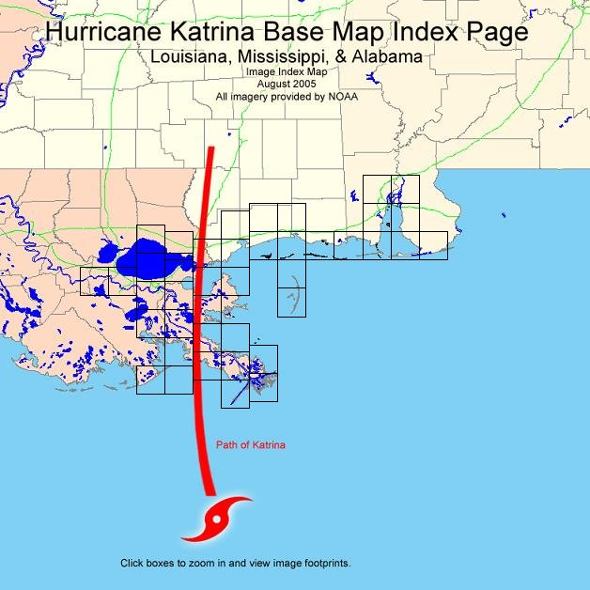

Hurricane Katrina
Began as a very low pressure weather system, which strengthened to become a tropical storm and eventually a hurricane as it moved west and neared the Florida coast on the evening of August 25, 2005. After crossing southern Florida, it strengthened further before veering inland towards Louisiana, eventually making landfall at Grand Isle, approximately 55 miles south of New Orleans, at 10am local time on August 29th. At this point, Katrina's sustained wind speed was approximately 175 mph.

Slide 5

Displaced Students in Alabama
128 school districts received displaced students
Almost 6,000 displaced students enrolled in 2005-06
75% of the students are still enrolled in 2006-07
Mobile County serves 46% of all AL displaced students

Slide 6
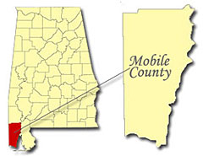
Some Facts About
Mobile County
Located in the southwest corner of Alabama
Covers more than 1,644 square miles
Population of 400,000 +
Public school enrolls over 67,000 students who speak 34 different languages
7,000 public school employees
100 + public school buildings
School district budget $ 600 M +

Slide 7

Mobile Co. Schools
Post Katrina
$30 million in property damage
All buildings received wind, water and/or roof damage - one school completely destroyed
1900 MCPSS children left homeless
1200 + displaced "neighbors" from LA, MS
Many homeless and displaced school employees
In spite of devastation, students only missed 9 instructional days

Slide 8

Our Vision:
A Short-Term Plan for Long-Term Recovery
Restore a sense of normalcy
for children and families.
The community recovers when the schools recover . . .

Slide 9
Organizational Readiness and Approaches
Management structures and leadership
Clear purpose and goals
Functionally defined roles
Team support
Stress management
Source: Comprehensive Training Manual for Mental Health Workers in Major Disasters, 2nd edition

Slide 10
Mobile's Approach:
Do What You Do Well . . .
Stay focused on doing a few things well that make a difference.
Do not diminish the contributions that others (e.g., individuals, organizations, agencies) can and already are making on their own initiative.
Avoid providing redundant services or interfering with the legitimate efforts of others who are better equipped to respond to critical needs.

Slide 11
School District
Response Goals
Connect children and families with needed services in an efficient and effective manner
Promote academic success by removing barriers to learning for affected children

Slide 12
School District
Guiding Principles
Disaster Psychology Theory
Maslow's Hierarchy of Needs
Student Support Component Institutionalized - Remove Barriers to Learning
Best Practice Model of Case Management
The 4 Magic Questions

Slide 13
What is a Disaster?
Hurricane Tornado
Flood Earthquake
Explosion Fire
Hazardous Materials War
Accident Famine
Transportation Epidemic
Accident
Source: Comprehensive Training Manual for Mental Health Workers in Major Disasters, 2nd edition

Slide 14
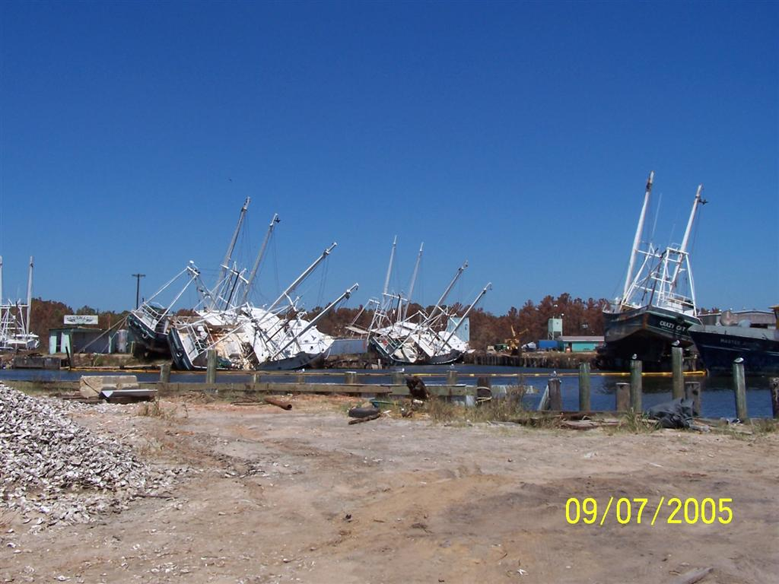
Disaster
Natural or human-made event
Severe and large
Requires coordinated effort
Degree of personal impact
Probability of recurrence
Notes:
Disasters vs. Traumas
Disasters exceed resources
Trauma needs are addressed locally.

Slide 15
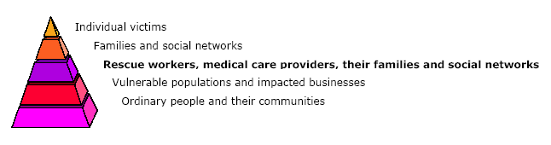
The Impact Pyramid

Slide 16

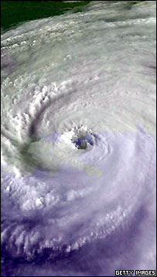

The Long Haul
Adapted from CDC Model: Phases of Disaster http://www.bt.cdc.gov/mentalhealth/pdf/primer.pdf
HONEYMOON
(Community Cohesion)
RECONSTRUCTION
HEROIC
Anniversaries and other
trigger events
PREDISASTER
DISASTER
DISILLUSIONMENT
1 to 3 days
1 to 3 years

Slide 17
Developmental
Reactions to Trauma
Preschool
Sleep problems Nightmares Fearfulness
Separation anxiety Regression Clinging Repetitive play
School-Age
Sleep problems Nightmares Guilt
Fears about safety Physical complaints Depression
Preoccupation with disaster Angry outbursts
Withdrawal from peers School performance decline
Pre-Adolescents and Adolescents
Sleep problems Physical complaints Depression
Guilt Withdrawal Isolation
Aggressive behavior Decline at school
Risk-taking behavior
Source: Comprehensive Training Manual for Mental Health Workers in Major Disasters, 2nd edition

Slide 18
Recovery
Psychological Tasks
Acceptance of disaster and losses
Identification, labeling and expression of emotions
Regaining sense of mastery and control
Resumption of age-appropriate roles and activities
Source: Comprehensive Training Manual for Mental Health Workers in Major Disasters, 2nd edition

Slide 19
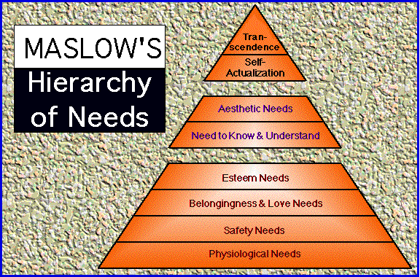

Slide 20
What Does Research Say About Removing Barriers to Learning?
Instruction
Enabling
(Supporting)
School
Student
Management
Family
Community
Source: UCLA Center for Mental Health in Schools

Slide 21
Framework for a
Student Support Component
Ensure Academic Success and Promote Healthy Development
Increase protective factors
Decrease risk factors
Address External and Internal Barriers to Student Learning
Address common educational/psychological problems
Counter external stressors-home, basic needs, violence
Accommodate disorders/disabilities
Provide Social/Emotional Support for Families
    Screen/assess/triage
    Provide direct services and instruction
    Connect to community resources
    Source: UCLA Center for Mental Health in Schools

Slide 22
Mobile's Post Katrina
Enabling Component
Intensive Case Management model using existing partners and resources to identify and remove barriers to service utilization
Improve service delivery through training for professionals and staff

Slide 23
The Four Magic Questions
Is this a GOOD IDEA? If so,
Is this something we SHOULD DO?
If not, refer to appropriate agency. If so,
Is this something we CAN DO?
If not, refer; if so,
Is this something we CAN DO WELL?
If not, refer; if so, take action.
Source: Dean Richard Hayes, University of South Alabama, College of Education

Slide 24
Agency Questions
What can we do well and who can do it best?
What are the identified needs?
What needs do we anticipate?
How can we develop a coordinated plan for integrated service delivery based on the best mix of needs and resources?
How can we develop a plan for triage, referral, and case management of students with identified needs?
What are the identified training needs?
What are the identified community needs?
Feed forward: What do we need to do right now to get things right?
Source: Dean Richard Hayes, University of South Alabama, College of Education

Slide 25
Levels of Intervention Needs
Level 1: Need immediate assistance
(1 to 3 days)
Level 2: Intense assistance needed
(3 days to 1 month)
Level 3: Moderate assistance
(Solutions and their impacts can be long-term)
Source: Baker, Craven, Albin & Wieseloer, 2002

Slide 26
Level 1: Immediate Assistance
Initial Responses
Met with existing partners to identify assets
Developed and shared vision through meeting and training staff, principals, work groups
Assessed needs

Slide 27
Level 1: Immediate Assistance
Initial Responses
Identified and removed barriers to service
Implemented, duplicated and expanded case management model
Developed plan of action
Took action!

Slide 28



Existing Partners
University of
South Alabama College of Education
MMHC
Mobile Mental Health Center
Mobile County
Public School System
Helping Families Initiative
Child Advocacy Center

Slide 29
The Partnerships at Work
Faith
Community
HFI
DHR
VOAD
Long Term Recovery
Juvenile Justice System
FEMA
MCPSS
MMHC
USA
Child
Advocacy
Center
Academic
Institutions &
Resources

Slide 30
Level 1: Immediate Assistance Initial Responses
Provided an immediate disaster training opportunity for student teachers entering schools
Established conduit for free-flowing resources (book bag donations, textbooks) including sharing donations
Conducted disaster training workshop for 300 school counselors (AL & MS), principals, student teachers, school nurses, attendance officers, social workers

Slide 31
Level 1: Immediate Assistance
Initial Responses
Provided training in Building and Facilities Disaster Planning for superintendents from Mississippi
MCPSS ESL translators employed after school hours by FEMA's Project Rebound
Redeployment of HFI staff to increase pool of case managers

Slide 32
Level 2: Intense Assistance
Extended Responses
Identified emerging needs and responded
  Graduating seniors' issues
  Academic concerns
Widened scope while sharpening focus
  Emerging unidentified students
  Higher level needs

Slide 33
Level 2: Intense Assistance
Extended Responses
The Red Folder Project
  Expanded range of partners, reformed working groups as needs changed
  Continued to evaluate effectiveness of actions and re-assess needs
Addressed need for stress management among staff

Slide 34
Level 2: Intense Assistance
Extended Responses
Developed responsive materials
  Included a broad range of what is normal
  Accounted for age-related reactions to disaster
  Included disaster-related lesson plans
  Encouraged health and physical education
  Produced video clips of hurricane-related lesson plans and enrichment activities; available on demand, although necessarily incomplete
Prepared and distributed hundreds of disaster-related handouts for students and faculty
  symptoms of stress,
  handouts for teachers, administrators, parents

Slide 35
Level 3: Moderate
Assistance Required
Persistent Problems:
  Dwindling resources
  Continuing grief reactions
  Rising anger and disappointment

Slide 36
Level 3: Moderate Assistance
Mobile's Responses
Solutions
  Nurtured relationships with partners
  Trained the "trainers"
  Provided outreach to affected "neighbors"
  Expanded capacity by reassigning assets
  Evaluated effectiveness of actions and re-assessed needs.

Slide 37
Things We Did Well in Mobile
Student Support - Removing Barriers theory was already institutionalized among staff, principals
Response infrastructure was in place quickly
  Materials
  Curriculum (training for adults,
  learning tools for children)
  Human resources and distribution of resources
Evaluation was ongoing and routine

Slide 38
Things We Did Well in Mobile
Health Services component was prominently included
Having In-place Partnerships
Integrating Services
Identify "hidden" populations
Accurately identifying needs
Not trying to do it all alone

Slide 39
Things We Did Well in Mobile
Staggering resources for long term utilization
Had Pre-disaster planning in place, especially for facilities
Created space for creative responses
  "Eye of the Storm"
  "Kid to Kid"
  Nickelodeon Play Day

Slide 40
Things We Could Have Done Better
Ask the 4 Magic Questions more consistently
Care for employees
  Whether they want it or not
  Good opportunity for using outside help
Triage - First things first
Create more reasonable expectations among the staff about the level of chaos

Slide 41
Next Steps
Community preparedness
  Family night at schools to prepare shoe boxes (see Red Cross)
  Re-Identify new enrollees by asking the right questions
  Infuse mental health component into the curriculum

Slide 42
Displaced Students and
State Assessments
Displaced students were administered quarterly criterion referenced tests and state assessments just like their peers.
Displaced students' scores in reading and math were more often at or above their peers in elementary school.
In middle school 8th grade displaced students outscored their peers.
High school displaced students scored less than their peers, although many took their own state's exit exams instead of AL.

Slide 43
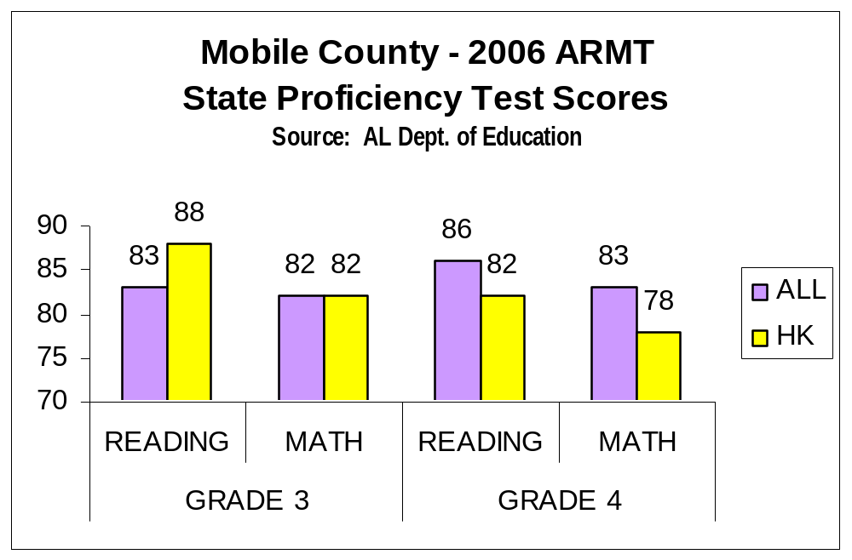

Slide 44
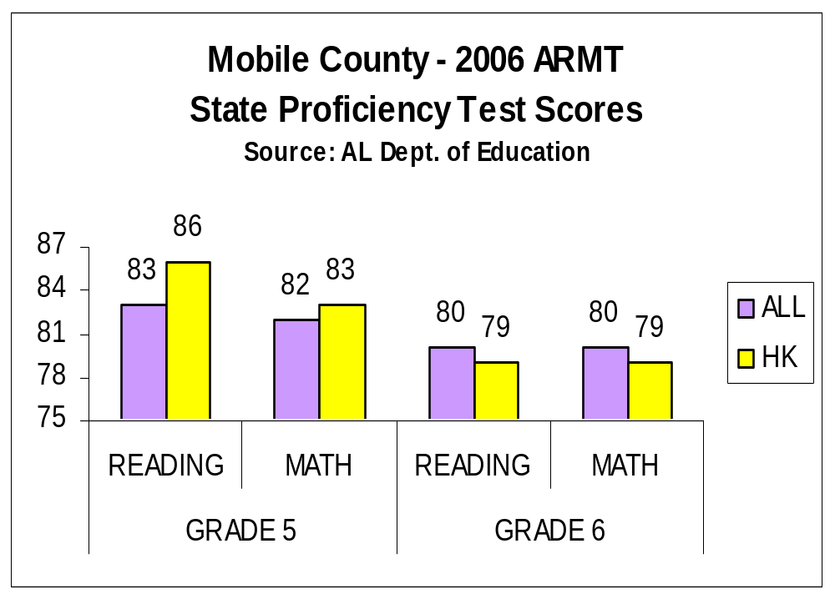

Slide 45
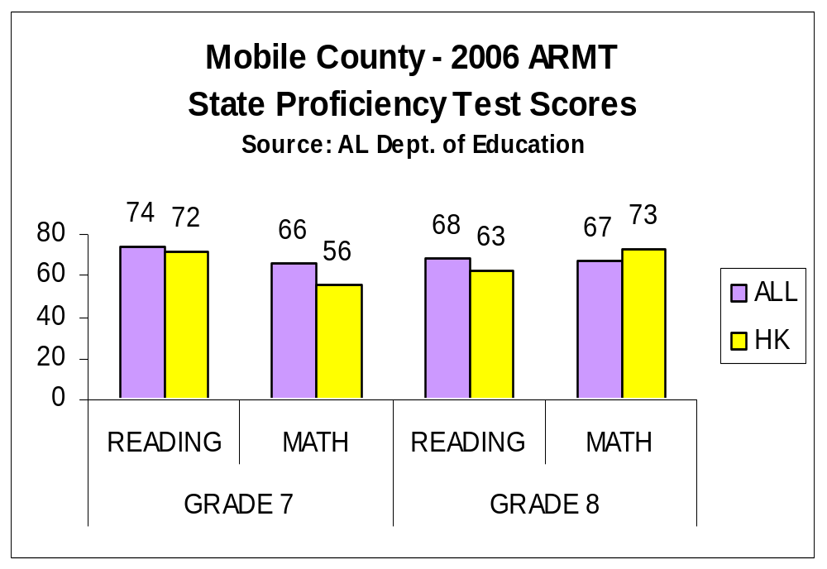

Slide 46
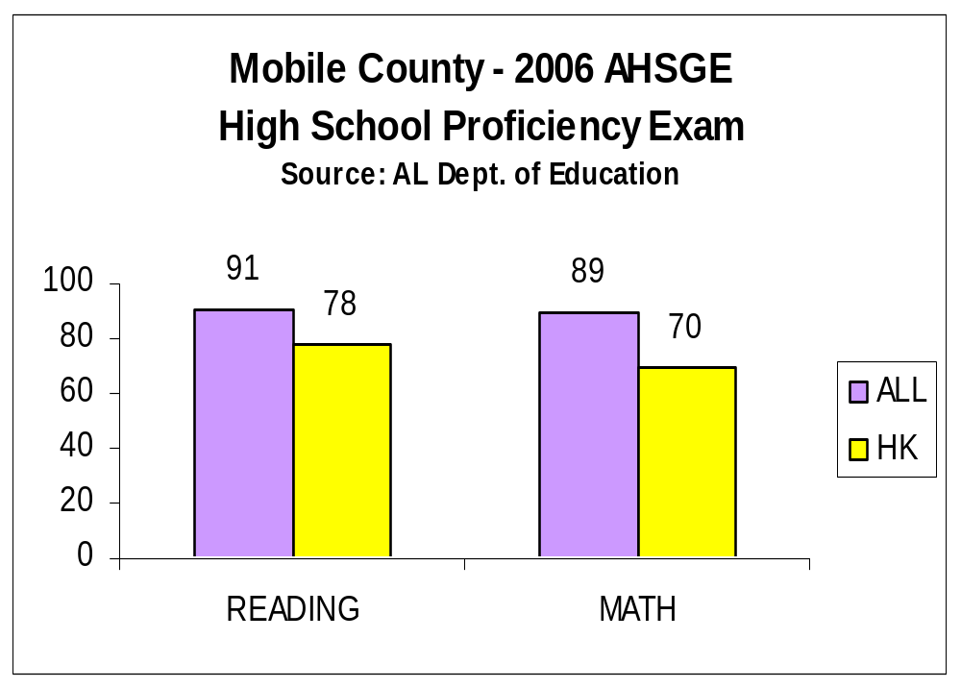

Slide 47
Additional Resources
American Red Cross - Talking Points for Educators: In the Aftermath of a Hurricane: www.redcross.org/disaster/masters/HurricaneKatrina.html
Georgetown University: www.gucchd.georgetown.edu/index.html
National Association of School Psychologists: Information for Parents and Educators on Response to Hurricane Katrina: www.nasponline.org/neat/katrina.html
National Center for Disaster Preparedness: www.ncdp.mailman.columbia.edu /index.html
National School Safety and Security Services: www.schoolsecurity.org /katrina.html
Operation Rebound - Helping Children Who Experience Psychological Trauma:
www.adph.org/ALPHTN/Default.asp?DeptId=143&TemplateId=3939&TemplateNbr=3

Slide 48
Additional Resources
SAMHSA: www.samhsa.gov
The Educational Rights of Students in Homeless Situations: What Service Providers Should Know: www.nlchp.org/FA_Education/EdRightsService.pdf
The National Child Traumatic Stress Network: Hurricane katrina Tools and Links: www.nctsnet.org/nccts/nav.do?pid=typ_nd_hurr_resource
Training Manual for Mental Health and Human Services Workers in Major Disasters: www.mentalhealth.samhsa.gov/publications/allpubs/ADM90-538/Default.asp
Transcending Trauma After a Disaster: A Guide for Schools: www.southalabama.edu/coe/katrina/mainmenu.htm
UCLA School Mental Health Project: Center for Mental Health in Schools: www.smhp.psych.ucla.edu

Slide 49
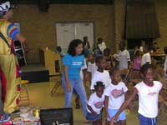

Thanks for your attention!

