Slide 1
Update to the Committee:
Oxybutynin Central Anticholinergic Effects
Pediatric Advisory Committee Meeting
April 11, 2007
Andrew D. Mosholder, M.D., M.P.H.
Medical Officer
Division of Drug Risk Evaluation (DDRE)

Slide 2
Background: Oxybutynin
Anticholinergic tertiary amine
Approved in U.S. in 1975
Formulations:
  Tablets (Ditropan, generics)
  Syrup (Ditropan, generics)
  Extended release tablets (Ditropan XL, generics)
  Transdermal patch (Oxytrol)
Indications:
  bladder instability with neurogenic bladder (Ditropan), overactive bladder (Ditropan XL, Oxytrol)
  Ditropan XL pediatric: patients > 6 y.o. with detrusor overactivity associated with a neurological condition
Pediatric Exclusivity granted February 8, 2002

Slide 3
Background: Oxybutynin (cont.)
June 2003 Pediatric Advisory Committee (PAC)
  Review of pediatric adverse events reports received in the first 13 months following pediatric exclusivity
  Few reports for analysis
  PAC requested additional monitoring
Follow-up review completed September 2006
  For Nov 2006 PAC
  Noted CNS events reported in 28% (32/114) of pediatric reports vs. 7.6% (99/1286) of adult reports
Office of Pediatric Therapeutics (OPT) requested in depth analysis of AERS data for CNS events, with comparison of pediatric to adult reports

Slide 4
Current Oxybutynin Labeling
Pediatric labeling:
  No pediatric labeling for Oxytrol (transdermal)
  Ditropan labeled for pts age >=5 yrs, but dosage specified only > 5 yrs
  Ditropan XL labeled for patients 6+ yrs
Precautions: may produce drowsiness
Adverse Reactions: somnolence, insomnia, nervousness, confusion, hallucinations
Overdosage: CNS excitation

Slide 5
Use data
Source: Verispan, LLC
Total 2006 Rx usage: 4,881,000 Rxs¹
  (> 1 mil. Pts²)
Approximately 63% of prescriptions in 2006 were for patients aged 60+ yrs
Consistently between 2002 and 2006, approximately
4-5% of U.S. prescriptions were for pediatric patients <17 years old
In 2006, 12% of pediatric prescriptions were off label (i.e., Ditropan XL for < 6 yrs, Ditropan for < 5 yrs, Oxytrol patch for < 17 yrs)
1Rx counts- Verispan Vector One National (VONA)
²Patient counts- Verispan Total Patient Tracker (TPT)

Slide 6
AERS search: Methods
AERS searched January 12, 2007 for reports of anticholinergic CNS adverse events in association with oxybutynin since approval, using 52 Preferred Terms (PTs) including hallucination, sedation, confusional state, agitation, anxiety, amnesia

Slide 7
AERS Search: Results
347 reports (55 peds, 256 adult, 36 missing age)
145/347 reports excluded
  35 duplicates
  110 other exclusions
202 cases remained
180 with age information
  37 pediatric cases
  143 adult cases
12% of all AERS adverse event reports for oxybutynin involved a CNS adverse event
  32% of pediatric reports
  11% of adult reports

Slide 8
Results: characteristics of oxybutynin AERS pediatric CNS cases (N=37)
33/37 reported by HCPs
Age range: 15 mos -16 yrs,
    Mean: 6.7 yrs
    Median: 6 yrs
Most common PTs reported:
  hallucinations (n=10)
  agitation (n=5)
  sedation (n=4)
  confusion (n=4)
  amnesia (n=4)
  abnormal dreams (n=4)

Slide 9
Results: characteristics of oxybutynin AERS pediatric CNS cases (N=37)
23/37 positive dechallenge
4/37 positive rechallenge
6 hospitalizations
14/37 with past psychiatric/neurologic history
17/37 off-label use (age < 5 yrs, nocturnal enuresis, dose>20mg)

Slide 10
Examples of case reports
4M received single 5 mg dose for enuresis:
  Hallucinations involved snakes, insects, other animals in his room, crawling on him
6F with incontinence from injury in auto accident, 2 weeks post dose increase to 10 mg/d:
  Agitation, visual hallucinations of insects, thought hands and feet were bleeding, personality change, fearfulness
  positive dechallenge
8F with overactive bladder and urinary frequency, treated with 5mg for <1 month:
  Confusion, hallucinations, mood changes, obsessive thoughts, delusions, disorientation
  positive dechallenge within 3 days
4F received oxybutynin 10mg/day for enuresis:
  Visual hallucinations
  Recurred after next dose
  Resolved when oxybutynin discontinued

Slide 11
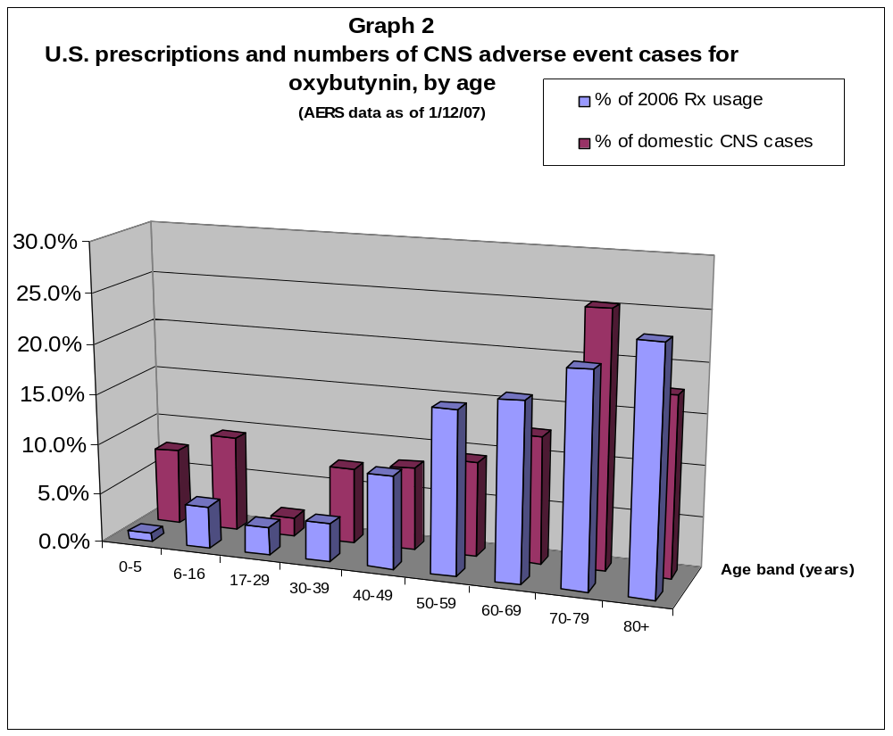
Source: Verispan VONA

Slide 12
Results: Comparison of Pediatric and Adult CNS cases – events reported
Hallucination
  most common CNS event reported for pediatric patients (27% of cases)
  2nd most common CNS adverse event in patients aged 60+ yrs (25% of cases)
  reported in 11% of cases in patients 17-59 yrs of age
Agitation
  Pediatric cases reported agitation about twice as often as adult cases (14% pediatric cases vs. 6% adult cases)
Sedation
  Adult cases reported sedation > twice as often as pediatric cases (24% adult cases vs. 11% pediatric cases)
Confusion
  Most commonly reported CNS event for patients aged 60+yrs (30% of cases, vs. 10% of cases in patients less than 60 yrs)

Slide 13
Conclusions/recommendations
A significant proportion of all adverse event reports for oxybutynin involve a CNS adverse event. The types of CNS events reported vary by age.
Current labeling does not explicitly describe the potential for CNS anticholinergic effects, or the age-dependent pattern of CNS effects that have been reported.
DDRE recommends that the labeling for anticholinergic CNS effects be strengthened.

Slide 14
Questions
Does the Committee recommend that oxybutynin labeling include more information for prescribers regarding adverse CNS anticholinergic effects?
Other comments, suggestions?
  Such as more specific language for pediatric CNS effects?

Slide 15
Acknowledgements
Paula Gish, R. Ph, Safety Evaluator, DDRE
Rosemary Johann-Liang, M.D., Deputy Director, DDRE
Melissa Truffa, R.Ph, Safety Evaluator Team leader, DDRE
Mary Willy, Ph.D., M.P.H., Epidemiologist Team Leader, DDRE
LCDR David Moeny, R.Ph, Drug Use Data Specialist, DSRCS
Lisa Mathis, MD, Associate Director, Pediatric and Maternal Health Staff
Gwen L. Zornberg, M.D., Sc.D., Medical Officer, ODE I/DPP
M. Dianne Murphy, M.D., Director, OPT

